Slide 1
R-bots for Data Science Workflow Automation
Sydeaka Watson, Ph.D.
Senior Data Scientist, AT&T Chief Data Office

Slide 2
Data Scientist Workflow

Slide 3
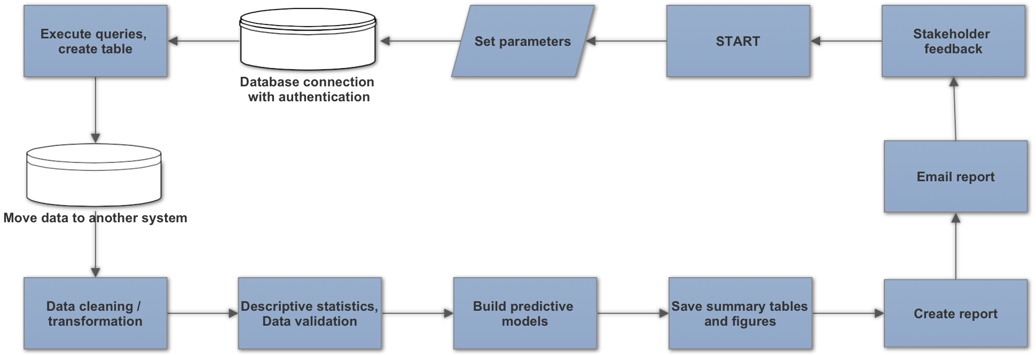
Actual Data Scientist Workflow
Workflow begins with data creation/ingestion.
Workflow “ends” with the distribution/publishing of reports.

Slide 4
Automated Data Science Workflows
An R-bot is an R script that executes one or more tasks in a data science workflow.
Examples:
Data ingestion
Create report with dynamically generated content
Send emails
Version control
An end-to-end automated data science workflow could consist of a collection of R-bots executed from a common framework.

Slide 5
DEMO: Lending Club Example
Set session parameters
Download dataset from LC website
Peer to peer lending platform
Goal: Build a model to predict probability of a loan default
Example automates the
data retrieval and storage
model building
report generation
version control
Github check-in
Move LC dataset into MySQL
Email report
Data cleaning/ transformations
Create report
Build predictive models

Slide 6
Use Cases
Well-defined analyses that will be performed over and over again
Analyses in development stages, where feedback must be incorporated over and over again
“Hands-free” automation
Task scheduler manages the runs
“Manual” automation
Entire process kicks off as soon as the data scientist presses the button

Slide 7
Benefits
Reproducible research
Version control over entire process
Less time spent on mundane, repetitive tasks
Easier to get results reports generated and distributed to stakeholders

Slide 8
Workflow automation framework
Adopt modularized approach, with flexibility to swap out components
Use common framework from which all R-bots are executed (e.g., R, Bash)
Set parameters (manually or dynamically)
Re-use code (functions)
Write code that creates/executes dynamically generated code
Relinquish low level decisions to computer
Use conditional logic
Error handling
Automated validation of results

Slide 9
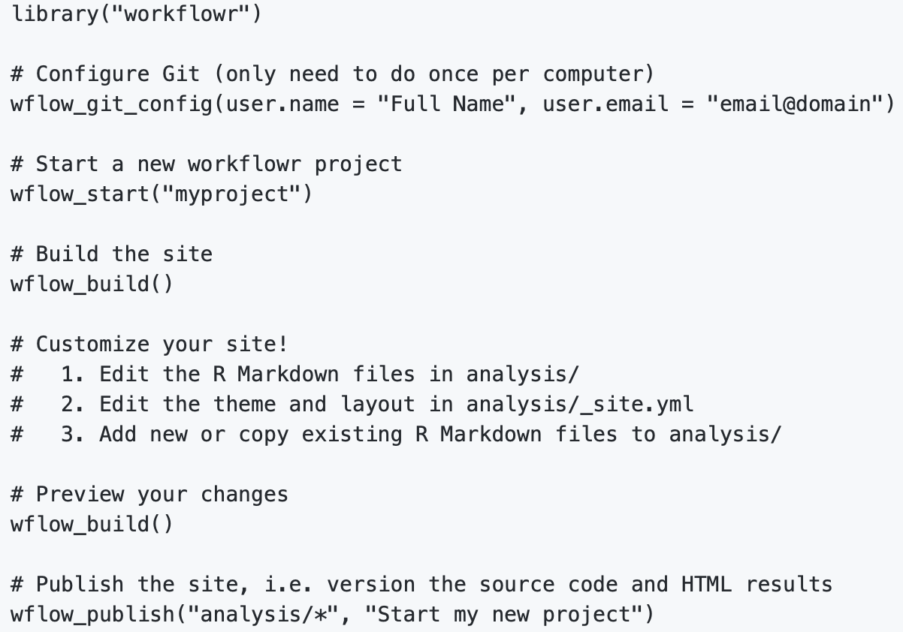
R packages for workflow management
workflowr
drake

Slide 10
Tools/Utilities
Task | R Packages | Bash Functions
Connect to SQL database, with authentication username/password; execute queries | RJDBC, odbc,RMySQL | --
Connect to Hadoop, with Kerberos authentication | krb5 | kinit
Create/populate Excel spreadsheet | XLConnect | --
Generate reports (documents, html website) | rmarkdown, knitr | --
Email notifications, reports | mailR*, sendmailR*, gmailr⁺ | mail/mailx
Schedule task to run at regular intervals | cronR | crontab
* More advanced configuration may be necessary in order to get these working behind firewalls with restricted network settings.
+ Works, but last major update was 2 years ago.

Slide 11
Enterprise considerations
In enterprise setting, you may have limitations on which types of packages you can install on the server, so you may be limited to mostly base R or system commands.
In the demo, I give an example of a workflow created under this scenario.

Slide 12
DEMO: Lending Club Example
Set session parameters
Download dataset from LC website
Peer to peer lending platform
Goal: Build a model to predict probability of a loan default
Example automates the
data retrieval and storage
model building
report generation
version control
Github check-in
Move LC dataset into MySQL
Email report
Data cleaning/ transformations
Create report
Build predictive models

Slide 13
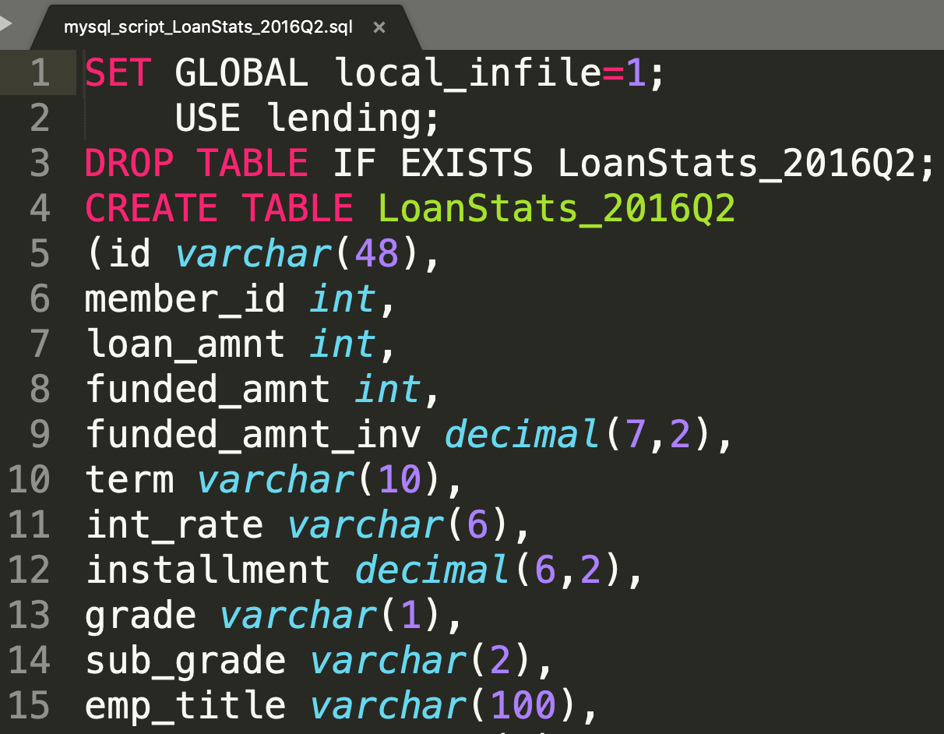
DEMO: Lending Club Example

Slide 14
Other considerations
Software, package, platform dependencies (Ex. Spark 2.0 vs 2.2; h2o 3.14 vs 3.18); solution: environments
Storage space and memory requirements
Scale: if dataset gets larger over time, the solution might not work as well (scale up). May need to adjust framework on the front end or do it later. Monitor strain on resource demands, run time, and other metrics
Tech dev requirements if you want to move process to production
Documentation of the workflow
Redundancy: make sure more than one person understands the process well and can help maintain it

Slide 15
Let’s talk automation!
Contact Info:
www.sydeaka.com
sydeakawatson@gmail.com
Demo: https://github.com/sydeaka/workflow-automation

Slide 16
Appendix

Slide 17
DEMO: Instructions
System requirements
Mac / Linux operating system
MYSQL (optional)
If you have MYSQL installed, set use_mysql=TRUE and create a credentials file in your system’s home directory. The file should contain two lines:
username=YourUserName
password=YourPassword
If not, set use_mysql=FALSE to run without MYSQL
To run
navigate to the top-level directory in the repository in your terminal
modify working directory at top of “mysql_example.sh” file
modify from/to email addresses in email.R, and create “gmail.txt” file in system home directory (file just contains your password as raw text, no quotes)
execute the following:
./mysql_example.sh

Slide 18
DEMO: Github directory structure
Folder | Subfolder | Contents
config |  | Session parameters, pointer to credential file location
data | dictionary | Lending Club data dictionary
 | downloads | Downloaded zip files from Lending Club website + unzipped CSVs
 | join_data | State-level datasets to be joined to Lending Club dataset
 | modeling_data | Cleaned/transformed Lending Club data subset prepared for modeling
 | sql | SQL scripts created/executed in the process
model_results |  | h2o model files + R workspace with objects saved for use in report
plots |  | Plots to be rendered in the report
R_bots |  | R-scripts executed in the workflow
reports |  | Rmarkdown files + rendered reports (HTML/Markdown formats)
slides |  | PPT and PDF of presentation
utils |  | Re-usable utilities that could be used in other projects

