Slide 1
Spotify Playlist
Song Recommender
Sydney Lynch
CSC 466

Slide 2
Project Goal
Build a playlist-based music recommender that recommends songs given a playlist.
Use two Kaggle datasets:
  Spotify Tracks Metadata (114k songs, audio features)
  Spotify Playlists (12.8M playlist entries from 100k+ playlists)
Combine song metadata + real playlist behavior to model user taste.
Sydney Lynch
CSC 466

Slide 3
Final Model Results
Per-Track kNN + track/artist/genre Word2Vec embeddings
Quantitative: Recall@5 ≈ 0.16
  ~60× improvement over genre baseline (≈0.0027)
Qualitative: the model consistently recommends tracks that match the playlist’s artists and genres
Sydney Lynch
CSC 466

Slide 4
Evaluation
Process
Test on 2000 playlists (4<n<300)
Hide 2 tracks per playlist
Feed remaining playlist tracks into the model
Get the top-5 song recommendations
Calculate the Recall@5 and MRR
Sydney Lynch
CSC 466

Slide 5
Baseline Models
1
Pure Random
Return a random song from the song metadata dataset.
Recall@5 = 0.0001
2
Random by Genre
Return a random song of the most common genre in the playlist.
Recall@5 = 0.0027
Sydney Lynch
CSC 466

Slide 6
All Models
1
Pure Random
Return a random song from the song metadata dataset.
Recall@5 = 0.0001
2
Random by Genre
Return a random song of the most common genre in the playlist.
Recall@5 = 0.0027
3
KNN on playlist centroid
Return the closest neighbors to the playlist’s averaged track features.
Recall@5 = 0.1537
4
KNN per playlist track
Returns tracks from aggregated per-track neighbors.
Recall@5 = 0.1672
Sydney Lynch
CSC 466

Slide 7
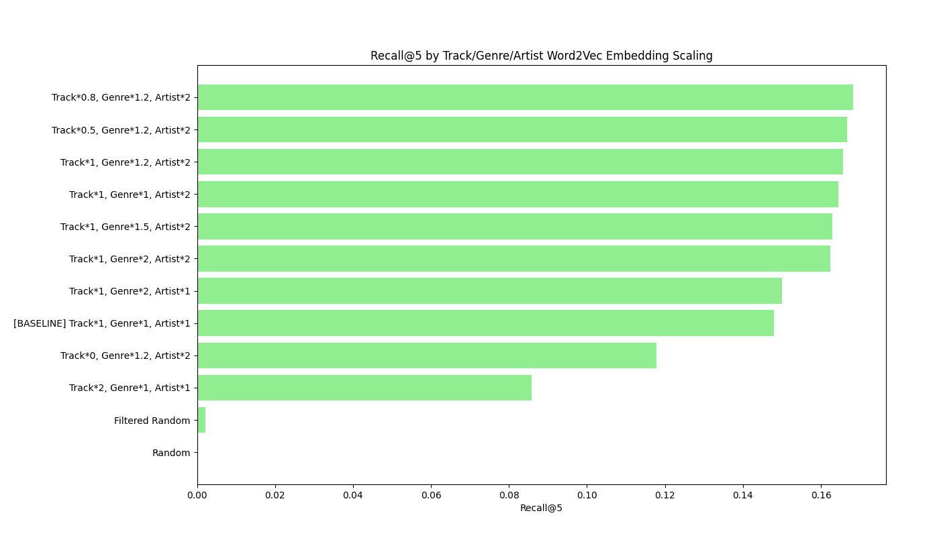
Word2Vec Embeddings
Track ID Embeddings
Learn vector representations of individual songs based on which tracks co-occur in playlists. This captures collaborative-filtering signals and groups songs users tend to listen to together.
Genre Embeddings
Embed genre labels based on how often genres appear together within playlists. This captures higher-level stylistic and mood relationships not tied to specific tracks.
Artists Embeddings
Learn embeddings for artists by observing which artists frequently appear in the same playlists. This captures cross-artist similarity and typical user listening patterns.
Sydney Lynch
CSC 466

Slide 8
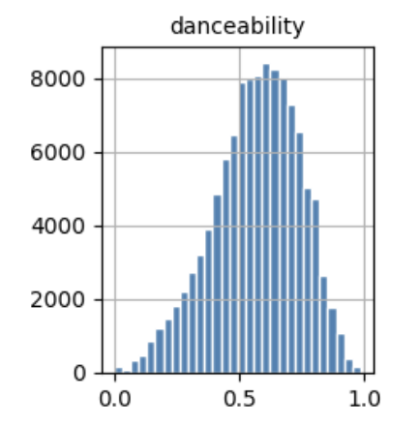
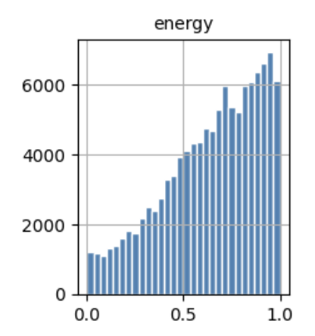
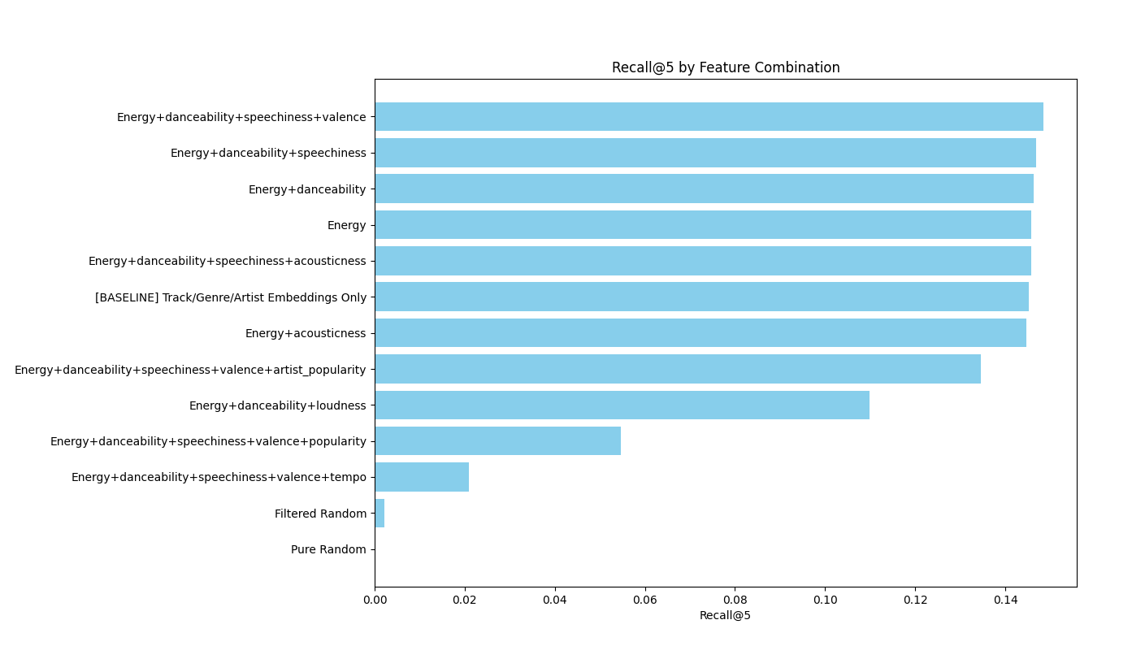
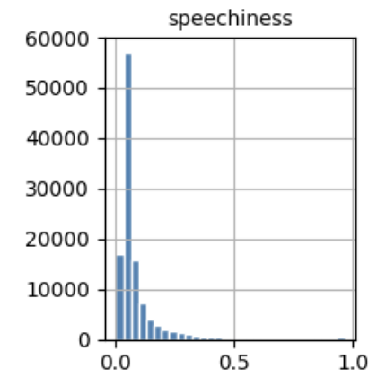
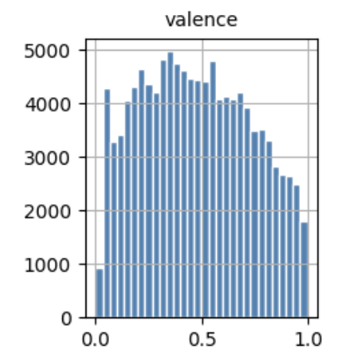
Song Metadata Features
Danceability
Energy
Speechiness
Valence
Sydney Lynch
CSC 466

Slide 9
Qualitative Check
Moody Teen Pop (input)
Moody Teen Pop (output)
Basic Rap (input)
Basic Rap (output)
Sweater Weather – The Neighbourhood
Another Love – Tom Odell
Locked out of Heaven – Bruno Mars
Lost – Frank Ocean
Electric Love – BØRNS
Dancing Queen – ABBA
Rolling in the Deep – Adele
Does Your Mother Know – ABBA
Treasure – Bruno Mars
That’s What I Like – Bruno Mars
Just the Way You Are – Bruno Mars
Talking to the Moon – Bruno Mars
Rumour Has It – Adele
Novacane – Frank Ocean
Chiquitita – ABBA
Set Fire to the Rain – Adele
Moonshine – Bruno Mars
No Role Modelz – J. Cole
Not Afraid – Eminem
Bohemian Rhapsody (Remastered 2011) – Queen
Without Me – Eminem
Rap God – Eminem
The Real Slim Shady – Eminem
The Prayer – Kid Cudi
Venom – Eminem
Lose Yourself – Eminem
Bohemian Rhapsody – Queen
On Fire – Lloyd Banks
Pistol Pistol (Remix) – Obie Trice
X Gon’ Give It To Ya – DMX
The Rain – DMX
Sydney Lynch
CSC 466

Slide 10
Thank you
Sydney Lynch
CSC 466

