Slide 1
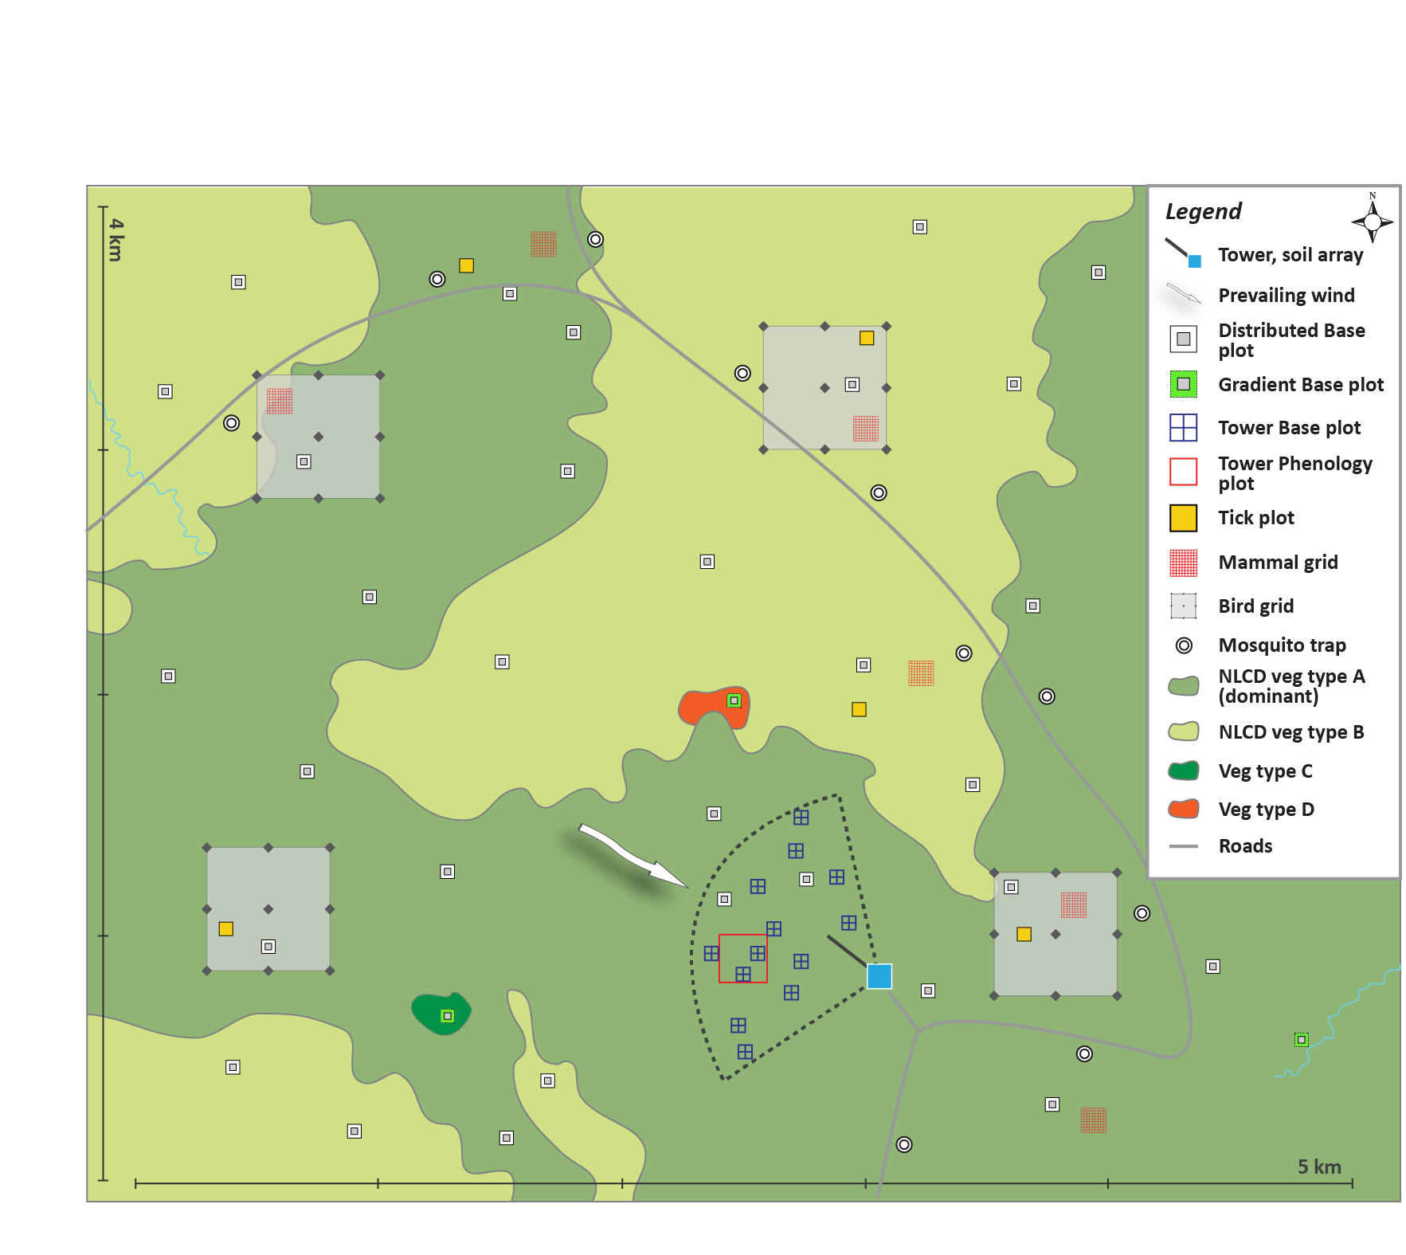
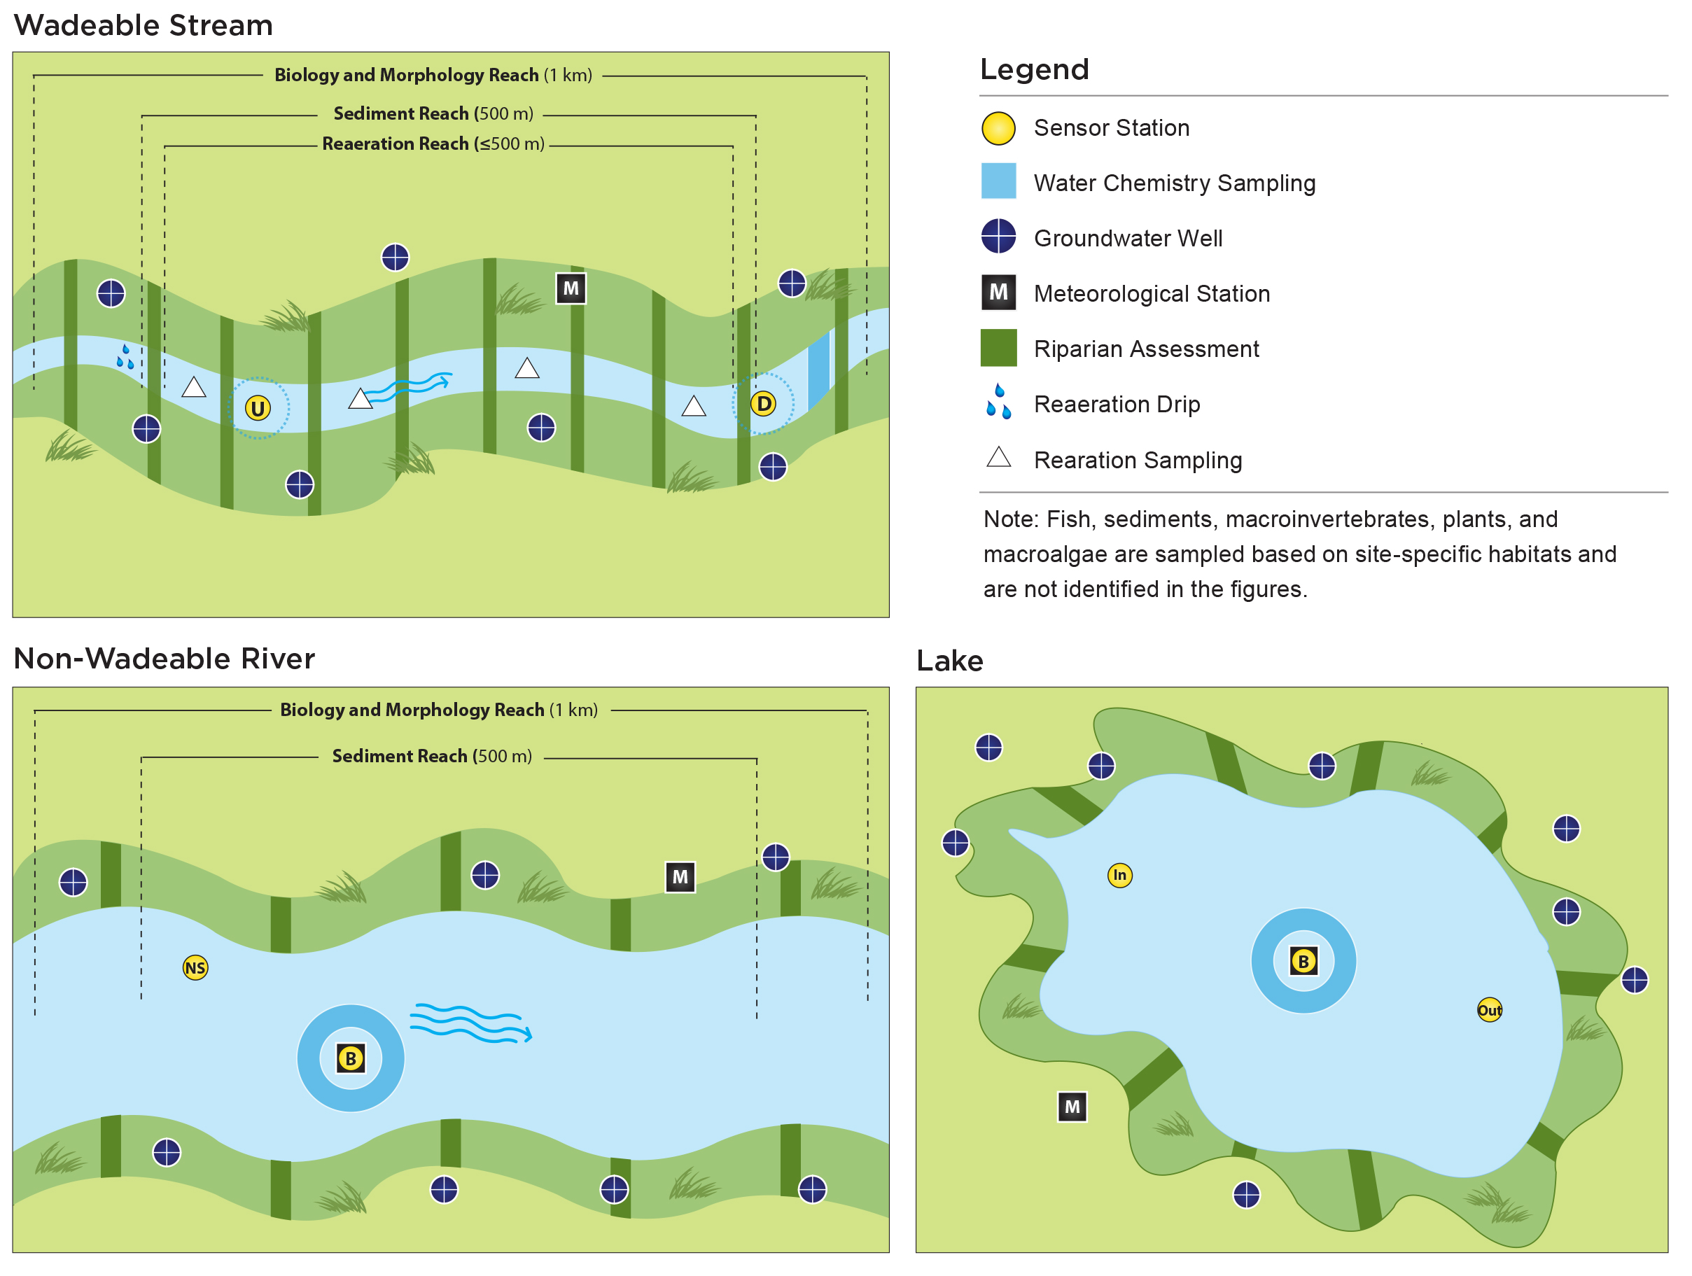
Legend
Tower, soil array
Prevailing wind
Distributed Base plot
Gradient Base plot
Tower Base Plot
Tower Phenology plot
Tick plot
Mammal grid
Bird grid
Mosquito trap
NLCD veg type A (dominant)
NLCD veg type B
Veg type C
Veg type D
Roads
A)
Wadeable Stream
Legend
Sensor station
Water Chemistry Sampling
Groundwater Well
Meteorological Station
Riparian Assessment
Reaeration Drip
Reaeration Sampling
Note: Fish, sediments, macroinvertebrates, plants and macroalgae are sampled based on site-specific habitats and are not identified in the figures.
B)
Non-wadeable River
Lake
C)
D)

