Slide 1

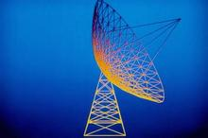

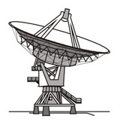
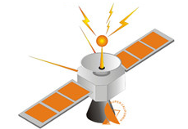
Huazhong University of Science and Technology
The Department of Electronics and Information Engineering
Electronic Circuit of Communication
Dr. Tianping Deng
Email: dengtp@hust.edu.cn

Slide 2
Electronic Circuit of Communication
Lec1 Basic of Telecommunication System
Lec2 Radio Frequency Amplifiers
Lec3 High-Frequency Power Amplifier
Lec4 Oscillator
Lec5 Amplitude Modulation
Lec6 Angle Modulation
Lec7 Digital Modulation
Lec8 Wireless Communication

Slide 3
Contents of Lecture 1
Basic of Telecommunication System
  Main Elements of a Telecommunication System
  the Functions of the Various Elements
  What is an analogue (analog) signal
  basic methods of Signal Representation in telecommunication systems

Slide 4
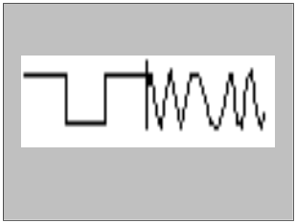
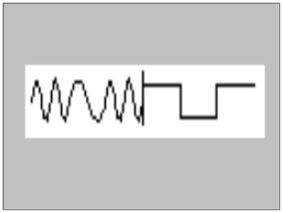

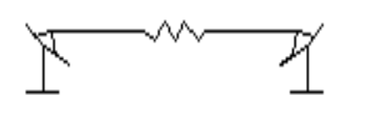

L1 – Main Elements
Aim: to transmit information from one point to another
  General Structure of a Telecommunication System
Source Transmitter Channel Receiver Sink
Examples: Radio, TV, Telephone, Data, ……

Slide 5
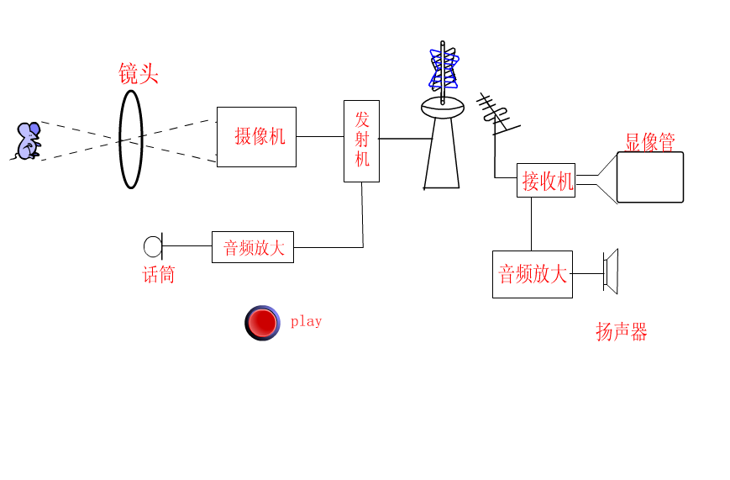

Slide 6
L1 – Main Elements
Description of the main elements
  Information source and input transducer
    Information source: voice, image, text, etc
    a transducer is used to convert the source output into an electrical signal suitable for transmission
  Output transducer and information sink
    at the output a transducer is used to convert the electrical signal to a form suitable for the user

Slide 7
L1 – the Functions
The Transmitter
  Converts (or maps) the electrical signal to a suitable section of frequency spectrum for transmission
  This process is referred to as modulation. The information signal is translated in frequency to complement the allocation of the channel
  Other functions may include amplification of modulated signal and radiation of signal via an antenna

Slide 8
telecommunication system
Modulator
Information
Source
Transmitter
Channel
Information
Sink
Receiver
Demodulator

Slide 9
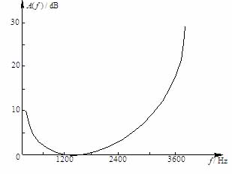
L1 – the Functions
What is MODULATION
    Modulation is one of the crucial signal processing operations being commonly applied in communication systems
    It can be used to match signal to the channel characteristics, to minimize the effect of channel impairments, and to provide capability to multiplex several signals onto one physical channel

Slide 10
L1 – the Functions
Why MODULATION
  Conservation of spectrum: want to use as little of it as possible
    Bandwidth is scarce resource
    The wider the bandwidth the more noise
      Why???

Slide 11
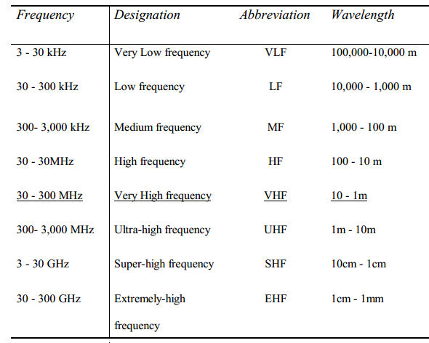

Slide 12


L1 – the Functions
  Translation of frequencies: use the allocated region of the frequency spectrum
    Makes it possible to accommodate transmission of multiple messages from many users over the same channel
same channel

Slide 13
L1 – the Functions
  Transmission efficiency: minimize the transmitter power to convey the information to the user
  Design feasibility: simple and inexpensive circuitry

Slide 14
L1 – the Functions
Examples of Use of Modulation
  Speech has a frequency spectrum of 300Hz~3.5kHz
    Noticed that the data rate for VoIP traffic ?
VoIP（Voice over Internet Protocol）

Slide 15
L1 – the Functions
Examples of Use of Modulation
  Music contains frequency components of 20Hz~20kHz
    Noticed that the Sampling Specs. Of CD(HDCD) for HiFi?

Slide 16
L1 – the Functions
  However, frequencies at which radio stations broadcast are much higher! e.g.
    95.7 MHz (ABC FM)
    98.9 MHz (JJJ FM)
    105.8 MHz(Wuhan Music Radio)

Slide 17
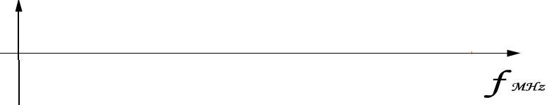

L1 – the Functions
Examples of Use of Modulation
  Hence there must be a frequency conversion (or modulation) taking place. That allows more than one station to broadcast simultaneously (using different carrier frequencies).
101.8MHz
103.8MHz
105.8MHz

Slide 18
L1 – the Functions
Choice of Modulation Method
  The choice of modulation method is based on several factors:
    amount of bandwidth available
    types of noise and interference in the channel
    electronic devices available for signal amplification prior to transmission
    cost of receivers and transmitters
  In this course, we will study two types of modulation:
    Amplitude Modulation (AM)
    Frequency Modulation (FM)

Slide 19
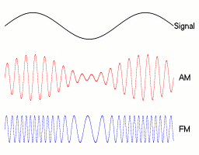
L1 – the Functions

Slide 20
L1 – the Functions
The Channel
  physical medium via which the signal output from the transmitter is sent (i.e. transmitted) to the receiver
  channel may provide simplex, half-duplex or full-duplex transmission
  examples of channel: free-space, copper twisted pair, coaxial cable, optical fiber

Slide 21
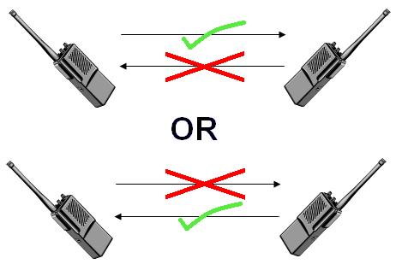
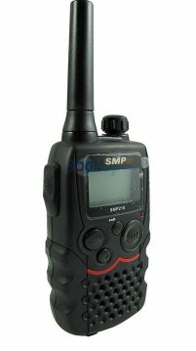
L1 – the Functions
The Channel
interphone
half-duplex

Slide 22

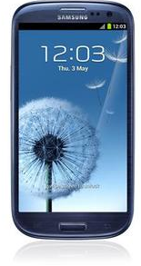
L1 – the Functions
The Channel
full-duplex
mobile phone

Slide 23
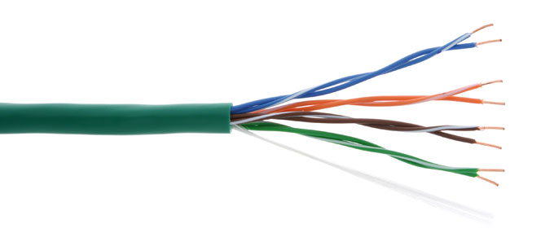
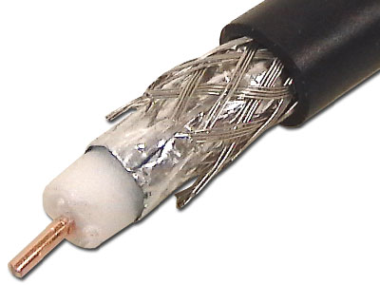
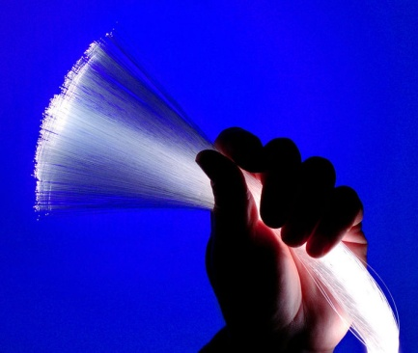
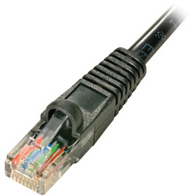
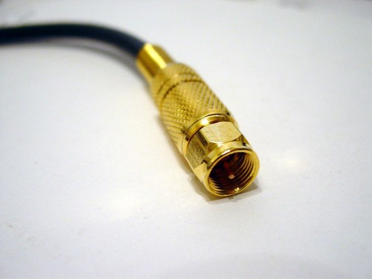
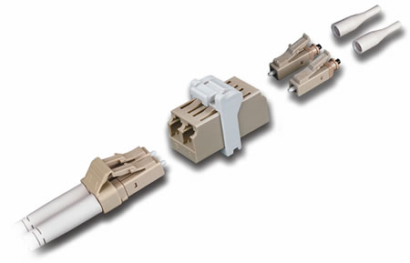
L1 – the Functions
Some picture for channel (cable and joint)
copper twisted pair
coaxial cable
optical fiber
Where can you find them in your real life??? Give me some example …

Slide 24
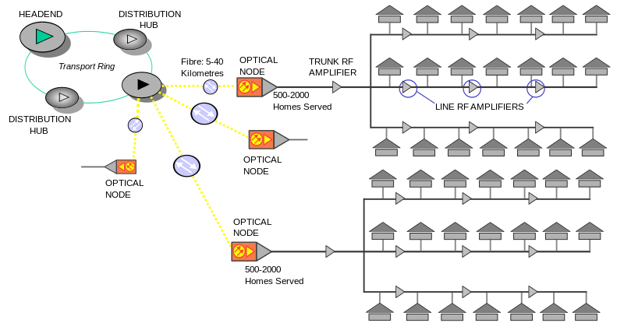
L1 – the Functions

Slide 25

L1 – the Functions
Some picture for channel (cable and joint)
ionosphere
d
h
R
Ground Wave
Sky wave
Space wave
Relay
Sat. Relay

Slide 26
L1 – the Functions
Noise in Analogue Transmission
  Channels are subject to noise, interference, fading and other degradation effects.
  Noise is generated by numerous natural and man-made events and introduces errors or degrades signal quality.
  An important parameter in designing communication systems is the so-called Signal-to-Noise-Ratio (SNR)
  Noise will be considered in future communications subjects. In our current subject we ignore its presence.

Slide 27
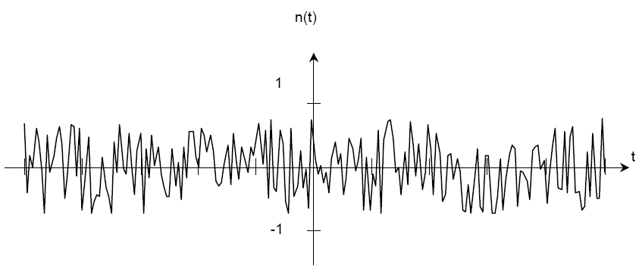
L1 – the Functions
Noise in Analogue Transmission
  A random, noise-like waveform
how to measure the noise ?

Slide 28
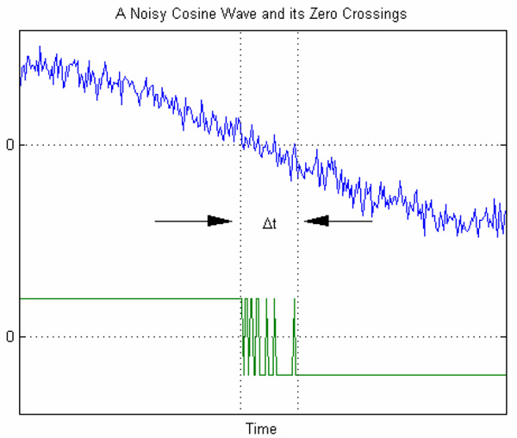
L1 – the Functions
Noise in Analogue Transmission

Slide 29
L1 – the Functions
The Receiver
  extracts the message from the received signal. This is called demodulation.
  also can perform some form of signal filtering and noise suppression.

Slide 30
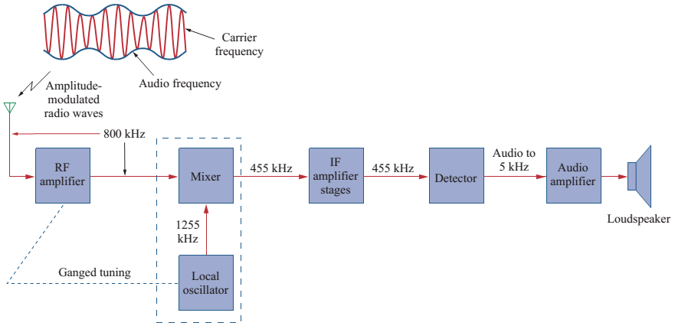
L1 – the Functions

Slide 31

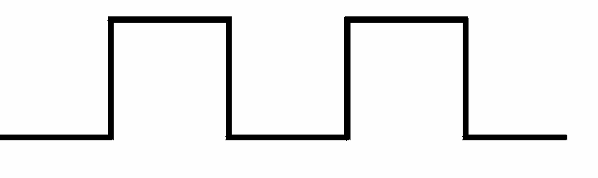
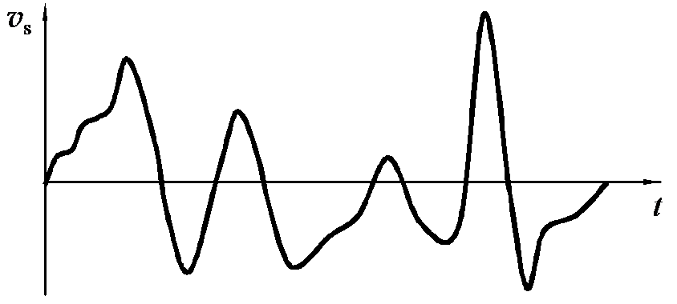


L1 – Signal Representation
Signals and Waveforms
Signal Representation in Time Domain
Convolution
Correlation

Slide 32
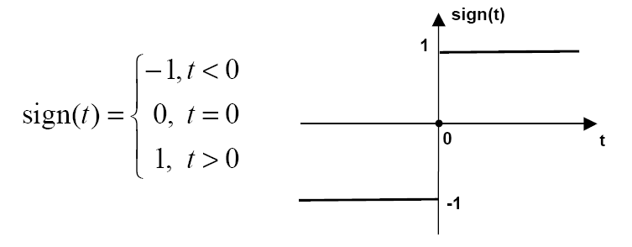
L1 – Signal Representation
Signum Function

Slide 33
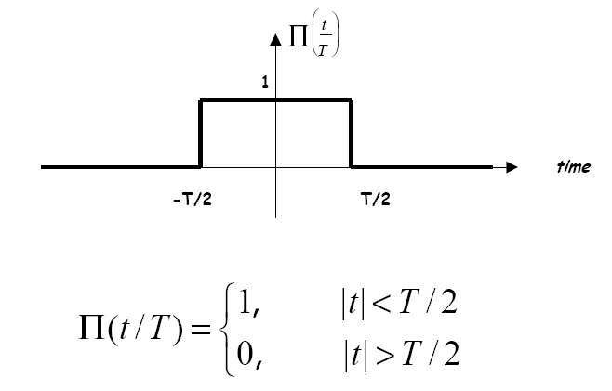
L1 – Signal Representation
Rectangular pulse

Slide 34
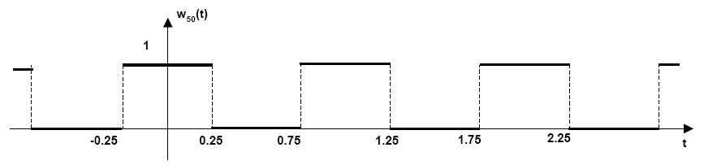
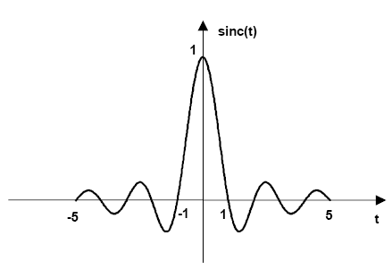

L1 – Signal Representation
Square wave
The sinc pulse

Slide 35

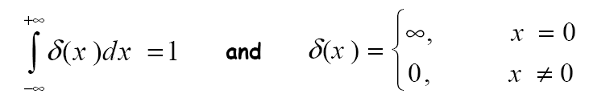
L1 – Signal Representation
Dirac Delta Function
Fourier Series
Fourier Transform

Slide 36
Homework
Lecture 1
  Page 102
    2, 3, 14, 17, 18
ECC Lectures (c) 2008~2012

Slide 37

Lecture 1 - END
for
Basic of Telecommunication System
ECC Lectures (c) 2008~2012
Notes:
for 6 lessons

