Slide 1

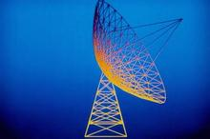

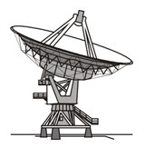
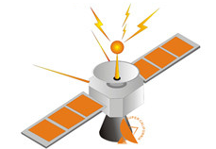
Huazhong University of Science and Technology
The Department of Electronics and Information Engineering
Electronic Circuits of Communication
Dr. Tianping Deng
Email: dengtp@hust.edu.cn

Slide 2
Electronic Circuits of Communication
Lec1 Basic of Telecommunication System
Lec2 Radio Frequency Amplifiers
Lec3 High-Frequency Power Amplifier
Lec4 Oscillator
Lec5 Amplitude Modulation
Lec6 Angle Modulation
Lec7 Digital Modulation
Lec8 Wireless Communication
Lec3 High-Frequency Power Amplifier

Slide 3
Contents of Lecture 3
Radio-Frequency Power Amplifier
  Class A and Class B Amplifier Review
  Class C Amplifier Circuits
  Cosine Pulse Decomposition
  Calculation for Class C amplification

Slide 4
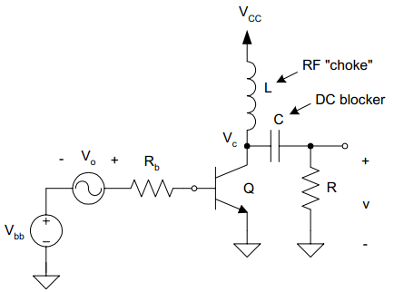

L3. RF Power Amplifier
Class A Amplifier Review
  Typical Circuit
Positive DC voltage

Slide 5

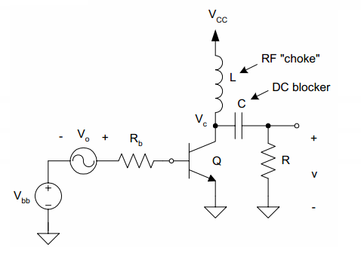
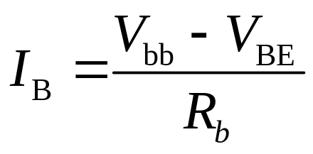



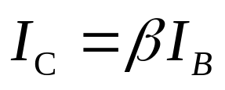

L3. RF Power Amplifier
Class A Amplifier Review
  Typical Circuit

Slide 6

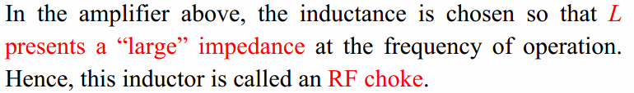
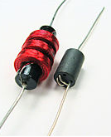
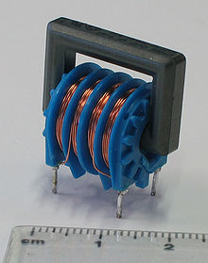
L3. RF Power Amplifier
Class A Amplifier Review
  Typical Circuit

Slide 7

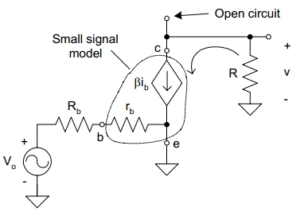



L3. RF Power Amplifier
Class A Amplifier Review
  Typical Circuit
small signal model

Slide 8

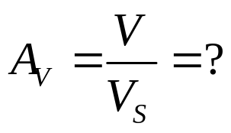
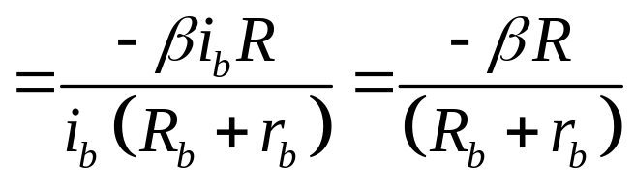

L3. RF Power Amplifier
Class A Amplifier Review
  Typical Circuit

Slide 9
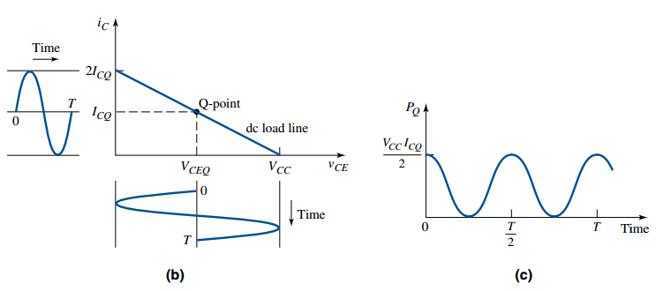
L3. RF Power Amplifier
Class A Amplifier Review
  Typical Circuit
The Power conversion efficiency is too low

Slide 10

L3. RF Power Amplifier
Class A Amplifier Review
  Typical Circuit
The Power conversion efficiency is too low

Slide 11
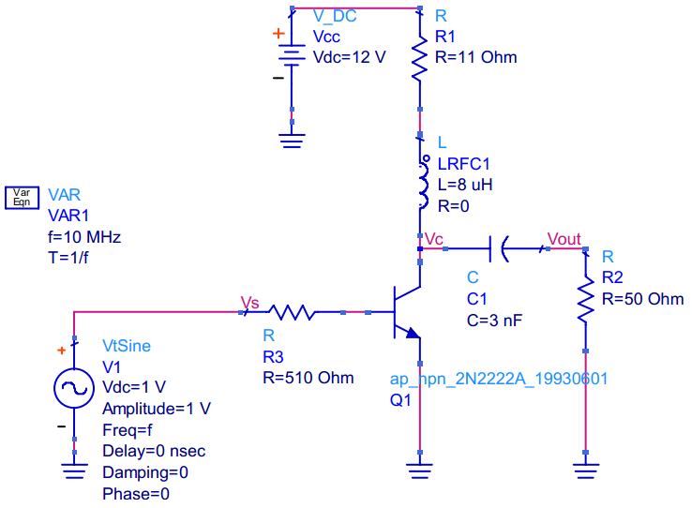
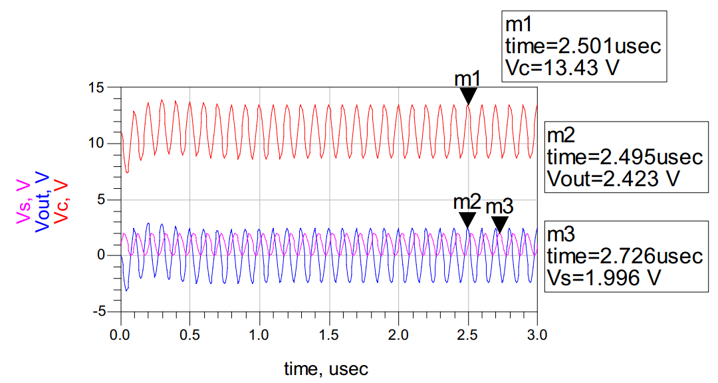
L3. RF Power Amplifier
Class A Amplifier Review
  Simple Example
Simulation
The Power Efficient of class A amplifier is no more than 50%!

Slide 12
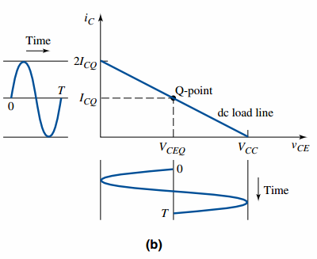

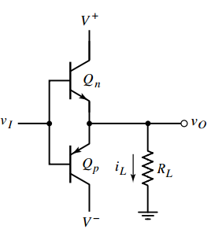



L3. RF Power Amplifier
Class B Amplifier Review
  Simple Example
distortion

Slide 13
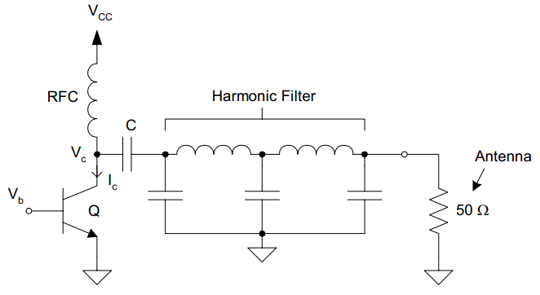
L3. RF Power Amplifier
Class C Amplifier Circuit
Class A Amplifier
Class C Amplifier
ECC Lectures (c) 2008~2012

Slide 14
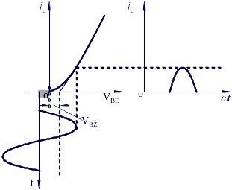
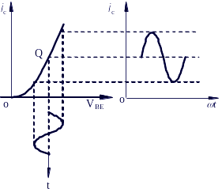
L3. RF Power Amplifier
Class C Amplifier Circuit
Class A Amplifier
Class C Amplifier
ECC Lectures (c) 2008~2012

Slide 15
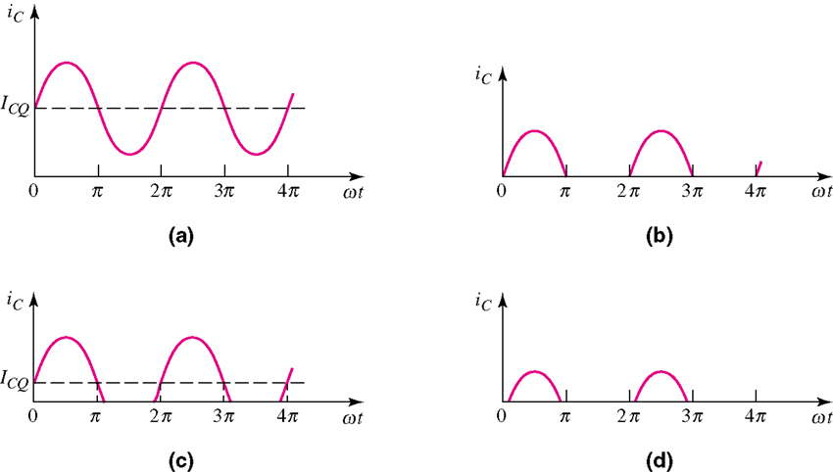
L3. RF Power Amplifier
Class C Amplifier Circuit
  Classify by Conduction Angle
    Conduction Angle := 2θ_{c}
    Fraction of a Cycle where current flows
(a) class-A amplifier
(b) class-B amplifier
(c) class-AB amplifier
(d) class-C amplifier

Slide 16

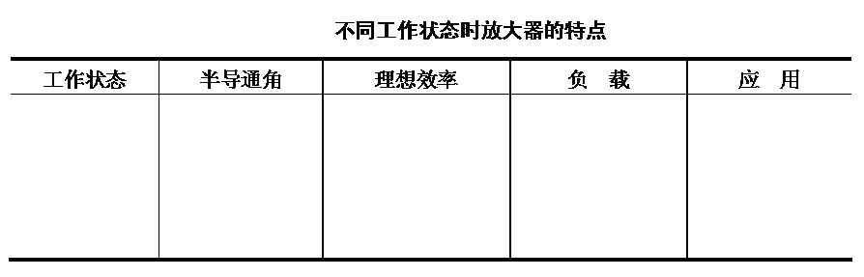
L3. RF Power Amplifier
Class C Amplifier Circuit
  Classify by Conduction Angle
    Conduction Angle := 2θ_{c}
    Fraction of a Cycle where current flows

Slide 17
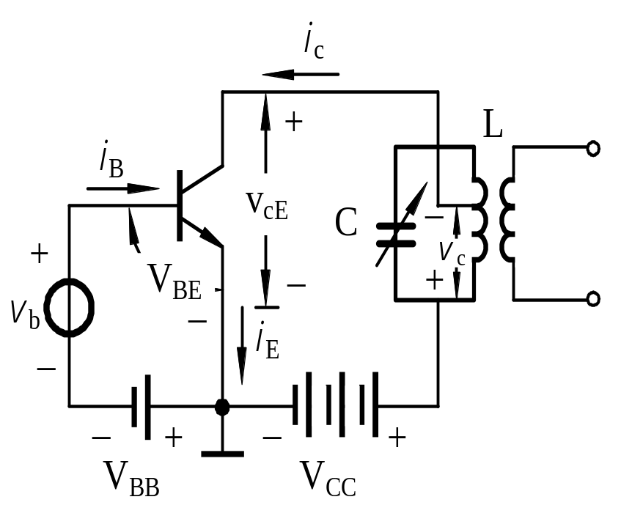
L3. RF Power Amplifier
The load of the collector
LC circuit
Class A?
Class B?
Class C?
Class C
√
DC Bias?
B-E Junction,
Forward active mode?
Cut off Region

Slide 18
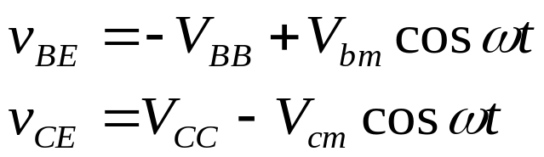
L3. RF Power Amplifier
Class C Amplifier Circuit
  Fundamental Circuit
Output
External Equations：

Slide 19
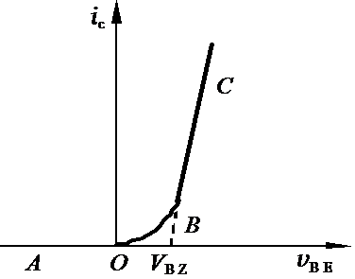

L3. RF Power Amplifier
Internal Equation：
What is i_{c}?
The current of the collector
The slope of the linear region

Slide 20
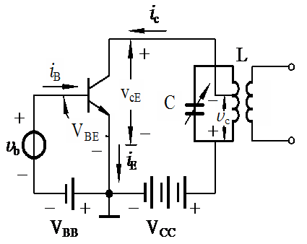
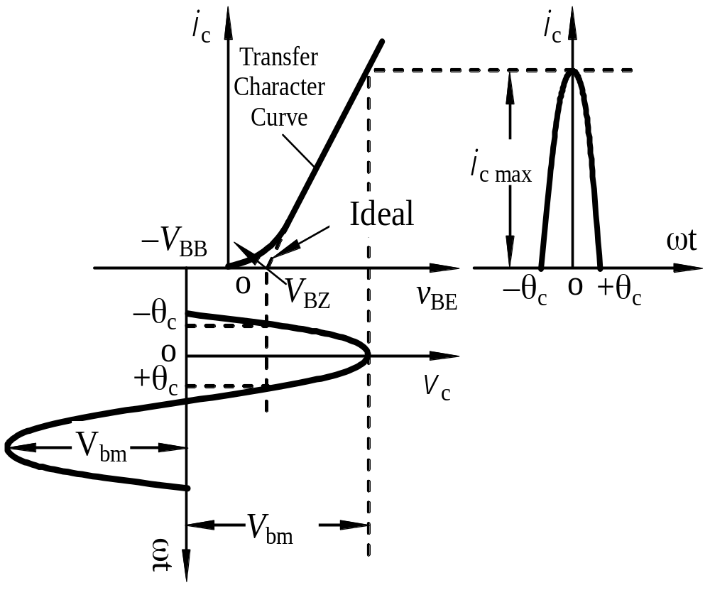
L3. RF Power Amplifier
Class C Amplifier Circuit
A ac voltage superposition on the negative voltage V_{BB}
Cut off Region
Forward active
Cut off Region
Conduction Angle
Harmonic Power Amplifier Curves

Slide 21
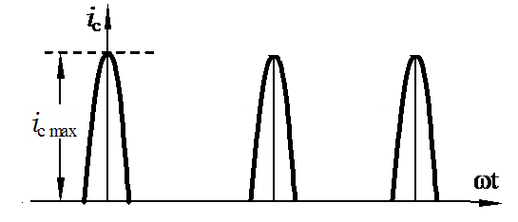
L3. RF Power Amplifier
Class C Amplifier Circuit
The waveform?

Slide 22

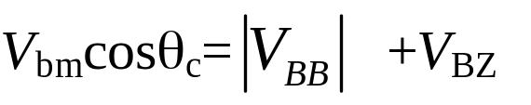
L3. RF Power Amplifier
Class C Amplifier Circuit
The value of this point is what?

Slide 23
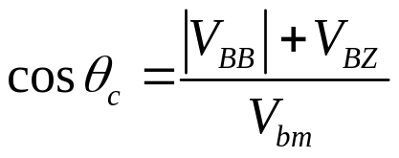
L3. RF Power Amplifier
Class C Amplifier Circuit
Keypoint：
Current of Collector i_{c} is pulse-like, but due to resonant circuit filtering effect, it can still output sinusoid waveform.
Harmonic Power Amplifier Curves

Slide 24

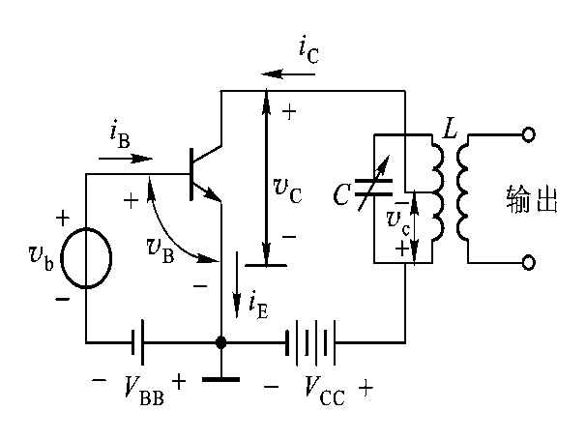

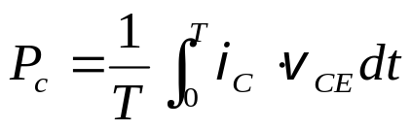


L3. RF Power Amplifier
v
Class C Amplifier Circuit
output
V
CE
cm
i
i
C
C
V
i
v
CC
c
max
CE
min
v
max
w
t
V
bE
o
q
BZ
c
－
V
BB
V
1. i_{C} , v_{BE} the same phase，
while inverse with v_{CE}；
bm
v
BE
2. when i_{C} maximum，
v_{CE} minimum
smaller conduction and v_{CEmin}，
P_{c} gets smaller
The Power conversion efficiency is high.

Slide 25
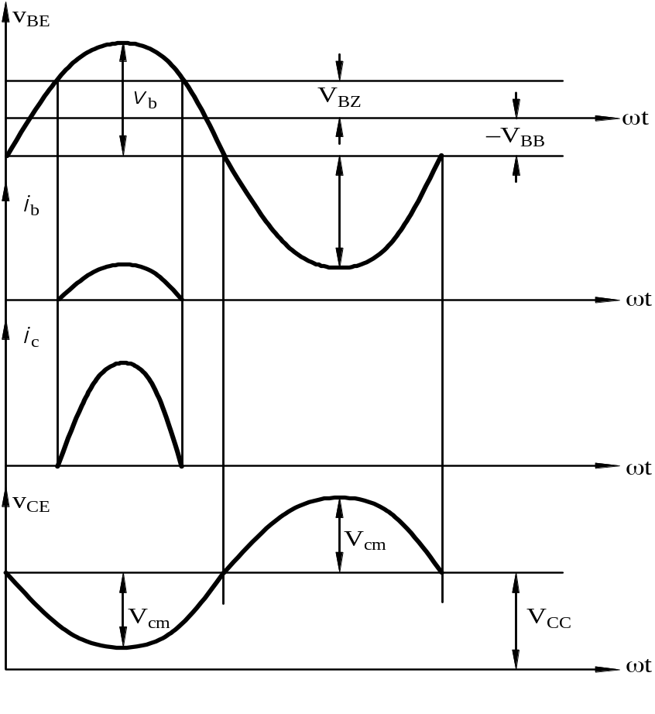
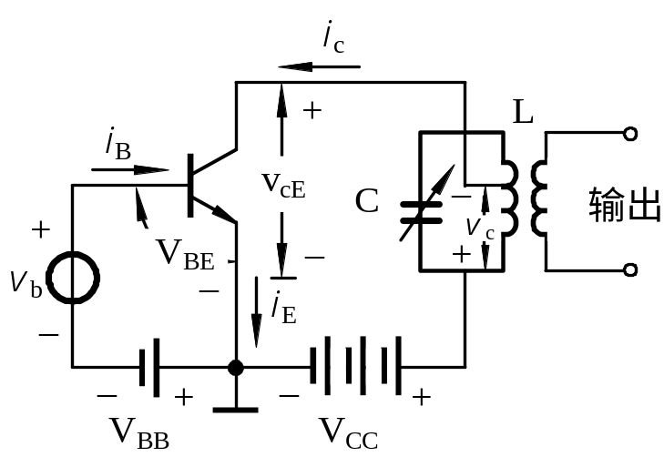
L3. RF Power Amplifier
Class C Amplifier Circuit
  Input VS. Output: Nonlinear Problem
OUTPUT

Slide 26
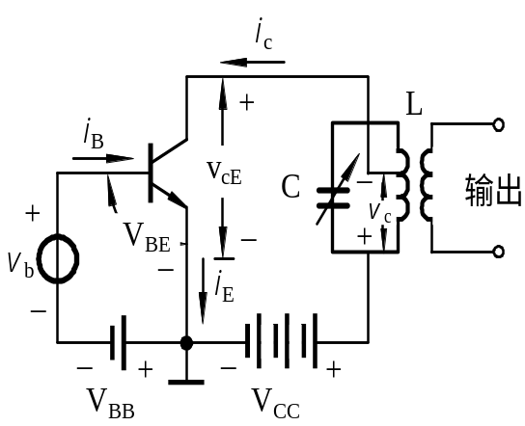

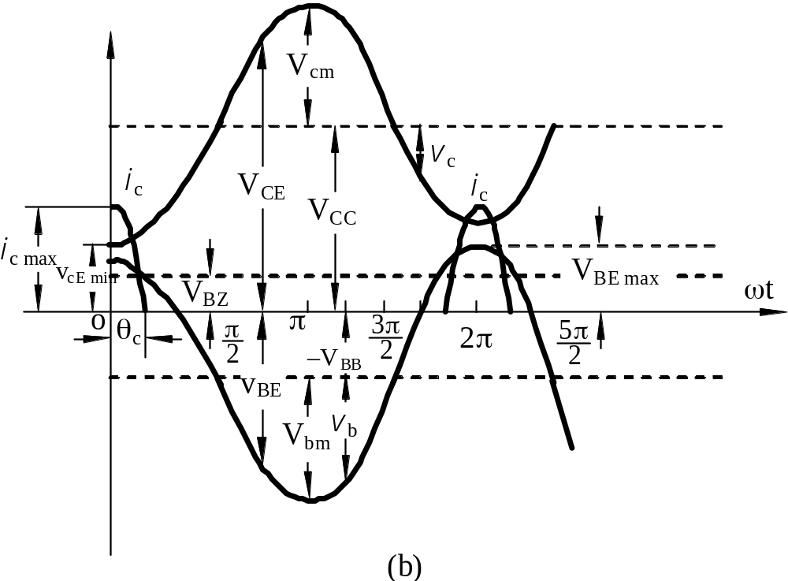
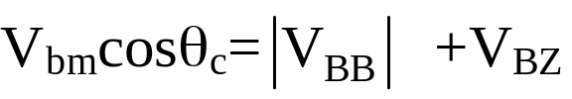
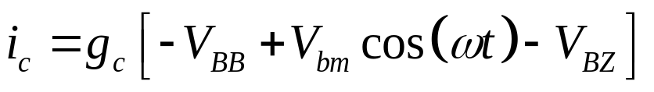
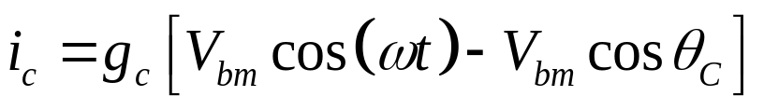
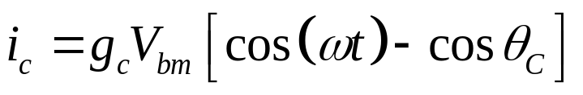

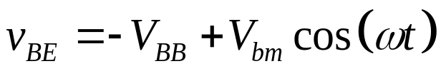
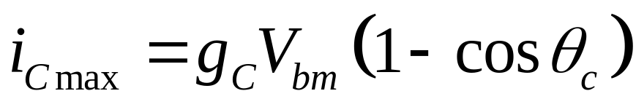
L3. RF Power Amplifier
Class C Amplifier Circuit
OUTPUT
Voltage or Current

Slide 27
L3. RF Power Amplifier
Class C Amplifier Circuit
  How to recovery the waveform ?
Cosine Pulse
v
CE
Sine wave

Slide 28
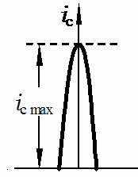
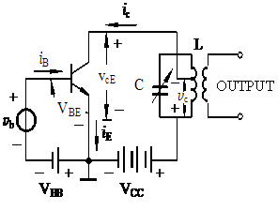
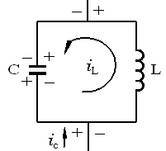

L3. RF Power Amplifier
Class C Amplifier Circuit
  How to recovery the waveform ?
ON
－
The current flowing through the
Inductor (L) can NOT change
Immediately.
＋
Thus the C get charged
The charging voltage is
Energy from DC source transfers to the C.

Slide 29
L3. RF Power Amplifier
Class C Amplifier Circuit
  How to recovery the waveform ?
V_{cc}
ON
OFF
After a while, when the voltage
reaches a relative high value which
approaching the voltage of DC
source,
The C begins to discharge through the L.

Slide 30
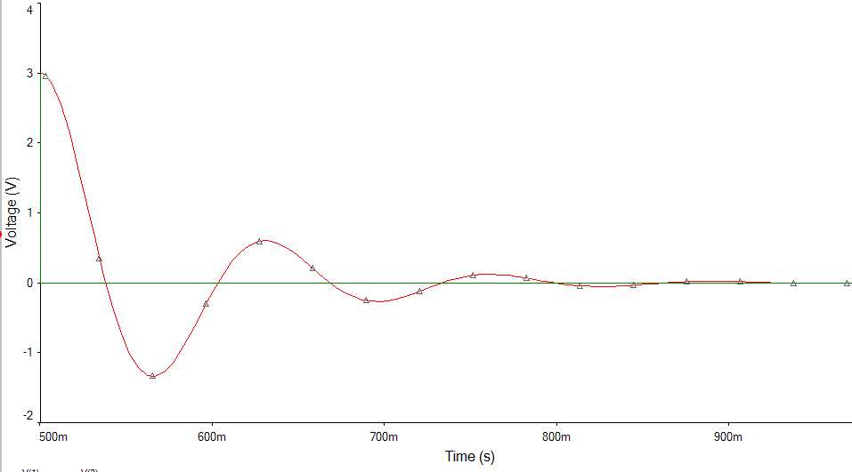

L3. RF Power Amplifier
Class C Amplifier Circuit
  How to recovery the waveform ?
ON
OFF
The C get charged
Simulation
The C begins to discharge through the L.

Slide 31
L3. RF Power Amplifier
Class C Amplifier Circuit
  How to recovery the waveform ?
Simulation

Slide 32
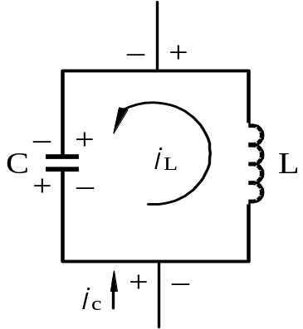
L3. RF Power Amplifier
Class C Amplifier Circuit
  How to recovery the waveform ?
Energy Point of View:
By Energy Transferring in LC Loop

Slide 33
L3. RF Power Amplifier
Class C Amplifier Circuit
  How to recovery the waveform ?
LC filter Point of View: By Filtering out the base frequency waveform
Cosine Pulse Current Formula of Collector
Key point of the next part!

Slide 34
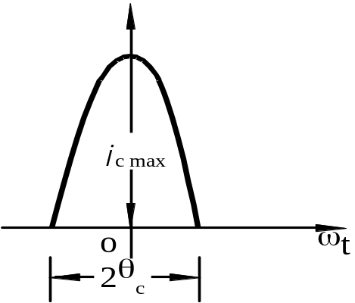
L3. RF Power Amplifier
Class C Amplifier Circuit
  Cosine Pulse Current decomposition in Collector
i_{c}=g_{c}(v_{BE}–V_{BZ}) (1)
v_{BE}= –V_{BB}+V_{bm}cosωt (2)
v_{CE}= V_{CC}–V_{cm}cosωt (3)
substituting…, we get:
i_{c} = g_{c}(–V_{BB}+V_{bm}cosωt–V_{BZ}) (4)

Slide 35
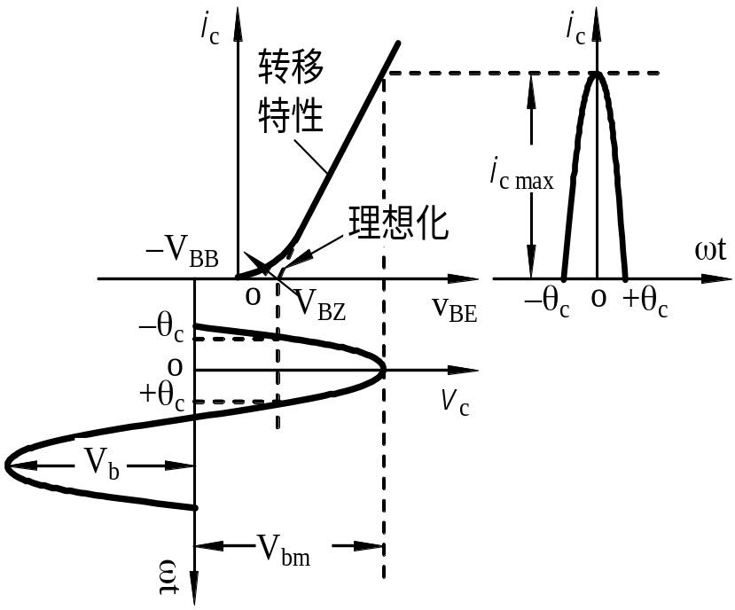


L3. RF Power Amplifier
Class C Amplifier Circuit
  Cosine Pulse Current decomposition in Collector
i_{c} = g_{c}(–V_{BB}+V_{bm}cosωt–V_{BZ}) (4)
When ωt=θ_{c}，i_{c}=0，with (4), we get:
0 = g_{c}(–V_{BB}+V_{bm}cosθ_{c}–V_{BZ}) (5)
Transfer Char.
Idealize
So:
(6)
θ_{c} : Derived from V_{bm}, V_{BB} and V_{BZ}

Slide 36


L3. RF Power Amplifier
Class C Amplifier Circuit
  Cosine Pulse Current decomposition in Collector
    i_{c} = g_{c}(–V_{BB}+V_{bm}cosωt–V_{BZ})
    The expression of i_{c} can be rewritten as following:
i_{cmax}= g_{c}V_{bm}(cosωt – cosθ_{c}) (7)
when ωt=0，i_{c}= i_{cmax}，

Slide 37





L3. RF Power Amplifier
Class C Amplifier Circuit
  Cosine Pulse Current decomposition in Collector
  The decomposition of the pulse can be derived as following:
Fourier Series!
where

Slide 38
L3. RF Power Amplifier
Class C Amplifier Circuit
  Cosine Pulse Current decomposition in Collector
    I_{c0} stands for the DC component,
    while I_{cm1} for the fundamental frequency component.

Slide 39


L3. RF Power Amplifier
Class C Amplifier Circuit
  Cosine Pulse Current decomposition in Collector
i_{C}
I_{CO}
i_{C1}
i_{C2}
i_{C2}

Slide 40

L3. RF Power Amplifier
Class C Amplifier Circuit
    The LC parallel circuits is resonant at fundamental frequency.
    It reaches the maximum resistance at fundamental frequency while appears low impedance at other harmonic frequencies. So, it picks up the fundamental voltage for the next stage.
i_{C}
I_{CO}
i_{C1}
i_{C2}
i_{C2}

Slide 41









L3. RF Power Amplifier
Class C Amplifier Circuit
  Efficiency
( DC V_{CC} Voltage Utilizing Ratio )
when ξ=1, η_{c} almost reaches 100%
where
Taking into consideration both Power and Efficiency, the best θ_{c} should be about 70°。

Slide 42








L3. RF Power Amplifier
Power Issue
power efficiency of Collector:
Power efficiency of Intermediary Circuit (from output loop to Antenna):

Slide 43













L3. RF Power Amplifier
Example1
  Conditions:
  Question: Output Power @ Collector
  Output Power @ Antenna

Slide 44







L3. RF Power Amplifier
Example1
  Sol.

Slide 45

L3. RF Power Amplifier
Exercise
■ For the transistor, f_{T}≧150MHz, A_{P} ≧13dB, I_{CM}=3A,
P_{cmax}=5W, V_{BZ}=0.6V, |V_{BB}|=1.4V,θ_{C}=70⁰, V_{CC}=24V,
ξ=0.9, cos(θ_{C})=0.342
■ Find P₌, P_{O}, P_{C}, η_{C}.

Slide 46



L3. RF Power Amplifier
Example2
■ For the transistor, f_{T}≧150MHz, A_{P} ≧13dB, I_{CM}=3A,
P_{cmax}=5W, V_{BZ}=0.6V, |V_{BB}|=1.4V,θ_{C}=70⁰, V_{CC}=24V,
ξ=0.9, cos(θ_{C})=0.342
■ Find g_{c}, V_{bm}, i_{cmax}, V_{cm}, P₌, P_{O}, P_{C}, η_{C}.
■Sol:

Slide 47

L3. RF Power Amplifier
Example2
■ For the transistor, f_{T}≧150MHz, A_{P} ≧13dB, I_{CM}=3A,
P_{cmax}=5W, V_{BZ}=0.6V, |V_{BB}|=1.4V,θ_{C}=70⁰, V_{CC}=24V,
ξ=0.9.
■ Find g_{c}, V_{bm}, i_{cmax}, V_{cm}, P₌, P_{O}, P_{C}, η_{C}.
■Sol:
I_{CM}=3A

Slide 48

L3. RF Power Amplifier
Example2
■ For the transistor, f_{T}≧150MHz, A_{P} ≧13dB, I_{CM}=3A,
P_{cmax}=5W, V_{BZ}=0.6V, |V_{BB}|=1.4V,θ_{C}=70⁰, V_{CC}=24V,
ξ=0.9.
■ Find g_{c}, V_{bm}, i_{cmax}, V_{cm}, P₌, P_{O}, P_{C}, η_{C}.
■Sol:

Slide 49


L3. RF Power Amplifier
Example2
■ For the transistor, f_{T}≧150MHz, A_{P} ≧13dB, I_{CM}=3A,
P_{cmax}=5W, V_{BZ}=0.6V, |V_{BB}|=1.4V,θ_{C}=70⁰, V_{CC}=24V,
ξ=0.9.
■ Find g_{c}, V_{bm}, i_{cmax}, V_{cm}, P₌, P_{O}, P_{C}, η_{C}.
■Sol:

Slide 50
L3. RF Power Amplifier
Example2
■ For the transistor, f_{T}≧150MHz, A_{P} ≧13dB, I_{CM}=3A,
P_{cmax}=5W, V_{BZ}=0.6V, |V_{BB}|=1.4V,θ_{C}=70⁰, V_{CC}=24V,
ξ=0.9.
■ Find g_{c}, V_{bm}, i_{cmax}, V_{cm}, P₌, P_{O}, P_{C}, η_{C}.
■Sol:

Slide 51






L3. RF Power Amplifier
Example2
■ For the transistor, f_{T}≧150MHz, A_{P} ≧13dB, I_{CM}=3A,
P_{cmax}=5W, V_{BZ}=0.6V, |V_{BB}|=1.4V,θ_{C}=70⁰, V_{CC}=24V,
ξ=0.9.
■ Find g_{c}, V_{bm}, i_{cmax}, V_{cm}, P₌, P_{O}, P_{C}, η_{C}.
■Sol:
P_{cmax}=5W

Slide 52

L3. RF Power Amplifier
Example2
■ For the transistor, f_{T}≧150MHz, A_{P} ≧13dB, I_{CM}=3A,
P_{cmax}=5W, V_{BZ}=0.6V, |V_{BB}|=1.4V,θ_{C}=70⁰, V_{CC}=24V,
ξ=0.9.
■ Find g_{c}, V_{bm}, i_{cmax}, V_{cm}, P₌, P_{O}, P_{C}, η_{C}.
■Sol:

Slide 53

L3. RF Power Amplifier
Discussion
If we want to increase the power conversion efficiency, how to implement ?
But decrease the conduction angle can effect what?
The output power also decrease.
This is not a good method, but……?

Slide 54



L3. RF Power Amplifier
Discussion
If we want to increase the power conversion efficiency, how to implement ?
We must pay attention to what?
The B-E junction mat be breakdown.

Slide 55

L3. RF Power Amplifier
Application

Slide 56

L3. RF Power Amplifier
Application

Slide 57
L3. RF Power Amplifier
Homework
  Page 197
    2
    3
    6
    Handout
    Simulation
ECC Lectures (c) 2008~2012

Slide 58
Handout for Homework
Why class-c amplifier is not for low frequency signal, but for high frequency signal well?
How to improve power and efficiency of a power amplifier?
Why use a resonant circuit as the load of a class-c power amplifier? And why the load circuit should be in its resonance state? If the circuit is detuning, what will happen?
If the maximum dissipation power is 20 watts, consider about how much the power that the collector can output when the efficiency are 80%, 70%, and 50%.
Class-C amplifier，working conditions: V_{CC}=24V，I_{c0}=250mA，P_{o}=5W，ξ=1. how about its P₌, η, R_{P}, I_{C1}, and θ_{c}.

Slide 59

Simulation for Homework
DC Biasing point
Time domain waveform

Slide 60

Lecture 3 (End)
for
High-Frequency Power Amplifier
ECC Lectures (c) 2008~2012
Notes:
for 6 lessons

