Slide 1





Huazhong University of Science and Technology
The Department of Electronics and Information Engineering
Electronic Circuits of Communication
Dr. Tianping Deng
Email: dengtp@hust.edu.cn

Slide 2
Electronic Circuits of Communication
Lec1 Basic of Telecommunication System
Lec2 Radio Frequency Amplifiers
Lec3 High-Frequency Power Amplifier
Lec4 Oscillator
Lec5 Amplitude Modulation
Lec6 Angle Modulation
Lec7 Digital Modulation
Lec8 Wireless Communication
Lec4 Oscillator

Slide 3
Contents of Lecture 4
Oscillator
  Oscillator Concept
    Wien Bridge Oscillator
  LC Oscillator
    Hartley Oscillator
    Colpitts Oscillator
    Clapp Oscillator
    Piezoelectric Oscillator
    Voltage Controlled Oscillator

Slide 4

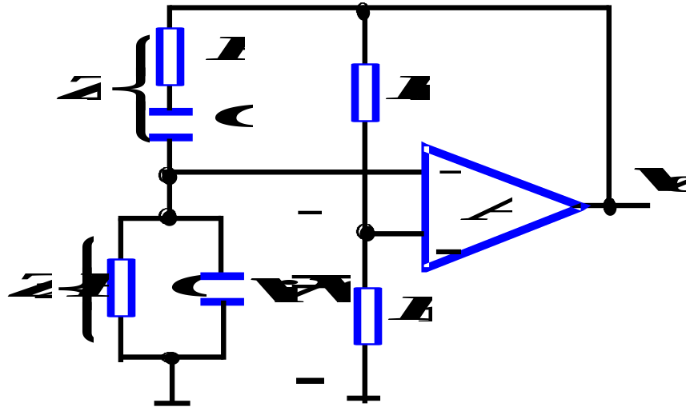
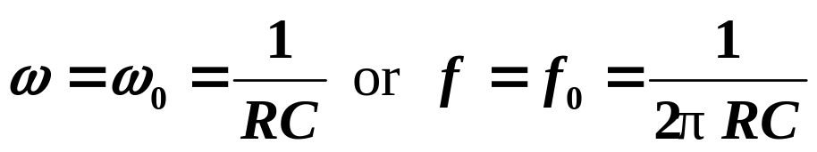
Review
Wien-Bridge Oscillator
Simulation
Oscillator with RC network can be used to produce signal in the 1 MHz frequency range.

Slide 5
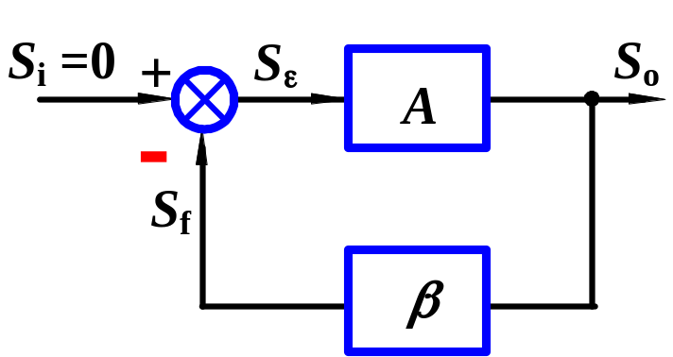
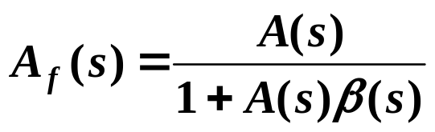



15.2 Oscillators(455)
15.2.1 Basic Principles for Oscillation
1. Condition of Oscillation
Oscillator block diagram shown in fig. Closed-loop gain
When loop gain
S_{o} also has output signal without input.
Conditions for sustained oscillations
Condition of magnitude
Total phase must be 2nπ
Condition of phase shift

Slide 6
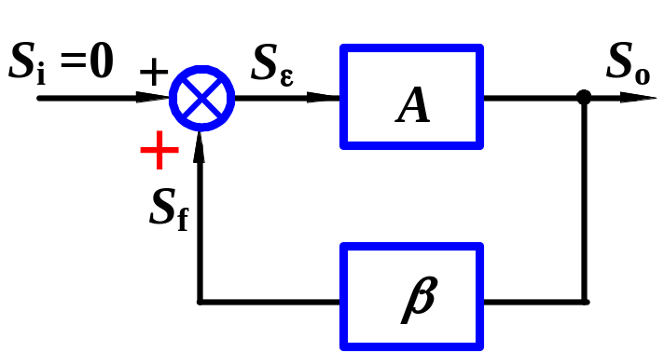

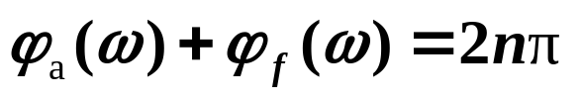
15.2 Oscillators
15.2.1 Basic Principles for Oscillation
1. Condition of Oscillation
If connect a positive feedback.
Conditions for sustained oscillations
Condition of magnitude
Condition of phase shift

Slide 7
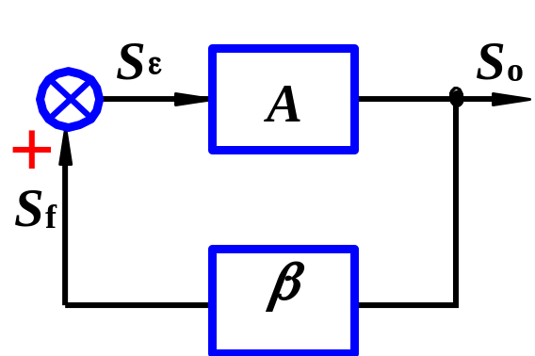

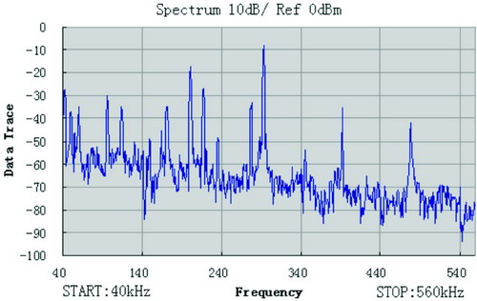
2. To Start Oscillator and Stabilize
Condition to start oscillator
# Oscillator only has output terminal, it can start to oscillate at the desired frequency without input signal, where does this signal come from?
Random noise can cause oscillations to begin.

Slide 8
2. To Start Oscillator and Stabilize
Condition to start oscillator
The desired freq. ω_{o} in noise has 2nπ phase shift, and can be amplified to produce output signal.
Increasing amplitude of output voltage should be limited before distortion occurs.

Slide 9
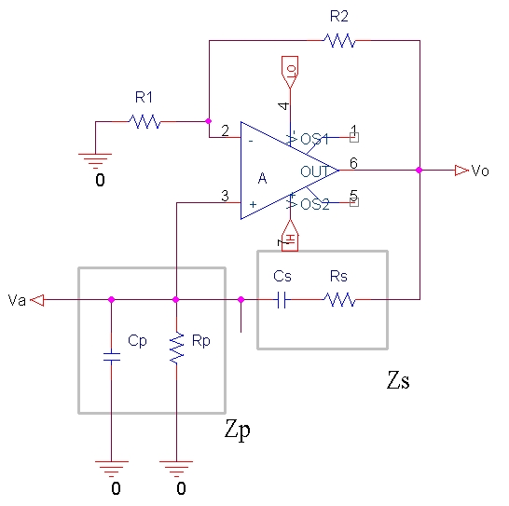

Slide 10
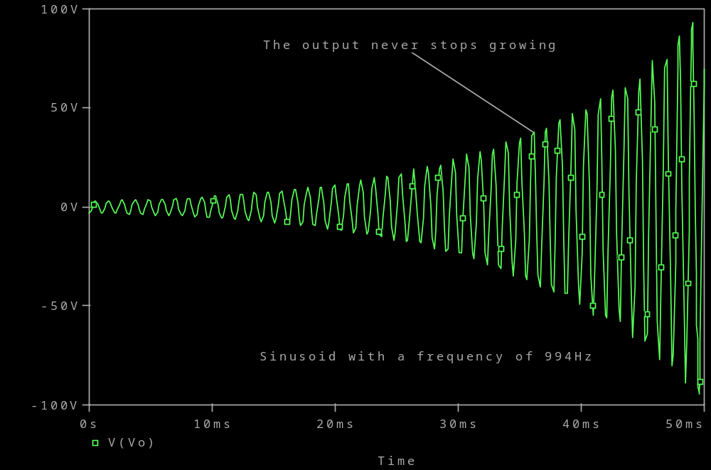

Slide 11
Adding nonlinear limiting device to make sure that Aβ=1, before distortion occurs.
Aβ >1
Aβ =1
start oscillator
Go Back
sustained oscillations

Slide 12
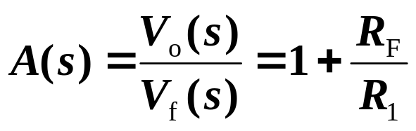
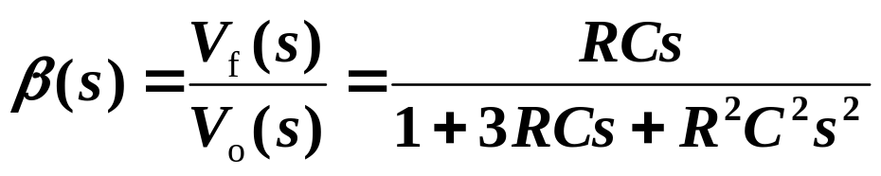
15.2.3. Wien-Bridge Oscillator(P459)
A. Structure
Basic amp and feedback network.
A series and a parallel RC networks are connected as freq-selecting network.
B. Frequency-selecting network
Voltage gain of basic amp
TF of feedback network
Substituting s=jω, and assume ω₀=1/RC

Slide 13
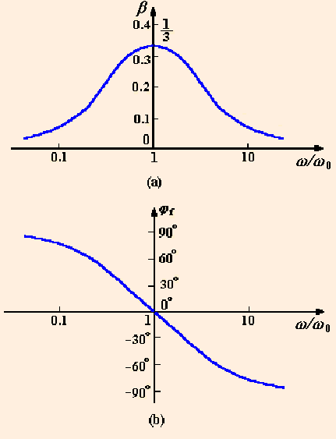
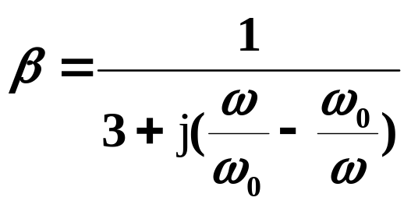
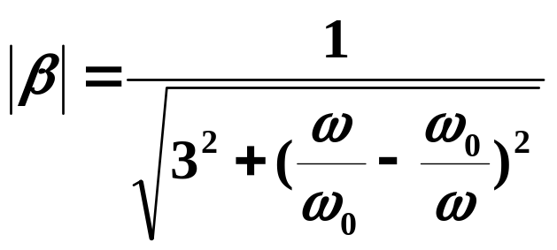
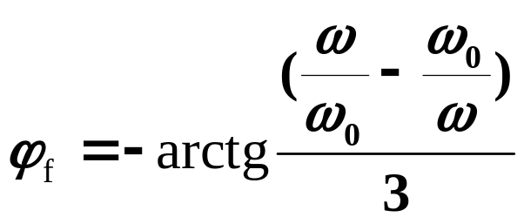
15.2.3. Wien-Bridge Oscillator(P459)
B. Frequency-selecting network
Magnitude response
Phase response
When

Slide 14
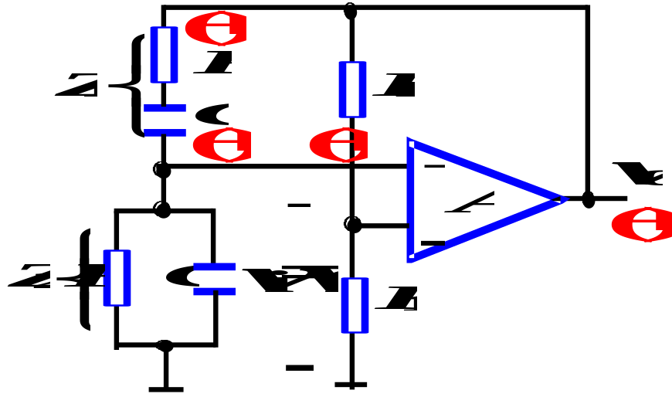
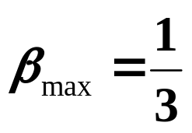


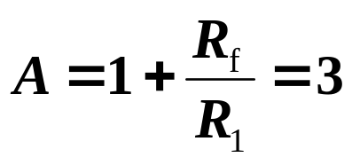
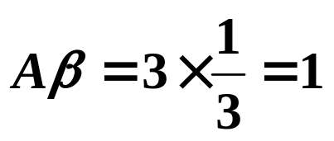
15.2.3. Wien-Bridge Oscillator(P459)
C. Operating
When
Max magnitude
Phase angle
Total phase shift is
If voltage gain of basic amp
Then
Circuit can sustain oscillation.
Output is a sine wave , and oscillation frequency is ω_{o} .
Oscillator with RC network can be used to produce signal in the 1 MHz frequency range.

Slide 15
L4. Oscillator
Radio-Frequency Oscillators
■RF oscillators do not differ in principle than other oscillators but practical circuits are quite different.
■ Any amplifier can be made to oscillate if a portion of the output signal is fed back to the input.
■ The Barkhausen criteria establishes the requirements for a circuit to oscillate.

Slide 16
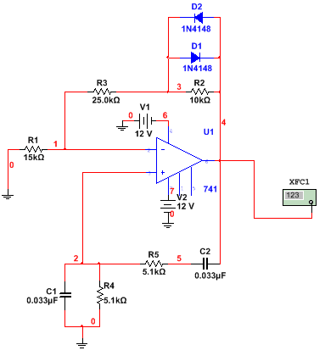
L4. Oscillator
The criteria for producing oscillations
Input power source
Gain
Frequency determining scheme
Feedback must be positive

Slide 17
L4. Oscillator
The criteria for producing oscillations
Input power source
The oscillator must deliver
power to be useful.
The oscillator circuit itself consumes
power and requires device biasing.

Slide 18
L4. Oscillator
The criteria for producing oscillations
Gain
Some devices providing signal
gain to overcome internal
signal losses.

Slide 19
L4. Oscillator
The criteria for producing oscillations
Frequency determining scheme
Some circuit or internal device
resonance is required
to control the frequency
of an oscillator.

Slide 20

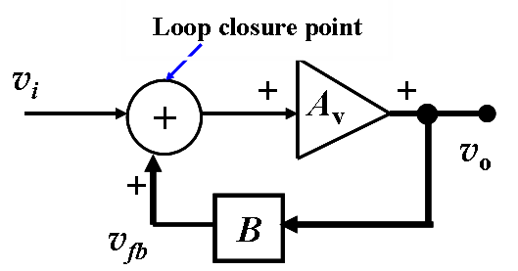
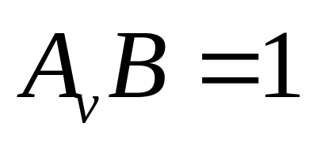
L4. Oscillator
The criteria for oscillations
Feedback must be positive
Barkhausen criteria:
▲ The feedback signal must be exactly in phase with the original input signal at the loop closure point.
▲ The overall steady-state gain around the feedback loop must be exactly equal to unity.

Slide 21
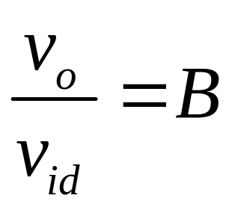
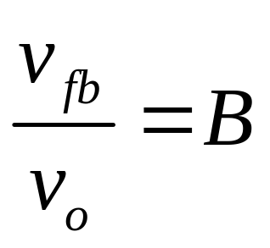
L4. Oscillator
Forward
gain
Feedback factor

Slide 22
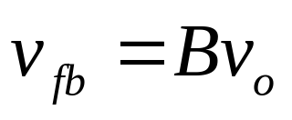
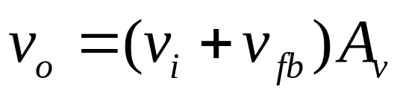
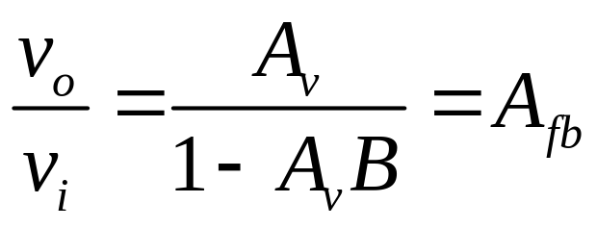
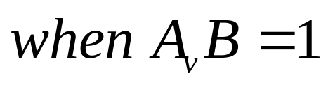
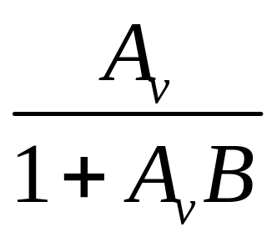
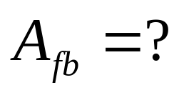
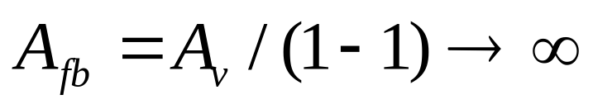
Oscillator
Loop closure point
v_{i}
+
+
+
A_{v}
v_{o}
+
v_{fb}
B
If feedback is negative

Slide 23
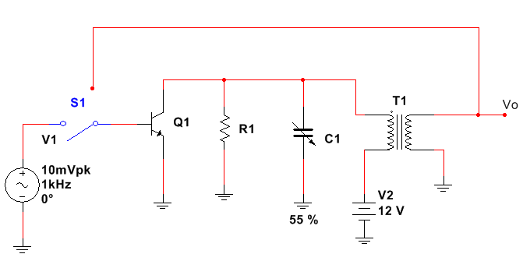

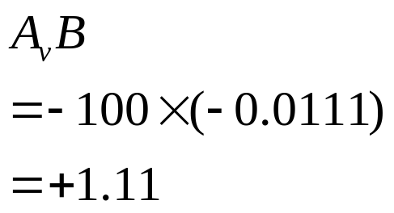

Oscillator
k=1
No power losses
n_{p}:n_{s}=90:1
Principle of Oscillation
Ideal
B=?
…
-1/90=-0.0111
CE
Suppose the voltage gain is -100
good for start oscillate

Slide 24
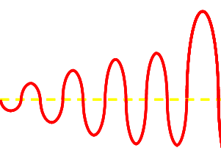
Oscillator
Principle of Oscillation
Suppose the voltage gain is -100
1110mV
1000mV
1000mV/90
?
?
10mV
11.1mV
11.1mV
12.3mV
12.3mV
Where will it stop?

Slide 25
Oscillator
12V
?
Principle of Oscillation
-12V
24V/90=266.7mV
V_{CES}=0
Where will it stop?
Linear system saturate

Slide 26
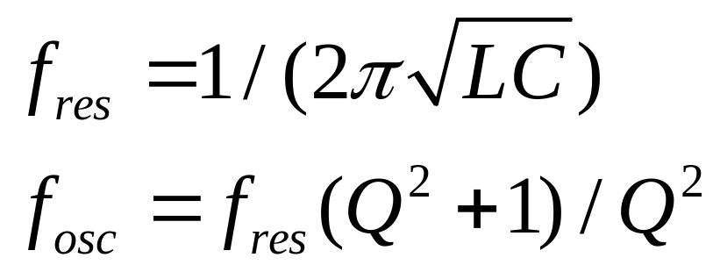
Oscillator
Principle of Oscillation

Slide 27
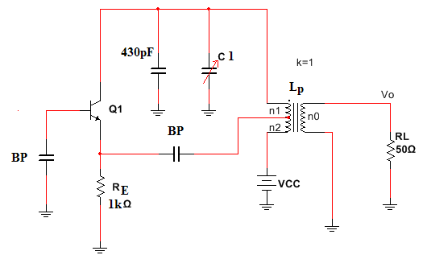
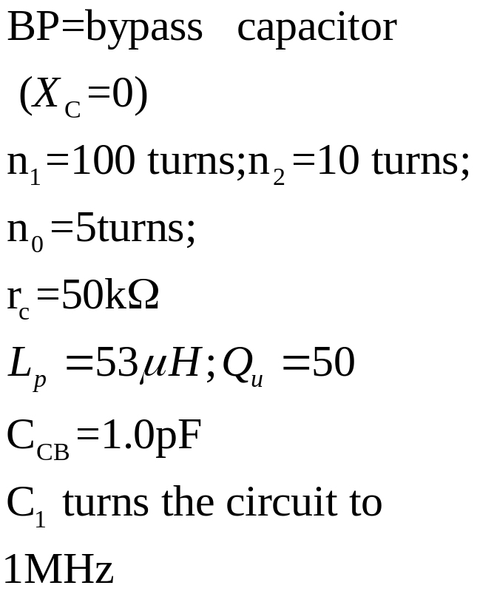
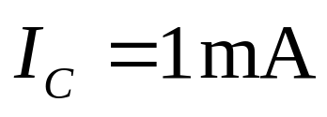
HARTLEY OSCILLATOR
+
+
+
+
+
Positive

Slide 28
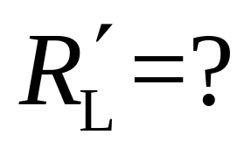
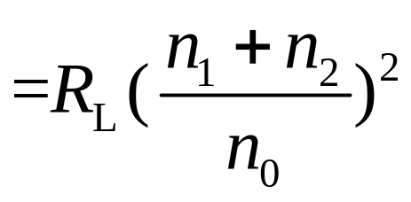
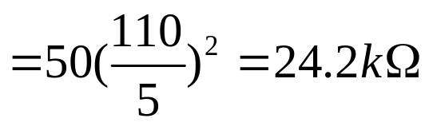

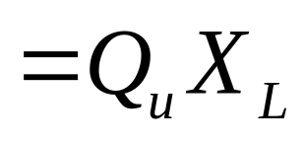
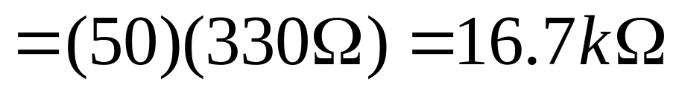
HARTLEY OSCILLATOR

Slide 29

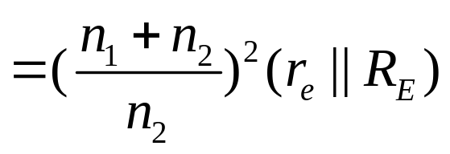
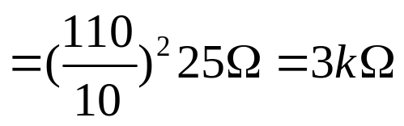

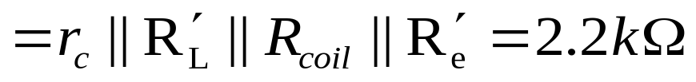
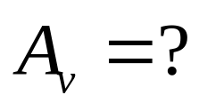
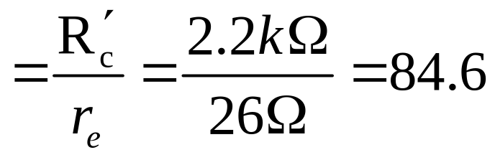
HARTLEY OSCILLATOR
The total collector loading

Slide 30

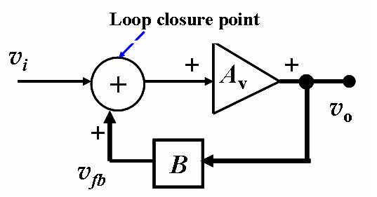


HARTLEY OSCILLATOR

Slide 31













HARTLEY OSCILLATOR

Slide 32




HARTLEY OSCILLATOR

Slide 33

HARTLEY OSCILLATOR
Judge the circuit can oscillate or not
+
-
+
+

Slide 34

HARTLEY OSCILLATOR
Judge the circuit can oscillate or not
-
+
+
+
+
-

Slide 35

HARTLEY OSCILLATOR
Judge the circuit can oscillate or not

Slide 36




COLPITTS OSCILLATOR
+
+
+
+
+

Slide 37



COLPITTS OSCILLATOR

Slide 38


COLPITTS OSCILLATOR

Slide 39



I_{E}=1.3mA
Example 2-1
The tuned circuit resonant frequency
Voltage gain A_{v}
Required base bias resistors
Loop gain，A_{v}B
Oscillations be sustained?

Slide 40







I_{E}=1.3mA
Example 2-1
The tuned circuit resonant frequency
Voltage gain A_{v}
Required base bias resistors
Loop gain，A_{v}B
Oscillations be sustained?

Slide 41


I_{E}=1.3mA
Example 2-1
The tuned circuit resonant frequency
Voltage gain A_{v}
Required base bias resistors
Loop gain，A_{v}B
Oscillations be sustained?

Slide 42


2V
1.3V
1mA
I_{E}=1.3mA
I_{B}=26uA
beta=50
Example 2-1
The tuned circuit resonant frequency
Voltage gain A_{v}
Required base bias resistors
Loop gain，A_{v}B
Oscillations be sustained?

Slide 43


I_{E}=1.3mA
Example 2-1
The tuned circuit resonant frequency
Voltage gain A_{v}
Required base bias resistors
Loop gain，A_{v}B
Oscillations be sustained?

Slide 44

I_{E}=1.3mA
Example 2-1
The tuned circuit resonant frequency
Voltage gain A_{v}
Required base bias resistors
Loop gain，A_{v}B
Oscillations be sustained?

Slide 45

COLPITTS OSCILLATOR
CB
+
+
+
+
+

Slide 46

COLPITTS OSCILLATOR
+
+
+
+

Slide 47


CLAPP OSCILLATOR
Simulation

Slide 48
CLAPP OSCILLATOR
Why Clapp?
C1 and C2 can be changed to get the optimum amount of feedback, and C3 can be a variable capacitor for setting the frequency of oscillation.
It was published by James Kilton Clapp in 1948

Slide 49

Judge the circuit can oscillate or not
+
+
+
+

Slide 50

Judge the circuit can oscillate or not

Slide 51



TUNED-INPUT /TUNED-OUTPUT
The generalized oscillator:
Z1 and Z2 must be the same reactance type, Z3 must be opposite to Z1 and Z2.

Slide 52

TUNED-INPUT /TUNED-OUTPUT
The generalized oscillator:
Xbe and Xce must be the same reactance type, Xcb must be opposite to Xbe and Xce.

Slide 53


TUNED-INPUT /TUNED-OUTPUT
The generalized oscillator:
Xbe and Xce must be the same reactance type, Xcb must be opposite to Xbe and Xce.

Slide 54

TUNED-INPUT /TUNED-OUTPUT
The generalized oscillator:
Xbe and Xce must be the same reactance type, Xcb must be opposite to Xbe and Xce.

Slide 55

Judge the circuit can oscillate or not

Slide 56

Judge the circuit can oscillate or not

Slide 57

Judge the circuit can oscillate or not

Slide 58
HARTLEY OSCILLATOR

Slide 59
COLPITTS OSCILLATOR

Slide 60
CLAPP OSCILLATOR

Slide 61
Siler OSCILLATOR

Slide 62



Crystal Oscillator
Piezoelectric Property

Slide 63

L4. Oscillator
Piezoelectric Oscillator (Quartz Crystal)

Slide 64

L4. Oscillator
Piezoelectric Oscillator (Quartz Crystal)

Slide 65


Simulation

Slide 66


Colpitts crystal-controlled oscillator
Inductor Ln is included in oscillators operating above 20 MHz. The purpose of Ln is to neutralize the 7- to 10-pF package capacitance, Cp, which at low frequencies would not be a problem.

Slide 67


Crystal Oscillators

Slide 68

Pierce Crystal Oscillator
The Pierce oscillator is often used in applications where different fundamental-mode crystals are switched in and out to provide various frequencies of crystal-controlled stability.

Slide 69

L4. Oscillator
C
4
C
(
BP
)
C
C
4
1
L
C
1
L
C
j
j
C
2
C
3
C
2
C
3

Slide 70
L4. Oscillator
Homework
  Page 76
    1
    4
    5

Slide 71

Notes:
for 6 lessons

