Slide 1

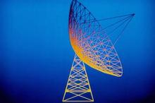

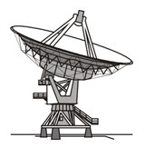
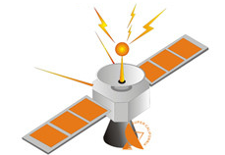
Huazhong University of Science and Technology
The Department of Electronics and Information Engineering
Electronic Circuits of Communication
Dr. Tianping Deng
Email: dengtp@hust.edu.cn

Slide 2
Electronic Circuits of Communication
Lec1 Basic of Telecommunication System
Lec2 Radio Frequency Amplifiers
Lec3 High-Frequency Power Amplifier
Lec4 Oscillator
Lec5 Amplitude Modulation
Lec6 Angle Modulation
Lec7 Receiver Circuits
Lec8 Wireless Communication
Lec7 Receiver Circuits

Slide 3
Lec7 Receiver Circuits
7-1 Low-Noise Amplifiers (LNAs)
7-2 Mixers
7-3 Tuning the Standard Broadcast Receiver
7-4 Filter Requirements for Interference Control and Selectivity
7-5 Filter Circuit Design
7-6 IF Amplifiers
7-7 AGC Circuits
7-8 The Audio System
7-9 Distortion and Feedback
7-10 Computer Analysis

Slide 4
Lec7 Receiver Circuits
7-1 Low-Noise Amplifiers (LNAs)
7-2 Mixers
7-3 Tuning the Standard Broadcast Receiver
7-4 Filter Requirements for Interference Control and Selectivity
7-5 Filter Circuit Design
7-6 IF Amplifiers
7-7 AGC Circuits
7-8 The Audio System
7-9 Distortion and Feedback
7-10 Computer Analysis

Slide 5
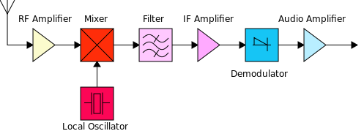
Introduction
AGC
Many concept:
Information bandwidth;
Multiplexing;
Distortion;

Slide 6
Introduction
AGC
Many concept:
Noise, SNR;
Modulation Index, Power
Superheterodying, image frequency,

Slide 7
Introduction
AGC
Many concept:
Selectivity;
Dynamic range and AGC;
AM demodulation

Slide 8
Lec7 Receiver Circuits
7-1 Low-Noise Amplifiers (LNAs)
7-2 Mixers
7-3 Tuning the Standard Broadcast Receiver
7-4 Filter Requirements for Interference Control and Selectivity
7-5 Filter Circuit Design
7-6 IF Amplifiers
7-7 AGC Circuits
7-8 The Audio System
7-9 Distortion and Feedback
7-10 Computer Analysis

Slide 9
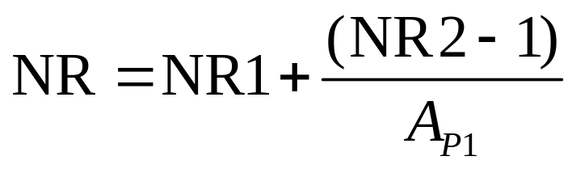
7-1 Low-Noise Amplifiers (LNAs)
◆ High performance receiver such as those used for satellite
communications require low noise amplifiers (LNAs).
◆ The LNAs used in the input stages to optimize the most
critical performance parameter, the noise figure.
Noise-power
Ratio of the second stage
The noise in the system:
Noise-power
Ratio of the first stage
Power gain
Ratio of the first stage

Slide 10
7-1 Low-Noise Amplifiers (LNAs)
◆ The first stage should have low noise and high gain.
◆ Low noise amplifier design:
Trade off
Low noise
High gain
◆ First stage:
Minimum noise and moderate gain
◆ Second stage:
Higher gain and moderate noise
We must reject the noise in the first stage

Slide 11
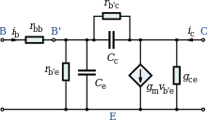
7-1 Low-Noise Amplifiers (LNAs)
◆ The noise source in RF bipolar transistor amplifiers are shot
noise in the emitter-base and base-collector junctions.
◆ Thermal noise generated by the base-spreading resistance.
◆ The circuit bias resistor noise.

Slide 12
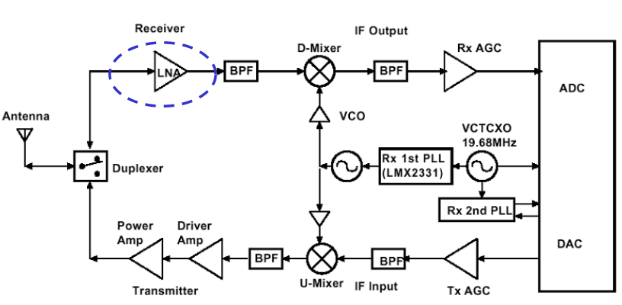
7-1 Low-Noise Amplifiers (LNAs)

Slide 13
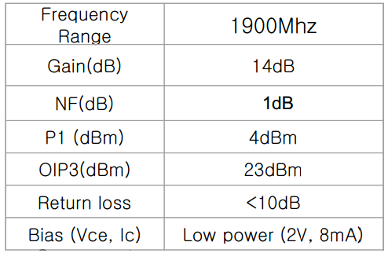
7-1 Low-Noise Amplifiers (LNAs)

Slide 14

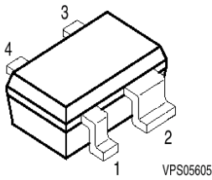
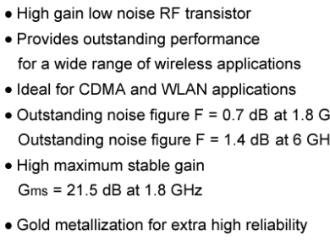
7-1 Low-Noise Amplifiers (LNAs)

Slide 15
7-1 Low-Noise Amplifiers (LNAs)
Amplifier Dynamic Range
◆ The dynamic range of an amplifier is loosely defined as:
the input power range over which the amplifier is useful
◆ For linear small signal amplifiers, the useful range has a
low power limit determined by noise, the noise floor.
◆ An RF amplifier can still be useful if the input signal power
is lower than the noise power.
But the noise must be minimized for maximum usefulness.

Slide 16
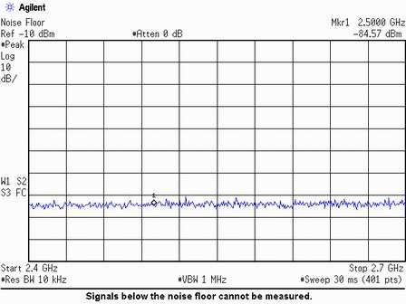
7-1 Low-Noise Amplifiers (LNAs)

Slide 17
7-1 Low-Noise Amplifiers (LNAs)
Third-order Intercept Point
◆ In telecommunications, a third-order intercept point
(IP3 or TOI) is a measure for weakly nonlinear systems and
devices, for example receivers, linear amplifiers and mixers.
◆ It is based on the idea that the device nonlinearity can be
modeled using a low-order polynomial, derived by means
of Taylor series expansion.

Slide 18


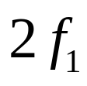
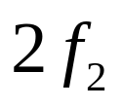
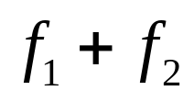
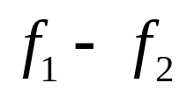
7-1 Low-Noise Amplifiers (LNAs)
Third-order Intercept Point
Linear
Amplifier
Amplifier
Second-order
products

Slide 19
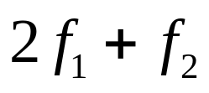
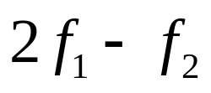
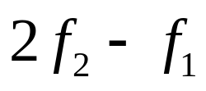
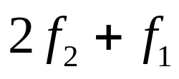
7-1 Low-Noise Amplifiers (LNAs)
Amplifier
Third-order
products
◆ The products usually fall inside the system bandwidth and
cause a distortion called intermodulation distortion (IMD) .

Slide 20
7-1 Low-Noise Amplifiers (LNAs)
Intermodulation distortion (IMD)
◆Intermodulation or intermodulation distortion (IMD) is the
amplitude modulation of signals containing two or more
different frequencies in a system with nonlinearities.
◆The intermodulation between each frequency component will
form additional signals at frequencies that are not just at
harmonic frequencies (integer multiples) of either, but also
at the sum and difference frequencies of the original
frequencies and at multiples of those sum and difference
frequencies.

Slide 21
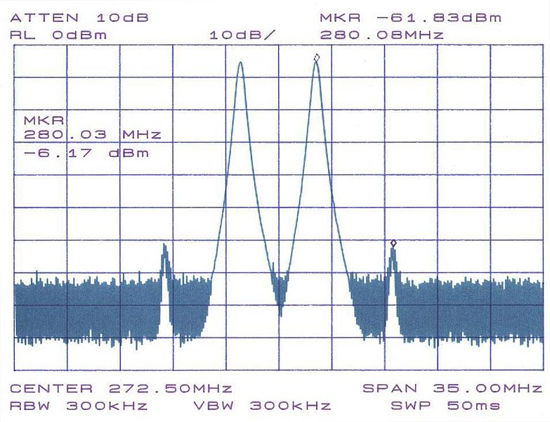
7-1 Low-Noise Amplifiers (LNAs)

Slide 22
Lec7 Receiver Circuits
7-1 Low-Noise Amplifiers (LNAs)
7-2 Mixers
7-3 Tuning the Standard Broadcast Receiver
7-4 Filter Requirements for Interference Control and Selectivity
7-5 Filter Circuit Design
7-6 IF Amplifiers
7-7 AGC Circuits
7-8 The Audio System
7-9 Distortion and Feedback
7-10 Computer Analysis

Slide 23
7-2 Mixers
◆ In electronics a mixer or frequency mixer is a nonlinear
electrical circuit that creates new frequencies from two signals
applied to it.
◆ In its most common application, two signals at frequencies
f₁ and f₂ are applied to a mixer, and it produces new signals
at the sum f₁ + f₂ and difference f₁ - f₂ of the original
frequencies.
◆ Other frequency components may also be produced in a
practical frequency mixer.

Slide 24
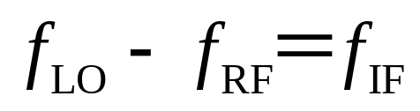
7-2 Mixers
◆High frequency receiver uses a mixer to down-convert the
received RF signal to an IF signal.
◆A mixer in RF system always refers to a circuit with a
nonlinear component, such diodes
◆The nonlinear devices can get the sum and the difference
frequencies of the input signals.

Slide 25
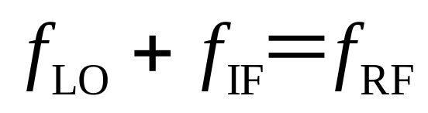
7-2 Mixers
◆The nonlinear devices can get the sum and the difference
frequencies of the input signals.
◆We can use the sum frequency to up-convert the carrier to
a higher frequency in the transmitter.

Slide 26
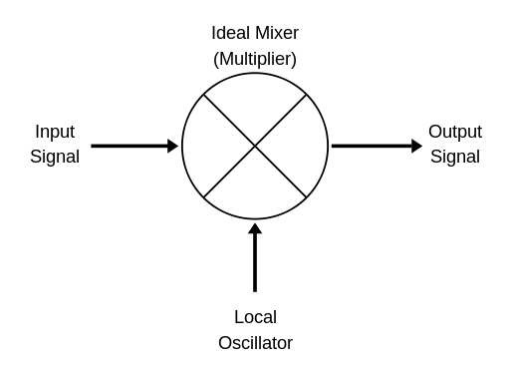
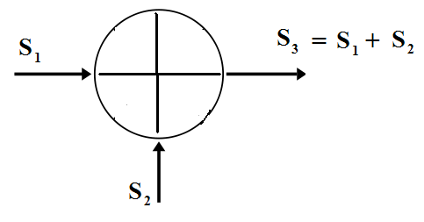
7-2 Mixers
◆The mixing of two signals.

Slide 27
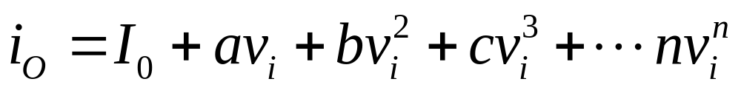
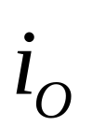
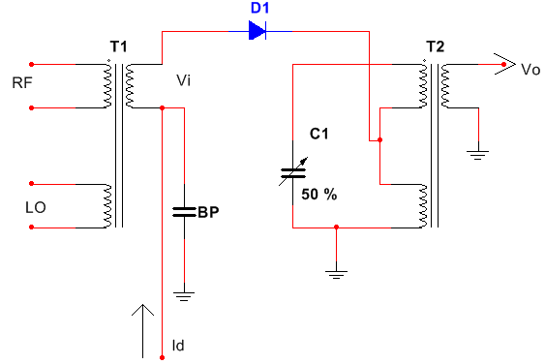
7-2 Mixers
◆General Nonlinearity
◆The output versus input nonlinearity of any device can be
express as:

Slide 28
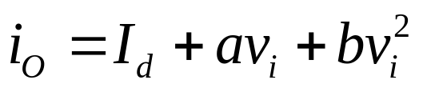
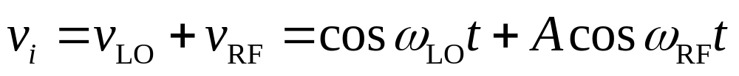
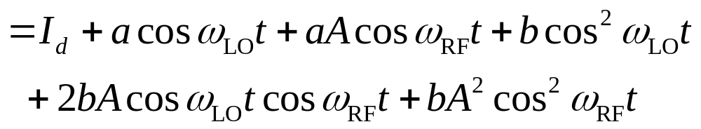
7-2 Mixers
◆For a simple second order nonlinear device such as FET

Slide 29
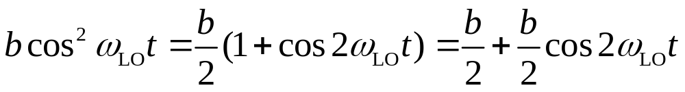
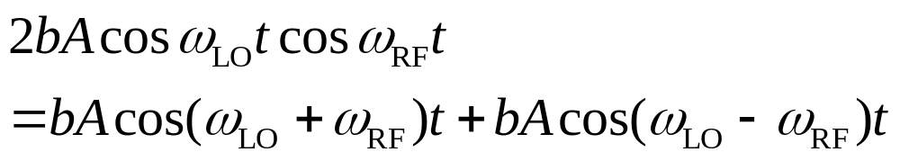
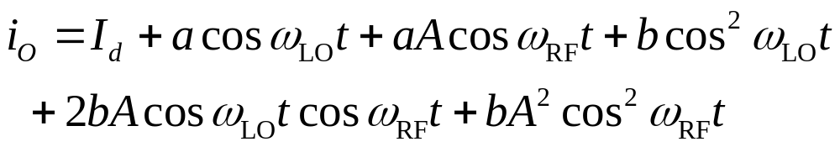
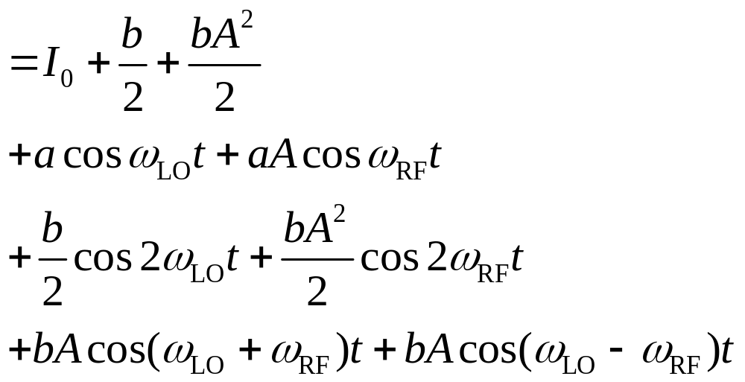
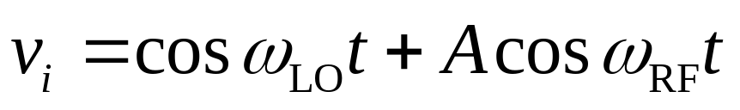
7-2 Mixers
◆The nonlinear devices can get
many new frequencies.

Slide 30
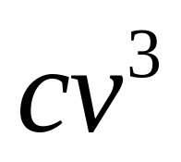
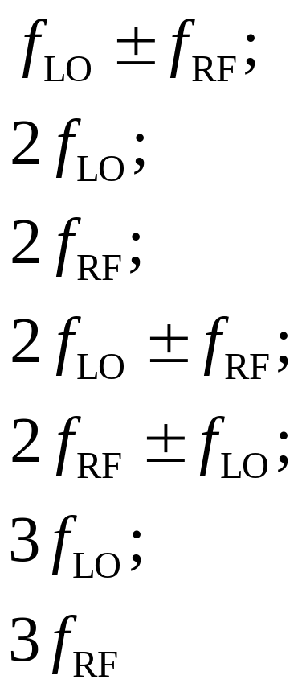
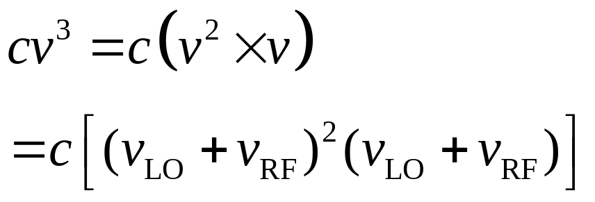
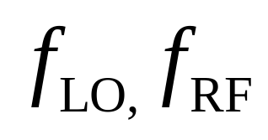
7-2 Mixers
◆If the expression has this term, what frequency component
will appear?

Slide 31
7-2 Mixers
◆Mixer Circuit Design
For DC
The DC Bias as if the circuit will operate class A
and adjust component values later when the optimum LO power is determined empirically.

Slide 32
7-2 Mixers
◆Mixer Circuit Design
For AC
The RF signal is transformer coupled and impedance matched to optimize the received signal/s path.
2) The LO is coupled to the input through a high impedance
circuit component, such as a small capacitor.
3)The output circuit must be optimum for the IF signal, including the modulation spectrum, while eliminating
f_{RF}, f_{LO}, f_{RF}+ f_{LO}.

Slide 33
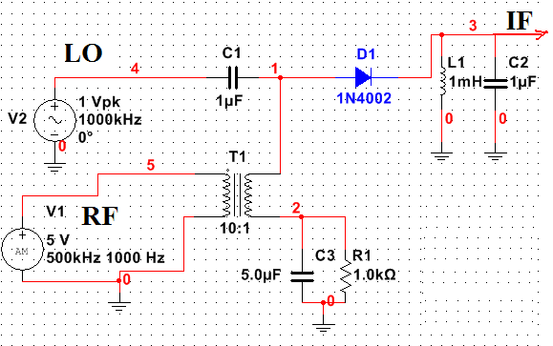

7-2 Mixers
◆Mixer Circuit Design
Nonlinear
device
Small
capacitor
Transformer
coupled

Slide 34
7-2 Mixers
D₁
T_{r1}
T_{r2}
+
v_{s}
+
-
v₀
-
D₂
RF v_{s}=V_{sm}cosω_{s}t
Small signal
LO v₀=V_{0m}cosω₀t
Large signal
Condition: V_{0m}>V_{sm}

Slide 35
7-2 Mixers
D₁
T_{r1}
T_{r2}
RF v_{s}=V_{sm}cosω_{s}t
LO v₀=V_{0m}cosω₀t
+
v_{s}
Condition: V_{0m}>V_{sm}
+
v₀
-
-
D₂
The circuit
D₁
r_{d}
+
+
-
i₁
+
v_{s}/2
R_{L}
v_{i}/2
-
-
+
+
v₀
-
+
v_{s}/2
i₂
R_{L}
v_{i}/2
V_{0m}>V_{sm}，when V₀>0，D₁、D₂ on，get i₁ and i₂。
-
+
-
-
D₂
r_{d}
The equivalent circuit

Slide 36

7-2 Mixers
D₁
T_{r1}
T_{r2}
RF v_{s}=V_{sm}cosω_{s}t
LO v₀=V_{0m}cosω₀t
+
v_{s}
Condition: V_{0m}>V_{sm}
+
v₀
-
-
whenV₀<0，D₁、D₂ off，
no current
D₂
D₁
r_{d}
+
-
+
i₁
+
v_{s}/2
R_{L}
v_{i}/2
So large LO signal act as a switch signal, and the frequency is
ω₀/2π。
-
-
+
-
v₀
+
+
v_{s}/2
i₂
R_{L}
v_{i}/2
-
-
+
-
D₂
r_{d}
S(t)
f =ω₀/2π
1
t
O

Slide 37
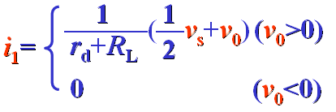
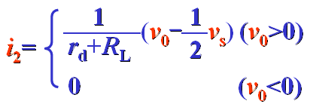

7-2 Mixers
RF v_{s}=V_{sm}cosω_{s}t
D₁
LO v₀=V_{0m}cosω₀t
T_{r1}
T_{r2}
Condition: V_{0m}>V_{sm}
+
v_{s}
+
v₀
-
-
D₂
The circuit
D₁
r_{d}
+
+
-
i₁
+
v_{s}/2
R_{L}
v_{i}/2
-
-
+
+
v₀
-
+
v_{s}/2
i₂
R_{L}
v_{i}/2
-
+
-
-
D₂
r_{d}
The equivalent circuit

Slide 38


7-2 Mixers

Slide 39
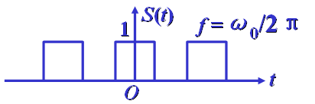
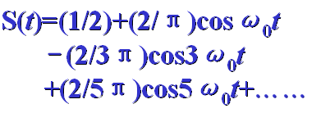
7-2 Mixers
The Fourier series of S(t)

Slide 40



7-2 Mixers
D₁
T_{r1}
T_{r2}
i₁
+
v_{s}
i
+
v₀
-
-
i₂
D₂

Slide 41
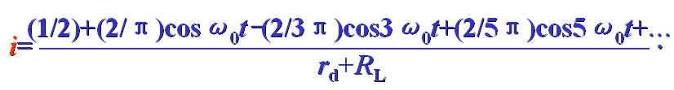

7-2 Mixers
◆New frequency component:

Slide 42
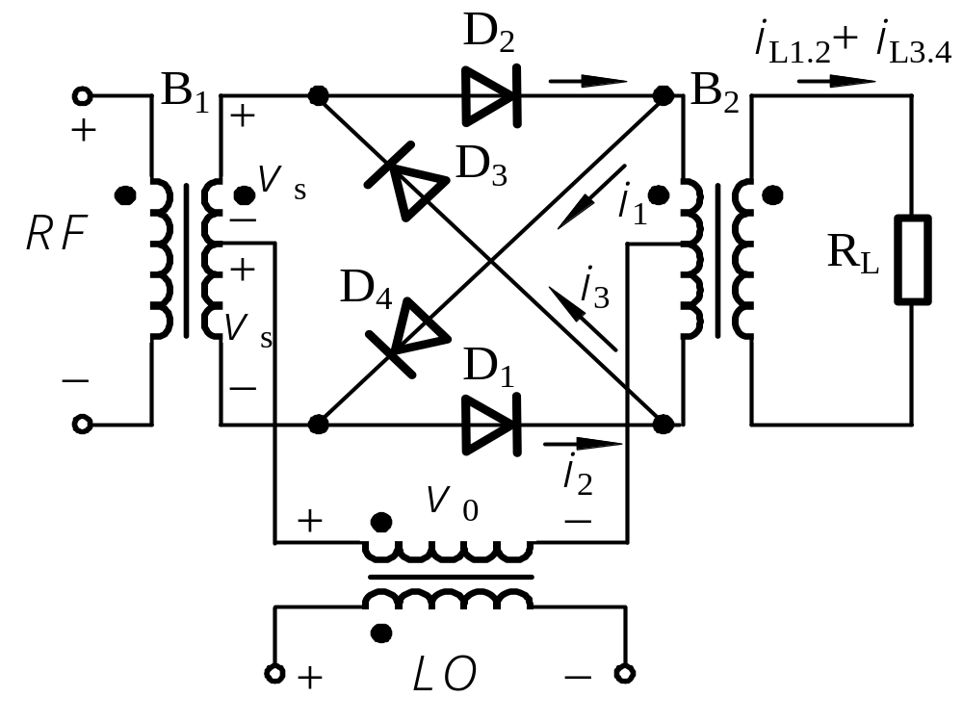
7-2 Mixers
◆Mixer Circuit Design
diode ring mixers

Slide 43
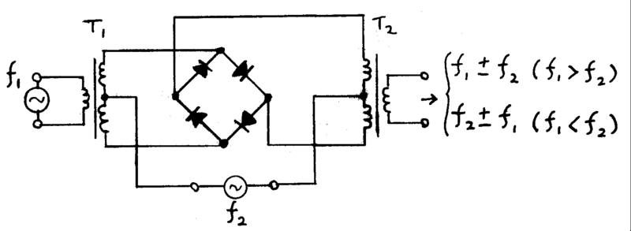
7-2 Mixers
◆Mixer Circuit Design
diode ring mixers

Slide 44
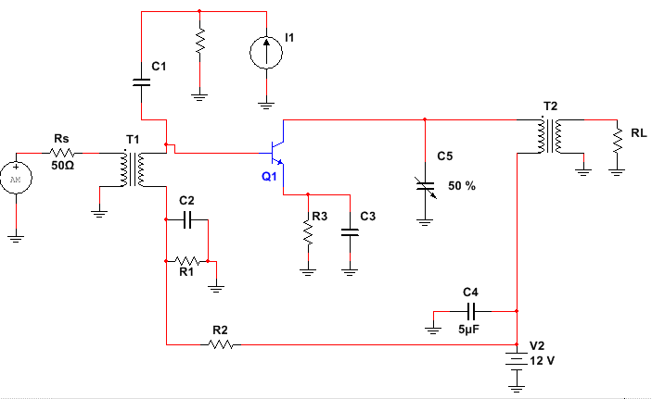
7-2 Mixers
EX1: Design an active mixer using a BJT: beta=50, C_{OB}=1pF,
C_{BE}=30pF,P_{Omax}=10mW, R_{L}=50Ω,collector efficiency η_{C}=50%,
Assume f_{RF}=1.6MHz, f_{IF}=455kHz, L1=0.25mH(infinite Q_{u}),
IF bandwidth must be 20kHz.
LO
5mW in 2.5kΩ
RF

Slide 45
7-2 Mixers
Determine all of the resistance and capacitance.
Determine the turns ratio for T1 to match input resistance 50Ω , and the turns ratio T2 to achieve the bandwidth.

Slide 46
7-2 Mixers
3. Determine the LO signal voltage dropped across Q1(v_{BE}),

Slide 47
7-2 Mixers
BJT: beta=50, C_{OB}=1pF,C_{BE}=30pF,
P_{Omax}=10mW, R_{L}=50Ω,
η_{C}=50%, f_{RF}=1.6MHz, f_{IF}=455kHz,
L1=0.25mH(infinite Q_{u}),
IF bandwidth must be 20kHz.

Slide 48





7-2 Mixers
C is open
L is short
DC circuit
AC source is zero.

Slide 49
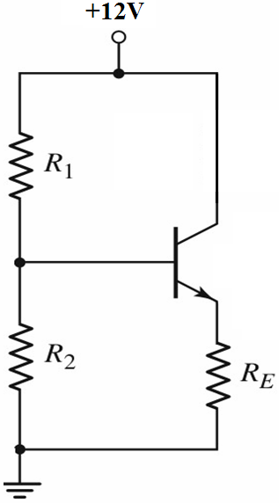





7-2 Mixers
DC circuit
BJT: beta=50,P_{Omax}=10mW,
η_{C}=50%,
P_{o} = P_{dc}*η ➔ P_{dc} = P_{o}/η = 20mW
V_{E}≈ (10% Supply Voltage)
V_{E}≈ (10%×12V）＝1.2V
P_{o} = V_{CE}I_{C} ＝（V_{CC}－V_{E}）×I_{C}
➔
I_{C}＝P_{O}/(V_{CC}-V_{E})
＝20mW/(12-1.2)=1.85mA
R₃＝1.2V/1.85mA=648Ω
V_{B}≈ 1.2V+0.6V=1.8V

Slide 50

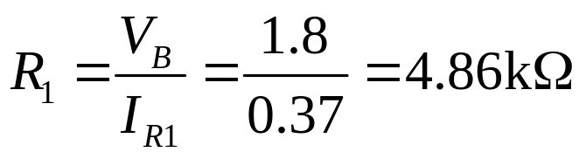

7-2 Mixers
DC circuit
BJT: beta=50,P_{Omax}=10mW,
η_{C}=50%,
V_{E}＝1.2V
V_{B}≈ 1.2V+0.6V=1.8V

Slide 51







7-2 Mixers
AC Analysis

Slide 52







7-2 Mixers

Slide 53







7-2 Mixers

Slide 54


7-2 Mixers

Slide 55




7-2 Mixers
2. Determine the turns ratio for T1 to match input resistance 50Ω , and the turns ratio T2 to achieve the bandwidth.

Slide 56










7-2 Mixers

Slide 57





7-2 Mixers
3. Determine the LO signal voltage dropped across Q1(v_{BE}),

Slide 58
Homework:
9,10

Slide 59
Lec7 Receiver Circuits
7-1 Low-Noise Amplifiers (LNAs)
7-2 Mixers
7-3 Tuning the Standard Broadcast Receiver
7-4 Filter Requirements for Interference Control and Selectivity
7-5 Filter Circuit Design
7-6 IF Amplifiers
7-7 AGC Circuits
7-8 The Audio System
7-9 Distortion and Feedback
7-10 Computer Analysis

Slide 60



7-6 IF Amplifiers
AGC
Reference
voltage
Q1 and Q2 carry the
same current.
Amplifier has high gain.
IF gain decease.

Slide 61


7-6 IF Amplifiers

Slide 62


7-6 IF Amplifiers
In the figure, R_{T}=2.5kΩ, and X_{L}=500Ω,
Determine the effective Q of the circuit with point 1 (only)
connect to ground, and compare it to the Q with point 2(only)
Connected to ground. The tap point is 1/3 of the turns from the
Bottom.

Slide 63

7-6 IF Amplifiers
R_{T}=2.5kΩ, and X_{L}=500Ω,

Slide 64





7-6 IF Amplifiers
R_{T}=2.5kΩ, and X_{L}=500Ω,

Slide 65






7-6 IF Amplifiers
？

Slide 66








Slide 67
Lec7 Receiver Circuits
7-1 Low-Noise Amplifiers (LNAs)
7-2 Mixers
7-3 Tuning the Standard Broadcast Receiver
7-4 Filter Requirements for Interference Control and Selectivity
7-5 Filter Circuit Design
7-6 IF Amplifiers
7-7 AGC Circuits
7-8 The Audio System
7-9 Distortion and Feedback
7-10 Computer Analysis

Slide 68

7-7 AGC Circuits
◆When the detector diode is reversed, and when the AGC voltage increases, just more negative voltages, the amplifiers
bias current decreases.
◆ When the IF gain is controlled by a reduction of current,
the system is known as reverse AGC.
◆ Reverse AGC is used in satellite and space transponder.

Slide 69



7-7 AGC Circuits
Gain
Collector Bias current
◆ For forward AGC, when the received signal strength increase,, the AGC voltage increase.
◆ When the AGC increases, the bias current also increases.
◆ When the bias current also increases. the current gain of the BJT decreases.

Slide 70

7-7 AGC Circuits
Reverse Biased.

Slide 71



7-7 AGC Circuits
DC circuit

Slide 72

7-7 AGC Circuits
AGC voltage

Slide 73








7-7 AGC Circuits

Slide 74





7-7 AGC Circuits
DC circuit

Slide 75






7-7 AGC Circuits

Slide 76

7-7 AGC Circuits
（1）Determine I_{B}
(2) Determine V_{E}, (V_{BE(on)=}0.6V), I_{E} and β;
(3) Is the AGC system forward or reverse AGC?
(4) If the total power gain from IF input to the detector input is 46dB,
determine the IF input signal power (in dBm) required for AGC threshold .Assume the IF input impedance is equal to Z_{i} of the detector.

Slide 77
（5）If P_{i} to the detector is 2mW total for an AM signal with m=0.9,
Determine each value
The carrier power P_{c};
V_{c} (peak value for carrier);
V_{o}(dc)
Vo(pk)
Sketch the v_{o}, including the peak voltage at V_{max} and V_{min}
Determine the value of C if modulation is 5kHz.
7-7 AGC Circuits

Slide 78



7-7 AGC Circuits

Slide 79





7-7 AGC Circuits

Slide 80
7-7 AGC Circuits
Reverse AGC

Slide 81




7-7 AGC Circuits

Slide 82



7-7 AGC Circuits

Slide 83

7-7 AGC Circuits
(4) If the total power gain from IF input to the detector input is 46dB,
determine the IF input signal power (in dBm) required for AGC threshold .Assume the IF input impedance is equal to Z_{i} of the detector.

Slide 84



7-7 AGC Circuits
（5）If P_{i} to the detector is 2mW total for an AM signal with m=0.9,
Determine each value
The carrier power P_{c};

Slide 85



（5）If P_{i} to the detector is 2mW total for an AM signal with m=0.9,
Determine each value
V_{c} (peak value for carrier);
7-7 AGC Circuits

Slide 86
（5）If P_{i} to the detector is 2mW total for an AM signal with m=0.9,
Determine each value
V_{o}(dc)
7-7 AGC Circuits

Slide 87
（5）If P_{i} to the detector is 2mW total for an AM signal with m=0.9,
Determine each value
Vo(pk)
7-7 AGC Circuits

Slide 88


（5）If P_{i} to the detector is 2mW total for an AM signal with m=0.9,
Determine each value
Determine the value of C if modulation is 5kHz.
7-7 AGC Circuits

Slide 89
Lec7 Receiver Circuits
7-1 Low-Noise Amplifiers (LNAs)
7-2 Mixers
7-3 Tuning the Standard Broadcast Receiver
7-4 Filter Requirements for Interference Control and Selectivity
7-5 Filter Circuit Design
7-6 IF Amplifiers
7-7 AGC Circuits
7-8 The Audio System
7-9 Distortion and Feedback
7-10 Computer Analysis

Slide 90

7-8 The Audio System
Class A
Class B
Class AB
Class C
Class AB

Slide 91
Lecture 7
Homework 17,21
Simulation homework
Using MATLAB, design a mixer.
f_{LO}=1.455MHz, the amplitude of LO is 5V,
f_{RF}=1MHz, the amplitude of RF is 0.5V,
you must get the waveform of LO,RF and IF.

Slide 92

Lecture 7 (END)
Notes:
for 6 lessons

