Slide 1

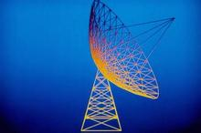
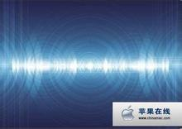
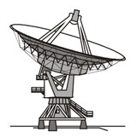
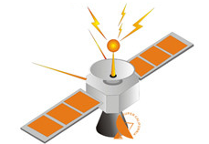
Huazhong University of Science and Technology
The Department of Electronics and Information Engineering
Electronic Circuits of Communication
Dr. Tianping Deng
Email: dengtp@hust.edu.cn

Slide 2
Electronic Circuits of Communication
Lec1 Basic of Telecommunication System
Lec2 Radio Frequency Amplifiers
Lec3 High-Frequency Power Amplifier
Lec4 Oscillator
Lec5 Amplitude Modulation
Lec6 Angle Modulation
Lec7 Receiver Circuits
Lec8 Sideband System
Lec8 Sideband System

Slide 3
Lec8 Sideband System
8-1 Vestigial Sideband
8-2 Double Sideband/Suppressed Carrier
8-3 Balanced Modulator
8-4 Product Detector
8-5 Phase Distortion in the Demodulation of Suppressed-Carrier Systems
8-6 Single Sideband/Suppressed Carrier
8-7 Frequency-Division Multiplexing in Telephone Systems
8-8 Quadrature Multiplexing
8-9 Costas Loop for Suppressed-Carrier Demodulation
8-10 Computer Analysis

Slide 4
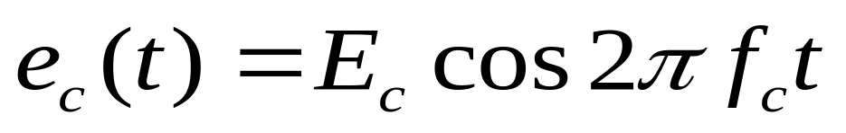
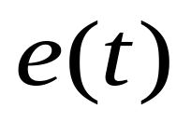
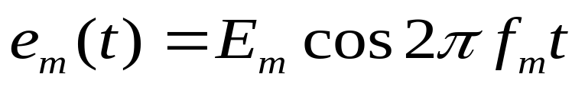
Review
Amplitude modulation
Amplitude
Modulator
Amplitude Modulated
Output signal, e(t)
High frequency
Carrier, e_{c}(t)
Modulating
signal, e_{m}(t)

Slide 5
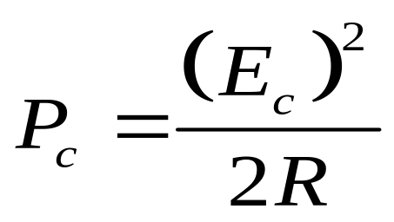
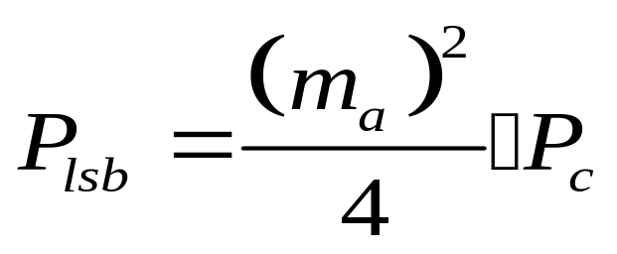
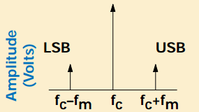
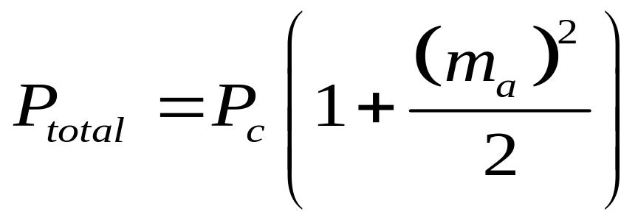
Review
Double Sideband
Full Carrier
(DSB-FC) AM

Slide 6
Introduction
◆ One side is the mirror image of the other.
◆ So either of one may be removed without loss of
information.
◆ Removal of either one results in 3-dB loss of
information power loss.

Slide 7

Introduction
Single Sideband Suppressed Carrier AM (SSB-SC AM)

Slide 8
Introduction
Double Sideband Suppressed Carrier (DSB-SC) AM:
SSB-SC AM
Vestigial sideband VSB
DSB-SC AM

Slide 9
Lec8 Sideband System
8-1 Vestigial Sideband
8-2 Double Sideband/Suppressed Carrier
8-3 Balanced Modulator
8-4 Product Detector
8-5 Phase Distortion in the Demodulation of Suppressed-Carrier Systems
8-6 Single Sideband/Suppressed Carrier
8-7 Frequency-Division Multiplexing in Telephone Systems
8-8 Quadrature Multiplexing
8-9 Costas Loop for Suppressed-Carrier Demodulation
8-10 Computer Analysis

Slide 10
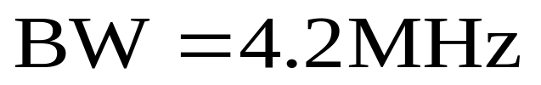
8-1 Vestigial Sideband
LSB
USB
Base
band
Vestigial
Sideband
filter
Amplitude
Modulation
Video signal
Carrier input
USB

Slide 11
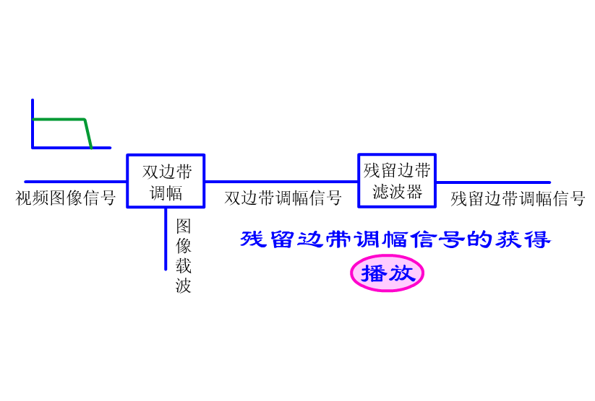
8-1 Vestigial Sideband

Slide 12


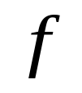

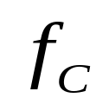



8-1 Vestigial Sideband
VSB TV video spectrum
LSB
USB
For the picture,
what will happen?

Slide 13
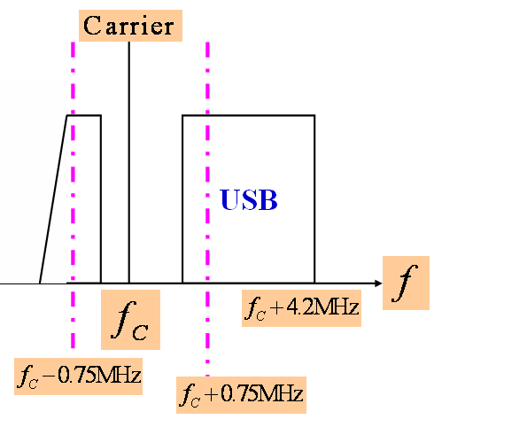
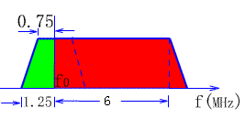
8-1 Vestigial Sideband
VSB TV video spectrum
◆ The power of f_{c}±0.75MHz will be
double of the power of (f_{c}+0.75MHz~
f_{c}+0.75MHz)

Slide 14
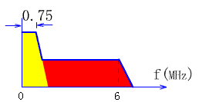
8-1 Vestigial Sideband
Transmitted signal
Contrast increase
Definition decrease
Received signal
We must compensate this in the TV receiver.

Slide 15


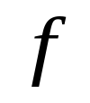


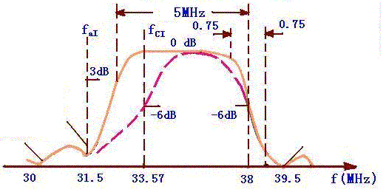

8-1 Vestigial Sideband
If the amplitude decreases 50%,
For dB unit, decrease what?

Slide 16
Lec8 Sideband System
8-1 Vestigial Sideband
8-2 Double Sideband/Suppressed Carrier
8-3 Balanced Modulator
8-4 Product Detector
8-5 Phase Distortion in the Demodulation of Suppressed-Carrier Systems
8-6 Single Sideband/Suppressed Carrier
8-7 Frequency-Division Multiplexing in Telephone Systems
8-8 Quadrature Multiplexing
8-9 Costas Loop for Suppressed-Carrier Demodulation
8-10 Computer Analysis

Slide 17
8-2 Double Sideband/Suppressed Carrier
Double Sideband Suppressed Carrier (DSB-SC) AM:

Slide 18

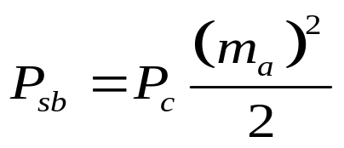
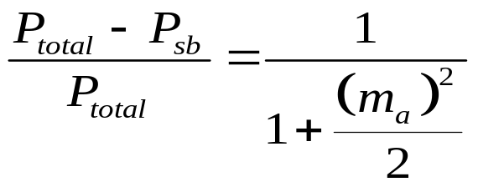
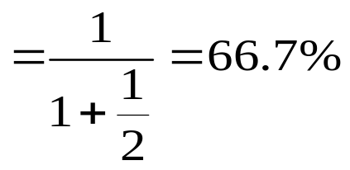
8-2 Double Sideband/Suppressed Carrier
Example 8-1
  Determine the power savings when the carrier is suppressed in a regular AM signal modulated to an index of 100%.
  Sol:
The power savings
Carrier consumes most of the power.

Slide 19
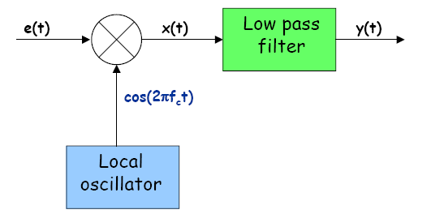
8-2 Double Sideband/Suppressed Carrier
Demodulation of DSB-SC AM
  Use a product detector (in Receiver):
  The question now remains how to obtain a coherent carrier signal from the DSB-SC AM signal!
This will explain in section 8.9

Slide 20
Lec8 Sideband System
8-1 Vestigial Sideband
8-2 Double Sideband/Suppressed Carrier
8-3 Balanced Modulator
8-4 Product Detector
8-5 Phase Distortion in the Demodulation of Suppressed-Carrier Systems
8-6 Single Sideband/Suppressed Carrier
8-7 Frequency-Division Multiplexing in Telephone Systems
8-8 Quadrature Multiplexing
8-9 Costas Loop for Suppressed-Carrier Demodulation
8-10 Computer Analysis

Slide 21
Review:
D₁
T_{r1}
T_{r2}
+
v_{s}
+
-
v₀
-
D₂
RF v_{s}=V_{sm}cosω_{s}t
Small signal
LO v₀=V_{0m}cosω₀t
Large signal
Condition: V_{0m}>V_{sm}

Slide 22





Review:
D₁
T_{r1}
T_{r2}
i₁
+
v_{s}
i
+
v₀
-
-
i₂
D₂

Slide 23
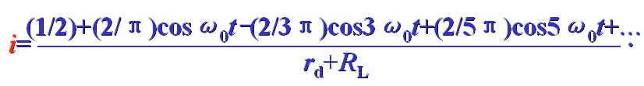

Review:
◆New frequency component:

Slide 24
8-3 Balanced Modulator
D₁
T_{r1}
-
T_{r2}
+
+
-
v_{s}
+
D₂
+
+
-
-
D₄
+
-
-
D₃
+
+
-
-
v₀
When v₀>0，
D₁、D₃ on，
D₂、D₄ off；

Slide 25
8-3 Balanced Modulator
When v₀>0，
D₁、D₃ on，
D₂、D₄ off；
D₁
T_{r1}
+
T_{r2}
-
+
+
v_{s}
-
D₂
-
-
+
-
D₄
+
When v₀<0，
D₁、D₃ off，
D₂、D₄ on；
-
+
D₃
-
-
+
+
v₀

Slide 26

8-3 Balanced Modulator
(1)v₀>0，D₁、D₃ on，
D₂、D₄ off。
D₁
T_{r1}
T_{r2}
+
+
i₁
v_{i}
+
v_{s}/2
—
-
D₂
2
v_{s}
-
+
+
Output current
v_{s}/2
v_{i}
-
i₃
D₄
—
-
2
-
D₃
+
v₀
-

Slide 27

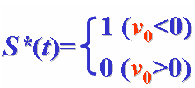


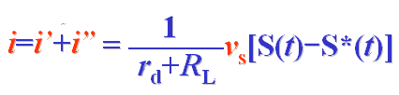
8-3 Balanced Modulator
(2)v₀<0，
D₂、D₄ on，
D₁、D₃ off。
T_{r1}
T_{r2}
i₂
+
+
v_{i}
+
v_{s}/2
—
-
D₂
2
v_{s}
-
+
+
v_{s}/2
v_{i}
-
D₄
—
Output current
-
i₄
2
-
-
v₀
+
The Fourier series of S*(t)

Slide 28

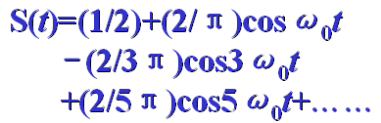



8-3 Balanced Modulator
T_{r1}
T_{r2}
i₂
+
+
v_{i}
+
v_{s}/2
—
-
D₂
2
v_{s}
-
+
+
v_{s}/2
v_{i}
-
D₄
—
-
i₄
2
-
-
v₀
+

Slide 29
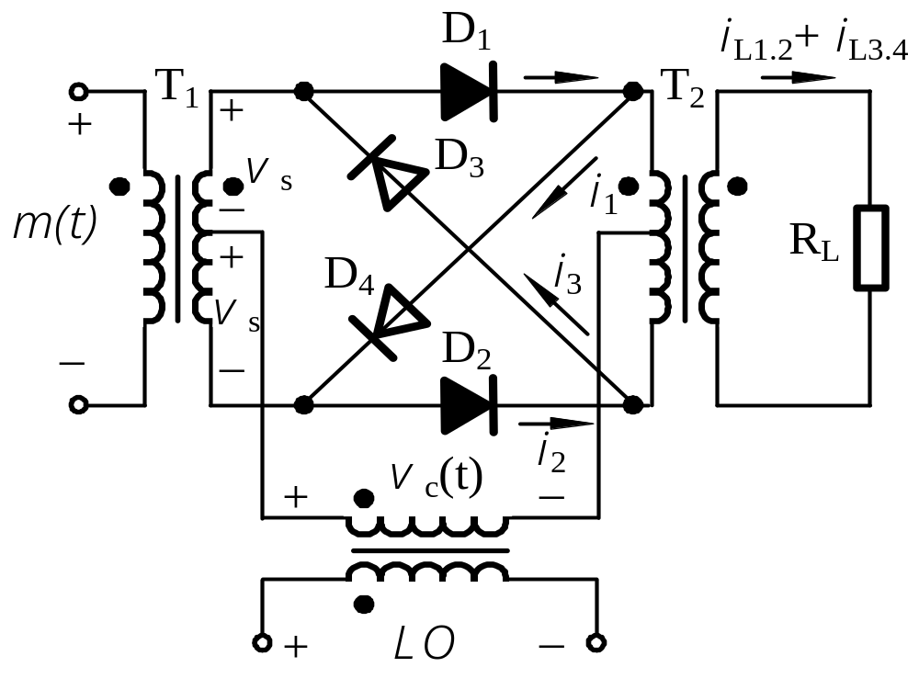




8-3 Balanced Modulator

Slide 30
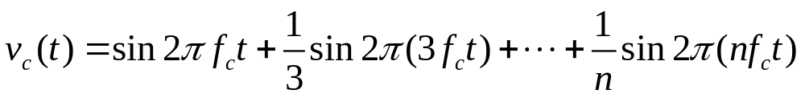
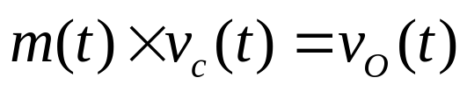
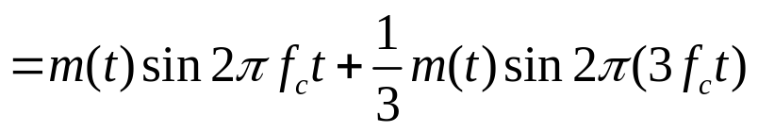


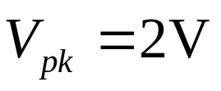
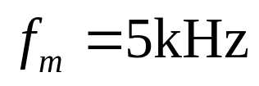
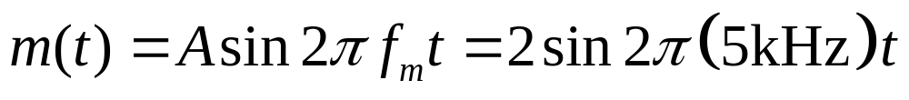
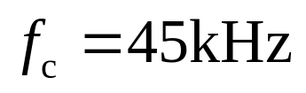
8-3 Balanced Modulator

Slide 31
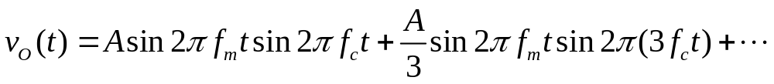
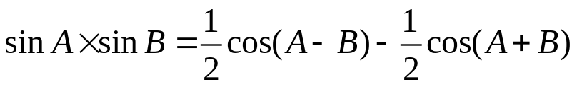
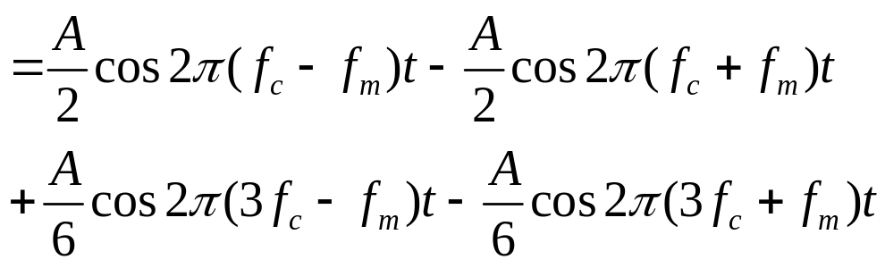
8-3 Balanced Modulator

Slide 32
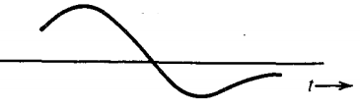
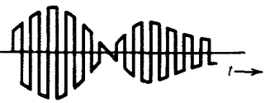

8-3 Balanced Modulator

Slide 33
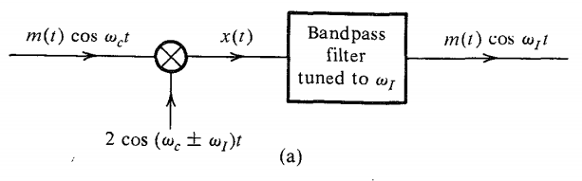

Slide 34
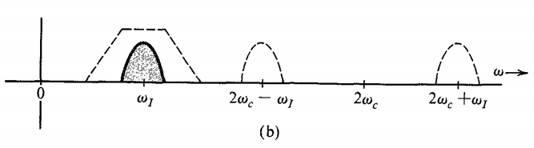

Slide 35
Lec8 Sideband System
8-1 Vestigial Sideband
8-2 Double Sideband/Suppressed Carrier
8-3 Balanced Modulator
8-4 Product Detector
8-5 Phase Distortion in the Demodulation of Suppressed-Carrier Systems
8-6 Single Sideband/Suppressed Carrier
8-7 Frequency-Division Multiplexing in Telephone Systems
8-8 Quadrature Multiplexing
8-9 Costas Loop for Suppressed-Carrier Demodulation
8-10 Computer Analysis

Slide 36
8-6 Single Sideband/Suppressed Carrier
Single Sideband Suppressed Carrier AM (SSB-SC AM)

Slide 37
8-6 Single Sideband/Suppressed Carrier
The Sideband Filter Method
SSB-SC
output
DSB-SC
SSB-SC
Balanced
Modulator
Mixer
Modulation
input
Upper sideband
filter
Linear PA
And filters
Amplifier
IF Carrier
frequency
IF Carrier
Generator
Up-converter
oscillator
Frequency
synthesizer
Reference
frequency

Slide 38
8-6 Single Sideband/Suppressed Carrier
The Sideband Filter Method
ω₀
Ω_{max}
LSB
USB
ω₀
This filter is very difficult to realize

Slide 39











8-6 Single Sideband/Suppressed Carrier
The Phase Method of SSB-SC Generation
SSB-SC
output
Wideband
90⁰ phase-shift
network
OSC
Linear PA
+90⁰
Modulation
Input signal

Slide 40
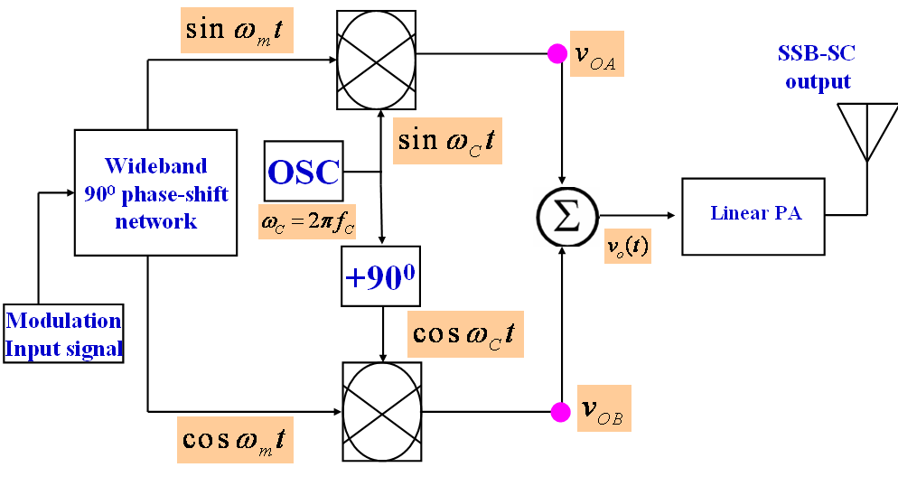
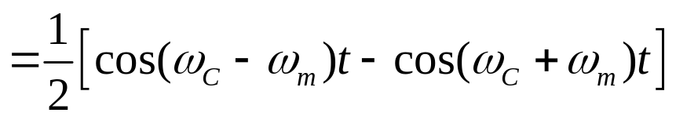

8-6 Single Sideband/Suppressed Carrier
The Phase Method of SSB-SC Generation

Slide 41
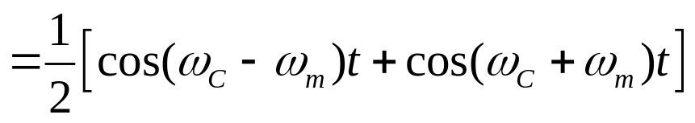

8-6 Single Sideband/Suppressed Carrier
The Phase Method of SSB-SC Generation

Slide 42




8-6 Single Sideband/Suppressed Carrier
The Phase Method of SSB-SC Generation

Slide 43



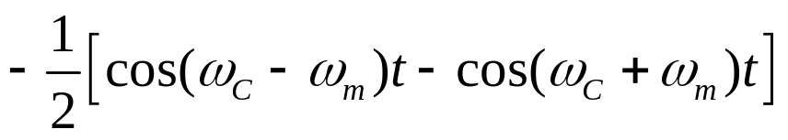
8-6 Single Sideband/Suppressed Carrier
The Phase Method of SSB-SC Generation
-
+

Slide 44
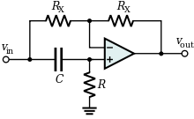
8-6 Single Sideband/Suppressed Carrier
The Phase Method of SSB-SC Generation
How to implement the phase-shift network?
All pass filter

Slide 45
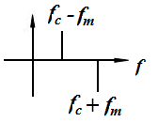
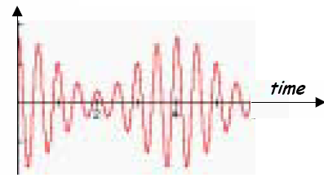






8-6 Single Sideband/Suppressed Carrier
The Phase Method of SSB-SC Generation

Slide 46
Lec8 Sideband System
8-1 Vestigial Sideband
8-2 Double Sideband/Suppressed Carrier
8-3 Balanced Modulator
8-4 Product Detector
8-5 Phase Distortion in the Demodulation of Suppressed-Carrier Systems
8-6 Single Sideband/Suppressed Carrier
8-7 Frequency-Division Multiplexing in Telephone Systems
8-8 Quadrature Multiplexing
8-9 Costas Loop for Suppressed-Carrier Demodulation
8-10 Computer Analysis

Slide 47





8-8 Quadrature Multiplexing
-90⁰
Carrier
oscillator
◆The two carriers have the same frequency value, but their
phases are orthogonal.

Slide 48


8-8 Quadrature Multiplexing
◆The Quadrature Multiplexing is used in the NTSC
(National Television System Committee).
Using this method to modulate two Chrominance signal:
(R-Y) and (B-Y).
Here Y is the luminance signal.

Slide 49
8-8 Quadrature Multiplexing
◆The two carrier signals are in phase quadrature, but they
have the same frequency, for the receiver, how to separate
the two signals, m₁(t) and m₂(t)?
◆At the receiver, these two modulating signals can be
demodulated using a coherent demodulator.

Slide 50







8-8 Quadrature Multiplexing
LPF
Cutoff
at w_{c}
-90⁰
Carrier
oscillator
Synchronized to
w_{c} of transmitter
LPF
Cutoff
at w_{c}

Slide 51








8-8 Quadrature Multiplexing
Using LPF to reject the high frequency components.

Slide 52
Summary
Double Sideband Full Carrier (DSB-FC) AM:
modulation index
envelope detection
power of DSB-FC AM signal
Double Sideband Suppressed Carrier (DSB-SC) AM:
Balanced Modulator
coherent demodulator
Single Sideband Suppressed Carrier AM (SSB-SC AM)
Single-Sided vs. Double-Sided Spectra

Slide 53

Summary
Single-Sided vs. Double-Sided Spectra

Slide 54

Summary
Comparison of DSB-FC, DSB-SC and SSB

Slide 55

Summary

Slide 56
Lecture 8
Homework 12,14
Simulation homework
Using MATLAB, produce the DSB-FC, DSB-SC and SSB time domain waveform.
And then analysis their spectrum.

