Slide 1

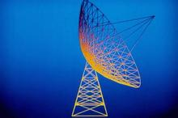

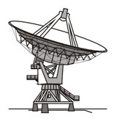
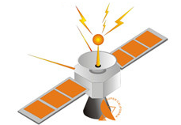
Huazhong University of Science and Technology
The Department of Electronics and Information Engineering
Electronic Circuits of Communication
Dr. Tianping Deng
Email: dengtp@hust.edu.cn

Slide 2
Electronic Circuits of Communication
Lec1 Basic of Telecommunication System
Lec2 Radio Frequency Amplifiers
Lec3 High-Frequency Power Amplifier
Lec4 Oscillator
Lec5 Amplitude Modulation
Lec6 Angle Modulation
Lec7 Receiver Circuits
Lec8 Sideband System
Lec9 Frequency and Phase Modulation
Lec9 Frequency and Phase Modulation

Slide 3
Lec9 Frequency and Phase Modulation
9-1 Frequency Modulation
9-2 Phase Modulation
9-3 Advantages of PM over FM
9-4 FM Transmitter Circuits
9-5 Frequency Stability and AFC
9-6 FM Receivers
9-7 Noise Performance
9-8 Stereo FM
9-9 Computer Analysis

Slide 4
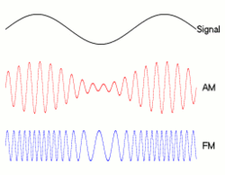
9-1 Frequency Modulation
◆ In telecommunications and signal processing, frequency
modulation (FM) is the encoding of information in a carrier
wave by varying the instantaneous frequency of the wave.

Slide 5
9-1 Frequency Modulation
In Amplitude Modulation (AM) the amplitude of the carrier signal is varied in proportion to the message signal.
But there are other characteristics of the carrier signal which can also be varied: frequency and phase.
In Frequency Modulation (FM) we vary the instantaneous frequency of the carrier signal in proportion to the message signal.

Slide 6
9-1 Frequency Modulation
Generally, we can express the sinusoidal carrier signal: c(t) = A(t)cos[θ(t)]
When amplitude A(t) is varied according to message m(t) (A(t) ∝ m(t)) – we get Amplitude Modulation.
When angle θ(t) is varied according to message m(t) , we get Angle Modulation (Phase Modulation or Frequency Modulation).

Slide 7
9-1 Frequency Modulation
A frequency modulated signal is any periodic signal whose
instantaneous frequency f is deviated from an average value
f_{c} by an information signal m(t).
The maximum amount by which the instantaneous frequency is deviated from the carrier frequency f_{c} is called the peak deviation, △f_{c}(pk) .

Slide 8



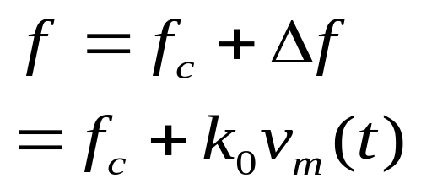
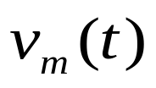
9-1 Frequency Modulation
The block diagram symbol of a linear frequency modulator, called a voltage controlled oscillator (VCO) or a voltage
tuned oscillator (VTO).
k₀ is the proportionality
constant that gives the amount
by which the input voltage
cause the output frequency to
deviate from the average value
f_{c}.
VCO
(VTO)

Slide 9
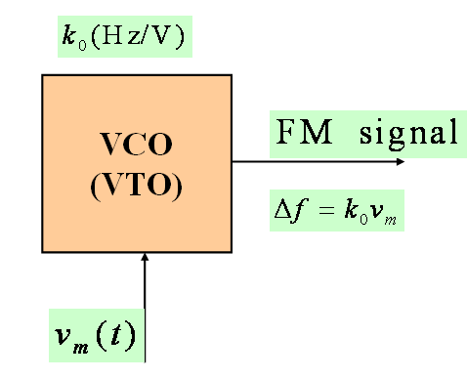
9-1 Frequency Modulation
VCO and Instantaneous Frequency
  We want to vary instantaneous frequency f(t) in proportion to the message signal m(t)
  We can use a VCO to produce a signal whose frequency is proportional to the input voltage.

Slide 10
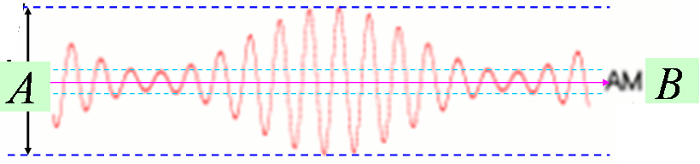
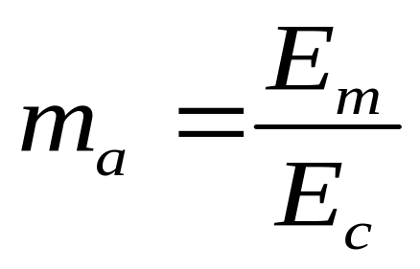
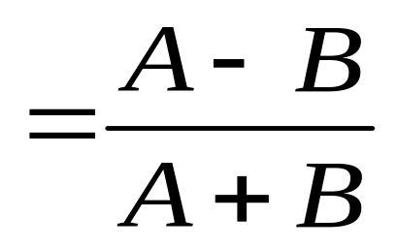
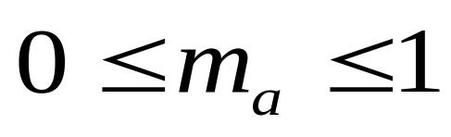
9-1 Frequency Modulation
Modulation Index
Are you remember in the AM, the modulation index is?

Slide 11
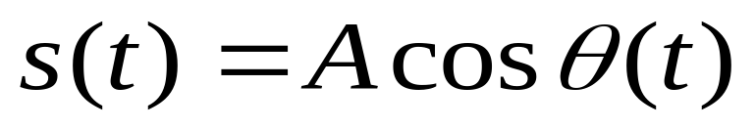
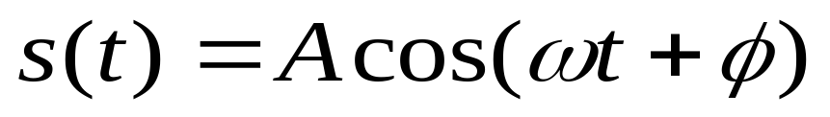
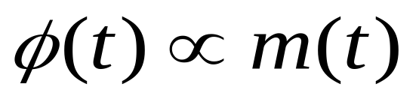
9-1 Frequency Modulation
Modulation Index
In general, a signal with angle modulation is expressed simply as:
The instantaneous angular displacement of the signal from a zero phase.
Angle modulation of high frequency carrier will result by varying the phase of:
Varied by the information signal,
Phase Modulation

Slide 12
9-1 Frequency Modulation
Is modulated by the information signal and
deviating the carrier frequency.
Held constant
Frequency Modulation
FM

Slide 13
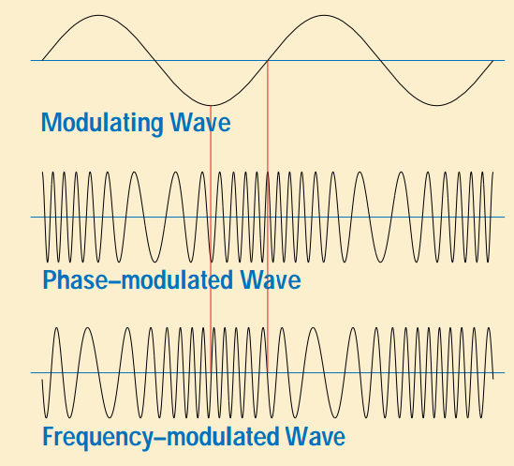
9-1 Frequency Modulation

Slide 14
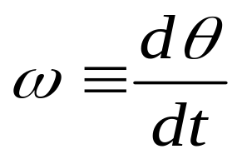
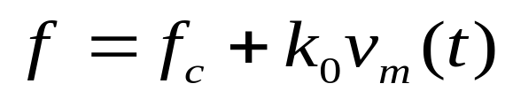
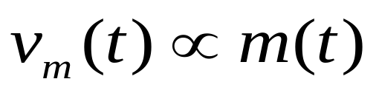

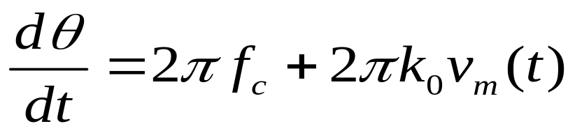
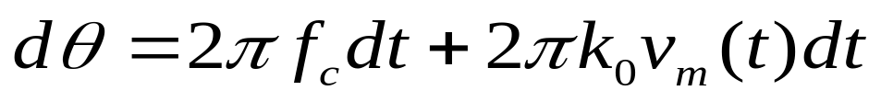
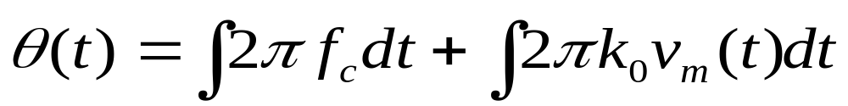
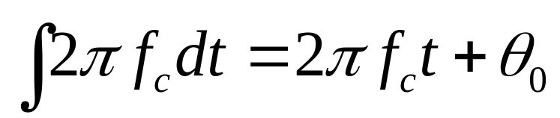
9-1 Frequency Modulation
Integrating both sides
The arbitrary starting phase at t=0

Slide 15
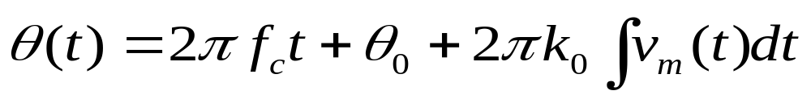
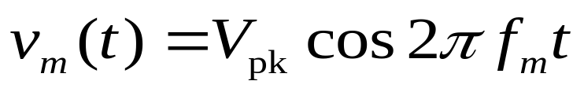
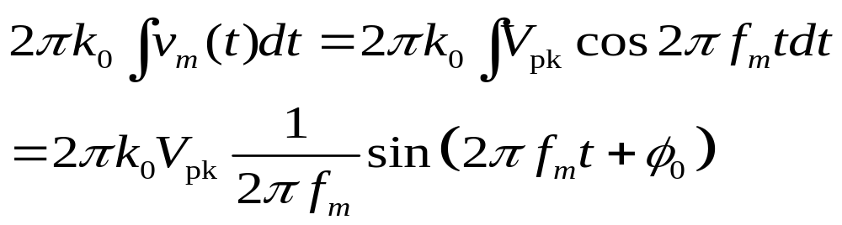
9-1 Frequency Modulation
The modulation index for angle modulation is defined as the peak phase deviation of the carrier.
For FM:
The arbitrary constant phase at t=0

Slide 16
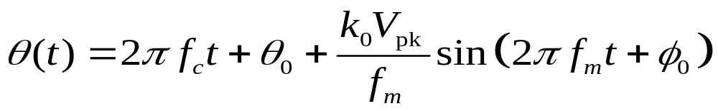
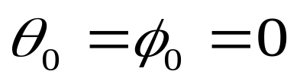
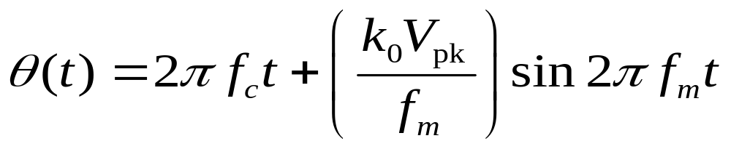
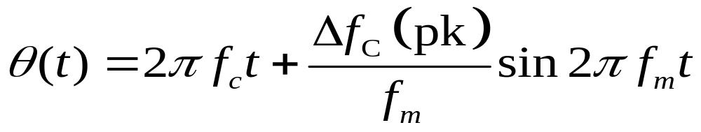
9-1 Frequency Modulation

Slide 17
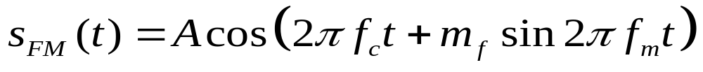
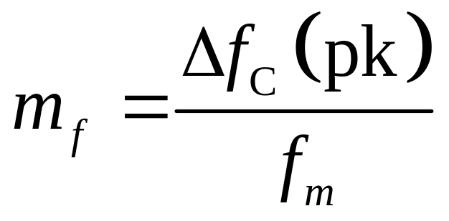
9-1 Frequency Modulation
Modulation Index

Slide 18
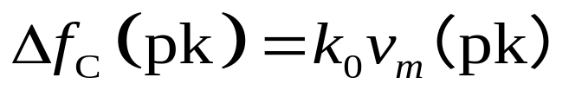
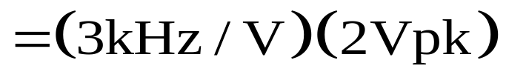

9-1 Frequency Modulation
Example 9-1
A 1MHz VCO with a measured sensitivity of k₀=3kHz/V
is modulated with a 2V pk, 4kHz sinusoid. Determine the following:
The maximum frequency deviation of the carrier.

Slide 19
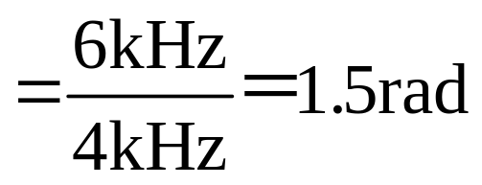
9-1 Frequency Modulation
Example 9-1
A 1MHz VCO with a measured sensitivity of k₀=3kHz/V
is modulated with a 2V pk, 4kHz sinusoid. Determine the following:
The peak phase deviation of the carrier and therefore the modulation index

Slide 20
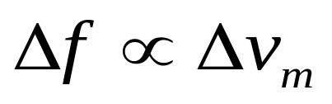
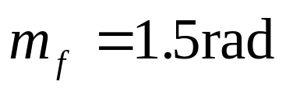
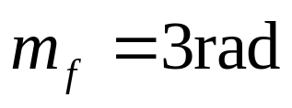
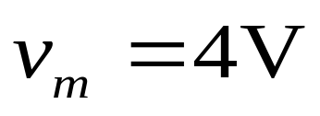
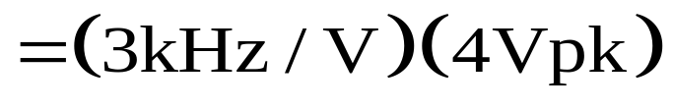

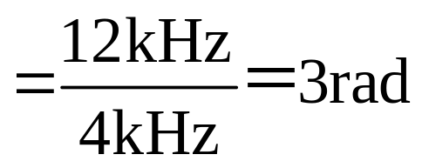
9-1 Frequency Modulation
Example 9-1
A 1MHz VCO with a measured sensitivity of k₀=3kHz/V
is modulated with a 2V pk, 4kHz sinusoid. Determine the following:
m_{f} if the modulation voltage is doubled.

Slide 21

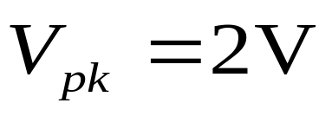
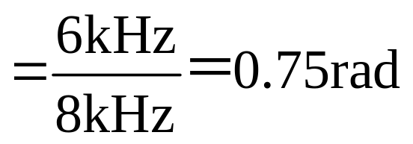
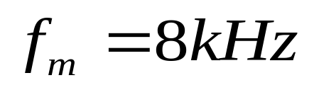
9-1 Frequency Modulation
Example 9-1
A 1MHz VCO with a measured sensitivity of k₀=3kHz/V
is modulated with a 2V pk, 4kHz sinusoid. Determine the following:
m_{f} for volts.

Slide 22
9-1 Frequency Modulation
Example 9-1
A 1MHz VCO with a measured sensitivity of k₀=3kHz/V
is modulated with a 2V pk, 4kHz sinusoid. Determine the following:
Express the FM signal mathematically for a cosine carrier and the cosine modulating signal of part4. the carrier amplitude is 10V pk.

Slide 23
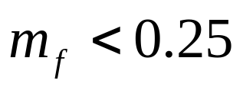
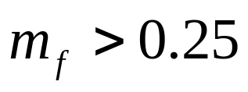





9-1 Frequency Modulation
Sidebands and spectrum
Narrow band FM
Wide band FM
For AM

Slide 24

9-1 Frequency Modulation
■ Next we look at how to obtain magnitude spectra for
Narrowband FM and Wideband FM.
Discrete carrier
sideband
term

Slide 25
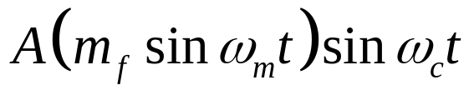
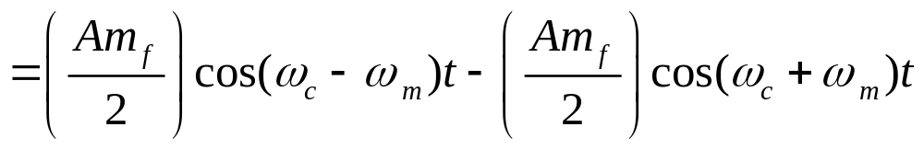
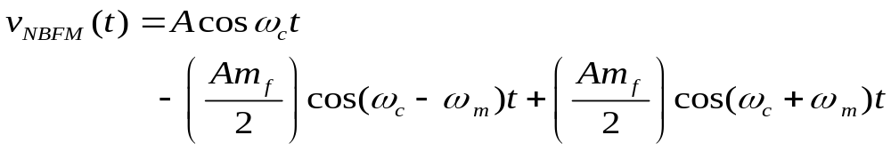
9-1 Frequency Modulation

Slide 26
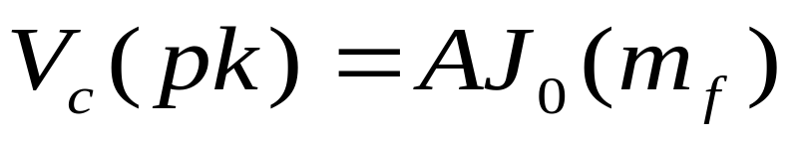
9-1 Frequency Modulation
Magnitude Spectrum of Wideband FM
  if m_{f} is not small (i.e. m_{f} ≥ 0.25 ) we can NOT use the approximations which we used for narrowband FM.
  Analysis becomes much more complex.
  However, frequency components of the FM signal can be written in terms of Bessel functions.

Slide 27
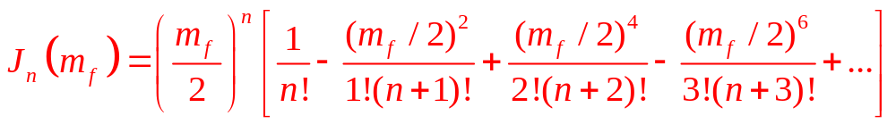

9-1 Frequency Modulation

Slide 28

9-1 Frequency Modulation

Slide 29


9-1 Frequency Modulation
◆ Information bandwidth and power
Peak voltage
Real impendence

Slide 30
9-1 Frequency Modulation
example:
  An FM signal v_{FM} is measured in a 50-Ω antenna. Determine the following :
  v_{FM} = 1000 cos(2π10⁷t + 0.5cos2π10⁴t)
    Total Power
    Modulation Index
    Peak frequency deviation
    Modulation sensitivity if 200mV pk is required to achieve part 3

Slide 31
9-1 Frequency Modulation
example: solution
  1, P_{total} = P_{unmod} = (V_{pk})²/2R = 10 kW
  2, m_{f} = 0.5
  3, m_{f} = Δf_{c}/f_{m} ➔ Δf_{c}= m_{f}*f_{m} = 5 kHz pk
  4, ΔV_{m}=0.2 V ➔ k₀ = Δf_{c}/ΔV_{m} = 25 kHz

Slide 32
Lec9 Frequency and Phase Modulation
9-1 Frequency Modulation
9-2 Phase Modulation
9-3 Advantages of PM over FM
9-4 FM Transmitter Circuits
9-5 Frequency Stability and AFC
9-6 FM Receivers
9-7 Noise Performance
9-8 Stereo FM
9-9 Computer Analysis

Slide 33





9-2 Phase Modulation
◆ Phase modulation (PM) is a modulation pattern that encodes
information as variations in the instantaneous phase of a
carrier wave.
constant

Slide 34






9-2 Phase Modulation
Discrete carrier
sideband
term

Slide 35







9-2 Phase Modulation
◆ Diode Modulator for PM
Crystal
Oscillator
(Carrier)
-90⁰

Slide 36







9-2 Phase Modulation
◆ Diode Modulator for PM
XO
BA
Buffer
Amplifier
(Carrier)
◆The most straightforward method of producing a PM signal.

Slide 37
9-2 Phase Modulation
◆ Diode Modulator for PM
XO
BA
Buffer
Amplifier
(Carrier)
Varicap
Varactor
◆The most straightforward method of producing a PM signal.

Slide 38

9-2 Phase Modulation

Slide 39



9-2 Phase Modulation
◆ From the Figure 9-10 in the textbook.
Voltage of the diode
The slope of the C(V)
Peak value
of V_{m}
Reverse voltage of the diode

Slide 40



9-2 Phase Modulation
Frequency shift

Slide 41
Lec9 Frequency and Phase Modulation
9-1 Frequency Modulation
9-2 Phase Modulation
9-3 Advantages of PM over FM
9-4 FM Transmitter Circuits
9-5 Frequency Stability and AFC
9-6 FM Receivers
9-7 Noise Performance
9-8 Stereo FM
9-9 Computer Analysis

Slide 42

9-4 FM Transmitter Circuits
◆voltage-controlled oscillator
◆A voltage-controlled oscillator or VCO is an electronic oscillator
designed to be controlled in oscillation frequency by a voltage
input.
◆The frequency of oscillation is varied by the applied DC voltage,
while modulating signals may also be fed into the VCO to cause
frequency modulation (FM) or phase modulation (PM);

Slide 43
9-4 FM Transmitter Circuits
◆Integrated Circuit VCO
MC1648

Slide 44
9-4 FM Transmitter Circuits
FM Demodulation
  The objective of all FM demodulators is to produce a transfer characteristic that is the inverse of that of the frequency modulator.
  There are many types of FM demodulators:
    Slop detectors (based on differentiation)
    zero-crossing detectors
    phase locked discriminators
    quadrature detectors.

Slide 45

9-4 FM Transmitter Circuits
FM Demodulation
  A common method to demodulate an FM signal (i.e. to recover the message from an FM signal) is to use a phase-locked loop

Slide 46

9-4 FM Transmitter Circuits
Clock distribution

Slide 47

9-4 FM Transmitter Circuits
Frequency synthesis

Slide 48
Homework
9

Slide 49

Lecture 9 (END)
Notes:
for 6 lessons

