Slide 1
Domain-Specific Knowledge Graphs in RAG-Enhanced Healthcare LLMs
Sydney Anuyah, Mehedi Mahmud Kaushik, Hao Dai, Rakesh Shiradkar, Arjan Durresi, Sunandan Chakraborty

Slide 2
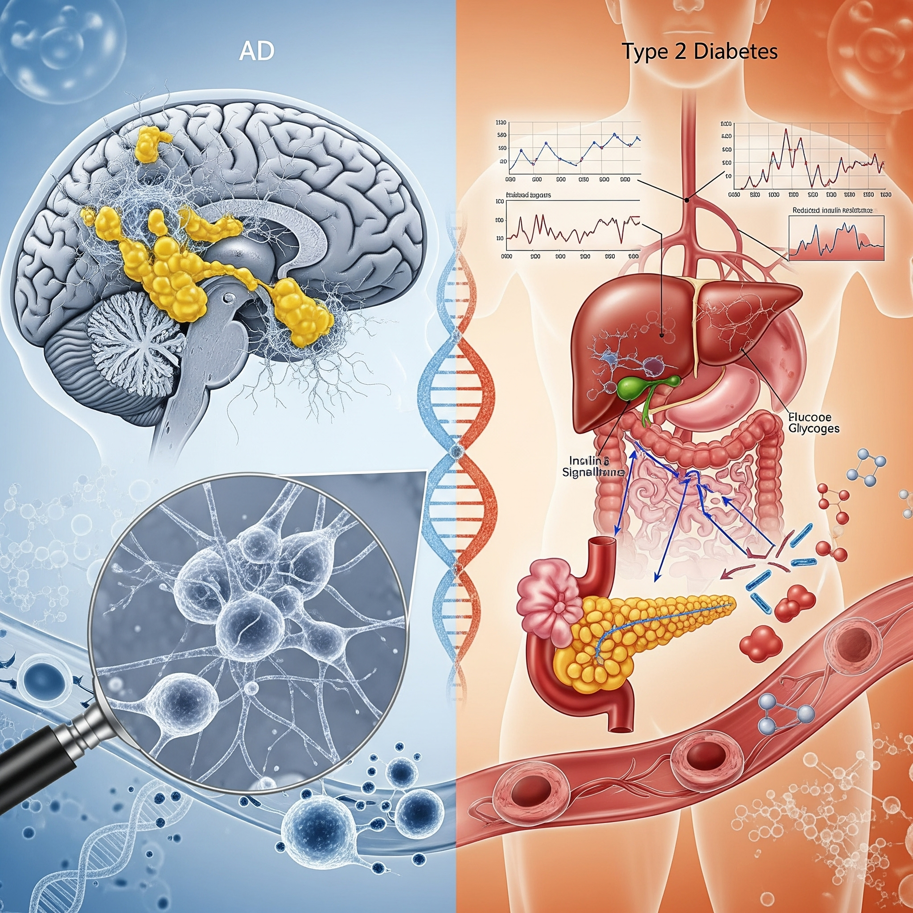
Introduction
The Problem: Alzheimer's (AD) and Type 2 Diabetes (T2DM) are massive, growing health crises with deep molecular links (e.g., insulin resistance, inflammation).
Large Language Models (LLMs) are unreliable for medical questions—they often "hallucinate" facts and citations, making them unsafe.
A Potential Solution: Retrieval-Augmented Generation (RAG) grounds LLMs in external facts.
Standard RAG uses messy text. We investigate if using structured Knowledge Graphs (KGs) (Subject, Relation, Object triples), provides cleaner, more accurate answers.
Key Research Questions:
Does using a domain-specific KG for RAG improve factual accuracy?
Does the scope of the KG matter? (e.g., a focused AD-only graph vs. a broad merged AD+T2DM graph).
How do small vs. large LLMs react to KG-RAG?

Slide 3
Methodology
Data Collection: We selected ~1000 top-ranking PubMed abstracts for three categories:
T2DM-only
AD-only
AD + T2DM combined
KG Construction: We used an improved CoDe-KG pipeline to automatically extract fact triples from the abstracts. We built 3 distinct KGs
G₁ (T2DM-only)
G₂ (AD-only)
G₃ (The combined KG)
Evaluation Probes: We created two custom multiple-choice question sets, Probe 1 and Probe 2, more in the slides.
The Experiment: We tested 7 different LLMs across 6 RAG configurations at different temperatures.
Pipeline: Abstract selection → KG construction → Probe generation → LLM evaluation

Slide 4
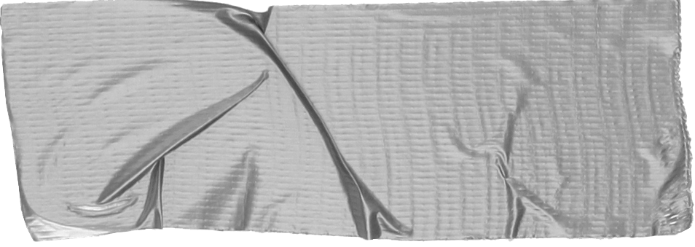

Experimental Setup
Models: Tested 7 different LLMs.
Setups: Compared LLM performance across 6 RAG configurations:
No-RAG (Baseline)
G1 (T2DM-only)
G2 (AD-only)
G1 + G2 (Two separate KGs)
G3 (The combined KG)
All KGs
Prompting: Used zero-shot instruction prompts, forcing the LLM to return only the single uppercase answer letter (e.g., "A").
Parameters: Ran tests at low "temperature" (T=0.0, 0.2, 0.5) to make the models stick to the retrieved facts.

Slide 5
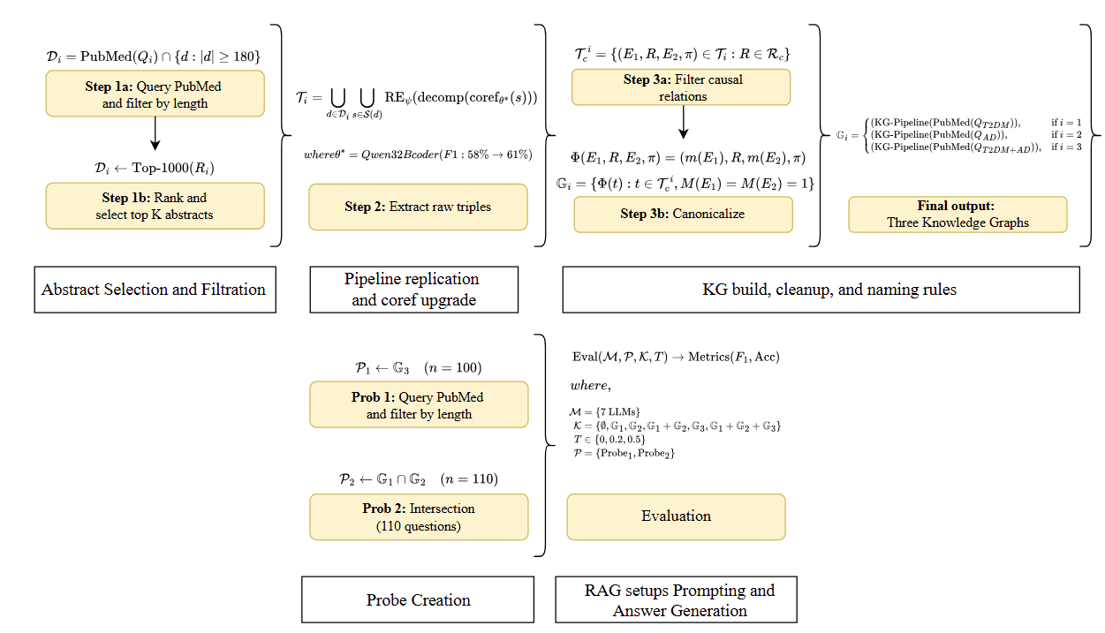
Overview of the methodology for constructing domain-specific knowledge graphs and evaluating their impact on RAG-enhanced healthcare LLMs.
The pipeline includes abstract selection, knowledge graph construction, probe generation, and systematic evaluation across multiple models and retrieval configurations

Slide 6
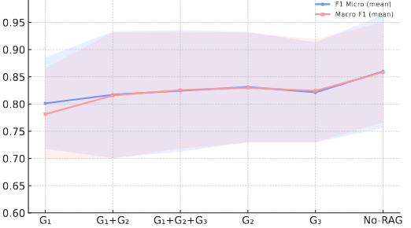
Probe 1: Based on Combined KG (G₃)
Content: 100 multiple-choice questions sourced from the combined AD+T2DM graph.
Question Types:
Single-hop: Tests a direct causal link (e.g., A -> B).
Multi-hop: Asks for two direct causes of a target (e.g., {A, B} -> C).
Fill-in-the-blank: Masks an entity in a known fact.
Results of Probe 1, averaged across the three temperatures (0.0, 0.2 and 0.5)

Slide 7
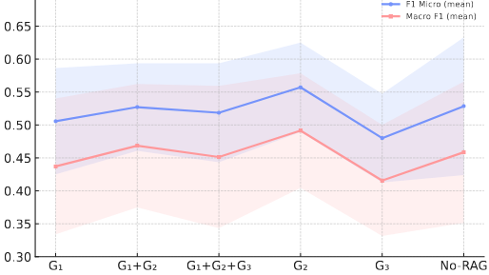
Probe 2: Based on KG Intersection (G1 + G2)
Goal: To test knowledge of concepts shared between both diseases (e.g., inflammation, insulin signaling).
Method:
Embedded all triples from G1 and G2.
Found overlapping concepts by finding triple-pairs with high cosine similarity (> 0.65).
Content: Focused on this shared subgraph and specifically tested for causal direction (i.e., knowing A -> X is different from X -> A).
Results of Probe 2, averaged across the three temperatures (0.0, 0.2 and 0.5)

Slide 8
Key Results
Finding 1: Higher "creativity" (Temperature 0.5) consistently reduced accuracy. T=0.0 was the safest default.
Finding 2: Large Models (Llama-70B, Claude-Haiku):
KG-RAG often hurt performance compared to the No-RAG baseline.
Why? These models already have strong internal knowledge. The retrieved KG facts often acted as "distractors" or noise, confusing the model and leading to statistically significant drops in accuracy.
Finding 3: Small/Mid-Models (Mistral-7B, Mixtral-8x7B):
These models benefited significantly from KG-RAG.
Why? The external KG context successfully filled gaps in their parametric knowledge, leading to statistically significant gains (especially on the harder Probe 2).
Finding 4: Which Graph Was Best?
Bigger was not better. The broad, merged graph G₃ and combined graphs often performed poorly.
The AD-focused graph G₂ was the most consistent and helpful, providing the only positive average improvement across all experiments.

Slide 9
Discussion & Takeaways
Takeaway 1: RAG is Not One-Size-Fits-All.
For Large Models, KG-RAG is risky and often harmful. Their strong internal knowledge is easily "distracted" by noisy or near-miss retrieved facts.
For Small Models, KG-RAG is highly beneficial, if the KG is clean and highly relevant.
Takeaway 2: Precision > Recall.
Simply adding more KGs (e.g., G₁ + G₂ + G₃) increased noise, diluted key facts, and significantly reduced accuracy.
A smaller, focused, high-precision KG (G₂ ) was far more effective.
Takeaway 3: Match Scope to Task.
The RAG-KG must be relevant to the question. Using a T2DM-only graph for a combined AD+T2DM question is ineffective.
Error Analysis: Most failures (over 50%) were in complex reasoning, like confusing cause/effect direction (A -> B vs. B -> A) or mis-ordering multi-step pathways.

Slide 10
Conclusion & Recommendations
Right-size RAG to your model: Small models benefit from clean, focused KGs; large models are often better off with no RAG or very strict filters.
Favor precision: Don't just dump KGs into the context. Filter for the most relevant facts.
Match retrieval scope to task scope: Use KGs that are built for the specific domain of the question.
Thank You

