Slide 1

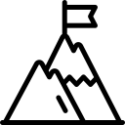

KGs in RAG for Healthcare LLMs
Domain-Specific Knowledge Graphs in RAG
Alzheimer’s (AD) & Type 2 Diabetes (T2DM)
Improve factual accuracy of LLMs
Research Presenter: Sydney Anuyah
Indiana University, Indianapolis
Notes:
Good day everyone. This presentation explores how knowledge graphs can improve the reliability of large language models in healthcare, focusing on Alzheimer’s disease and Type 2 diabetes.

Slide 2
INTRODUCTION

Slide 3
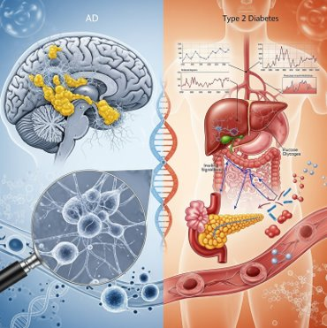
The Problem
AD & T2DM are linked (insulin resistance, inflammation)
LLMs can hallucinate medical facts
Standard RAG uses messy text, leading to noise.
Notes:
Both Alzheimer’s and Type 2 diabetes are growing global health concerns and are biologically connected. However, LLMs often generate incorrect or fabricated medical information, especially when relying on unstructured text.

Slide 4
Proposed Solution
Use structured Knowledge Graphs (KGs)
Triples: Subject – Relation – Object
Cleaner, more precise retrieval for LLMs
Notes:
To address this, we use knowledge graphs. These structure information into clear relationships, making it easier for models to retrieve accurate and relevant facts.

Slide 5
Research Questions
Do KGs improve accuracy in RAG?
Does KG scope (focused vs. broad) matter?
Do small vs. large LLMs behave differently?
Notes:
Our study focused on three key questions: whether knowledge graphs improve accuracy, whether the scope of the graph matters, and how different model sizes respond.

Slide 6
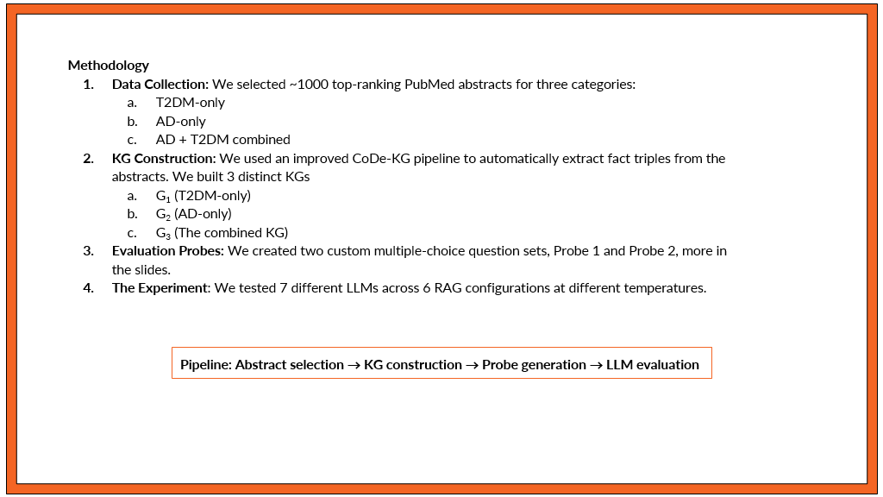
Notes:
We collected around 1000 research abstracts and built three types of knowledge graphs. We then tested their effectiveness using multiple-choice questions across several models.

Slide 7


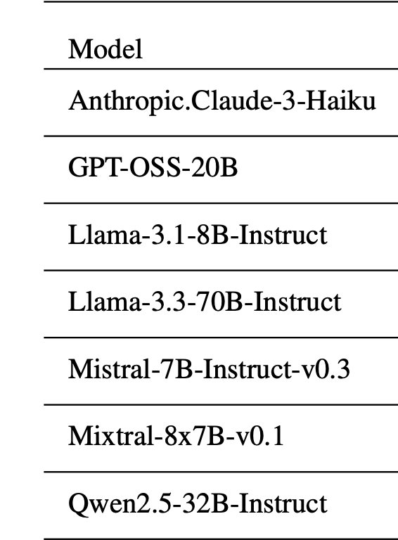
Experimental Setup
•Compared 6 setups (No-RAG → All KGs)
•Zero-shot prompts (single-letter answers)
•Low temperature for factual consistency
Notes:
We compared different setups, from no RAG to multiple knowledge graph combinations, and ensured consistency using controlled prompting and low randomness.

Slide 8
Key Results 1, 2, & 3
Higher temperature leads to lower accuracy.
T=0.0 performed best consistently.
2. Large models: KG-RAG reduced performance.
Reason: added noise/distractors.
Small models: significant improvement with KG-RAG.
3. Bigger KGs ≠ better.
Focused KG (AD-only) performed best.
Precision beats volume.
Notes:
(k1)One key finding was that higher randomness reduced accuracy. Models performed best when they stuck closely to retrieved facts. (k2) Interestingly, large models performed worse with knowledge graphs because the additional information sometimes confused them. Smaller models, however, improved significantly.
(k3) We also found that larger or combined graphs were not necessarily better. A focused, high-quality graph performed best.

Slide 9
Takeaways
RAG is not one-size-fits-all
Small models benefit most
Use focused, relevant KGs
Notes:
The main takeaway is that RAG must be tailored. It works well for smaller models, but requires careful design and filtering.

Slide 10
Conclusion
Match KG to task and model
Prioritize clean, relevant data
Avoid unnecessary context noise
Notes:
In conclusion, success depends on matching the right data to the right model and prioritizing precision over quantity.

Slide 11

Thank you.
ANY
Notes:
Thank you for listening. I’m happy to take any questions.

