Slide 1

Vietnamese Graduation Exam Analytics
Student Name: Dat Tran
Student ID: BJ24DSYU08
Proof of Work:
https://github.com/sydneycally-inclane-2812/data_vis_uni2024

Slide 2
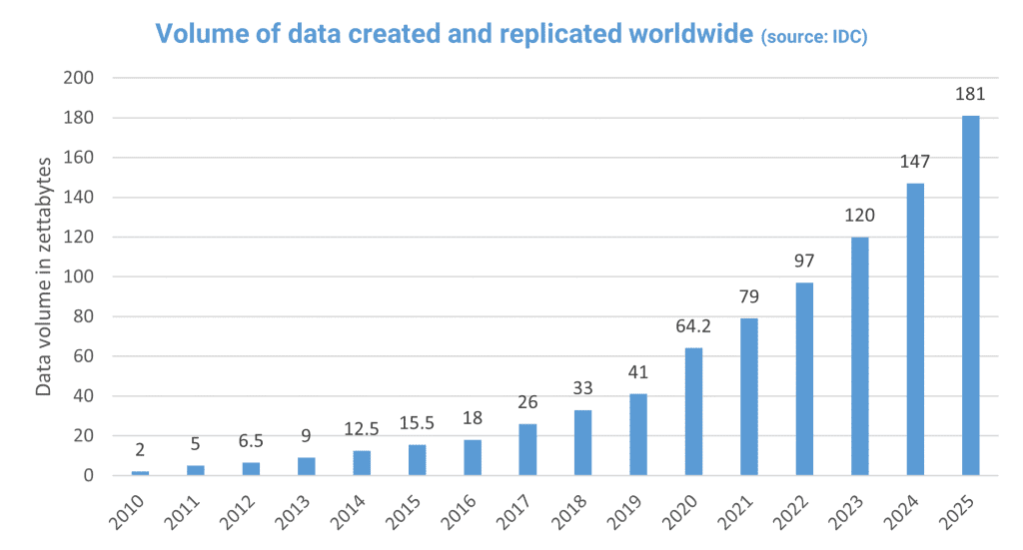
Importance of Data
The amount of data produced worldwide is increasing exponentially every year.
40% of companies use Big Data Analytics
44% use data-driven decisions making
90% believe data is important to business
We offer a great course for a promising field, in a rapidly growing economy; how do we make the most of our efforts?
Optimize the curriculum, find inspiring educators and empowering the right student.
Source: QuantHub

Slide 3
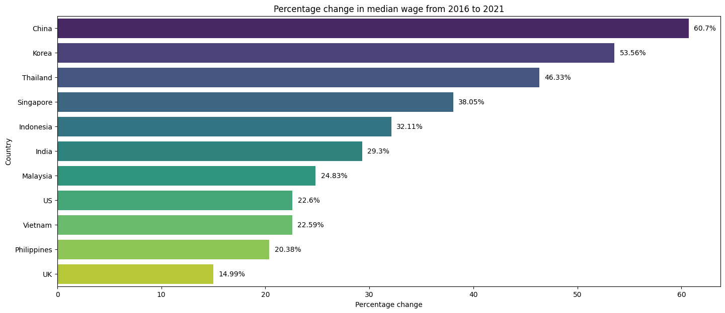
Vietnamese migrants are becoming larger and larger contributors to the Australian economy.
Vietnam has a comprehensive, SAT-like national examination which result is used by all domestic universities.
Can that be a good indicator of promising talents for our program?

Slide 4
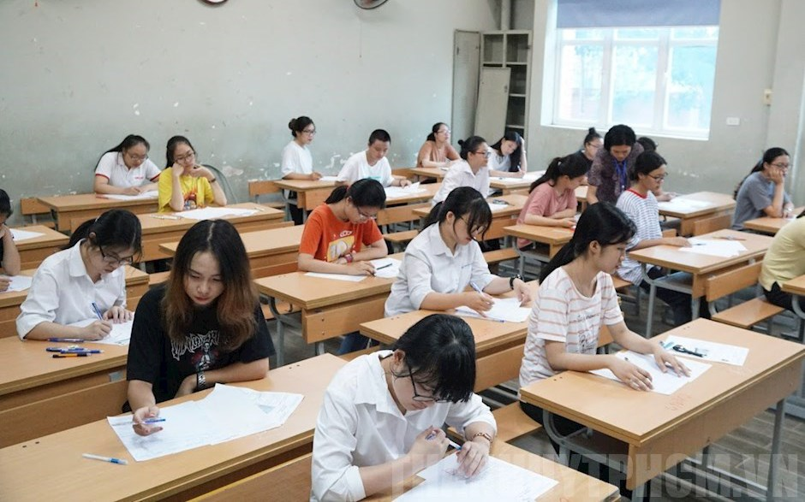
Context
Overview of Vietnamese HS Graduation Test:
Usually occurs over 2 days in July
Taken by 12th graders or anyone who wishes to be enrolled into a tertiary education institute
3 compulsory subjects: Math, Vietnamese Literature and 2nd language (typically English)
Choose 1 in 2 groups:
Natural Sciences (Biology, Physics, Chemistry)
Social Sciences (History, Geography, Civics)
All tests are Multiple Choice, except for Vietnamese Literature
To graduate, all subjects must be taken, none has scores <= 1 and the average must be >= 5
In 2024, after nine years of implementation, the test was administered in this format for the final time.
People who wants to go to university and have been studying for this format has one last attempt, so the number of test takers saw a substantial increase.

Slide 5
Business Questions
We are looking to verify:
The quality of Vietnamese students are gradually increasing to meet our standards, especially STEM subjects
The test is standardized and stable over multiple years, so student’s results are representative of their ability.
We will use data visualizations to find out:
How much the distribution changes?
Which subjects significantly improved/declined?
How many students don’t meet the graduation criteria? Where are they?
How do scores vary by region?
Is there correlation between STEM subject scores?
How does COVID-19 affect 2021?
How different is 2024 is from the previous years, considering the change in test format?
How can we further our admission campaigns in Vietnam with this findings?

Slide 6
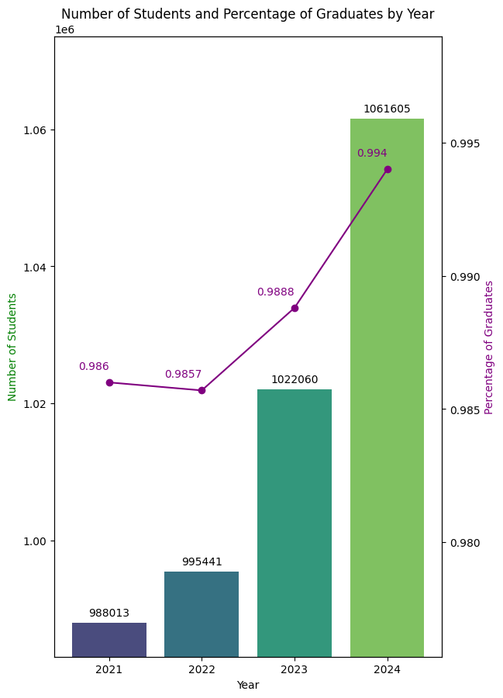
Number of Students and Percentage of Graduates by Year
The number of test takers increases year by year, but 2024 saw an increase by as much as the previous two combined.
The graduation rate also inclined rapidly, indicating an increase in learner’s quality.

Slide 7
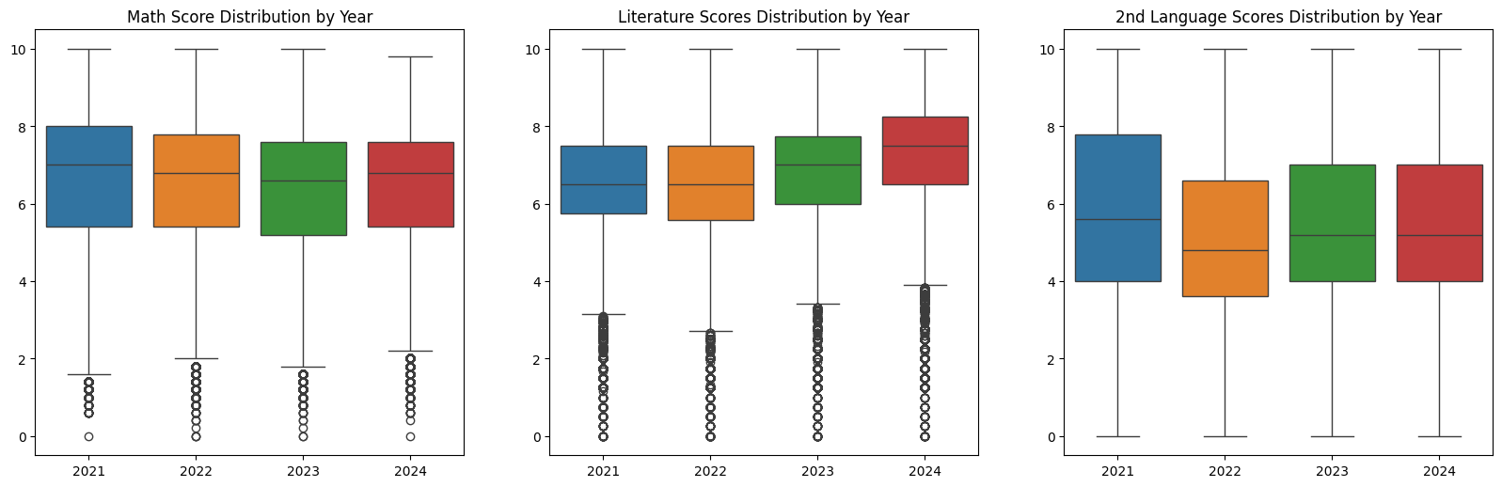
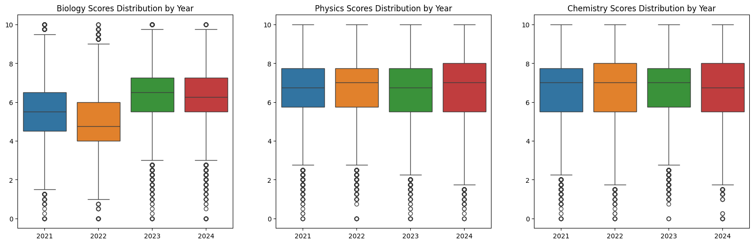
Score Distribution: STEM vs Social Science
The distribution of 9 subjects, over 4 years, are shown in the adjacent graphic.
Results mostly follow normal distribution centered at the middle of the scale, showing effective classification.
Despite being the last year, results of 2024 (in red) does not deviate much from previous year, except for a small bump for Literature and Geography

Slide 8
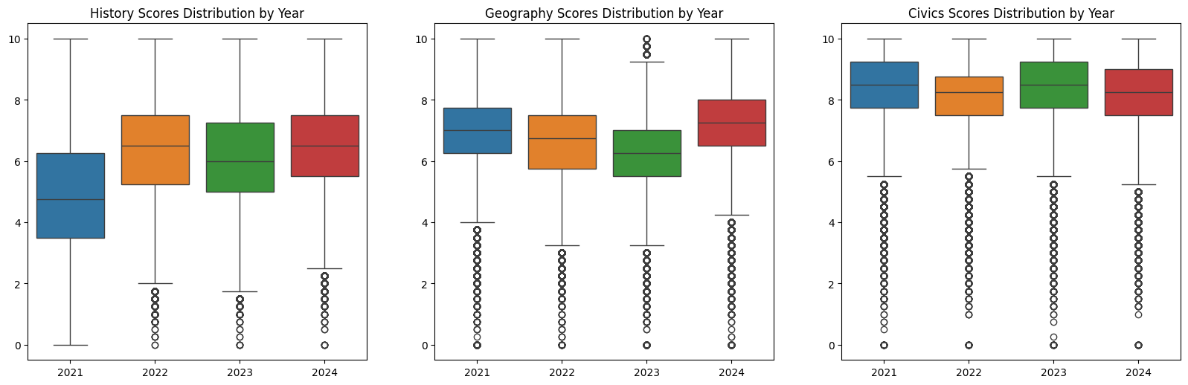
Performance of the STEM subject tests (1st row) is also more consistent than social science (2nd row), indicating more reliable testing and results.

Slide 9
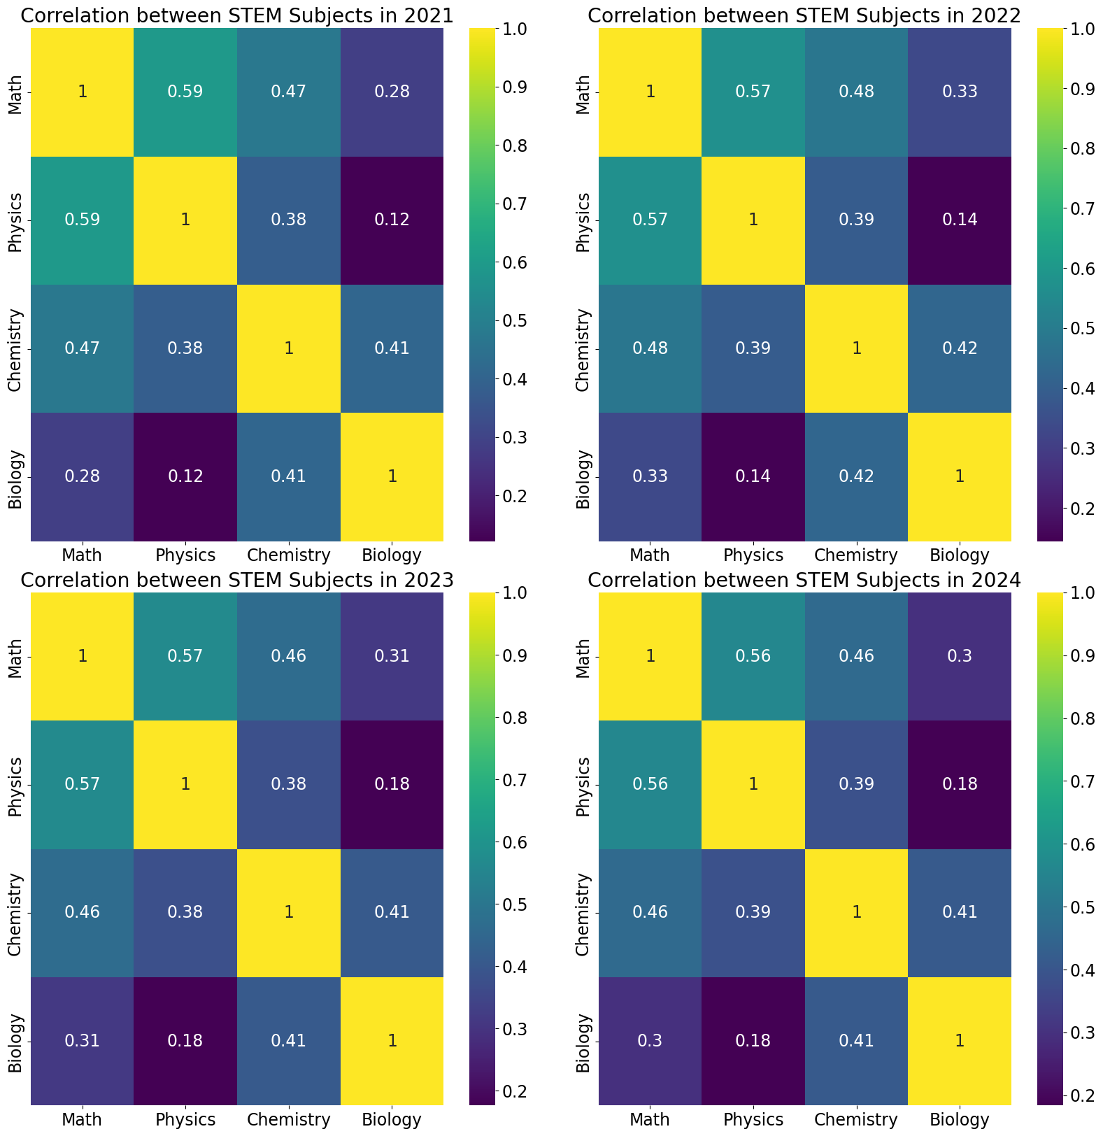
STEM Score Correlation
Throughout the four years, the correlation between STEM subject scores stay relatively unchanged.
Math, Physics and Chemistry all show significance correlation.
Chemistry and Biology are also correlated
This can be explained by:
STEM students would usually be interested in all four.
Universities often use Math, Physics and Chemistry scores for admission.
Chemistry and Biology is another combination for medicine schools.

Slide 10
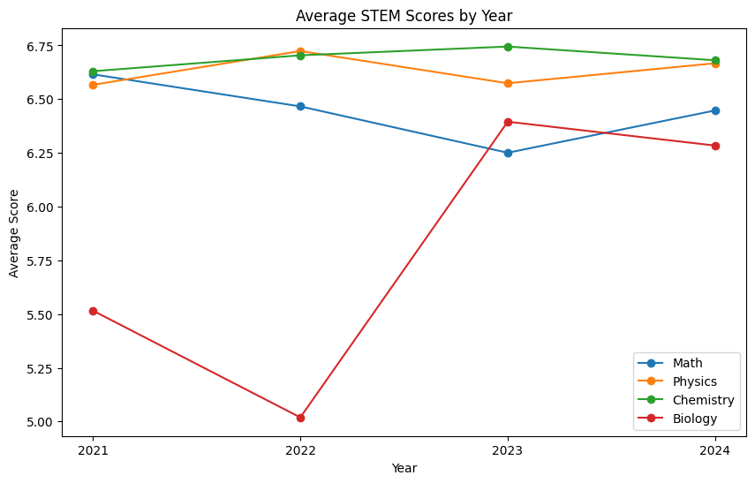
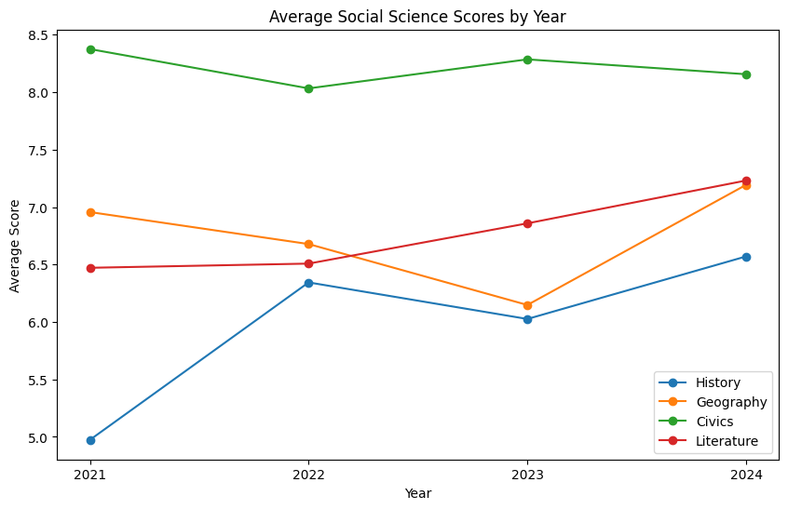
Average Score by Year
The mean score of each STEM subjects maintained relatively stable, except for 2022 after COVID-19 (overly ambitious test makers)
The last two years has mostly stabilized
Social science scores, in contrast, has larger range and more fluctuation.
Vietnamese education put more effort into education and evaluation for STEM subjects.

Slide 11
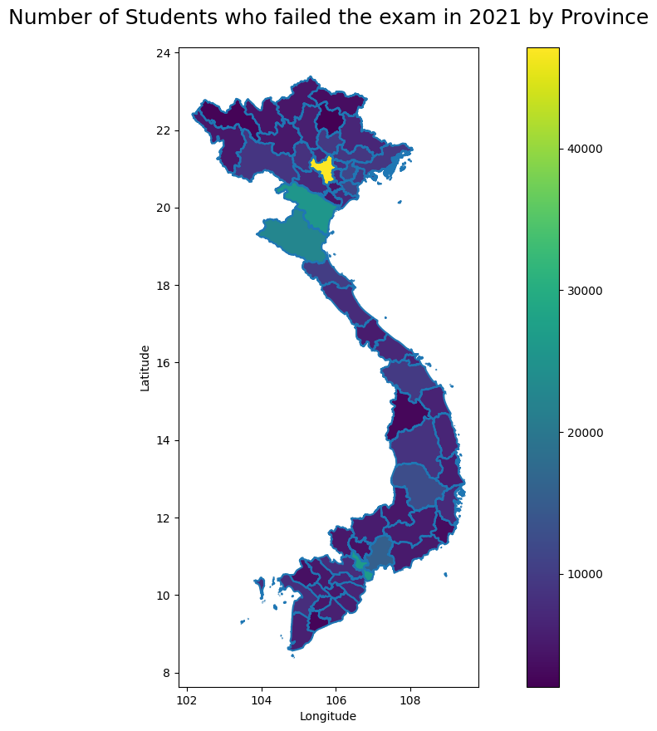
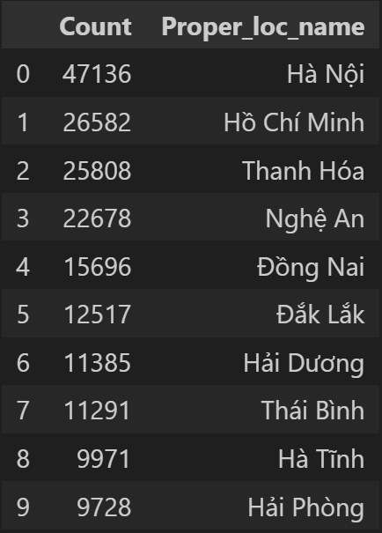
Under-performing provinces
This is the number of students that failed the exam, grouped by region in 2021.
All subsequent years are almost identical.
Most regions are similar, but 1 and 2 are the two major metropolitans of Vietnam, Ho Chi Minh City and Hanoi, so the number of drop-outs also scale up.
Provinces with the highest # of failing student:

Slide 12
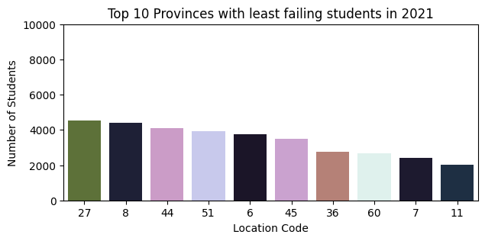
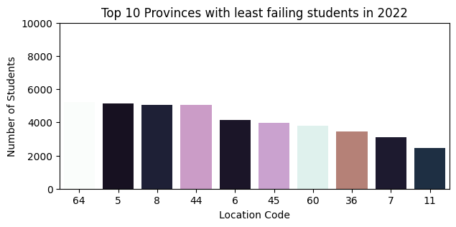
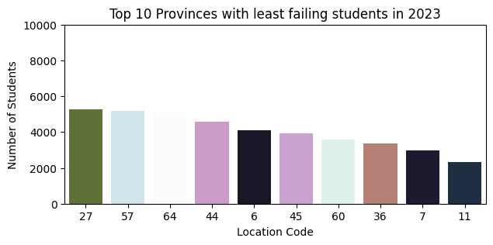
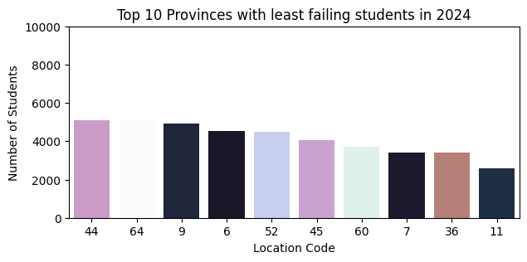
Provinces with least failing students
Same color,
same province.
Looking at the other end of the spectrum, the provinces consistently having the lowest number of failing students are:
6: Cao Bang
7: Lai Chau
11: Bac Kan
27: Ninh Binh
36: Kon Tum
44: Binh Duong
45: Ninh Thuan
60: Bac Lieu
64: Hau Giang
Except for 44, 45, 27, most are the poorer regions of Vietnam.
The ones going through hardships are the hardest working ones. Maybe we can help empower them?

Slide 13
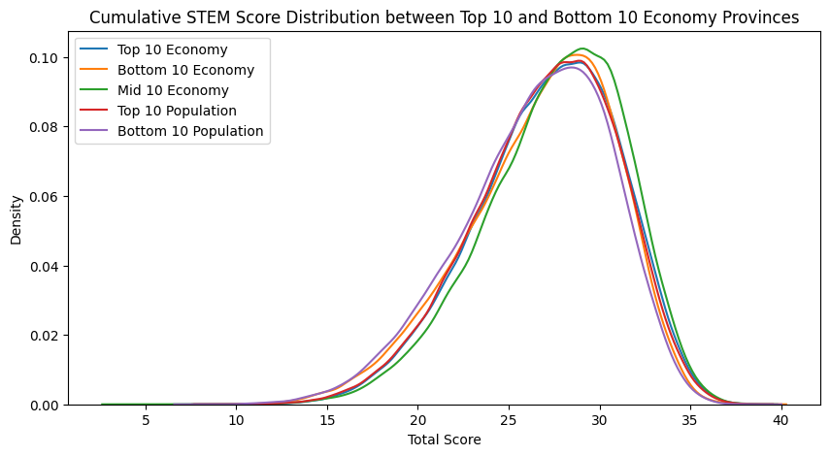
STEM Score Distribution Across Regions
The cumulative STEM subjects’ score between regions, surprisingly, are similarly distributed.
This might be because different regions prioritize different subjects (due to cultural influences), but the accumulated differences cancel out.
However, a different story is told with the Math score.

Slide 14
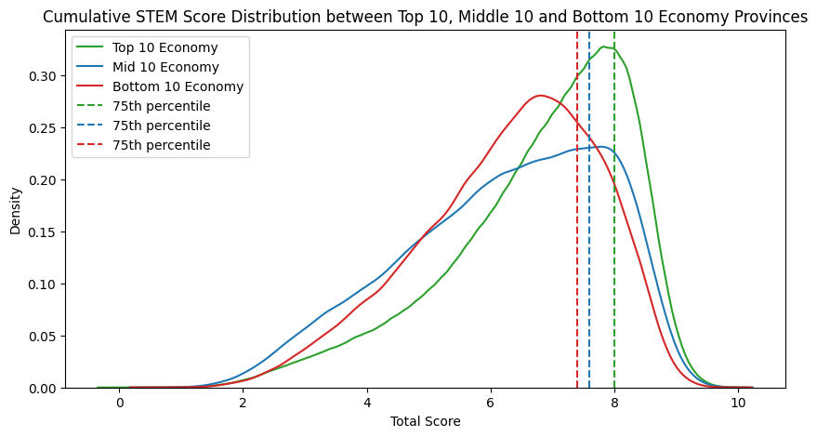
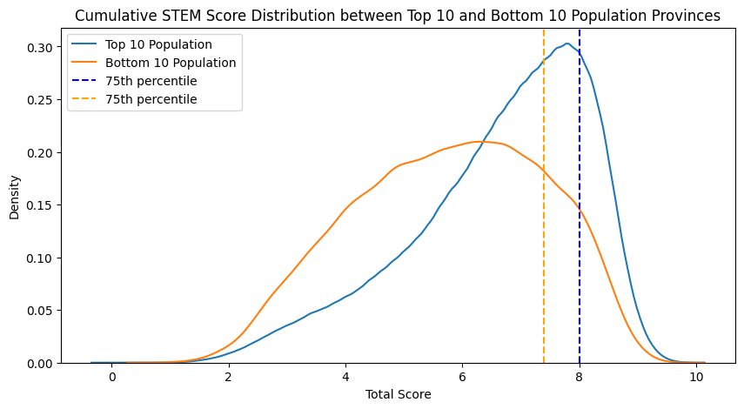
STEM Score Distribution Across Regions
The math scores reflects in order the top, middle and bottom economically provinces of Vietnam.
Note that the top has the sharpest point, indicating that a larger portion of students from top earning cities got good scores.
From a population point of view, the 10 largest cities has many more high scorers, and the bottom 10 is more spread out and peaking almost 2 points lower.
We want to aim to appeal to the top 75th percentile for our institute, a balance between target size and performance.
Scores vary significantly between economic and population regions of Vietnam

Slide 15
04
Conclusion
From the perspective of this presentation,
you are the admission officer for the BDS course of SP Jain.

Slide 16
Conclusion
The Vietnamese graduation test is fully comprehensive, stable and provide a reasonable baseline to assess a student’s performance.
Vietnamese people place heavy emphasis on STEM education.
Students are usually all rounders for these subjects but focuses on ones that gets them into University.
Vietnamese students’ performance vary wildly between economic and population regions, but cumulative performance is similar throughout Vietnam.
Regions with lower economies have less people failing the exam. Major cities, where education is more accessible, saw more failing people.
Scores should be interpreted in context.

Slide 17
Recommendations
Based on the insights,
here are my recommendations for the institute:
The Vietnamese Graduation Exam results should be available as an additional metric for admission. Collaboration with Vietnamese top high school in major economic hubs can also bring a stream of successful applicant, but do not overlook applicants from other areas
When using exam results, the region in which the applicant resides is also important for a holistic evaluation.
It is also important to continuously improve academic standards, curriculum and resources to attract talented individuals.

