Slide 1
The Pearce Group
Web Enhancement Project
By: Sydney Pearce

Slide 2
My Goal
Enhance The Pearce Group company website to....
Modernize it (Was made in 2013!)
Secretary references it often to clients and wanted a more updated look
Add a booking forum for appointments
A way to filter the amount of phone calls received daily about availability

Slide 3
What Was Accomplished
Modernize front end
Updated the 2013 theme
Transfer information over
Implement booking system
Show availability
Require specific details --name, phone number, email, address, employee, services, ...
Pick time --only show available
Store bookings --can see from admin side & option to store in Google Calendar
Make sure double bookings don’t occur --delete time slots as they are taken
Allow admin to approve/decline appointments
Allow admin to block days off/configure time slots available
Confirmation email to client --configure SMTP
New booking alert sent to client

Slide 4
Biggest Roadblocks
Migrating the site to a new domain
Did not want to break live website
Working around previous developers schedule
He had to give me permissions and send over his backup files
Copied using WP all-in-one migration...easy
Biggest struggles: File size limitations, Recaptcha ERROR
Had to connect to my website via SSH using Putty and use Linux commands to navigate through files and delete Recaptcha plugin files

Slide 5
Eventually...
I had my new test website which I called…
http://tpgtestwebsite.com
Why Should The Pearce Group authorize this version?
Will take stress of the secretary
Receive more business
Easy for admin to use
Organization (integration from paper to online booking)

Slide 6
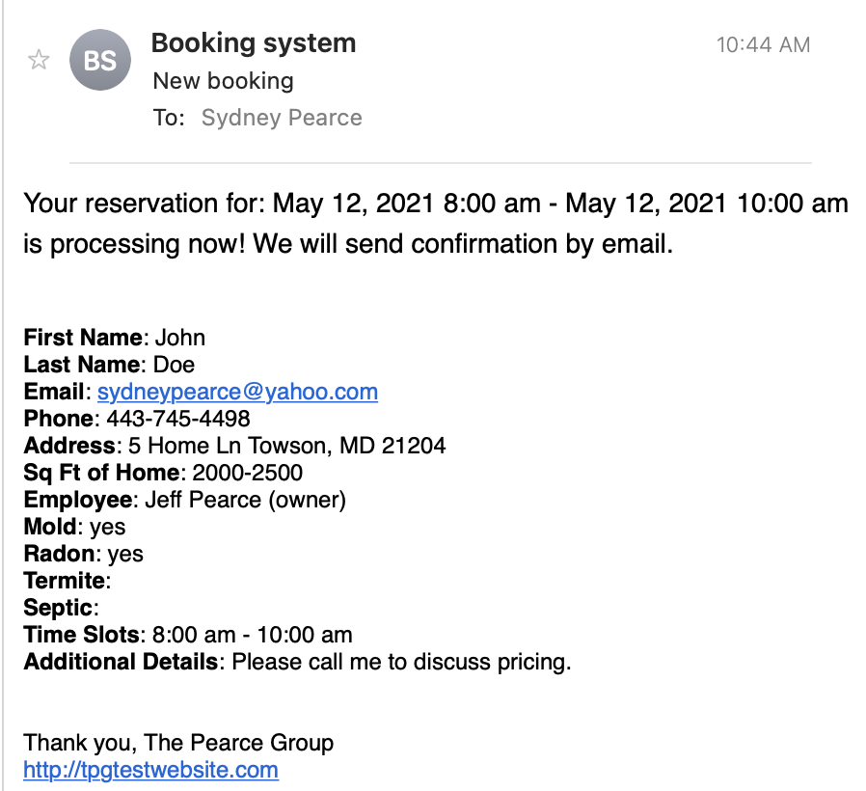
Client Email

Slide 7
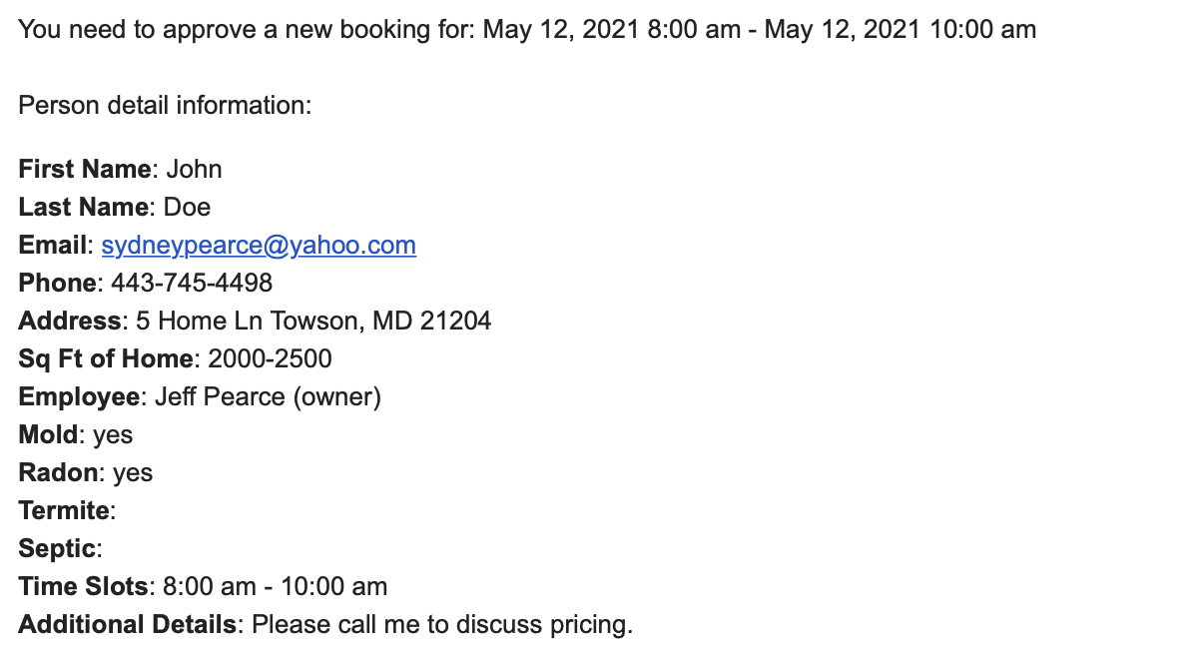
Admin Email

Slide 8
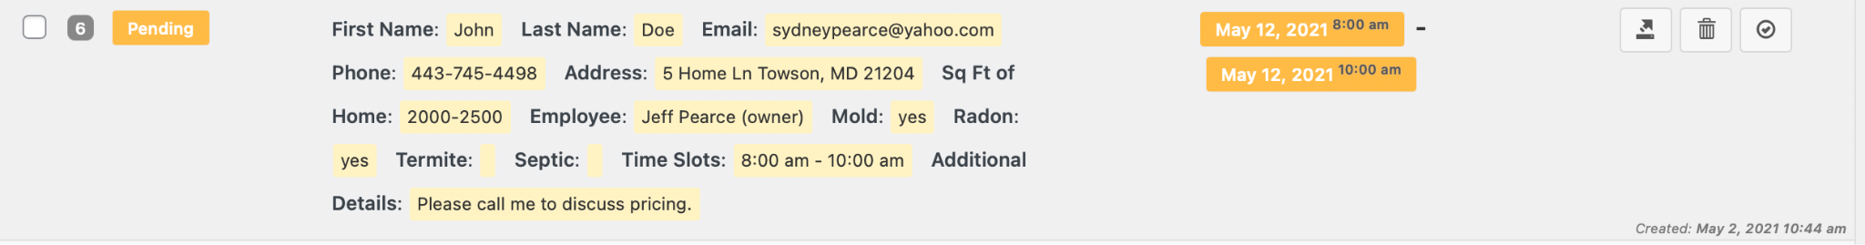
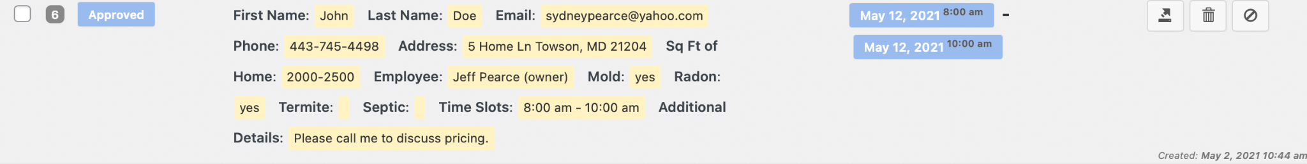
Admin Approval

Slide 9
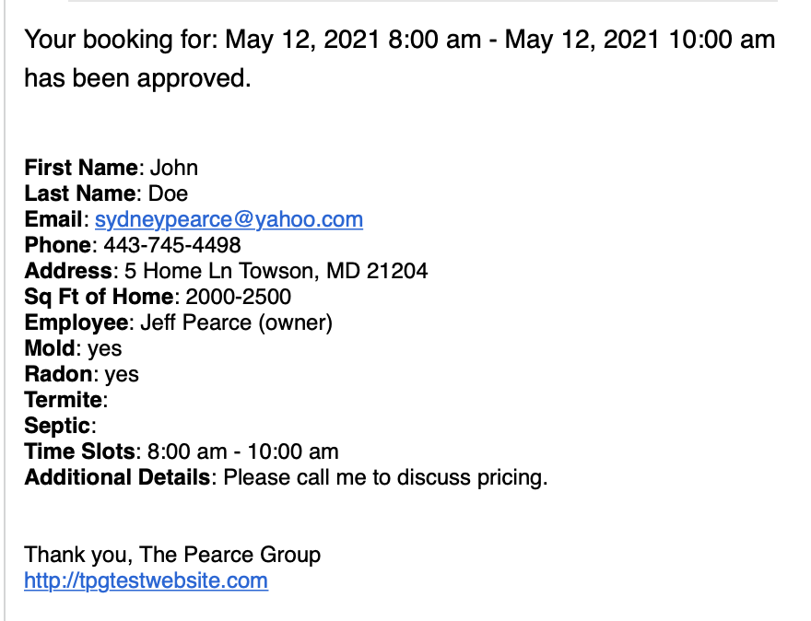
Client Notification

Slide 10
Now...
Live Demo!

Slide 11
Questions?

