Slide 1
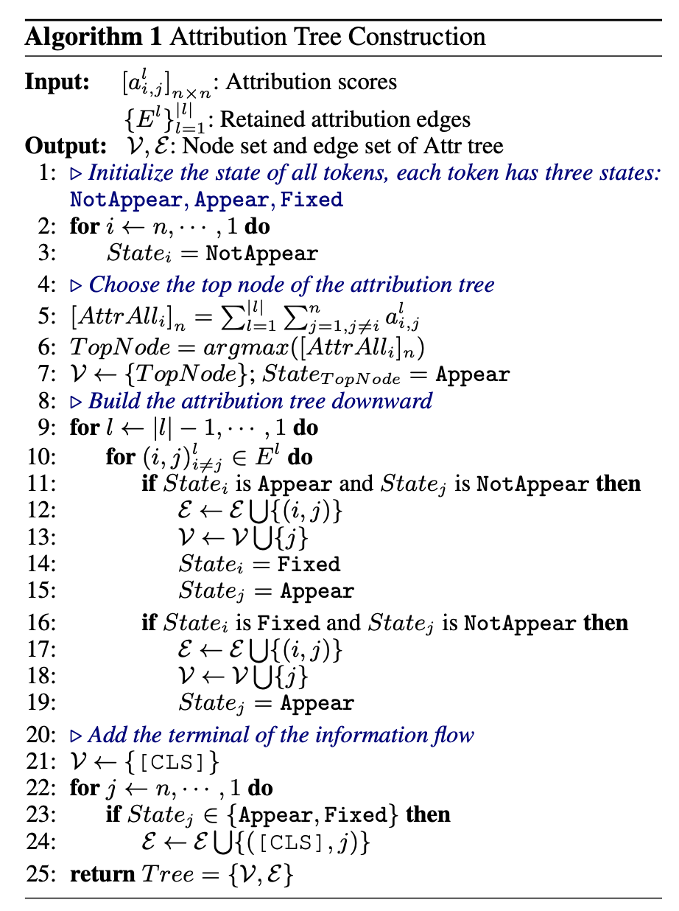
Sentence: Seldom has a movie so closely matched the spirit of a man and his work
Model input is the attribution scores between each token in the sentence and the edges which tokens are related

Slide 2
Status NotAppear Tokens
seldom
closely
a
has
matched
man
a
the
and
movie
spirit
his
so
of
work

Slide 3
Attribution Tree
matched

Slide 4
Attribution Tree
matched
has
spirit

Slide 5
Attribution Tree
matched
has
spirit
seldom

Slide 6
Attribution Tree
matched
has
spirit
seldom
movie

Slide 7
Attribution Tree
matched
has
spirit
seldom
so
movie

Slide 8
Attribution Tree
matched
has
spirit
of
seldom
so
movie
closely
the
man
work

Slide 9
Attribution Tree
[CLS]
matched
has
spirit
of
seldom
so
movie
closely
the
man
work

