Slide 1
Relationship between Suicide Rate, Country and Generation
Ximan Liu

Slide 2
G.I. Generation (Greatest Generation)
People born from 1901 to 1927.

Slide 3


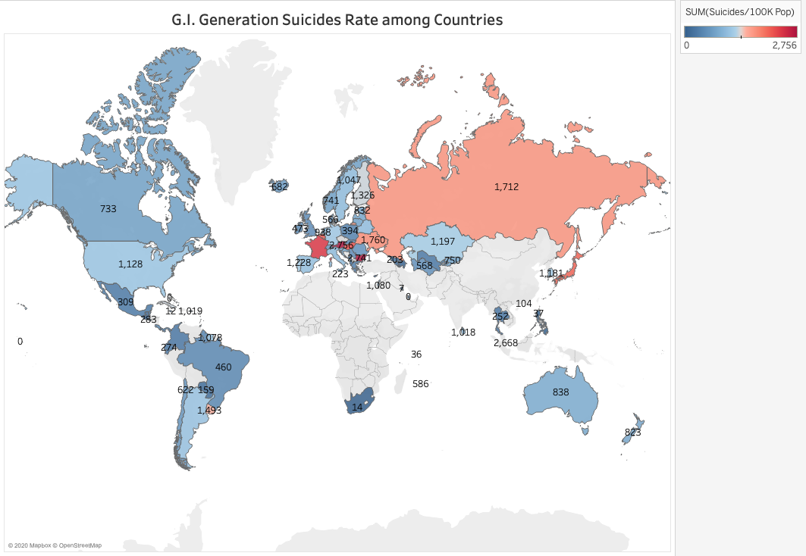




Slide 4
Silent Generation
People born from 1928 to 1945.

Slide 5
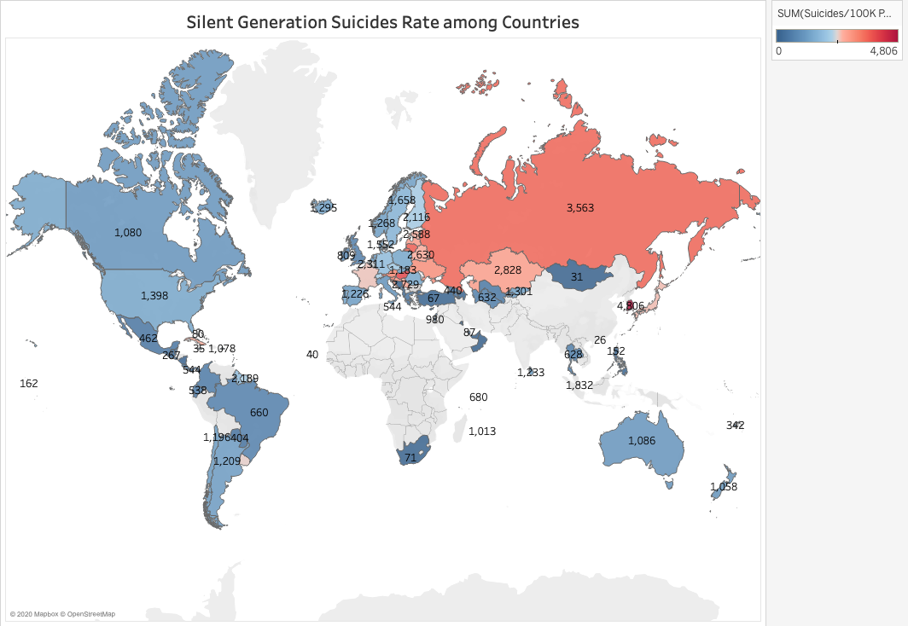

Slide 6
Boomer Generation
People born from 1946 to 1964.

Slide 7
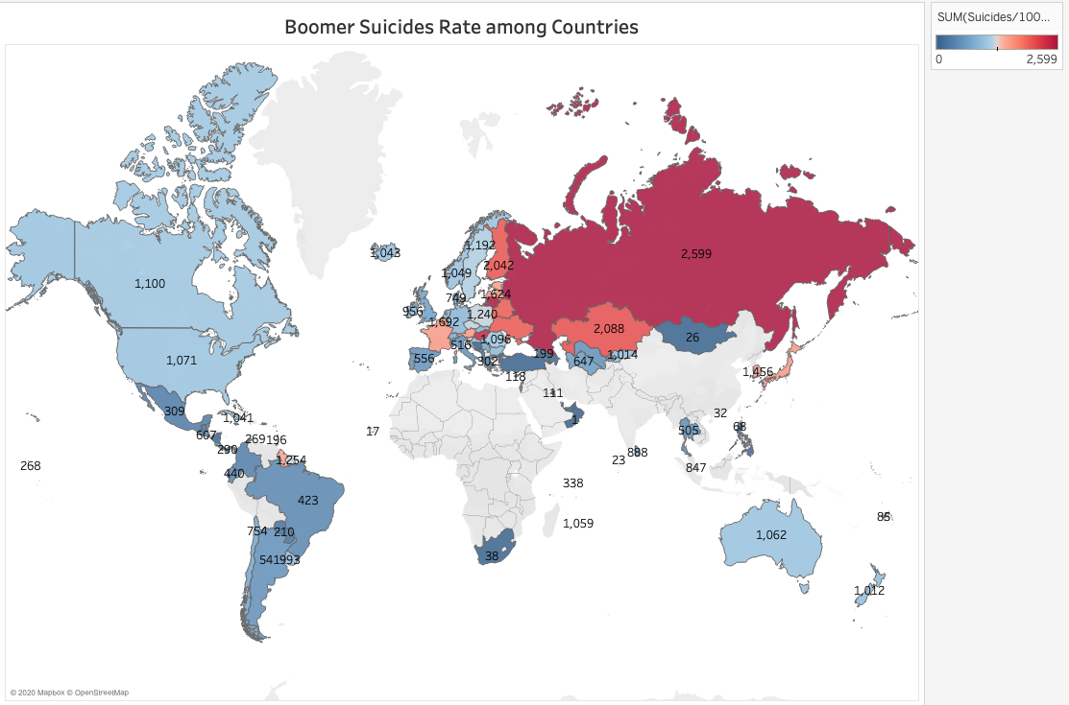

Slide 8
Generation X
People born from 1965 to 1980.

Slide 9
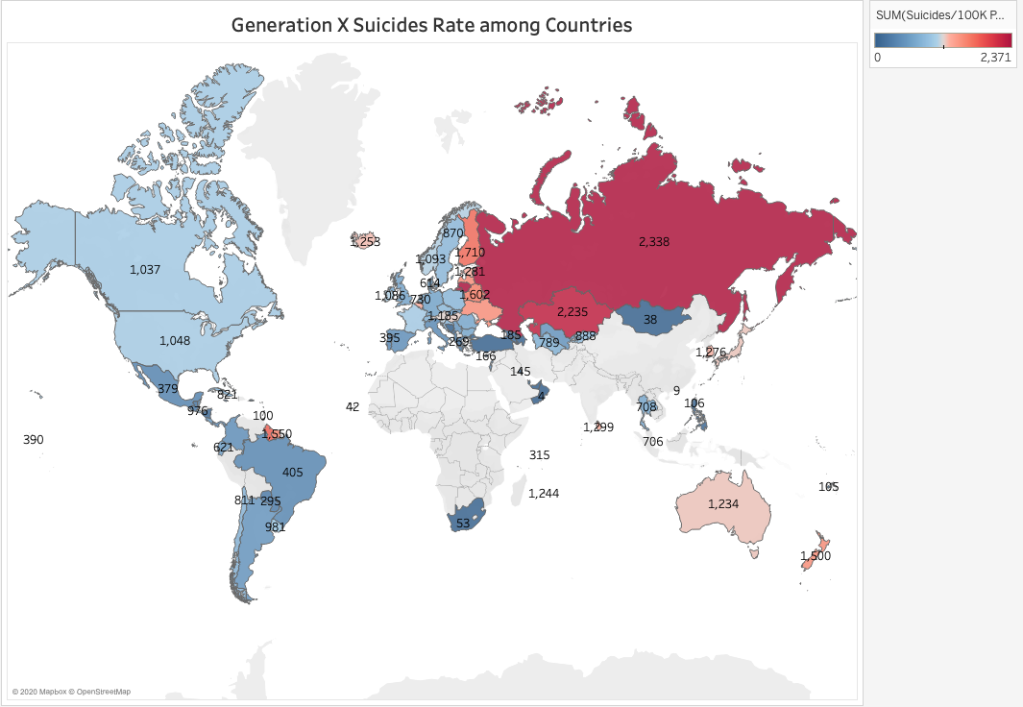

Slide 10
Millennials
People born from 1981 to 1996.

Slide 11
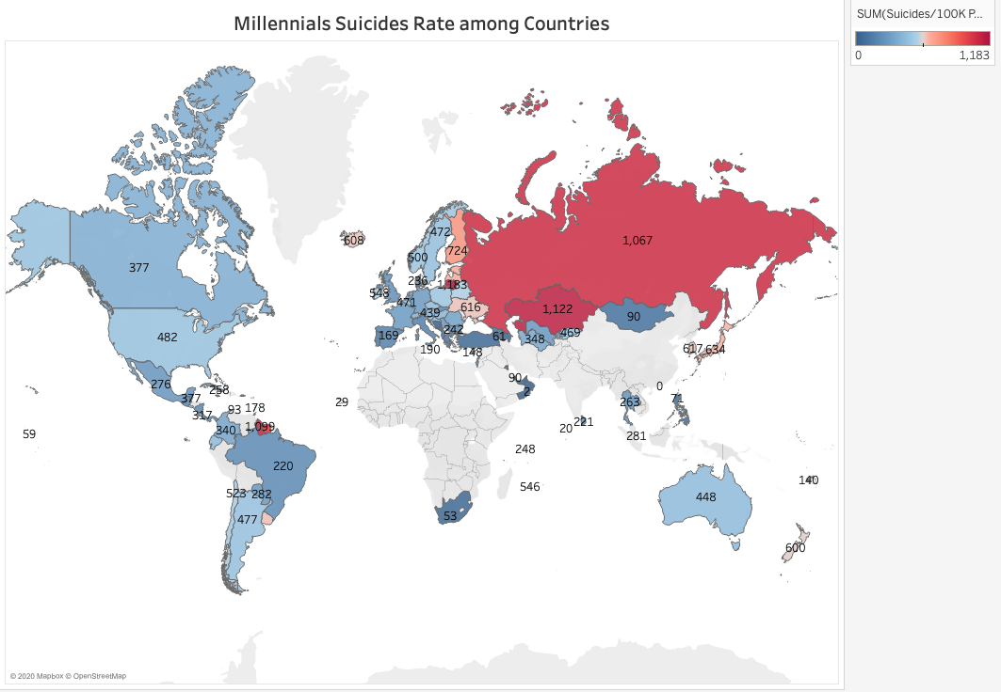

Slide 12
Generation Z
People born from 1997 to 2012.

Slide 13
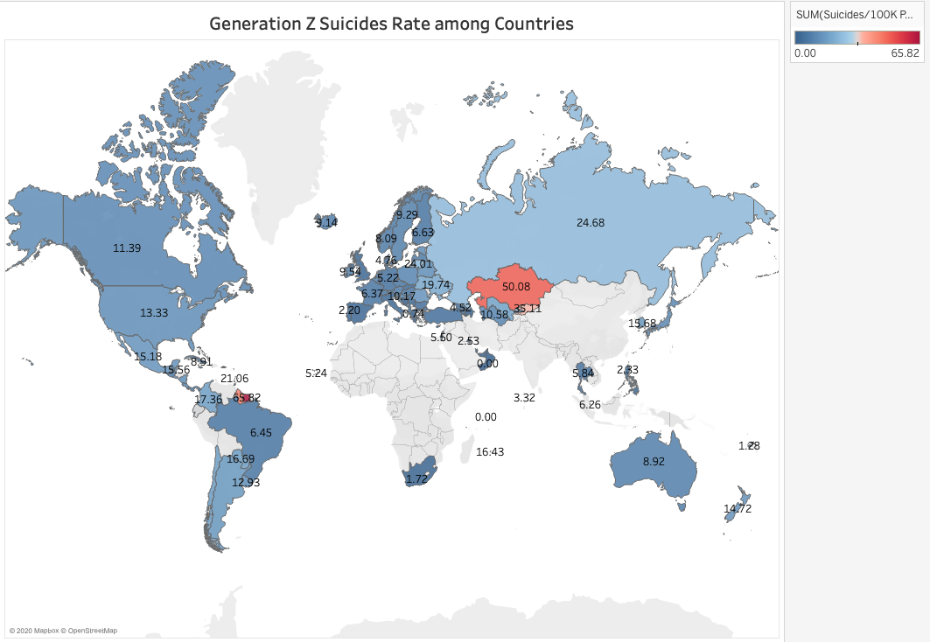

Slide 14
Thank You

