Slide 1
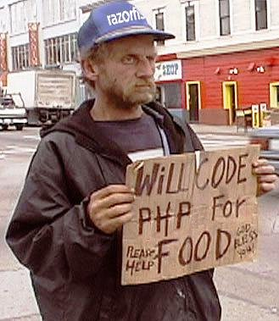
PHP SYDNEY USERS GROUP OCTOBER
Distributed PHP

Slide 2
Jared Mooring
Platform Engineer
Former lead developer
BigPond GameArena
BigPond Kids
BigPond Prepaid
Ausgamers

Slide 3
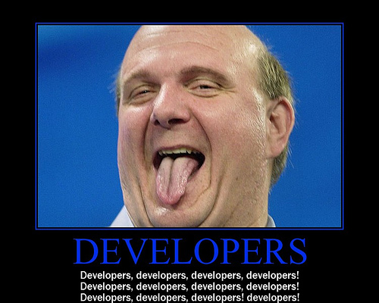
Notes:
Being a good developer is more than writing code
Be aware of your environment
What OS are you developing for?
Are you using a cluster?
Where are your servers? AU/EU/US?
Do you have servers for specific tasks?
Web Servers
Mail Servers
Tools Servers

Slide 4
What is distribution?
It seems to be a ‘buzz word’ at the moment
'A distributed system consists of multiple autonomous computers that communicate through a computer network. The computers interact with each other in order to achieve a common goal' – wikipedia
Share the work, sharing is caring!

Slide 5

SCENARIO – PHOTO GALLERY
User uploads photo through form
Photo get resized – thumb, medium, original
Web server resizes images
Stores new sizes on disk
Display resized photos

Slide 6
Issues?
Web server is meant to server HTTP requests
Why should it do the heavy lifting?
Be kind to your presentation server(s)
CPU spent on resizing images

Slide 7
Alternative - Distribute
Upload Image
Process Request
Request to resize image
Receive request
User
Apache
Job Request
Job Server
Job Worker
Idle Worker
Idle Worker
Resize image
Idle worker
Wait for other connections
Notes:
Use your web server to serve HTTP requests
Offload (distribute) the tasks that aren’t related to serving HTTP requests
Move the image processing
Send a request to resize images
Worker picks up request, resizes image
Writes image to disk
Returns paths to images

Slide 8
Message Queue Systems
Store data as a ‘message’ for processing
Serialized objects
Text
Allows different applications to interact
Includes different operating systems
Different languages
Message Persistence
RAM: Memcache
DB: mySQL, SQLite, PostgreSQL

Slide 9

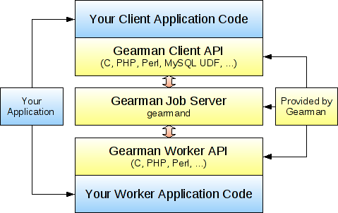
Introducing
‘Gearman provides a generic application framework to farm out work to other machines or processes that are better suited to do the work’ - http://gearman.org

Slide 10
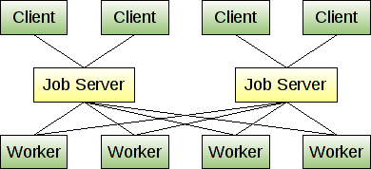
Basics
Gearman Layer
Server | Manages jobs / Multiple instances
Client | Makes request to job server – it wants work done!
Worker | Performs job / Tells server what it can do / Distributed
Notes:
Client does: * Connect to gearmand. * submit's a job for a particular func.
Gearmand does: * Acks the job, finds all *sleeping workers* related to the function. * Sends them all a 'noop' command to wake them up.
Worker does: * Urk, I'm awake now. * Worker asks for jobs. * If jobs, do work. * If no jobs, sends command 'pre_sleep' to all gearmand's, etc.

Slide 11

Example Time

Slide 12

http://gearman.org
Source / Repositories
API available through PECL
http://pecl.php.net/package/gearman
http://php.net/manual/en/book.gearman.php
Drivers available for other languages
Perl
Python
Java
.NET

Slide 13
How are Yahoo!7 using it?
Platform for distributing management of content
Developers are able to build distributed plugins
Individual business units
Building feeds RSS/MRSS
Video transcoding
Allows us to add new nodes easily
Distributed managed transcoding

Slide 14




Who else is using it?

Slide 15
ALL DONE! THANK YOU
Twitter: @jadzor
Forward Pass: http://fwdpass.it/bN4Q4v
MammothVPS Coupon:
http://www.mammothvps.com.au
SYDPHP

