Slide 1
Regularization
~Abhishek Kumar

Slide 2
Scope
Problem of Overfitting
What is regularization?
Why do we need regularization?
Types of regularization
When to use them?
Model Evaluation

Slide 3
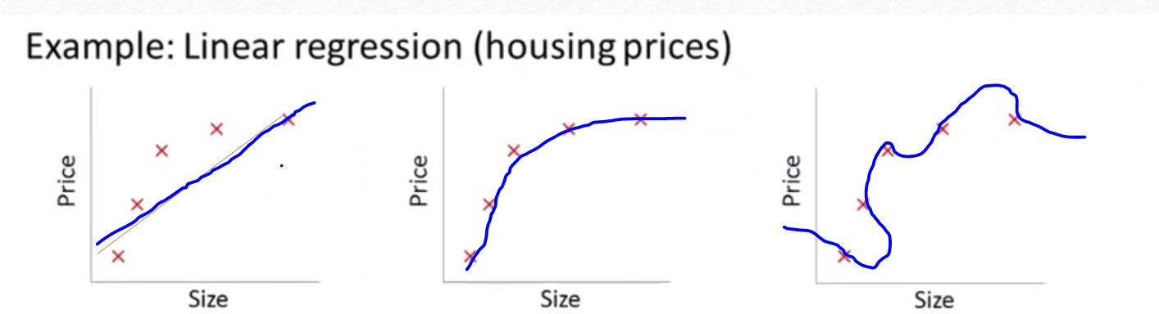
Overfitting
mx + c
m₁x + m₂x² + c
m₁x + m₂x² + m₃x³ + m₄x⁴ +c
“Underfitting”
High Bias
“Just right”
“Overfitting”
High Variance

Slide 4
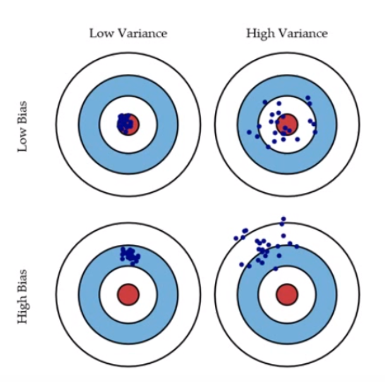

Slide 5
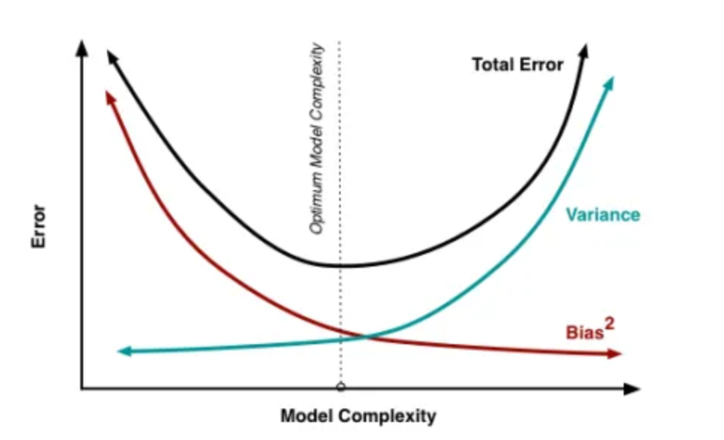

Slide 6
Bias & Variance
High Bias: It means the algorithm has a strong preconception / bias that housing prices are going to vary linearly with their size despite the evidence based on previous data.
High Variance: If we fit a high order polynomial then hypothesis can fit to any function. So in this case our possible hypothesis is too large or too variable.

Slide 7
Overfitting
If we have too many features, the learned hypothesis may fit the training set very well(cost function almost zero) , but fail to generalize new examples.
When we have a high dimensional data set, it would be highly inefficient to use all the variables since some of them might be imparting redundant information.

Slide 8
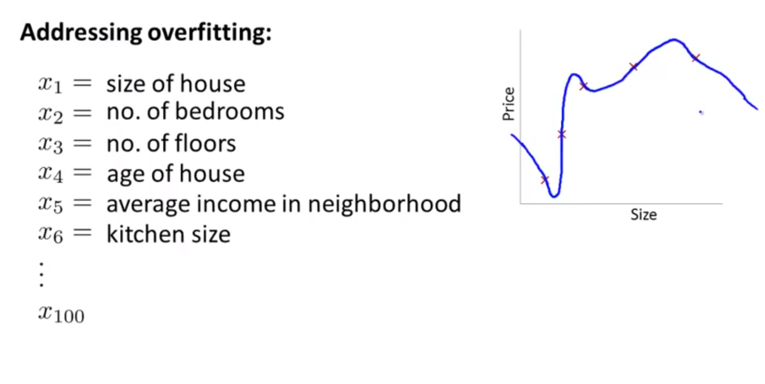

Slide 9
Addressing Overfitting
Reduce number of features
Manually select which features to keep
Business Understanding & Domain knowledge
Forward Selection
Backward Elimination
Regularization

Slide 10
Regularization
Keep all /some of the features, but reduce magnitude/value of parameter m_{j.}
Works well when we have lot of features, each of which contributes a bit to predicting y.

Slide 11
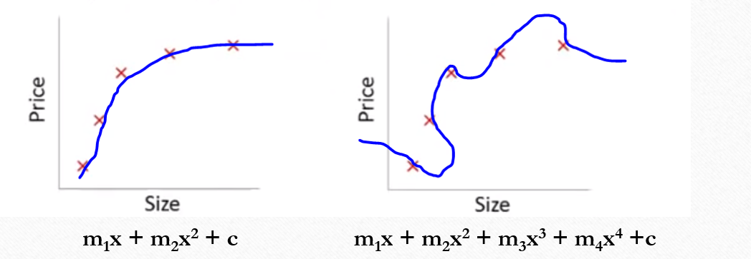
Cost Function
We penalize and make m₃ and m₄ really small

Slide 12
“Everything should be made simple as possible, but not simpler – Albert Einstein”
Small values of parameters m₁, m₂, ……….. , m_{k}
“Simple” hypothesis
Less prone to overfitting

Slide 13
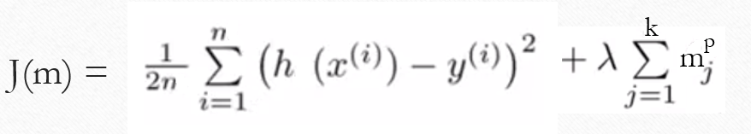
Regularization
parameter
min J(m)
Lambda controls the trade off between fitting the training set well and setting the value of parameters m_{j} small and therefore keeping the hypothesis simple to avoid overfitting.
Regularization term

Slide 14
What happens if we set lamda very large?
It means we end up penalizing parameters m_{j} very heavily.
Horizontal flat line a result, “Underfitting”
So lamda should be choose very carefully.

Slide 15
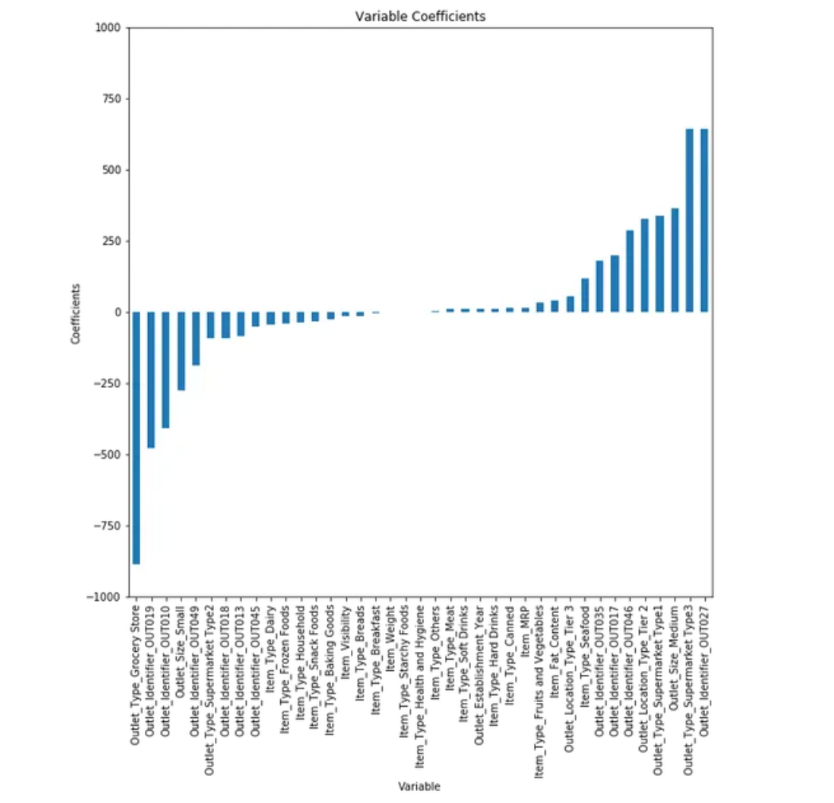

Slide 16
Ridge Regression

Slide 17
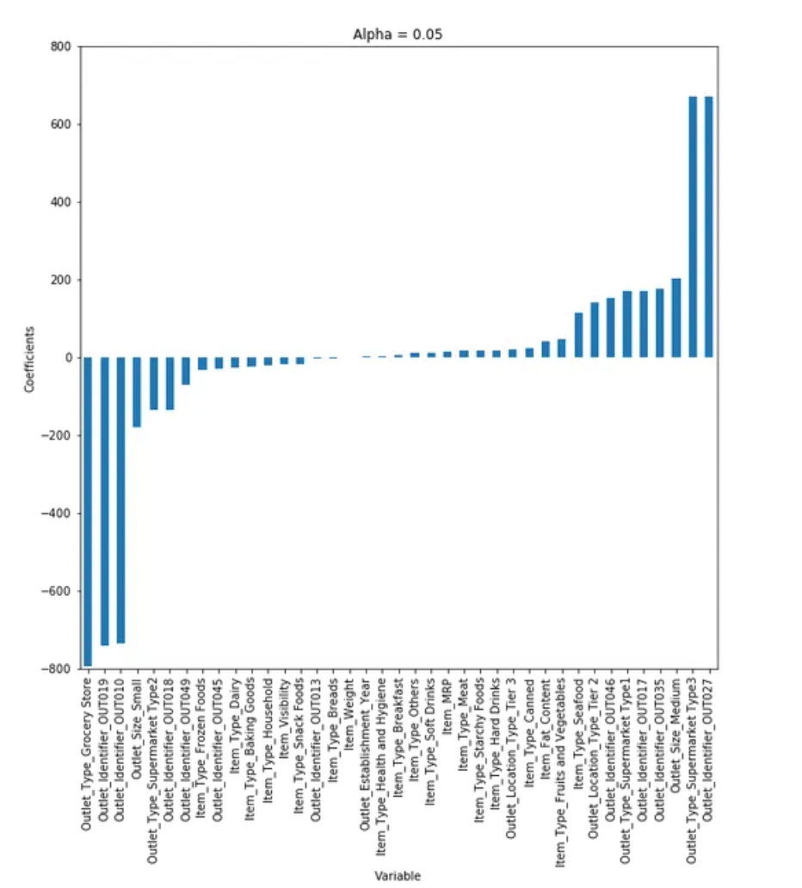

Slide 18
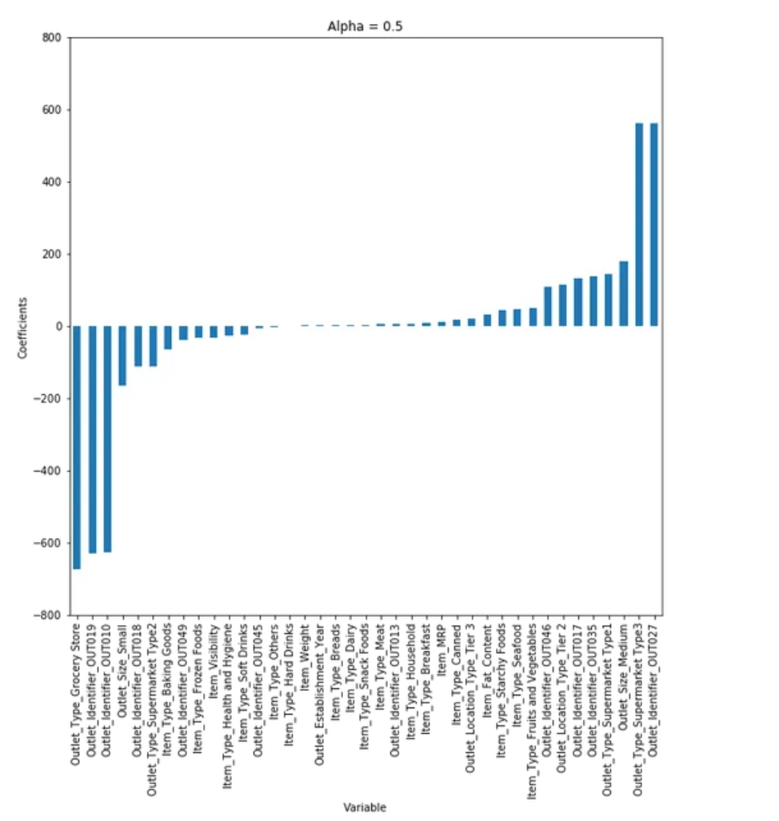

Slide 19
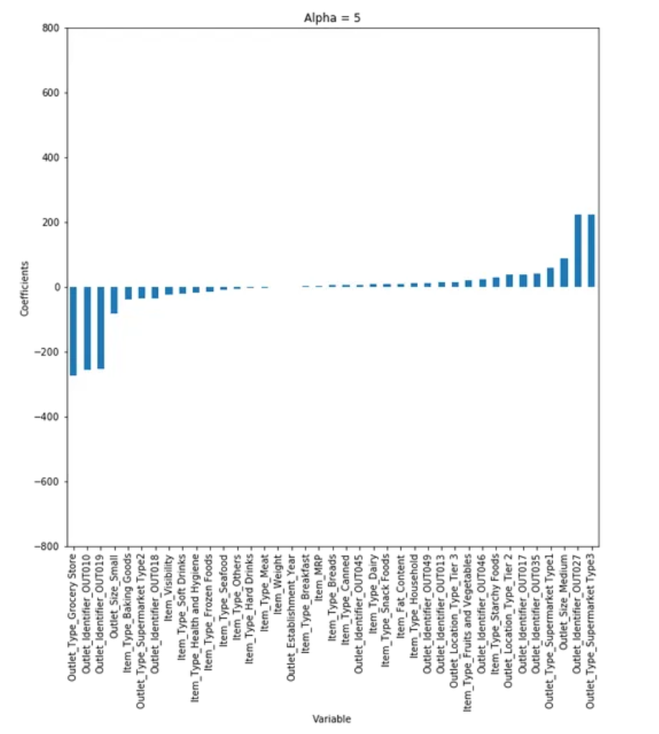

Slide 20
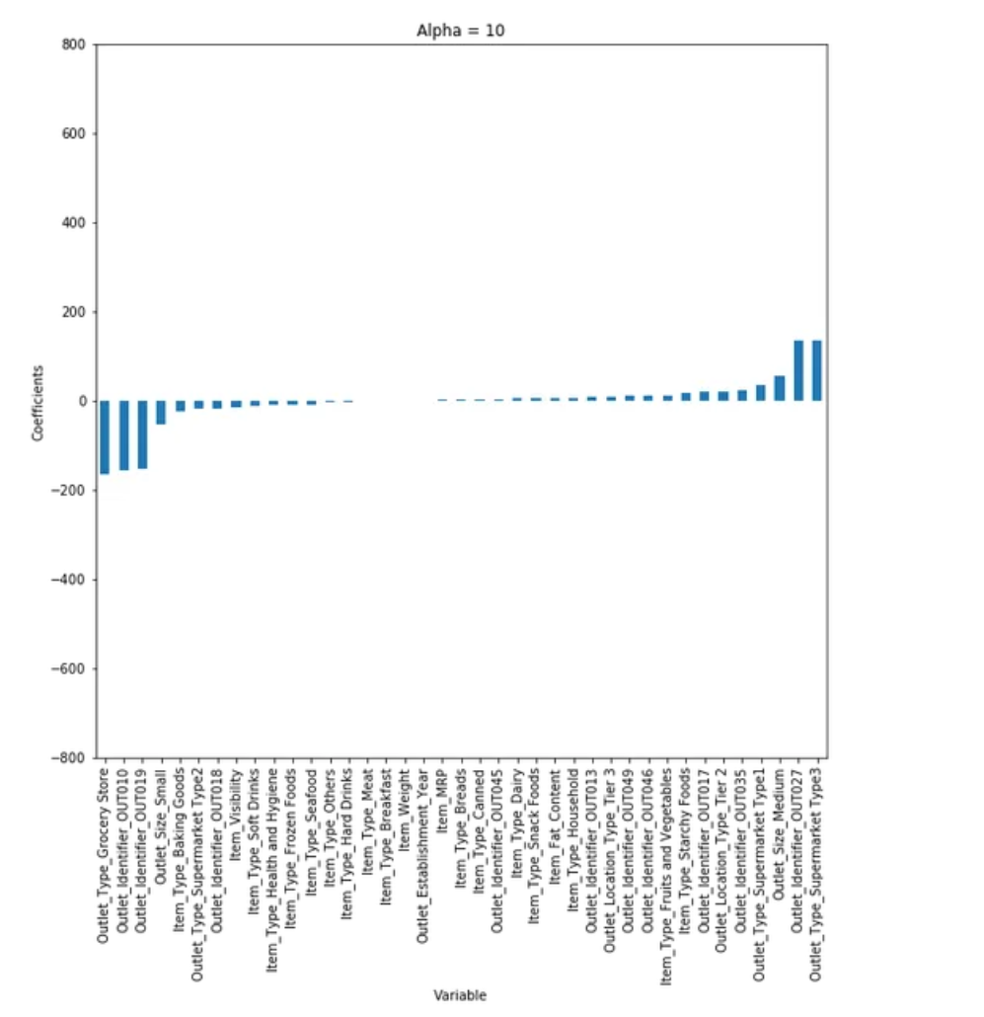

Slide 21
Ridge Regression
You can see that, as we increase the value of lambda, the magnitude of the coefficients decreases, where the values reaches to zero but not absolute zero.
R-square for each lambda, will be different
So we have to choose it wisely by iterating it through a range of values and using the one which gives us lowest error.

Slide 22
Ridge Regression
from sklearn.linear_model import Ridge
## training the model
ridgeReg = Ridge(alpha=0.05, normalize=True)
ridgeReg.fit(x_train,y_train)
pred = ridgeReg.predict(x_cv)
Higher the values of lambda, bigger is the penalty and therefore the magnitude of coefficients are reduced.

Slide 23
Ridge Regression
p = 2
It uses L-2 regularization technique.

Slide 24
Lasso regression
LASSO (Least Absolute Shrinkage Selector Operator)

Slide 25
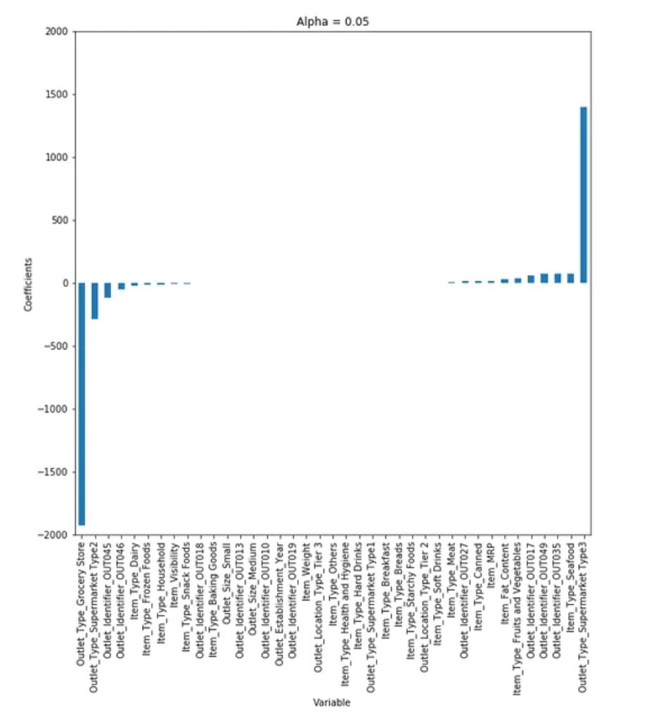

Slide 26
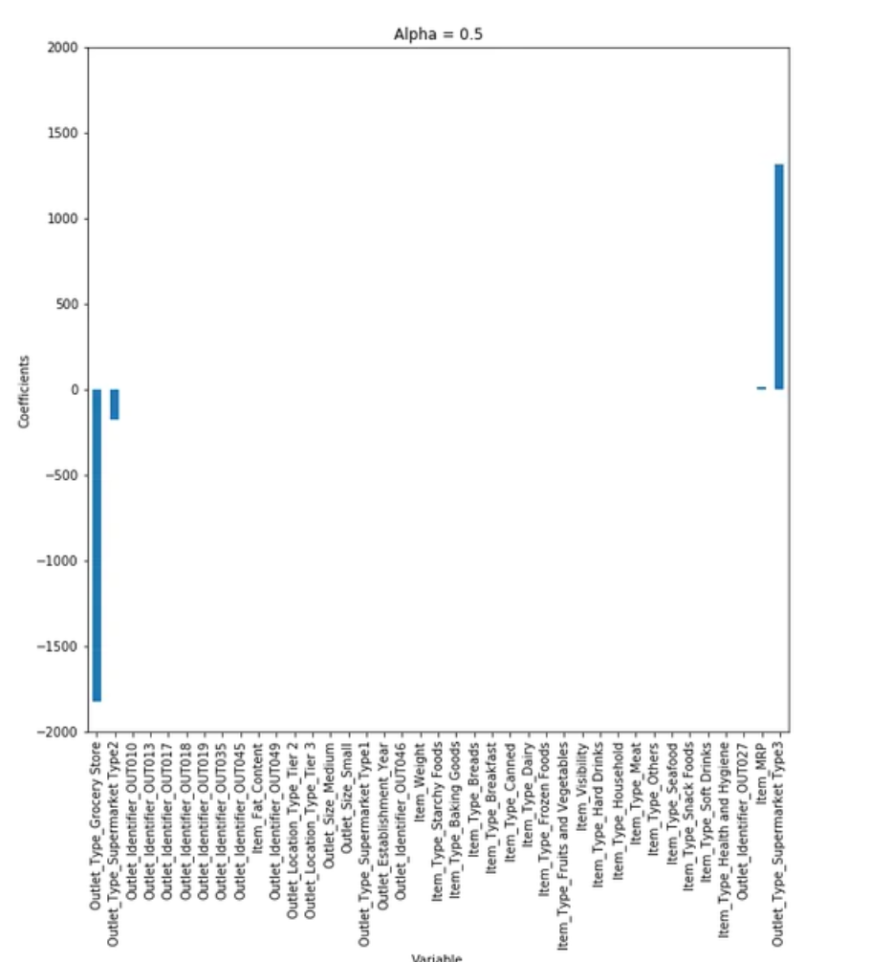

Slide 27
Any differences between ridge and lasso?

Slide 28
Lasso regression
We can see that as we increased the value of lambda, coefficients were approaching towards zero.
But if you see in case of lasso, even at smaller lambda’s, our coefficients are reducing to absolute zeroes.
Therefore, lasso selects the only some feature while reduces the coefficients of others to zero.
This property is known as feature selection and which is absent in case of ridge.

Slide 29
Lasso regression
It uses L1 regularization technique p = 1
It is generally used when we have more number of features, because it automatically does feature selection.

Slide 30
Code
from sklearn.linear_model import Lasso
lassoReg = Lasso(alpha=0.3, normalize=True)
lassoReg.fit(x_train,y_train)
pred = lassoReg.predict(x_cv)

Slide 31
Which one to use?
An example where we have a large dataset, lets say it has 10,000 features.
Ridge : model complex
Lasso: loose some information

Slide 32
Elastic Net Regression
It is basically a combination of both L1 and L2 regularization (you can implement both Ridge and Lasso by tuning the parameters)
We need to define alpha and l1_ratio
from sklearn.linear_model import ElasticNet
ENreg = ElasticNet(alpha=1, l1_ratio=0.5, normalize=False)
ENreg.fit(x_train,y_train)
pred_cv = ENreg.predict(x_cv)

Slide 33
Elastic Net Regression
Alpha = a + b and l1_ratio = a / (a+b)
Let alpha (or a+b) = 1, and now consider the following cases:
If l1_ratio =1, therefore if we look at the formula of l1_ratio, we can see that l1_ratio can only be equal to 1 if a=1, which implies b=0. Therefore, it will be a lasso penalty.
Similarly if l1_ratio = 0, implies a=0. Then the penalty will be a ridge penalty.
For l1_ratio between 0 and 1, the penalty is the combination of ridge and lasso.

Slide 34
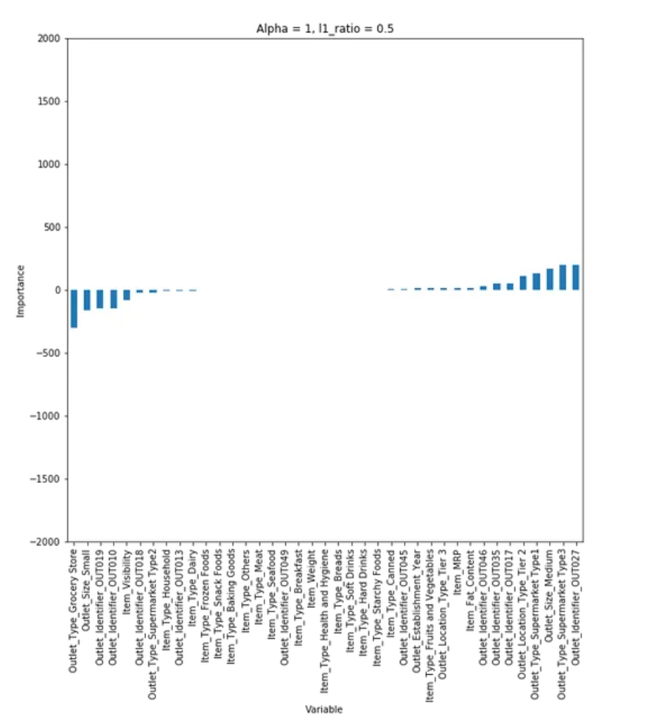

Slide 35
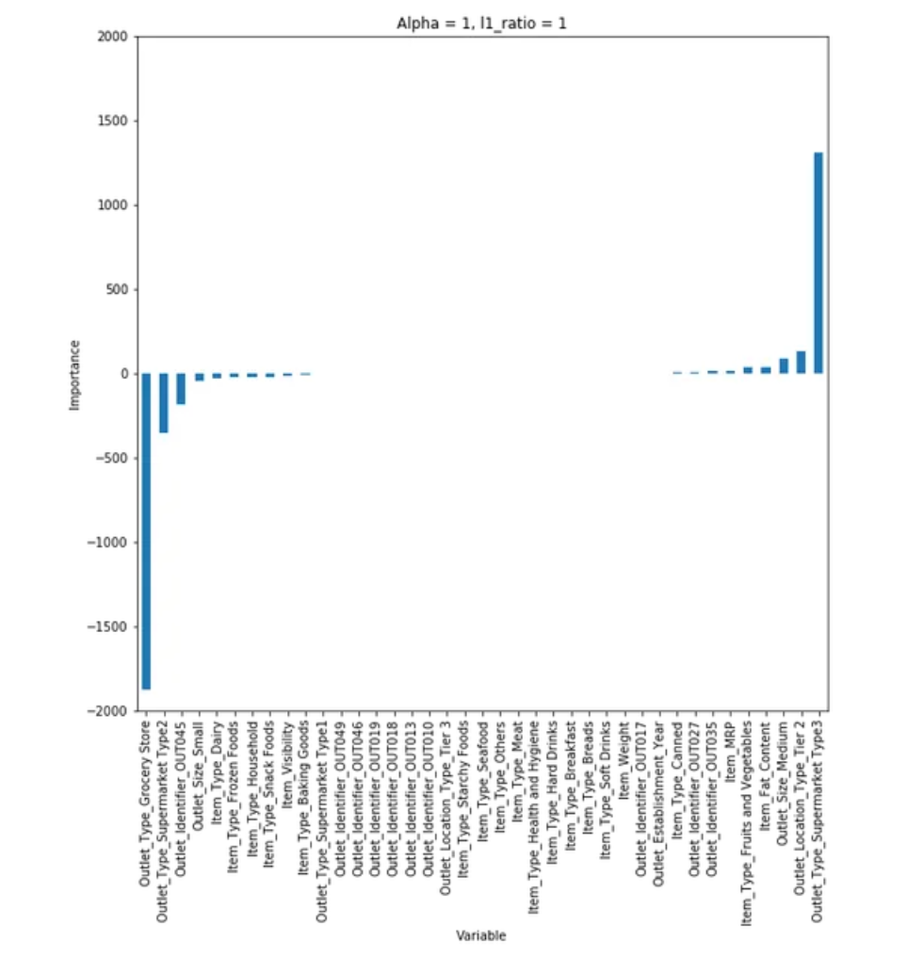

Slide 36
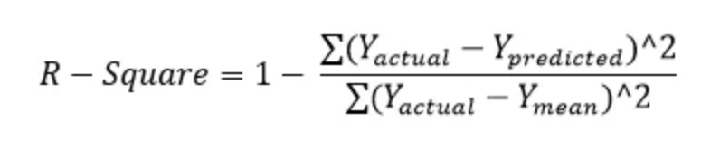
Evaluate the model
How accurate do you think the model is?
R square and adjusted R- square

Slide 37
R square
It determines how much of the total variation in Y (dependent variable) is explained by the variation in X (independent variable).
The value of R-square is always between 0 and 1,
where 0 means that the model does not model explain any variability in the target variable (Y)
and 1 meaning it explains full variability in the target variable.

Slide 38
Adjusted R-square
The only drawback of R² is that if new predictors (X) are added to our model, R² only increases or remains constant but it never decreases.
We can not judge that by increasing complexity of our model, are we making it more accurate?
The adjusted R-Square only increases if the new term improves the model accuracy.

Slide 39
“Knowledge is the treasure and practice is the key to it”

Slide 40

Discussion

Slide 41

Thank you!!!!!!

