Slide 1
Power Manager Telemetry ( This project focuses on monitoring CPU power consumption using the s-tui tool, which provides real-time telemetry data for CPU performance metrics.)
Syed Talha Ahmed
Virat Jaiswal

Slide 2
Solution
Solution for Power Manager Telemetry Problem Statement Using s-tui:
Researching and Identifying Open-Source Tools for Power Measurement:
Tool Selection: The chosen tool for this project is s-tui, which is a terminal user interface for monitoring CPU temperature, frequency, power, and utilization.
Identifying and Documenting Available System Knobs to Measure Power:
System Knobs: Utilize s-tui to monitor:
CPU temperature
CPU frequency
Power consumption
Utilization
Documentation: Document how to access and adjust these parameters within s-tui.

Slide 3
Collecting Power Telemetry Data:
CPU Monitoring with s-tui: Use s-tui to continuously monitor and log CPU metrics such as temperature, frequency, power consumption, and utilization.
Measuring and Recording System Power Utilization:
System Utilization Parameters: Define system utilization levels (e.g., 0%, 25%, 50%, 75%, 100%).
Load Simulation: Utilize Docker or Kubernetes to simulate different load levels. Employ stress or stress-ng to generate specific CPU loads.
A solution capable of:
Running the system under varying utilization levels.
Collecting and analyzing telemetry data for power consumption using s-tui.
Recommendations: Offer strategies for reducing power consumption based on the analysis, such as optimizing CPU usage or improving cooling solutions.
Expected Outcomes:
Telemetry Data Acquisition: Successfully gather telemetry data for CPU (temperature, frequency, power, and utilization) using s-tui.
System Utilization Simulation: Simulate different load levels on the system using containerization technologies and collect the resulting telemetry data.
Solution Development: Develop a comprehensive solution that utilizes s-tui for monitoring and gathering telemetry data based on system utilization percentages.

Slide 4
Features Offered
Real-Time Monitoring with s-tui:
Live Data Visualization: s-tui provides a real-time graphical interface to monitor CPU metrics such as temperature, frequency, power consumption, and utilization.
Historical Data Logging: The tool can log historical data, allowing for the analysis of CPU behavior over time under various load conditions
Stress Testing: Implement tools like stress or stress-ng within containers to generate specific CPU loads and observe power consumption patterns.
Automated Data Logging: Scripted processes to automate the collection and logging of telemetry data at predefined intervals and under various load conditions.
Graphical Reports: Generate graphical reports and charts to visualize CPU performance and power consumption trends.
User-Friendly Interface: Ensure that the solution is user-friendly and can be easily used by system administrators and engineers to monitor and manage CPU power usage.

Slide 5
Process flow
Project Initiation
Define Objectives
Gather Requirements
Tool Setup and Configuration
Install s-tui
Setup Docker/Kubernetes
Run s-tui
Load Simulation
Design Load Scenarios
Implement Load Generators
Data Collection Under Load
Run Simulated Loads
Log Data

Slide 6
Optimization Strategy Development
Identify Inefficiencies
Propose Solutions
Implementation of Optimizations
Apply Strategies
Monitor Impact
Validation and Testing
Re-run Load Scenarios
Compare Data
Deployment
Deploy Solution
Monitor and Maintain
This process flow ensures a structured approach to monitoring, analyzing CPU power consumption, leveraging the capabilities of s-tui and containerization technologies.

Slide 7
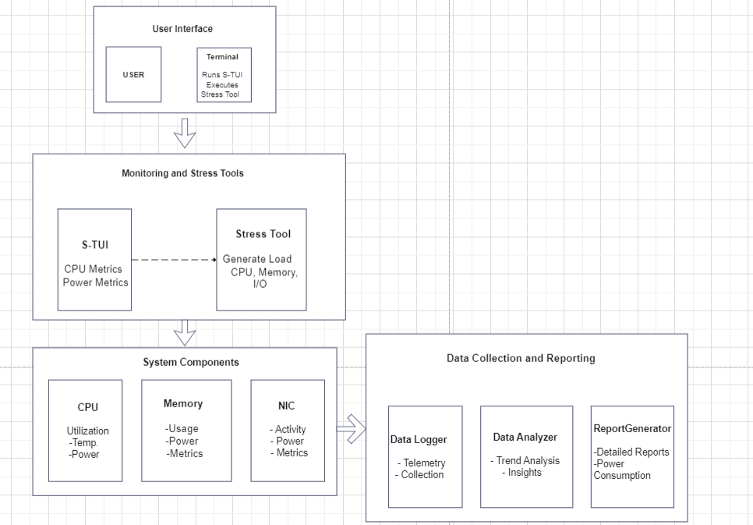
Architecture Diagram

Slide 8
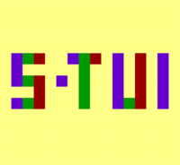
Technologies used
Python: For scripting and automation.
subprocess module: To run shell commands.
sys module: For system-specific functions.
APT: For package management.
apt-get: To install packages.
add-apt-repository: To add PPAs.
Linux Utilities:
stress: To generate system load.
s-tui: To monitor system performance metrics.
sudo: To run commands with elevated privileges.
dpkg: To check package installation status.
Linux OS: Specifically designed for Debian-based distributions like Ubuntu.
Exception Handling: To manage errors and ensure the script exits gracefully on failure.
These technologies collectively allow the script to automate the installation and execution of performance monitoring tools on a Linux system.

Slide 9
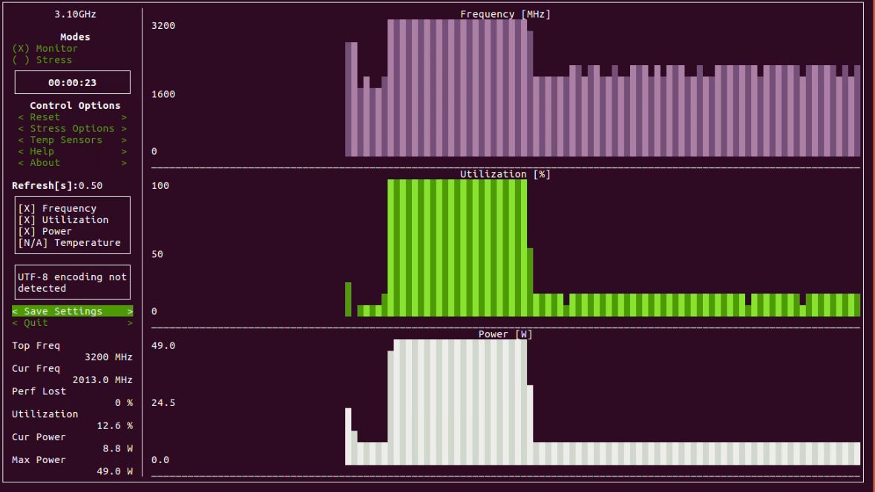

Slide 10
Conclusion
The Power Manager Telemetry project demonstrates a comprehensive approach to monitoring and analyzing power usage in computer systems using open-source tools and technologies. Leveraging Python for scripting and automation alongside monitoring tools such as S-TUI and stress, the project effectively measures system performance and power consumption across various components, including the CPU. The script automates the installation of necessary tools, ensuring a streamlined setup process, and provides real-time visualization of system metrics. This allows for thorough testing and analysis under different load conditions.
Overall, the Power Manager Telemetry project highlights the importance of monitoring and optimizing power consumption in modern computing environments. It offers a scalable and effective solution for enterprises aiming to improve energy efficiency and sustainability, ultimately driving significant improvements in power management practices and contributing to both environmental sustainability and operational cost savings.

Slide 11
Teammate Contribution
1. Virat Jaiswal (Role and Contribution):
Role: Define project objectives, research power consumption metrics, and design implementation strategies.
Contribution: Responsible for setting up the experimental environment, configuring `s-tui` for data collection, and initial data analysis.
2. Syed Talha Ahmed (Role and Contribution):
Role: Implement data collection mechanisms, integrate `s-tui` with data logging systems, and ensure data reliability.
Contribution: Develop scripts or tools to automate data collection, perform detailed analysis of power consumption trends using `s-tui` outputs, and collaborate on the interpretation of results.
Each member would likely collaborate closely on refining the experimental setup, interpreting findings, and documenting the project outcomes. This division ensures comprehensive coverage of both technical implementation and analytical insights necessary for the project's success.

