Slide 1
CptS 360
Network Programming

Slide 2
Connection from Last Session
System I/O
File descriptors and meta data
Partial I/O and address mapping
Motivation for this session
Sockets? Remote Procedure Calls? Proxies?
Which I/O techniques can we leverage?
Assignments: PA4 (this week), EA2 (next week)
Next Session
Concurrent & Parallel Programming
Yes, they are not the same

Slide 3
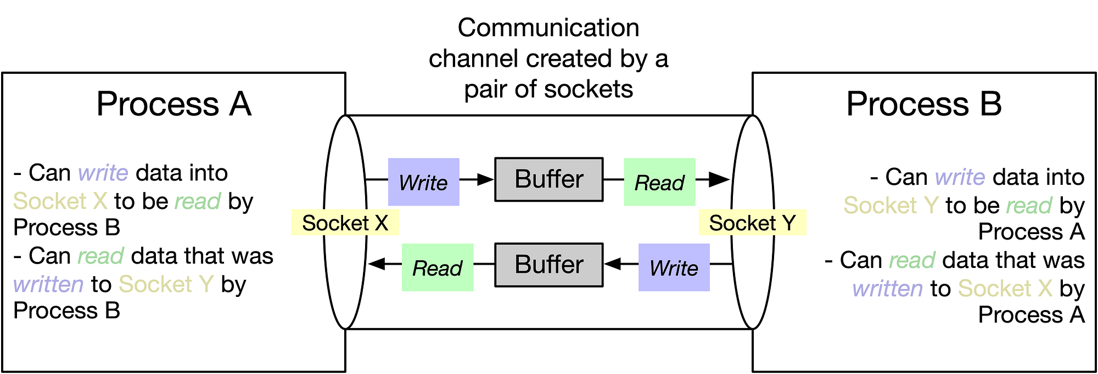
Sockets
Sockets are endpoints
N/w is big endian; local machines are little endian
htons, ntohs, htonl, ntohl

Slide 4
Sockets
Everything is a file → Sockets are FDs
read-write semantics apply
Partial I/O, EINTR, … are all applicable
Socket sys calls
Client: socket() → connect()
Server: socket() → bind() → listen() → accept()
API essentials: getaddrinfo(3) - Linux manual page
getaddrinfo (gai) address resolution
How to convert https://www.example.com?
Parameters known as hints
ai_family: address info type
ai_socktype: stream socket or datagram socket
ai_flags: socket identification flags
ai_next: pointer to loop through structs
freeaddrinfo: deallocate dynamically assigned memory

Slide 5
Sockets
Blocking sockets
read() stalls until data arrives
Stalling used via EINTR
Non-blocking sockets
read() returns immediately
Data not ready? EAGAIN
Methods to see which sockets are ready
poll() and select()
read(fd, buf, 4096)
Typically returns 1000 bytes unless it hits EOF or stalls
Use loops to accumulate bytes until the expected payload is received
Call 1 might receive 17 bytes, call 2 might get 22 bytes, …
Abruptly disconnecting a socket
EPIPE: Error return value, usually when an agent disconnects
SIGPIPE: Signal, usually when an asynchronous interrupt is triggered

Slide 6
Graceful Close and Reuse
Graceful close aka Half-close
shutdown(fd, SHUT_WR)
Client: “I’m done, closing”
Server: “Ok, close” or
Server: “Wait, I have more”
Useful when request sizes are unknown ahead of time
Enable streaming communication
Reusing socket addresses
Sockets have a TIME_WAIT
bind() can be reassigned before TIME_WAIT expires
Allows quick rebinding
Avoid open sockets problem
SO_REUSEADDR()

Slide 7
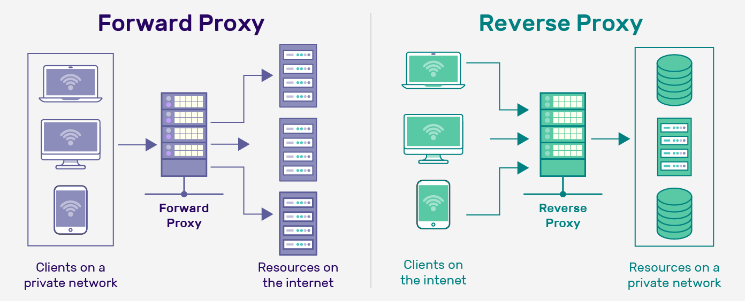
Proxies
An intermediary server for clients seeking resources from other servers
Forward proxy: hides the client
Reverse proxy: hides the server

Slide 8
Remote Procedure Calls
Sockets manually craft HTTP headers
Manage byte orders, parse string buffers
Tedious and error-prone
Typical software engineers do not use manual sockets
Instead use RPCs, REST / FastAPI calls
Understanding and being able to use manual socket is a disntinction
Separates sys engrs from software engrs
How to abstract network calls away from network management?
C-compiler can generate “client stubs” that marshals args
Args are then sent to “server stubs” which unmarshalls them
Runs the function and return value back
RPCs dramatically reduce the amount of code to be used

Slide 9
Manual
// 1. Create a socket
socket = create_socket()
// 2. Connect to the server's IP address and port
connect(socket, "192.168.1.1", 8080)
// 3. Manually format the message (serialization)
message = "Hello, server!"
send_data = encode_string_to_bytes(message)
// 4. Send the data over the network
send(socket, send_data)
// 5. Manually receive the response and decode it
received_data = receive(socket)
response = decode_bytes_to_string(received_data)
// 6. Close the connection
close(socket)
// 1. Create a socket and bind to a port
server_socket = create_socket()
bind(server_socket, 8080)
listen(server_socket)
// 2. Accept a client connection
client_socket = accept(server_socket)
// 3. Receive the raw bytes and decode
received_data = receive(client_socket)
message = decode_bytes_to_string(received_data)
// 4. Process the message and encode a response
response_message = "Msg received: " + message
response_data = encode_string_to_bytes(response_message)
// 5. Send the raw response
send(client_socket, response_data)
// 6. Close the client socket
close(client_socket)

Slide 10
RPC
// The client simply calls a function as if it were local
result = echo(“Hello”, “World”)
// The server simply implements the function
function echo(a, b):
return printf(“%s %s\n”, a, b)
// The RPC library handles:
Serializing (marshalling) the function name ‘echo' and arguments (“Hello”, “World”)
Sending the data over an underlying socket connection
Waiting for the response (blocking the thread)
Deserializing (unmarshalling) the result
// The RPC runtime handles:
Listening for requests on an underlying socket
Decoding the request (unmarshalling)
Invoking the correct local ‘echo' function
Encoding the result (marshalling)
Sending the response back to the client

Slide 11
Demos
gcc -O2 –Wall –Wextra http_client.c –o http_client
./http_client example.com 80
gcc -O2 –Wall –Wextra http_proxy.c –o http_proxy
./http_proxy 8080
curl -x http://127.0.0.1:8080 http://example.com/ -v
gcc -O2 -Wall -Wextra rpc_server.c –o rpc_server
gcc –O2 –Wall –Wextra rpc_client.c –o rpc_client

Slide 12
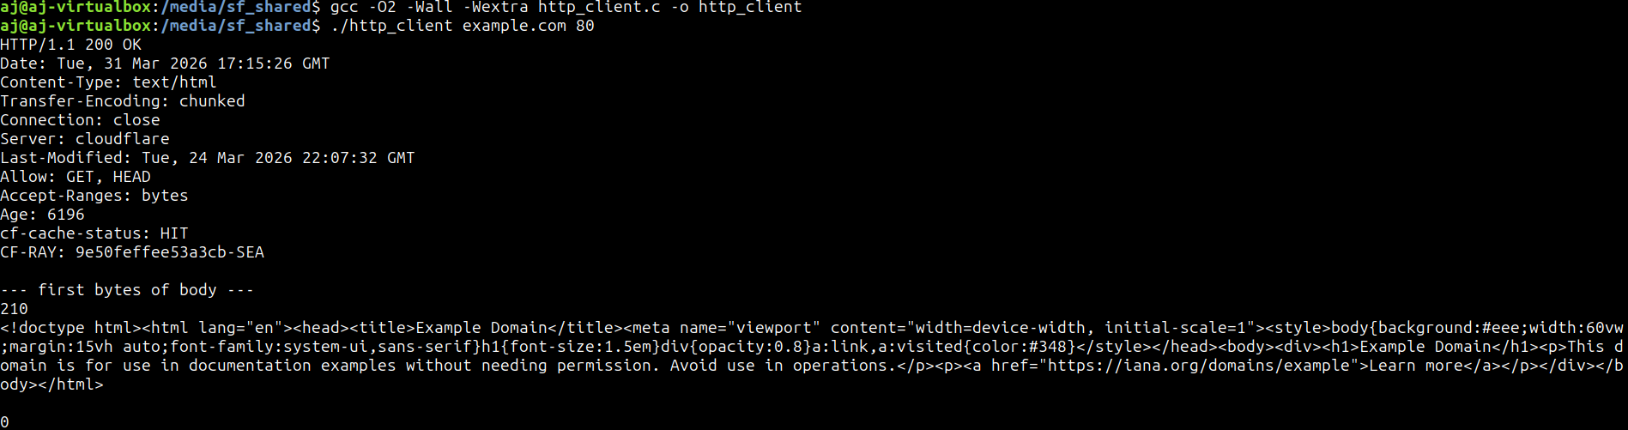
Demos

Slide 13
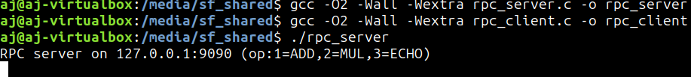


Demos

Slide 14
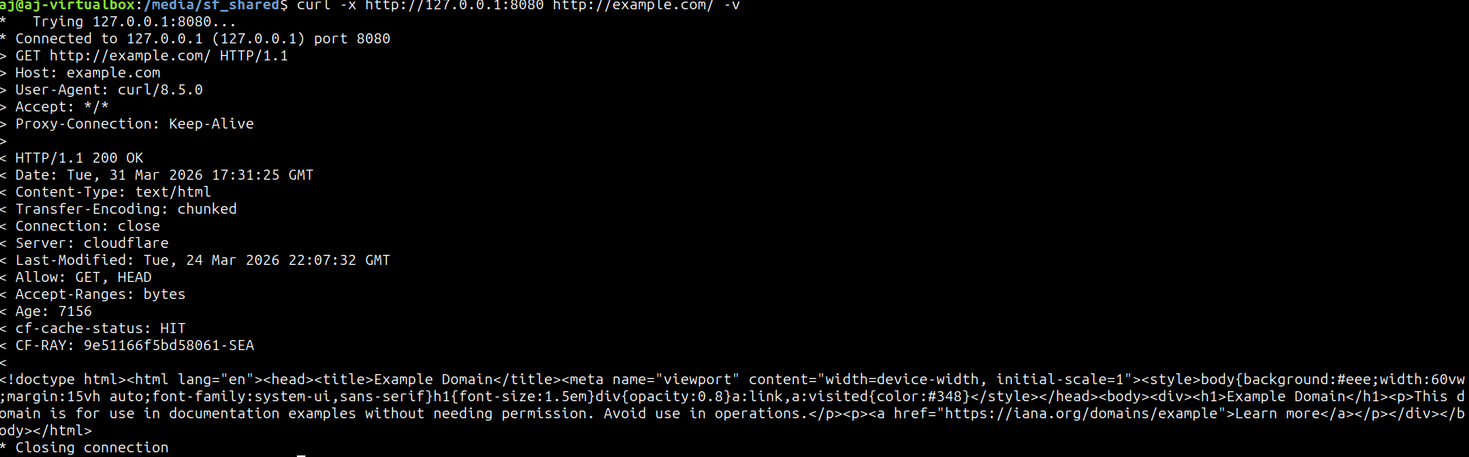
Demos

