Slide 1
CptS 360
System I/O

Slide 2
Connection from Last Week
Virtual Memory
Paging, TLB, virtual addresses, page walk, faults, …
Motivation for this week
How to read and write to files directly from the kernel?
STDIO vs SYSIO
File descriptors and metadata
I/O redirection and duplication
Assignments: PA3 (this week), CYA1 (next week)
Week 10
File system implementation in *nix-like systems

Slide 3
Resource Handling Paradigms
Resources: Devices, sockets, processes, data, …
Everything is a File
Resources are processed as byte streams
All streams use the same filesystem
Everything can be managed using same syscalls
Manage using /dev
Unix-like OSes, including macOS
Everything is an Object
Resources are processed as struct objs
Each obj type has separate properties, methods, and calls
Obj-calls differ by resource
Manage using PowerShell CMDlets
Windows

Slide 4
STDIO VS SYSIO
Standard I/O via fread/fwrite/fopen/printf
Utilize an intermediate buffer via malloc in user space
Buffer size varies, typically 8 KiB, can be set by SETVBUF and BUFSIZ
Faster, useful for smaller, frequent r-w; why?
Higher storage requirements
Disk → Kernel → STDIO → USR
Portable, OS-agnostic
Thread safety implicit with UID segmentation
Sys I/O via read/write/open/close
Directly calls the OS kernel; unbuffered
Slower, useful for large-block transfer; why?
Lower storage requirements
OS-dependent, limited portability
Thread safety requires explicit locking

Slide 5
Buffering
Why does buffering matter?
Reduces the number of sys calls
Switching from USR to KRNL mode is expensive
Both time and space expensive
Reading 1-byte 1024 times → 1024 SYSIO calls
Using 8 KiB buffer → 1 STDIO call
Higher throughput
HDDs and SSDs are optimized for large-block r-w
Time wasted on disk for smaller ops
Optimal buffer size?
8 KiB to 64 KiB

Slide 6
File Descriptors
Non-negative integers that identify open files
Used by processes or I/O agent
Serve as handles that pass-through system calls
IO agents? Pipes, sockets, devices, …
How do FDs work?
Pointers referring to Kernel Tables
Kernel Tables?
FDT: File Descriptor Table
SWOT / SWOFT: System-Wide Open File Table
INT: Index Node Table

Slide 7
Kernel Tables
FDT: File Descriptor Table
Per process, created when a proc starts
FD value refers to this table
Each FD points to a row in FDT
Each FDT row is mapped to a SWOFT
SWOFT: Sys-Wide Open File Table
Global and not per-process
Each entry tracks
The current file offset AKA cursor
Read-write cursors
Access mode (r / w / r-w / …)
Ref count of how many FDs point to this SWOFT
Multiple FDs can originate from same proc via dup()
Helps us kick out a proc if it is spamming FDs

Slide 8
Kernel Tables
INT: Index Node Table
Each entry in SWOFT points to an entry in INT
Index node AKA inode is a struct that contains all the file metadata
File type, size, permissions, and timestamps
Pointers to the physical data blocks on the disk
BMs: Block maps (UFS / ext3)
Direct Pointer
Ptr → Data Block
Single Indirect
Ptr → RefBuf → Data Block
Double Indirect
Ptr → SeekBuf → RefBuf → Data Block
ext4 replaces BMs with EXTs: Extents
Ptr ranges instead of multi-layered ptrs

Slide 9
Frequently Used FDs
Standard FDs
STDIN_FILENO (0)
Standard input stream: read input data channel
Default connected to Keyboard
Can change, other devices can be added via <
STDIN_FILENO (1)
Standard output stream: write output data channel
Default connected to Terminal
Can change, other devices can be added via >
STDIN_FILENO (2)
Standard error stream: write error data channel
Default connected to Terminal
Can change, other devices can be added via 2>
All three opened automatically at boot
| can send stdout of one proc as stdin to another proc

Slide 10
Semantics
read(): reads bytes from current position
Returns: number of bytes read, 0 (EOF), or -1 (ERR)
write(): writes bytes to the current position
Returns: number of bytes written, or -1 (ERR)
O_APPEND: ensures multiple procs can write to the same file
AKA ‘Atomicity’
Partial reads / writes are possible and occur often
Recursive reads / writes occur often
Send a range to r / w / r-w
Pointer moves → repeat
O_RDONLY, O_WRONLY, O_RDWR, O_CREAT
O_TRUNC: if file exists and open for writing, truncate bits to 0, destroying content
O_EXCL: exclusive locking, used to fail calls when desired state is existing
O_NONBLOCK: prevents waiting if a call targets a device that is not ready

Slide 11
Demos
gcc –O2 –Wall –Wextra sys_cp.c –o sys_cp
echo “Hello CPTS 360” > test.txt
./sys_cp test.txt copy.txt
cat copy.txt
gcc -O2 -Wall -Wextra bufcat.c -o bufcat
dd if=/dev/urandom of=big.bin bs=1M count=1024
./bufcat big.bin out.bin 4
./bufcat big.bin out.bin 64
./bufcat big.bin out.bin 1024
gcc -O2 -Wall -Wextra random_blocks.c -o random_blocks
./random_blocks big.bin 100000

Slide 12
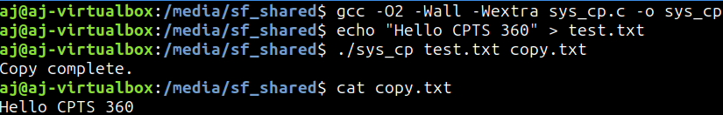
Demos

Slide 13
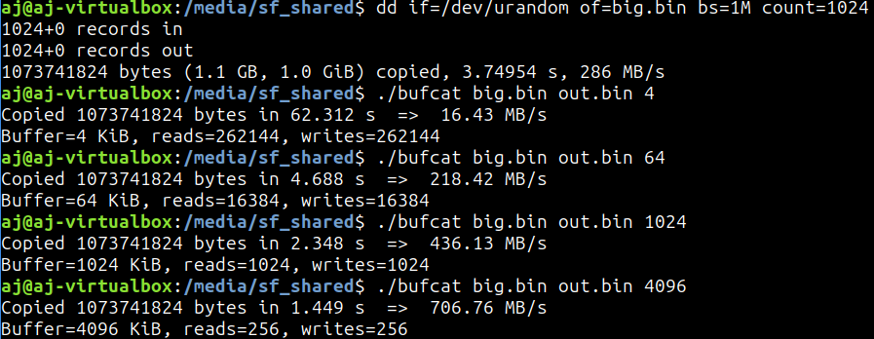
Demos

Slide 14
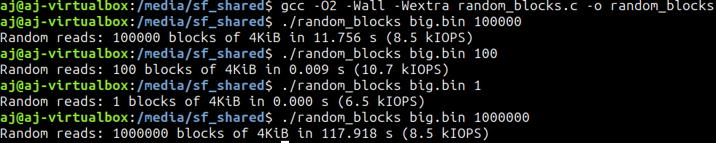
Demos

Slide 15
Copy Avoidance
Last session: quantity of data stdio vs sysio
How much and what type of data
This session: copy avoidance
How data moves through the machine
How to minimize copies
Typical read-write pipeline
Disk / Memory ←→ page cache
Page cache ←→ user buffer
User buffer ←→ kernel socket buffer
Two PU copies
Avoid bouncing between kernel and user space?

Slide 16
Vectored I/O and Memory Maps
Operate on multiple buffers in one syscall
readv, writev(fd, [buf1, buf2, buf3])
Minimizes syscalls but PU copies problem remains
sendfile(socket, file)
Cut out user-buffer
Pipeline: disk ←→ page cache ←→ kernel socket buffer
Vectored I/O is less flexible than fread, fwrite, read, write
Solution? Memory Maps (mmap)
Map a file directly into the process addr space
addr = mmap(file)
Kernel sets virtual memory mpappings
Allows accessing data like memory
char x = addr[i];

Slide 17
Memory Maps
Pages are loaded into the process addr space
Disk ←→ page cache ←→ user virtual memory
Zero-copy or low-copy
Demand / lazy loading
Random access
Sacrifices:
PU-driven; higher upfront time costs
Tricker I/O timing control
Writes are trickier due to msync, dirty pages
msync: sync data from mmap to physical storage (memory or disk)
MS_SYNC, MS_ASYNC, MS_INVALIDATE, MAP_PRIVATE
Sync is blocking-wait, async is immediate
Invalidate forces reload, Private prevents mmap ←→ device sync
Dirty page: Page modified in mmap but not yet updated on device
Tracked by dirty bits

Slide 18
SIGBUS vs SIGSEGV
SIGBUS indicates a proc trying invalid addr
E.g., with mmap when accessing corrupted pages
SIGSEGV indicates a proc trying valid addr but invalid access
E.g., with buffers when accessing read-only data
fwrite, write, writev, sendfile, mmap …?
fwrite: uses two buffers, two syscalls
write: uses one buffer, two syscalls
writev: uses one buffer, one syscall
sendfile: uses no buffers, syscalls; inflexible
mmap: uses no buffers, syscalls; flexible
But takes more

Slide 19
Demos
gcc –O2 –Wall –Wextra writev_demo.c –o writev_demo
./writev_demo out.bin
gcc -O2 -Wall -Wextra copy_rw.c -o copy_rw
./copy_rw src.bin dst.bin
gcc -O2 -Wall -Wextra copy_sendfile.c -o copy_sendfile
./copy_sendfile src.bin dst.bin
gcc -O2 -Wall -Wextra sendfile_http.c –o sendfile_http
./sendfile_http big.bin 8080
curl –o /dev/null –s http://127.0.0.1:8080/
gcc -O2 -Wall -Wextra mmap_random.c -o mmap_random
./mmap_random big.bin 100000

Slide 20
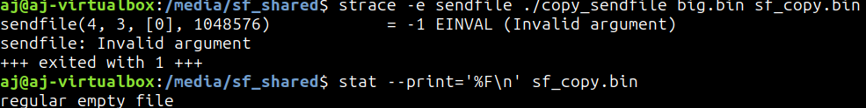
Demos

Slide 21
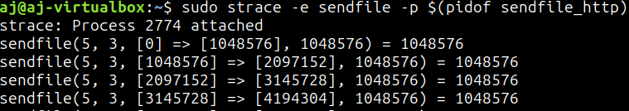
Demos

Slide 22
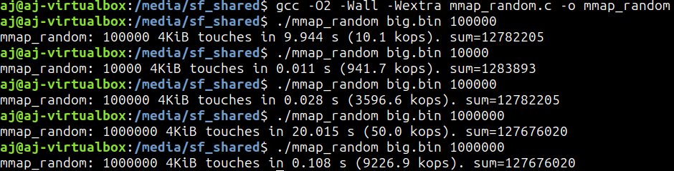
Demos

Slide 23
Tie-In to Virtual Memory and File Systems
How does SYSIO deal with page faults, TLB, MLPTs?
SYSIO routes data into a page cache
Subsequent reads go through the page walkthrough process
Results in hits or misses
STDIO and SYSIO both operate mostly on VFS
Virtual File System
What is VFS? How does that differ from standard FS?
Where do page caches operate?
How do file systems organize on-disk data?
What is journaling and how does it fit into all the above?

