Slide 1
CptS 360
Concurrency and Parallel Programming

Slide 2
Connection from Last Session
System I/O, Networking, File Systems
File descriptors and meta data
Partial I/O and address mapping
Motivation for this session
How do we scale from one connection to many connections?
Or one thread / core to many threads / cores?
Assignments: PA4 (this week), EA2 (next week)
Next Session
Distributed: Systems, Filesystems

Slide 3
Concurrency
Concurrency → multiple tasks are in progress
Not necessary for all to run simultaneously
Many things can go wrong
Races, Deadlocks
Starvation, Heisenbugs
Concurrency rule of thumb
Make it correct then make it fast
Prioritize structure and coordination
Concurrency types
Context-switching
Multithreading
Parallelism aka multiprocessing
Cooperative asyncs
Interrupt handlers
Distributed computing

Slide 4
Concurrency
Context-switching example
Web-browser: single-core, single-thread
Task A: [Load UI] → [Render Assets] → [Send User Inputs]
Task B: [Load Data] → [Run Scripts] → [Transmit Data]
Without context-switching:
[Load UI] → [Render Assets] !! → [Send User Inputs] !! → [Load Data] → [Run Scripts] → [Transmit Data] !!
With context-switching:
[Load UI] → [Load Data] → [Render Assets] → [Run Scripts] → [Send User Inputs] → [Transmit Data]
Still sequential and not simultaneous but optimized for structure/coordination

Slide 5
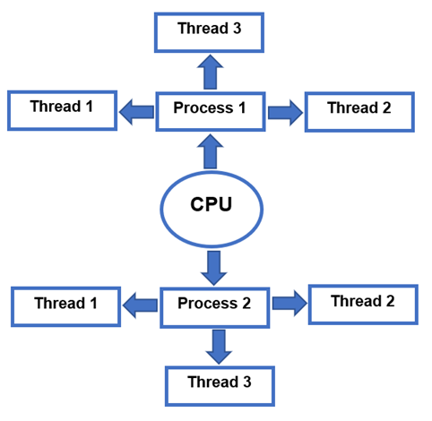
Threads and Processes

Slide 6
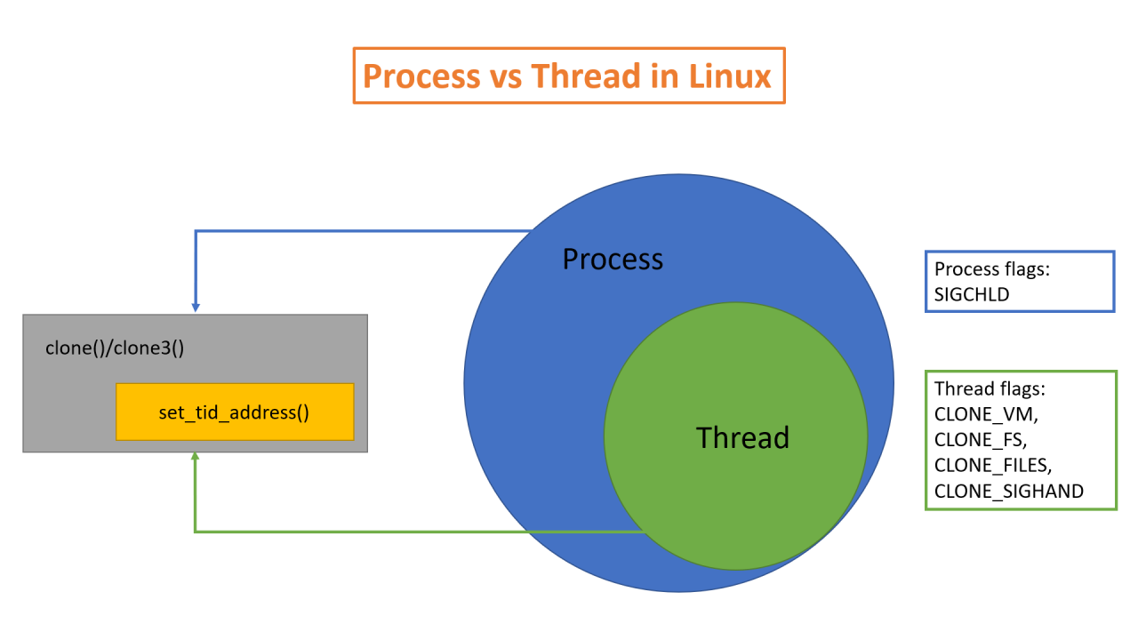
Threads and Processes

Slide 7
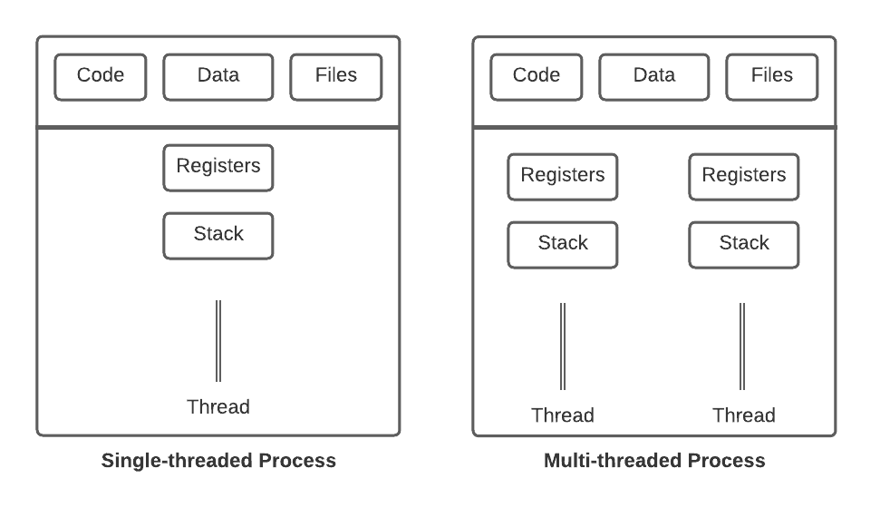
Threads and Processes

Slide 8
Multithreading
Single-threaded
Every process has one thread
Handles all aspects of an app sequentially
Func A must wait for Func B
E.g., web browsers is frozen when a page is loading
Multi-threaded
Every process has several threads
One thread handles UI, other loads data, another runs scripts
Funcs are responsive even when waiting
E.g., web browser is responsive even when loading data/scripts
Allows a process to multiple things at once
Sacrifice? Space
Each thread needs its own registers-stack

Slide 9
Single-Threaded
#include <stdio.h>
#include <unistd.h>
void perform_task(int id) {
printf("Task %d starting...\n", id);
sleep(2); // Simulates a time-consuming task
printf("Task %d finished.\n", id);
}
int main() {
// These run sequentially. Total time: 4s
perform_task(1);
perform_task(2);
return 0;
}

Slide 10
Multithreaded
#include <stdio.h>
#include <pthread.h>
#include <unistd.h>
void* perform_task(void* arg) {
int id = *(int*)arg;
printf("Thread %d starting...\n", id);
sleep(2); // Simulates a time-consuming task
printf("Thread %d finished.\n", id);
return NULL;
}
int main() {
pthread_t thread1, thread2;
int id1 = 1, id2 = 2;
// Launch both tasks at the same time. Total time: 2s
pthread_create(&thread1, NULL, perform_task, &id1);
pthread_create(&thread2, NULL, perform_task, &id2);
// Wait for threads to finish
pthread_join(thread1, NULL);
pthread_join(thread2, NULL);
return 0;
}

Slide 11
Parallelism (Multiprocessing)
Multiple processes run at the same time
Usually requires multi-core devices
Not necessarily multithreaded in theory but always is in practice
Processes are not only structured / coordinated
But also run simultaneously
Web-browser: 2-core, single-thread
Task A: [Load UI] → [Render Assets] → [Send User Inputs]
Task B: [Load Data] → [Run Scripts] → [Transmit Data]
Core 1: [Load UI] →Stall→ [Render Assets] → [Send User Inputs]
Core 2: [Load Data] → [Run Scripts] →Stall → [Transmit Data]

Slide 12
Parallelism (Multiprocessing)
Web-browser: 2-core, 2-threads
Task A: [Load UI] → [Render Assets] → [Send User Inputs]
Task B: [Load Data] → [Run Scripts] → [Transmit Data]
C1-T1: [Load UI] → [Render Assets] → [Send User Inputs]
C1-T2: [N/w node] → [Send/Receive data streams]
C2-T2: [Load Data] → [Run Scripts] → [Transmit Data]
C2-T2: [N/w node] → [Send/Receive data streams]
Stalls can be minimized via dynamic transmits of data

Slide 13
Concurrency Variants
All the concurrency variants are cooperative
Not mutually exclusive
Analogies
Context-switching: one chef cooking two dishes by switching
Has only one stove
Multithreading: one chef cooking two dishes by switching
Has two or more stoves
Multiprocessing: two chefs cooking two dishes simultaneously
Each has one stove
Multiprocessing with multithreading (Beta):
Two chefs cooking two dishes simultaneously
Each have two or more stoves

Slide 14
Concurrency Variants
Beta with cooperative aysncs (Delta):
Two chefs cooking two dishes simultaneously
Each have two or more stoves
An assistant helped with prep earlier in the day
Delta with interrupt handlers (Gamma):
Two chefs cooking two dishes simultaneously
Each have two or more stoves
An assistant helped with prep earlier in the day
Another assistant helps with utensil management
Gamma with distributed computing (Epsilon):
Two chefs cooking two dishes simultaneously
Each have two or more stoves
An assistant helped with prep earlier in the day
Another assistant helps with utensil management
The two dishes made by the chefs will be served together on a plate

Slide 15
Data Races
Two or more threads access the same memory location
At least one of the accesses is a write
Accesses are not synchronized
counter = 0;
T1: counter++;
T2: counter++;
print counter
Expected output: 2
Observed output: 1
Why?

Slide 16
Data Races
counter is not atomic
Read counter
Add 1
Write back
Thread interleaving:
T1 reads 0
T2 reads 0
T1 writes 1
T2 writes 1 ← overwrites T1
How to fix?
Mutex: mutual exclusion
Ensures only one thread accesses a critical section at a time

Slide 17
Data Races
mutex lock;
Thread 1:
lock.lock();
counter++;
lock.unlock();
Thread 2:
lock.lock();
counter++;
lock.unlock();
Serialize access to critical memory locations
One thread enters the critical section while the other waits

Slide 18
Atomics and Mutex
An atomic operation is indivisible
Cannot be interrupted
Guarantees
No corruption from interleaving
Hardware-level safety
Atomic vs Mutex?
Simple vs complex ops
Counters vs multiple variables
Low contention vs high contention (needs locking)
Easier to implement vs more complicated
atomic<int> counter = 0;

Slide 19
Data Race vs Race Conditions
Data races
Unsafe memory access has occurred
Race conditions
Logical problem, one reason behind data races
Produces unexpected or non-deterministic outcomes
int counter = 0; // Shared variable
void* increment(void* arg) {
for (int i = 0; i < 100000; i++) {
counter++; // DATA RACE
}
return NULL;
}
int balance = 100;
void withdraw(int amount) {
if (balance >= amount) {
balance = balance - amount;
}
}
T1: withdraw(80);
T2: withdraw(80);

Slide 20
Producer-Consumer Problem
Producer
Generates data and writes to files in a buffer
Consumer
Processes data by reading files in a buffer
Shared buffer between producer and consumer
Problem?
What if the buffer is empty when the consumer reads?
What if the buffer is full when the producer reads?
Solution?
Condition variables
Enables sleeping of a thread when or until a condition is true
Typically used with mutex

Slide 21
Producer-Consumer Problem
queue buffer;
Producer:
while (true) {
item = produce();
buffer.push(item);
}
Consumer:
while (true) {
item = buffer.pop();
consume(item);
}
mutex m;
condition_variable not_full, not_empty;
queue buffer;
int MAX = 10;
Producer:
lock(m);
while (buffer.size() == MAX)
wait(not_full, m);
buffer.push(item);
signal(not_empty);
unlock(m);
Consumer:
lock(m);
while (buffer.empty())
wait(not_empty, m);
item = buffer.pop();
signal(not_full);
unlock(m);
Observe:
while not if

Slide 22
Thread Pools
Thread pools
Task queue
Worker threads
Creating threads is expensive
Pre-create a fixed number of threads on boot
Reuse the thread pools for tasks
Avoids thread creation overhead
Granular control of concurrency levels
Prevent real-time resource exhaustion
Increases boot time
More applicable for enterprise systems rather than PCs
Boot/reboot once a month
while (true) {
task = queue.pop();
execute(task);
}

Slide 23
Concurrency in Servers
while (true) {
client = accept();
handle(client);
}
One client blocks others
Thread per connection
accept() → thread → handle(client)
Too many threads: memory + PU overhead
Thread pool queue and task
accept() → push task → execute(task)
Multiple threads share cache, session data, file handles
Mutex or atomic the threads

Slide 24
Concurrency: ServerShutdown
Concurrency makes server shutdown a complex process
Running threads’ interdependencies?
What to close among open sockets?
Careless shutdowns could deadlock
Recommended procedure:
Stop new accept()
Signal workers to stop via SIGTERM
Wait for threads to finish
Free locks, clean memory
Shutdown

Slide 25
Demos
gcc -O2 -Wall -Wextra -pthread race_counter.c -o race_counter
./race_counter 8 5000000
gcc -O2 -Wall -Wextra -pthread race_counter_mutex.c -o race_counter_mutex
./race_counter_mutex 8 5000000
gcc -O2 -Wall -Wextra -pthread bounded_queue.c -o bounded_queue
./bounded_queue
gcc -O2 -Wall -Wextra -pthread thread_pool.c -o thread_pool
./thread_pool

Slide 26
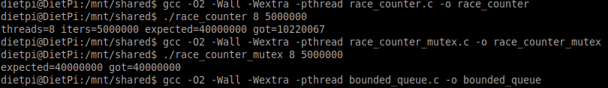
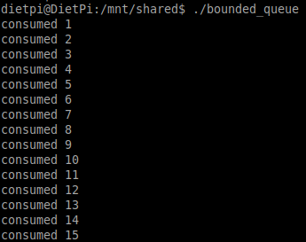

Demos

Slide 27
Demos
gcc -O2 -Wall -Wextra poll_echo_server.c -o poll_echo_server
./poll_echo_Server 9091
nc 127.0.0.1 9091
gcc -O2 -Wall -Wextra -pthread parallel_sum.c -o parallel_sum
./parallel_sum 8 200000000

Slide 28

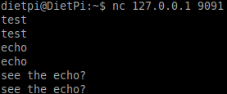
Demos

Slide 29
Most Minimal VM
Many have a VM speed issue
Any options even more minimal than Lubuntu?
Try using DietPi
A stripped-down version of Debian
Intended to be used on single-board computers such as RaspberryPi
Has systemd and apt
Can still benefit from many Ubuntu support resources
If you are daring enough to leave Ubuntu and systemd and apt
TinyCoreLinux is another option
192MB iso download and takes 70MB RAM by default
Has a GUI

Slide 30
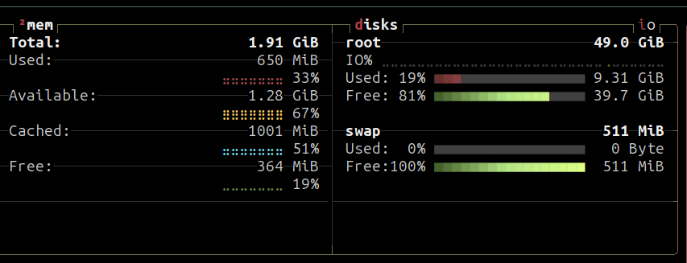
Demos

Slide 31
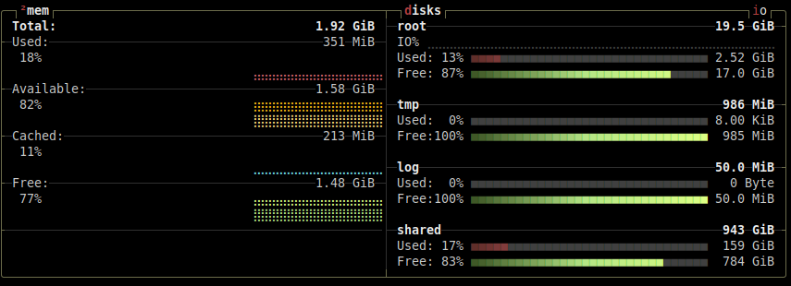
Demos

Slide 32
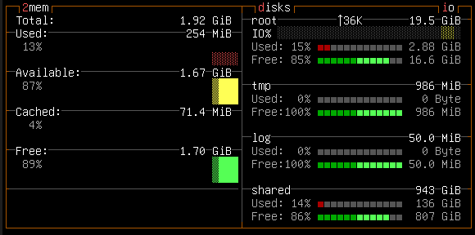
Demos

