Slide 1
CptS 360
Distributed Systems and File Systems

Slide 2
Connection from Last Session
Concurrency and parallelism
Motivation for this session
Imagine you’re Netflix
One machine no matter how many cores cannot serve millions of users
How do we create systems that are very large scale?
Assignments: EA, PA5, Peer Interviews
Final in-class session
Course Project Interviews start next week

Slide 3
Delivery at Scale
Delivery of services and data at scale
Distributed systems and file systems
A type of concurrency
Why not have one machine with a trillion cores?
Physical limits → cores are integrated circuits
Current limits are 1,000,000 cores on one silicon wafer
Experimental toy-chips
Commercially, 300 cores per chip
Intel Xeon 6
Why is there such a big gap between experimental and commercial?
Heat dissipation
A million cores require cryogenic cooling, not easy to market
Memory bandwidth
A million cores are of no use if RAM doesn’t scale with processing

Slide 4
Distributed Systems
Multiple systems. Typically
Connected together
Fulfilling an overarching mission
Geographically spread
Not all distributed systems follow this
Some distributed systems are in the same room
Cryptocurrency mining rigs
Greater exposure to physical calamities or issues
Natures
Independent storage, memory
Independent processing, although cooperating
Benefits
If one node crashes, the system continues although in a degraded state

Slide 5
Fallacies of Distributed Computing
The network is always reliable
Outages happen all the time
Network latency is always zero
Latency is rarely below 10ms
Bandwidth is infinite
Bottlenecks occur often
The network is secure
Plan for network attacks e.g., DDoS, MITM, …
Topology does not change
One portion maybe star, another maybe mesh, another maybe line, …
Networks each have only one admin
Each subnet has multiple admins with conflicting policies
Transport cost is zero
Building and maintaining a network is costly
The network is homogeneous

Slide 6
Distributed Systems
Given the fallacies
Important to track operational status
One node going down is not problem
If we ignore, many others will eventually go down
System crash
Tracking issues
Some nodes can become slow / delayed
How to differentiate delayed nodes from failed nodes?
Some nodes can become compromised or intentionally misbehave
How to differentiate?
Solution
Focus on overall network / system
CAP

Slide 7







Slide 8
CAP Principles
Consistency
Every read receives the most recent write or an error
All nodes should see the same data at the same time
Availability
Every request receives a non-error response
No guarantee that it is the most recent write
Partition Tolerance
Node continues to operate even when ‘N’ number of msgs dropped/delayed
AKA Persistence
Attaining all three CAP in a network is a pipe dream. Practically:
CP: Upon partition, shutdown inconsistent nodes – sacrificing availability
AP: Upon partition, nodes remain online but may provide older data
CA: Nodes always provide latest, non-error responses. No partitions allowed
Disconnect partitioned nodes

Slide 9
CAP Deployment
Modern trend is AP
BASE
Basically Available
3-nines (99.9%), 4-nines (99.99%), or 5-nines (99.999%)
Soft states
Daily backups or snapshots, easy to restore/revert
Eventual Consistency
Nodes will eventually start producing latest data
Dynamo motivation
CAP focuses on data syncs
How to measure data correctness?
ACID

Slide 10






Slide 11
ACID
Atomicity
Every transaction can either succeed or fail, no partials
If one part fails, the whole things is considered failed → rollback
Consistency
Transactions should transit between valid states
Block transactions that would not produce valid output
Isolation
Manage concurrent transactions
Allows multiple users to read-write simultaneously
Durability
Once a transaction is committed → remains saved
Even after power loss, reboot, crash
Provide integrity, reliability, concurrent access management, fault tolerance

Slide 12

Heartbeats
Heartbeats and Pulses
Heartbeats: timely pings
Pulses: deterministic frequency of heartbeats
Disadvantage?
Nodes can be delayed or slowed down
Miss pulses
Nodes can be intentionally avoiding pings
Byzantine faults: CPTS 427
Solution?
Leader-Follower Model
Quorum Model

Slide 13
Leader & Quorum
Leader-follower model
One node is designated or elected as a leader
Others are followers
Only the leader can order writes
Others can read
Quorum model
N: Number of nodes
W: Write quorum
R: Read quorum
W + R > N: consistency but poor availability
W > R+N: durability but poorer latency
R > W+N: better latency but likely stale data
N > W + R: best availability but poorer latency or stale data
Dozens of other consensus models: CPTS 427

Slide 14
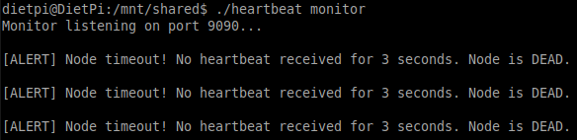

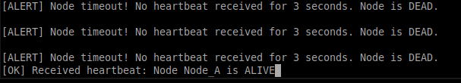
Demo
gcc heartbeat.c –o heartbeat
gcc heartbeat.c –o heartbeat2
./heartbeat monitor
./heartbeat2 worker Node_A

Slide 15
Demo
gcc -O2 -Wall -Wextra rlog_node.c –o rlog_node
gcc -O2 -Wall -Wextra rlog_node.c –o rlog_node2
gcc -O2 -Wall -Wextra rlog_node.c –o rlog_node3
gcc -O2 -Wall -Wextra rlog_client.c –o rlog_client
Terminal 1
./rlog_node follower 9001
Terminal 2
./rlog_node follower 9002
Terminal 3
./rlog_node leader 9000 127.0.0.1:9001 127.0.0.1:9002
Terminal 4
./rlog_client 127.0.01 9000 “entry-1”
./rlog_client 127.0.01 9000 “entry-2”

Slide 16
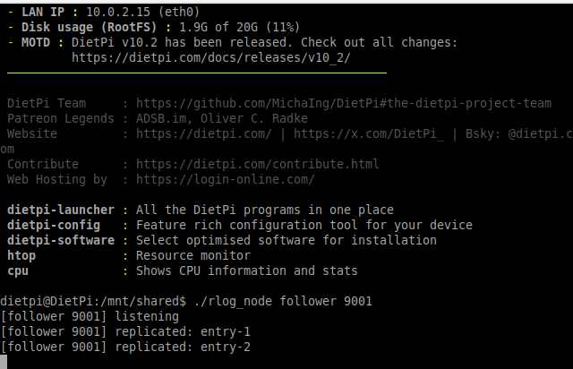
Demos

Slide 17
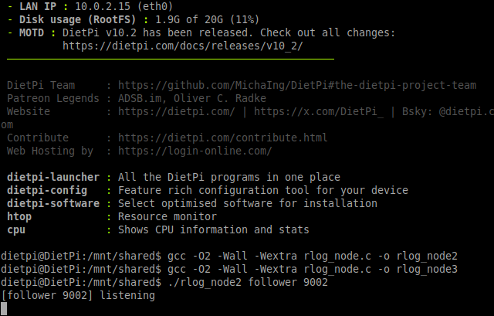
Demos

Slide 18
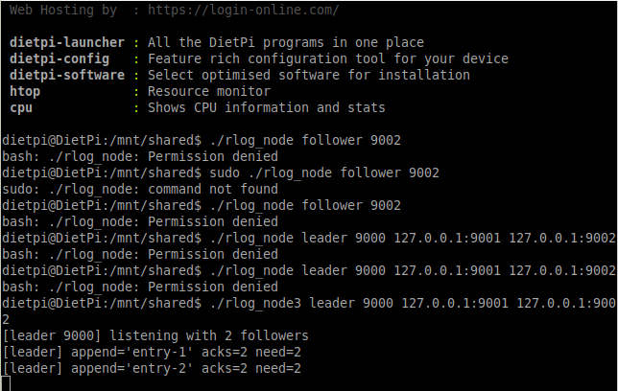
Demos

Slide 19
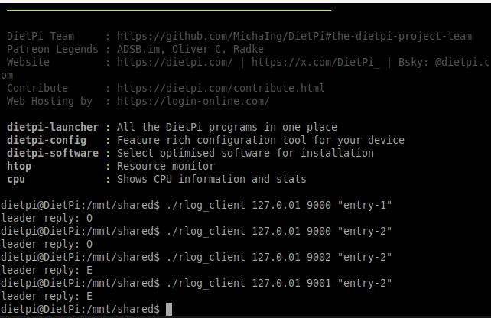
Demos

Slide 20
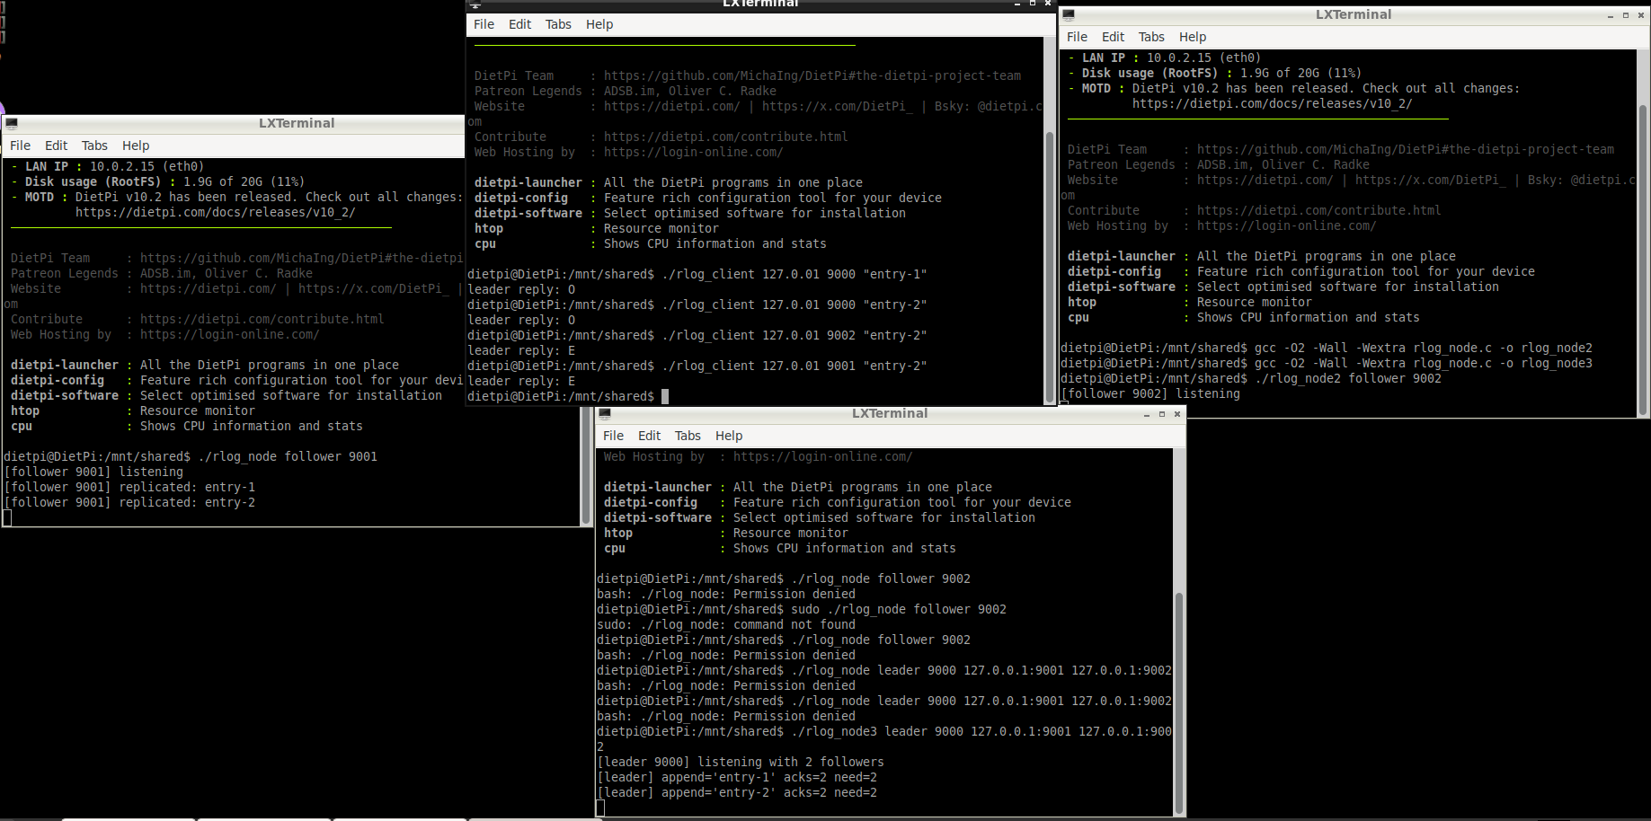
Demos

Slide 21
Distributed File Systems
‘Everything is a file’; program treats network as a file
Network File System (NFS)
Server shares dirs
client mounts those dirs and operates like local
Protocol-first i.e., clients don’t care how the server stores files
Can swap backend storage without changing clients
NFSv3 adds:
File locking + mount functionality
Statelessness: server does not track file pointers
Idempotency: allows multiple concurrent reads
NFSv4 adds:
Global mounts, Statefulness, client caching
Compound operations
LOOKUP → OPEN → READ-WRITE → CLOSE
[LOOKUP + OPEN + READ-WRITE + CLOSE]

Slide 22
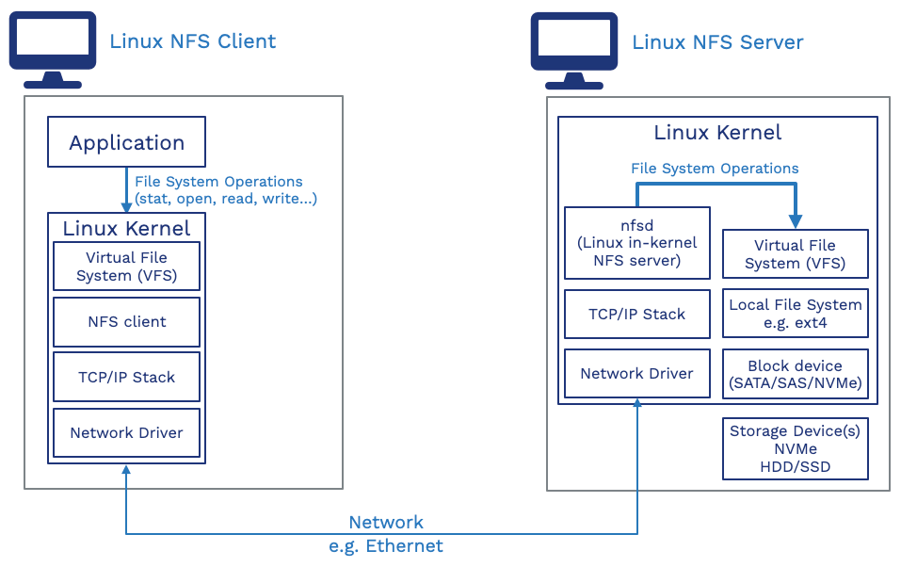

Slide 23
Distributed File Systems
Hadoop File System
Open-source, originally Java-based
128MB chunks
Leader-follower: NameNode, DataNode
Optimized for batch processing and large data sets
Rack-awareness: tracks topology via latency estimates
Places replicas on separate racks
Google File System
Open-source, originally Java-based
64MB chunks
Leader-follower: Master, Chunker
Optimized for frequent accesses
Rack-awareness: added in Colossus
CRUSH: Controlled Replication Under Scalable Hashing

Slide 24
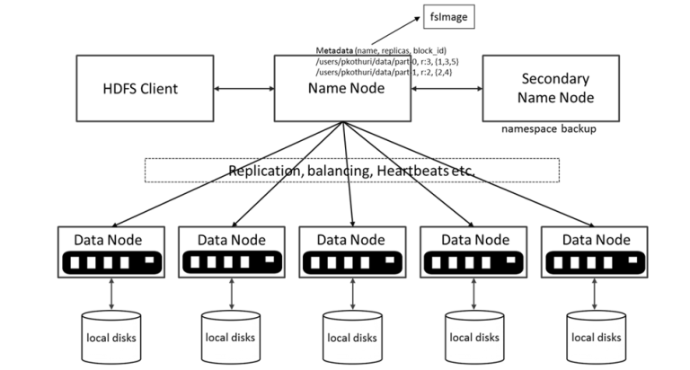

Slide 25
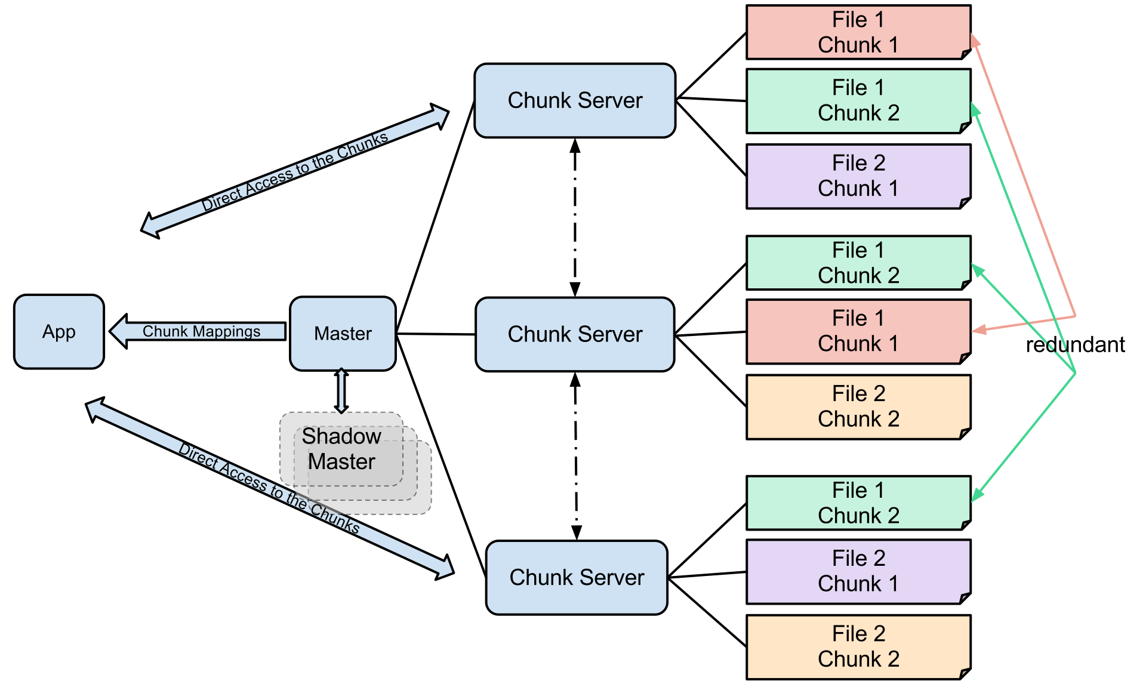

Slide 26


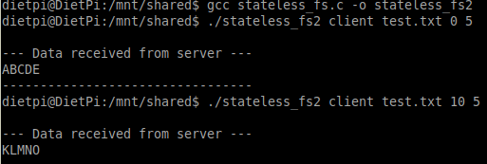
Demo
gcc stateless_fs.c -o stateless_fs
gcc stateless_fs.c -o stateless_fs2
echo “ABCDEFGHIJKLMNOPQRSTUVWXYZ” > test.txt
./stateless_fs server
./stateless_fs2 client test.txt 0 5
./stateless_fs2 client test.txt 10 5

Slide 27
Demo
gcc -O2 -Wall -Wextra dfs_chunk.c –o dfs_chunk
gcc -O2 -Wall -Wextra dfs_meta.c –o dfs_meta
gcc -O2 -Wall -Wextra dfs_client.c –o dfs_client
Terminal 1
./dfs_chunk 9101
Terminal 2
./dfs_chunk 9102
Terminal 3
./dfs_meta 9200 127.0.0.1:9101 127.0.0.1:9102
Terminal 4
dd if=/dev/urandom of=sample.bin bs=1K count=200
./dfs_client put 127.0.0.1 9200 sample.bin file.bin
./dfs_client get 127.0.0.1 9200 file.bin out.bin
cmp sample.bin out.bin && echo “match”

Slide 28


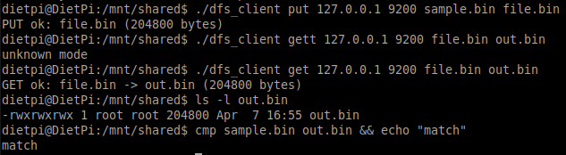
Demo

