Slide 1
CptS 360
Computer Memory Systems
Notes:
Template-WSU Hrz 201.ppt

Slide 2
Connection from Last Week
We recapped C programming landscape
We started experimenting with Linux terminals
Motivation for this week
  How does memory work in computers?
    CPTS 260 deals with architecture-level memory structures
    Here we deal with software-level memory structures
PA2: cache memory management
Weeks 3 and 4
  Focus on linking and control of flows and processes
Notes:
Template-WSU Hrz 201.ppt

Slide 3
Overview
Basic memory types
Why caches exist, cache types
Power-of-two constraints
  Computing offset, index, and tag bit widths from cache and block sizes
  Decompose an address into tag/index/offset
Accuracy statistics
Notes:
Template-WSU Hrz 201.ppt

Slide 4
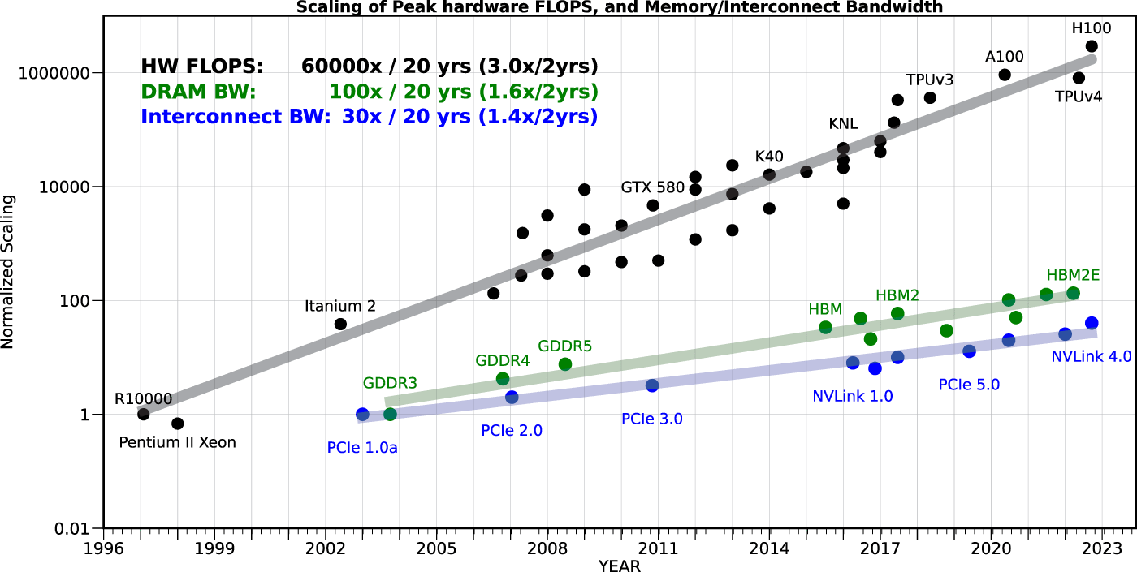
Memory Wall
Notes:
Template-WSU Hrz 201.ppt

Slide 5
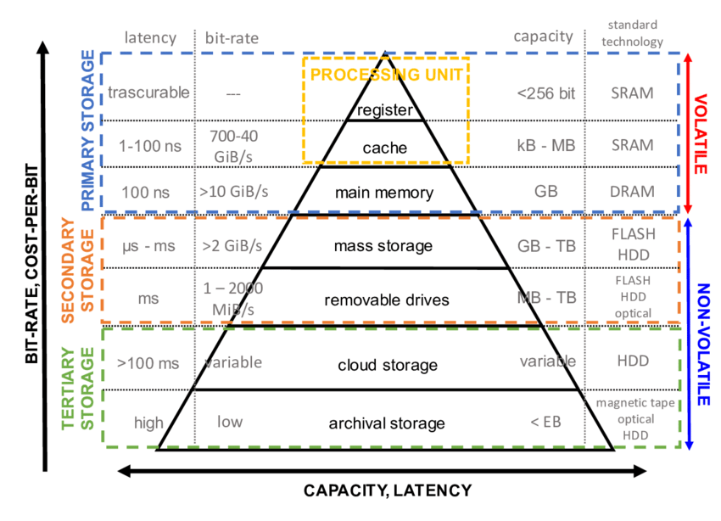
Memory Locality
Notes:
Template-WSU Hrz 201.ppt

Slide 6
Registers and Memory – Physical
Memory
  Capacitors
  Transistors
  Typical size: 10 nm
Registers
  D-Flip-Flop: modern or large-scale
  SR-Latch: legacy or small-scale
  Typical size: 5 nm
Transfer of values from memory to registers
  Grid of electric currents
    Word line (rows, transistor triggers)
    Bit line (columns, capacitor triggers)
  Typical size: 7nm
Human hair typical diameter: 80k nm
https://www.youtube.com/shorts/odx5NLbYz8g
Notes:
Template-WSU Hrz 201.ppt

Slide 7
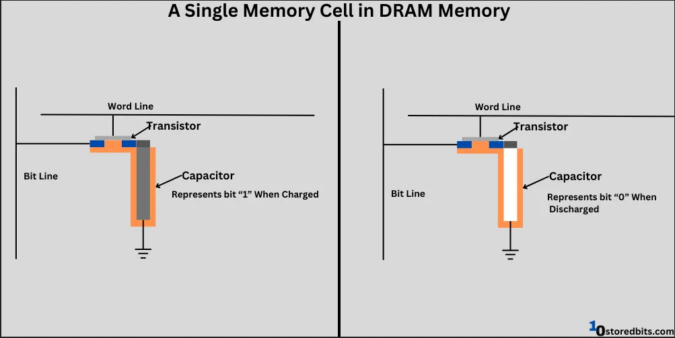
Notes:
Template-WSU Hrz 201.ppt

Slide 8
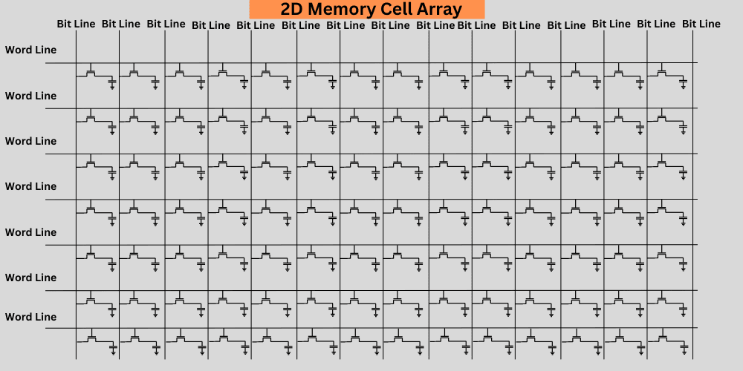
Notes:
Template-WSU Hrz 201.ppt

Slide 9
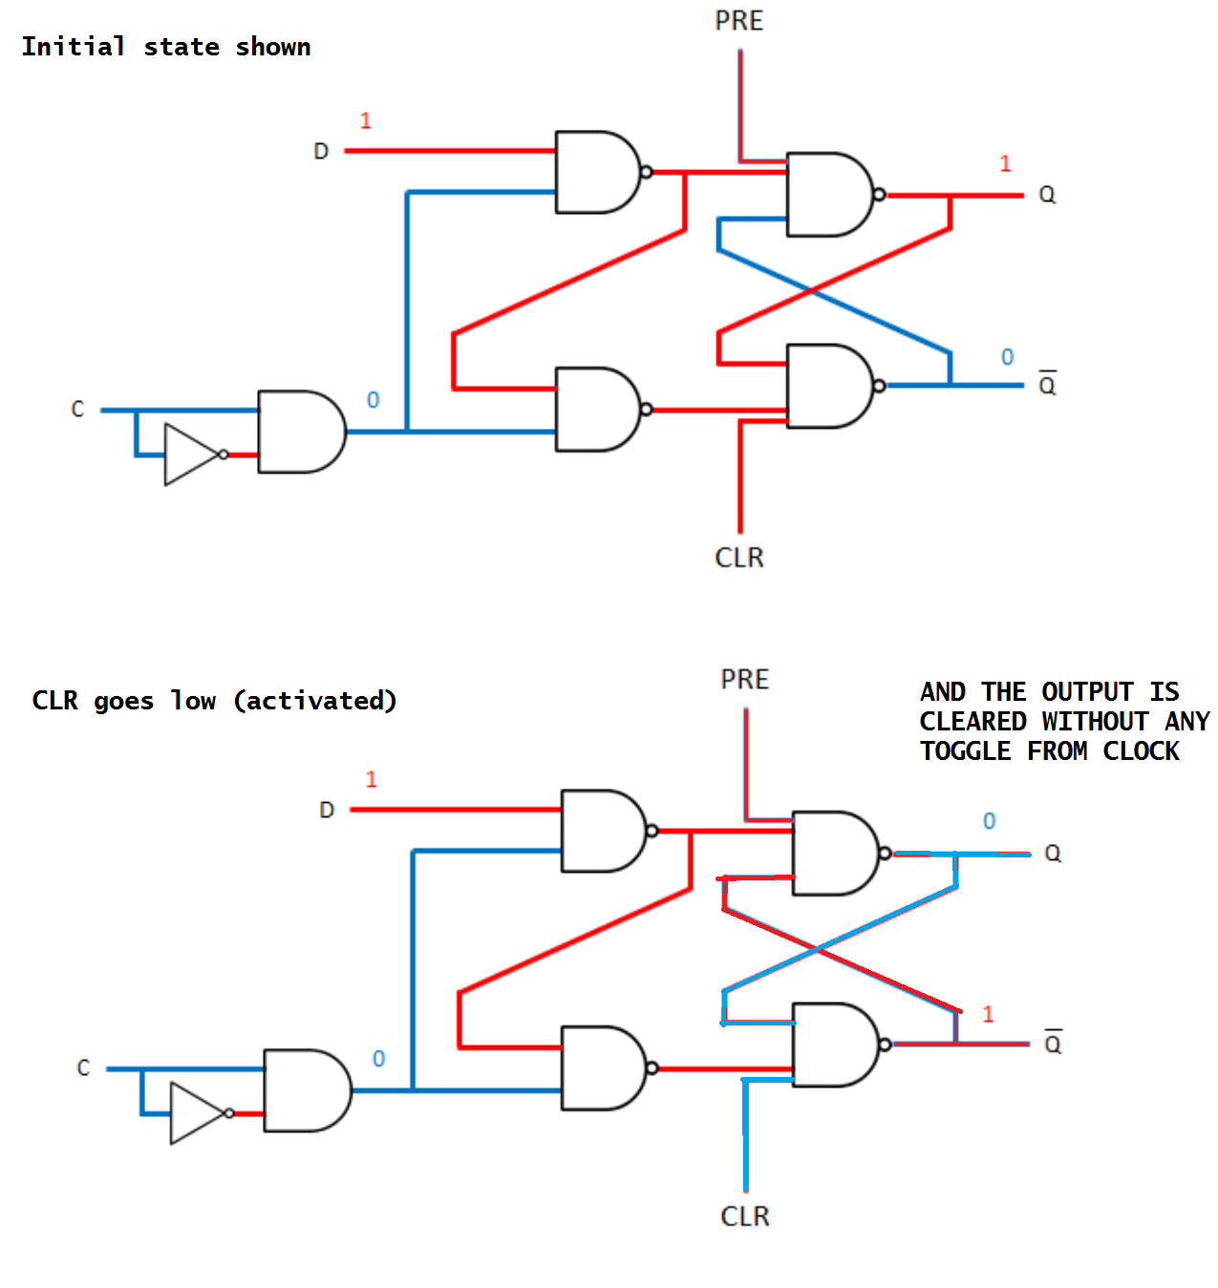
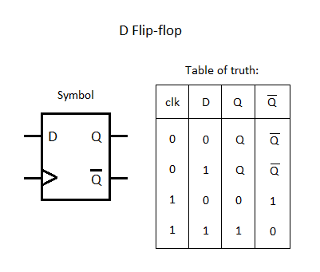
Notes:
Template-WSU Hrz 201.ppt

Slide 10
Addressing – Logical
One register has 32 or 64 flip-flops
  Each register has an address
    V: validity check bits
    D: dirty bits for tracking desyncs
    Tag: label for a specific flip-flop
    Data: bit for a specific flip-flop
Cache line
  Completely logical, not a physical module; maps memory ←→ registers
  Lines on a motherboard are called Data Paths
    Not the same as cache lines
  Cache line address is a logical address
    Tag: validity check bits
    Index: register addresses
    Offset: flag bits to identify Index
Notes:
Template-WSU Hrz 201.ppt

Slide 11
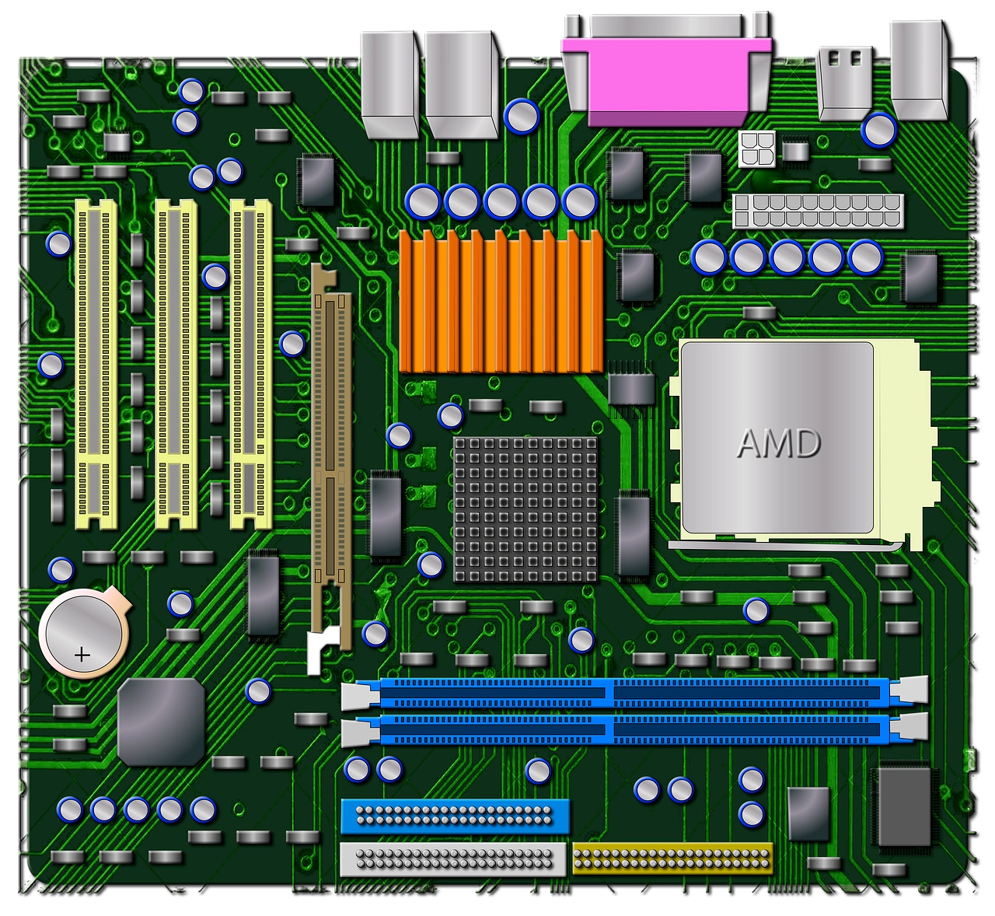
Notes:
Template-WSU Hrz 201.ppt

Slide 12
Cache Taxonomy
SRAM vs DRAM
Temporal locality e.g., sum += a[i];
Spatial locality e.g., for (i = 0; i < N; i++) sum += a[i];
Locality leverage via cache blocks, lines
Cache lines: fixed-size chunk of memory e.g., 64 bytes
  AKA blocks sometimes
  ‘Blocks’ can also mean other things
Cache hit, hit rate
Cache miss, miss rate
  Miss penalty: time to fetch from lower level
Notes:
Template-WSU Hrz 201.ppt

Slide 13
Cache Types
Types (Memory block ←→ cache lines)
  Direct-mapped: one block ←→ one line
    Simple, cheap, fast; high miss rate
  Fully associative: one block ←→ any number of lines
    Complex, expensive, slow; very low miss rate
  Set-associative: register divided into sets
    2-way: 2 cache lines map to one block
    4-way: 4 cache lines map to one block
    …
    Hybrid of direct and fully associative
Notes:
Template-WSU Hrz 201.ppt

Slide 14
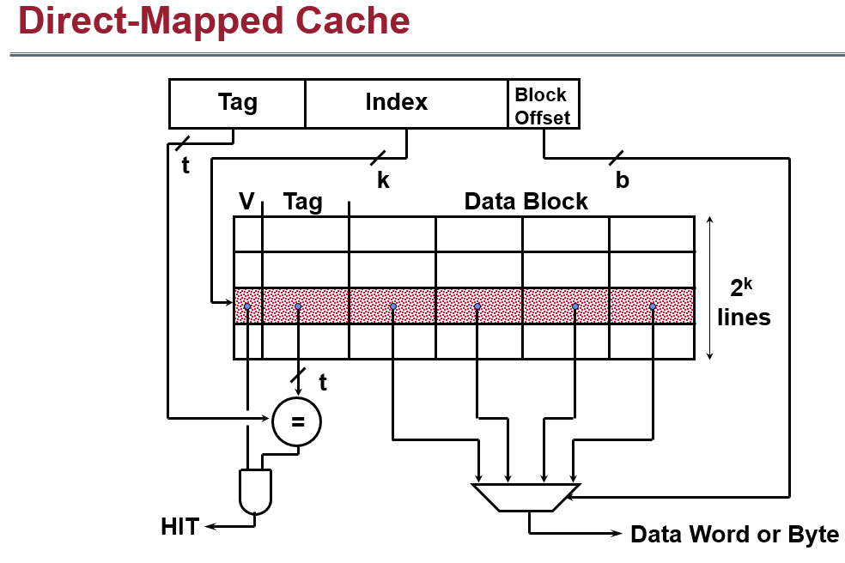
Notes:
Template-WSU Hrz 201.ppt

Slide 15
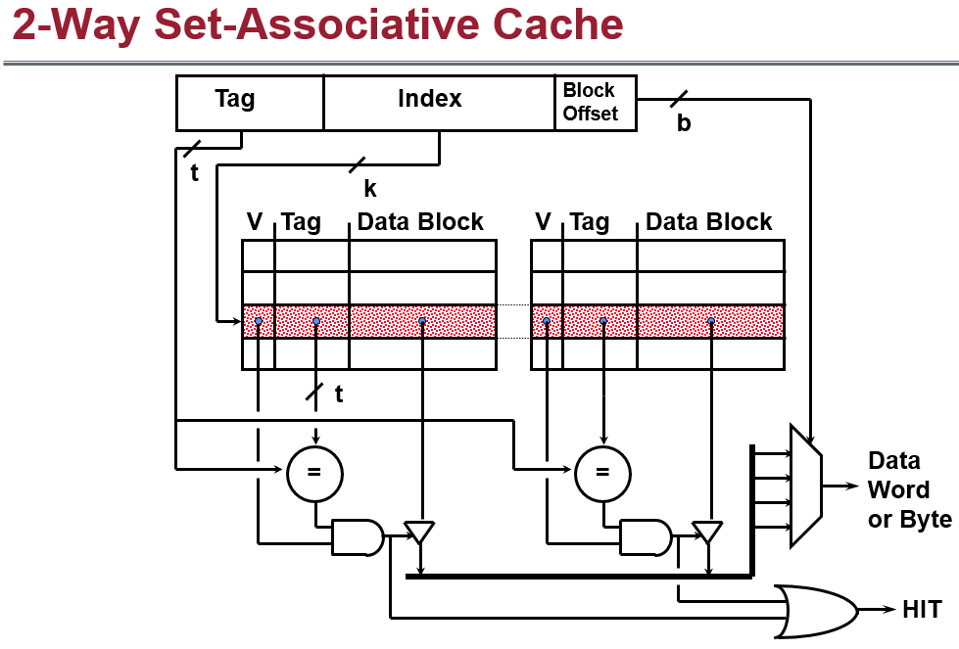
Notes:
Template-WSU Hrz 201.ppt

Slide 16
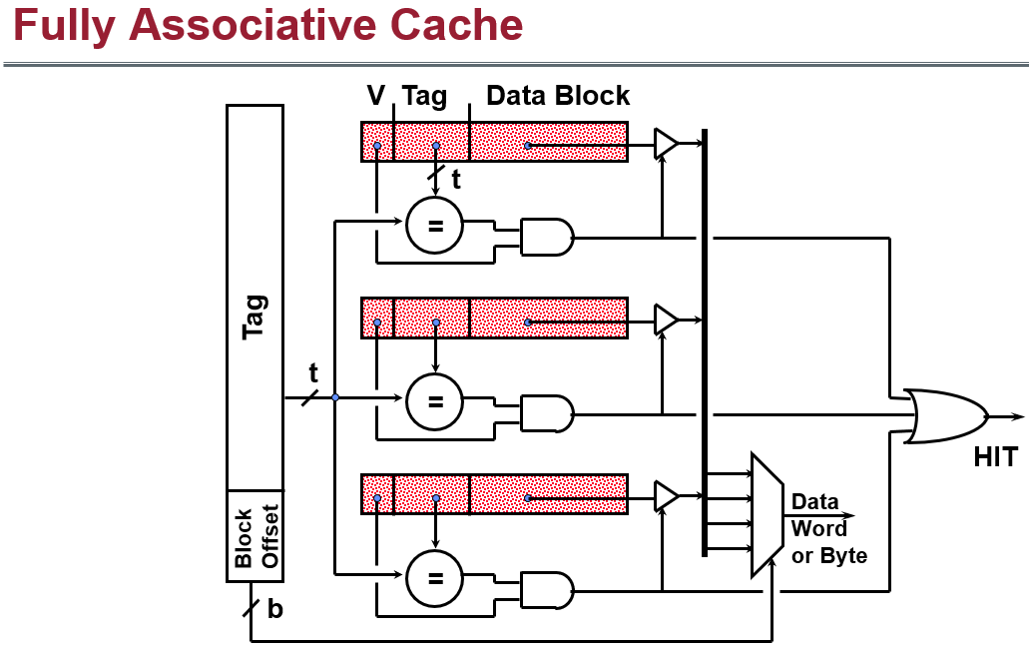
Notes:
Template-WSU Hrz 201.ppt

Slide 17
Cache Replacement Policies
When a line is full and a new block must be loaded
What to do?
LRU: Least Recently Used
  Temporal locality but costlier
FIFO
  Spatial locality, cost in-between
Random
  Cheapest but no locality
Notes:
Template-WSU Hrz 201.ppt

Slide 18
Cache Write Policies
When writing to cache, to update the memory or not?
Dozens of write policies
Two popular
  write-through: when writing to cache, update memory immediately
    Memory in-sync with cache, simple
    Slow writes
  write-back: when writing to cache, do not write to memory
    Memory is updated later before a line is evicted
    Faster writes
    Memory de-synced with cache, complex
      Additional bits needed to track memory-cache desyncs
        ‘Dity bits’ → higher space complexity
Notes:
Template-WSU Hrz 201.ppt

Slide 19
Cache Performance Analysis
AMAT: Avg Mem Acc Time
  Hit Time + Miss Rate X Miss Penalty
Hit time: lowest unit of time taken to find a hit
  Current value
Miss rate: avg misses
  Prior value
Miss penalty: avg time for retrieving info from lower cache
  Prior value
Examples file
Tools
  Valgrind
  Dr. Memory
  Xcode Instruments applet with Leaks template
Notes:
Template-WSU Hrz 201.ppt

Slide 20
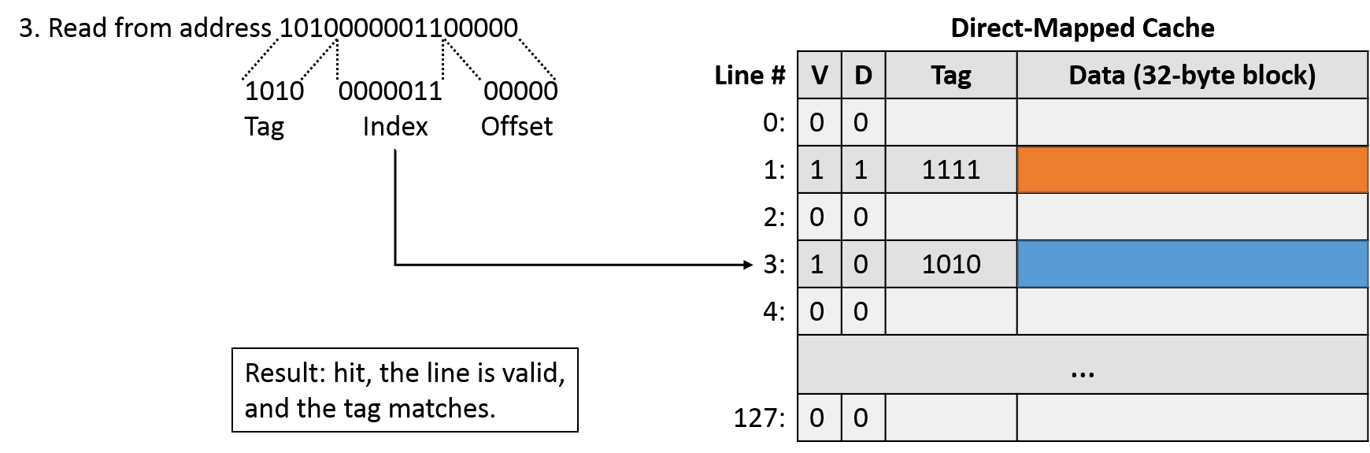
Direct Mapped Cache
Cache line (block) size: B bytes
  Total cache size: # of blocks * B
Each line stores: valid bit, tag, and data frame
Mapping: each block has a specific index
Notes:
Template-WSU Hrz 201.ppt

Slide 21
Bit Fields of Memory Addresses
Address decomposition
  C = total cache size
  B = size of each block in bytes
  A = address width
  N = total number of lines = C / B
  D = Block address = A / B
Offset bits = log₂(B)
Index bits = log₂(N)
  OR (D % N)
Tag bits = (A – offset – index)
  OR (D / N)
Notes:
Template-WSU Hrz 201.ppt

Slide 22
Bit Fields of Memory Addresses
Example #1:
  B = 16 bytes
  A = 32 bits
  N = 4
Offset bits = log₂(B) = 4
Index bits = log₂(N) = 2
Tag bits = A – offset – index = 32 – 4 – 2 = 26
Sequencing: [tag | index | offset]
Given an address 0xFFFF2462: convert to binary
0b11111111111111110010010001100010
Notes:
Template-WSU Hrz 201.ppt

Slide 23
Types of Misses
Compulsory miss
  First time a block is accessed
Capacity miss
  Working set > cache capacity
Conflict miss
  Different lines map to the same index
Hits: when an address in cache returns an expected value
  Line is valid and tag content matches
Miss: when no hits
Notes:
Template-WSU Hrz 201.ppt

Slide 24
Powers of Two, Bitmasking
Power-of-two binary number values are more efficient for hardware mapping
  Why? Binary: base 2
Bitmasking: for setting, extracting, flipping
  Bitwise AND: extract value (Value: 0101, Mask: 1111, M & V: 0101)
  Bitwise OR: set value (Value: 0001, Mask: 0100, M | V: 0101)
  Bitwise XOR: toggle / flip the value (Value: 0011, Mask: 0110, M ^ V: 0101)
Notes:
Template-WSU Hrz 201.ppt

Slide 25
Bit Fields of Memory Addresses
Example #1:
  B = 32 bytes
  A = 32 bits
  N = 8
Offset bits = log₂(B) =
Index bits = log₂(N) =
Tag bits = A – offset – index =
Sequencing: [tag | index | offset]
Given an address 0xFFF92462: convert to binary
Notes:
Template-WSU Hrz 201.ppt

Slide 26
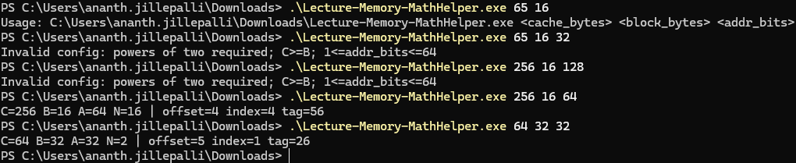
Automation
MathHelper.c
Given cache size in bytes, line size in bytes, address width in bits
  Automates checking for POW(2)
  Performs the calculations
Notes:
Template-WSU Hrz 201.ppt

Slide 27
Automation
Tracer.c
Given cache size in bytes, line size in bytes, address width in bits, trace file
Trace file containing cache addresses
  Extracts tag bits, index bits, and offset bits
Notes:
Template-WSU Hrz 201.ppt

Slide 28
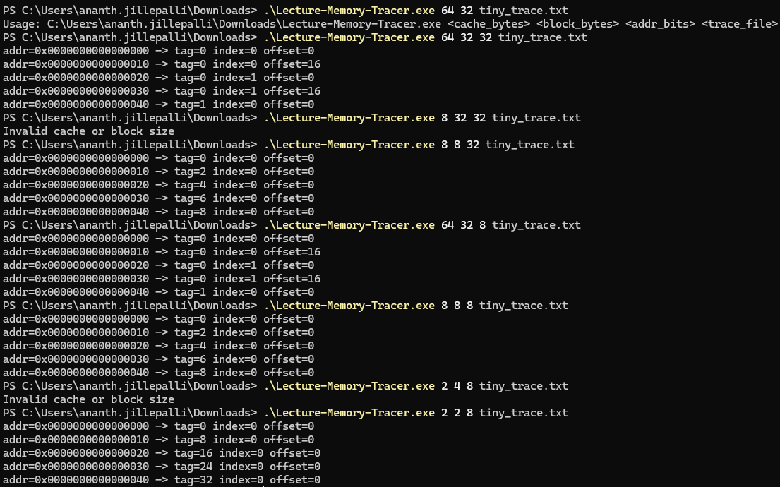
Notes:
Template-WSU Hrz 201.ppt

Slide 29
Cache Simulation
Begin with the valid bits set to 0
  If valid == 0 && tag = tag, miss
    valid++
  If valid == 1 && tag = tag, hit
Hit rate?
  (hits / accesses) * 100
Keep track of counts
  Hits
  Misses
  Accesses
Notes:
Template-WSU Hrz 201.ppt

Slide 30
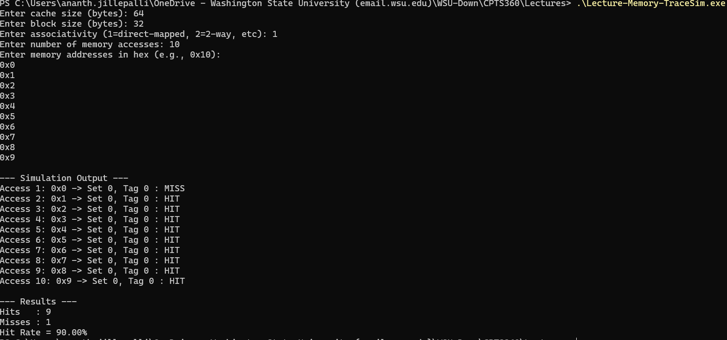
Notes:
Template-WSU Hrz 201.ppt

Slide 31
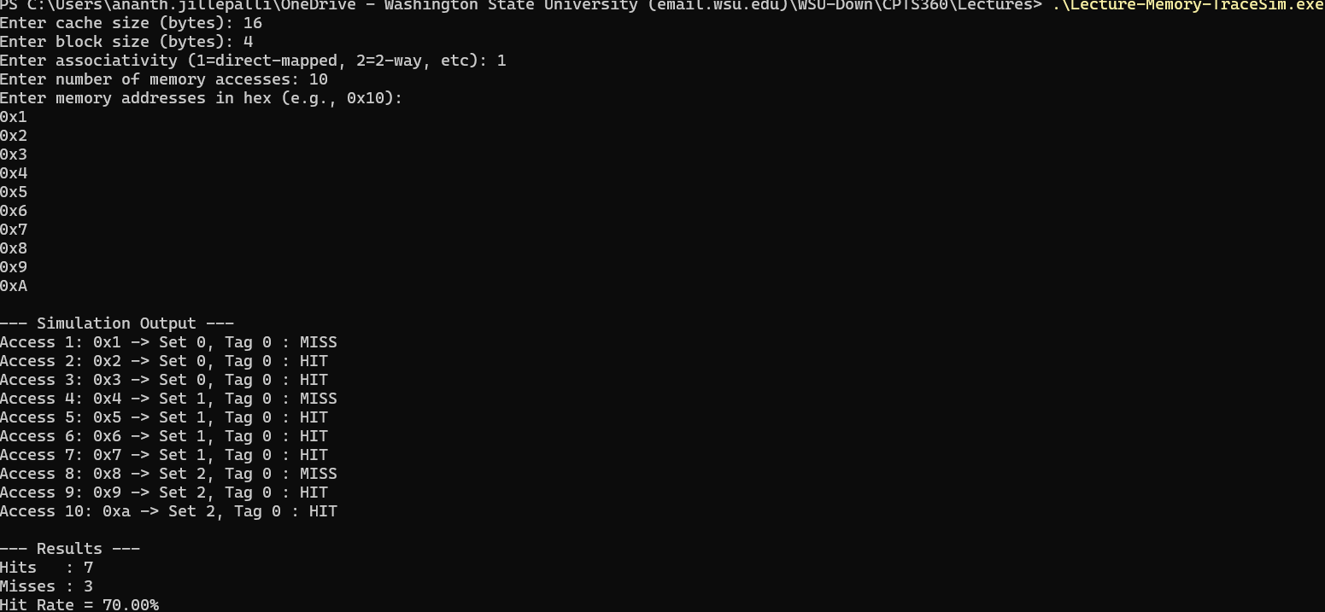
Notes:
Template-WSU Hrz 201.ppt

Slide 32


