Slide 1
CptS 360
Linking
Notes:
Template-WSU Hrz 201.ppt

Slide 2
Connection from Last Week
We started delving into memory systems
  Virtual memory lecture later in the semester
Motivation for this week
  How are programs compiled? Difference between compiling and linking?
    Compiler & assembler produce relocatable object files
      Unresolved externals → linker resolves them
        Produces an executable (sharable object)
Assignments: PA2, Project Proposal
Weeks 4 and 5
  Control of flows and processes, scheduling
Notes:
Template-WSU Hrz 201.ppt

Slide 3
Overview
Compilation pipeline
  Preprocess → Compile → Assemble → Link
  Roles of compiler, assembler, linker, and loader
ELF object files: sections, symbol tables, and relocation entries
Static libraries, link orders, and symbol resolution rules
Dynamic linking, shared libraries, and runtime loaders
Runtime library search pathing and symbol interposition
Common tools and flags
Notes:
Template-WSU Hrz 201.ppt

Slide 4
Stages of Compilation
Demystifying gcc: a driver, not just a compiler
  Executable: gcc hello.c –o hello
Preprocessor: gcc –E hello.c -o hello.i
  Macro expansion, header inclusion, comp conditionals, comment removal
  No types, no syntax checking
  Output is still C, uglier and unrefined
  Reason behind early errors when headers are missed
  Why macros can be a security threat
Notes:
Template-WSU Hrz 201.ppt

Slide 5
Stages of Compilation
Compiler proper: C → Assembly; gcc –S hello.i –o hello.s
  Parsing & type checking: syntax/type errors generated
  Optimization: dead code elimination, common subexp elimination, reordering, inlining, register allocation, …
    Can be controlled by gcc options –O0, -O1, …
  Assembly is architecture-specific (x86, x64, ARM, …)
    GNU uses AT&T syntax by default
  Compare the C code with assembly code
    Observe mapping of
      calls
      stack usage
      registers
Notes:
Template-WSU Hrz 201.ppt

Slide 6
Stages of Compilation
Assembler: Assembly → Object; gcc –c hello.s –o hello.o
  Assembly to machine code
  Produces a relocatable object file
    Executable and Linkable Format: ELF
  ELF files not executable by default
  Contains: machine code, symbol table, relocation entries
    Addresses are not final yet
    BSS: block started by symbol; stores unintialized global & static vars
    .rdata: read-only data; stores constants
    .pdata: pointer-data; stores pointers
    .xdata: external data; stores register pointers
    .data: initialized data; stores assigned vars
    .text: text data; stores program’s executable code
Notes:
Template-WSU Hrz 201.ppt

Slide 7
Stages of Compilation
    .comment: comment data; stores program’s comments
  Other symbols
    STB_GLOBAL
    STB_WEAK
    UND
    FUNC
    OBJ
Tools:
  readelf, objdump, nm
    Many options / subtools
Notes:
Template-WSU Hrz 201.ppt

Slide 8
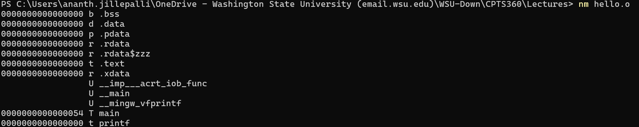
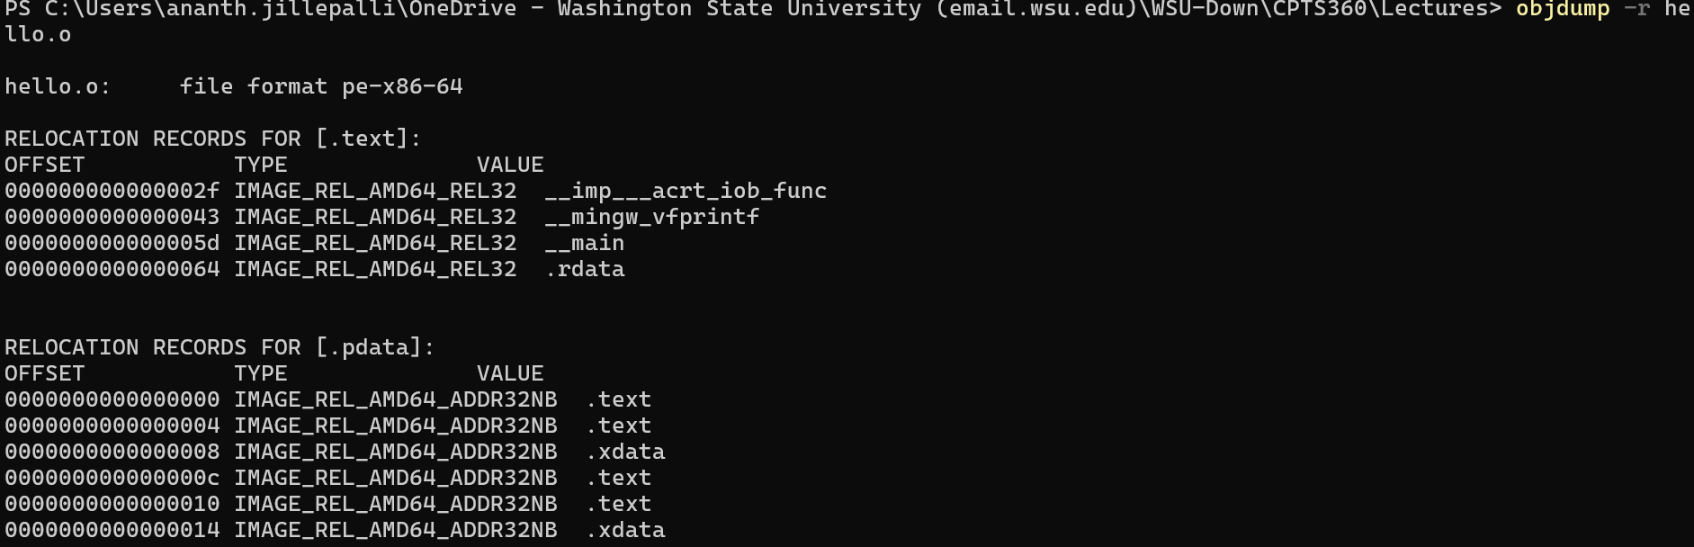
Name Mangling and Object Dumping
Notes:
Template-WSU Hrz 201.ppt

Slide 9
Stages of Compilation
Linking: Symbol Resolution & Relocation; gcc hello.o –o hello
  Match machine symbols to machine definitions
    Connect static (.a) and shared libraries (.so)
    Resolves keywords, in-built functions, …
    Can cause errors when one symbol has multiple definitions
  Fixes addresses after final layout
    Adjusts function calls and global var refs
  Object files assume they start at address 0
    Not practical, linker makes it practical
  Try:
    objdump –d hello.o
    objdump –d hello
Notes:
Template-WSU Hrz 201.ppt

Slide 10
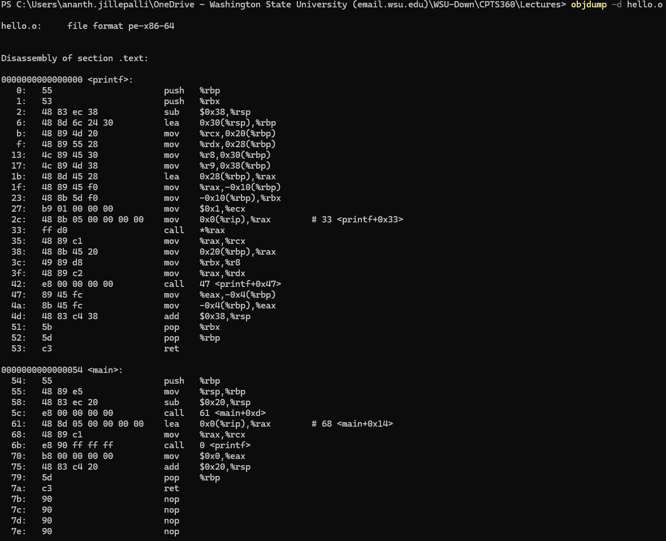
Object Dumping
Notes:
Template-WSU Hrz 201.ppt

Slide 11
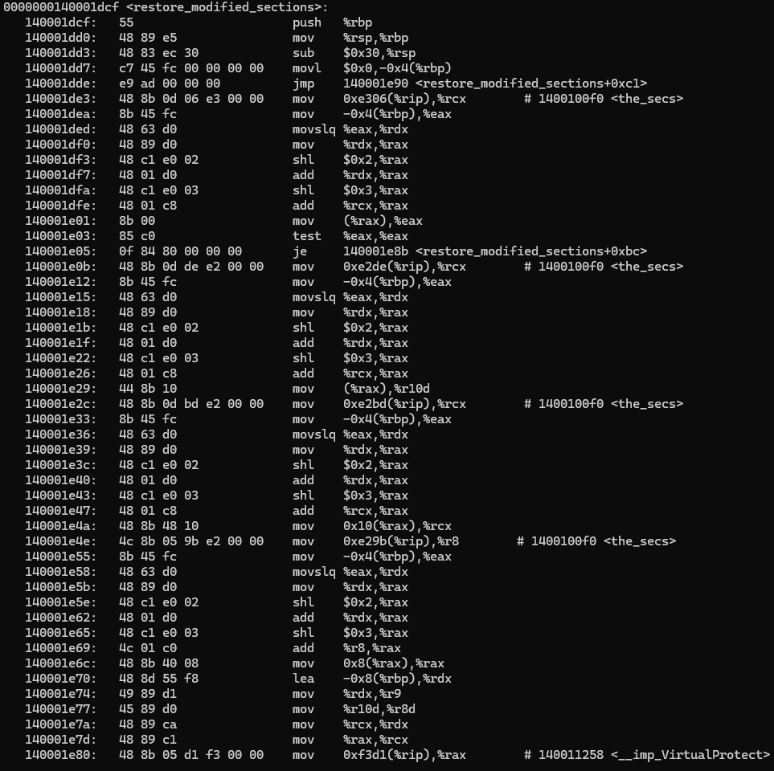
Object Dumping
Notes:
Template-WSU Hrz 201.ppt

Slide 12
Dissecting The Pipeline
Dissecting the pipeline for a modular program
  # Preprocessing
  gcc -E file1.c -o file1.i
  gcc -E file2.c -o file2.i
  # Compilation
  gcc -S file1.i -o file1.s
  gcc -S file2.i -o file2.s
  # Assembly
  gcc -c file1.s -o file1.o
  gcc -c file2.s -o file2.o
  # Linking
  gcc file1.o file2.o -o outputExe
Notes:
Template-WSU Hrz 201.ppt

Slide 13
ELF Object Types
Relocatable (.o)
  Input to linker
Executable (ET_EXEC)
  Fixed virtual addresses
Shared (.so / ET_DYN)
  Position-independent, loaded at runtime
Summary:
  Compilation is not one step
    Errors come from all steps in the pipeline
  Understanding the pipeline helps with
    Debugging
    Reasoning and Optimizing Performance
Notes:
Template-WSU Hrz 201.ppt

Slide 14
Static Linking, Libraries, and Symbols
Static library (.a)
  Pre-packaged archive of .o files
Linker ordering
  GNU: libraries should appear after objects that reference them
    Correct: gcc main.o –L. –library
    Incorrect: gcc –L. –library main.o
Symbol? Name + binding + definition
  Defines functions and global variables
  Binding: strong vs weak
    Strong binding:
      variables with an initializer; int x = 42;
      Only one strong binding allowed per variable per program
      Linker error: int x = 42; int x = 07;
Notes:
Template-WSU Hrz 201.ppt

Slide 15
Static Linking, Libraries, and Symbols
Weak binding
  Variables without an initializer
  Can be marked with the label __attribute__((weak))
  Unmarked: int x;
  Marked: int y __attribute__((weak));
  Multiple weak definition are allowed
A strong symbol overrides a weak symbol of the same name
  int x; int x = 42;
    42 overrides the uninitialized symbol
Rule of thumb practice
  Initialize everything weak;
    Strengthen as needed with assignments
  Helps manage interrupts
Notes:
Template-WSU Hrz 201.ppt

Slide 16
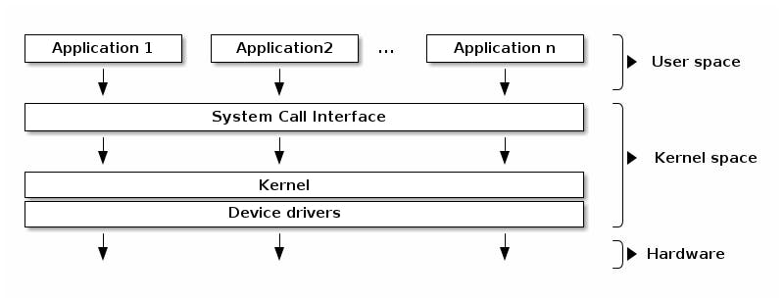
Operating System Layers
Notes:
Template-WSU Hrz 201.ppt

Slide 17
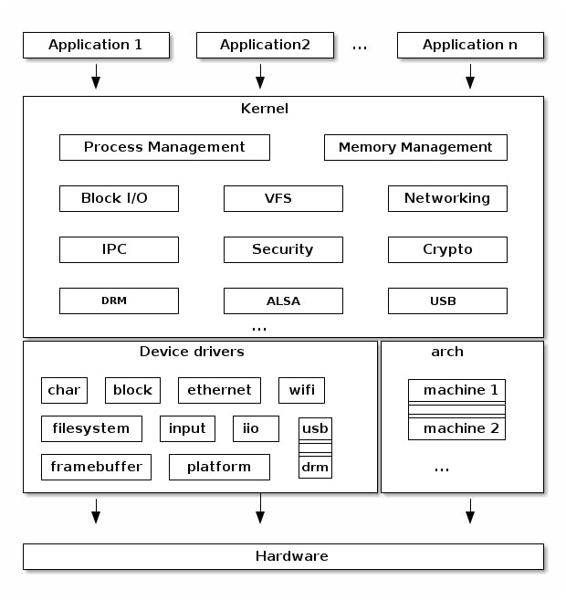
Notes:
Template-WSU Hrz 201.ppt

Slide 18
ASLR and KASLR
Static addressing leads to predictable addresses
  Malicious obj code can be injected into an address
  Important obj data can be exfiltrated from an address
Randomizing addressing is crucial
  ASLR: Address Space Layout Randomization
  KASLR: Kernel Address Space Layout Randomization
ASLR scrambles user-space; KASLR scrambles kernel space
ASLR scrambles once per process; KASLR scrambles once at boot-time
  Importance of rebooting once every few days
Entropy of ASLR higher than KASLR
  Due to Kernel’s memory space limitations
ASLR tries to fight against app exploits
KASLR tries to fight against privilege escalation; rootkits; bootkits
Notes:
Template-WSU Hrz 201.ppt

Slide 19
Linking: Relocation Phase
Linking: Resolution + Relocation
  Relocation moves address from one static address to another
PIC: Position Independent Code
  Code that does not need relocation
PIE: Position Independent Executable
  Executables that do not need relocation
PIC and PIE are slower than PDC and PDE
  Sacrifice worth the security protections
Most modern Linux / Unix distros are PIC and PIE
Notes:
Template-WSU Hrz 201.ppt

Slide 20
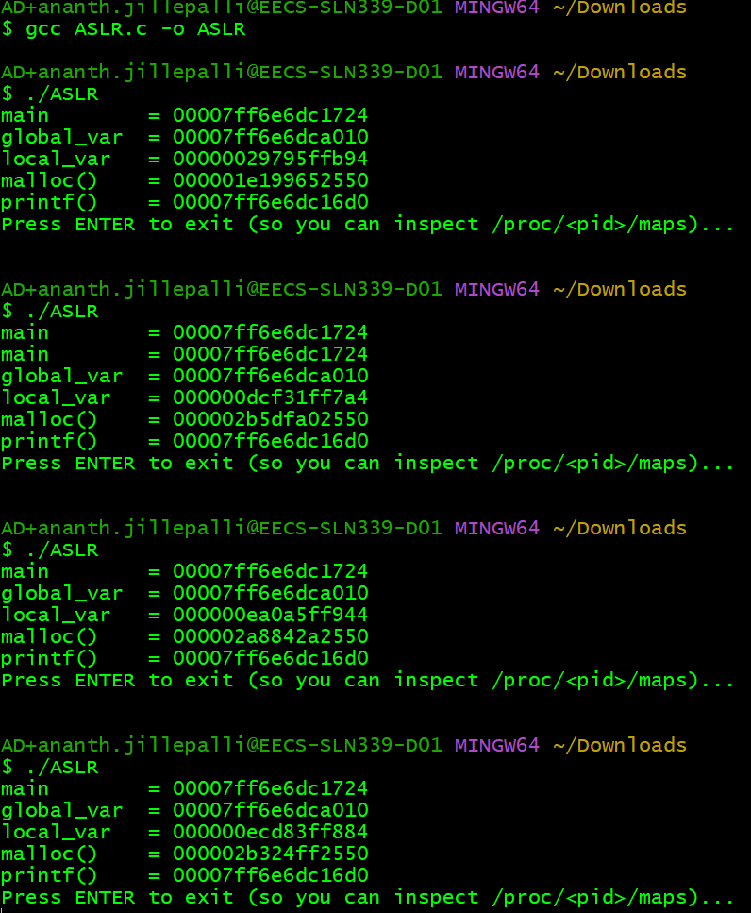
  gcc ASLR.c –o ASLR
  ./ASLR
Notes:
Template-WSU Hrz 201.ppt

Slide 21
Shared Libraries
PIC and PIE optimization mechanism
  For limiting the speed costs
Smaller binaries since code shared in memory
  Enables easier updates
Runtime dependencies
  Need libraries to run programs
App Bin Interface (ABI) stability
  Over-dependence on shared libraries freezes progress
Building a shared library
  gcc -fPIC -c greet.c -o greet.o
  gcc -shared -o libgreet.so greet.o
Notes:
Template-WSU Hrz 201.ppt

Slide 22
Shared Libraries
Link app to the shared library
  gcc use.c ./libgreet.so -o use_shared
Observe dynamic dependencies
  ldd ./use_shared
Run
  ./use_shared || echo "might fail if lib not found”
  Readelf –dW ./use_shared | egrep ‘NEEDED|RPATH|RUNPATH’
If loader cannot find the shared lib
  LD_LIBRARY_PATH=. ./use_shared
Notes:
Template-WSU Hrz 201.ppt

Slide 23
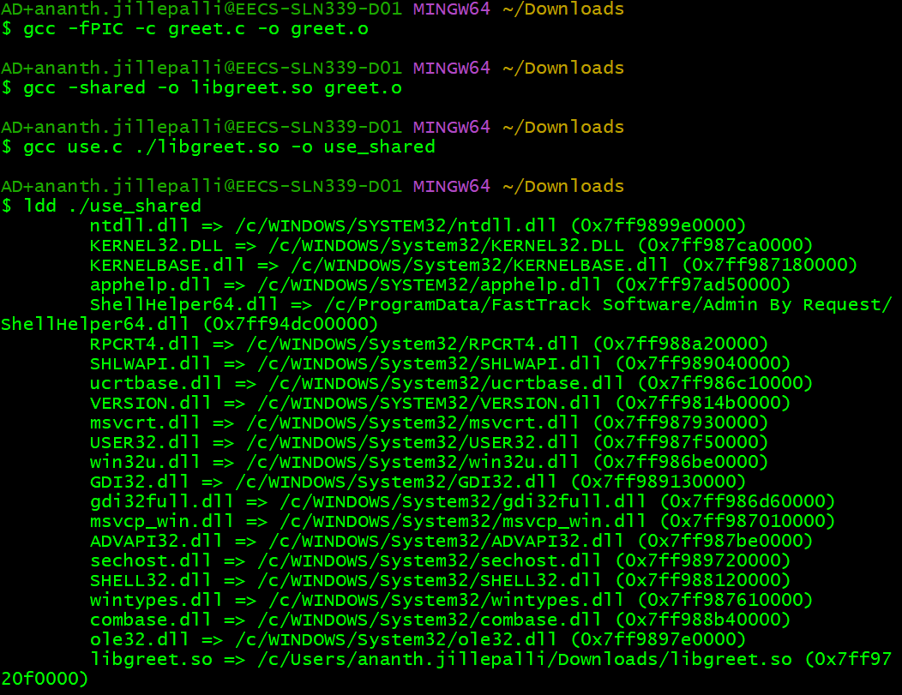
Notes:
Template-WSU Hrz 201.ppt

Slide 24

Notes:
Template-WSU Hrz 201.ppt

Slide 25
Lazy Binding and Eager Resolve
Global Offset Table (GOT): holds addresses used by PIC symbols
Procedure Linkage Table (PLT): stubs for calling external symbols
Lazy binding: first call goes through PLT stub → resolver updates GOT → PU
  Shared lib symbols resolved only when called
  Problem? Can cause crashes if dependencies turn out to be missing later
Solution?
  Eager resolve: linker resolves symbols immediately when a library is loaded
    Example: LD_BIND_NOW = 1
  Sacrifice startup speed to ensure dependencies, avoiding crashes later
Notes:
Template-WSU Hrz 201.ppt

Slide 26
Lazy Binding and Eager Resolve
objdump -d ./use_shared | less > output.txt # look for .plt and .got.plt sections
readelf -rW ./use_shared # look for JUMP_SLOT relocations
If running on MINGW, the objdump will not have .plt and .got.plt sections
Because MINGW produces PE and not ELF
Reason behind the shift in my env from MINGW to Unix
Notes:
Template-WSU Hrz 201.ppt

Slide 27
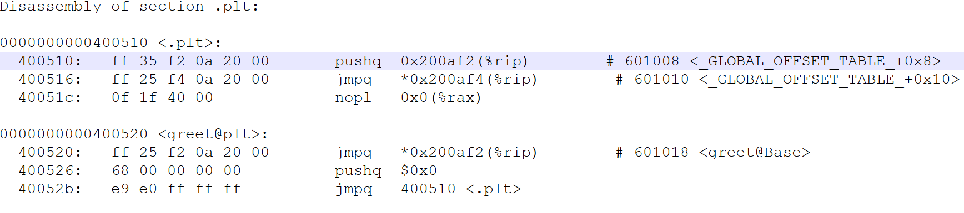
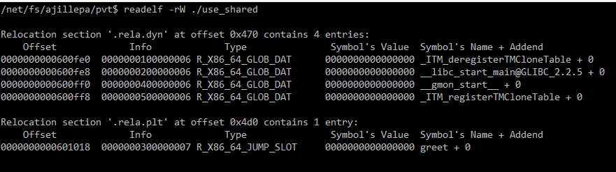
Notes:
Template-WSU Hrz 201.ppt

Slide 28
Pathing
Search order
  LD_LIBRARY_PATH: base library path
  DT_RUNPATH: for dependencies other than the one defining it
  Default system paths are OS dependent
    E.g. /lib, /usr/lib, … on unix
    PATH sysenv var on Windows
RPATH vs RUNPATH
  AKA DT_RPATH vs DT_RUNPATH
  RUNPATH is the modern replacement of RPATH
  Linkers now set RUNPATH by default
    Can still manually set RPATH
      -Wl,-rpath,<path>
      -Wl,-rpath,'$ORIGIN/../lib'
Notes:
Template-WSU Hrz 201.ppt

Slide 29
Interpositioning
LD_PRELOAD can override symbols at load time
  Useful for debugging, profiling, sandboxing
  For security, ignored for setuid / setgid binaries
Visibility: can export APIs selectively
  -fvisibility=hidden + __attribute__((visibility("default")))
    By default, hide all symbols
    Export the specific API that is calling this command
Versioning: libraries are version-sensitive
Example exercise
  gcc -fPIC -shared -o liboverride.so liboverride.c –ldl
  gcc say.c -o say
  ./say #normal
  LD_PRELOAD=./liboverride.so ./say #interposed
Notes:
Template-WSU Hrz 201.ppt

Slide 30
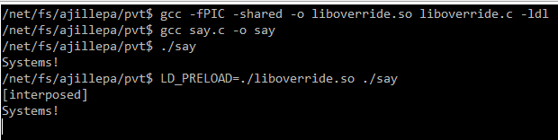
Notes:
Template-WSU Hrz 201.ppt

Slide 31
Knowledge Unit Check
Why is gcc described as a ‘driver’ rather than a ‘compiler’?
What are the four major stages of the compilation pipeline in order?
What artifacts are produced by each stage of the compilation pipeline?
What are strong and weak symbols? How do they function?
How often do ASLR and KASLR randomize addresses?
How do PIC and PIE relate to relocation?
Why do shared libraries typically required –fPIC?
How does lazy binding reduce startup times?
Notes:
Template-WSU Hrz 201.ppt

