Slide 1
CptS 360
Control
Notes:
Template-WSU Hrz 201.ppt

Slide 2
Connection from Last Week
Compilation pipeline
  Preprocessor, compiler, assembler, linker (resolution, relocation)
Motivation for this week
  How to redirect control flow without editing source?
    Excepts, signals, syscalls, … i.e., runtime redirections
    Runtime symbol binding i.e., load-time redirections
    Not limited to using conditionals or loops
Assignments: PA2, Project Proposal
Week 5
  Process scheduling, tagging
Notes:
Template-WSU Hrz 201.ppt

Slide 3
Interposition
We looked at dynamic library interposition previously
We can override symbols used by a program without recompiling
Pattern:
  Build a shared library exporting a func
  Inside the func, call another fun using dlsym
  Run target program
Used for profiling, sandboxing, debugging
Does not work for setuid / setgid binaries
gcc -O0 -Wall -Wextra victim_open.c -o victim_open
gcc -O0 -Wall -Wextra -fPIC -shared libopenlog.c -o libopenlog.so -ldl
./victim_open
LD_PRELOAD=$PWD/libopenlog.so ./victim_open
Notes:
Template-WSU Hrz 201.ppt

Slide 4
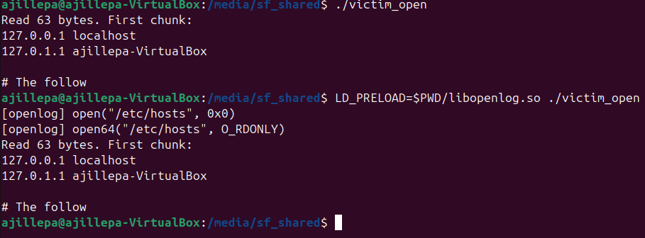
Notes:
Template-WSU Hrz 201.ppt

Slide 5
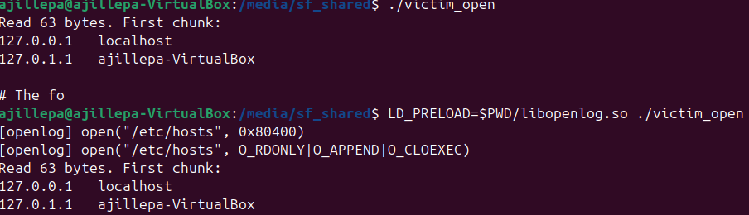
Notes:
Template-WSU Hrz 201.ppt

Slide 6
Control Flow
Where do we go next?
  Who decides?
What state must be recorded?
Enter Control Flow
  Program Counter: where do we go next? Decided by instructions
  Stack frames: what states must be recorded?
PC: Program Counter
  Holds address of the current or next instruction to be run
  EIP: Extended Instruction Pointer – 32-bit name
  RIP: Register Instruction Pointer – 64-bit name
Stack frame: records function calls
  Args, vars, regs, ret, ret addr,
Notes:
Template-WSU Hrz 201.ppt

Slide 7
Control Flow
What happens when a function is called?
  Caller: I want to run function ‘f’
  PU: save ret addr, jmp to ‘f’
  Stack: runs ‘f’
  Return: jmp bk using ret addr
Call vs Jumps
  Jmp: move to another address
  Call: jmp and ret
    ‘ret’ allows recursion, nesting, structuring
Indir calls: what if the destination is not a static addr?
  Pointers, callbacks, reference addressing, …
    Look up an address at runtime, then jmp
    E.g., call ‘f’ VS call *ptr
Notes:
Template-WSU Hrz 201.ppt

Slide 8
Layers of Control Flow
User-level: signals, …
C-level
  Beginner: if, for, while, switch, …
  Advanced: call/return, jumps, callbacks, function pointers, …
OS-level / Kernel-level: syscalls, faults, interrupts, …
System designers instrument control flow out of need
  Attackers love control flow measures. Why?
What’s the difference between changing where code runs VS
  Changing what symbol gets called?
Notes:
Template-WSU Hrz 201.ppt

Slide 9
System Calls
Sys call: jmp, ret addr, mode switch
Sys call invoking OS control
A system call transfers control from user space → kernel space
  Why need this?
    User space restrictions, code execution is limited
    Kernel space full access
  Authenticating processes is crucial
Function calls VS System calls
  User vs user-kernel spaces
  One vs multiple stacks
  One vs multiple code domains
  Caller vs OS control
Notes:
Template-WSU Hrz 201.ppt

Slide 10
Faults and Exceptions
These are triggered by the PU
  Page fault, div/0, invalid instruction, …
Sequence
  PU stops current execution
  Saves state
  Transfers control to the OS
  OS decides what to do
  Execution may resume or terminate
    Resume: warnings, dysfunctional
    Terminate: errors, crashes
Faults and excepts can occur without your program requesting
  Involuntary control flow
Notes:
Template-WSU Hrz 201.ppt

Slide 11
Interrupts and Signals
Time-based or event-based control flow
  Timer interrupts
  Keyboard inputs
  Network packet arrival
Anatomically, same as a function call
Typically
  Asynchronous
  Occurs between two instructions
  Not triggered by program behavior
  Enables: preemptive execution, multithreading
  Interrupts: hardware-initiated
  Signals: user / OS-initiated
Notes:
Template-WSU Hrz 201.ppt

Slide 12
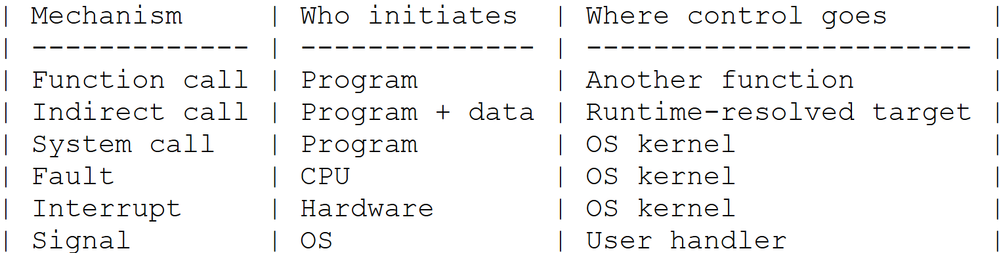
Quick Reference
Notes:
Template-WSU Hrz 201.ppt

Slide 13
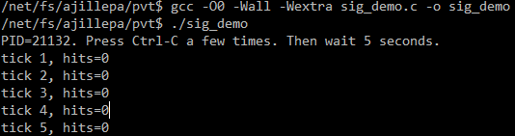
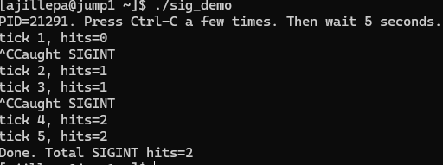
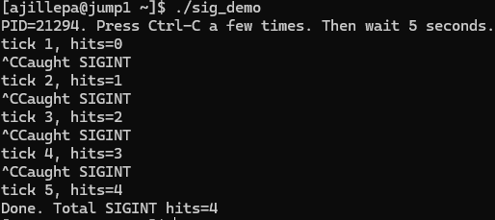
Interrupts and Signals
Notes:
Template-WSU Hrz 201.ppt

Slide 14
Interrupts and Signals
Why write() instead of printf()
  printf() assumes sequential, uninterrupted control flow
    printf() internal state can be corrupted
    Deadlocked or undefined behavior can occur
  write() is async-signal-safe POSIX call
    No global buffers, no states
sig_atomic_t
  Signal handlers typically run in the same address space as code
  sig_atomic_t is a safe comm channel between a handler and code
SA_RESTART
  Signal / Interrupts interleave calls errno = EINTR
  Some calls are restarted, not all
  ucode → syscall → signal handler → syscall resumes → ucode
Notes:
Template-WSU Hrz 201.ppt

Slide 15
API Control
Session 1 tackled async control flow via signals and runtime detours
Session will tackle hybrid control flow via fork/exec/wait, and related signals
Process lifecycle
  PID, PPID: address space
    Process ID unique to each process; Parent PID is shared by children
      PID 1 (init / systemd) and PID 0 (kernel procs) have no PPID
    ps –ef; pstree
  PID, PPID: address space
  Fork
  Execve
  Waitpid
  Graceful termination vs Zombies vs Orphans
Notes:
Template-WSU Hrz 201.ppt

Slide 16
fork() syscall
fork() creates a new child process by making an exact duplicate of parent
  Parent: process calling fork; Child: process created by fork
  Returns 0 to the child process; and the child’s PID to the parent
  Child inherits parent’s memory including file descriptors such as pointers
    Identical values initially but different locations
    Some file descriptors are shared e.g., read() or lseek()
      Modifying descriptors in child can affect parent; Vice versa
  Both parents and children can run concurrently
  Separate memory spaces and stack frames
  Hierarchy is straightforward in theory but can get convoluted in practice
  COW: copy-on-write
    Creating duplicate memory structures for all children is inefficient
    Solution: create a duplicate only when a ‘write’ occurs on child
Notes:
Template-WSU Hrz 201.ppt

Slide 17
execve() syscall
execve(): execute vector environment
replaces the current process’ image with a new program
  The new program runs within the same PID, PPID, WD, UIDs
    But has new machine code, data, heap, and stack
  Does not return to the calling process because it is the same process
    If a return occurs, it is due an error (ret: -1, code stored in errno)
  How is this different from forking?
    Does not create a new process
  Often used with forking
    Forking creates a child; Execve loads a new program into the child
  Several other execute syscalls
    execl, execle, execlp, execvp, execv, …
Notes:
Template-WSU Hrz 201.ppt

Slide 18
waitpid() syscall
waitpid: suspends parent execution until a specific child changes state
The state changes can be termination, resumption, pausing, …
Store’s child’s status in a specified integer pointer (status_ptr)
Return options:
  PID of the child that changed state
  -1: an error occurred (e.g., ECHILD error if no children)
  Signal: if interrupted: SIGTTIN, SIGCONT
How to prevent parent from hanging?
  WNOHANG flag
  Suspends parent to check on a child, not wait for a state change
    Returns 0 if no change, PID of child if state change
Common statuses
  WIFEXITED: true if the child died normally
  WEXITSTATUS: returns the exit code of the child
  WIFSIGNALED: true if the child was killed by a signal
Notes:
Template-WSU Hrz 201.ppt

Slide 19
Fate of Processes
Graceful termination
  Execution completed
  Process table entry removed; Process resources freed
  Parent process exists (PPID 0 or 1 always on)
Zombification
  Execution interrupted or partially completed
  Process table entry remains
  Some process resources still used, including PID
  Parent process exists but inactive
  How to cure zombies? Kill (reap) them
Orphaned
  Execution incomplete and underway
  Process table entry remains
  All resources still used, including RAM, compute nodes
  Dead parent; How to fix? PID 1 (init) adopts, PID 1 kills (reaps) the child
Notes:
Template-WSU Hrz 201.ppt

Slide 20
Fate of Processes
Process Lifecycle Demo
gcc -O0 -Wall -Wextra proc_demo.c -o proc_demo
./proc_demo
./proc_demo --zombie
ps -o pid,ppid,state,comm -p <PARENT_PID>,<CHILD_PID>
./proc_demo --sigchld
Notes:
Template-WSU Hrz 201.ppt

Slide 21
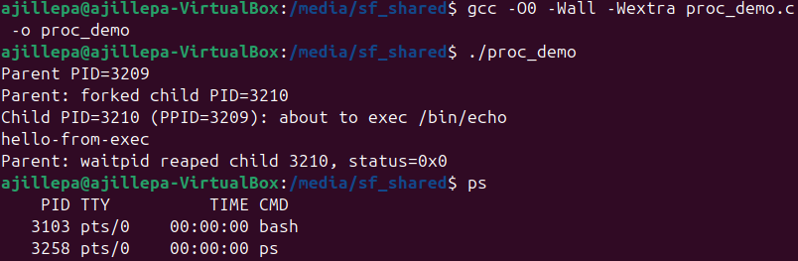
Process Lifecycle Demo: Graceful Termination
Notes:
Template-WSU Hrz 201.ppt

Slide 22
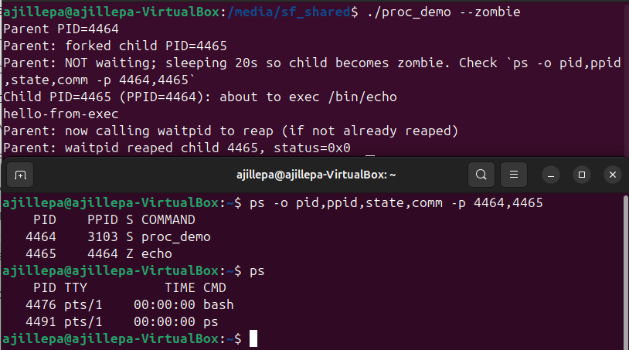
Process Lifecycle Demo: Zombie and Reaping
Notes:
Template-WSU Hrz 201.ppt

Slide 23
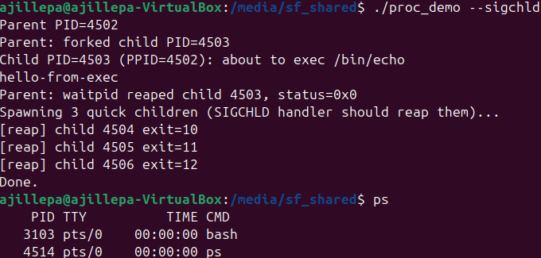
Process Lifecycle Demo: Orphan Reaping
Notes:
Template-WSU Hrz 201.ppt

Slide 24
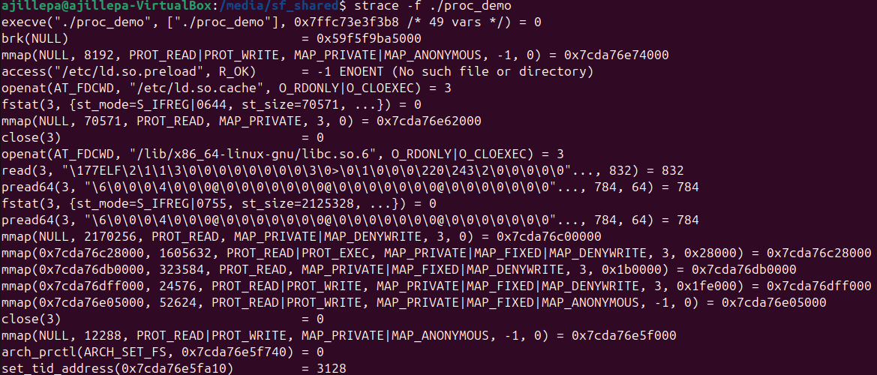
execl () vs execev ()
Notes:
Template-WSU Hrz 201.ppt

Slide 25
Observations
Process groupings
  Foreground, background; shells send SIGINT to foregrnd to alert users
Several signals can be used to control
  SIGTSTP, SIGQUIT, SIGINT, …
  SIGSTOP vs SIGTSTP
    SIGTSTP can be handled or ignored by the process
    SIGSTOP cannot be handled or ignored
    Both pause/suspend the process, can be resumed
  SIGCHLD not the only reaper signal
  SIGCHLD can kill, but also kill() syscall
  SIGTERM: graceful termination, cleanup, kill() syscall signal
    Can be handled or ignored by the process
Notes:
Template-WSU Hrz 201.ppt

Slide 26
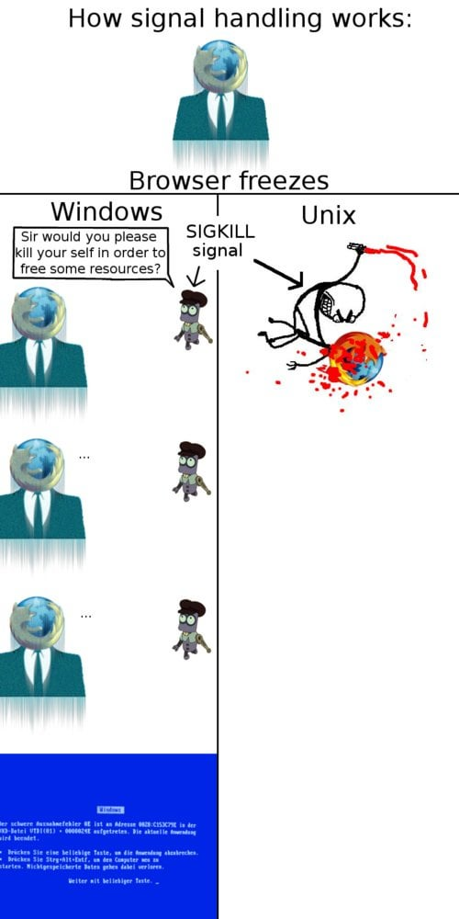
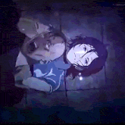
SIGKILL
Notes:
Template-WSU Hrz 201.ppt

Slide 27
Overview
This week
  Control flow and processes genesis, dynamic loading, interposition, …
Next week
  How does the scheduler work on Unix systems?
    Identify ownership UID/GID for users and groups
    State tracking: running, sleeping, …
    Resource accounting, process metadata
    Priority of termination, scheduling class / policy (conceptual)
      How does the OS decide what to do after a process is terminated?
Notes:
Template-WSU Hrz 201.ppt

Slide 28
Announcements 2/5
Address: width or value? Depends on context
  Want to compute the lengths of TIO? Width
  Want to compute the contents of TIO? Value
PA2 is a cache simulator, not an actual cache
  We are not accessing any real cache values
  Creating a fake cache line that is not mapped to a register line
  Discord channel has additional help/guidance
PA1 grading: agreed that stress tests are too strict with formatting
  Requested TAs to not apply any penalties if >10/20 tests pass
  0.15 (5%) penalty if <10/20 tests pass
  Late penalty 10% per day, capped at 30%
Last session: some syscall flags were not deciphered correctly
  Fixed the issue
Anything other items?
Notes:
Template-WSU Hrz 201.ppt

