Slide 1
CptS 360
Scheduling
Notes:
Template-WSU Hrz 201.ppt

Slide 2
Connection from Last Week
Control flow
  Signals, fork/exec/wait, interposition, …
Motivation for this week
  How does the scheduler pick next task?
    What does the kernel know about each process?
    Which tags/metadata labels are involved?
    Resource arbitration, niceness, rlimits, cgroup, priorities, …
Assignments: Proposal, Midterm
Week 6
  Kernel Programming
Notes:
Template-WSU Hrz 201.ppt

Slide 3
Tagging and Scheduling
Kernenl’s master record
  Used for every sequence that can run on a PU
task_struct: kernel object tracks process detail
  Scheduling info; ID and perms
  Resource limits; Accounting data
  Pointers to memory, files, signals, …
Scheduling policies
  Static vs RT priorities: RT beats non-RT; RT values range from 1 to 99
  Static
    SCHED_OTHER: def, time-sharing, uses nice, preemptible, gen loads
    SCHED_BATCH: lower wakeup priority, throughput over latency, bg proc
    SCHED_IDLE: lowest priority, runs only when PU idle, cleanup tools
  RT
    SCHED_FIFO: no timeslicing, run, done, block, yield, can starve
    SCHED_RR: time slicing via quantum units, equal opportunity
Notes:
Template-WSU Hrz 201.ppt

Slide 4
Scheduling Algorithms
FIFO: First-In, First-Out
  FCFS: First-Come, First-Serve
SJF: Shortest Job First
  Shortest Job Next
STCF: Shortest Time-to-Completion First
Jobs / Process Times
  AT: time in ms that a proc arrives at the ready queue to begin exec
    AT = CT – TAT
  BT: time in ms for a proc to finish its exec
    BT = CT – WT
  CT: time in ms for a proc to have terminated
    CT = AT + WT +BT
  TAT: time in ms for a proc to finish its cycle
    TAT = CT – AT
  WT: time in ms process spends in the ready queue
    WT = TAT - BT
Notes:
Template-WSU Hrz 201.ppt

Slide 5
Tagging and Scheduling
task_struct: kernel object tracks process detail
  R: running or runnable
  S: Sleep – interruptible sleep
  D: Do not disturb – uninterruptible sleep
  T: Traced – stopped because being traced
  Z: Zombie – process has become zombified
Niceness: user-driven scheduling; values range from -20 to +19
  Being ‘nice’ means it is waiting; nice() and renice()
  Higher nice values: lower priority
  Lower nice values: higher priority
CFS: Completely fair scheduler
  Automated scheduling
  Uses red-black tree to set vruntime; smallest vruntime is prioritized
    RBT? Self-balancing BST; typically O(log n)
  CFQ: Queuing, manages I/O disk-storage requests
Notes:
Template-WSU Hrz 201.ppt

Slide 6
RBT Properties
P1: each node is either red or black (node color)
P2: the root of the tree is always black (root property)
P3: red nodes cannot have red children (red node property)
P4: every path from a node to its descendant leaves must have the same number of black nodes (black node property)
P5: all leaves are black (leaf property)
These properties ensure that the longest path from the root to any leaf is no more than twice as long as the shortest path, maintaining the tree's balance and efficient performance.
Notes:
Template-WSU Hrz 201.ppt

Slide 7
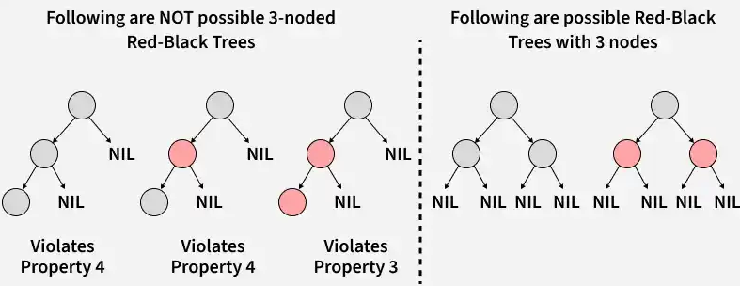
RBT Visual
Notes:
Template-WSU Hrz 201.ppt

Slide 8
PU Affinities and Resource Limits
Logical PUs are each assigned a bit
  PU affinity Bitmasks
  Enables pinning tasks to a specific PU
  Avoids contention of resources
  Enables deterministic latencies
  Enables cache locality
  sched_setaffinity, taskset
Hard and soft limits can be set per task
  Hard limit? Defines the range of soft limits
  Soft limit? Defines how many res a proc can use at most
  RLIMIT_NOFILE: max open files
  RLIMIT_CPU: max CPU seconds
  RLIMIT_AS: virtual memory
  RLIMIT_NPROC: number of correlated proc
  Can enforce limits at allocation or usage time
Notes:
Template-WSU Hrz 201.ppt

Slide 9
IDs and Groups
UID / GID: security ID tags
  cred struct referenced by task_struct
  File access, IPC perms, signal perms, …
  EUID vs RUID vs SUID; EGID vs RGID vs SGID
    Effective vs Real vs Saved-Set
      Effective changes dynamically during runtime
      Real always stays constant
      Saved-set is just effective ID saved to restore on startup
Procs belong to cgroup on the system, defines
  CPU, Mem, I/O, PID ranges,…
  Each proc has pointers linking it to a cgroup
Proc tags? A combination of all instruments
  Improperly managed process tags can lead to conflicts
  Kernels override conflicts for safety
    Leads to programs crashing
Notes:
Template-WSU Hrz 201.ppt

Slide 10
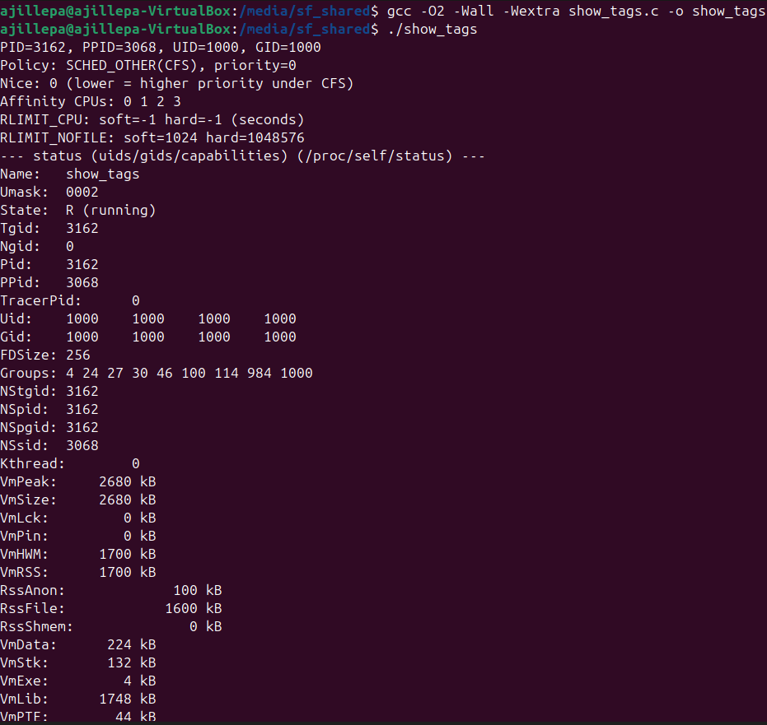
Tags Demo
Notes:
Template-WSU Hrz 201.ppt

Slide 11
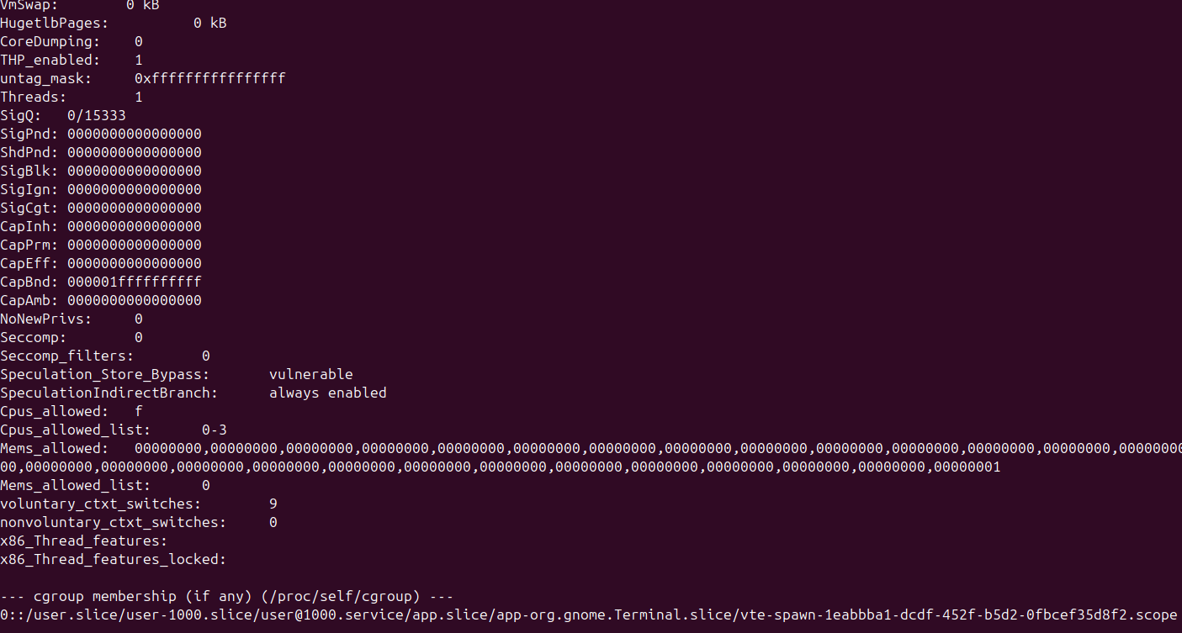
Tags Demo
Notes:
Template-WSU Hrz 201.ppt

Slide 12
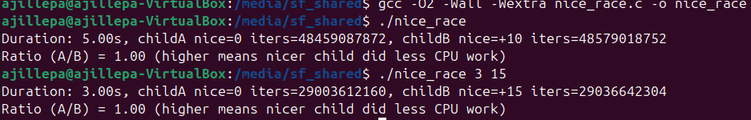
Nice Demo
Notes:
Template-WSU Hrz 201.ppt

Slide 13
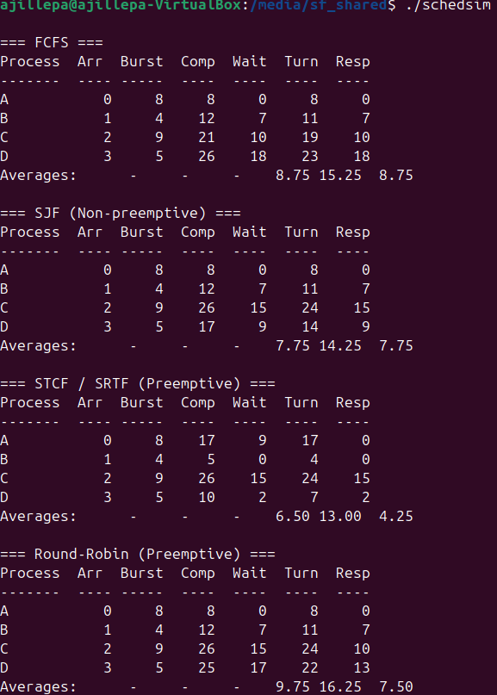
Scheduler Demo
Notes:
Template-WSU Hrz 201.ppt

Slide 14
Scheduler Workout
Unithread, Multithread, Unicore, Multicore: FCFS, SJN, STCF, RR
Notes:
Template-WSU Hrz 201.ppt

Slide 15
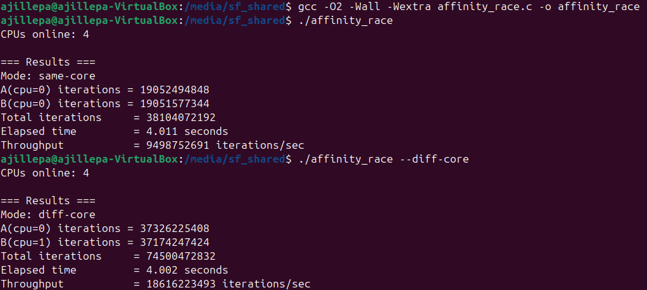
Affinities Demo
Notes:
Template-WSU Hrz 201.ppt

Slide 16
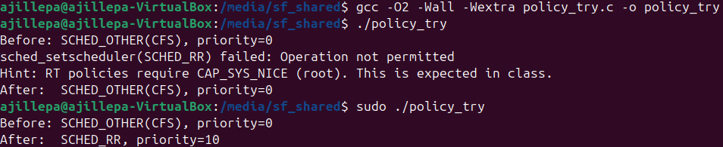
Priorities and Permissions Demo
Notes:
Template-WSU Hrz 201.ppt

Slide 17
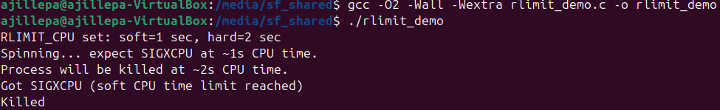
RLIMIT Demo
Notes:
Template-WSU Hrz 201.ppt

Slide 18
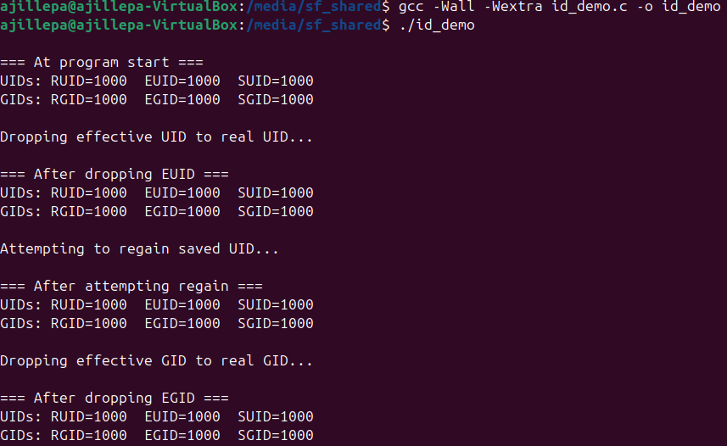
ID Demo
Notes:
Template-WSU Hrz 201.ppt

Slide 19
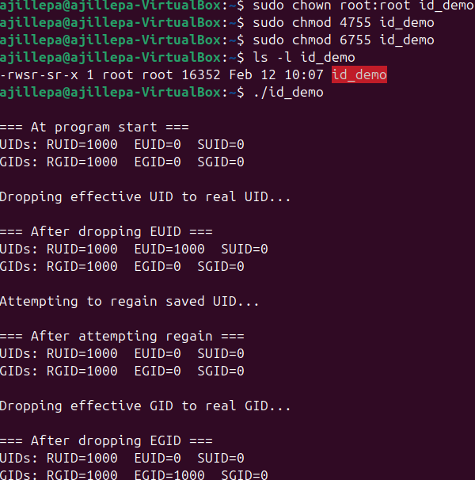
ID Demo
Notes:
Template-WSU Hrz 201.ppt

