Slide 1
CptS 360
Kernel Programming
Notes:
Template-WSU Hrz 201.ppt

Slide 2
Connection from Last Week
Scheduling
  Process tagging, kernel resource management, …
Motivation for this week
  What aspects of a program are available in user space?
    How does that differ from kernel space?
    How do we wrangle with kernel programming?
Assignments: Midterm interviews
Week 8
  Virtual Memory
Notes:
Template-WSU Hrz 201.ppt

Slide 3
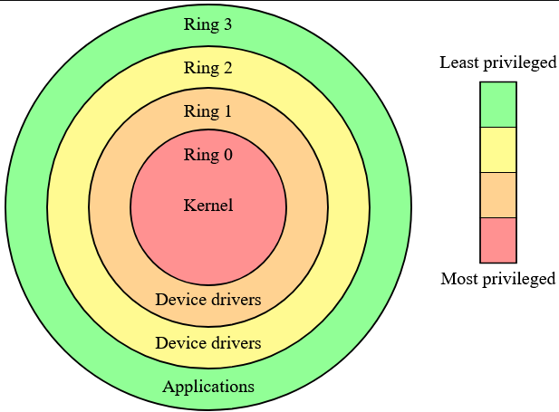
OS Rings – Traditional
Notes:
Template-WSU Hrz 201.ppt

Slide 4
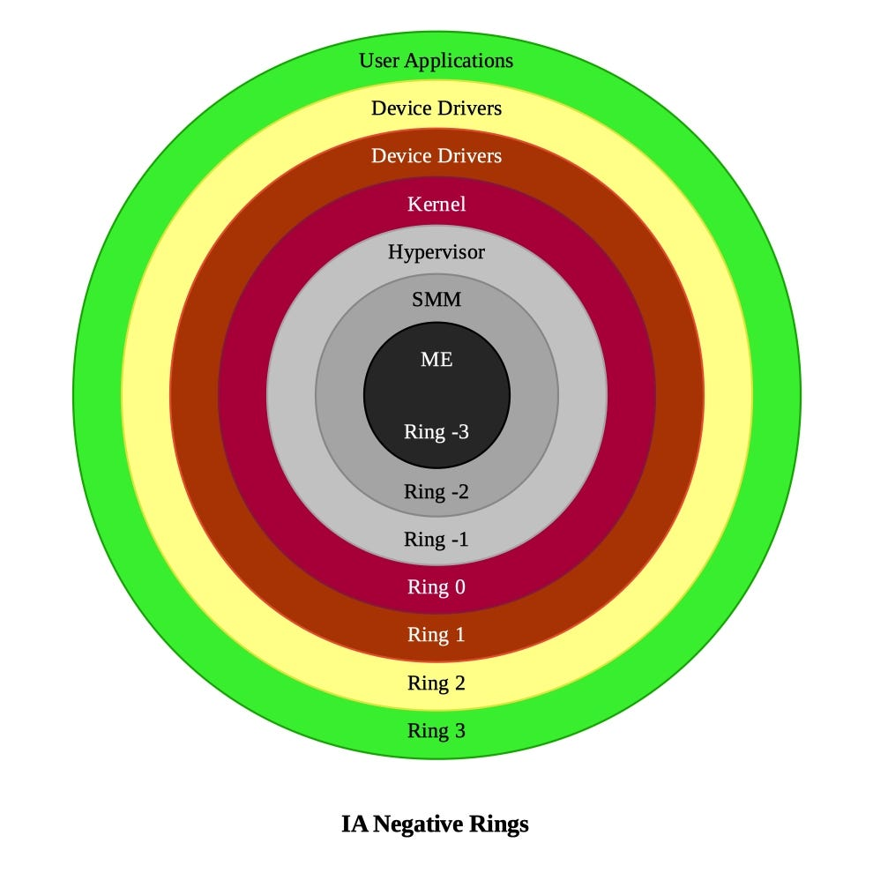
OS Rings – Modern
BIOS: not listed
ME / HME: Hardware Mgmt Engine
Platform Controller Hub
SMM: System Mgmt Mode
Sys Mgmt Interrupts
Hypervisor: “bare-metal”
These new layers allow creation of virtual machines
Not VBox-type
But rather ESXi-type
Notes:
Template-WSU Hrz 201.ppt

Slide 5
User Space
User-space AKA userland knobs
  Config params; Env vars
  Ctrl APIs; CLI flags/args
  Some sys-calls in /proc and /sys
  Enable users, sysadmins, and app devs to
    Modify the behavior of apps, libs, or user-level sys-svcs
      Without needing to modify underlying kernel code
Config params usually loaded in /etc/ or ~/.config
  Many apps have their own configs
  POSIX ulimit configs can set max file descs, stack sizes, core dumps
    Per user, some even per session
Userland knobs offer higher flexibility but lower safety
Notes:
Template-WSU Hrz 201.ppt

Slide 6
Kernel Types
Monolithic kernels
  All OS services in a high-performance addr space
    Faster execution but lower fault tolerance
  E.g., Linux, Windows XP, Unix
Microkernels
  Only essential services in a high-perf addr space
    Increased flexibility and fault tolerance but slower execution
      Due to higher IPC calls between modules
  E.g., QNX, Minix, Mach
Hybrid kernels
  Microkernel approach w/ more modules in the high-perf addr space
    Faster than micro and more fault tolerant but slower than Mono
  E.g., macOS (Unix + Mach), Windows 7+
Notes:
Template-WSU Hrz 201.ppt

Slide 7
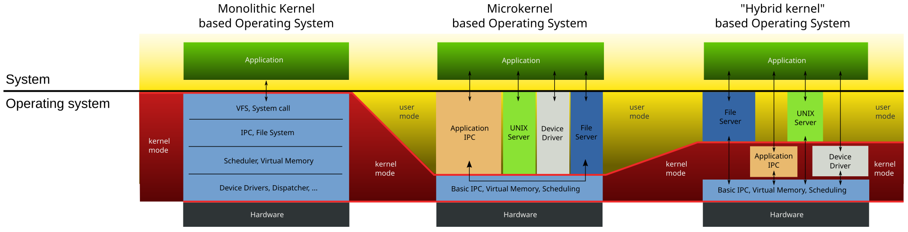
Kernel Types
Notes:
Template-WSU Hrz 201.ppt

Slide 8
Linux Intentionality
Linux intentionally remains a monolithic kernel
  Best performance and lightweight
  Simpler development → better security
    Easier to teach → used in academia
Drawbacks
  Low relative flexibility
  Low relative fault tolerance
    → not user-friendly; try changing desktop theme in Linux
Modularity issue is addressed
  Loadable Kernel Modules
    Keeps the monolithic design but loads drivers only when needed
    Adding a new Bluetooth mouse? Load BT drivers
    Loadable modules are AKA Out-Of-Tree (OOT) modules
Notes:
Template-WSU Hrz 201.ppt

Slide 9
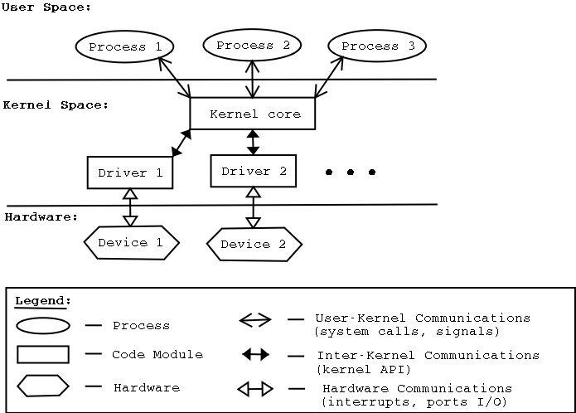
Loadable Kernel Modules (LKM)
Notes:
Template-WSU Hrz 201.ppt

Slide 10
LKM Tools
Currently loaded modules: lsmod
Want to load a module (.ko files)? insmod
Done with a module? rmmod
Don’t want to deal with dependencies during load/unload? modprobe
Pristine vs Tainted Kernels
  Pristine: default kernel; open-source; community-vetted
  Tainted: not pristine, flag can be triggered by
    P: proprietary module loaded (not open-source)
    F: module forcibly loaded (insmod -f);
    R: module forcibly unloaded (rmmod -f)
    M: machine check exception; PU reported a hardware issue
    U: Undeclared; user-requested taint
    D: Dead; kernel crashed or a panic trigger was activated
    … dozen more flags
  How to check taint status? cat /proc/sys/kernel/tainted
Notes:
Template-WSU Hrz 201.ppt

Slide 11
LKM Trade-Offs
Dynamicity: modules can be loaded at runtime
  Adapt the kernel to different hardware configs and needs
Easier updates: patch bugs or roll out updates for individual modules
Memory optimization: only the necessary code resides in memory, saving space
Security risks
  OOT modules can be closed-source
  Even open-source OOT modules may use insecure dependencies
  Malicious OOT module loaded → Game Over
    Can usually get root, unless using SELinux
Should you worry about tainted kernels?
  Not unless dealing with high-value data
Notes:
Template-WSU Hrz 201.ppt

Slide 12
LKM Syscalls & Logs
module_init(): call func when the module is loaded
module_exit(): call cleanup when the module is unloaded
MODULE_LICENSE(“GPL”): provide license
  Non-GPL licenses will straightaway taint the kernel
No main() function in LKM programs
OOT modules can be built against kernel headers instead
  OOT module must match kernel version, arch, config
Logging
  No libc → cannot use printf() printk
  Use print macros instead
  pr_emerg pr_alert
  pr_crit pr_err
  pr_warn pr_notice
  … dozen more macros
  To view logs, use the display msg dmesg tool
Notes:
Template-WSU Hrz 201.ppt

Slide 13
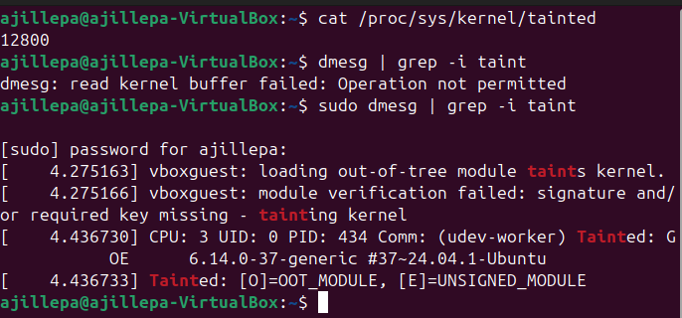
Who Among Us is Not Tainted?
Notes:
Template-WSU Hrz 201.ppt

Slide 14
LKM Demos
make –f hello_task_make
sudo insmod hello_task.ko
dmesg | tail -n 50
sudo rmmod hello_task
dmesg | tail -n 50
Make –f ktags_make
sudo insmod ktags.ko
cat /proc/ktags
renice +10 -p $$
cat /proc/ktags
sudo rmmod ktags
gcc -O2 -Wall -Wextra vm_faults.c -o vm_faults
./vm_faults 128 # 128 MB; adjust to be lower if needed
Notes:
Template-WSU Hrz 201.ppt

Slide 15
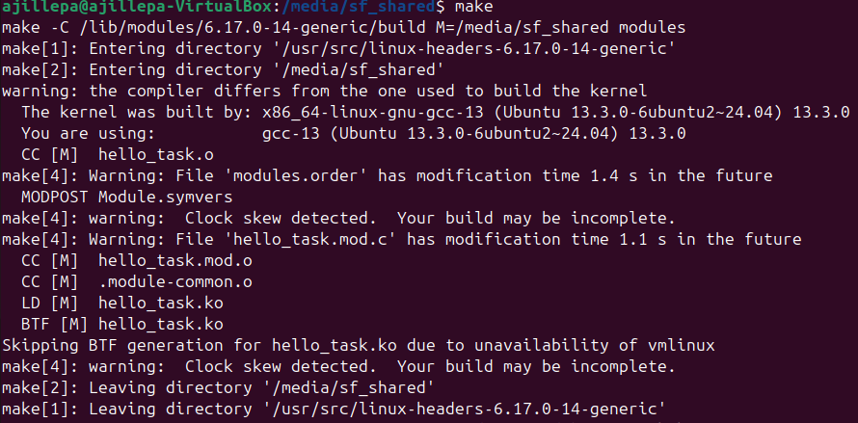
Notes:
Template-WSU Hrz 201.ppt

Slide 16
Notes:
Template-WSU Hrz 201.ppt

Slide 17
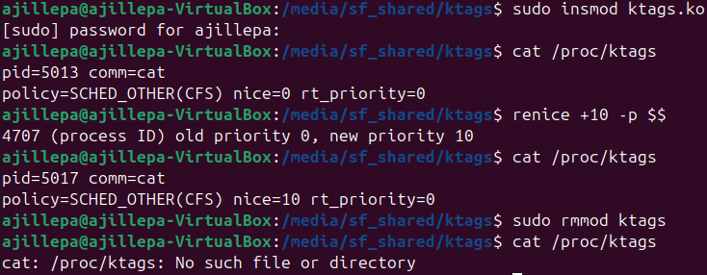
Notes:
Template-WSU Hrz 201.ppt

Slide 18
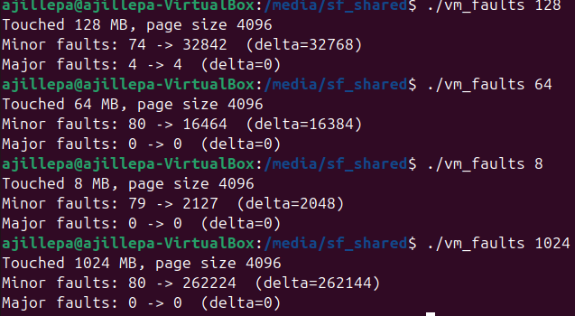
Notes:
Template-WSU Hrz 201.ppt

Slide 19
Announcements 3/3
Midterm grades released, class average: 86% (2.59 / 3)
Feedback-1: “AI-use should not impact project scope”
  Changed project demo video to project interviews
Feedback-2: “Any way to interview with people that are not staff?”
  Changed the final interview to be a peer-review system
Feedback-3: “I’m not good at interviews but I know the material”
  Added additional assignments for increased diversity of assessments
Feedback-4: Already doing well, the new assignments are a distraction
  Adjusted weights to help students who did well so far
Additional feedback always welcome
Notes:
Template-WSU Hrz 201.ppt

Slide 20


Announcements 2/17
Adjusted example projects to fit the AI-use class model
  My project was individual:
    language parser, tokenizer, compiler for C--
    One project for both 360 and 452
When I hear YACC and Bison to this day
Notes:
Template-WSU Hrz 201.ppt

