Slide 1
CptS 360
Virtual Memory
Notes:
Template-WSU Hrz 201.ppt

Slide 2
Connection from Last Week
Kernel programming
  Inserting modules, removing modules, pristine vs tainted kernels, …
Motivation for this week
  How is memory treated by operating systems?
    What are physical and virtual spaces?
    How do we manage them and the translation between them?
Assignments: EA1 (this week), PA3 (next week)
Week 9
  System-level I/O
Notes:
Template-WSU Hrz 201.ppt

Slide 3
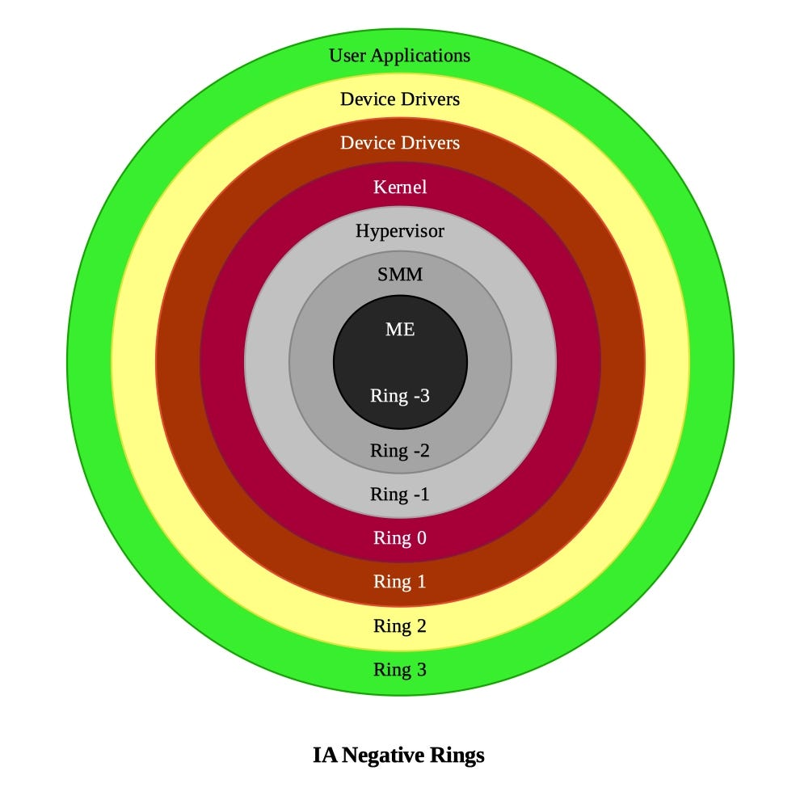
OS Rings – Modern
Typically speaking:
Rings -3 to -1 deal with Physical memory
Rings 0 can deal with both Physical and virtual memory
Rings 1 to 3 deal with virtual memory
Virtual memory?
Fabricated reality
Notes:
Template-WSU Hrz 201.ppt

Slide 4
MMU: Memory Management Unit
How does the fabricated reality of virtual memory work?
  MMU – hardware component; it’s what the apps crave
Physical memory (frames) is chunked into virtual memory (pages)
  MMU translates frames into pages, handles access control
Every user-process thinks that it has exclusive access to a block of RAM
  Enables performance and compartmentalization
    Proc A does not interfere with Proc B
Shared libraries such as libc.so exist in Physical
  Mapped to multiple virtual memories when a proc calls them
What if user procs require more memory than available in RAM?
  Demand Paging: overflows into LTS (disk storage)
Notes:
Template-WSU Hrz 201.ppt

Slide 5
Virtual Memory Address
Virtual address: VPN + Offset
  VPN: Virtual Page Number
    Location of page in virtual memory, MMU translates this to PPN
  PPN: Physical Page Number
    Location of frame in physical memory
  Offset: exact location of data in a page
MMU translates VPN to PPN via PTE
  Page Table Entries AKA Page Table
What if a PTE has no PPN for a VPN?
  Page fault → check other PTEs → found?
  Yes? Minor fault → Update the PTE
  Not found? Major fault
    Read and write from disk / LTS; slower
Notes:
Template-WSU Hrz 201.ppt

Slide 6
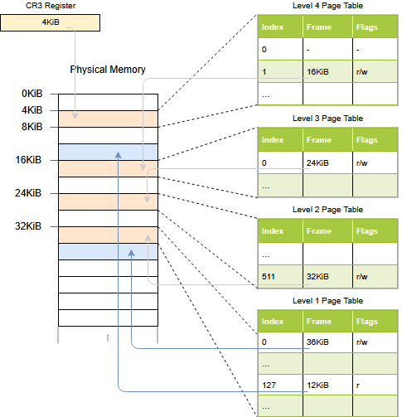
Notes:
Template-WSU Hrz 201.ppt

Slide 7
Translation Lookaside Buffer
MMU’s PTEs are stored in RAM
  If every mem access requires reading PTE, the process is slowed 2x
Solution? TLB
  Small, hyper-fast cache inside MMU
  Stores recent PTE entries (VPN ←→ PPN translations)
    Spatial locality: fast access to adjacent data
    Temporal locality: frequently accessed data translations cached
Although a cache, TLB is not the same as a regular data cache
  TLB caches PTEs and not direct data items; used for speedy addr trans
TLB reach = #TLB_Entries * page_size
  Implication? Larger page sizes increase TLB reach
Notes:
Template-WSU Hrz 201.ppt

Slide 8
Translation Lookaside Buffer
PCID: Processor-Context ID; Intel tag
ASID: Addr Space ID; ARM tag
    ARM? Advanced RISC Machine – computer architecture
These tags identify which proc owns a PTE
  Tags help PU avoid flushing the entire TLB during context switches
    Faster proc switching and improved performance
      Especially if using KPTI: U-TLb and K-TLB
Context switching? Switching PU between multiple procs
KPTI? Kernel Page Table Isolation
  Added in 2018 to enhance KASLR security
Once the TLB reaches tag limit, it is flushed
Notes:
Template-WSU Hrz 201.ppt

Slide 9
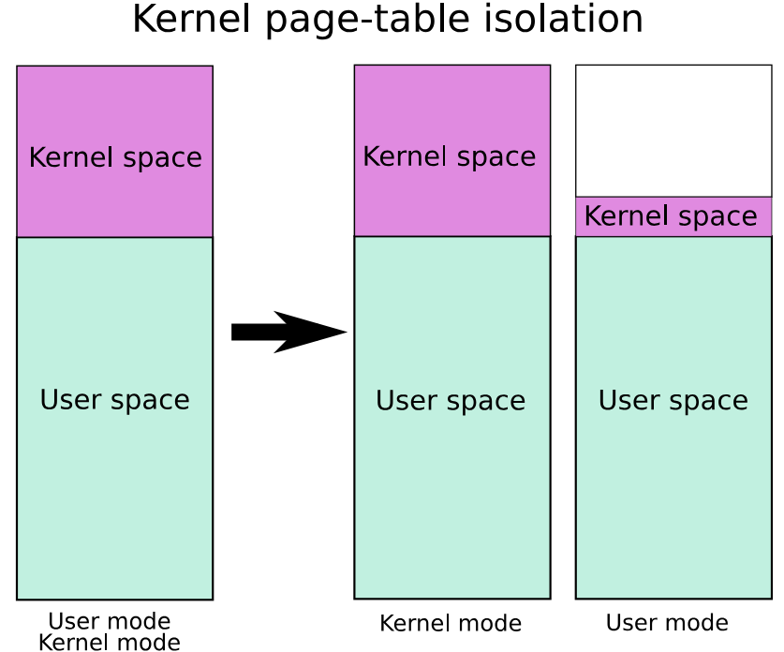
Notes:
Template-WSU Hrz 201.ppt

Slide 10
Translation Lookaside Buffer
What if a VPN misses a TLB lookup?
  Invoke HW: Hardware Walker
    Traverses the entire PTE hierarchy
    Found VPN ←→ PPN entry? Fill TLB with a new entry → Minor page fault
      TLB already at limit? Evict existing entries
        LRU, FIFO, …
    VPN not found? Trap to kernel → Major page fault
      If Virtual Mem Offset is valid
        Write to LTS / disk
    Attackers can use this to intentionally provide invalid VPNs to crash Pus
      Apply limits for kernel traps i.e., major faults
Notes:
Template-WSU Hrz 201.ppt

Slide 11
TLB Demos
gcc –O0 tlb_thrash.c –o tlb_thrash
  ./tlb_thrash 1
  ./tlb_thrash 4096
gcc –O0 tlb_stride.c –o tlb_stride
  ./tlb_stride 128 | column –t
gcc –O2 –Wall –Wextra prefault_vs_demand.c –o prefault_vs_demand
  ./prefault_vs_demand 128
Notes:
Template-WSU Hrz 201.ppt

Slide 12
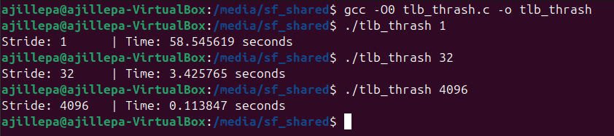
Notes:
Template-WSU Hrz 201.ppt

Slide 13
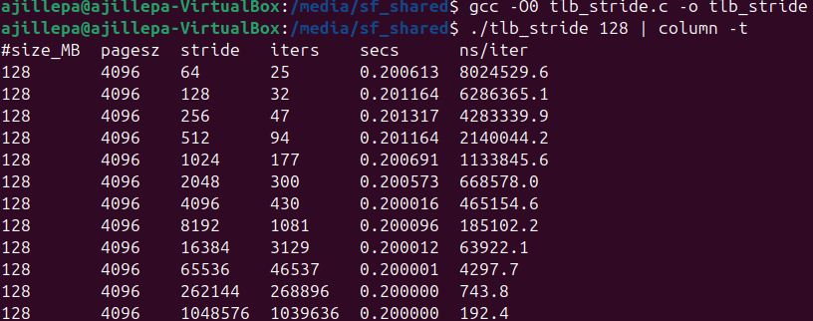
Notes:
Template-WSU Hrz 201.ppt

Slide 14
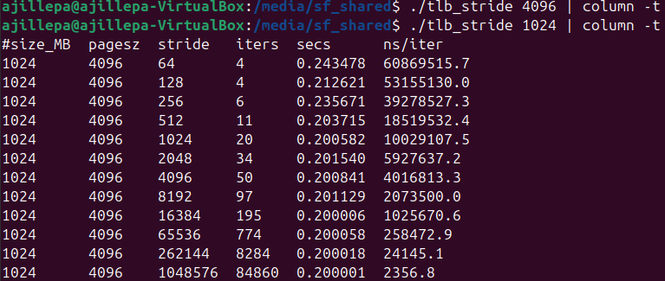
Notes:
Template-WSU Hrz 201.ppt

Slide 15
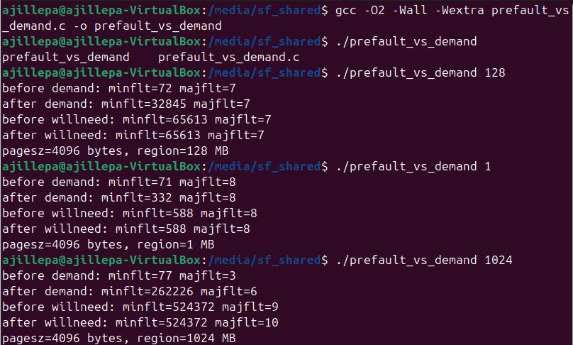
Notes:
Template-WSU Hrz 201.ppt

Slide 16
Notes:
Template-WSU Hrz 201.ppt

Slide 17
Canonical Addressing
Virtual addresses are 64-bit on x86-64 systems
  Sign extension: bits 63 to 48 (16 bits)
  PML4: Page Map Level 4 – Index – bits 47 to 39 (9 bits)
  PDPT: Page Directory Pointer Table – Index – bits 38 to 30 (9 bits)
  PD: Page Directory – Index – bits 29 to 21 (9 bits)
  PT: Page Table – Index – bits 20 to 12 (9 bits)
  Offset: Independent Addr – bits 11 to 0 (12 bits)
Canonical address standards
  000000000000-0x0000: user
  0000000000000000000000000000000000000000000000000000000000000000
  00000000-0xFFFFFFFF: kernel
  0000000000000000000000000000000011111111111111111111111111111111
Notes:
Template-WSU Hrz 201.ppt

Slide 18
Multi-Level Page Tables
Flat page tables are a problem
  64-bit system 4KB pages → millions of page tables → thousands of TLBs
Solution? Multi-level Page Tables
  Hierarchical, tree-like structure
  Only need to invoke lower-level tables when physical memory needs access
4- or 5-layer page tables
  Parsing the tables is known as ‘Page Walk’
  Control Registers help PUs manage the system
    CR0: controls the PU mode (write, read-write, write-through, …)
    CR1, 5, 7: reserved for experimentation and testing
    CR2: PFLA – Page Fault Linear Address; stores addr of proc
    CR3: virtual addressing i.e., paging
    CR4: page size extensions
    CR8: TPR – Task Priority Register; organizes interrupts via priority
Notes:
Template-WSU Hrz 201.ppt

Slide 19
CR3 and CR4
CR3: PTRP – Page Table Root Pointer
  Higher volatility i.e., frequent read-writes
  Stores Physical Address of Page Table
  Allows virtual memory management
CR4: PFEC – Page Feature Extensions Control
  Lower volatility i.e., read-writes occur on boot
  Stores bitmask of enabled features
  Allows configuring PAE and VMX
PAE: Physical Address Extension, bit 5 in CR4
  If PAE is set, CR3 writes cause PU to reload PDPTs every write
VMX: Virtual Machine Extensions, bit 13 in CR4
  Triggers VMXON, VMXOFF useful for HW-accelerated virtualization
Notes:
Template-WSU Hrz 201.ppt

Slide 20
Canonical Addressing
Typical default page size is 4 KiB = 4096 bytes
  KiB vs KB? Kebibytes vs Kilobytes
    1024 vs 1000
Some Pus support 5-level indices and larger page sizes
  LA57: Linear Address 57-bit – flag indicating 5-level paging
  Adds PML5 on top of PML4
  Triggered by setting bit 12 of the CR4 control register (CR4.LA57)
  Page size: 2 MiB to 1 GiB
  Capacity increases from 256 TiB to 128 PiB virtual, 64 TiB to 4 PiB physical
PGD: Page Global Dir
P4D: Layer-4 Page Dir
PUD: Page Upper Dir
PMD: Page Lower Dir
Notes:
Template-WSU Hrz 201.ppt

Slide 21
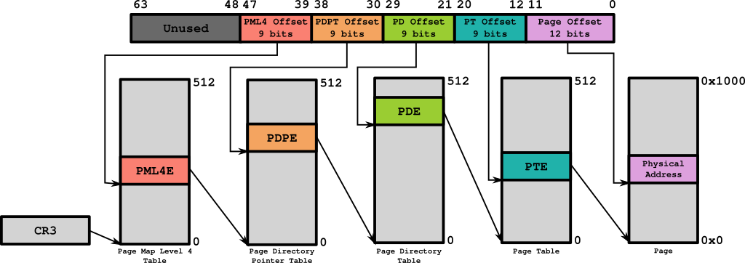
Canonical Addressing 4-Levels
Notes:
Template-WSU Hrz 201.ppt

Slide 22
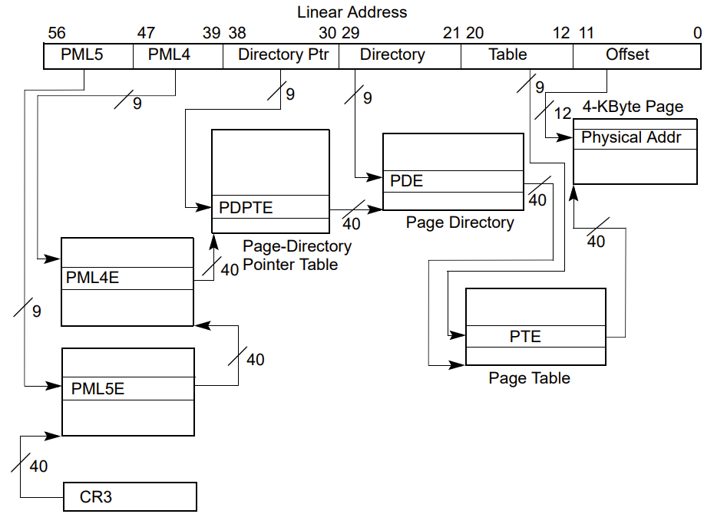
Canonical Addressing 5-Levels
Notes:
Template-WSU Hrz 201.ppt

Slide 23
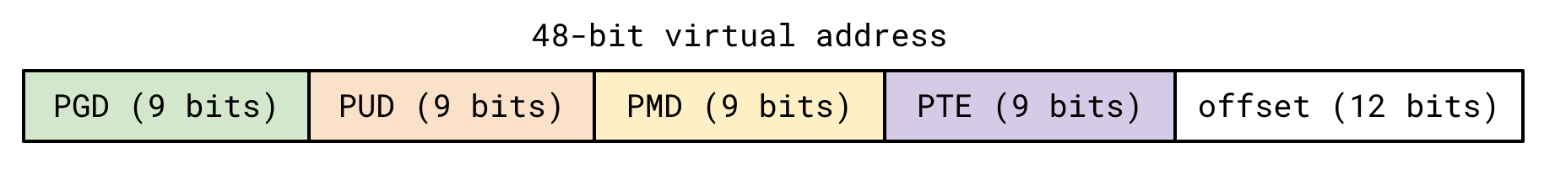
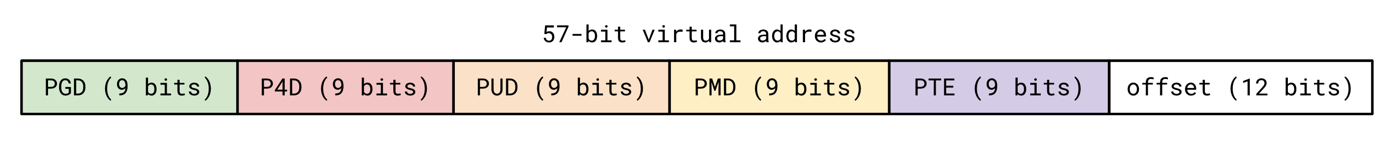
Canonical Addressing
Notes:
Template-WSU Hrz 201.ppt

Slide 24
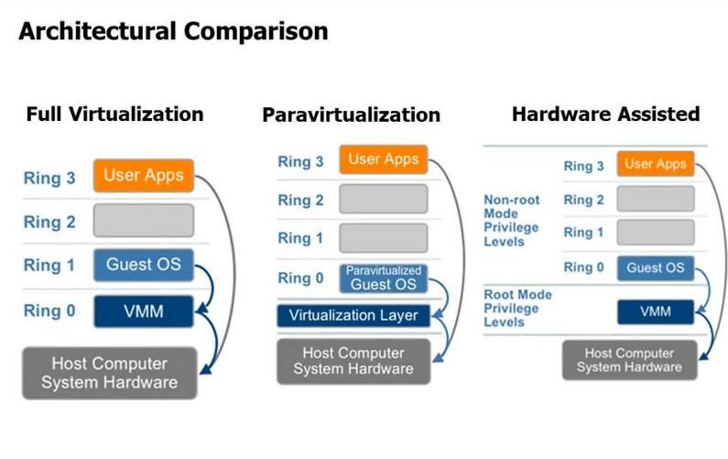
Virtualization Methods
Notes:
Template-WSU Hrz 201.ppt

Slide 25
Paging Demos
gcc -O2 -Wall -Wextra vaddr_decode.c -o vaddr_decode
  cat /proc/self/maps | head -n 3
  ./vaddr_decode 0x7fffffffdead
gcc -O2 -Wall -Wextra segv_classify.c -o segv_classify
  ./segv_acer_classify maperr
  ./segv_map_classify accerr
gcc –O2 –Wall –Wextra page_faults.c –o page_faults
  ./page_faults
Notes:
Template-WSU Hrz 201.ppt

Slide 26
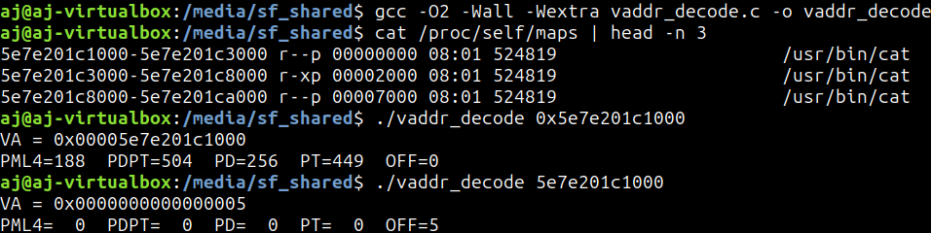
Paging Demos
Notes:
Template-WSU Hrz 201.ppt

Slide 27
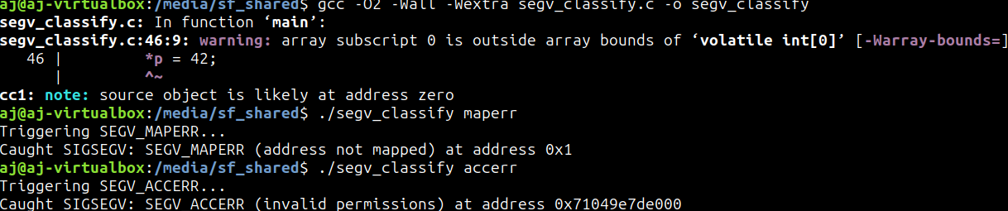
Paging Demos
Notes:
Template-WSU Hrz 201.ppt

Slide 28
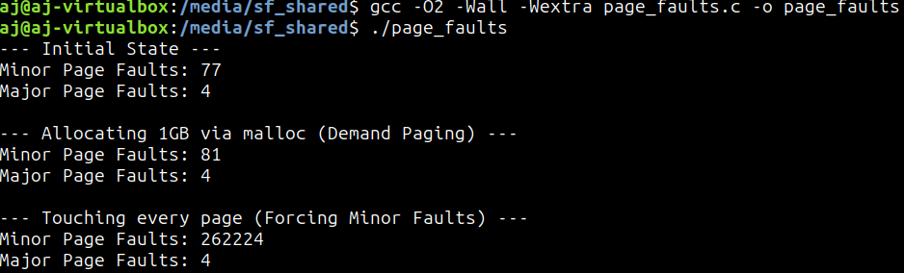
Paging Demos
Notes:
Template-WSU Hrz 201.ppt

Slide 29
Announcements 3/10
Ubuntu 26.04 LTS scheduled for release on 4/23
  Linux kernel 7
  Switching from C to Rust
What are some FOSS projects that need help?
  Find a tool that you use regularly
    Else you risk motivation falling off a cliff
  If you still want recommendations:
  Ubuntu MATE: https://bugs.launchpad.net/ubuntu-mate
  Ubuntu Unity: https://gitlab.com/ubuntu-unity/ubuntu-unity-issues/-/issues
  Lubuntu: https://manual.lubuntu.me/stable/B/Contributing.html
Begin with smaller contributions and baby steps
Notes:
Template-WSU Hrz 201.ppt

Slide 30
Announcements 3/5
Peer Interview assignments are bundled
  No credit for the ‘Interviewer’ assignment if ‘Interviewee’ is skipped
    To prevent one-way interviewing
CYA assignments
  How many issues to complete for an open-source project?
  How many jobs to apply?
  How many tasks to complete at my current tech role?
  Answer: ~11-12 hours amount of work
    Same is true for EA assignments
What should the email from supervisor contain?
  A brief description of contribution(s)
  Time spent on completing the contribution(s)
Notes:
Template-WSU Hrz 201.ppt

