Slide 1
CptS 360
File Systems

Slide 2
Connection from Last Session
System I/O
FDT, SWOFT, INT, stdio vs sysio, vector r-w, mmaps, …
Motivation for this session
(C)FS and VFS
Journaling
File extent mapping
Assignments: CYA1 (this week), PA4 (next week)
Next Session
Network Programming

Slide 3
VFS vs CFS
Dozens of file systems
ext4, NTFS, FAT32, APFS, …
How does a program run on all of them using the same base?
Kernel provides an interface layer: VFS
Virtual File System
Function pointers (struct, file_operations, …)
(Concrete) File System
Handles organizing data on a physical device
Translates VFS pointers and calls into device-specific protocols
Manages journalling
VFS can be persistent or volatile
FS is persistent

Slide 4
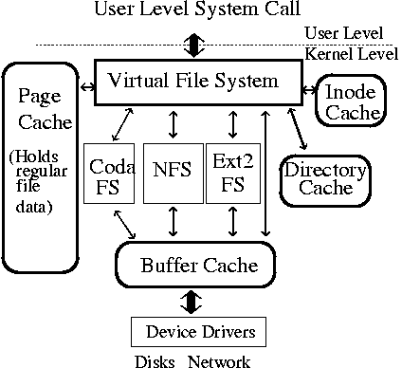
VFS vs FS

Slide 5
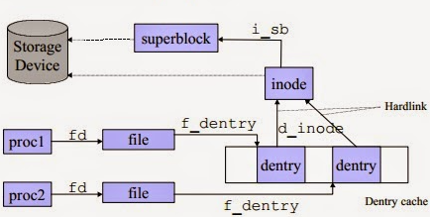
VFS Data Model
VFS components:
dentry: directory cache path
inode: INT values
file: page cache
superblock: mounted (concrete) file system
struct super_block

Slide 6
On-Disk Organization
FDT → SWOFT → INT → EXT
INT stores file size, perms, timestamps
Pointers describing where file’s data lives on a device
These pointers tie to extents in a filesystem
ext4 directories
Classic linear dirs
O(n) lookup time → slows down with many files
HTree dirs
File names are hashed
Hashed entries are stored in a tree struct
Lookup time near O(log n)
Faster lookup with many files

Slide 7
INT → EXT Mapping
Block-by-block mapping
Slow
FIEMAP: File Extent Map
Range of blocks
VFS ranges are mapped to FS ranges
fm_start: byte offset (inclusive) at which to start mapping (in)
fm_length: logical length of mapping which userspace wants (in)
fm_flags: FIEMAP_FLAG_* flags for request (in/out)
fm_mapped_extents: number of extents that were mapped (out)
fm_extent_count: size of fm_extents array (in)
fm_extents: array of mapped extents (out)

Slide 8
FIEMAP
fe_logical: byte offset of the extent in the file
fe_physical: byte offset of extent on disk
fe_length: length in bytes for this extent
fe_flags: FIEMAP_EXTENT_* flags for this extent
fi_flags: Flags as passed from user
fi_extents_mapped: Number of mapped extents
fi_extents_max: Size of fiemap_extent array
fi_extents_start: Start of fiemap_extent array
fm_ vs fe_ vs fi_?
Basics vs extents vs info
FIEMAP: byproduct – allows identification of “holes” – gaps in VFS-FS maps
lseek() also does this with SEEK_HOLE and SEEK_DATA

Slide 9
Journaling
A lot of mapping
Things go wrong all the time
Critical to log events
Allows for auto-recovery
ext4: uses JBD2 journaling
Journaling Block Device 2
Acts as a middle layer between FS and HW device driver
Contains
Superblocks: manages journal state journal_t / journal_s
Descriptor: maps the transactors
Data: byte-level modifications
Committer: validates the transactions
Revoker: marks obsolete blocks

Slide 10
Journaling
A lot of mapping
Things go wrong all the time → storage leaks
Critical to log events: allows for auto-recovery
ext4: uses JBD2 journaling
Journaling Block Device 2: middle layer between FS & HW driver
Contains
Superblocks: manages journal state
Descriptor: maps the transactors
Data: byte-level modifications
Committer: validates the transactions
Revoker: marks obsolete blocks
Modes:journal, writeback, ordered
Journal: transact | record metadata (slow, high safety)
Writeback: record metadata → transact (fast, low safety)
Ordered: default; transact → record metadata (middle ground)

Slide 11
Demos
gcc -O2 –Wall –Wextra minifs_demo.c –o minifs_demo
./minifs_demo
hexdump –C virtual_disk.img | head –n 5
gcc -O2 -Wall -Wextra mincore_view.c –o mincore_view
./mincore_view big.bin
gcc -O2 -Wall -Wextra fiemap_print.c –o fiemap_print
./filemap_print big.bin
gcc -O2 -Wall -Wextra fsync_bench.c –o fsync_bench
./fsync_bench out.bin 64 100

Slide 12
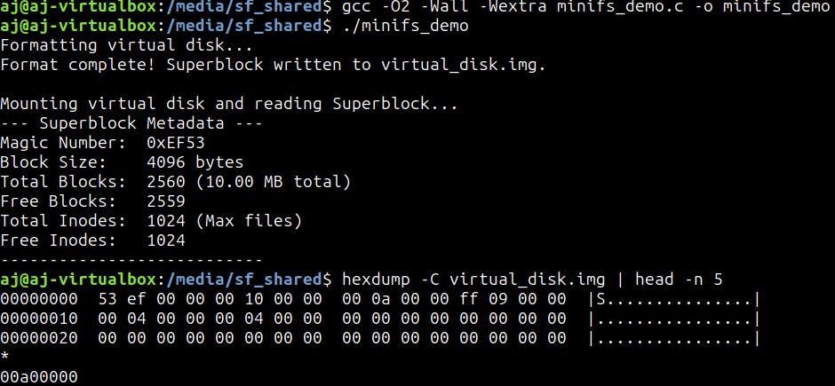
Demos

Slide 13
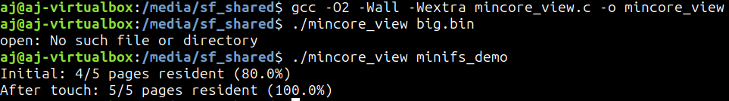

Demos

Slide 14
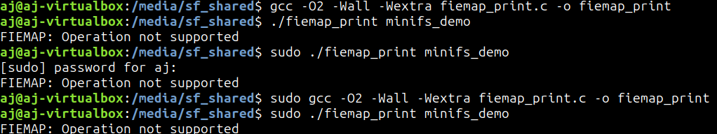
Demos

