Slide 1


GIT HUB
Notes:
EIMSを通じて戦略プロジェクトの成功確率を増やす。EIMSは企業戦略立案を成功に導くためのソフトウェア・ツールです。
EIMSは戦略の成功の鍵になる。
カスタマーコンサルを使ったがハッピーではなく、Strategy in not working that is why a new approach is required by Ideapoke
First Information Explosion 情報過多社会における課題
Second: Uncertainty 不確実性に関すること課題
Third: Multiple elements so many things to get to know 意思決定するにあたり、様々な要素が戦略立案に影響している課題

Slide 2

GitHub

Slide 3
Introduction of GitHub
GitHub is a code hosting platform for collaboration and version control.
GitHub is made up of two words Git and Hub
Git-: Git is a version control system, but what does that mean? When developers create something (an app, for example), they make constant changes to the code, releasing new versions up to and after the first official (non-beta) release. Version control systems keep these revisions straight, storing the modifications in a central repository. This allows developers to easily collaborate, as they can download a new version of the software, make changes, and upload the newest revision.
Git is a command-line tool, but the center around which all things involving Git revolve is the hub—GitHub.com—where developers store their projects and network with like minded people.
Over all GitHub lets you (and others) work together on projects.

Slide 4
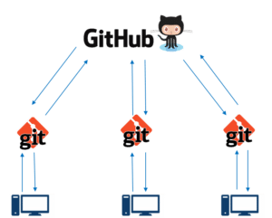
GitHub Example
If you look at the image on the left, GitHub is a central repository and Git is a tool which allows you to create a local repository. Now people usually get confused between git and GitHub but its actually very different. Git is a version control tool that will allow you to perform all kinds of operations to fetch data from the central server or push data to it whereas GitHub is a core hosting platform for version control collaboration.
How to install the GitHub- https://ideapoketech.sharepoint.com/:w:/r/sites/DevelopmentTeam/_layouts/15/Doc.aspx?sourcedoc=%7BD1F2865E-B539-4F61-B524-FC04205B56AB%7D&file=GIT-Installation.docx&action=default&mobileredirect=true

Slide 5
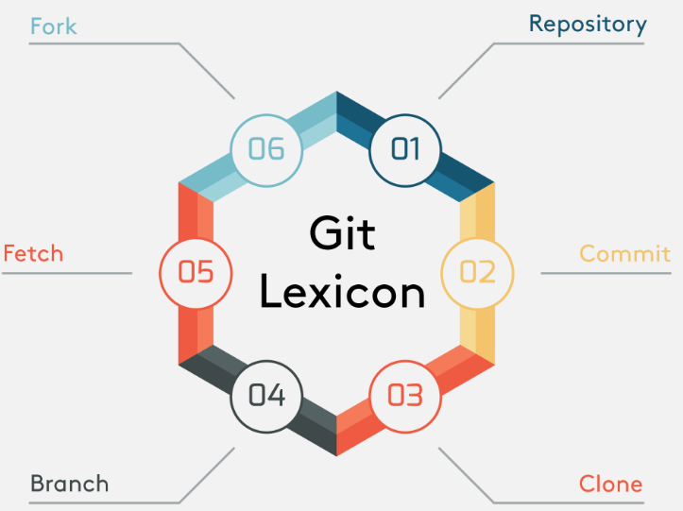
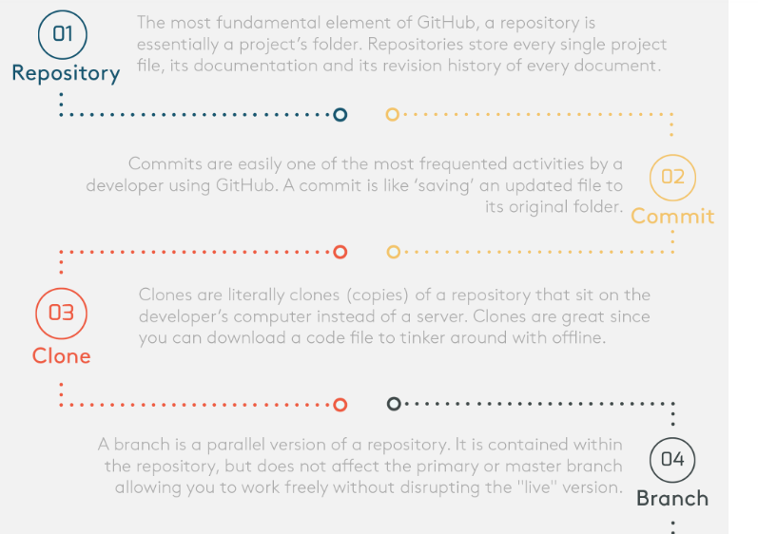
Elements of GitHub

Slide 6
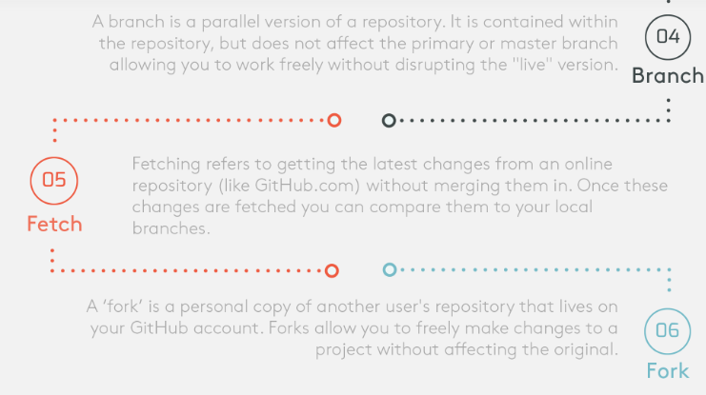
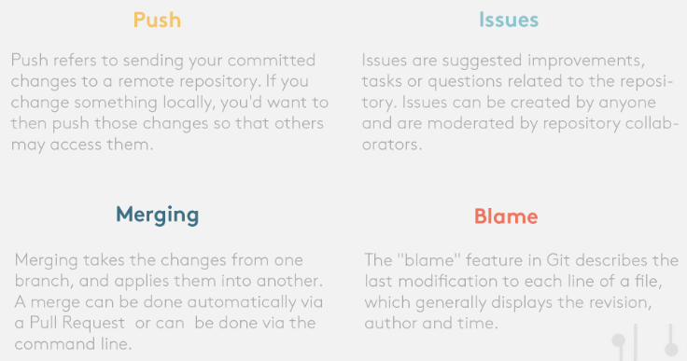
Elements of JSON

Slide 7
Elements of JSON
Repository-: The most fundamental element of GitHub, a repository is essentially a project’s folder, much like the kind of folder you would see in a Google Drive folder.Repositories store every single project file, its documentation and its revision history of every document. Repositories can also accept multiple private or public collaborators.
Commit-: A commit or revision is like 'saving' an updated file to its original folder and overwrites an older version.It is an individual change to a file (or set of files). It's like when you save a file, except with Git, every time you save it creates a unique ID (a.k.a. the "SHA" or "hash") that allows you to keep record of what changes were made when and by who. Commits usually contain a commit message which is a brief description of what changes were made.
Clone-: Clones are literally clones (copies) of a repository that sit on the developer’s computer instead of a server elsewhere. Clones are great since you can download a code file to tinker around with offline or to be edited in a preferred code editor or integrated development environment.
Branch-: A branch is a parallel version of a repository (ie; it literally branches out or away from the main repository, kind of like a temporary sub-folder).It is contained within the repository, but does not affect the primary or master branch allowing you to work freely without disrupting the "live" version. The beauty about ‘branches’ is that you can merge it back into the master branch when you’re ready to publish your changes.

Slide 8
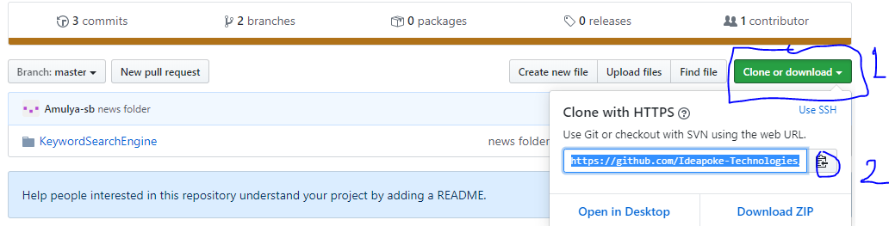
How to Clone the project->
Open the GitHub – If you want to clone the project than first click on particular project then click copy the link.
Then go to any folder of your system and right click do the git clone and then click on ok button. It will take sometime and then project will display there.
Then import this project to eclipse and start working on it.

Slide 9
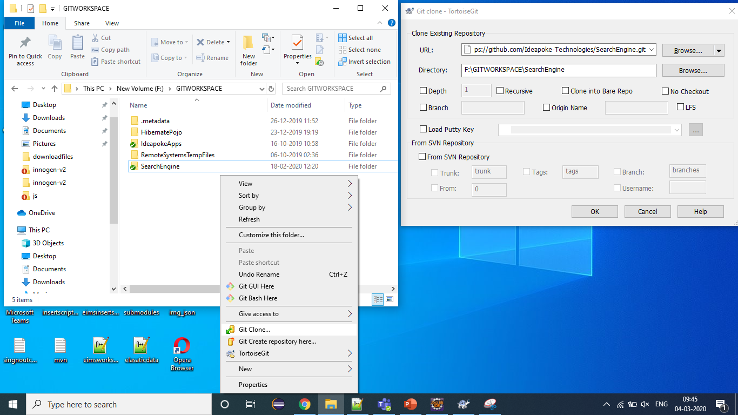
How to Clone the project

Slide 10
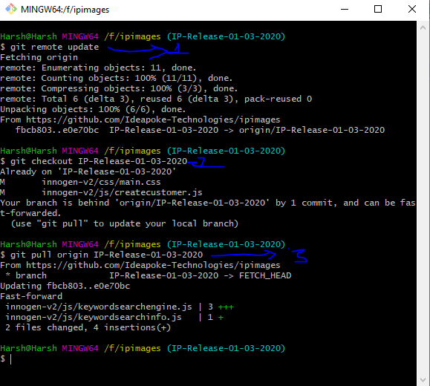
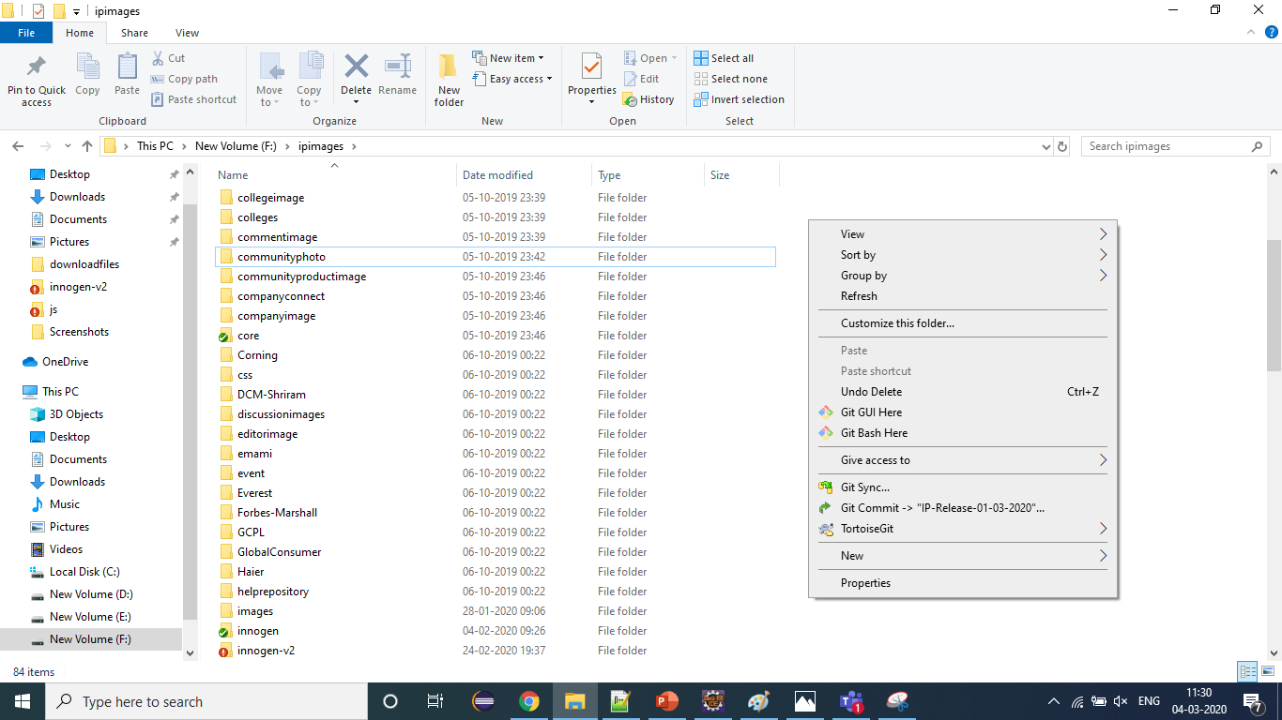
How to connect to the specific branch
First go to any specific folder for js,jsp or source then right click inside that folder then click on Git Bash Here then you need to run these command as follows-
git remote update for if any new branch created then it will displayed there.
git checkout branch name to connect to that branch.
git pull origin branch name to pull the file from that branch.
git reset --hard origin/branch name to reset the branch.

Slide 11
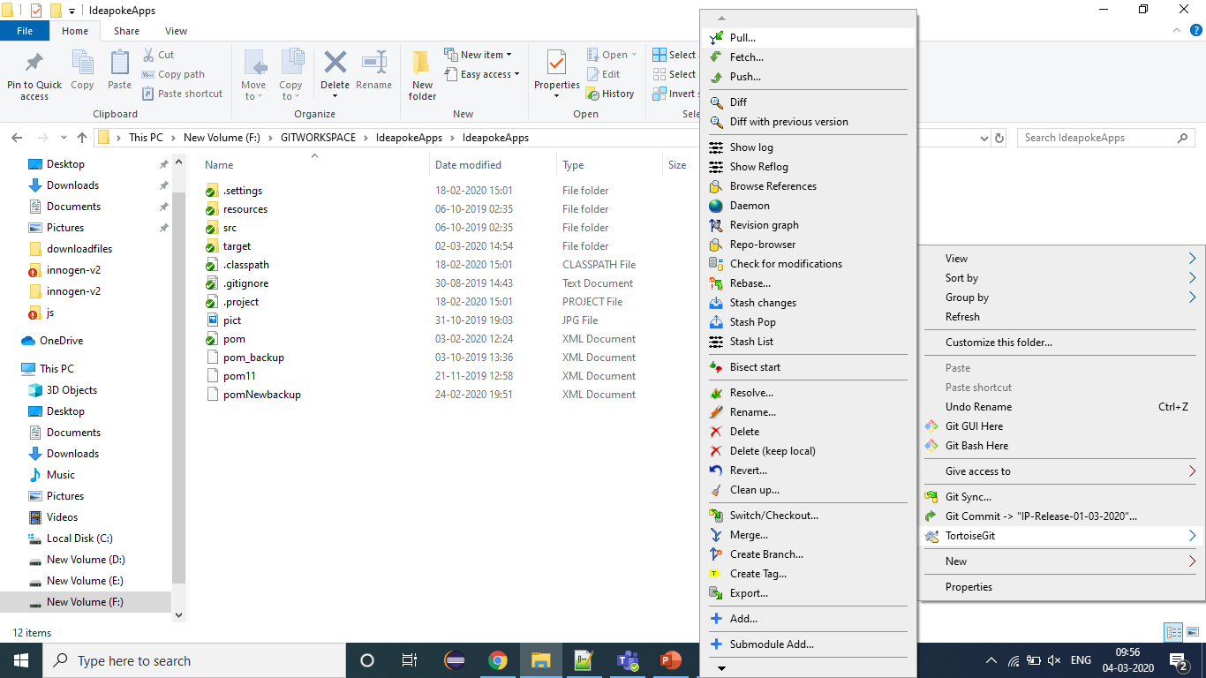
How to pull the file from the GitHub->
First go to any specific folder for js,jsp and source then right click on that folder then click on tortoise- git then click on pull.

Slide 12
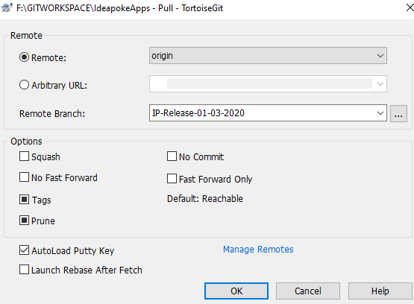
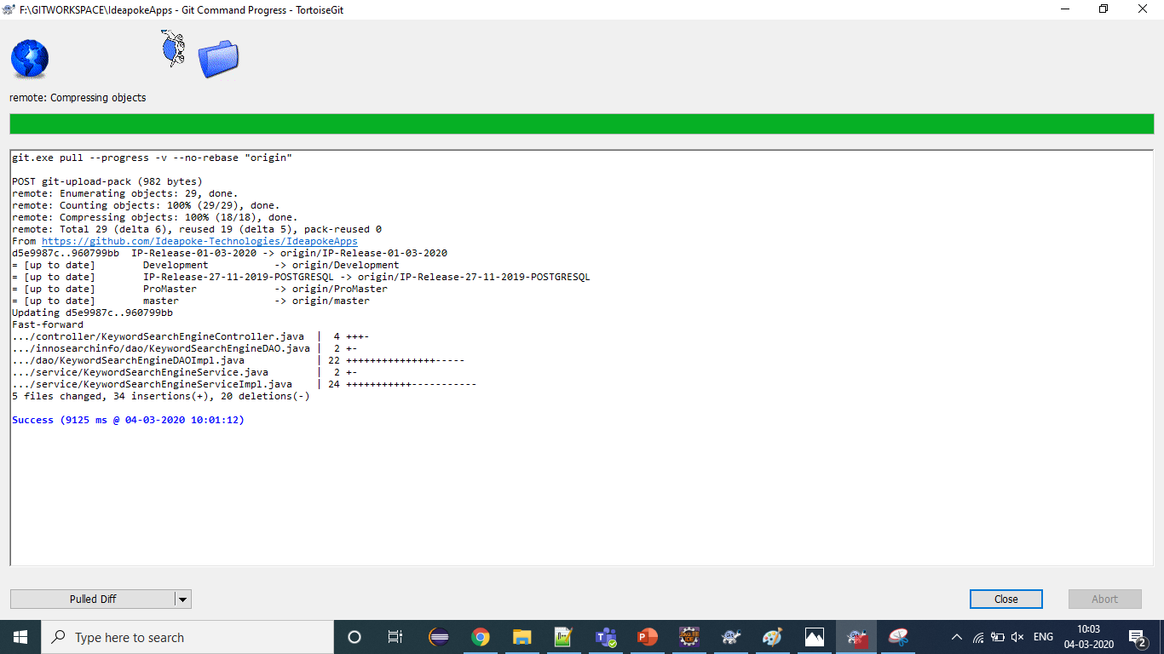
How to pull the file from the GitHub
2 Once you click on pull then you need to check that the branch name is correct or not if it is correct then click on OK then all the file will come who ever the people change.

Slide 13
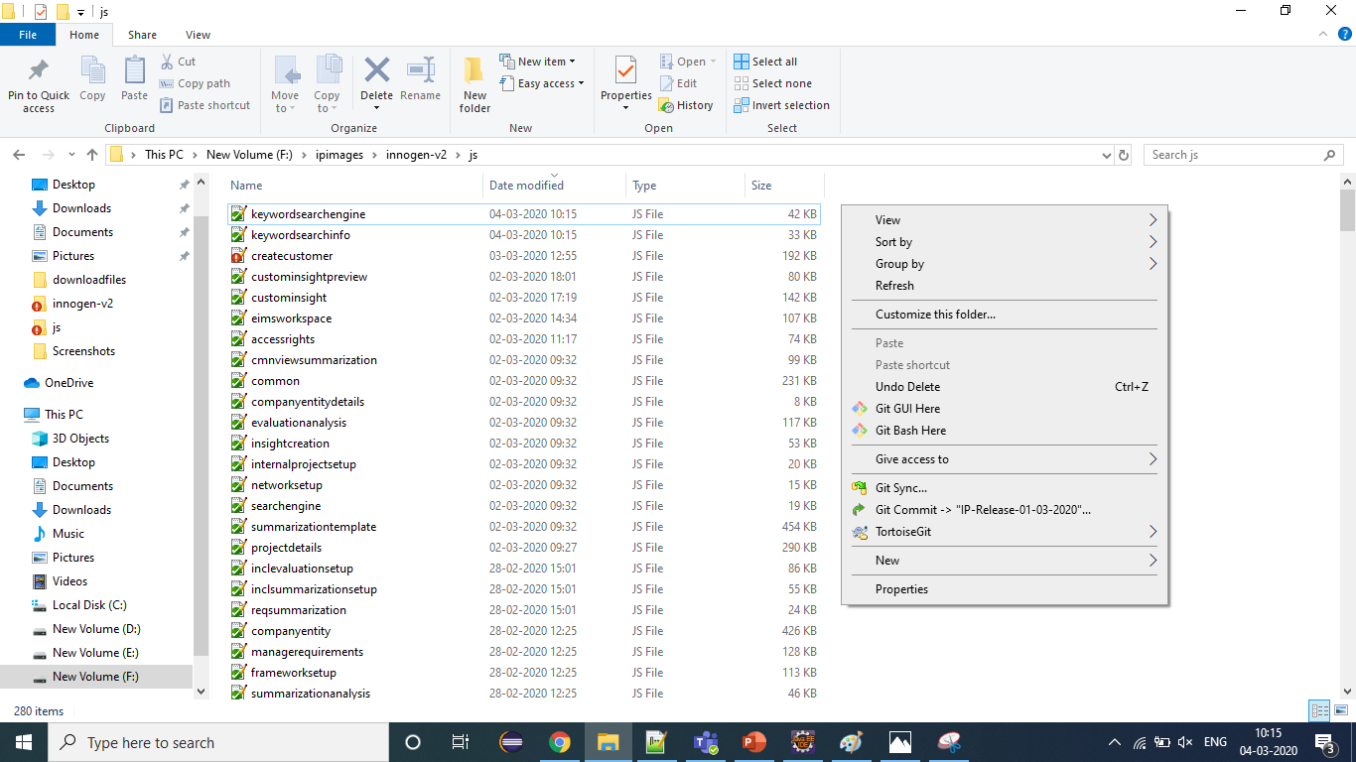
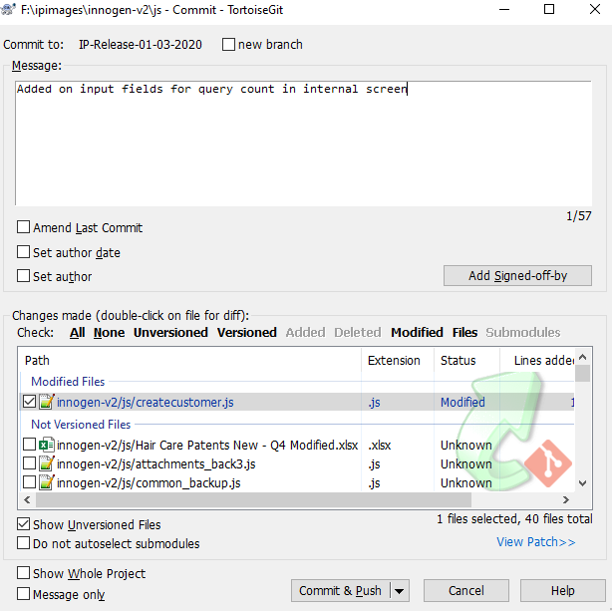
How to push or commit the file to the GitHub
Before going to commit or push the file you need to pull the file because if someone already pushed the file to git than it will throw error. So better do the pull than commit the file to the specific branch. To commit the file you need to go to specific js,jsp or src folder then there it will show red label on that file then u comes to know you change those file right click on that folder and click on git commit then one popup will open there all the changes file will list down. In that you needs to select the only your changes and give the description for what purpose you change these file and then click on commit and push. Then you will get success message.

