Slide 1


Log4j and J2EE

Slide 2

Table of Contents
Introduction to LOG4j
JSP
1
7
Implementation of LOG4j
Implicit Objects
2
8
3
Date Time Format
Advanced Java
4
J2EE
5
Servlets
6

Slide 3


LOG4j

Slide 4
LOG4j
What is Log4j?
Log4j is a popular logging package written in Java.
Log4j is a reliable, fast and flexible logging framework (APIs) written in Java, which is distributed under the Apache Software License.
Log4j is a tool to help the programmer output log statements to a variety of output targets.

Slide 5
LOG4j- Further Explanation
The log4j.properties file is a log4j configuration file which stores properties in key-value pairs. The log4j properties file contains the entire runtime configuration used by log4j.
This file will contain log4j appenders information, log level information and output file names for file appenders. Error , and Warning. Reference link :Log4j.pptx (sharepoint.com)

Slide 6
Assignment
The log4j Implementation Assignment for Sample Program.

Slide 7
Date Time Format

Slide 8
Date Time Format
In Java we can import the java.time package to work with the date and time API. The package includes many date and time classes. For example:
Different Formats of Date and Time are 1. yyyy-MM-dd
2. dd/MM/yyyy
3. dd-MMM-yyyy etc

Slide 9
Assignement
1. Write a Program to convert the different types of data and time format in Java.

Slide 10
Advanced Java

Slide 11
J2EE
What is Advanced Java?
2. Why must we learn Advanced Java?

Slide 12
J2EE
What is Advanced Java?
It is an advanced technology or advance version of Java specially designed to develop web-based, network-centric or enterprise applications. 2. Why must we learn Advanced Java?
For normal application core Java is sufficient but for if we must create a web application and establish connection between client and server advanced Java is required which includes servlets , JSP , JDBC connection

Slide 13
J2EE

Slide 14
J2EE- Java 2 Enterprise Edition
1.What is J2EE?
2.Difference between Java and J2EE

Slide 15
J2EE- Java 2 Enterprise Edition
What is J2EE?
J2EE is a platform-independent, Java-centric environment for developing, building and deploying Web-based enterprise applications online. The J2EE platform consists of a set of services, APIs, and protocols that provide the functionality for developing multi-tiered, Web-based applications.
Difference between Java and J2EE
Java SE is used for general purpose programming and almost anything written in Java is based on the Core Java | J2EE is the API built on top of the SE API to provide the tools necessary to do large scale projects more easily. Using J2EE technology stack you can write complex business application.

Slide 16
J2EE
What is J2EE used for?
It simplifies the concepts of building applications
Standardizes an API between the components and application server container.
J2E application server and container provides the framework services

Slide 17
SERVLETS

Slide 18
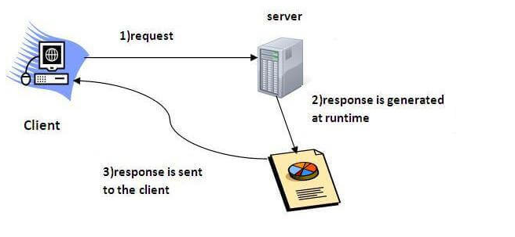
SERVLETS
What is Servlets?
Servlet technology is used to create a web application (resides at server side and generates a dynamic web page).
Servlet technology is robust and scalable because of java language. Before Servlet, CGI (Common Gateway Interface) scripting language was common as a server-side programming language.
There are many interfaces and classes in the Servlet API such as Servlet, GenericServlet, HttpServlet, ServletRequest, ServletResponse, etc.

Slide 19
SERVLETS- Further Explanation
What is Servlet?
Servlet is a technology which is used to create a web application.
it is an API that provides many interfaces and classes including documentation.
Servlet is an interface that must be implemented for creating any web application.
It is a class that extends the capabilities of the servers and responds to the incoming requests. It can respond to any requests.
Servlet is a web component that is deployed on the server to create a dynamic web page.

Slide 20
SERVLETS- Advantages and Use
Advantages of Servlet?
Better performance: because it creates a thread for each request, not process.
Portability: because it uses Java language.
Robust: JVM manages Servlets, so we don't need to worry about the memory leak, garbage collection, etc.
Secure: because it uses java language.
What is the use of Servlet:
Using Servlets, you can collect input from users through web page forms, present records from a database or another source, and create web pages dynamically.

Slide 21
JSP

Slide 22
JSP
What is JSP ?
JSP technology is used to create web application just like Servlet technology. It can be thought of as an extension to Servlet because it provides more functionality than servlet such as expression language, JSTL, etc.
JSP technology is the extension to Servlet technology. We can use all the features of the Servlet in JSP.
In addition to, we can use implicit objects, predefined tags, expression language and Custom tags in JSP, that makes JSP development easy.

Slide 23
JSP tags
The scripting elements provides the ability to insert java code inside the jsp. There are three types of scripting elements:
scriptlet tag: <% java source code %>
expression tag: <%= statement %>
declaration tag :<%! field or method declaration %>
include tag: include action tag is used to include the content of another resource it may be jsp, html or servle

Slide 24
Implicit Objects in JSP

Slide 25
Implicit Objects:
What are Implicit Objects in JSP?
These Objects are the Java objects that the JSP Container makes available to the developers in each page and the developer can call them directly without being explicitly declared.
There are 9 jsp implicit objects. These objects are created by the web container that are available to all the jsp pages.
JspWriter | HttpSession
HttpServletRequest | PageContext
HttpServletResponse | Object
ServletConfig | Throwable
ServletContext

Slide 26
GET and POST Methods
What are get and Post Method?
Get and Post methods are the HTTP request methods used inside the <form> tag to send form data to the server.
HTTP protocol enables the communication between the client and the server where a browser can be the client, and an application running on a computer system that hosts your website can be the server.
Why GET and POST metods are used?
The GET and POST method are used for sending the data to the server,
Main difference between them is that GET method append the data to the URI defined in the form's action attribute. Conversely, POST method attaches data to the requested body.

Slide 27
Assignment
1. Build a app/For, for Register and Login using Jsp and Servet
The form should contain the field , First name , last name , Password
Once the field are filles give the message registered successfully and create a Login form

Slide 28
Thank You

