Slide 1
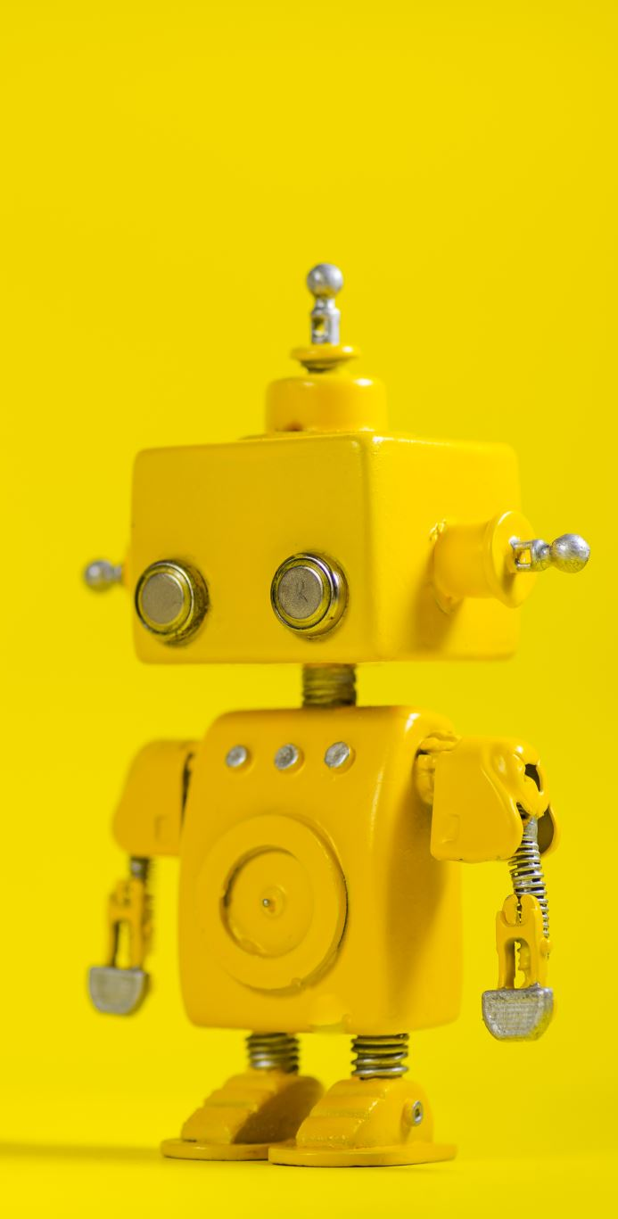
Artificial Intelligence
Introduction
Dr. Amina Jameel
Dept. of Software Engineering
Bahria University, Karachi

Slide 2
Instructor
Dr. Amina Jameel
Office: NA
E-mail: amina@bahria.edu.pk
Consultation Hours:

Slide 3
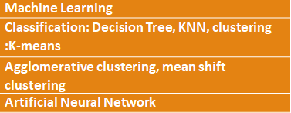
Topics
Introduction to AI,
Categories of AI definitions/Evolution of AI
Intelligent Agents
Types of intelligent agents/ agent environment
Problem solving using searching
Problem formulation
Uninformed searching (BFS, DFS, IDS, DLS)
Informed search & concept of heuristic
A* search, Hill climbing, genetic algorithm
Deterministic Adversarial Search
Non deterministic game search
knowledge based agents

Slide 4
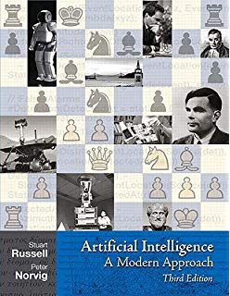
Text book
S. Russell and P. Norvig, “Artificial Intelligence: A Modern Approach”, Prentice Hall, 2010, 3rd Edition.
(Used in over 1400 universities in over 125 countries.
The 22nd most cited computer science publication on Citeseer (and 4th most cited publication of this century).

Slide 5
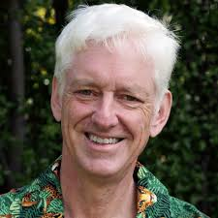
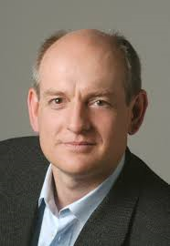
Textbook
Peter Norvig is a director of research at Google. Previously he was head of Google’s core search algorithms group and of NASA Ames’s Computational Sciences Division, making him NASA’s senior computer scientist. He received the NASA Exceptional Achievement Award in 2001. He has taught at the University of Southern California and the University of California, Berkeley, from which he received a PhD in 1986 and the distinguished alumni award in 2006.
Stuart Russell is a computer scientist known for his contributions to artificial intelligenceHe is a Professor of Computer Science at the University of California, Berkeley. He founded and leads the Center for Human-Compatible Artificial Intelligence (CHAI) at UC Berkeley

Slide 6
Grading
Quizzes (10%)
Assig (20%)
Midterm exams (20%),
Final exam (50%)

Slide 7
Policies regarding Assignments
One Day Late submission of assignments leads to 10% deduction
Two Days Late submission leads to 20% deduction and so on.

Slide 8
Policies regarding Quizzes
I will take 3 to 5 quizzes and all quizzes are included in final grade calculation
Quizzes may be announced or surprise
There will be no makeup quiz

Slide 9
Academic Honesty
All parties involved in any kind of cheating in any exam will get zero in that exam

Slide 10

Intelligence Are the things shown below intelligent?
Notes:
Dolphins are very intelligent.

Slide 11
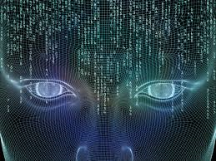
Artificial Intelligence
Homo Sapiens --- Man the wise
For centuries, tried to understand how we think
AI attempts not just to understand but also to build intelligent entities

Slide 12
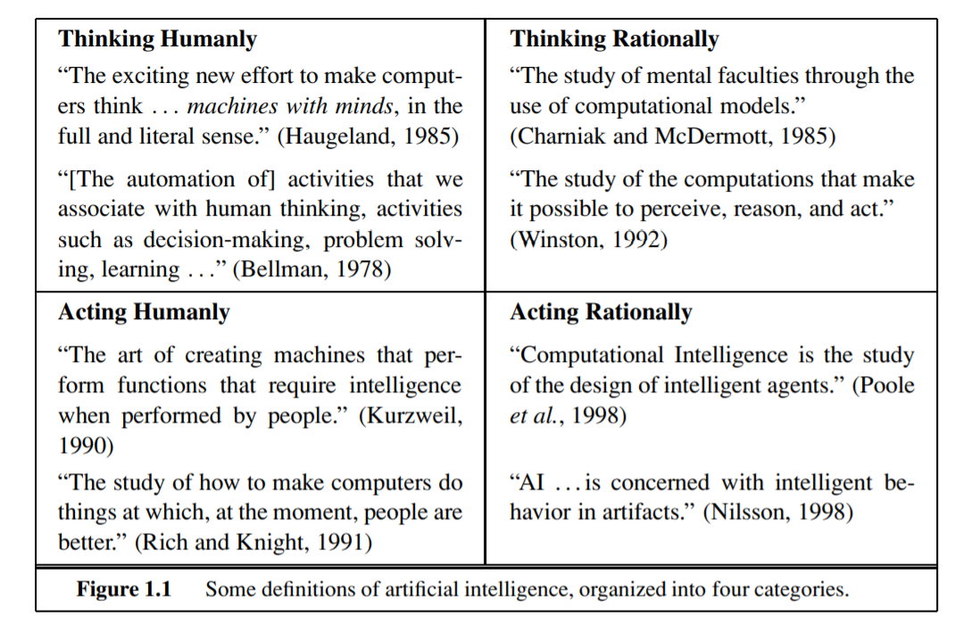
What is AI?

Slide 13
What is AI?
Thought Process & Reasoning
Systems that think like humans | Systems that think rationally
Systems that act like humans | Systems that act rationally
Behavior

Slide 14
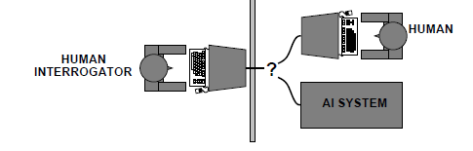
Acting humanly: The Turing test

Slide 15

Acting humanly: The Turing test
Proposed by Alan Turing (1950)
A computer passes the test if a human interrogator, after posing some written questions, cannot tell whether the written responses come from a person or from a computer.
Suggested major components of AI: knowledge representation, reasoning, Natural language processing, machine learning
For total Turing test: Computer vision, robotics

Slide 16

Thinking humanly: Cognitive Science
how humans think
actual workings of human minds.
through introspection—trying to catch our own thoughts as they go by;
through psychological experiments—observing a person in action;
and through brain imaging—observing the brain in action.
Allen Newell and Herbert Simon, who developed GPS, the “General Problem Solver” (Newell and Simon, 1961), were not content merely to have their program solve problems correctly. They were more concerned with comparing the trace of its reasoning steps to traces of human subjects COGNITIVE SCIENCE solving the same problems.
Both approaches (roughly, Cognitive Science and Cognitive Neuroscience) are now distinct from AI
Hence, all three fields share one principal direction!

Slide 17

Thinking rationally: Laws of Thought
Normative (or prescriptive) rather than descriptive
Aristotle: what are correct arguments/thought processes?
Several Greek schools developed various forms of logic:
notation and rules of derivation for thoughts;
may or may not have proceeded to the idea of mechanization
Direct line through mathematics and philosophy to modern AI
Problems:
Not all intelligent behavior is mediated by logical deliberation
What is the purpose of thinking? What thoughts should I have out of all the thoughts (logical or otherwise) that I could have?

Slide 18

Acting rationally
Rational behavior: doing the right thing
The right thing: that which is expected to maximize goal achievement, given the available information
Doesn't necessarily involve thinking--e.g., blinking reflex | but thinking should be in the service of rational action

Slide 19
AI prehistory
Philosophy
logic, methods of reasoning
mind as physical system
foundations of learning, language, rationality
Mathematics
formal representation and proof
algorithms, computation, (un)decidability, (in)tractability
probability
Psychology
adaptation
phenomena of perception and motor control
experimental techniques (psychophysics, etc.)

Slide 20
Economics
formal theory of rational decisions
Linguistics
knowledge representation
grammar
Neuroscience
physical substrate for mental activity
Control theory
homeostatic systems, stability
simple optimal agent designs
Notes:
Substrate: an underlying substance or layer

Slide 21
History of AI
1943 McCulloch & Pitts: Boolean circuit model of brain
1950 Turing's Computing Machinery and Intelligence"
1950s Early AI programs, including Samuel's checkers program,
Newell & Simon's Logic Theorist, Gelernter's Geometry Engine
1956 Dartmouth meeting: “Artificial Intelligence" adopted
1965 Robinson's complete algorithm for logical reasoning
1966--74 AI discovers computational complexity
Neural network research almost disappears
1969--79 Early development of knowledge-based systems
1980--88 Expert systems industry booms
1988--93 Expert systems industry fall: “AI Winter"
1985--95 Neural networks return to popularity
1988--- Resurgence of probability; general increase in technical depth
Nouvelle AI: A Life, GAs, soft computing
1995--Agents, agents, everywhere : : :
2003-- Human-level AI back on the agenda…………………………
Notes:
Computing Machinery and Intelligence is an article published in 1950 that explains the turing test, machine learning, genetic algorithm and reinforcement learning.
Gelernter's Geometry Engine: It can prove geometry related theorm

Slide 22
To what extent are the following computer systems instances of artificial intelligence:
• Supermarket bar code scanners.
• Web search engines.
• Voice-activated telephone menus.
• Internet routing algorithms that respond dynamically to the state of the network.

Slide 23
State of the art
Which of the following can be done at present?
Play a decent game of table tennis
Drive safely along a curving mountain road
Buy a week's worth of groceries on the web
Play a decent game of bridge
Discover and prove a new mathematical theorem
Design and execute a research program in molecular biology
Write an intentionally funny story
Give competent legal advice in a specialized area of law
Translate spoken English into spoken Swedish in real time
Converse successfully with another person for an hour
Perform a complex surgical operation

Slide 24

Credits
Stuart Russell's (Berkeley) course slides, http://aima.cs.berkeley.edu/instructors.html

