Slide 1
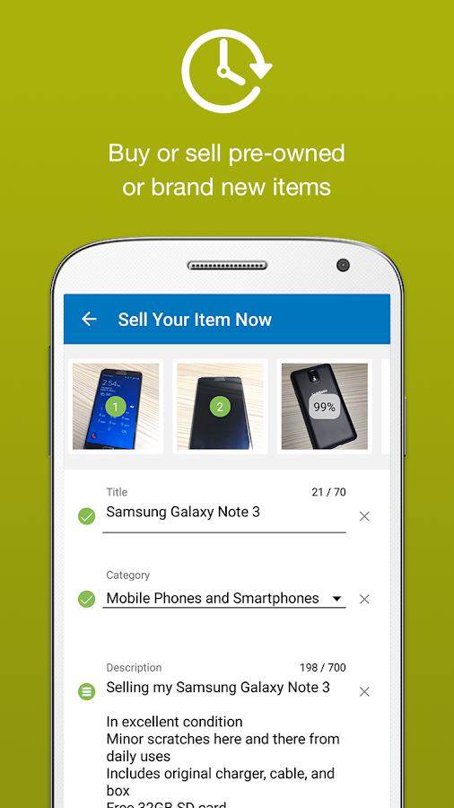
Online Selling
And Buying App
GROUP MEMBERS:-
MOHIT KUMAR
NEERAJ CHAUHAN
SYED AMAAN ALI
ADITI SAHU
PROJECT MENTOR:-
Mr. Santosh Santhu

Slide 2
OUTLINE:
PROBLEM STATEMENT
INTRODUCTION
PROJECT OVERVIEW
MODEL FLOW FOR BUYING PRODUCTS
MODEL FLOW FOR SELLING PRODUCTS
ARCHITECTURE
TECHNOLOGIES
CONCLUSION
SNAPSHOTS

Slide 3
PROBLEM STATEMENT
To Build a system to sell and buy any products like olx system. The user can directly buy from the owner. It will increase the reach of the seller worldwide and customers can have variety of products at a single place.

Slide 4

INTRODUCTION
An Online Marketplace website where people buy and sell a wide variety of goods, products and services under different categories over Internet.
It also pertains to “any form of business transaction in which the parties interact electronically rather than by physical exchanges or direct physical contacts.

Slide 5

PROJECT OVERVIEW OF SELLER/USER
LANDING PAGE OF
SELLX
USER/SELLER WILL REGISTER TO CREATE ACCOUNT
USER IS REGISTERED
CONFIRM ALERT AND HE GETS BALANCE OF 50 RUPEES FOR REGISTERING
SELLER CAN REGISTER PRODUCTS WHICH HE WANTS TO SELL
PRODUCT DASHBOARD
CONTAINING CATEGORY OF PRODUCTS
USER IS REDIRECTED TO LOGIN PAGE
GIVES PRODUCT NAME,PURCHASE DATE,DESCRIPTION CHOOSES CATEGORY AND CHOOSES TO BUY OR EXCHANGE,UPLOADS PHOTO OF THE PRODUCT THEN GIVES EMAIL AND LOCATION .
PRODUCT POSTED SUCCESS ALERT

Slide 6
MODEL FLOW FOR
BUYING PRODUCTS
BUYER IS RECOMMENDED PRODUCTS TO BUY
BUYER THEN CLICKS ON PRODUCT IMAGE
PRODUCT DESCRIPTION ABOUT PRODUCT OWNER DATE OF POSTING,LOCATION AND YEAR OF PURCHASE IS DISPLAYED AND BUYER CAN CHAT WITH OWNER
A PAYMENT MODAL IS DISPLAYED SHOWING BUYER BALANCE,MODE OF PAYMENT AND OPTION TO REQUEST PURCHASE OR ADD MORE MONEY
BUYER CLICKS ON BUY BUTTON
BUYER CLICKS ON REQUEST PURCHASE AND IS ALERTED THAT TRANSACTION IS SUCCESS

Slide 7
ARCHITECTURE DIAGRAM
HOME
PAGE
USER REGISTERS AND LOGIN
USING AUTHENTICATION SERVICE
API GATEWAY
THROUGH
PRODUCT DASHBOARD
ADDING PRODUCTS
GOES TO
MYSQL
DATA OF USER IN USER SERVICE
STORED IN
EUREKA SERVER SHOWS ALL MICROSERVICES
CONTAINERIZES IMAGES USING DOCKER
RECOMMENDATION SERVICE
MONGODB

Slide 8







TECHNOLOGIES

Slide 9
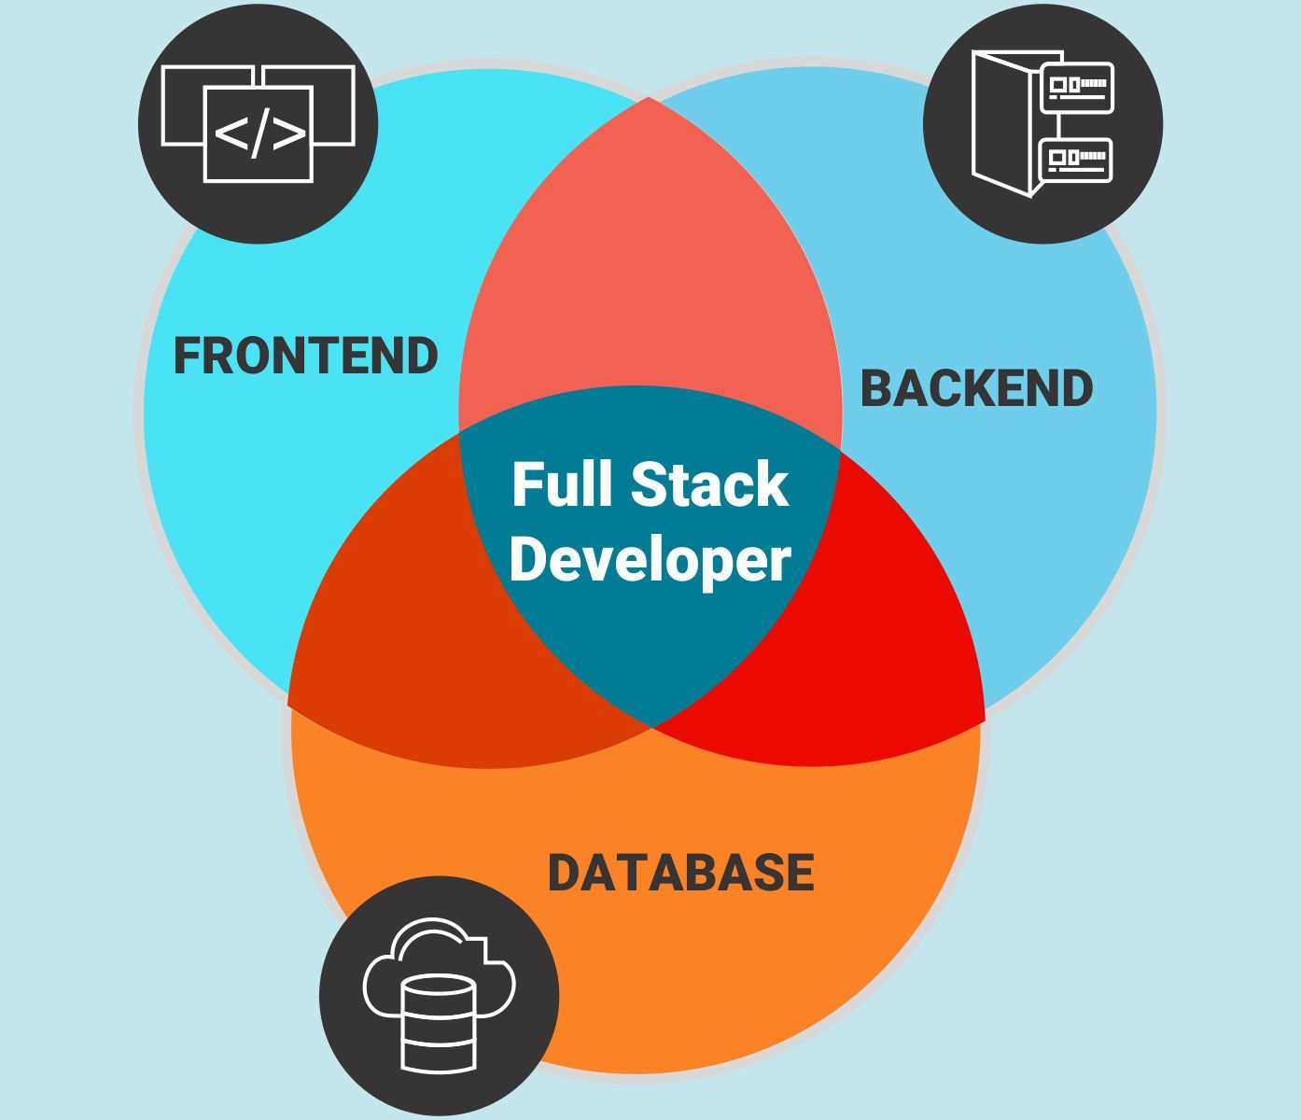
CONCLUSION
This Application in whole encompasses these elements.

Slide 10
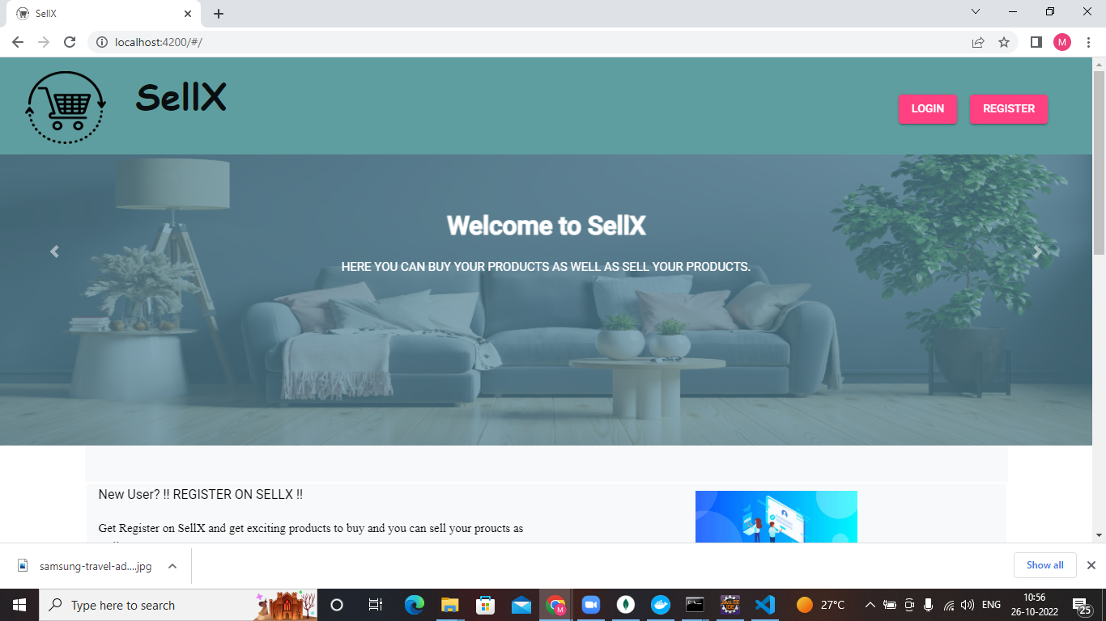
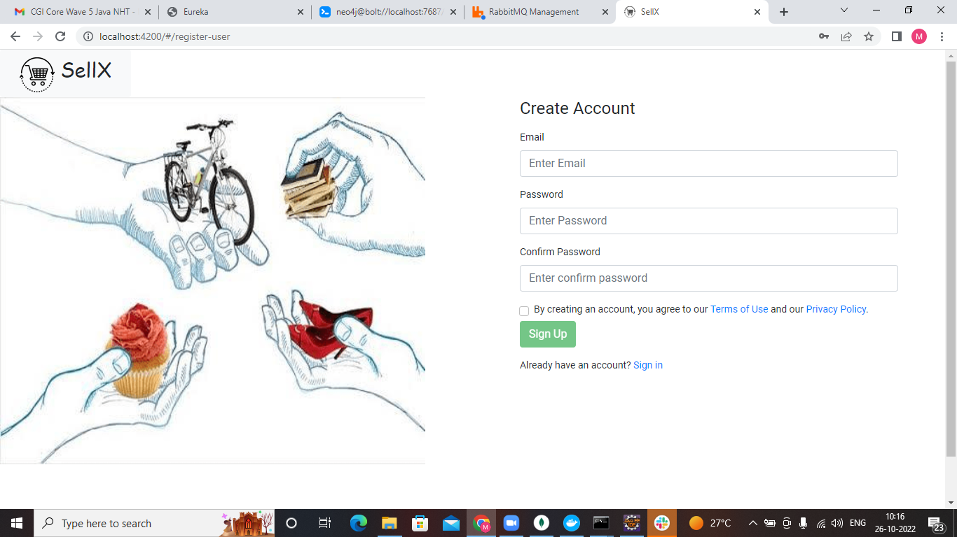
SNAPSHOTS
Default landing Page
User Registration Page

Slide 11
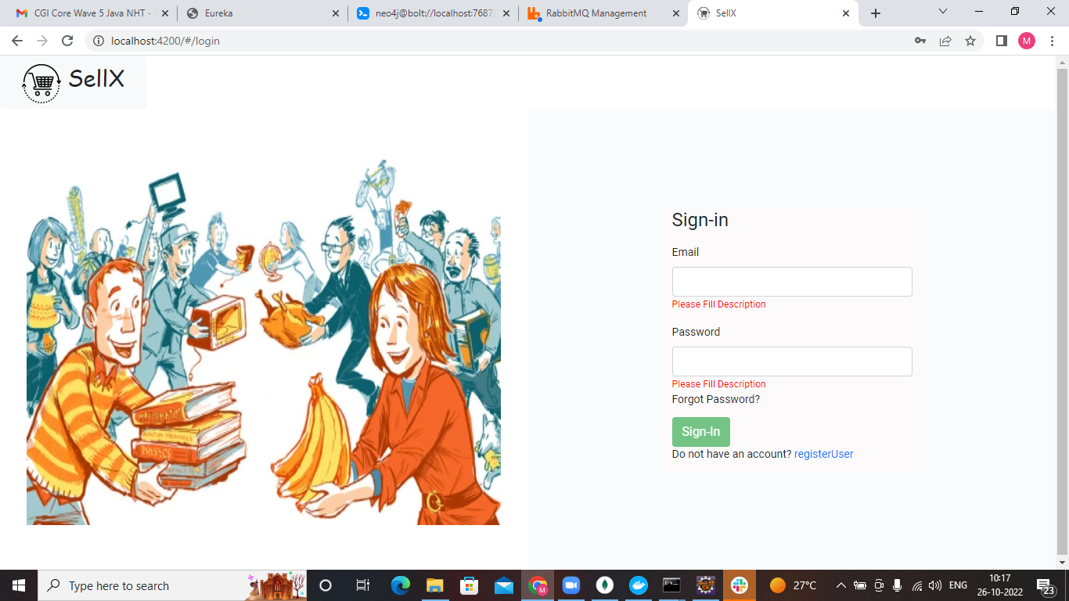
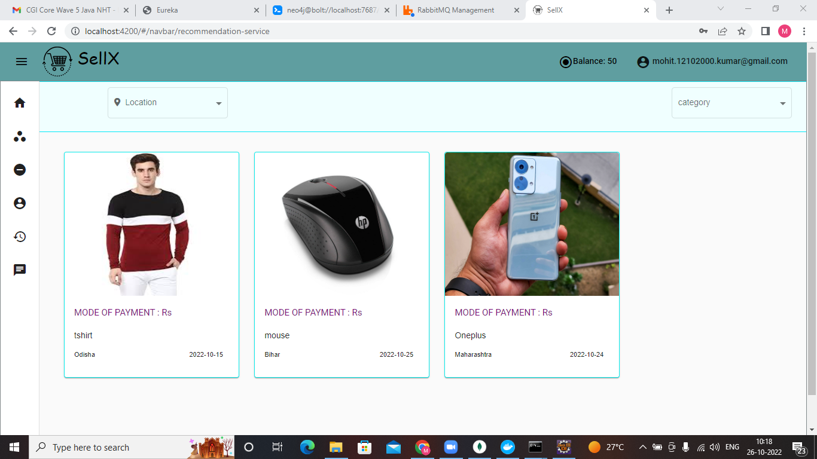
SNAPSHOTS
Login Page
Product recommendation Page

Slide 12
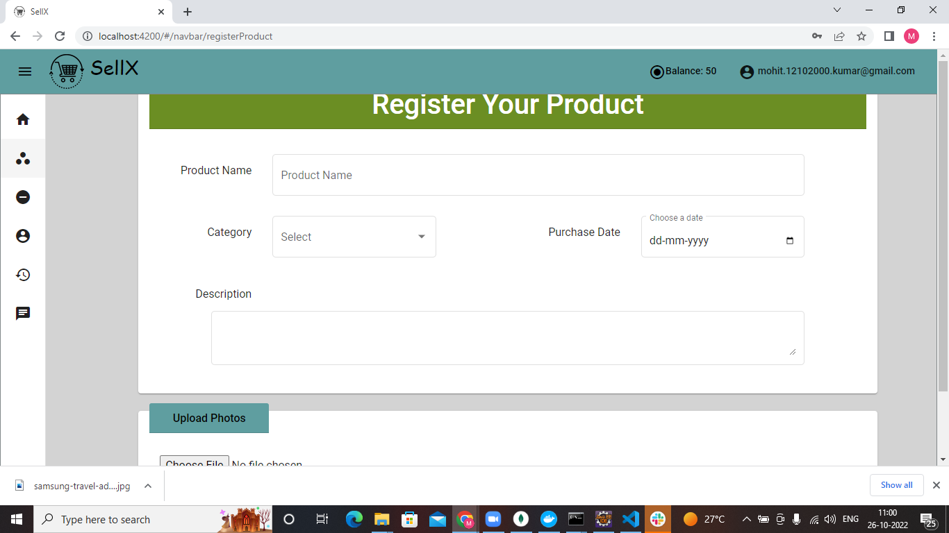
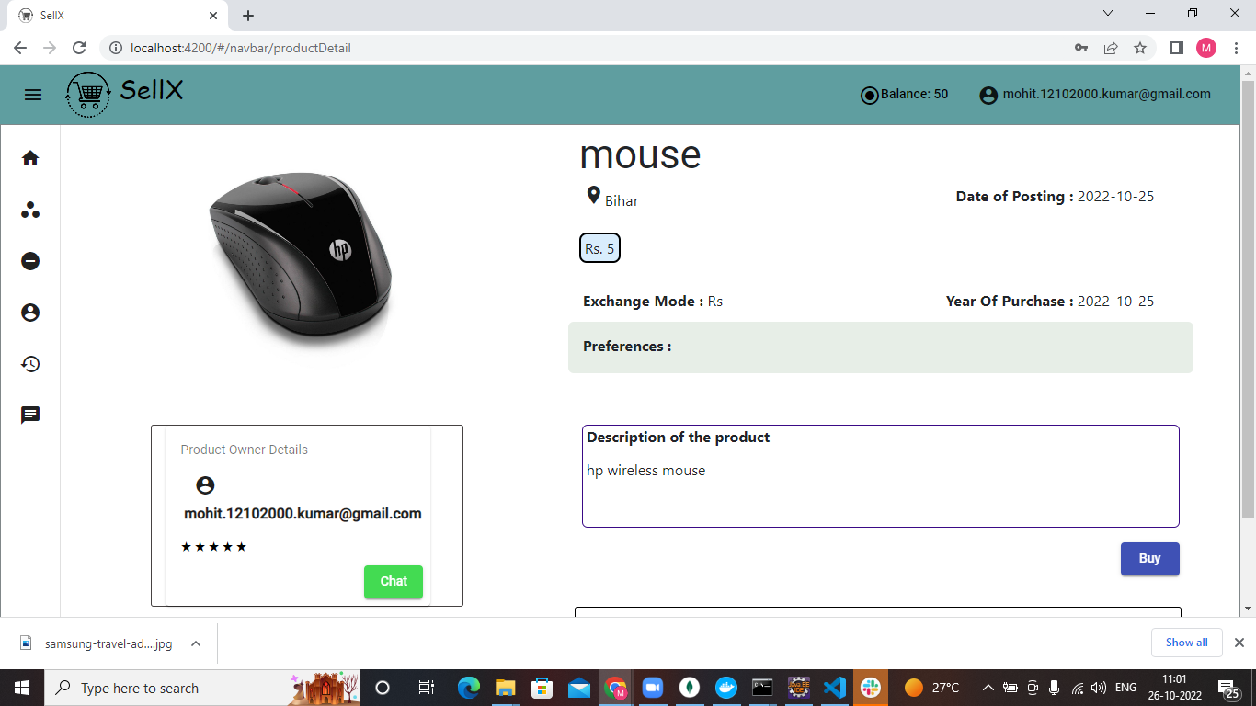
SNAPSHOTS
Product registration dashboard
Product Details

Slide 13
REFERENCES:-
https://getbootstrap.com/ ,
https://spring.io/guides/gs/spring-boot/,
https://angular.io/,
https://www.youtube.com/,
https://www.bigcommerce.com/blog/build-an-ecommerce-website/,
https://www.quicksprout.com/create-ecommerce-website/,

Slide 14
Thank You !

