Slide 1
Computer Devices
VIP Internation School, Tolichowki
Hyderabad
Syeda SHIFA Tazeen

Slide 2
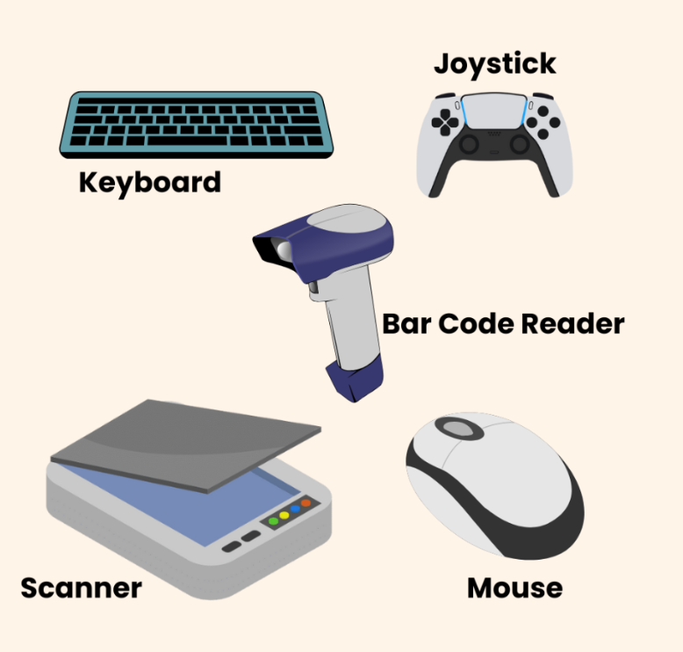
Input Devices
Help us to tell the computer what to do

Slide 3
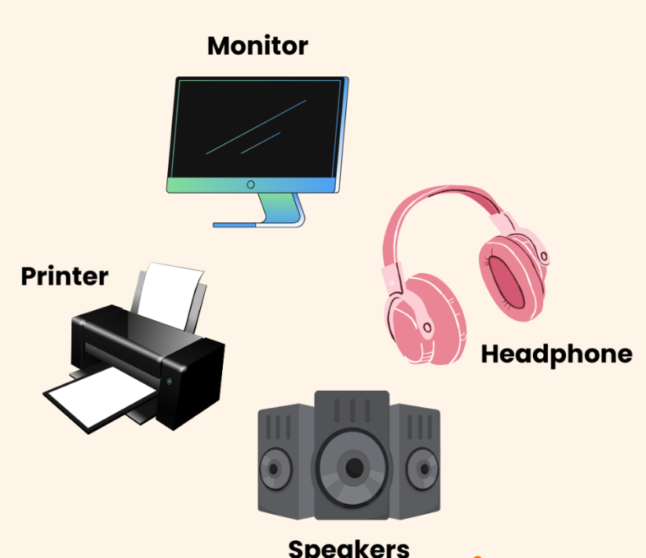
Output Devices
Help Computer talk back to us

Slide 4
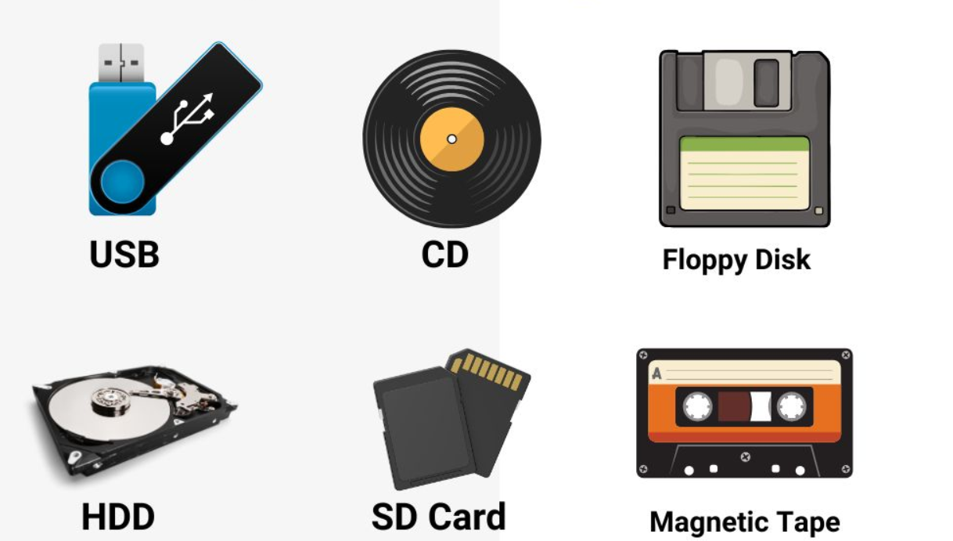
Storage Devices

Slide 5
Sounds
Loud Sounds & Quite Sounds
Syeda SHIFA Tazeen

Slide 6



Loud Sounds
Big and Noisy

Slide 7
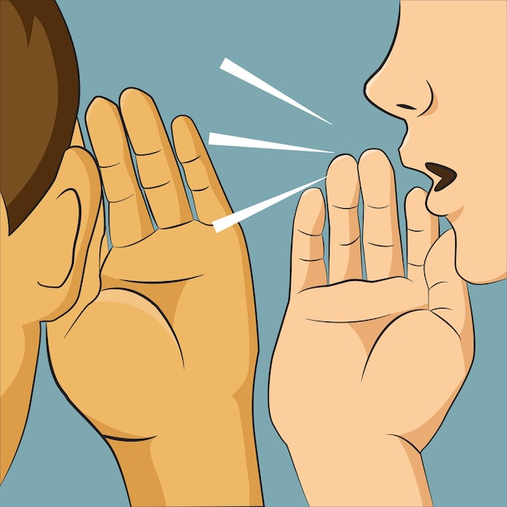


Quiet Sound
Soft and Gentle

Slide 8
Thank you
Syeda SHIFA Tazeen ‧₊˚❀༉‧₊˚.

