Slide 1
Negative Numbers
VIP Internation School, Tolichowki
Hyderabad INDIA
Syed ABRAR Hussain

Slide 2
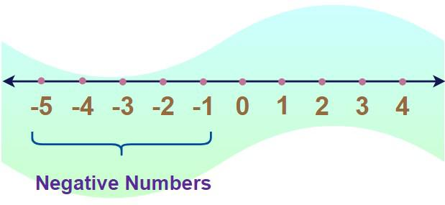
Definition
Real Number which is less than Zero

Slide 3
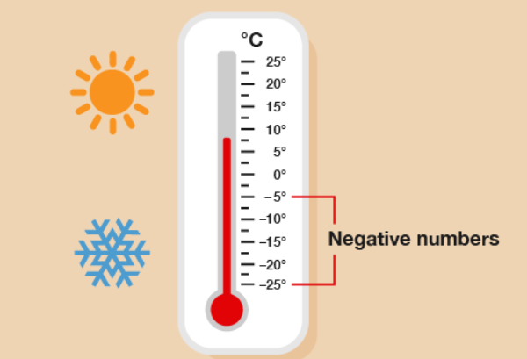
Negative Number Usage
Temperature

Slide 4
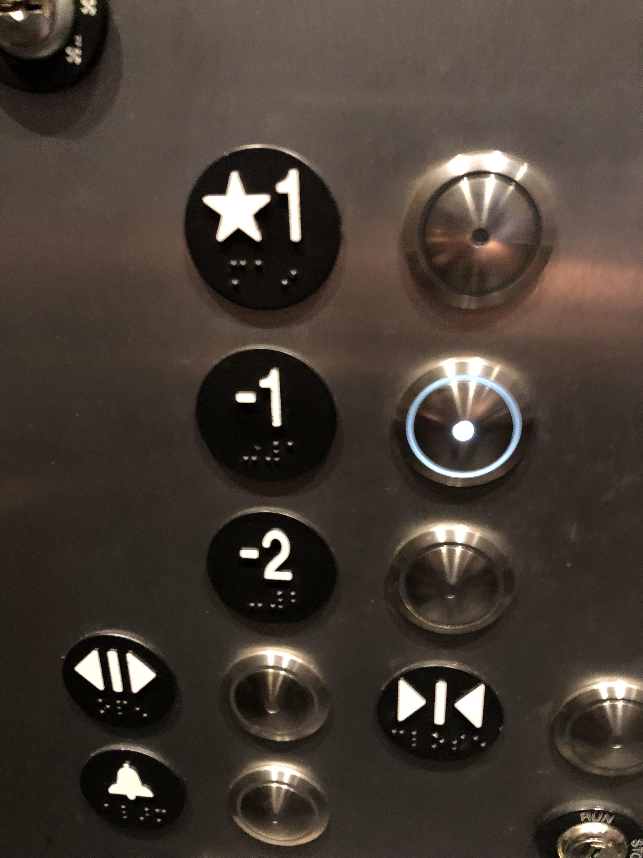
Negative Number Usage
Elevators

Slide 5
Number left of Zero is negative and right of Zero are positive
Zero is in the middle

Slide 6
Thank you
EVERYONE
Syed ABRAR Hussain

