Slide 1
Computer Devices
VIP Internation School, Tolichowki
Hyderabad
Syeda SHIFA Tazeen

Slide 2
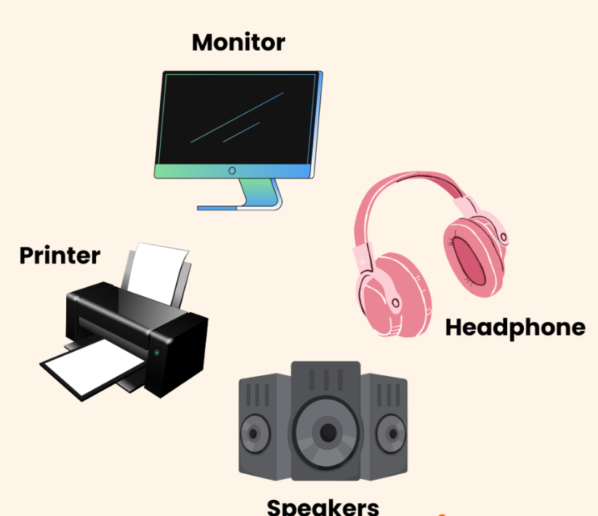
Output Devices
Help Computer talk back to us

Slide 3
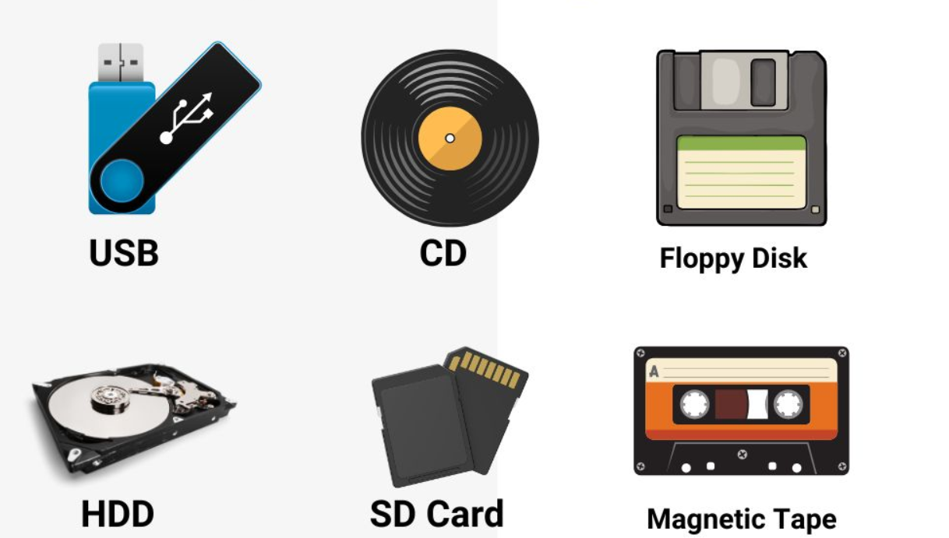
Storage Devices

Slide 4
Sounds
Loud Sounds & Quite Sounds
Syeda SHIFA Tazeen

Slide 5



Loud Sounds
Big and Noisy

Slide 6
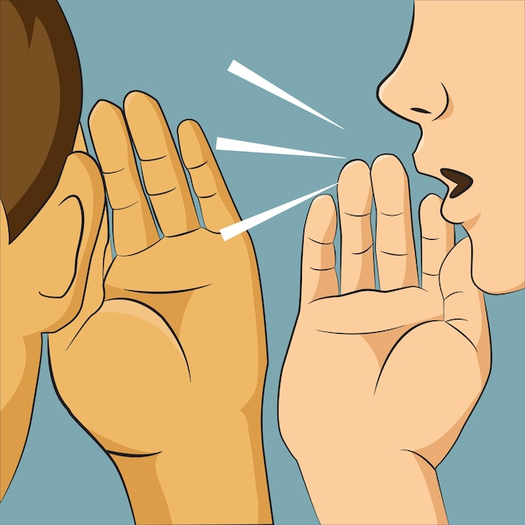


Quiet Sound
Soft and Gentle

Slide 7
Thank you
Syeda SHIFA Tazeen ‧₊˚❀༉‧₊˚.

