Slide 1
COMP 228
Java Programming
Week 1 – Introduction to Java

Slide 2
Objectives
Have a good understanding of the Java platform
Utilize the Eclipse IDE to write simple Java applications
Introduction to the Java Programming Language
Anatomy of a Java Application
Eclipse IDE

Slide 3
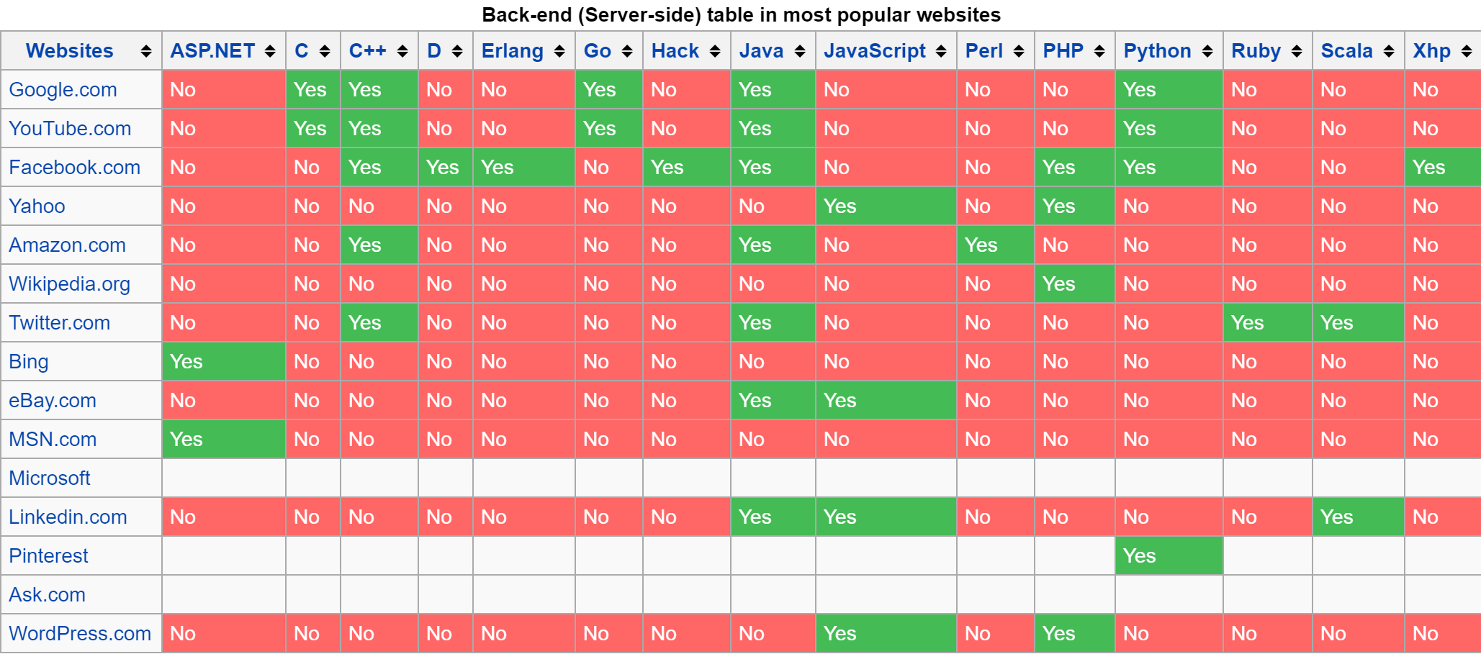
Introduction
Java is widely regarded as being one of the most popular programming languages in the world.
Used mostly to implement internet-based applications that communicate over a network
Billions of Java-enabled devices
Left: Most popular websites are implementing and utilizing Java

Slide 4
Introduction
Java – Considered the most widely used computer programming language
Programming creates software which is used to control hardware
Java is currently owned by Oracle
Maintenance, updates, etc.
Java is an object-oriented language. What does this mean?
Object-oriented programming (OOP) is a methodology (or way of thinking).
Largely replace procedural programming.
You program with objects. This will become clear in labs.

Slide 5
Introduction
Java is currently on version 8.
This is what we will be using in this course.
Many different “editions” of Java are available
SE – Standard Edition
EE – Enterprise Edition (large corporations)
ME – Micro Edition (small devices)

Slide 6
Introduction
Programming allows us to create applications that do work for us and make our lives easier.
Examples:
The Internet
Human Genome Project
Mapping and analyzing DNA
GPS
Tracks physical location in the world. Useful for navigation
AMBER Alerts
Notify the community of a missing or abducted children

Slide 7
Computers: Hardware and Software
A program processes data under the control of a set of instructions.
Instructions are created by programmers.
Software can be used to control hardware. Software can also be used to control other pieces of software running on a device.
Ex: Copy and pasting between Word and Powerpoint.
Software can be found in embedded systems run by microprocessors.
Much smaller in scale.
Software is streamlined and performs very specific tasks
Ex: Anti-lock breaks, home security, etc.

Slide 8
Computers: Hardware and Software
Moore’s Law
Every ~18 months the capability of computers double with no change in price.
Often current technology in 18 months will be half the price
This law refers to semiconductors becoming more efficient and also becoming much smaller
Researchers believe there is a limit to semiconductor efficiency.
Can only get so small and can only get so fast
Other forms of technology may replace semiconductors
Quantum computers?

Slide 9
Data Hierarchy
Bit – Short for “binary digit”. Either a 0 or 1.
8 bits = 01010101 (also called a byte)
All the functions of modern computers are accomplished by working bits.
Not readable
Character
Readable images that humans can interpret
Decimals, letters, special symbols (@, #, $, …)
Java uses Unicode which is 2 bytes (16 bits) of information.
ASCII – American Standard Code for Information
Subset of Unicode

Slide 10
Data Hierarchy
Fields – Group of characters (or bytes) that has meaning
Sentences, phrases, words
Records – Group of related fields. In programming this done using a class.
Files – Group of related records

Slide 11
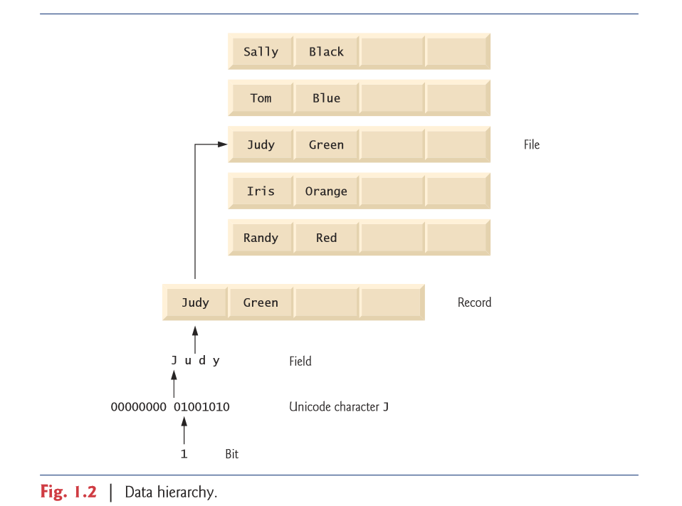
Data Hierarchy

Slide 12
Computer Organization
Input – Receive data
Typically through input devices.
Ex: Keyboard, mouse, USB stick, Blu-Ray
Output – Sending data
Typically through output devices
Ex: Monitor, printer
Can output from one program and input to another program.
Memory – Quick brains
Volatile memory – Data is lost when the computer loses power.
Random Access Memory (RAM)
“Random” because the information stored here can be processed randomly
Rapid access storage. Typically stores input actions making them available to be processed immediately.

Slide 13
Computer Organization
Arithmetic Logic Unit (ALU) – The calculator and decider
Performs simple calculations (+, -, x, ÷)
Performs comparison between items in memory. Checks equality.
ALU is often integrated directly into the CPU
Central Processing Unit (CPU) – The brains
Manages areas of the computer.
Tells the ALU what information to process and how to process it.
Multi-core processor can do multiple tasks at once
Secondary storage Unit – The warehouse
Programs not used often are stored here.
Hard-drives, DVD, Blu-ray, flash drives
Persistent memory – Data is saved even when device is powered off.

Slide 14

Programming Languages
Machine Languages
Lowest level language. The syntax (words/phrases) used are dependent on the machine used (aka machine dependent).
The design of the hardware defines the machine language.
This language is the primary interface between the hardware and software.
This language is unreadable.
Ex: Adds overtime pay to base pay and stores the result in gross pay.
Programming is too slow.

Slide 15

Programming Languages
Assembly Languages
Programmers started using English-like words to perform operations.
These “words” needed to be translated into machine code to perform their function
This was accomplished with assemblers
Ex: Adds overtime pay to base pay and stores the result in gross pay.
Remember: Computers do not understand this. It must be presented as machine code.
Problem: Still need lots of instructions to perform a simple task.

Slide 16

Programming Languages
High-level Languages
Using understandable phrases to create programs. Almost like everyday English.
These statements had to be translated to machine code using compilers.
Different programming languages have different compilers but their jobs are all the same. Turn statements into machine code.
Ex: Adds overtime pay to base pay and stores the result in gross pay.
Compilers can take a long time to convert from high-language to machine code.
Interpreters execute high-level programs directly without compiling.

Slide 17
Operating Systems
Allows for easier use of computers for users, developers and administrators
Runs applications safely, efficiently and concurrently (in parallel).
Core of the operating system is called the kernel.
Examples:
Windows
Linux
Android

Slide 18
Java
Sun Microsystems in 1991 funded a research project which resulted in Java
Based off another popular language (C++)
Goal of Java was to have programs that can run on a variety of systems and devices.
Became popular thanks to its usage in the early days of the internet (1993).
Provided interactions and animations to web pages
Currently used in large-scale enterprises, web servers, consumer devices.
In 2009, Oracle bought Java from Sun Microsystems.

Slide 19
Java
Java API (Application Programming Interfaces)
Provides libraries that contain classes and methods to aid programmers
If you don’t know what a class or method is don’t worry we will go over it.
For now a library is an aid.
Libraries cut down on development time by providing functionality
“Stand on the shoulder of giants” – Issac Newton
Other libraries exist that contain unique functionality

Slide 20
Anatomy of Java
Java programs consist of separate pieces called Classes
Classes can include methods that perform a task and return information when the task is complete
Your Java program will interface with the Java API
It is important to learn the Java syntax itself as well as commonly used Java class libraries.

Slide 21
Java Applications
5 phases of running a Java application
Creating the program
Compiling a Java program into Bytecode
Loading a program into memory
Bytecode verification
Execution

Slide 22
Java Applications
Creating the Program
Accomplished with an editor.
Type out words and phrases according to Java guidelines (source code)
Source code is saved to secondary storage with the .java extension
Simple text editors work…
Notepad, TextPad, etc…
…but Integrated Development Environments (IDE) are the most common editors used when creating programs.
Provides tools and aids while typing programs
Ex: Visual Studio, Eclipse

Slide 23
Java Applications
Compiling a Java Program into Bytecode
If using a simple text editor, you will have to start compilation through a command window
javac myJavaProgram.java
If using an IDE, this is done for you with the press of a button.
If compilation is success it will produce myJavaProgram.class

Slide 24
Java Applications
Compiling a Java Program into Bytecode
Java source code is translated into bytecode.
Represents the tasks to execute
Bytecode is run by a Java Virtual Machine (JVM).
Part of the JDK and foundation of the Java platform
A virtual machine is software that simulates a computer but hides the operating system and hardware from it directly.
If the same virtual machine is installed on many different devices, then your program can run on all those different devices
Remember the goal of Java?
Bytecode is platform independent
Does not require particular hardware
Results in bytecode being portable
Don’t have to recompile source code every time

Slide 25
Java Applications
Loading a program into memory
JVM places the program into memory and executes it (aka loading)
The class loader loads .class files containing bytecode of your program into primary memory.
.class files can be loaded from disk, a system or through a network

Slide 26
Java Applications
Bytecode Verification
Once the classes are loaded the bytecode verifier examines the bytecode to make sure it’s valid and adheres to Java security restrictions.
Ensures that any Java programs cannot damages other files on your system
Java enforces strong security to make sure programs arriving over the network do not damage files or the system itself (like a virus or worm)

Slide 27
Java Applications
Execution
The JVM executes the programs bytecode
The actions outlined in your program are performed.
An analysis of the bytecode is performed to search for hot spots or frequently executed sections of the bytecode.
Java uses a combination of compilation and interpretation. This is called just-in-time compilation (JIT).
JVM analyzes bytecode for areas that executes frequently and compiles them with JIT. The other areas are interpreted.
Translate the bytecode into the underlying computer’s machine language
If the JVM encounters these hot spots again, the machine code is executed (faster!)
Typically 2 phases of compilation
Source code translated into bytecode (for portability)
Bytecode is translated into machine language for the actual computer

Slide 28
Java Applications

Slide 29
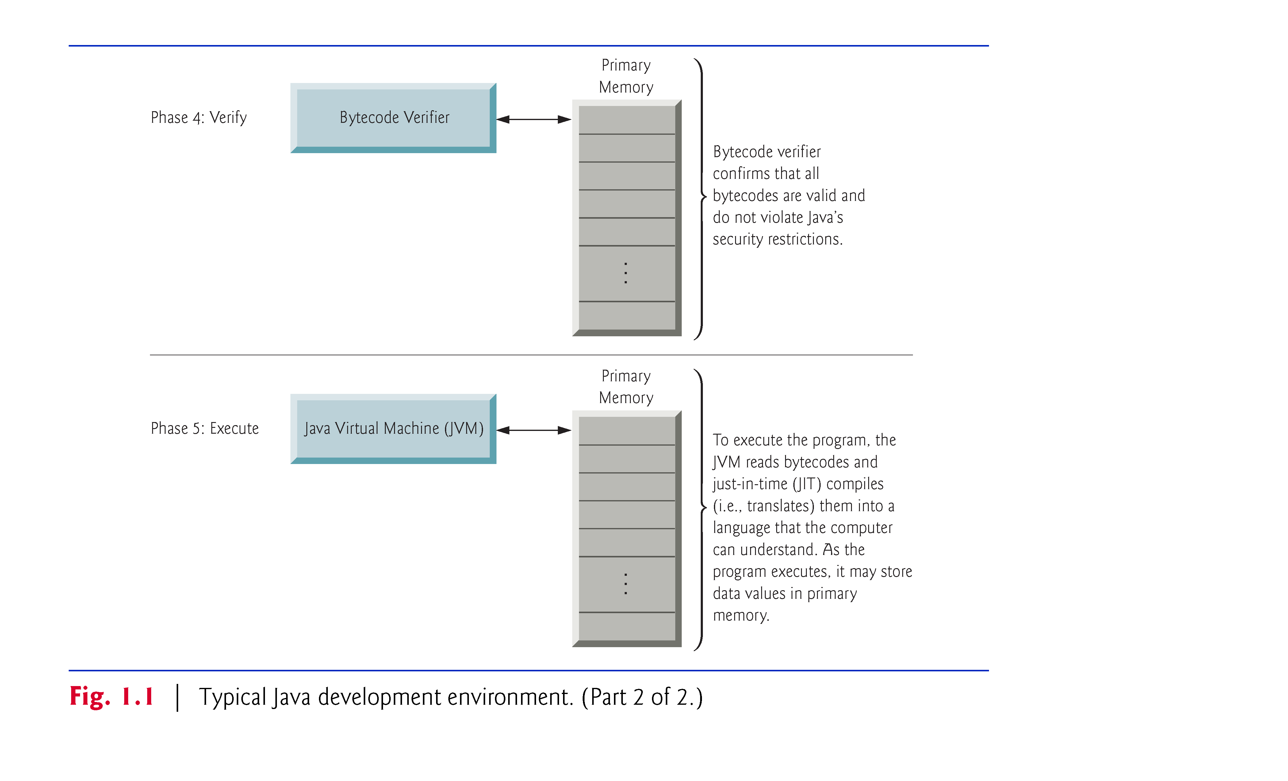
Java Applications

Slide 30
First Java Program
Launch Eclipse now

Slide 31
First Java Program
public class Welcome1
{
// main method begins execution of Java application
public static void main(String[] args)
{
System.out.println("Welcome to Java Programming!");
} // end method main
} // end class Welcome1

Slide 32
First Java Program
Commenting
// ← Indicates that the line will be a comment
Used to document programs and improve readability
Compiler ignores comments
When using //, it means the comment terminates at the end of the line
Traditional comment can be spread over multiple lines
/* This is a traditional comment. It
can be split over multiple lines */
Begins with a /* and ends with a */
Anything written between those to symbols will be ignored by the compiler.

Slide 33
First Java Program
Javadoc comments
Delimited by /** … */
Compiler ignores all text between delimiters
Useful in creating documentation directly within your program
The Javadoc utility program reads Javadoc comments and uses those comments to prepare documentation in an HTML format.

Slide 34
First Java Program
Syntax errors
Errors detected by the compiler that violates the rules of the Java language
Syntax errors must be eliminated before the application can compile properly
Cannot run a program that has not been compiled

Slide 35
First Java Program
Blank lines, space, tabs
Whitespace is useful for making your code readable
All whitespace is ignored by the compiler
No need to compress all your code together. Consider that in enterprise development, you are not the only person that will see code.

Slide 36
First Java Program
Declaring a class
public class Welcome1
Every Java program consists of at least one class
The class keyword introduces a class declaration and is immediately followed by the class name
Keywords are reserved by Java is are always lower case. Appendix C of the textbook contains a list of commonly used keywords

Slide 37
First Java Program
Filename for a public class
A public must be placed in a file that has the same name as the class name
For example:
Creating public class Welcome1…
This class must be stored in a file called Welcome1.java

Slide 38
First Java Program
Class names and identifiers
By convention, these begin with a capital letter and capitzaliz the first letter of each word included
Ex: SomeClassName
A class name is known as an identifier. These are a series of characters consisting of letters, digits, underscores and dollar signs.
Note: Cannot start with a digit
Note: Cannot contain space
Java is case sensitive. Uppercase and lowercase letters are distinct.
Ex: a1 and A1 are different (but also valid)

Slide 39
First Java Program
Class body
A left brace {, begins the body of every class
A right brace }, must end each class declaration
So far..
public class Welcome1 { … }

Slide 40
First Java Program
Declaring a method
public static void main( String[] args )
The main method is the starting for of every Java application
The parentheses “( )” indicate that this is a method
Java class declaration normally contain 1 or more methods
The main method must be implements as shown above. If not then the JVM will not execute the application
Methods perform tasks and can return information when they complete the task
The keyword void indicates that this method will not return any information

Slide 41
First Java Program
The body of a method declaration utilizes left and right braces { }
Statement
System.out.println(“Welcome to Java Programming”);
Instructs the computer to perform an action
Display the characters between the quotation marks onto the console
The characters between the quotation marks is known as a string
Also known as a character string or string literal
Notice that white space is NOT ignored by the compiler
Strings cannot span multiple lines of code

Slide 42
First Java Program
System.out object
Represents a standard output object
Allows a Java application to display information in the command window
System.out.println method
Displays the line of text provided
The string in the parenthesis is known as an argument for the println method.
println will position the cursor on the next line after printing the test
Can use print to keep the cursor on the same line
Most statement end with a semicolon ;

Slide 43
Modifying Your First Java Program
// Fig. 2.3: Welcome2.java
// Printing a line of text with multiple statements.
public class Welcome2
{
// main method begins execution of Java application
public static void main(String[] args)
{
System.out.print("Welcome to ");
System.out.println("Java Programming!");
} // end method main
} // end class Welcome2

Slide 44
Modifying Your First Java Program
Newline characters tell System.out’s print and println methods when to position the output cursor at the beginning of the next line in the command window
Newline characters are whitespace characters
The backslash (\) is called an escape character
Indicates that this is a “special character”
Backslash is combined with the next character to form an escape sequence.
Example: \n – Represents a newline character
A list of escape sequences can be found online

Slide 45
Modifying Your First Java Program
// Fig. 2.4: Welcome3.java
// Printing multiple lines with a single statement.
public class Welcome3
{
// main method begins execution of Java application
public static void main(String[] args)
{
System.out.println("Welcome\nto\nJava\nProgramming!");
} // end method main
} // end class Welcome3

Slide 46
Displaying Text with printf
System.out.printf method
The “f” means formatted
This means this method displays formatted data
Multiple method arguments are placed in a comma-separated list
Calling a method is referred to as invoking a method
Java allows large statements to be split over many lines
Cannot split in the middle of an identifier or a string
The first argument in the printf method is a format string
Consists of fixed text and formatted specifiers
Fixed text is output as it would be with print or println
Format specifiers act as placeholders for a value and specifies the type of data to output
Format specifiers begin with a % and is followed by a character representing the data type
Ex: %s is placeholder for a string

Slide 47
Displaying Text with printf
// Fig. 2.6: Welcome4.java
// Displaying multiple lines with method System.out.printf.
public class Welcome4
{
// main method begins execution of Java application
public static void main(String[] args)
{
System.out.printf("%s%n%s%n",
"Welcome to", "Java Programming!");
} // end method main
} // end class Welcome4

Slide 48
Adding Integers
Integers
Whole numbers like -22, 7, 0 and 1024
Programs remember numbers and other pieces of data in the computers memory and access that data through variables
Let’s look at an example…

Slide 49
Adding Integers
// Fig. 2.7: Addition.java
// Addition program that displays the sum of two numbers.
import java.util.Scanner; // program uses class Scanner
public class Addition
{
// main method begins execution of Java application
public static void main(String[] args)
{
// create a Scanner to obtain input from the command window
Scanner input = new Scanner(System.in);
int number1; // first number to add
int number2; // second number to add
int sum; // sum of number1 and number2
System.out.print("Enter first integer: "); // prompt
number1 = input.nextInt(); // read first number from user
System.out.print("Enter second integer: "); // prompt
number2 = input.nextInt(); // read second number from user
sum = number1 + number2; // add numbers, then store total in sum
System.out.printf("Sum is %d%n", sum); // display sum
} // end method main
} // end class Addition

Slide 50
import Declarations
Helps the compiler locate a class being used by the program
Rich set of predefined classes that you can reuse rather than “reinventing the wheel”
“Stand on the shoulders of giants” – Issac Newton
Classes are grouped into packages
Used to group related classes together.
Import declarations are used to identify which predefined classes you are using in your Java application
They are placed before the class declaration

Slide 51
Scanner Object for Input
Variable declaration statement
Scanner input = new Scanner( System.in );
Notice the format
Type name = new Type(…)
Variable
A location in computer’s memory where a value can be stored for use later
Must always be declared with a name and a type
The name allows the program to access the value in memory
The name can be any valid identifier
The variable type specifies what kind of information is stored at that location in memory.

Slide 52
Adding Integers
Scanner
Enables a program to read data for use in the program
Data can come from many sources
Keyboard, or a file on disk
To use Scanner you must first create it and specify the source of the data being input (System.in)
The equals (=) in the declaration indicates that the variable (input) should be initialized with the result of the expression to the right of the equals =
The new keyword creates an object
System.in
Enables applications to read bytes of data types by the user
Scanner translate these bytes into types understood by a program

Slide 53
Declaring Variables
Variable declaration statements
int number1; // first number to add int number2; // second number to add int sum; // sum of number1 and number2
Declaring 3 different variables (with different names). Each will hold data of type int.
int value range (-2,147,483,648 to + 2,147,483, 647)
Cannot use commas
Several variables of the same type can be declared together at once
int numer1, number2, sum;
CamalCaseNaming

Slide 54
Prompting the User for Input
Prompt
Good practice to provide a statement that directs the user to take a specific action.
Don’t just have a cursor blinking on screen. Tell them what to do.

Slide 55
Obtaining an int Input
Scanner method nextInt()
number1 = input.nextInt()
Expects an integer value from the user at the keyboard
The program will wait for user to type the number and press the enter key.
The result of method nextInt() takes the value and places it inside the variable number1
number1 gets the value of input.nextInt()
The operator = is called a binary operator. It has 2 operands
Right of the operator is always evaluated BEFORE the assignment is performed (left).

Slide 56
Adding Integers
Arithmetic
sum = number1 + number2; // Adds numbers then stores the result in “sum”
The arithmetic is completed first (number1 + number2), then the result is assigned to the variable sum by using the = operator.
sum gets the value of number1 + number2
The part of a statement that does calculations are called expressions
Expressions have a value associated with them

Slide 57
Displaying the Calculation Results
Integer formatted output
System.out.printf(“Sum is %d%n”, sum)
Format specifier %d is a placeholder for some int value
The “d” stands for “decimal integer”.

Slide 58
See you next time
“Don’t do bad things” – Dr. Ilia Nika

