Slide 1
Docker Containers
1

Slide 2

Outline
1. Recap
2. Motivation / Tutorial
3. What is a Container
4. Tutorial: Building & Running Containers using Docker
5. Why use Containers?
2

Slide 3
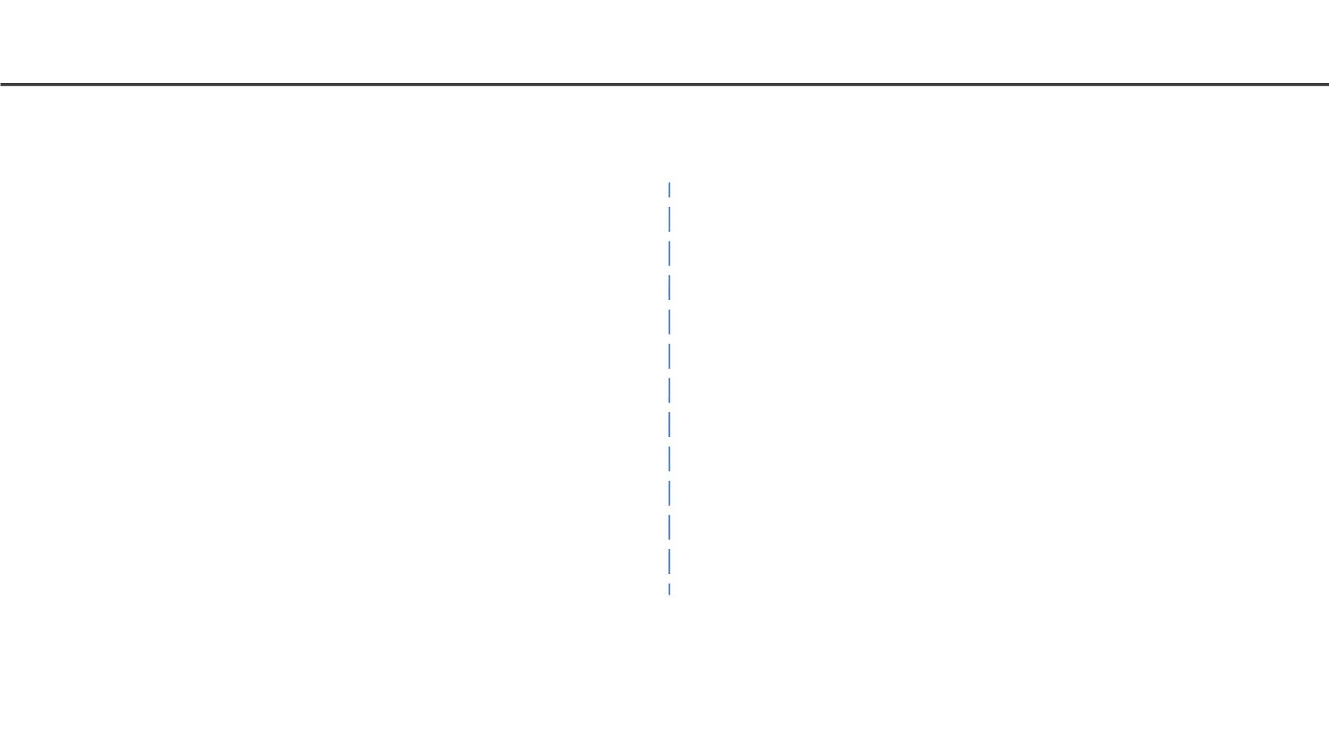
Virtual Environments
Pros
• Reproducible research
• Explicit dependencies
Cons
• Difficulty setting up your environment
• Not isolation
• Improved engineering collaboration • Does not always work across different
OS
3

Slide 4
Virtual Machines
Pros
Cons
• Full autonomy
• Very secure
• Lower costs
• Uses hardware in local machine
• Not very portable since size of
VMs are large
• Used by all Cloud providers for on
demand server instances
• There is an overhead associated
with virtual machines
4

Slide 5
Wish List
We want a system that:
● Automatically set up (installs) all OS and extra libraries and set up the python environment
● It is isolated
Containers
● Uses less resources
● Startups quickly
5

Slide 6
What is a CONTAINER
• Extremely portable and lightweight
• Fully packaged software with all dependencies included
• Can be used for development, training, and deployment
• Development teams can easily share containers
Docker is an open source platform for building, deploying, and
managing containerized applications.
6

Slide 7
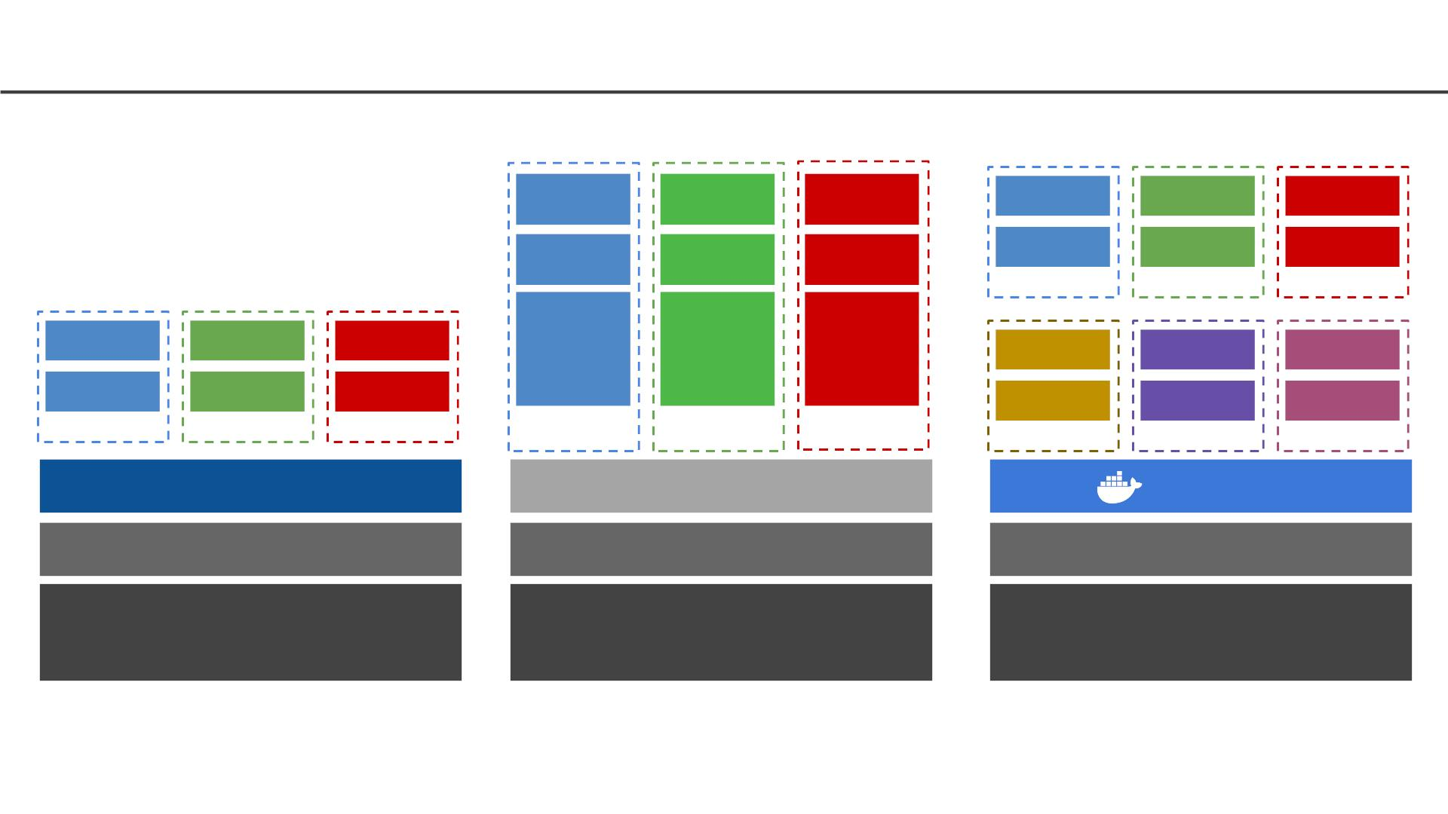
Environments vs Virtualization vs Containerization
App1
App2
App3
App1
App2
App3
Bins/lib
Bins/lib
Bins/lib
Bins/lib
Bins/lib
Bins/lib
Container
Container
Container
App1
App2
App3
OS
OS
OS
App3
App2
App3
Libs
Libs
Libs
Bins/lib
Bins/lib
Bins/lib
Venv
Venv
Venv
VM
VM
VM
Container
Container
Container
Python
Hypervisor
Docker
Operating System
Operating System
Operating System
Infrastructure
Infrastructure
Virtualization
Infrastructure
Virtual Environments
Containerization
7

Slide 8
Tutorial
● Create a GCS Bucket and read/write files to it
● Let us run the simple-translate app using Docker
● For this we will do the following:
○ Create a VM Instance
○ SSH into the VM
○ Install Docker inside the VM
○ Run the Containerized simple-translate app
● Full instructions can be found here
8

Slide 9
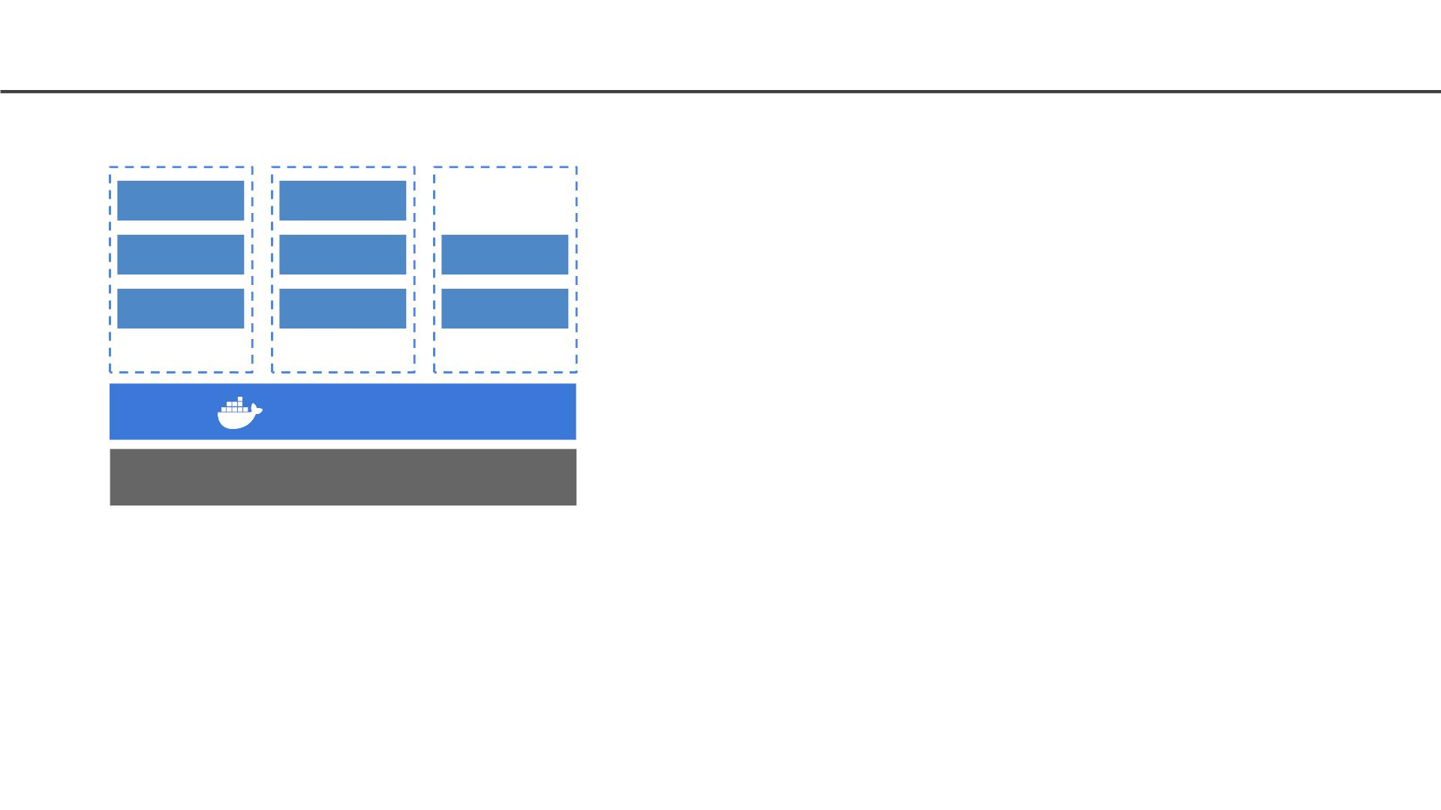
What is a Container
• Standardized packaging for software
dependencies
Tomcat
Java
SQL Server
.Net
Static Binary
• Isolate apps from each other
• Works for all major Linux distributions,
MacOS, Windows
Debian
Ubuntu
Alpine
Container
Container
Container
Docker
Kernel
9

Slide 10
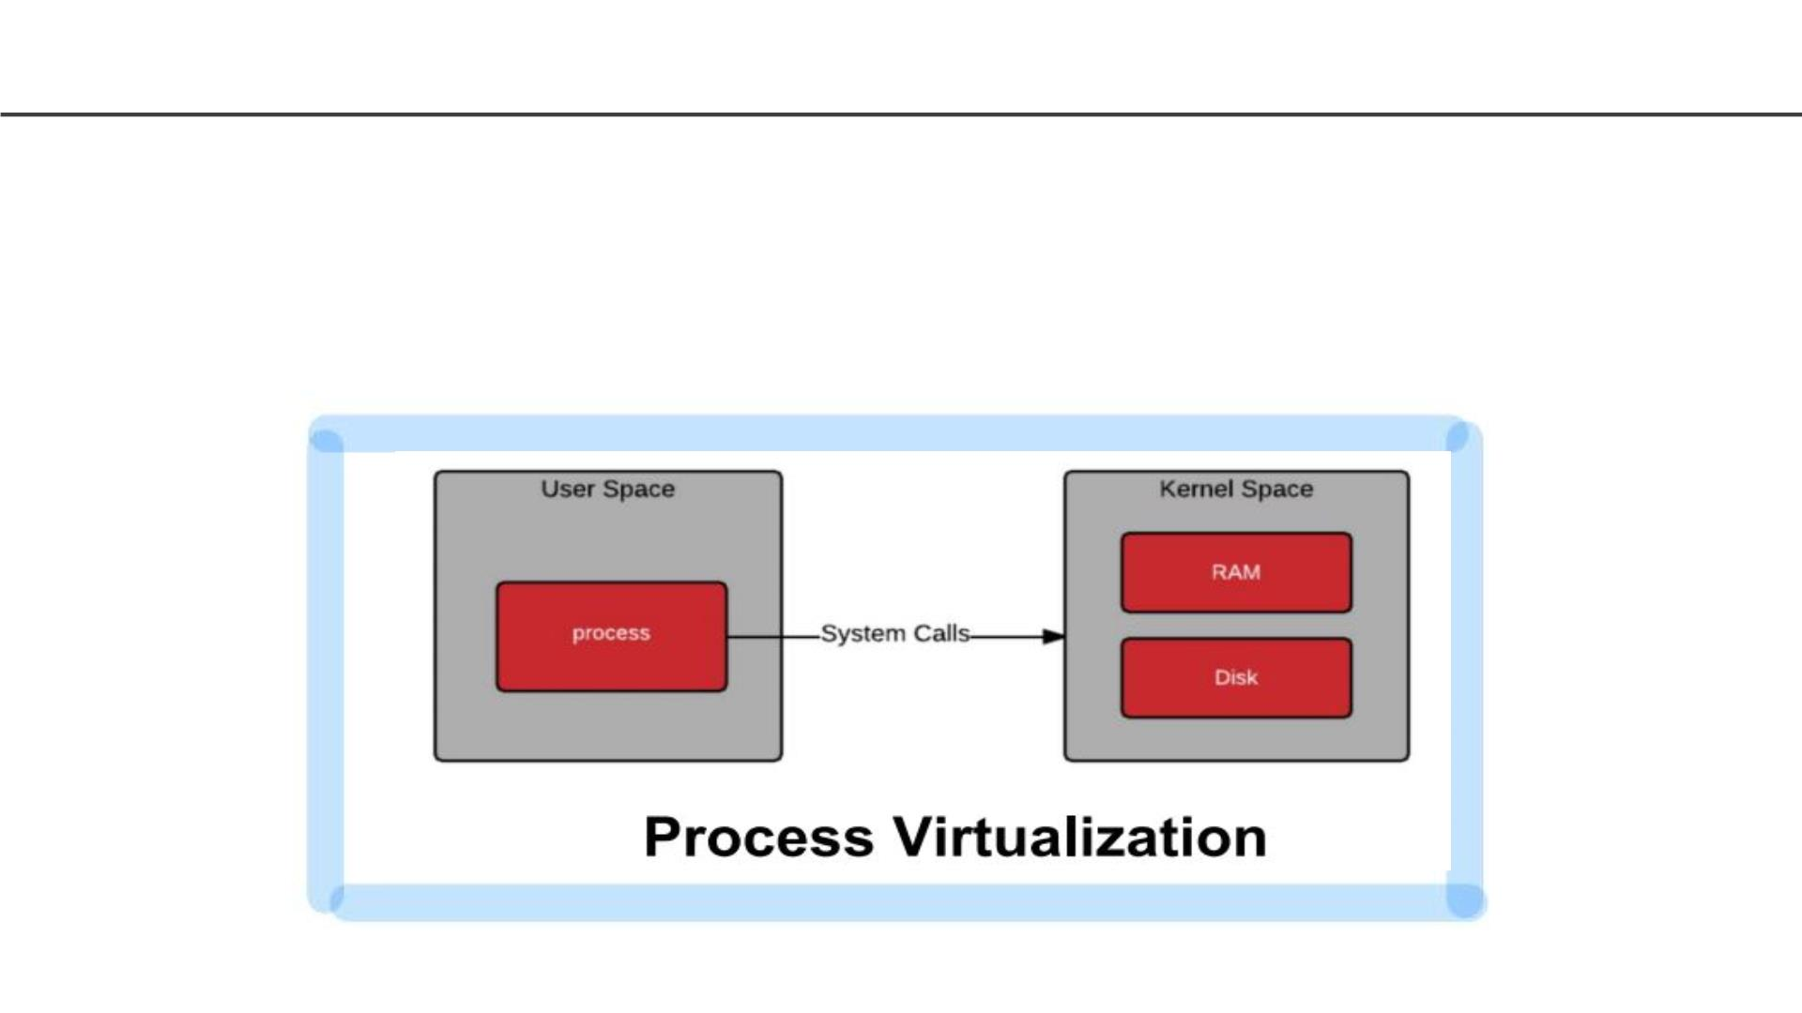
What Makes Containers so Small?
Container = User Space of OS
• User space refers to all of the code in an operating system that lives
outside of the kernel
10

Slide 11
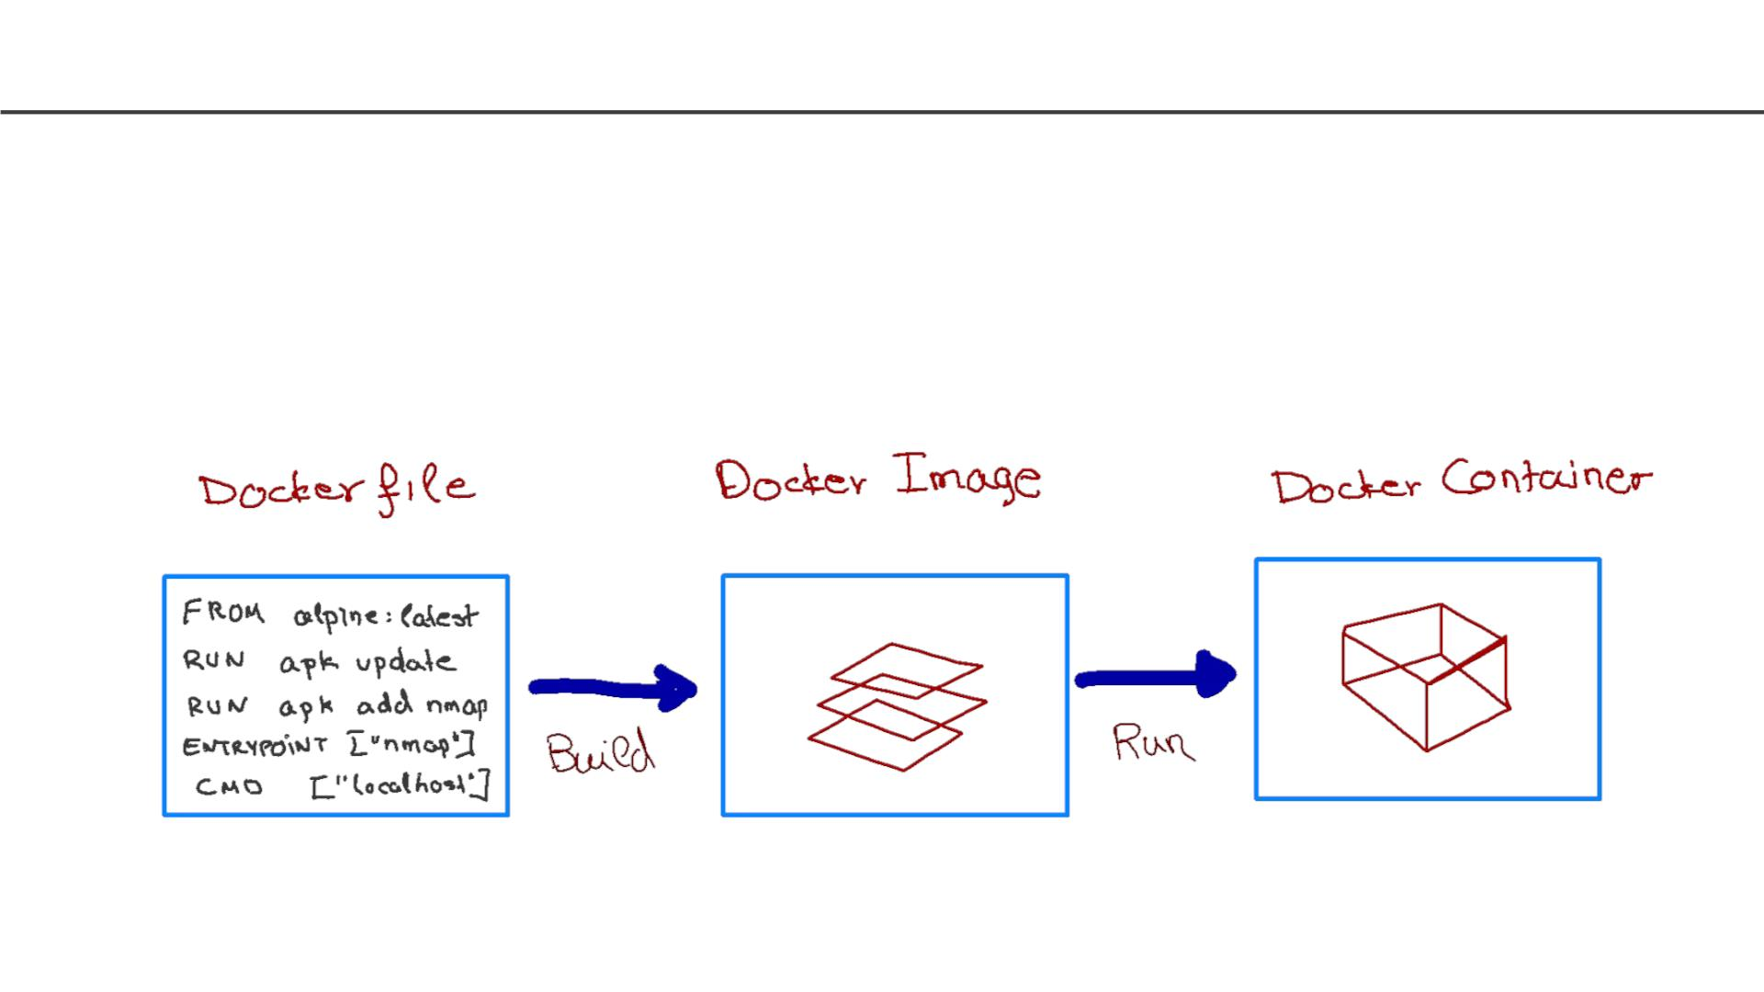
How to run a docker container
• We use a simple text file, the Dockerfile, to build the
Docker Image, which consists of an iso file and other files.
• We run the Docker Imageto get Docker Container.
11

Slide 12
What is the difference between an image and container
Docker Imageis a template aka a blueprint to create a running
Docker container. Docker uses the information available in the
Image to create (run) a container.
Image is like a recipe, container is like a dish.
Alternatively, you can think of an image as a class and a
container is an instance of that class.
12

Slide 13
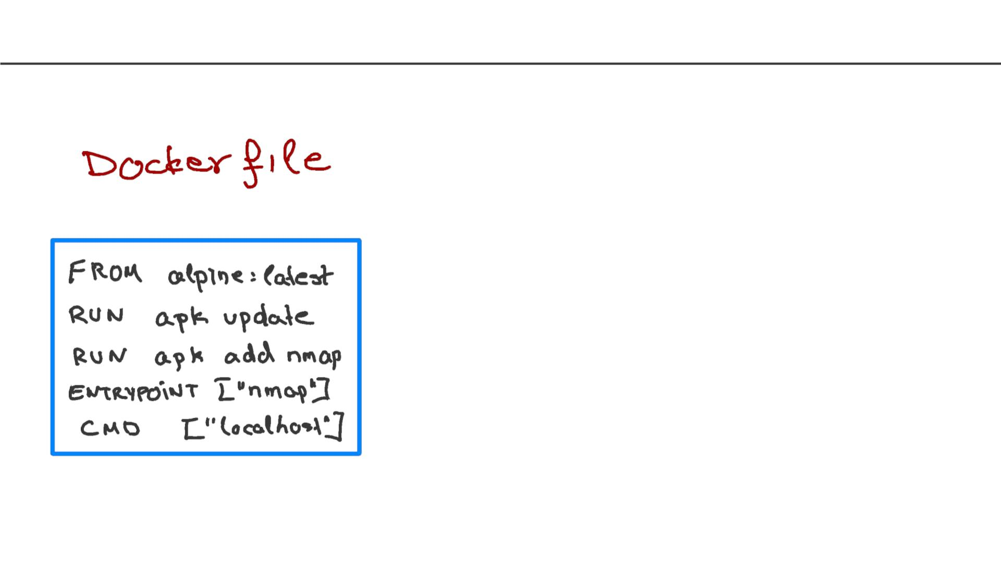
Inside the Dockerfile
FROM: This instruction in the Dockerfile tells the daemon, which
base image to use while creating our new Docker image. In the
example here, we are using a very minimal OS image called alpine
(just 5 MB of size). You can also replace it with Ubuntu, Fedora,
Debian or any other OS image.
RUN: This command instructs the Docker daemon to run the given
commands as it is while creating the image. A Dockerfile can have
multiple RUN commands, each of these RUN commands create a
new layer in the image.
ENTRYPOINT: The ENTRYPOINT instruction is used when you
would like your container to run the same executable every time.
Usually, ENTRYPOINT is used in scenarios where you want the
container to behave exclusively as if it were the executable it's
wrapping.
CMD: The CMD sets default commands and/or parameters when a
docker container runs. CMD can be overwritten from the command
line via the docker run command.
13

Slide 14
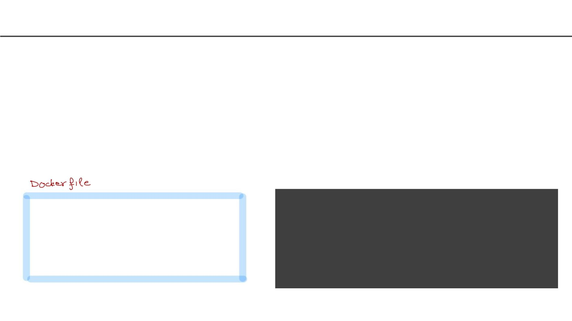
Multiple containers from same image
How can you run multiple containers from the same image?
Yes, you could think of an image as instating a class.
Wouldn’t they all be identical?
Not necessarily. You could instate it with different parameters using the CMD and
therefore different containers will be different.
> docker build -t hello_world_cmd:first -f Dockerfile_cmd .
FROM ubuntu:latest
RUN apt-get update
ENTRYPOINT ["/bin/echo", "Hello"]
CMD ["world"]
> docker run -it hello_world_cmd:first
> Hello world
> docker run -it hello_world_cmd:first Pavlos
> Hello Pavlos
14

Slide 15
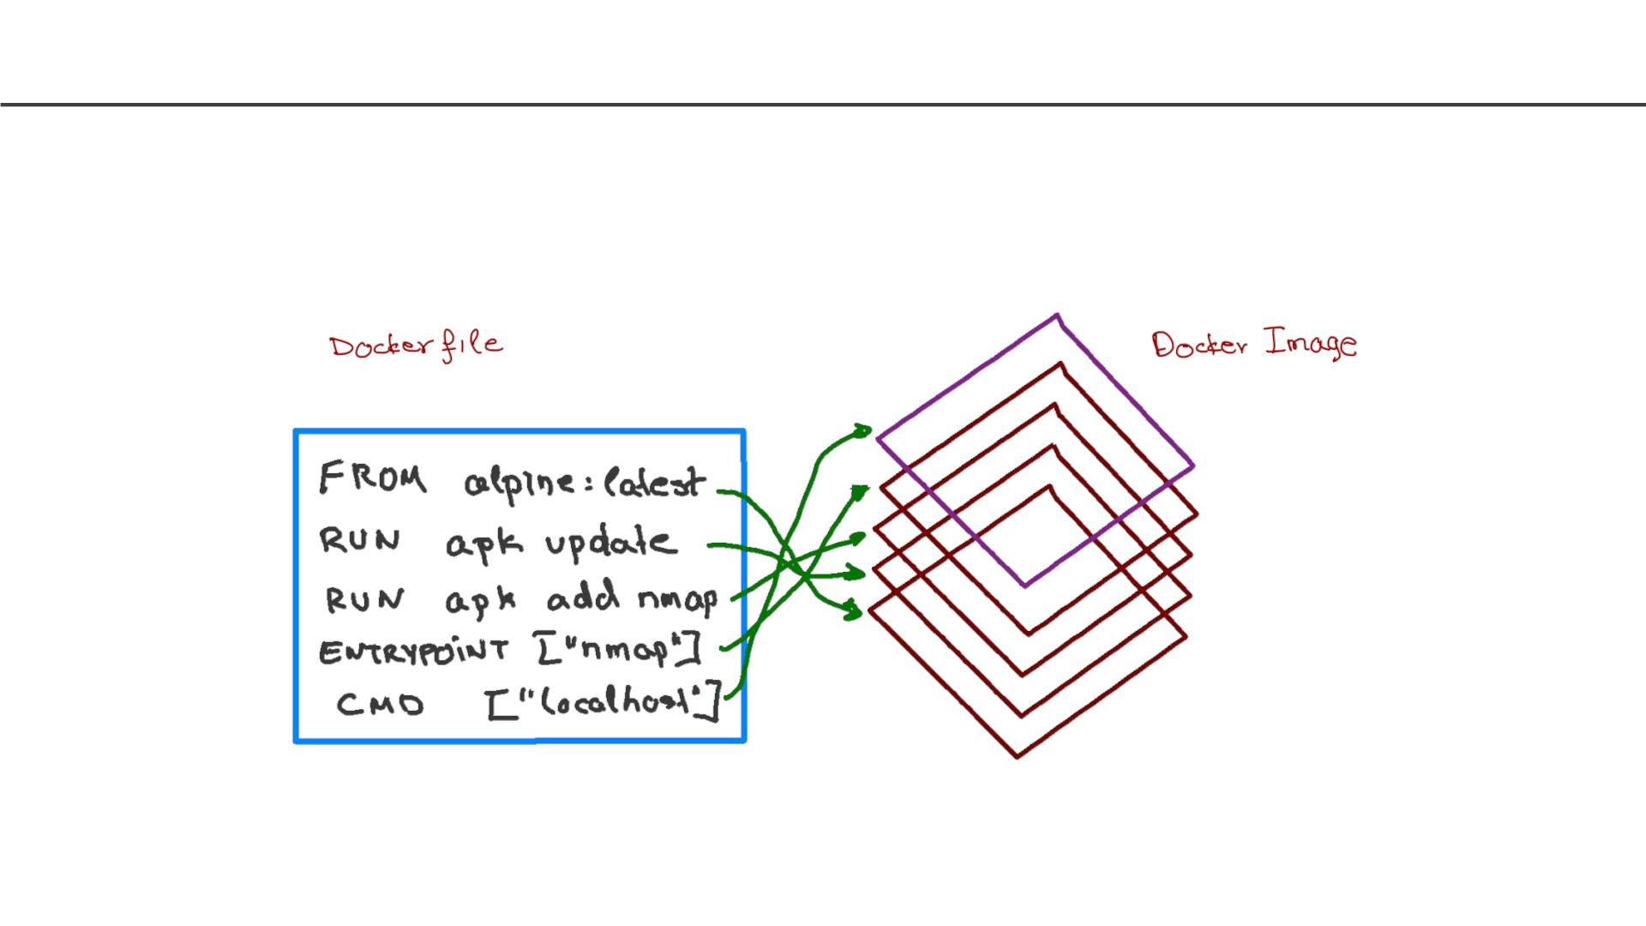
Docker Image as Layers
When we execute the build command, the daemon reads the Dockerfile
and creates a layer for every command.
15

Slide 16
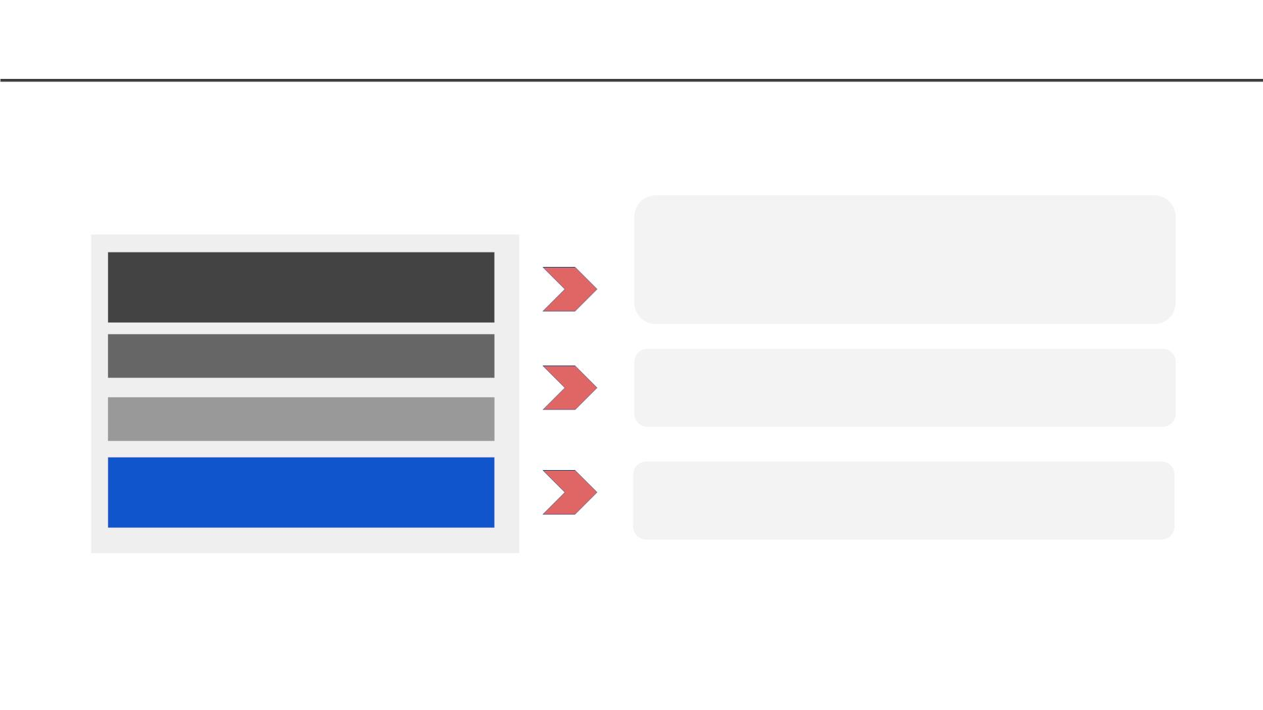
Image Layering
A application sandbox
- Each container is based on an image that holds necessary
config data
- When you launch a container, a writable layer is added on
top of the image
Container
(Writable, running application)
Layered Image 2
Layered Image 1
A static snapshot of the container configuration
- Layer images are read-only
- Each image depends on one or more parent images
Platform Image
An Image that has no parent
(Runtime Environment)
- Platform images define the runtime environment, packages
and utilities necessary for containerized application to run
16

Slide 17
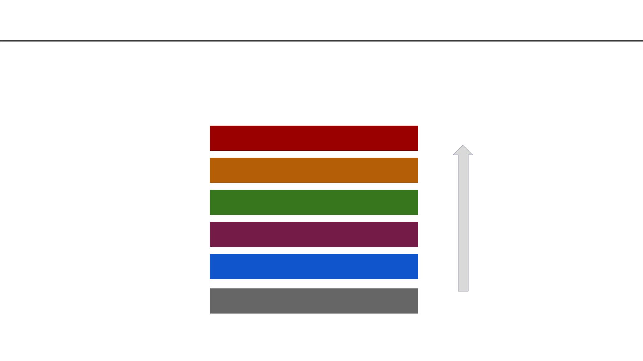
Image Layering - Example
Docker layers for a container running debian and a python environment using
Pipenv
Pipenv Sync
Install Pipenv
Upgrade Pip
Install Python & Pip
Debian Linux
Kernel
17

Slide 18
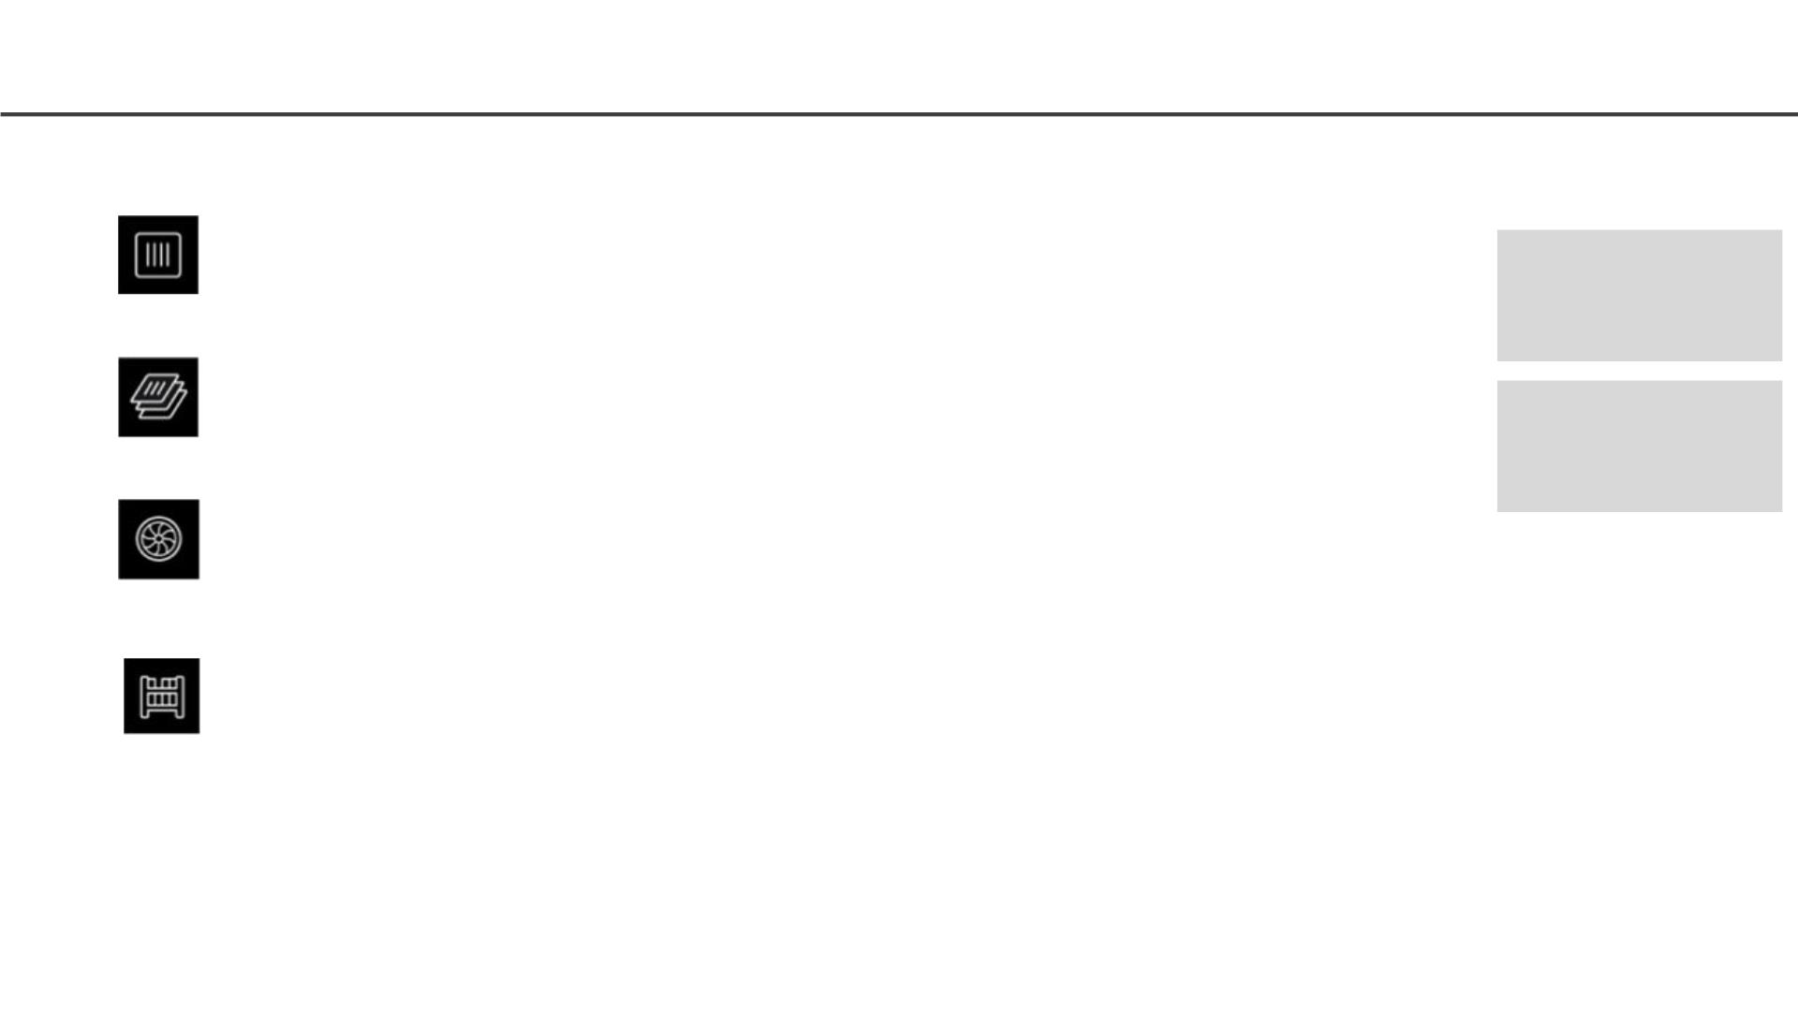
Some Docker Vocabulary
Docker Image
The basis of a Docker container. Represent a full application
Images
How you store
your application
Docker Container
The standard unit in which the application service resides and executes
Containers
How you run your
application
Docker Engine
Creates, ships and runs Docker containers deployable on a physical or
virtual, host locally, in a datacenter or cloud service provider
Registry Service (Docker Hub or Docker Trusted Registry)
Cloud or server-based storage and distribution service for your images
18

Slide 19
Tutorial
Installing Docker Desktop
1. Install Docker Desktop. Use one of the links below to download the proper Docker application
depending on your operating system.
○ For Mac users, follow this link- https://docs.docker.com/docker-for-mac/install/.
○ For Windows users, follow this link- https://docs.docker.com/docker-for-windows/install/
Note: You will need to install Hyper-V to get Docker to work.
○ For Linux users, follow this link- https://docs.docker.com/install/linux/docker-ce/ubuntu/
2. Once installed run the docker desktop.
3. Open a Terminal window and type docker run hello-worldto make sure Docker is installed
properly.
19

Slide 20
Tutorial
● Let us build the simple-translate app Docker Container
● For this we will do the following:
○ Clone or download code
○ Build a container
○ Run a container
○ Pavlos will update a container on Docker Hub
○ You will pull the new container and run it
● For detail instruction go here
20

Slide 21
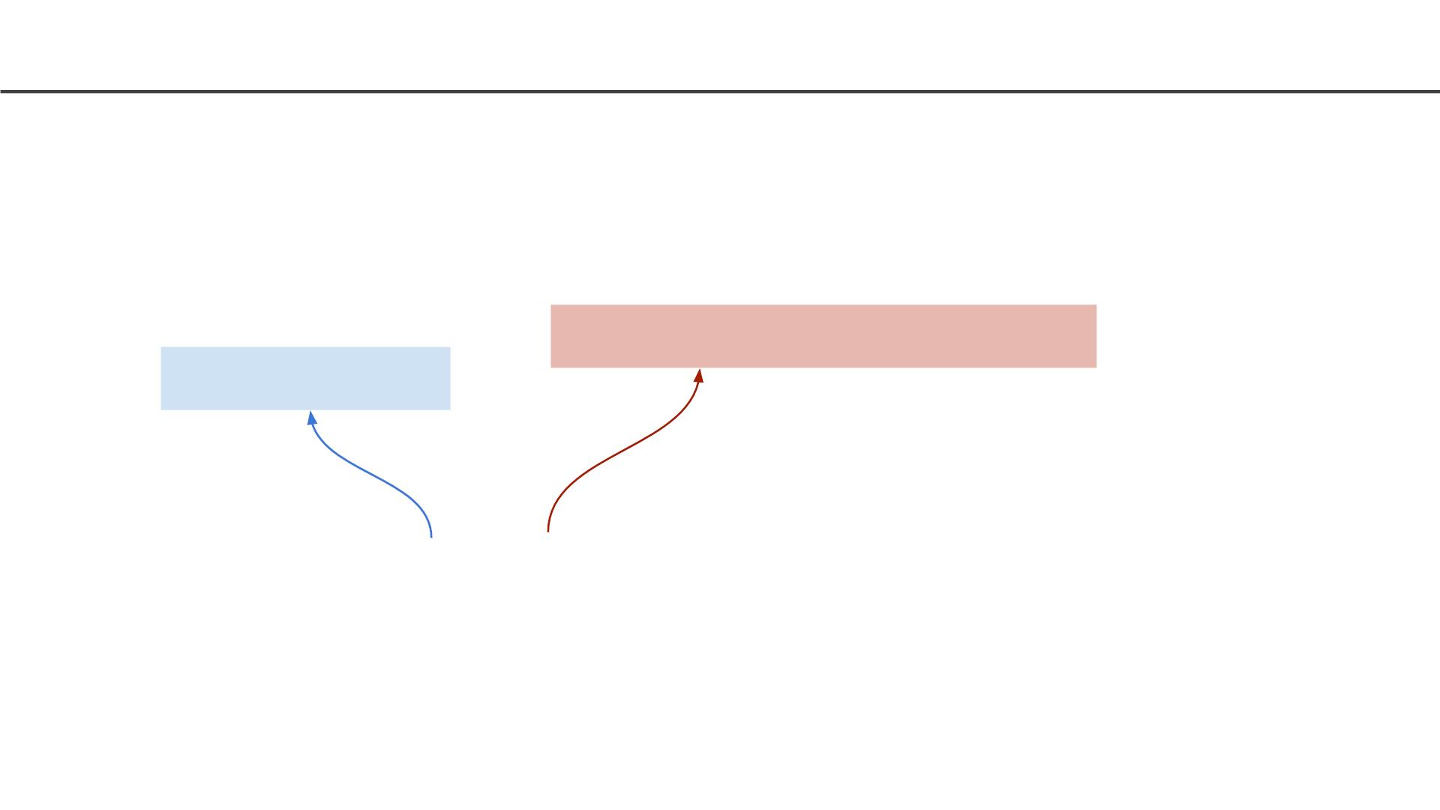
Tutorial: Docker commands
Check what version of Docker
Get version of Docker CLI
docker command
docker --version
21

Slide 22
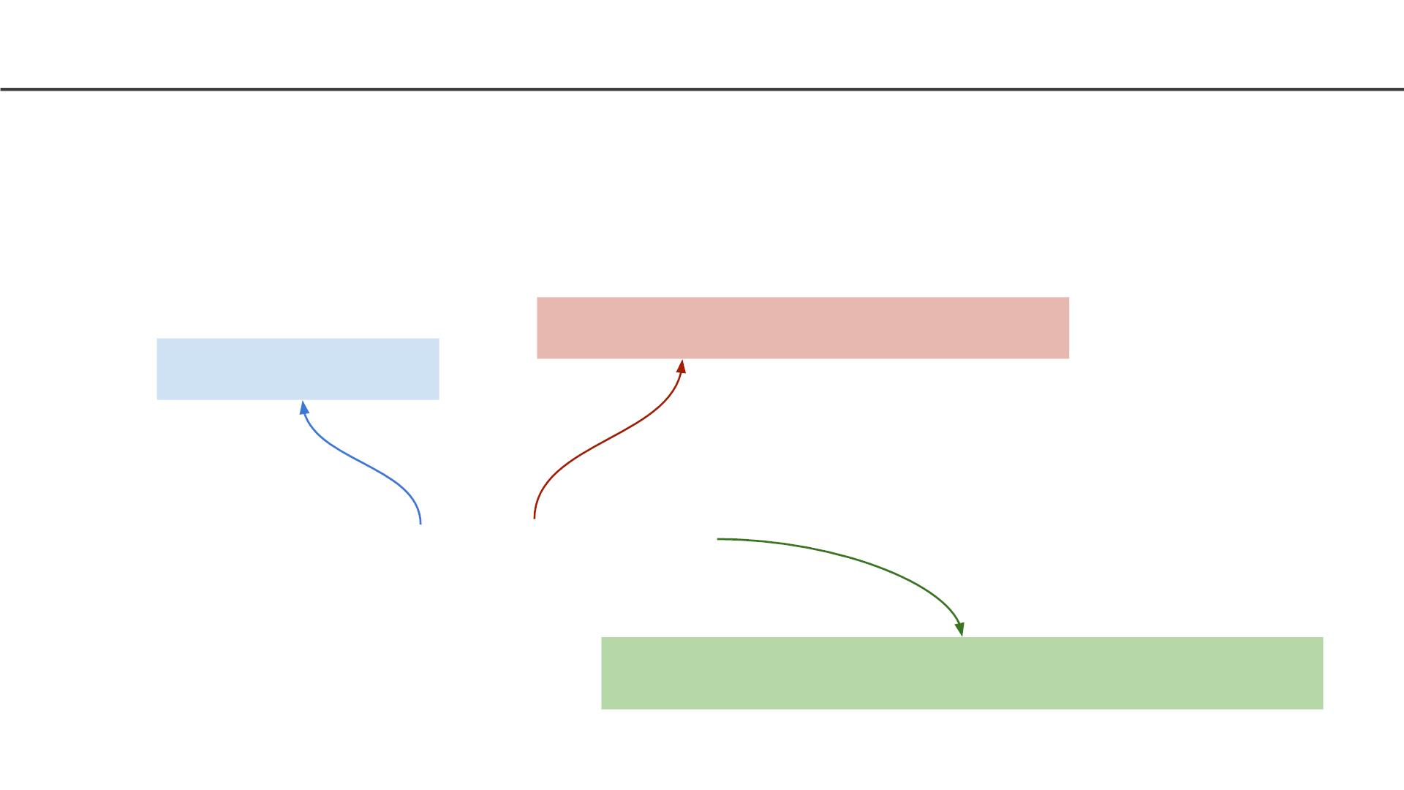
Tutorial: Docker commands
List all running docker containers
Docker command for container
docker command
docker container ls
Docker command option to list all containers
22

Slide 23
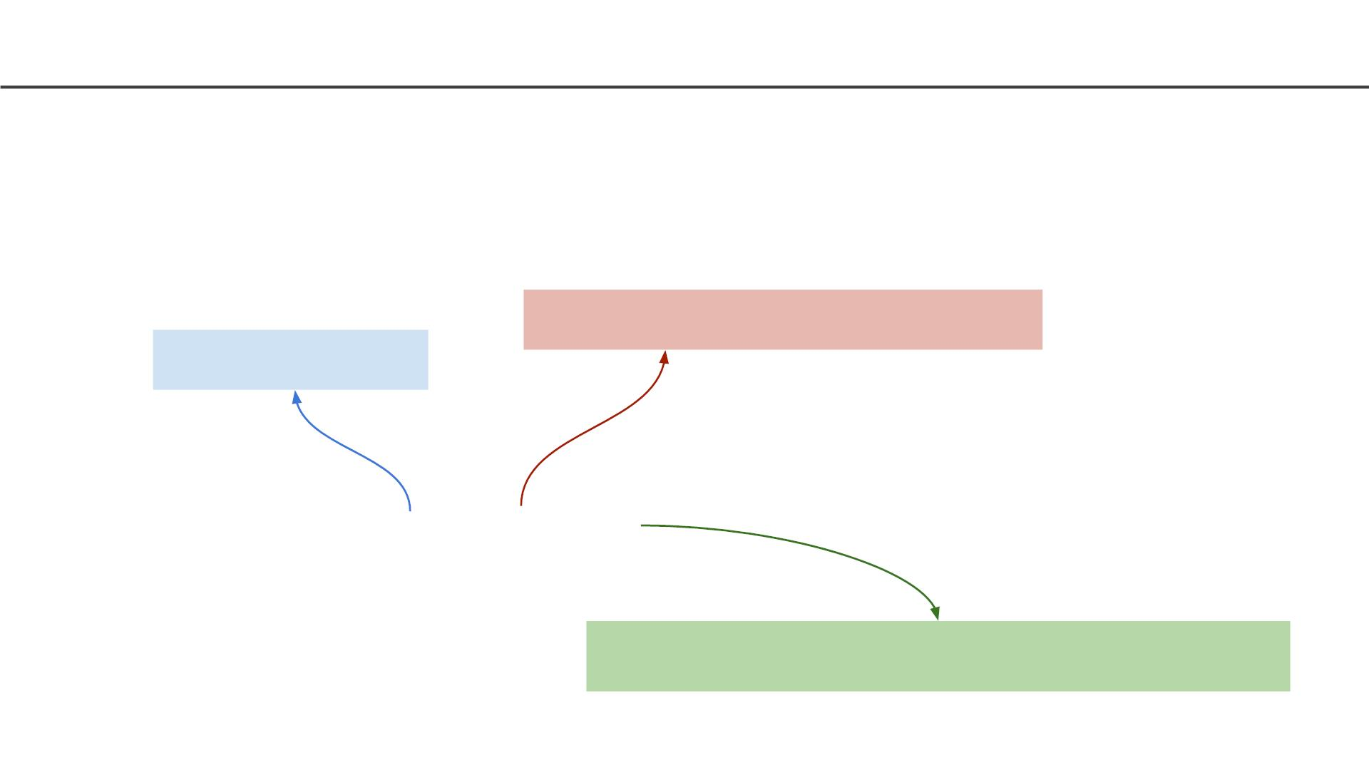
Tutorial: Docker commands
List all docker images
Docker command for image
docker command
docker image ls
Docker command option to list all images
23

Slide 24
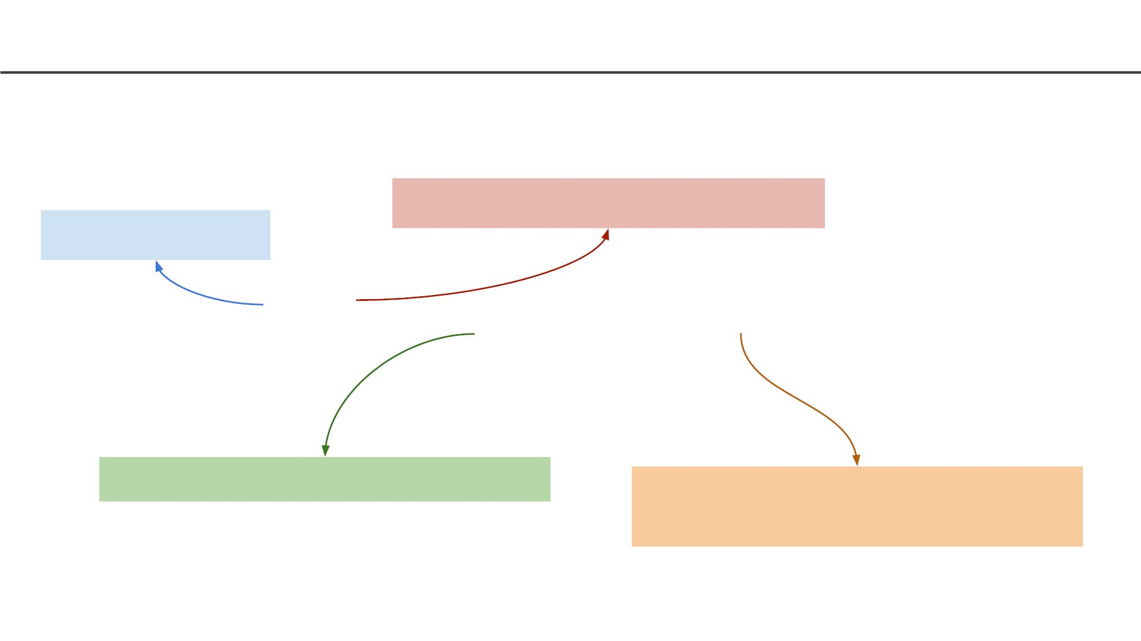
Tutorial: Docker commands
Build an image based on a Dockerfile
Build the image
docker command
docker build -t ac215-d1 -f Dockerfile .
Name the image
Name of docker file and “.” means look at
the current working directory
24

Slide 25
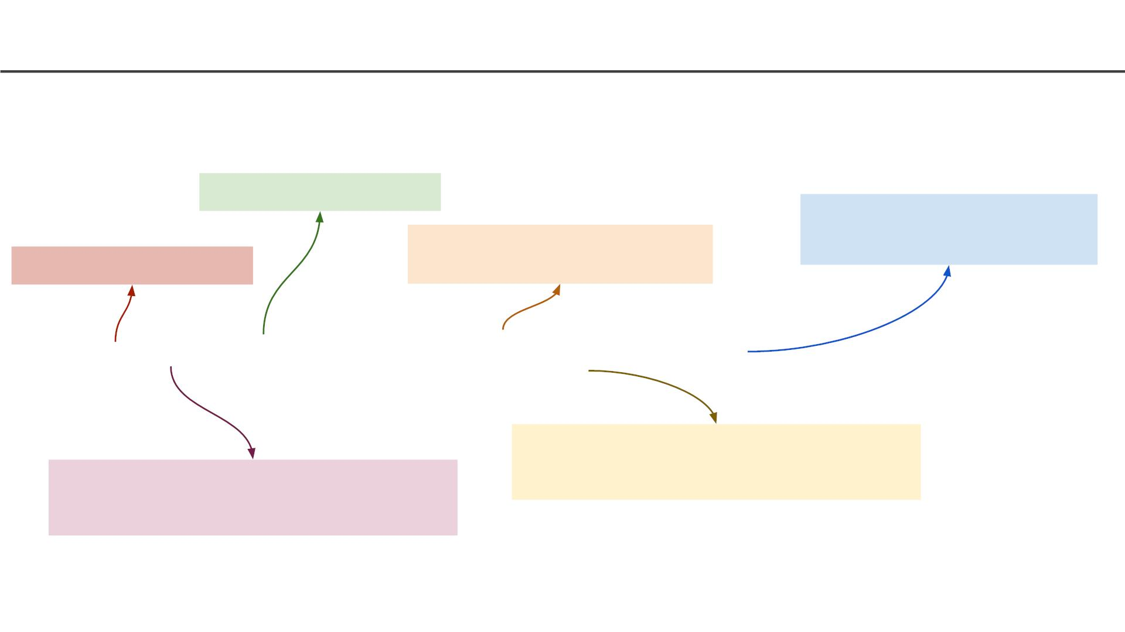
Tutorial
Run a docker container using an image from Docker Hub
Name of the container
Name of the image to use
Default command to execute on
startup
Run the container
docker run --rm --name ac215-d1 -ti --entrypoint /bin/bash ac215-d1
‘t’ is to give us a terminal and ‘i’ is for
interactive mode
automatically clean up the container and
remove the file system when the container
exit
25

Slide 26
Tutorial
Open another command prompt and check how many container
and images we have
docker container ls
docker image ls
26

Slide 27
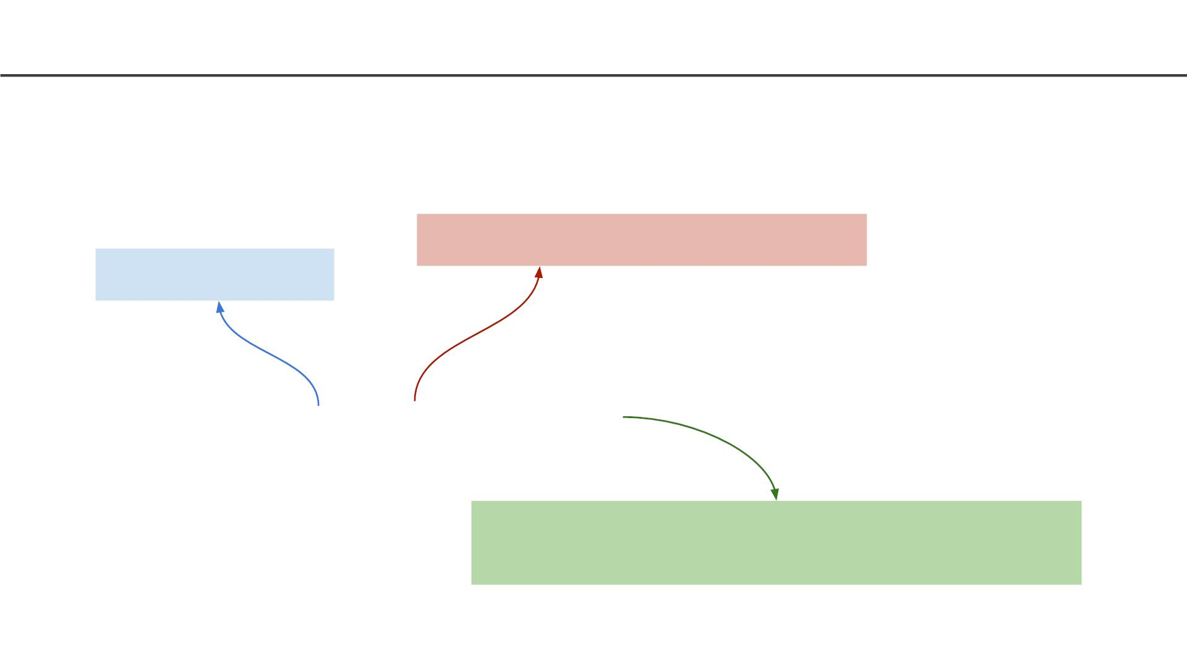
Tutorial
Exit from all containers and let us clear of all images
Docker command for system
docker command
docker system prune -a
Docker command option to remove all images not
referenced by any containers
27

Slide 28
Tutorial
Check how many containers and images we have currently
docker container ls
docker image ls
28

Slide 29
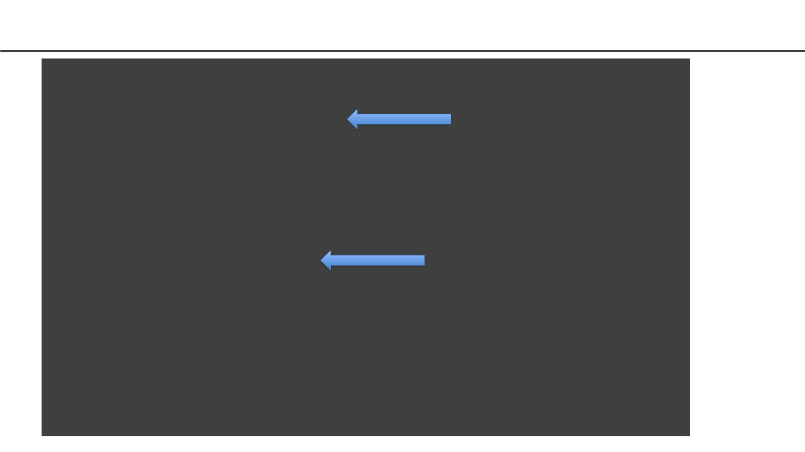
Docker Image as Layers
>docker build -t hello_world_cmd -f Dockerfile_cmd .
Sending build context to Docker daemon 34.3kB
Step 1/4 : FROM ubuntu:latest
latest: Pulling from library/ubuntu
54ee1f796a1e: Already exists
Step1: Instruction
1
f7bfea53ad12: Already exists
46d371e02073: Already exists
b66c17bbf772: Already exists
Digest: sha256:31dfb10d52ce76c5ca0aa19d10b3e6424b830729e32a89a7c6eee2cda2be67a5
Status: Downloaded newer image for ubuntu:latest
---> 4e2eef94cd6b
Step 2/4 : RUN apt-get update
---> Running in e3e1a87e8d6e
Step2: Instruction
2
Get:1 http://archive.ubuntu.com/ubuntu focal InRelease [265 kB]
Get:2 http://security.ubuntu.com/ubuntu focal-security InRelease [107 kB]
Get:3 http://security.ubuntu.com/ubuntu focal-security/universe amd64 Packages [67.5 kB]
Get:4 http://archive.ubuntu.com/ubuntu focal-updates InRelease [ 111 kB]
Get:5 http://archive.ubuntu.com/ubuntu focal-backports InRelease [98.3 kB]
Get:6 http://security.ubuntu.com/ubuntu focal-security/main amd64 Packages [231 kB]
Get:7 http://archive.ubuntu.com/ubuntu focal/restricted amd64 Packages [33.4 kB]
Get:8 http://archive.ubuntu.com/ubuntu focal/main amd64 Packages [1275 kB]
Get:9 http://security.ubuntu.com/ubuntu focal-security/multiverse amd64 Packages [1078 B]
…
29

Slide 30
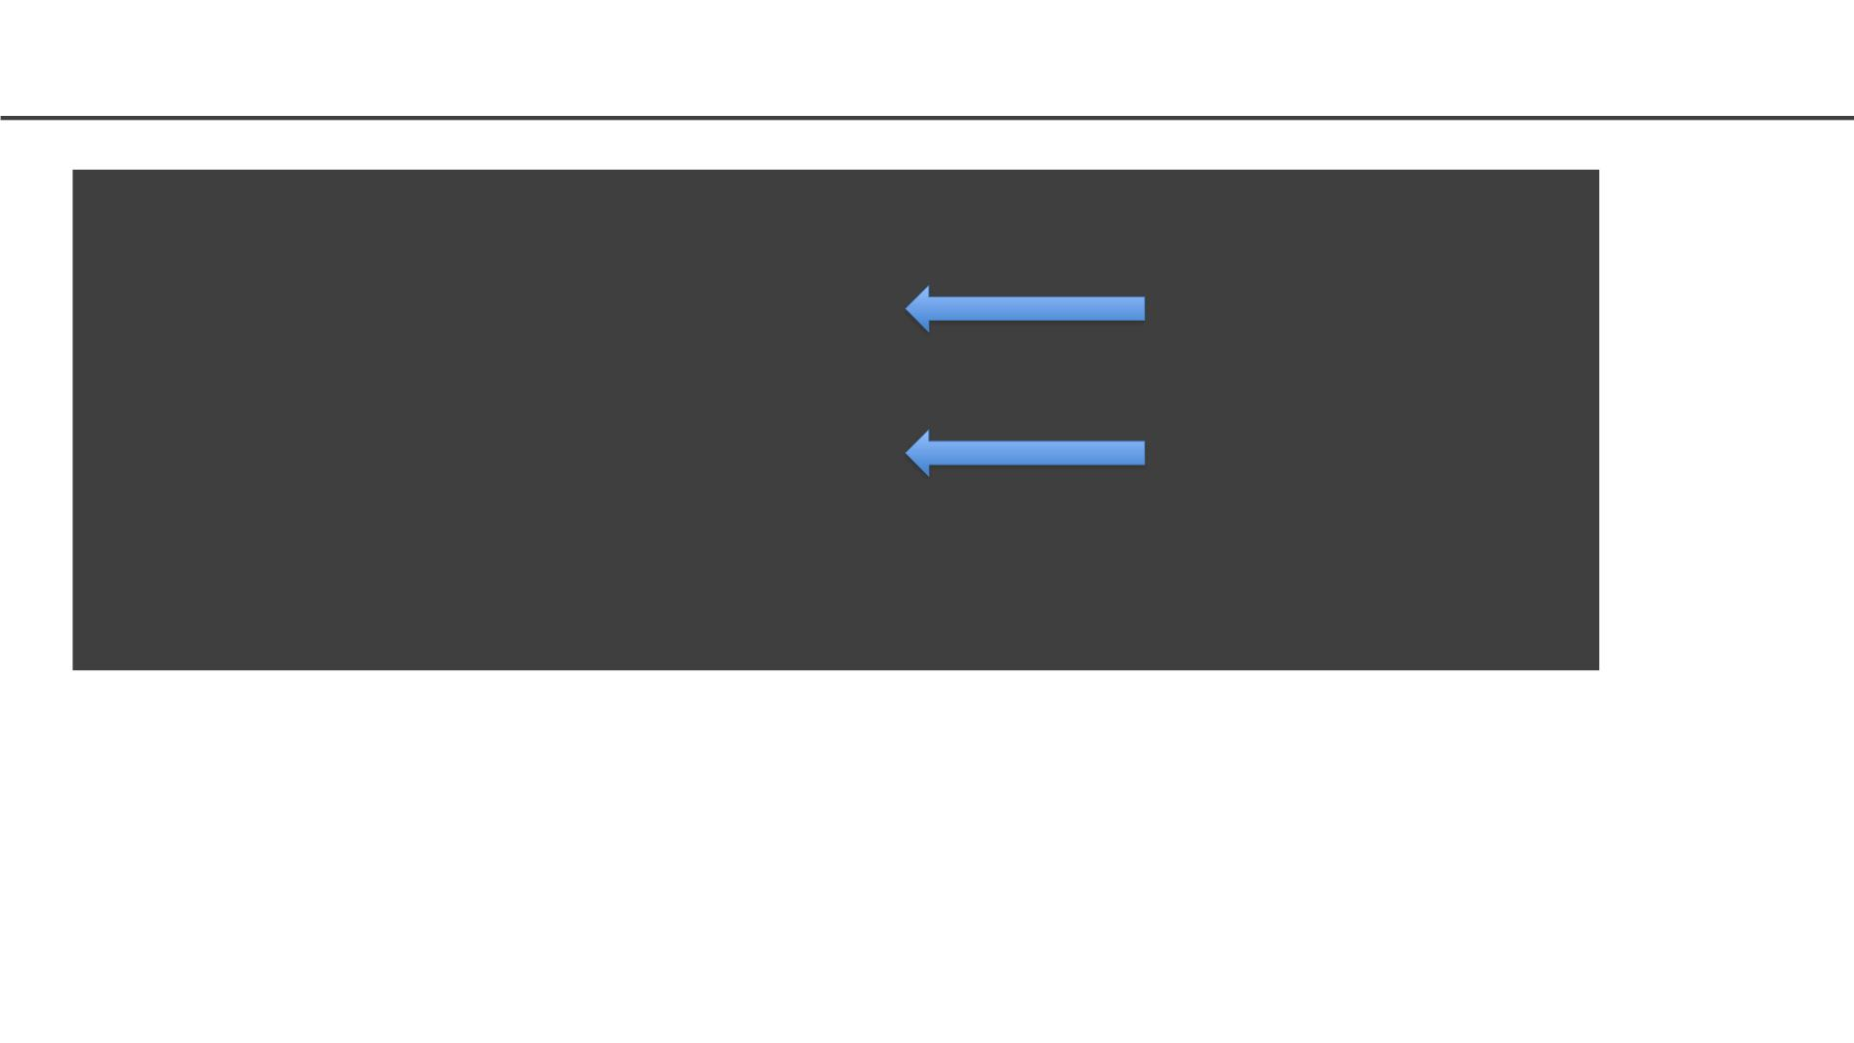
Docker Image as Layers
>docker build -t hello_world_cmd -f Dockerfile_cmd .
….
Step 3/4 : ENTRYPOINT ["/bin/echo", "Hello"]
---> Running in 52c7a98397ad
Removing intermediate container 52c7a98397ad
---> 7e4f8b0774de
Step3: Instruction 3
Step4: Instruction 4
Step 4/4 : CMD ["world"]
---> Running in 353adb968c2b
Removing intermediate container 353adb968c2b
---> a89172ee2876
Successfully built a89172ee2876
Successfully tagged hello_world_cmd:latest
30

Slide 31

Docker Image as Layers
> docker images
REPOSITORY
hello_world_cmd latest
ubuntu latest
TAG
IMAGE ID
a89172ee2876
4e2eef94cd6b
CREATED
7 minutes ago
3 weeks ago
SIZE
96.7MB
73.9MB
> docker image history hello_world_cmd
IMAGE
CREATED
8 minutes ago
CREATED BY
/bin/sh -c #(nop) CMD ["world"]
/bin/sh -c #(nop) ENTRYPOINT ["/bin/echo" "… 0B
SIZE
COMMENT
a89172ee2876
7e4f8b0774de
cfc0c414a914
4e2eef94cd6b
<missing>
<missing>
<missing>
<missing>
0B
8 minutes ago
8 minutes ago
3 weeks ago
3 weeks ago
3 weeks ago
3 weeks ago
3 weeks ago
/bin/sh -c apt-get update
/bin/sh -c #(nop) CMD ["/bin/bash"]
22.8MB
0B
/bin/sh -c mkdir -p /run/systemd && echo 'do… 7B
/bin/sh -c set -xe && echo '#!/bin/sh' > /… 811B
/bin/sh -c [ -z "$(apt-get indextargets)" ] 1.01MB
/bin/sh -c #(nop) ADD file:9f937f4889e7bf646… 72.9MB
31

Slide 32
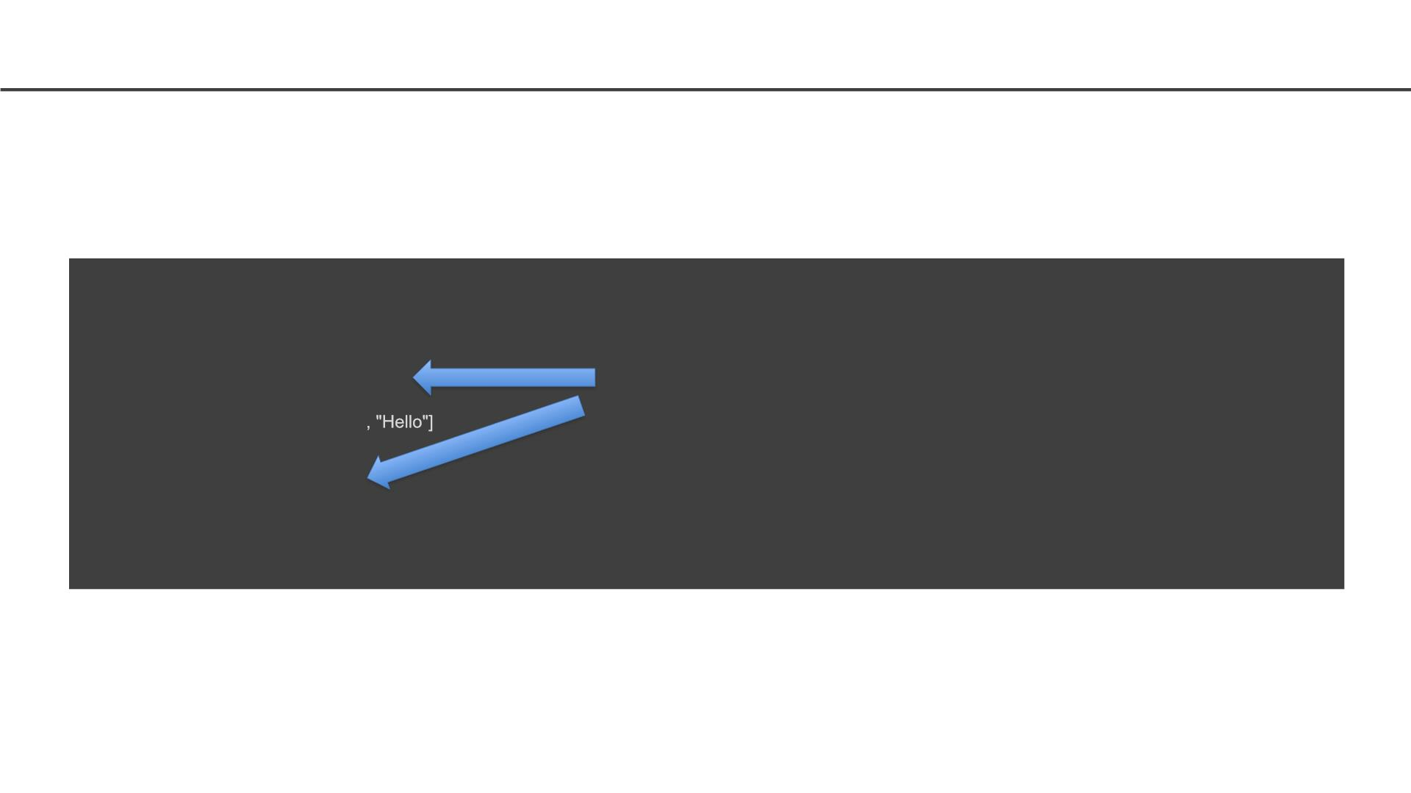
Why Layers
Why build an image with multiple layers when we can just build it in a single layer?
Let’s take an example to explain this concept better, let us try to change the Dockerfile_cmd we
created and rebuild a new Docker image.
> docker build -t hello_world_cmd -f Dockerfile_cmd .
Sending build context to Docker daemon 34.3kB
Step 1/4 : FROM ubuntu:latest
---> 4e2eef94cd6b
Step 2/4 : RUN apt-get update
---> Using cache
---> cfc0c414a914
Step 3/4 : ENTRYPOINT ["/bin/echo"
---> Using cache
Have seen this before. Use
cache
---> 7e4f8b0774de
Step 4/4 : CMD ["world"]
---> Using cache
---> a89172ee2876
Successfully built a89172ee2876
Successfully tagged hello_world_cmd:latest
As you can see that the image was built using the existing layers from our previous docker image
builds. If some of these layers are being used in other containers, they can just use the existing layer
instead of recreating it from scratch.
32

Slide 33
Why use Containers?
• Imagine you are building a large complex application (e.g.
Online Store)
• Traditionality you would build this using a Monolithic
Architecture
33

Slide 34
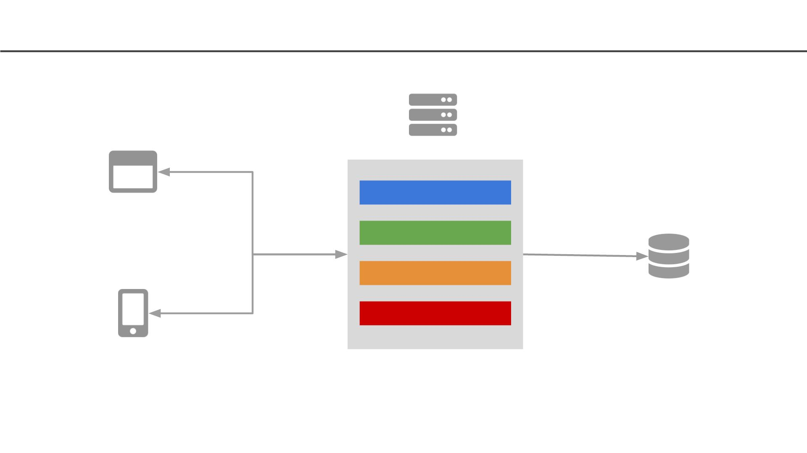
Monolithic Architecture
HTML / REST / JSON
Server
Storefront UI Module
Catalog Module
Reviews Module
Orders Module
Browser Apps
Database
REST / JSON
Mobile Apps
34

Slide 35
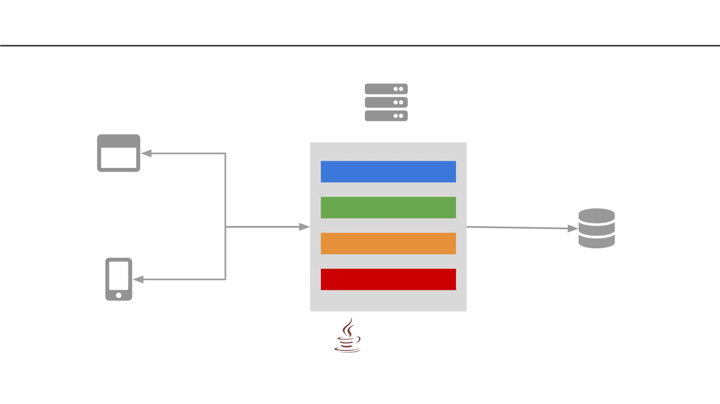
Monolithic Architecture
HTML / REST / JSON
Server
Storefront UI Module
Catalog Module
Reviews Module
Orders Module
Browser Apps
Database
REST / JSON
Mobile Apps
Oracle
Java
35

Slide 36
Monolithic Architecture - Advantages
Simple to Develop, Test, Deploy and Scale:
1. Simple to develop because all the tools and IDEs support the
applications by default
2. Easy to deploy because all components are packed into one
bundle
3. Easy to scale the whole application
36

Slide 37
Monolithic Architecture - Disadvantages
1. Very difficult to maintain
2. One component failure will cause the whole system to fail
3. Very difficult to create the patches for monolithic architecture
4. Adapting to new technologies is challenging
5. Take a long time to startup because all the components needs to
get started
37

Slide 38
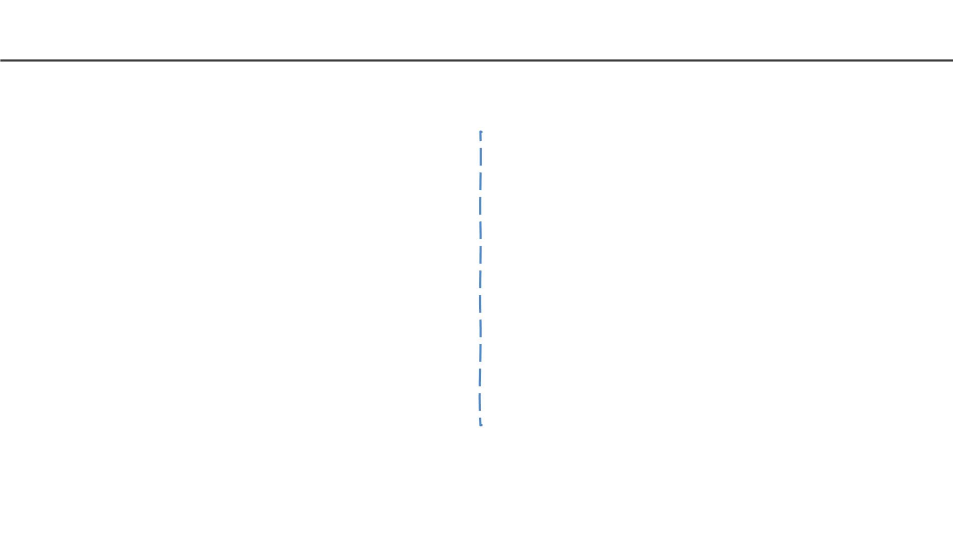
Applications have changed dramatically
Today
A decade ago
Apps are constantly being developed
Build from loosely coupled components
Newer version are deployed often
Deployed to a multitude of servers
Apps were monolithic
Built on a single stack (e.e. .NET or Java)
Long lived
Deployed to a single server
38

Slide 39
Applications have changed dramatically
Today
A decade ago
Apps are constantly being developed
Build from loosely coupled components
Newer version are deployed often
Deployed to a multitude of servers
Apps were monolithic
Built on a single stack (e.e. .NET or Java)
Long lived
Deployed to a single server
Data Science
Apps are being integrated with various
data types/sources and models
39

Slide 40
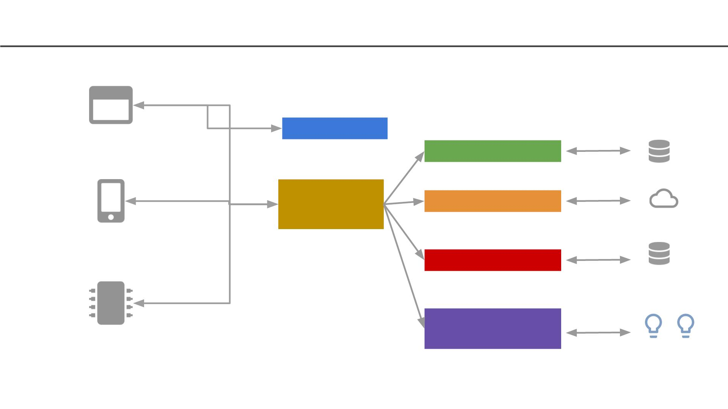
Today: Microservice Architecture
REST / JSON
Browser Apps
Storefront UI
HTML
Catalog Module
Reviews Module
Database
REST / JSON
API Service
Cloud Store
Mobile Apps
Orders Module
Database
REST / JSON
Recommendation
Module
Edge Device Apps
Models
40

Slide 41
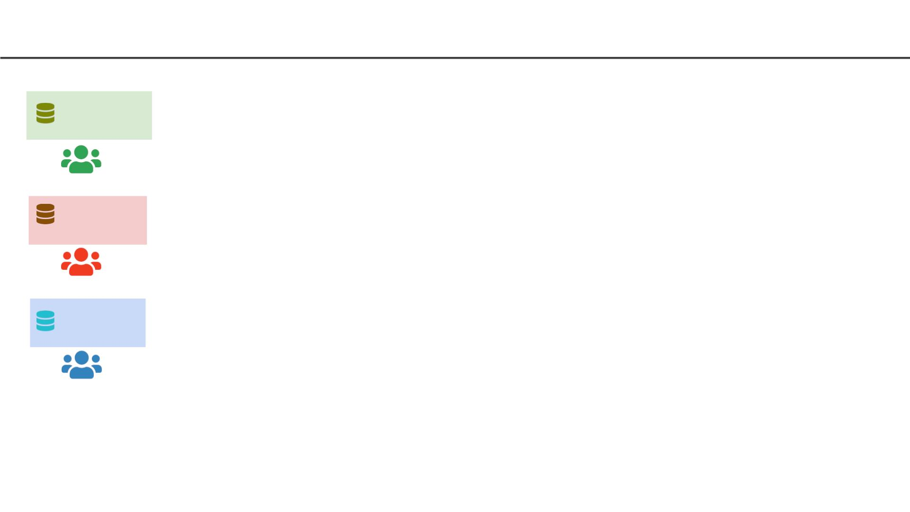
Software Development Workflow (no Docker)
Windows
Node.js
Python
Linux
Node.js
Python
Mac
Node.js
Python
OS Specific installation in
every developer machine
41

Slide 42
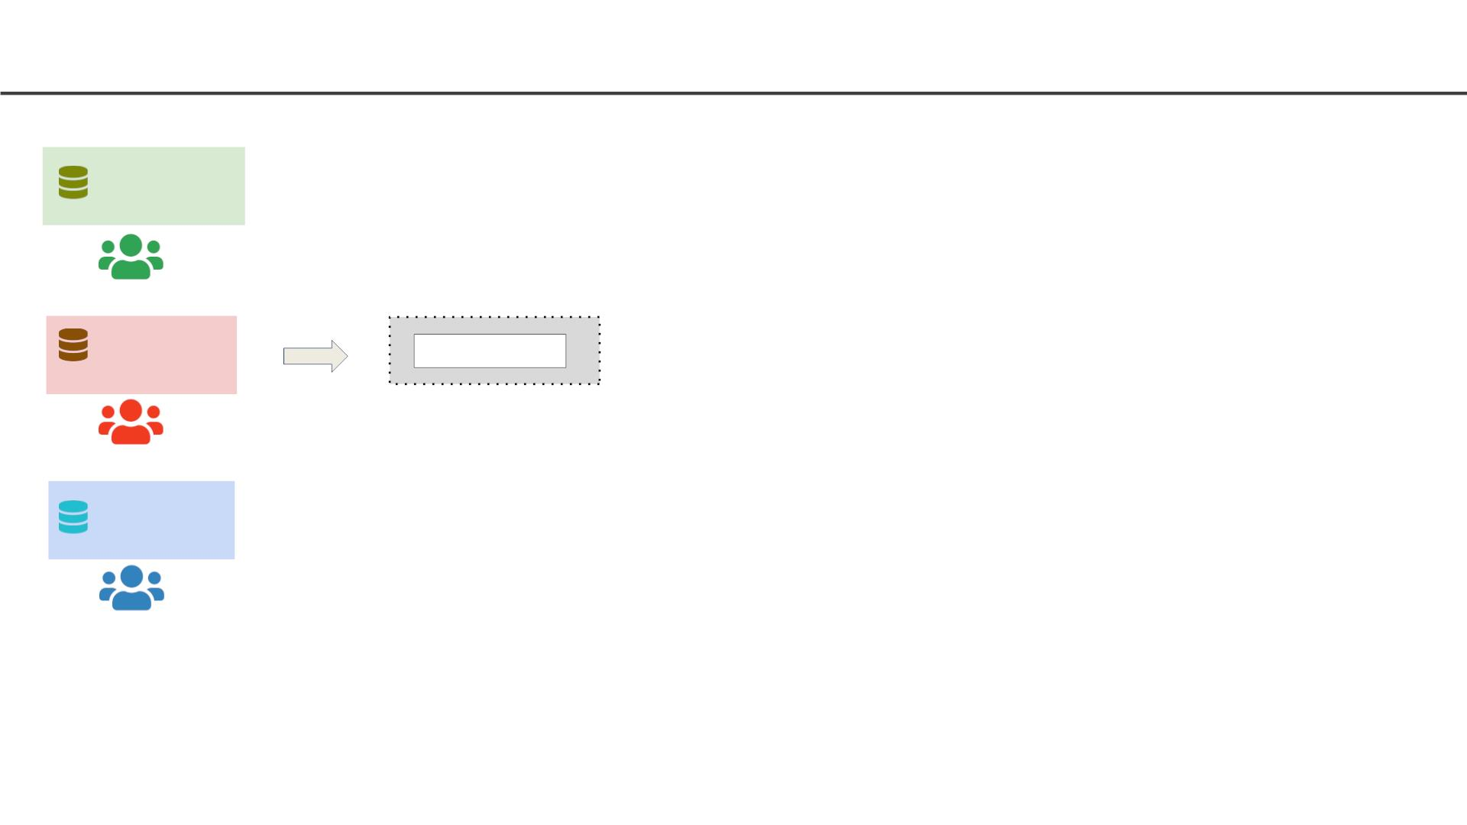
Software Development Workflow (no Docker)
Windows
Node.js
Python
Linux
Source Control
Node.js
Python
GitHub
Mac
Every team member moves
code to source control
Node.js
Python
OS Specific installation in
every developer machine
42

Slide 43
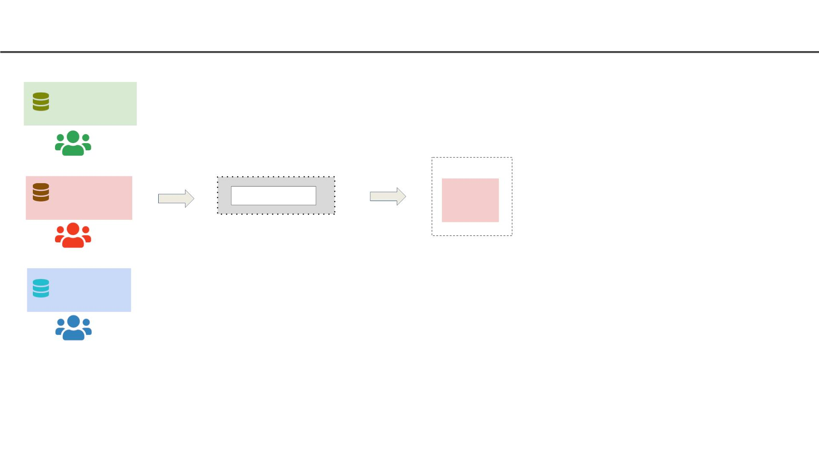
Software Development Workflow (no Docker)
Windows
Node.js
Python
Build Server
Linux
Source Control
Linux
Node.js
Python
GitHub
Mac
Every team member moves
code to source control
Node.js
Python
Build server needs to be
installed with all required
softwares/frameworks
Production build is performed
by pulling code from source
control
OS Specific installation in
every developer machine
43

Slide 44
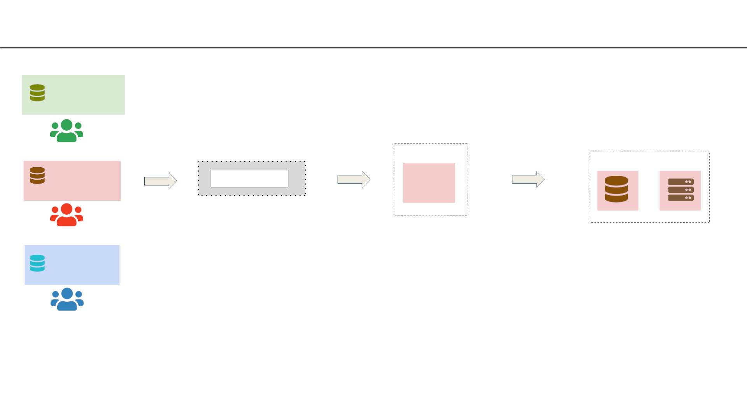
Software Development Workflow (no Docker)
Windows
Node.js
Python
Build Server
Production / Test Servers
Linux Linux
Linux
Source Control
Linux
Node.js
Python
GitHub
Mac
Every team member moves
code to source control
Node.js
Python
Build server needs to be
installed with all required
softwares/frameworks
Production server needs to
be installed with all required
softwares/frameworks
Production build is performed
by pulling code from source
control
Production server will be
different OS version than
development machines
OS Specific installation in
every developer machine
44

Slide 45
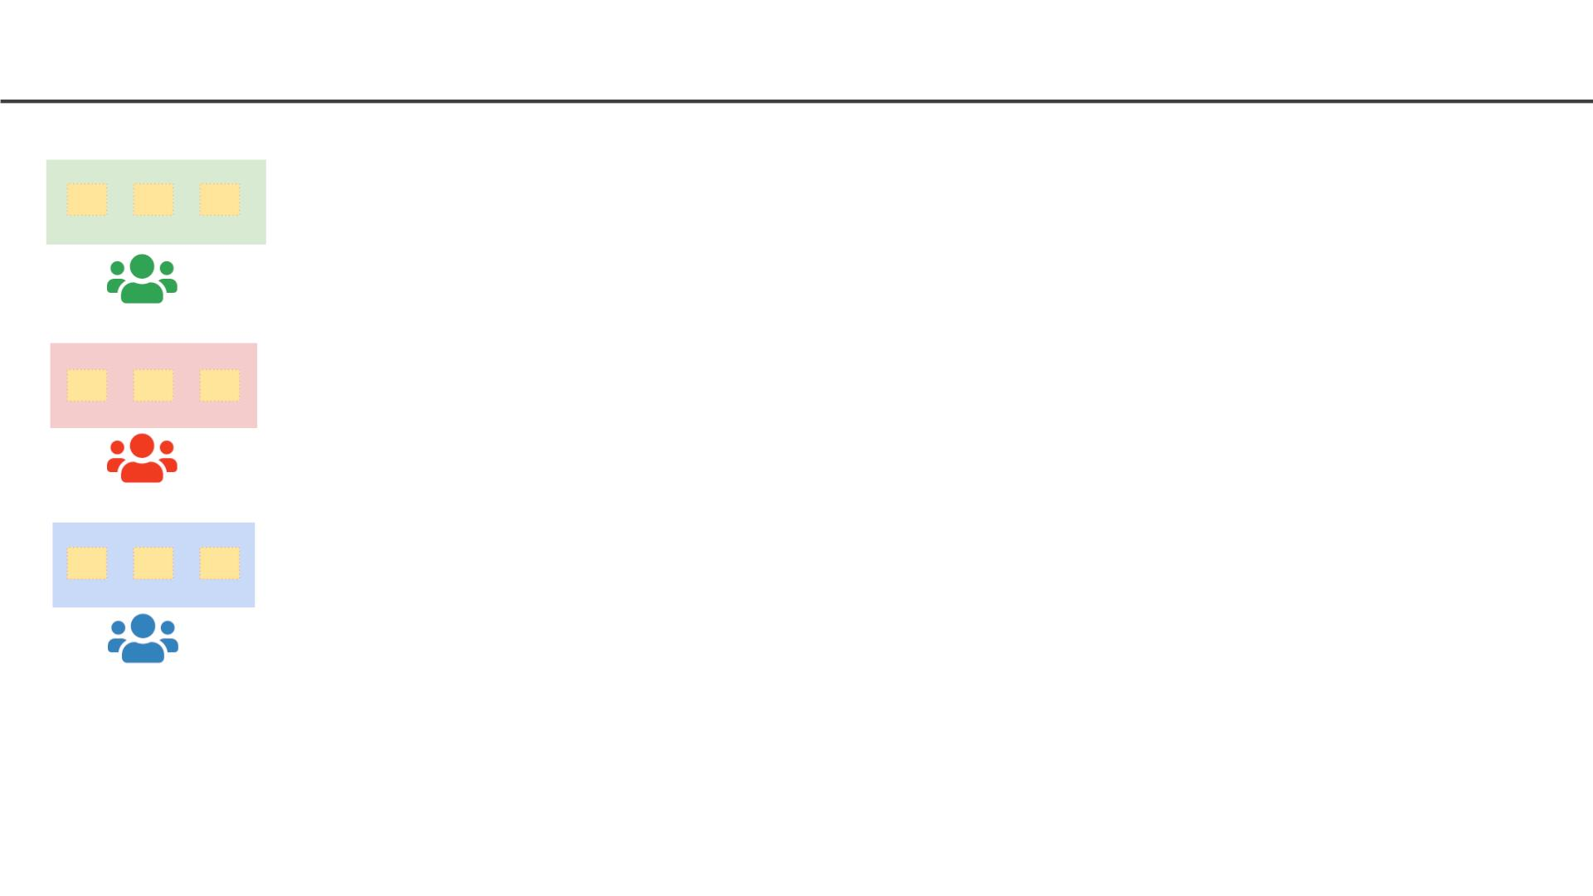
Software Development Workflow (with Docker)
Windows
Linux
Mac
Development machines only
needs Docker installed
Containers need to be setup
only once
45

Slide 46
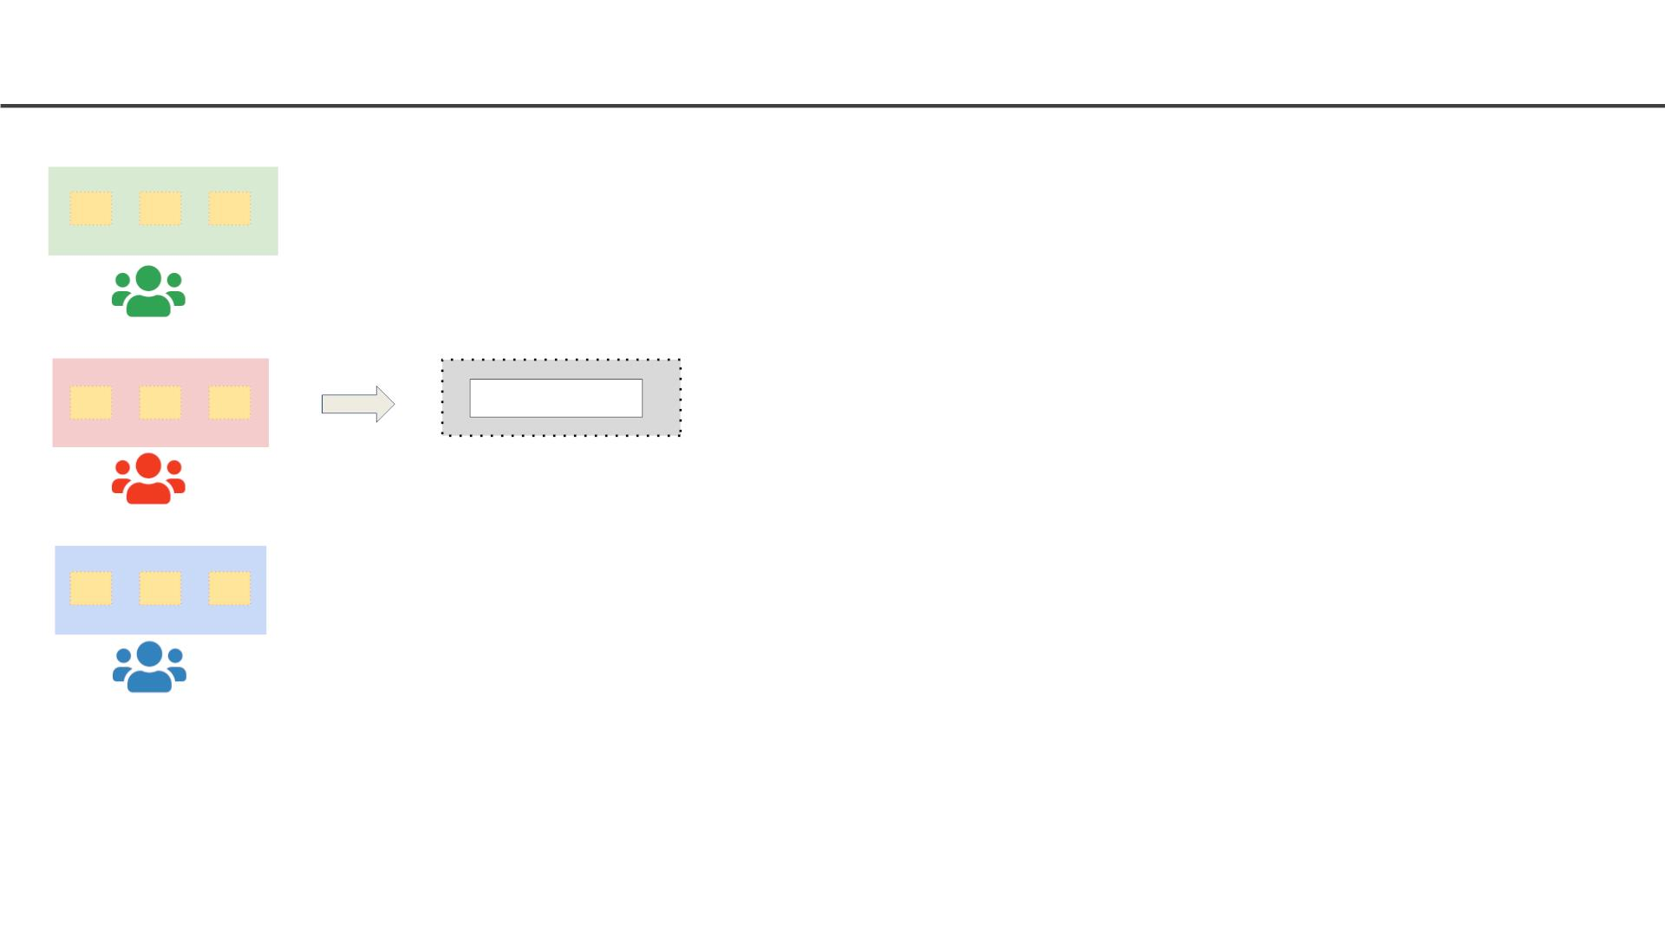
Software Development Workflow (with Docker)
Windows
Linux
Source Control
GitHub
Mac
Every team member moves
code to source control
Development machines only
needs Docker installed
Containers need to be setup
only once
46

Slide 47
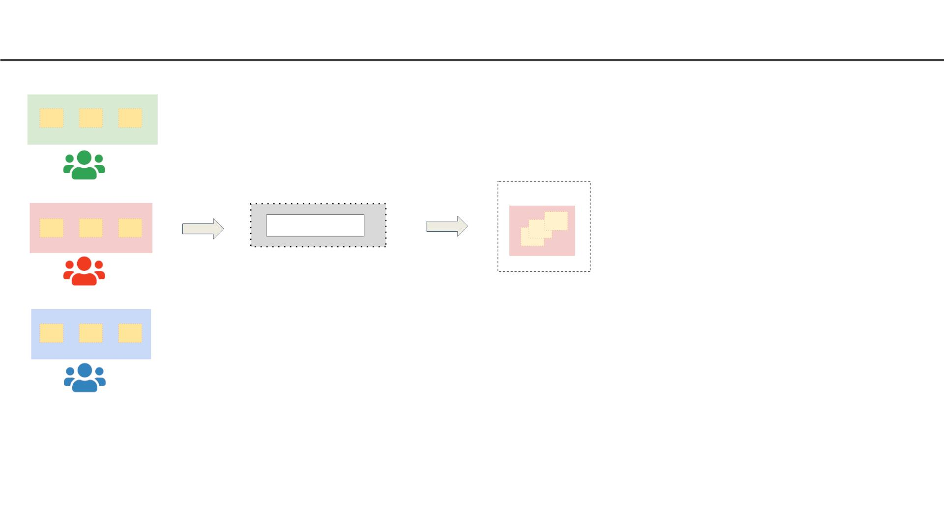
Software Development Workflow (with Docker)
Windows
Build Server
Linux
Source Control
Linux
GitHub
Mac
Every team member moves
code to source control
Build server only needs
Docker installed
Docker images are built for a
release and pushed to
container registry
Development machines only
needs Docker installed
Containers need to be setup
only once
47

Slide 48
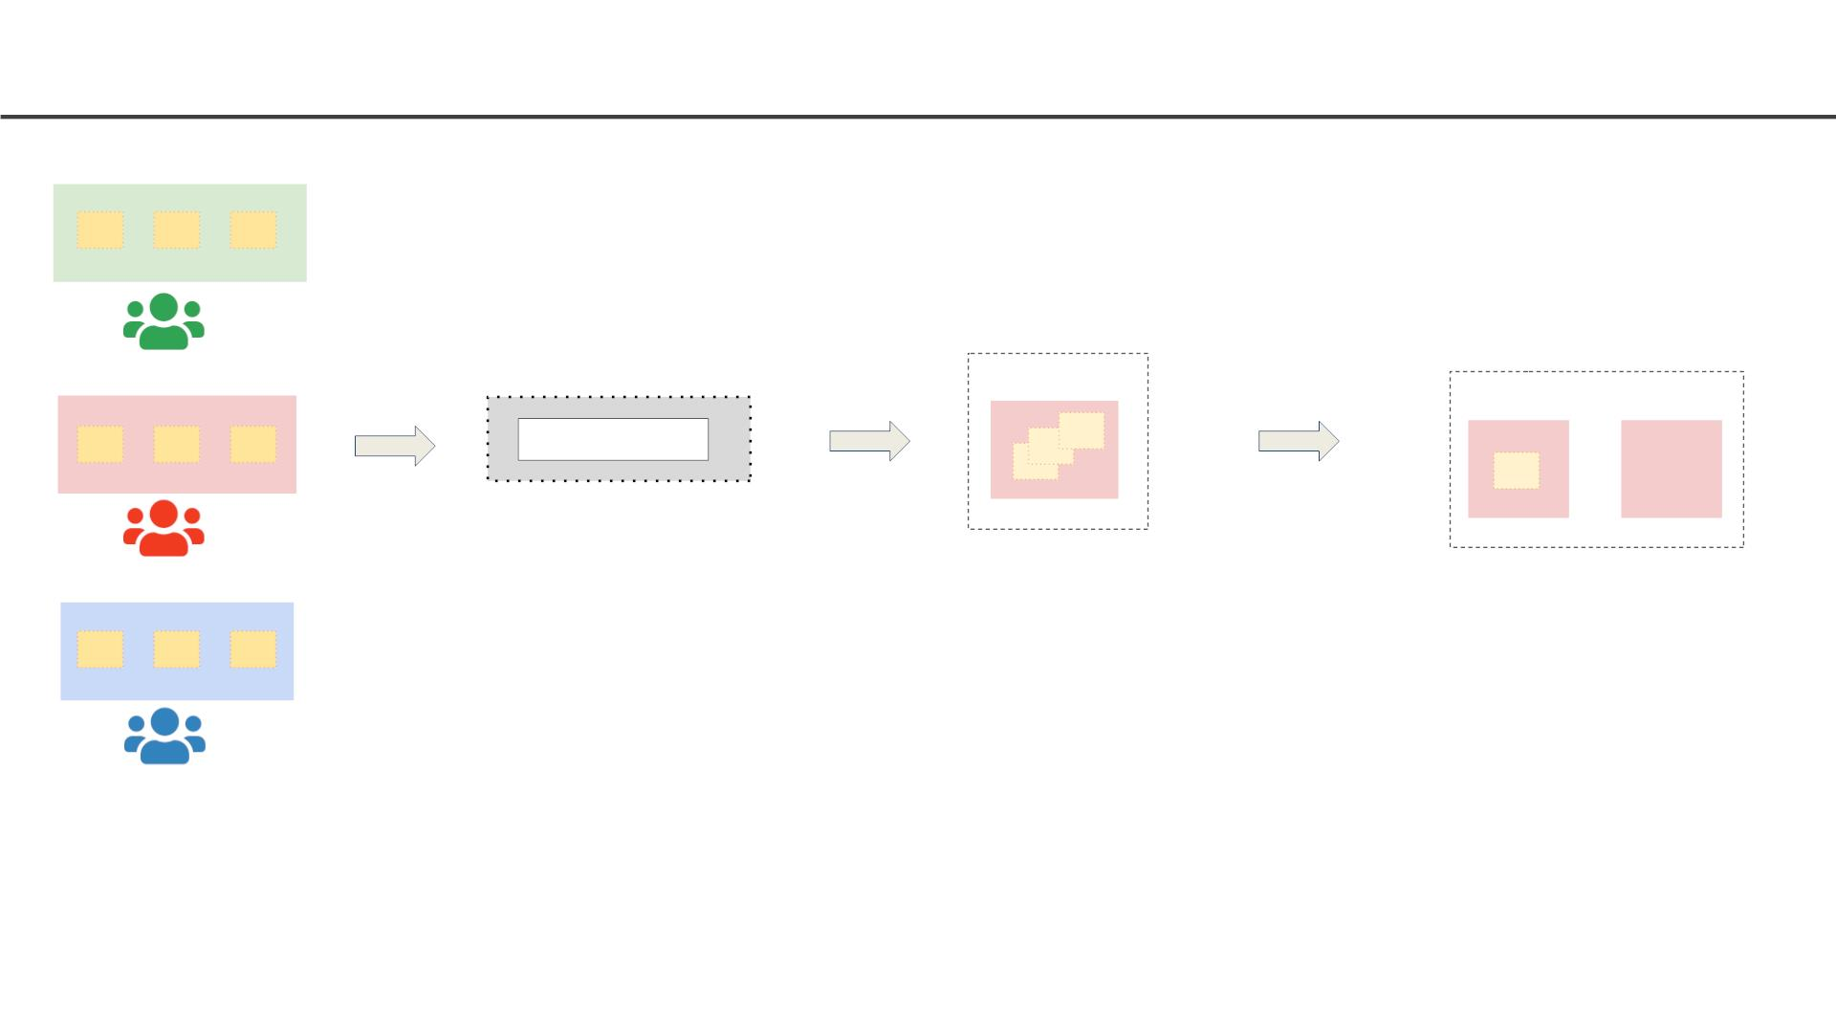
Software Development Workflow (with Docker)
Windows
Build Server
Production/ Test Servers
Linux Linux
Linux
Source Control
Linux
GitHub
Mac
Every team member moves
code to source control
Build server only needs
Docker installed
Production server only needs
Docker installed
Docker images are built for a
release and pushed to
container registry
Production server pulls
Docker images from
container registry and runs
them
Development machines only
needs Docker installed
Containers need to be setup
only once
48

Slide 49
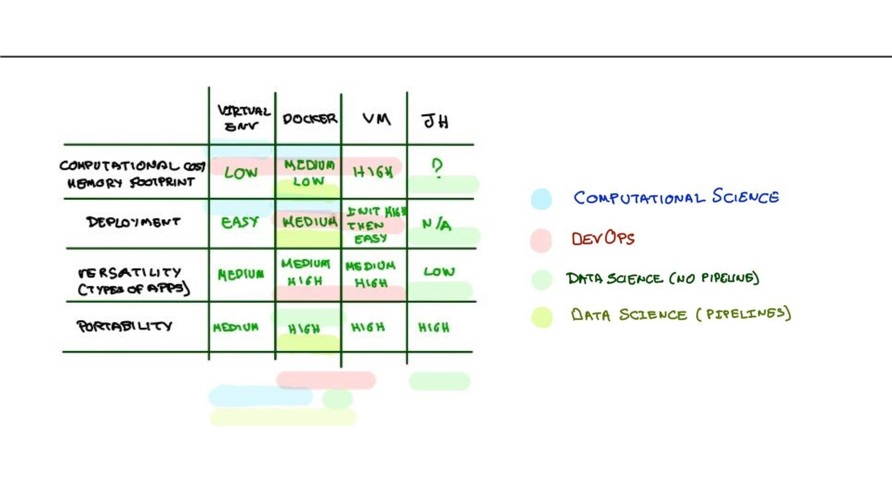
Comparison
49

Slide 50

THANK YOU
50

