Slide 1
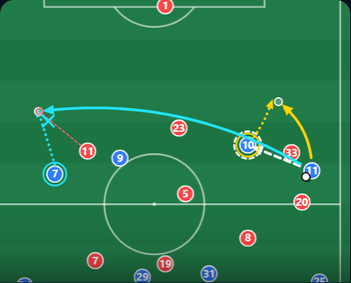
Scan & Play
Train how you see the game, with real Bundesliga moments
Brain1 Hackathon · Neu-Isenburg · 30 October 2026
How to read the pitch
Your pass
The pro's real pass
Best option (pass model)
A teammate's run onto the ball
Danger: opponent close to the pass
Curved line = lofted pass
Notes:
Open with a question: What do the best midfielders do before the ball reaches them? They look around. That's what this game is about.

Slide 2





Football is decided in the head first
Scan
Remember
Read the pattern
Decide
Hold back
Scanning
What they did
Filmed 27 players at a Premier League club over 21 matches and counted every look over the shoulder before receiving the ball (9,574 possessions).
What they found
Players who scanned more completed more passes.
Anticipation and decisions
What they did
Players faced life-size 11 v 11 match clips that froze at a key moment, then had to predict the play and choose an action.
What they found
Skilled players were right 68.8% of the time, less skilled 36.2%.
Executive functions
What they did
Gave Swedish top- and second-division players standard brain tests (creativity, inhibition, flexibility), then followed their goals and assists.
What they found
Better test scores predicted more goals and assists two seasons later.
Inhibition and flexibility
What they did
Tested 88 youth players aged 13–17, elite and sub-elite, on memory, inhibition, flexibility and planning tasks.
What they found
Elite players were better at inhibition and flexibility, even after accounting for training hours.
Jordet et al. 2020 · Front. Psychol.
Roca et al. 2011 · Cognitive Processing
Vestberg et al. 2012 · PLoS ONE
Huijgen et al. 2015 · PLoS ONE
Notes:
Quick question to start. What do the best midfielders do before the ball reaches them? They look around. They check over their shoulder, so when the ball arrives, they already know where it's going.
These skills work as one chain: scan, remember, recognise the pattern, decide, and sometimes hold back from the obvious pass. And research links them to real performance. One study filmed Premier League players for a whole season and counted every look over the shoulder: the ones who scanned more completed more passes. In another, players watched life-size match clips that froze at a key moment; skilled players read the play right about twice as often. A Swedish study gave players brain tests and found the scores predicted their goals and assists two seasons later. And in youth players, inhibition and flexibility separate the elite from the rest.

Slide 3
These skills can be trained
Better, faster decisions
Video training · 6 weeks
Academy players (about 14 years old) watched match clips that stopped at the key moment and chose what to do, twice a week.
More correct decisions and faster answers (0.41 s to 0.31 s). The group without this training didn't improve.
Scanning more than doubled
VR training · 7 weeks
U16–U17 players added VR drills for scanning and passing, three times a week, compared with a group that trained normally.
Looks over the shoulder before receiving the ball rose from 18 to 43 on average.
Best when it looks real
Review of 22 studies
Combined the results of 22 training studies in team sports.
Training helps, but the gain in real games is only about half the gain in lab tests. Game-like training works best.
Nimmerichter et al. 2016 · Sports
Erisik et al. 2025 · BMC Sports Sci Med Rehabil
Zhu et al. 2024 · Behavioral Sciences
Our design rule: training transfers best when it looks like the real game
Warning sign: a generic tracking task that once improved passing decisions (Romeas et al. 2016) did not transfer in a follow-up with 62 academy players (Romeas et al., follow-up)
Notes:
The good news: these skills can be trained. In one study, young academy players watched match clips that stopped at the key moment and chose what to do. After six weeks they made better and faster decisions. In a VR study, players more than doubled how often they looked over their shoulder before receiving the ball.
But there's an honest catch. A 2024 meta-analysis shows the effect in real games is much smaller than in the lab. And a generic tracking task that once looked promising didn't transfer in a bigger follow-up. So training only really carries over when it looks like real football. That was our design rule.

Slide 4
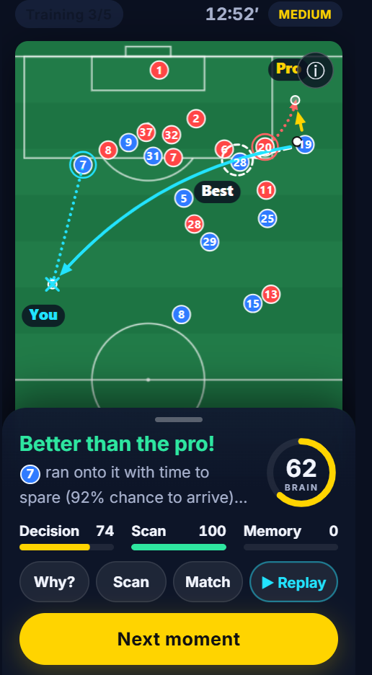



The idea: Scan & Play
1. Scan Attention
The ball comes to you. Drag to look around: you only see where you look.
2. Blackout Working memory
At the exact moment the pro passed, the screen goes dark.
3. Pass Decision under pressure
Tap where to play it: to feet, into space, or lofted.
4. Reveal Learning
Your pass vs the pro's vs the best option, and why.
Every round is a real Bundesliga moment: official DFL tracking data, 25 frames per second (Bassek et al. 2025)
Notes:
So here's our idea. Every round is a real moment from a Bundesliga match, from the official DFL tracking data, where every player's position is recorded 25 times a second.
The ball is coming to you. You can look around, but you only see where you're looking, like in real life. Then, at the moment the pro actually played his pass, the screen goes black. Now you pass from memory: to a teammate, into space, or a lofted ball.
After that we show you three things: your pass, what the pro really did, and what was best. And we tell you why.

Slide 5

More than another mind game
Typical brain game
Scan & Play
Abstract shapes or numbers
Real Bundesliga situations
Representative design
Training should look like the real task: realistic scenes, real time pressure and a sport-specific response.
That's why we use real tracking data and ask for a pass, not a reaction.
Trains one skill in isolation
Scanning, memory, reading and deciding in one action
Tap fast or remember a list
A real football decision: where to pass
A score only
Compared with the pro on exactly the same frame
Little evidence it reaches the pitch
Built the way transfer research recommends
Broadbent et al. 2015 · Zhu et al. 2024
Notes:
Most brain games train one thing in isolation, with shapes or numbers. That's fine for the brain, but the research says it barely carries over to the pitch.
Scan & Play is different. Real situations, real time pressure, and the answer is a real football decision. All the skills from the first slide are used together, in one action, like in a match. And you're always compared with the pro on exactly the same picture he saw, at the frame where he played the pass.

Slide 6
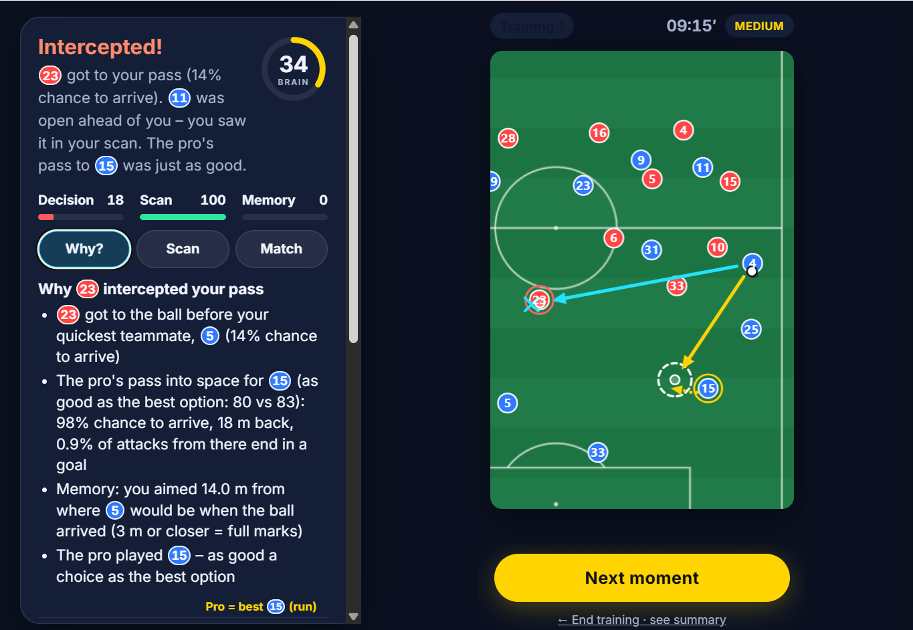
The feedback is the training
Three passes, one pitch
Yours, the pro's and the best, on the real positions.
The why
Danger gained, chance to arrive, open lanes, offside, risk.
Your scan
When you looked and what you missed: "you looked too early".
991
real passes calibrate the pass model
72
real Bundesliga moments
1,500+
simulated taps, auto-checked
≈ 55%
pro's choice as good as the best
Model basis: pitch control, Spearman et al. 2017 · EPV grid, L. Shaw (MIT)
Notes:
For us, the feedback is the actual training. A score alone doesn't teach you anything.
After every round you see three passes on the real pitch: yours, the pro's and the best one. And we tell you why: the pass was more dangerous, the lane was blocked, or you simply looked too early.
Behind this is a model that works out who gets to the ball first and how dangerous a pass is, calibrated on 991 real Bundesliga passes. The pro's choice comes out as good as the best one in about half the moments; in the other half there was a better option, and that's where you learn something. Every moment is checked automatically with over 1,500 simulated taps.
[Demo here: play one round live, open Why?, show the 3D replay.]

Slide 7


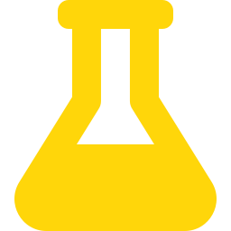

What comes next
The game
For Brain1
Proof
Vision levels: Full view → Scan → Blackout
First-person 3D view: scan like on the pitch
Choose when to pass, not just where
Futsal moments
The playable version of Brain1's scanning reels (800k+ views)
Reel → same moment in the game → download
Premium: unlimited training and 3D mode
Club version: coach dashboard
Pilot with a youth academy
6 weeks, match video before and after
Measure scan frequency and pass decisions
Play the demo now
Scan the code or open
scanandplay.vercel.app
Notes:
What's next? In the game: levels from full view up to blackout, a first-person 3D view so you scan like on the pitch, choosing not just where but also when to pass, and futsal moments.
For Brain1: your own reels already prove the demand. Two of your scanning and decision-making reels got over 800,000 views together, but the game shown at the end isn't the skill from the video. Scan & Play is exactly that skill, playable. Show the real clip, then the same kind of moment in the game, then the download link. On top: premium for unlimited training and the 3D mode, and a club version with a coach dashboard.
And because claims need proof: we'd like to test it properly with a youth academy, six weeks, before and after. The QR code is right here: play the demo now on your own phone.

Slide 8
Sources
Jordet et al. (2020). Scanning and performance in Premier League footballers. Frontiers in Psychology
Roca et al. (2011). Anticipation and decision-making in a dynamic soccer task. Cognitive Processing
Mann et al. (2007). Perceptual-cognitive expertise in sport: a meta-analysis. J Sport Exerc Psychol
Vestberg et al. (2012). Executive functions predict the success of top-soccer players. PLoS ONE
Vestberg et al. (2017). Core executive functions and success in young elite players. PLoS ONE
Huijgen et al. (2015). Cognitive functions in elite and sub-elite youth soccer players. PLoS ONE
Faubert (2013). Professional athletes learn complex dynamic visual scenes rapidly. Scientific Reports
Scharfen & Memmert (2019). Cognitive functions in elite athletes: a meta-analysis. Appl Cogn Psychol
Nimmerichter et al. (2016). Video-based training in adolescent football players. Sports
Erisik et al. (2025). VR drills, scanning and passing in youth players (RCT). BMC Sports Sci Med Rehabil
Pocock et al. (2019). Imagery to train visual exploratory activity. J Appl Sport Psychol
Zhu et al. (2024). Perceptual-cognitive training in team sports: a meta-analysis. Behavioral Sciences
Broadbent et al. (2015). Perceptual-cognitive training and transfer to the field. Eur J Sport Sci
Romeas et al. (2016) and follow-up: 3D-MOT training and (no) transfer in soccer
Bassek et al. (2025). Integrated DFL tracking and event dataset (CC BY 4.0). Scientific Data
Spearman et al. (2017). Physics-based pass probabilities · Shaw: LaurieOnTracking (MIT)
Notes:
Every entry is a clickable link to the paper or page.

