Slide 1

Docker

Slide 2
Agenda
What is Docker?
Why Docker?
Containers Vs Virtual Machine
Docker Architecture
Development overflow
Docker Installation
Docker Commands
Dockerfile
Docker Compose
Volumes and Container Communication

Slide 3
What is Docker
A Platform for building, running and shipping applications

Slide 4
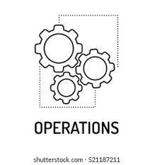



Why we need Docker?

Slide 5
Framework
Application
Dependencies
Os Level Features

Slide 6
Shipping Application Issues
One or more file missing
Software version mismatch
  OS
  Packages
  Different Application using different version of same package
Different configuration settings
Dependents you don’t aware about it

Slide 7

Blame Game

Slide 8
Solution
It Work on my machine
Then well ship your machine to production
And that is how docker was born and come to rescue

Slide 9
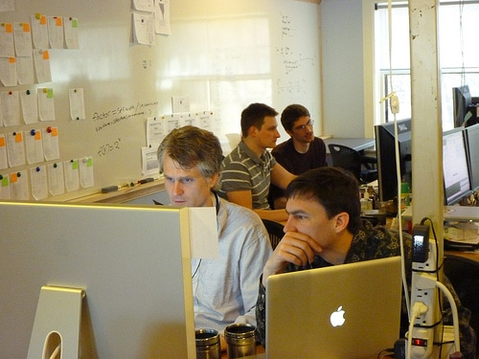
Why Docker
Some one new join in team
Just pull the repo
$ docker compose up

Slide 10
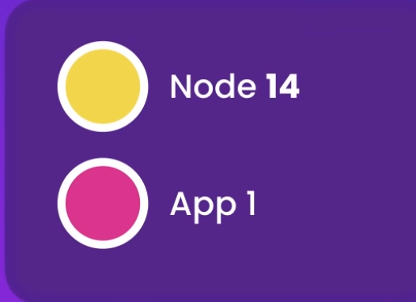
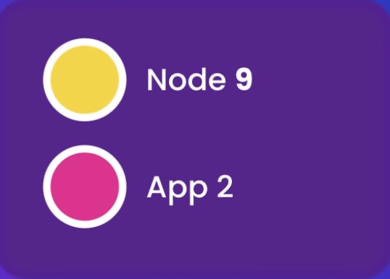
Why Docker

Slide 11
One more benefit – Destroying Application

Slide 12
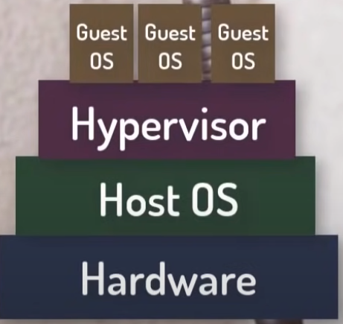
Virtual Machine Vs Containers
Lets Build Scenario
Shipping Application
  Some OS level dependencies
  Is it possible to Copy C drive and ship?
Hypervisor ? Crating OS Image
Multiple instance of image
Bu Licenses

Slide 13
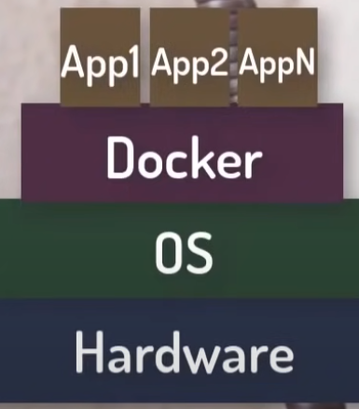
Docker Containers
Thanks to containers
Containers are Hypervisor
Lightweight
We don’t need to install new OS
All Containers share same OS kerne (Host OS)
Each Containers run its own application

Slide 14
Docker Images
Docker containers can create with help of images
Container are image instances
OOP (Class and Objects)
Load Balancing (Kubernetes)
Docker Hub (Collection of images)
Docker Inc.

Slide 15
Docker Installation
sudo apt install docker-ce
sudo systemctl status docker.service
sudo systemctl status docker.socket
docker info
docker --version

Slide 16
Docker CLI
Docker build # Build an image from Dockerfile
Docker images # list all images
Docker run # run docker image
Docker # show all stopped and running instances
Docker container ls # List all containers
Docker up # up an image
Docker stop # stop running container
Docker rm # remove container
Docker rmi # remove an image

Slide 17
Practical Work

Slide 18
Github Gist
https://gist.github.com/syed-nadeem/e2101728a6c55364bb17a968ae915fe0
https://gist.github.com/syed-nadeem/456153604965f5a16ca70f4b9497d96a

Slide 19
Questions?

