Slide 1





Slide 2



TEAM DETAILS
    Team Leader : Akshitha B -2nd year
    Team Member 1: Tharun Vignessh S -2nd year
    Team Member 2: Mohammed Faiz -2nd year
    Team Member 3: Tanishka M -2nd year
    Team Member 4: Dhanaishwariya R- 2nd year

Slide 3

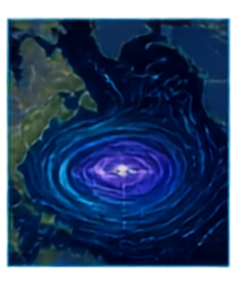
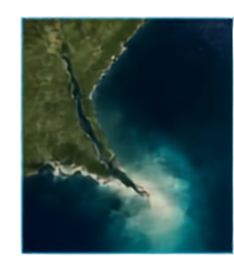
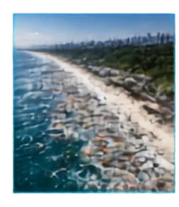















MARINE DEBRIS IS A MOVING-TARGET PROBLEM
Today’s observation is only a snapshot. The real question is where the risk moves next.
01 | GOAL
02 | EXACT PROBLEM
03 | REAL-WORLD VALIDATION
Enable proactive
marine-debris management
Floating debris does not stay where we observe it.
Identify potential floating marine-debris hotspots and understand where they are likely to move next.
Ocean areas are too vast for continuous manual monitoring
Satellite observations are snapshots, not future predictions
Surface currents and wind continuously transport floating material
DETECT
TRACK
FORECAST
PRIORITIZE
Ocean circulation
Land → River → Ocean
Transport → Accumulation
Cleanup resources are limited — priority zones must be identified
11+ MILLION TONNES
plastic enters the ocean annually
UNEP
How can we detect potential hotspots early and forecast their likely movement?
TODAY: WHERE IS THE DEBRIS?
TOMORROW: WHERE WILL IT MOVE?
AquaTrace AI is designed to answer both.

Slide 4





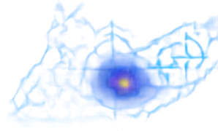
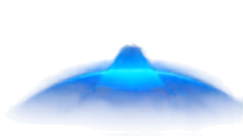
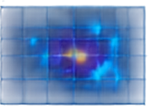

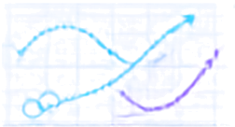










AQUATRACE AI
FROM DETECTING DEBRIS TO PREDICTING ITS NEXT MOVE
An AI-powered Earth-observation decision-support system for proactive marine-debris management.
OBSERVE
DETECT
FUSE
FORECAST
PRIORITIZE
NASA PACE OCI
AI ANALYSIS
OCEAN + WIND
DRIFT MODEL
ACTION MAP
Satellite ocean observations
Identify potential floating marine-debris hotspots
Surface currents
+ wind
Predict movement over 24–48 hours
Rank cleanup priority zones
MULTIMODAL
PREDICTIVE
ACTIONABLE
Satellite + Current + Wind
Today → Tomorrow
Forecast → Cleanup Priority
Satellite observation
AI intelligence
Ocean dynamics
Prediction
Action
Output: potential debris hotspot
+ confidence + predicted trajectory
Prediction

Slide 5





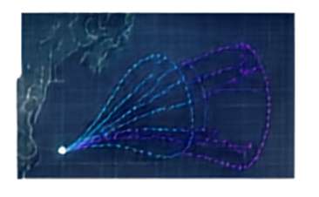
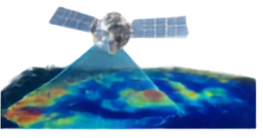
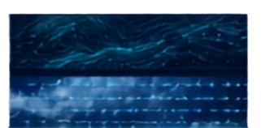
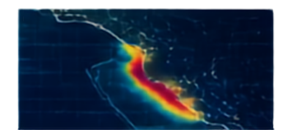
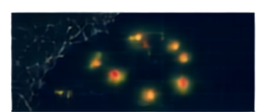
HOW AQUATRACE AI WORKS
A multimodal Earth-observation + ocean-drift forecasting pipeline
01
OBSERVE
02
AI HOTSPOT IDENTIFICATION
03
ENVIRONMENTAL FORCING
04
LAGRANGIAN DRIFT MODEL
05
CLEANUP RISK SCORE
NASA PACE OCI
Spectral features
Spatial texture
Temporal change
Quality filtering
Surface currents
+
NASA OSCAR
10 m wind
Hotspot confidence
Predicted location
Persistence / recurrence
Proximity to vulnerable areas
Forecast uncertainty
Surface reflectance
Spectral information
Spatial information
Cloud / quality flags
NOW
+24 H
+48 H
Satellite observation layer
Potential debris
hotspot + confidence
Movement forcing
Cleanup priority map
Predicted trajectory
+ uncertainty
PACE OCI
AI DETECTION
OSCAR
+ MERRA-2
RISK SCORE
Satellite observations indicate potential marine debris hotspots; supervised training and validation require appropriate marine debris ground-truth observations.
DRIFT FORECAST
ACTION

Slide 6

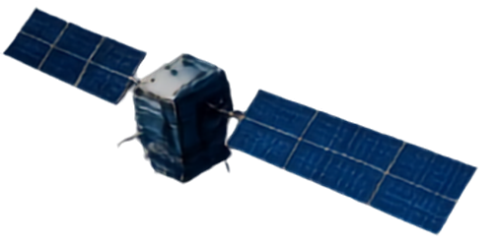











TECHNOLOGY STACK
Purpose-built technologies for Earth observation, AI detection, ocean-drift forecasting and actionable mapping
SATELLITE DATA
NASA Pace OCI – Surface Reflectance
Hyperspectral ocean data provides rich spectral features to detect potential floating debris.
1
EARTH OBSERVATION
AI DETECTION
NASA OSCAR – Surface Currents NASA Merra-2 – 10 m Wind
Earth-system datasets provide consistent environmental data to model and predict debris movement.
2
OCEAN & ATMOSPHERIC DATA
WHY THIS STACK?
CURRENT + WIND
.
Geospatial ML tools extract key features to detect debris hotspots and estimate confidence.
.
3
AI / MACHINE LEARNING
Python + scikit-learn / Pytorch
Open-source & research-friendly
NASA Earth-observation data compatible
DRIFT FORECAST
Lagrangian Particle Advection Model
Simulates debris movement using ocean currents and wind to predict 24–48-hour trajectories.
.
4
DRIFT FORECASTING
Geospatial + AI capabilities
RISK MAP
Scalable from regional pilot to larger areas
5
xarray + NumPy + GeoPandas FastAPI + React + Leaflet
Processes multidimensional Earth data and delivers interactive forecast and cleanup priority maps.
GEOSPATIAL APPLICATION
Designed for rapid prototype deployment
CLEANUP ACTION
DATA → INTELLIGENCE → FORECAST → ACTION

Slide 7

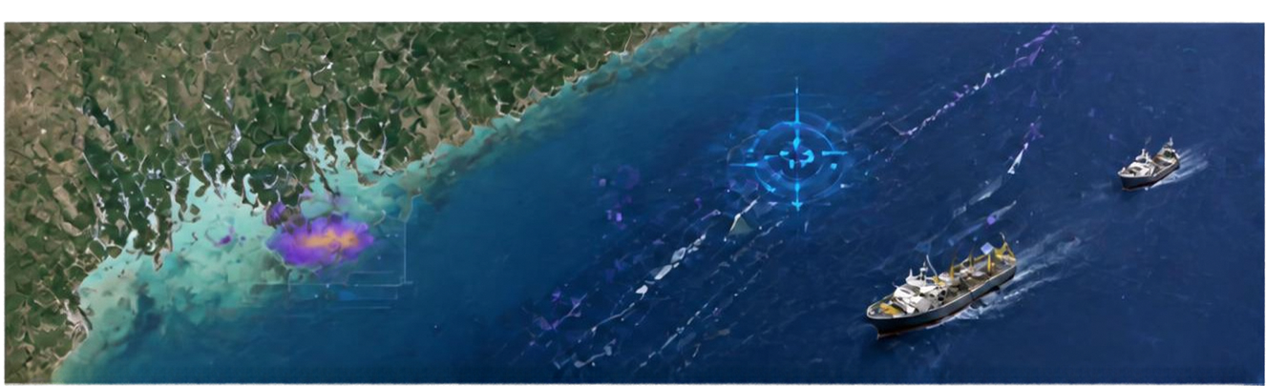





















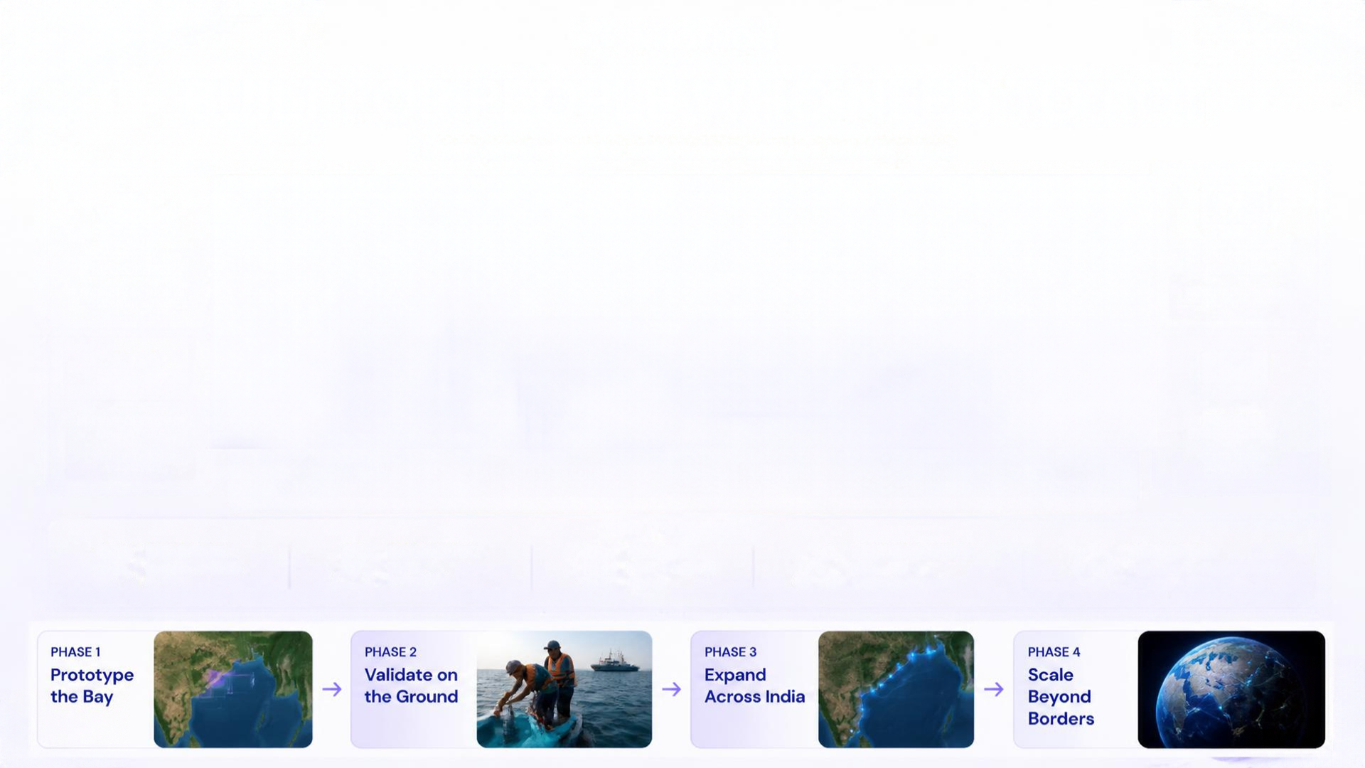
TARGET INDUSTRY & FEASIBILITY
From prediction to actionable marine intelligence
Coastal authorities
Environmental Agencies
Priority Patrol & Cleanup Zones
Track Recurring Hotspots
Marine Clean-Up Operators
Marine Researchers
Where & When to Deploy
Satellite Data
Detection
Drift Forecast
Risk Map
Study Debris Transport
Action
Why It’s Feasible
NASA Dataset
Regional First
Scalable
Daily Intelligence
Measurable
Machine-readable EO Data
Bay of Bengal Pilot
Pilot → India → Global
Data → AI → Forecast → Action
Precision → Forecast Error → Ranking → Calibration
Phase 1
Phase 2
Phase 3
Phase 4
Prototype the Bay
Validate on the Ground
Expand Across India
Scale Beyond Borders

Slide 8


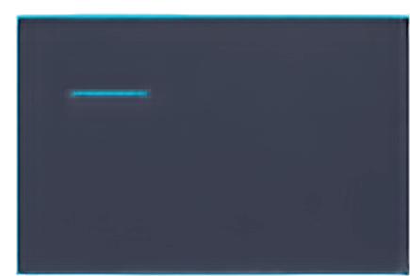





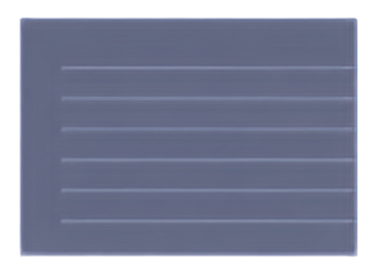
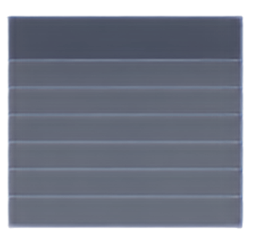
WE PREDICT THE NEXT MOVE.
USP — WE DON’T JUST DETECT.
From observing potential marine-debris hotspots to forecasting where the risk may move next.
WHAT MAKES AQUATRACE AI DIFFERENT?
01
02
03
04
MULTIMODAL FUSION
PREDICTIVE
ACTIONABLE
UNCERTAINTY-AWARE
Satellite + Surface Currents + Wind
Today → +24h +48h
Forecast → Risk Score → Cleanup Priority
Confidence + Forecast Uncertainty
Combine multiple Earth-system data sources instead of relying on a single observation.
Move beyond identifying a hotspot to estimating its likely future trajectory.
Convert technical observations into a decision-support output for cleanup teams.
Communicate confidence instead of presenting predictions as certainty.
EXISTING APPROACHES VS AQUATRACE AI
MANUAL / FIELD MONITORING
SINGLE-SENSOR MONITORING
CURRENT-BASED MODELS
AQUATRACE AI
HOTSPOT OBSERVATION
✔
✔
depends on implementation
✔
MOVEMENT TRACKING
limited
limited
depends on implementation
✔
WIND + CURRENT FUSION
✔
limited
depends on implementation
✔
FUTURE TRAJECTORY
✔
X or limited
depends on implementation
✔
CLEANUP / CONFIDENCE
✔
Limited
depends on implementation
✔

Slide 9
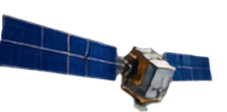
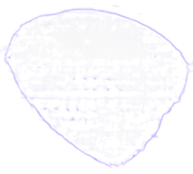

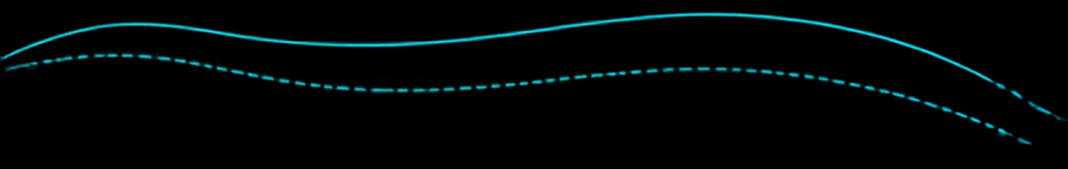






















IMPACT & BENEFITS
COASTAL RISK ZONE
24H PREDICTED TRAJECTORY
DETECTED
DEBRIS HOTSPOT
48H PREDICTED TRAJECTORY
CLEANUP PRIORITY
TODAY
AQUATRACE AI
FUTURE
Observe → Search → React
Satellite + AI + Ocean Dynamics
Detect → Forecast → Prioritize → Act
AUTHORITIES
OPERATORS
AGENCIES
RESEARCHERS
Priority Zones
Targeted Cleanup
Proactive Monitoring
Debris Movement Insights
SOCIAL
ENVIRONMENT
OPERATIONS
Faster Response | Safer Coasts | Better Decisions
Early Intervention | Risk Pathways | Ecosystem Protection
Smarter Resources | Less Searching | Targeted Planning
DETECTION
FORECAST
PRIORITIZATION
TRUST
Precision → Recall → F1
24H → 48H Error
Hotspot Ranking
Confidence Calibration
SEE THE PROBLEM. PREDICT ITS NEXT MOVE. ACT FIRST.

Slide 10
RESULTS: AI DEBRIS DETECTION
TESTED ON 194,863 LABELLED PIXELS THE MODEL NEVER SAW
94.1%
0.93
0.78
0.9%
Overall accuracy
15 classes: debris, sargassum, ships, waves, clouds and 5 water types
F1: floating material
Precision 0.90 · Recall 0.97
F1: marine debris
Recall 0.89: finds 89 of every 100 debris pixels
Calibration error
Its confidence matches how often it is right (deck: TRUST)
First model → final model (%)
WHAT MADE THE DIFFERENCE
Texture features: debris lines, ships, waves and foam differ in shape, not just colour (+8 pts)
Background-relative spectra: one model works on Sentinel-2 and NASA PACE
Two expert models: Extra Trees finds debris, gradient boosting names the rest (+2 pts); chosen on validation data only
Extra Trees + gradient boosting · MARIDA marine-debris benchmark (Kikaki et al., 2022), official train / validation / test splits · Sentinel-2 L2A
Notes:
Our AI is tested on MARIDA, the public benchmark for marine debris in Sentinel-2 imagery, on pixels it never saw. 94.1% overall accuracy, F1 0.93 for floating material and 0.78 for debris itself. Most pixels are water, so we report F1, not just accuracy. Two things made the difference: texture features, and two expert models. Extra Trees decides whether a pixel is floating material; gradient boosting is better at telling water types, waves and wakes apart, so it names everything else. Every choice was made on the validation split before the test split was scored. MARIDA scenes are not from India; local ground truth is Phase 2.

Slide 11
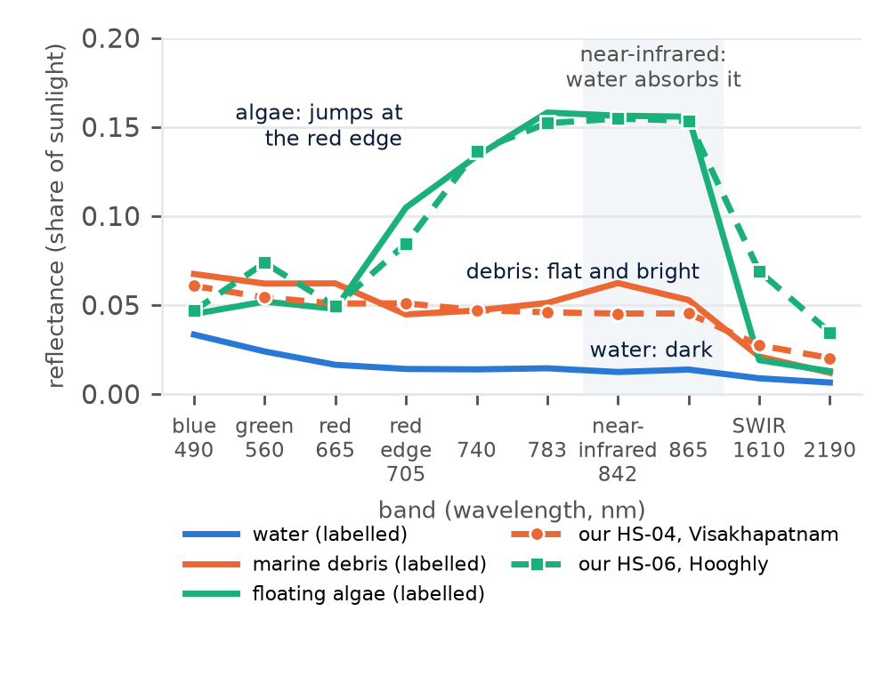
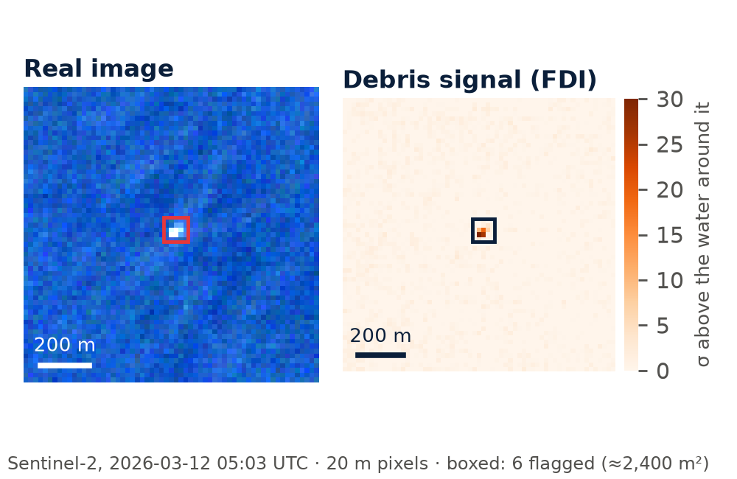
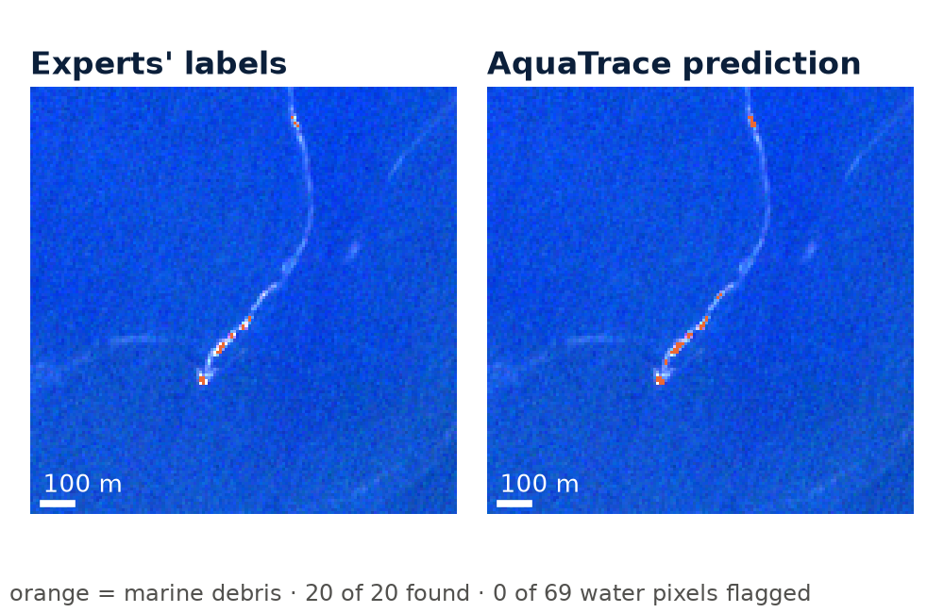
HOW IT SPOTS PLASTIC: THE EVIDENCE
NO SATELLITE SEES A BOTTLE: IT MEASURES HOW FLOATING MATERIAL REFLECTS LIGHT
1 · WHAT THE SATELLITE SEES
2 · THE LIGHT FINGERPRINT
3 · CHECKED AGAINST EXPERTS
Real pixels, not a photo: each square is 20 m. Hotspot HS-04, 9 km off Visakhapatnam (Sentinel-2, 12 Mar 2026): 6 pixels stand out from the water around them, a potential floating patch of about 2,400 m².
Water absorbs infrared, floating things reflect it. Debris is flat and bright; algae jumps at the red edge. Our Visakhapatnam hotspot follows the debris curve, our Hooghly patch the vegetation curve.
20 of 20 debris pixels found, 0 of 69 water pixels flagged in a Gulf of Honduras scene the AI never saw (MARIDA test set). Across all 194,863 test pixels it finds 89% of the labelled debris.
In the app, the map is a background basemap and the dots are forecast particles · detections come from 20 m Sentinel-2 and 1.2 km NASA PACE pixels · FDI: Biermann et al. 2020 · MARIDA: Kikaki et al. 2022
Notes:
The jury asked how a satellite can see plastic. The honest answer: it can't see a bottle. Sentinel-2 pixels are 20 metres, PACE pixels about a kilometre. What it can see is a patch or line of floating material changing the light. Water absorbs near-infrared light, so the sea looks dark in infrared; anything floating on it reflects infrared back. The shape of that reflection is a fingerprint: algae jumps at the red edge because of chlorophyll, debris is flat and bright. Left: the real 20 m pixels of one of our hotspots off Visakhapatnam; the clear map in our app is only a background map, and the dots are our forecast particles. Middle: our hotspot follows the debris fingerprint and our Hooghly patch follows the vegetation one. Right: the proof that the AI reads these fingerprints correctly, on a scene it never saw: it found all 20 debris pixels that experts marked, with no false alarms. That is why we always say potential debris, with a confidence, and why ground truth from boats and drones is Phase 2.

Slide 12
RESULTS: FORECAST vs REAL BUOYS
87 FORECASTS ON A MONTH NOT USED FOR TUNING · 5 NOAA BUOYS · NASA OSCAR + MERRA-2
16.6 km
30.4 km
59%
86%
Median error at +24 h
Where we said the buoy would be vs where it went
Median error at +48 h
Two days ahead, with an uncertainty cone
Better than a snapshot
“It stays where the satellite saw it” is off by 74 km
Inside the 48 h cone
Real buoys inside our 90% uncertainty cone (5% before the fix)
Median forecast error (km): lower is better
WHY IT MATTERS
Wind + current fusion cuts 48 h error from 37 to 30 km: our USP, now proven with data
~6× smaller search area for a cleanup boat than searching around the last sighting
Honest by design: tuned on January buoys, scored on February buoys it never saw
NOAA Global Drifter Program (6-hourly QC tracks) · NASA OSCAR v2.0 surface currents · NASA MERRA-2 10 m wind · Lagrangian ensemble, 300 particles per hotspot with wind drag and current error
Notes:
We did not just build a forecast, we measured it. We tuned the model on January 2025 buoys and then tested it on February, which it never saw: 87 cases where we started the model at a real NOAA buoy's position and compared the forecast with where the buoy actually went. Median error: 17 km after one day, 30 km after two. Assuming debris stays where the satellite saw it is off by 74 km, so we are 59% better. Adding wind to currents cut the error from 37 to 30 km, which proves the fusion idea on our USP slide. And we checked our uncertainty cone: the real buoy ended up inside the 48-hour cone 86% of the time. Before our fix it was only 5%. So when the map says search here, it means it.

Slide 13
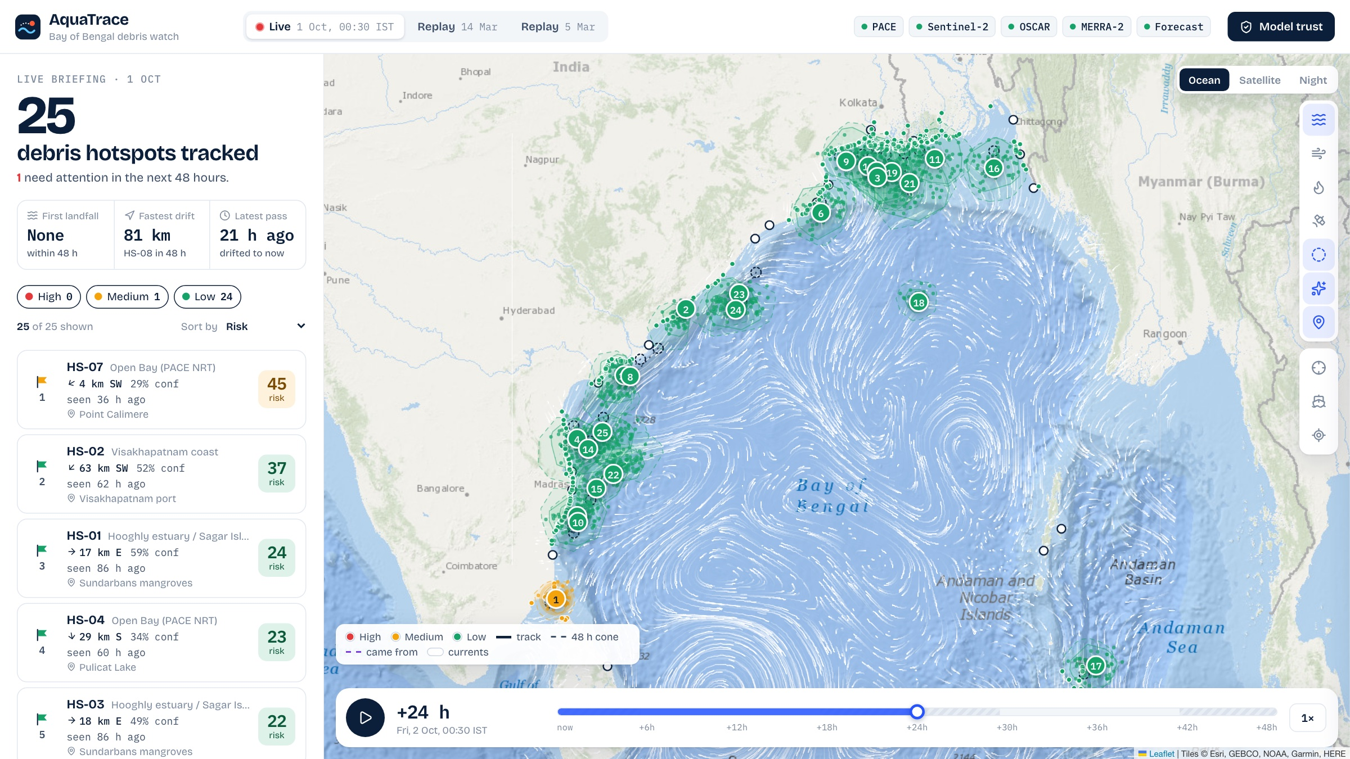
LIVE PROTOTYPE: NEAR-REAL-TIME MAP
NOT A LIVE VIDEO, A LIVE FORECAST: LAST PASS → NOW → NEXT 48 H
01
OBSERVE
NASA PACE near-real-time data is online ~3 h after each daily pass; Sentinel-2 adds 10–20 m coastal detail
02
NOWCAST
Each detection is drifted to “now”, so the map stays current between passes and under clouds
03
FORECAST
+24 h / +48 h tracks with uncertainty cones and predicted beaching points
04
ACT
Risk-ranked list with a recommended action: vessel, shoreline team or monitor
Live run, 30 Sep 2026 19:00 UTC: 3 PACE passes (69–95% cloud) + Sentinel-2 → 25 candidate hotspots, each drifted to “now”
Runs daily with one command after the satellite pass · FastAPI + React + Leaflet · free NASA / ESA / NOAA / Open-Meteo data
Notes:
The jury said live debris tracking is impossible, and a live video of every bottle is. That is not what we claim. NASA's PACE passes over the Bay once a day and its near-real-time data is online about 3 hours later. When the sky is clear we detect likely floating-debris patches. Then the drift model carries each one forward, so the map shows where it most likely is now, even under clouds (this pass was 95% cloudy), and where it will be in 48 hours. Oil-spill forecasting and sargassum outlooks use the same idea.

Slide 14
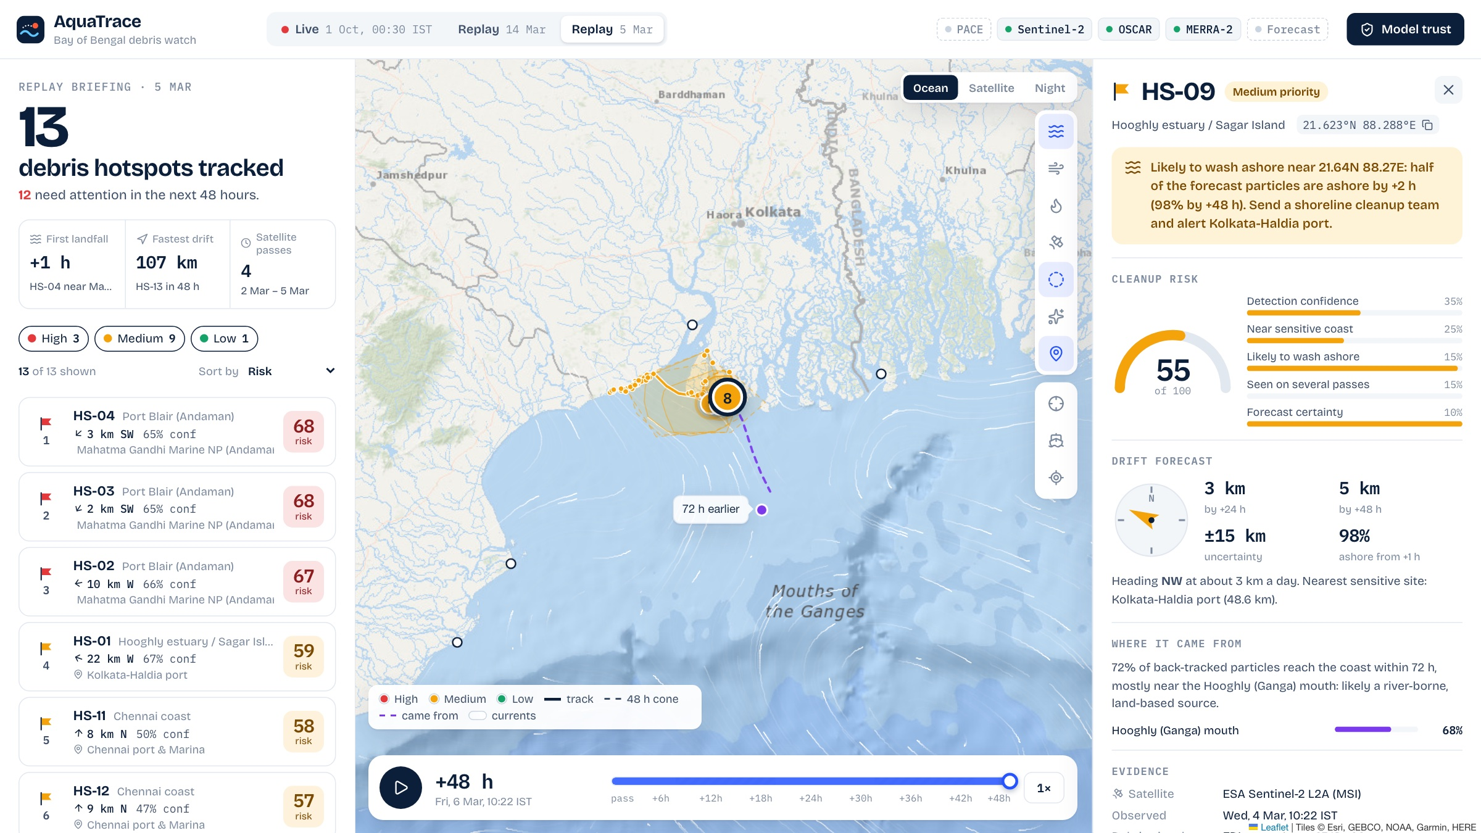
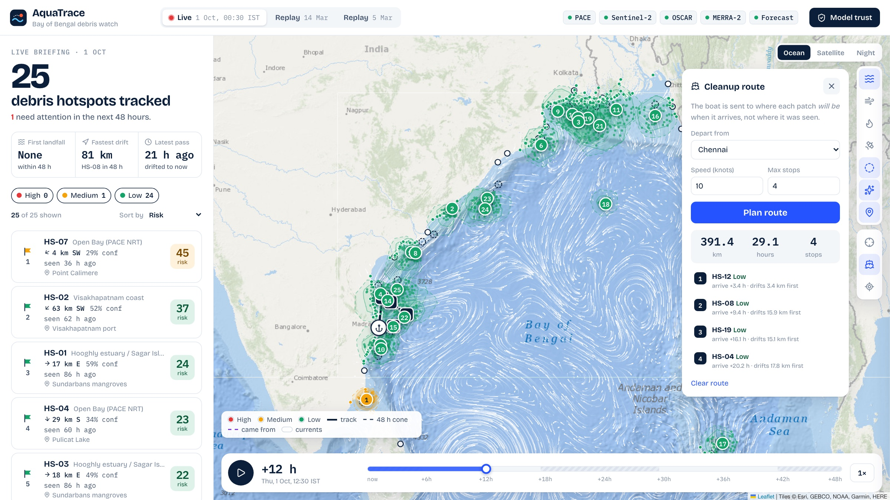
NEW: FROM DETECTION TO ACTION
TWO FEATURES THAT TURN A FORECAST INTO A DECISION
SOURCE TRACKING: WHERE DID IT COME FROM?
MOVING-TARGET CLEANUP ROUTE
The drift model run backwards 72 h: 72% of this patch's particles reach the coast, mostly at the Hooghly (Ganga) mouth, so authorities can stop plastic at the source.
The boat is sent to where each patch will be when it arrives. These patches drift up to 18 km before the vessel gets there, so aiming at the last sighting would miss them.
Nowcasting under clouds
One AI model, two satellites
Uncertainty cones
Validated on real buoys
Free, open NASA / ESA data
Notes:
Two features move us from a map to a decision. First, source tracking: we run the same physics backwards. This patch traces back to the Hooghly, the Ganga's mouth, which tells authorities where to act upstream. Second, the cleanup route: the boat is sent to where each patch will be when it arrives, because debris keeps moving. Here the patches move up to 18 km before the boat gets there. Along the bottom is what makes AquaTrace new.

Slide 15
RESEARCH & REFERENCES
BUILT ON TRUSTED EARTH-OBSERVATION DATASETS, OCEAN SCIENCE AND ENVIRONMENTAL RESEARCH
01 — NASA PACE / OCI
Advanced ocean-colour observations and hyperspectral measurements used as the Earth-observation foundation.
🔗 NASA PACE Ocean Color Data
02 — PACE Surface Reflectance (SFREFL)
Surface-reflectance product used for satellite-based ocean observation and feature extraction.
🔗 NASA PACE Data Access
03 — NASA OSCAR v2.0
Global surface-current data used to model the movement of floating material.
🔗 NASA OSCAR Dataset
04 — NASA MERRA-2
Atmospheric reanalysis data providing wind information for movement/drift modelling.
🔗 NASA GMAO MERRA-2
05 — UNEP: From Pollution to Solution
Global research on marine litter and plastic pollution, including environmental and socioeconomic impacts.
🔗 UNEP Research Report
06 — NASA PACE Validation Research
Research demonstrating validation of PACE/OCI observations using airborne and in-situ measurements.
🔗 NASA PACE Validation Research

Slide 16
THANK YOU!

