Slide 1
Loan Management System
Technology Stack
Backend
Frontend
Java Microservices
Angular
Scalable architecture
Responsive user interface
Independent service deployment
Real-time updates
Modern web experience
High availability

Slide 2
Introduction to Loan Management System
An end-to-end, microservices-enabled digital lending platform
Automates loan application, approval, EMI calculation, and repayment tracking.
Provides secure, scalable, and role-based access for all users.
Problem statement
Solution
Technology Stack
Cloud-ready microservices architecture with Angular frontend providing:
Online loan applications with instant status tracking
Automated EMI calculations and payment schedules
Multi-role access (Customer, Loan Officer, Admin)
Real-time notifications and comprehensive reporting
Traditional loan systems are manual, time-consuming, and lack transparency in loan processing.
Backend: Spring Boot (Microservices)
Frontend: Angular 17
Database: PostgreSQL
Security: JWT Authentication
Deployment: Docker
Impact: Faster approvals, better customer experience, operational efficiency, and data-driven decision making

Slide 3
System Architecture Overview
Our Loan Management System follows a cloud-ready microservices architecture that ensures scalability, security, and independent service deployment.
01
02
Authentication Service
Loan Application Service
Provides role-based access control for Admin, Loan Officer, and Customer.
Handles user registration, login, and JWT-based authentication.
Manages loan applications submitted by customers.
Tracks application status (Submitted, Approved, Rejected).
03
04
Loan Service
Notification Service
Maintains loan details and outstanding balances.
Handles loan approval, EMI calculation, and repayment schedules.
Provides insights into loan status and repayment tracking.
Generates system notifications and loan-related reports.

Slide 4
Technical Architecture
Core Components
API Gateway handles request routing, JWT authentication, and role-based authorization for all client requests.
Angular Frontend provides a responsive user interface for customers, loan officers, and administrators.
RESTful Microservices enable secure and efficient communication between frontend and backend services.
Database Layer (PostgreSQL) stores user, loan, and repayment data with transactional consistency
Scalability
Modularity
Resilience
Independent microservices allow horizontal scaling based on system load.
Loosely coupled services enable easier maintenance and faster feature development.
Service isolation ensures that failure in one service does not impact the entire system.

Slide 5
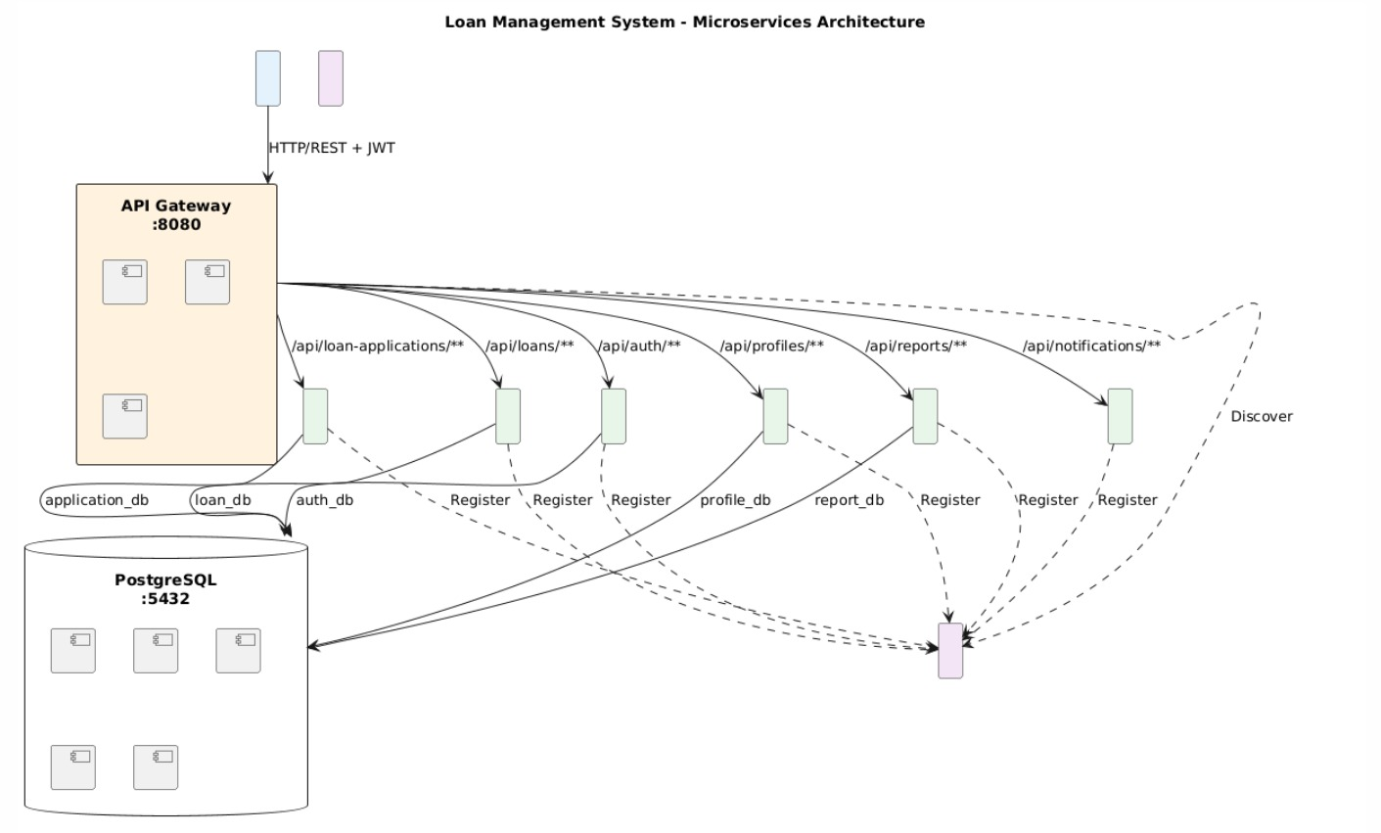
Architecture Diagram
A secure, scalable microservices architecture with an API Gateway, independent backend services, and dedicated databases.

Slide 6
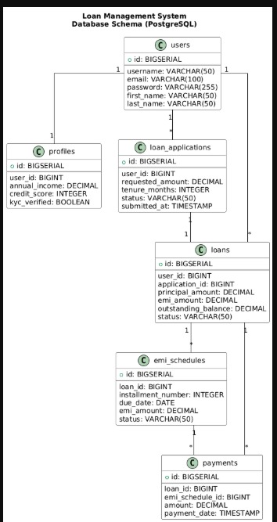
Entity Relationship Diagram

Slide 7
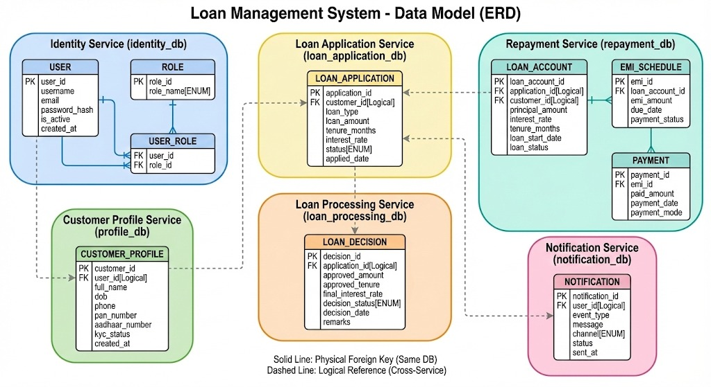
Data Model Introduction
The Loan Management System follows a distributed data model where each microservice maintains its own database.
Logical references are used between services to ensure loose coupling, scalability, and independent data management.

Slide 8
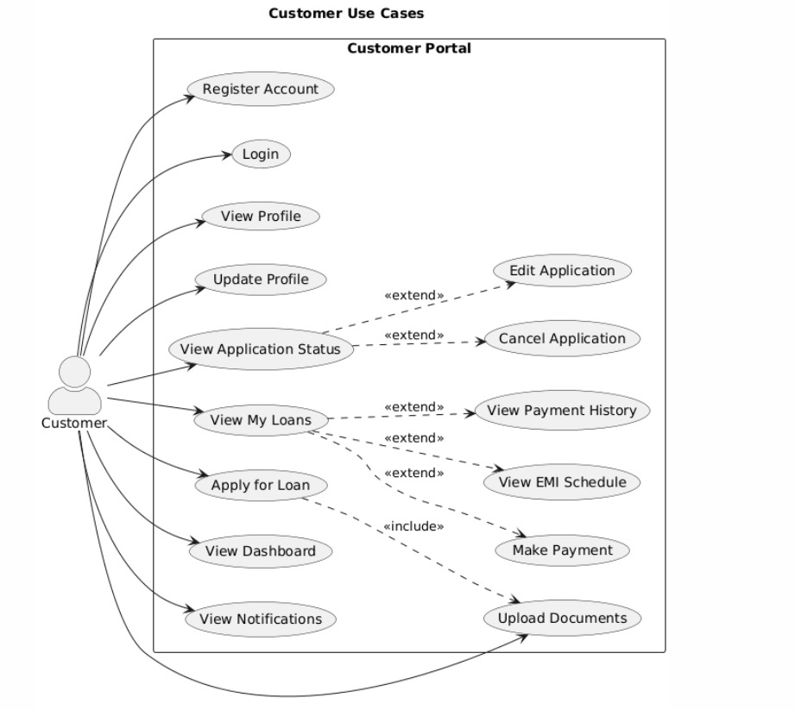
Use cases:-

Slide 9
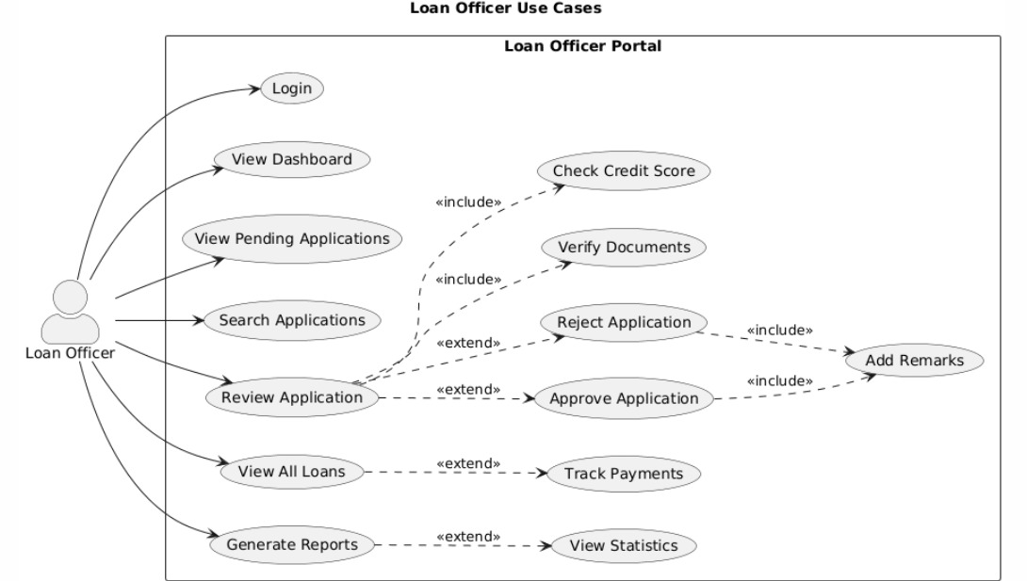

Slide 10
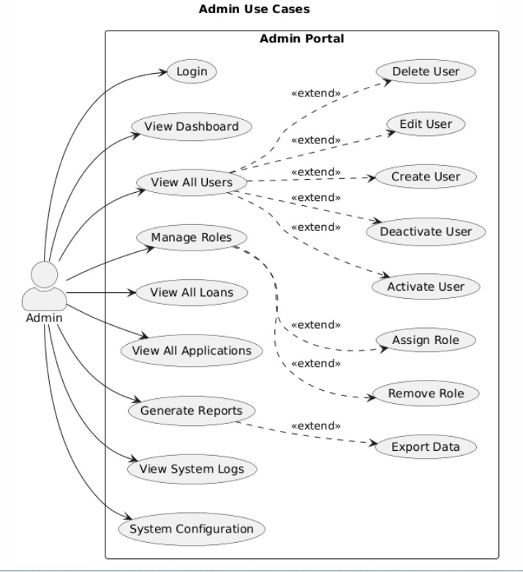

Slide 11
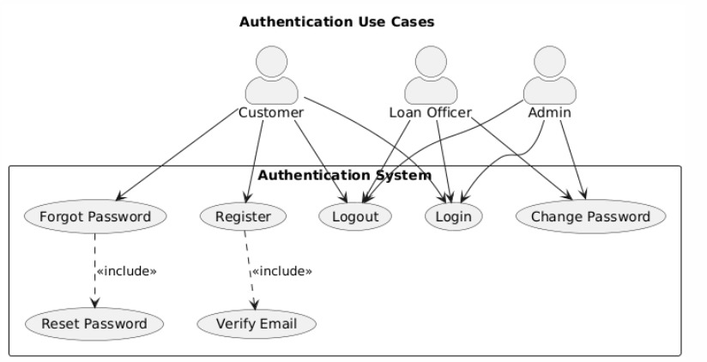

Slide 12
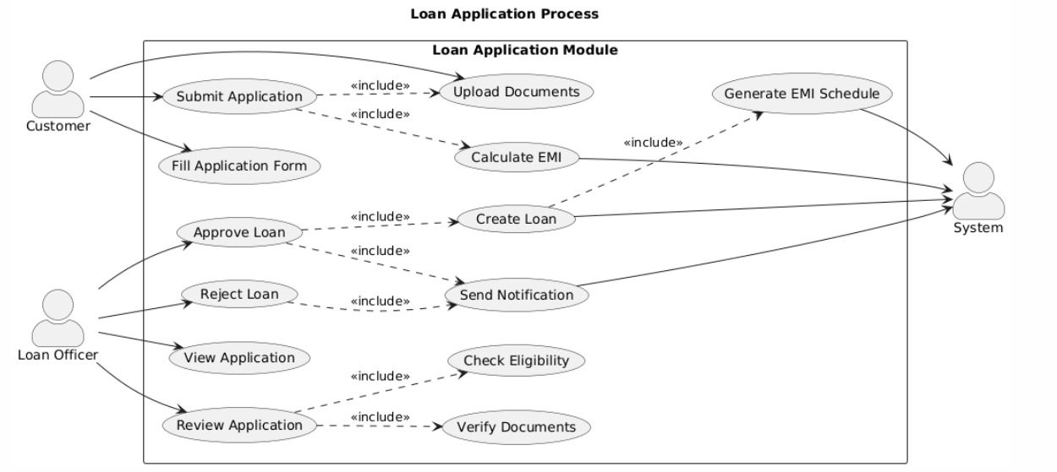

Slide 13
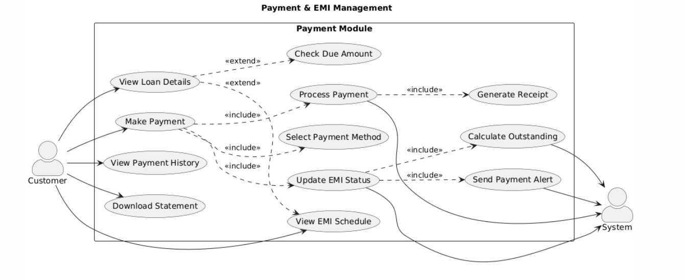

Slide 14
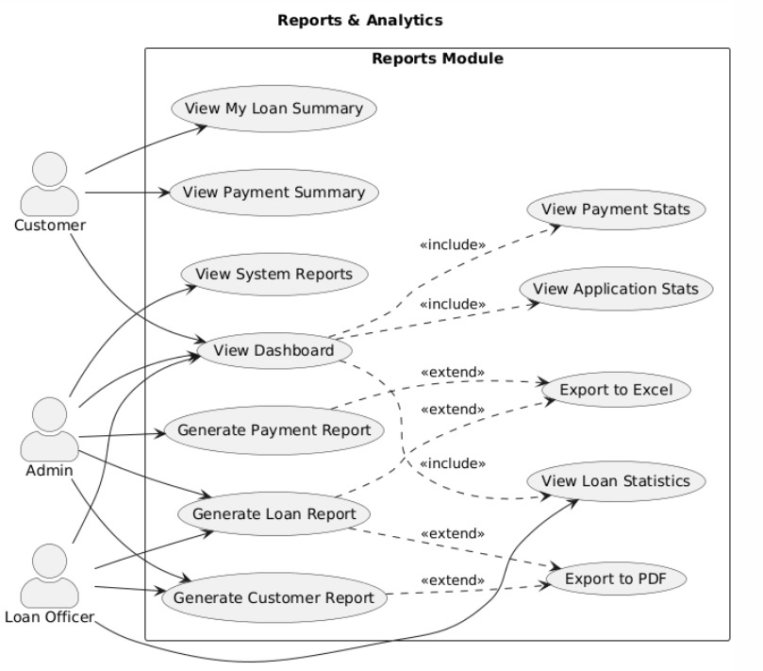

Slide 15
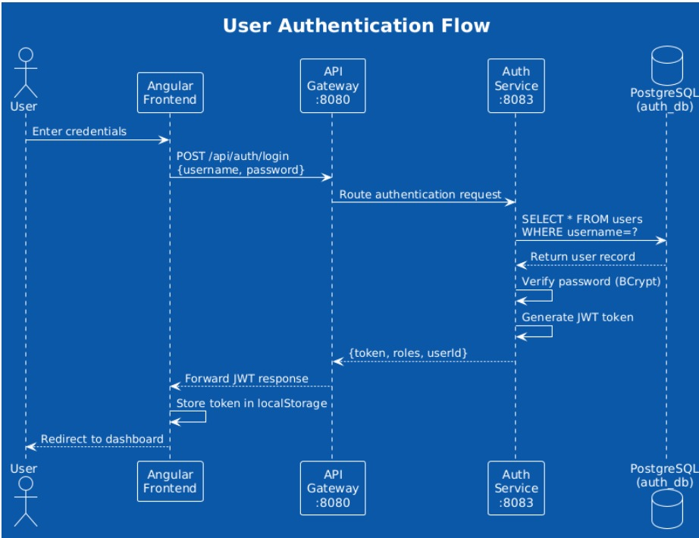
Sequence diagrams:-

Slide 16
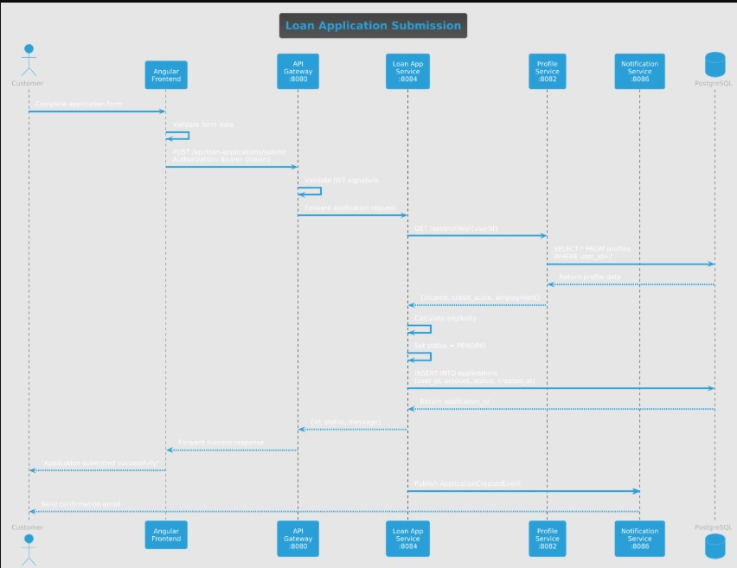

Slide 17
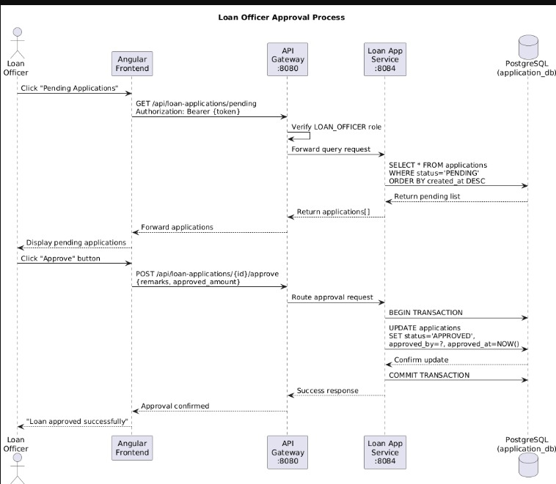

Slide 18
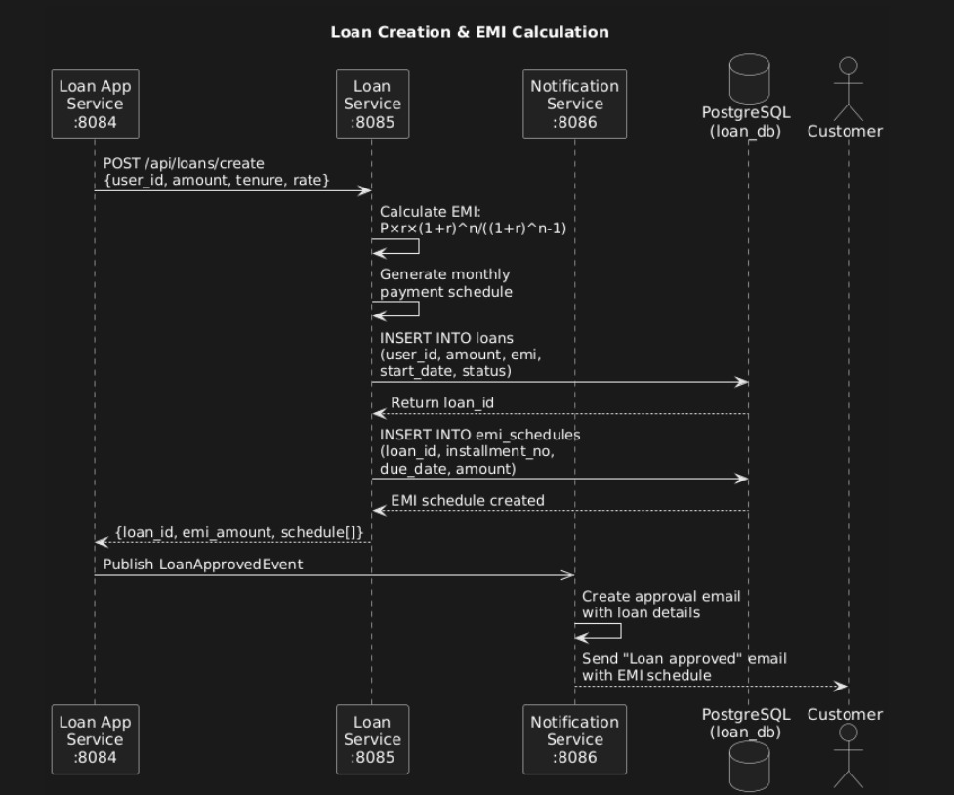

Slide 19
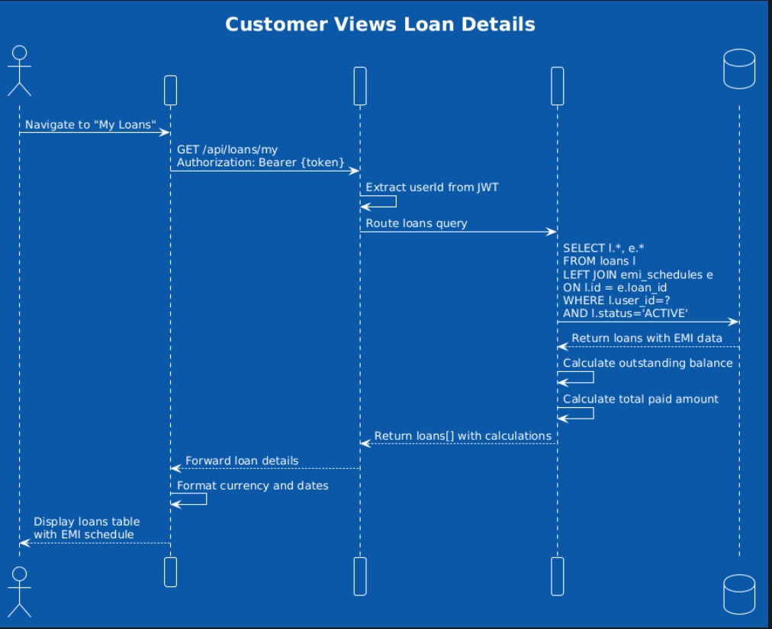

Slide 20
Future Work & Advanced Features
Real-Time Enhancements
AI / ML Integration
Credit Risk Assessment: Machine learning models to predict loan default probability.
Automated Credit Scoring: AI-based credit score calculation using customer financial data.
Fraud Detection: Anomaly detection to identify suspicious or fraudulent loan applications.
AI Chatbot Support: Intelligent chatbot for customer queries and loan assistance.
Document Verification: OCR and AI-based automatic KYC document validation.
Loan Recommendation Engine: Personalized loan suggestions based on customer profile and history.
Live Chat Support: Real-time communication between customers and loan officers.
Real-Time Dashboard: Live tracking of loan status, EMIs, and repayments.
Push Notifications: Instant mobile and browser notifications for approvals, reminders, and alerts.
WebSocket Integration: Real-time system updates and notifications.

