Slide 1
A Novel approach for brain tumor prediction using hybrid model
PIP104 University Project
Final Review
Batch Number:
Roll Number | Student Name
20211COM0066 20211COM0085 | K.M.Madhushree Sakshi.S
20211COM0052 | Misbah Anum
20211COM0086 | Syeda Taskiya Fathima
20211COM0061 | Suhana Anjum
Under the Supervision of,
Assistant Prof. Mr. Arun Kumar S
School of Computer Science & Engineering
Presidency University

Slide 2
Introduction
1.Brain tumors are a significant health concern, with around 250,000 new cases diagnosed annually.
2.They are a leading cause of cancer-related deaths due to their aggressive nature.
3.Tumors are categorized into:
Benign: Non-cancerous and localized.
Malignant: Cancerous and spreading.
4.Early and precise identification of brain tumors is essential to enhance survival outcomes.
5.The complex structure of brain tissues makes manual MRI interpretation time-consuming and difficult.
6.There is a growing need for advanced automated systems to aid in accurate diagnosis.

Slide 3
Introduction
This project focuses on designing a hybrid model by integrating Convolutional Neural Networks (CNN) with EfficientNet.
8.Key goals include:
Detecting tumors effectively.
Segmenting tumor regions within MRI scans.
Classifying tumors into benign or malignant types with high accuracy.
9. EfficientNet enhances the model’s accuracy while minimizing computational overhead, making it more efficient.
10. The hybrid approach ensures better performance in terms of both accuracy and speed.

Slide 4
Literature Review
Importance of Early Detection: Early diagnosis is crucial for improving survival rates. Manual MRI interpretations, though standard, are error-prone due to brain tissue complexity, driving the need for automated systems.
Machine Learning in Imaging: CNNs have proven effective for brain tumor detection, achieving high accuracy with annotated MRI datasets.
EfficientNet's Role: EfficientNet, balances performance and efficiency, outperforming models in medical imaging tasks
Hybrid Model Advancements: Combining CNNs with EfficientNet enhances accuracy and speed, ideal for real-time diagnostic systems along with tumour size and the respective graph.
Tumor Segmentation: Hybrid models integrating EfficientNet improve MRI tumor segmentation, making it more robust and precise.

Slide 5
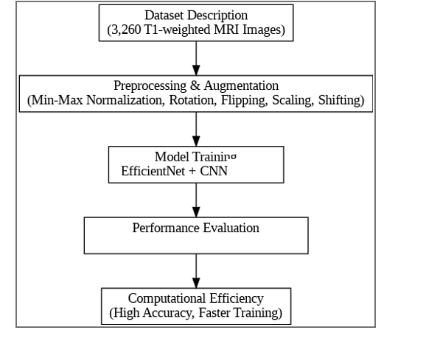
Proposed Model to detect the Brain Tumor

Slide 6
Proposed Method
Data Preprocessing: Normalize and augment MRI datasets to enhance quality and address data scarcity.
Feature Extraction: Utilize CNN for identifying critical tumor patterns.
Classification: Integrate EfficientNet for accurate and computationally efficient tumor classification.
Hybrid Model: Combine CNN's feature extraction with EfficientNet's classification for superior performance.
Segmentation: Use EfficientNet attention mechanisms for precise tumor boundary detection.
Evaluation: Assess the model using accuracy.
Visualization:Tumour detection along with tumour size and its respective graph for explainability and reliable clinical use.

Slide 7
Objectives
Preprocess MRI Data: Enhance image quality through normalization and augmentation to address data scarcity.
Feature Extraction with CNN: Use CNN to identify key tumor features in MRI images.
Tumor Classification with EfficientNet: Implement EfficientNet for accurate and efficient tumor classification.
Hybrid Model Development: Combine CNN feature extraction with EfficientNet classification for enhanced performance.
User Interface Development: Create a user-friendly interface for real-time tumor detection and with tumour size and its respective graph .

Slide 8
Methodology
Data Collection: Acquire MRI images from public datasets.
Data Preprocessing: Normalize and augment data to enhance image quality and address data scarcity.
Feature Extraction: Use CNN to extract tumor-related features from MRI images.
Tumor Classification: Implement EfficientNet for accurate tumor classification.
Hybrid Model: Combine CNN feature extraction with EfficientNet classification for improved performance and with tumour size and its respective graph .

Slide 9
Expected Outcomes
High Accuracy in Tumor Detection: The model will classify MRI images with high accuracy, identifying whether a brain tumor is present or not.
Tumor Size Estimation: The model will provide an estimate of the tumor size based on the segmented MRI images, helping to assess the severity of the condition.
Real-Time Detection: A user-friendly web interface will allow clinicians to upload MRI images and receive instant feedback on tumor presence and size.
Scalable and Reliable : The model is trained for scalability, capable of handling large datasets and providing quick, reliable results for multiple users.

Slide 10
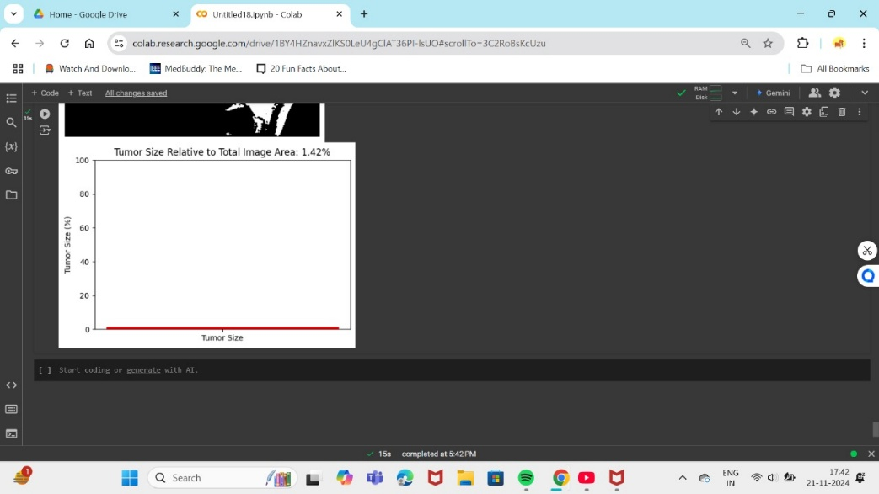
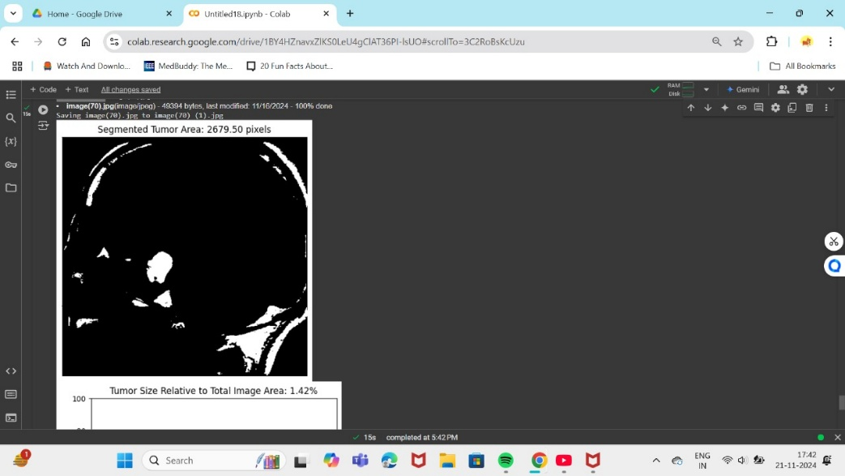
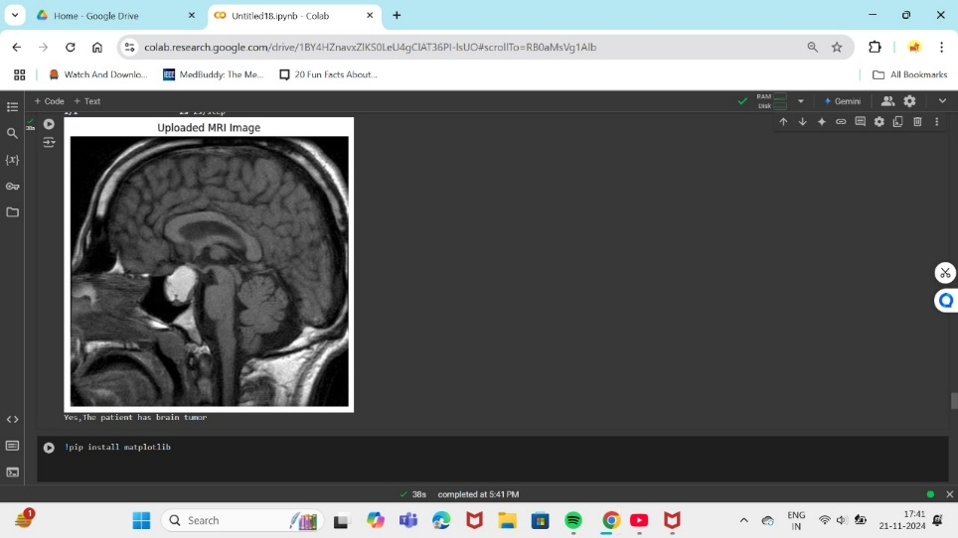
RESULT

Slide 11
Conclusion
The project develops a hybrid model combining CNN and EfficientNet for accurate brain tumor detection and classification.
It ensures high diagnostic accuracy by segmenting tumors and estimating their size.
A user-friendly interface allows clinicians to upload MRI images and receive instant feedback on tumor presence and size.
The system is deployed on cloud platforms for scalability, efficiently handling large datasets.
The model aims to improve clinical workflows and contribute to better patient outcomes.

Slide 12
References
[1]Aashutosh Kharb and Prachi Chaudhary , Designing efficient brain tumor classifier using hybrid EfficientNet-faster R-CNN deep learning model, September 2024.
[2]Chetan Swarup, Kamred Udham Singh, Ankit Kumar,Saroj Kumar Pandey, Neeraj varshney and Teekam Singh, Brain tumor detection using CNN, AlexNet & GoogLeNet ensembling learning approaches, electronic research archive(2023).
[3]Sushreeta Tripathy,Rishabh Singh , Mousim Ray ,Automation of Brain Tumor Identification using EfficientNet on Magnetic Resonance Images, ScienceDirect,2023.
[4]Khaliki, M.Z., Başarslan, M.S. Brain tumor detection from images and comparison with transfer learning methods and 3-layer CNN. Sci Rep 14, 2664 (2024).
[5]Dillip Ranjan, Nayak,Neelamadhab,Padhy,PradeepKumar, Mallick,Mikhail Zymbler and Sachin Kumar,Brain Tumor Classification Using Dense Efficient-Net,MDPI, 17 January 2022.
[6]Tan, M., & Le, Q. , EfficientNet: Rethinking Model Scaling for Convolutional Neural Networks,Proceedings of the 36th International Conference on Machine Learning (ICML), PMLR,2019.
[7]LeCun, Y., Bottou, L., Bengio, Y., & Haffner, P. , Gradient-Based Learning Applied to Document Recognition. Proceedings of the IEEE,1998

Slide 13
References
[8]Cheng, J., Huang, W., Cao, S., Yang, R., Yang, W., Yun, Z., Wang, Z., & Feng, Q. , Enhanced Performance of Brain Tumor Classification via Tumor Region Augmentation and Partition. PLOS ONE,2015.
[9]Shorten, C., & Khoshgoftaar, T. M, A Survey on Image Data Augmentation for Deep Learning. Journal of Big Data,2019.
[10]Jayaraman, S., Esakkirajan, S., & Veerakumar, T, Digital Image Processing. Tata McGraw-Hill Education,2009.
[11]Cortes, C., & Vapnik, V, Support-Vector Networks. Machine Learning,1995.
El-Dahshan ESA, Mohsen HM, Revett K, Salem ABM. Computer-aided diagnosis of human brain tumor through MRI: A survey and a new algorithm. Expert Syst Appl,2014.
[12]Shenbagarajan Anantharajan, Shenbagalakshmi Gunasekaran, Thavasi Subramanian, Venkatesh R,MRI brain tumor detection using deep learning and machine learning approaches,2024.
[13]Pacal, I., Celik, O., Bayram, B. et al. Enhancing EfficientNetv2 with global and efficient channel attention mechanisms for accurate MRI-Based brain tumor classification. Cluster Comput ,2024.
[14]Md Manowarul Islam, Md. Alamin Talukder, Md Ashraf Uddin, Arnisha Akhter, Majdi Khalid,”BrainNet: Precision Brain Tumor Classification with Optimized EfficientNet Architecture”,wiley(2024).

Slide 14
Thank You

