Slide 1
E‑Commerce Sales Dashboard Analysis
Prepared by: Syeda Khuteja (Data Analyst)
Email: syedakhuteja77@gmail.com

Slide 2
Project Objective
• Analyze sales, profit, customer behavior, and category performance.
• Identify trends across states, customers, and payment modes.
• Provide action-oriented insights for improving profitability.
• Support stakeholders in making data-driven decisions.

Slide 3
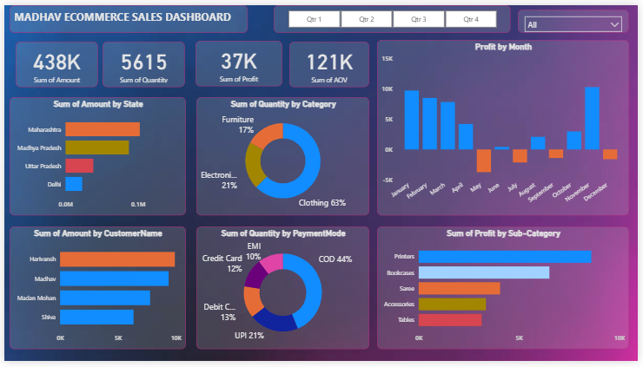
Dashboard Overview

Slide 4
Key Performance Indicators
• Total Sales Amount: 438K
• Total Quantity Sold: 5615 units
• Total Profit: 37K
• Average Order Value (AOV): 121K
These KPIs highlight strong overall business performance.

Slide 5
Insights: State & Customer Performance
• Maharashtra and Madhya Pradesh contribute the highest sales.
• Delhi shows lower sales volume — an opportunity for targeted marketing.
• Top customers (Harikrash, Madhav) drive a significant share of revenue.
• Long-tail customers have low engagement, indicating potential for loyalty programs.

Slide 6
Insights: Category & Sub‑Category
• Clothing contributes 63% of quantities sold, making it the top-performing category.
• Electronics & Furniture show smaller but stable demand.
• Printers and Bookcases have high sub‑category sales — consider expanding stock.
• Accessories and Tables show lower performance; pricing evaluation may be needed.

Slide 7
Insights: Payment Mode
• COD accounts for 44% of the transactions.
• UPI is the second-most preferred mode at 21%.
• High COD usage increases return risks—digital payment incentives could improve efficiency.

Slide 8
Monthly Profit Trend
• Most months show positive profit, with a strong spike in December.
• April and August appear to generate losses.
• Low-profit months need review of pricing, promotions, and inventory strategies.

Slide 9
Business Recommendations
• Increase marketing focus in low-performing regions like Delhi.
• Introduce loyalty programs to improve engagement of long‑tail customers.
• Boost inventory for high-demand sub‑categories (Printers, Bookcases).
• Reassess pricing and product visibility for low-performing categories.
• Reduce COD dependency by offering cashback/discounts on online payments.
• Investigate loss‑making months to optimize discounts and operations.

Slide 10
Thank You!
Prepared by: Syeda Khuteja
Role: Data Analyst
Email: syedakhuteja77@gmail.com
Looking forward to your feedback.

