Slide 1
Online Book donate Management System
A Web-Based Platform for Buying, Selling, and Donating Books

Slide 2
Abstract
Online Book Donate Management is a website, developed to buy, sell or donate the books. It maintains the information about the personal details of their customers, also manage the books purchased or donated by them.
It is simple to understand and can be used by anyone who is not even familiar with simple Book Donate system. This software package has been developed using the powerful coding tools of HTML, CSS & Bootstrap at Front End and MySQL Server at Back End.
The application provides a user-friendly interface for both donors and administrators. Donors can register, log in, and submit their book donations, including relevant details such as book title, author, condition, and quantity.

Slide 3
Introduction
Online Book Donate and Donation is a form of e commerce website which allows customer for buying, Donate and donation of books directly from a seller over the Internet using a web browser.
Objective:
To provide a simple interface for users to donate and receive books.
The main objective of the project is to create an online book Donate and donation store that allows users to search and buy a book online based on title, author and subject.
There are many online book stores like Amazon Kindle, e-readers which were designed using Html.
In our website, we focused on donation section which is the most important part of our website.
Online Book store is an online web application where the customer can buy, sell and donate books online. Through a web browser the user can search for a book by its title or author.

Slide 4
Purpose & scope
Purpose:
Using this website, user can purchase a book, resell and donate online instead of going out to a book store and wasting time.
Scope:
This system is intended for use by educational institutions, non-profit organizations, libraries, and individuals who wish to donate or receive books.

Slide 5
System specification
Hardware Requirement:
PROCESSOR : Intel Core i5.
RAM : 4 GB DDR2 RAM
MONITOR : 15.6 inc” COLOR
HARD DISK : 512 GB
Software Requirement:
Front End : HTML, CSS, JavaScript, Bootstrap
Back End : MYSQL, PHP
Operating System : Windows 11

Slide 6
Modules
Administration Module: The webpage or the network may be run by library professionals on voluntary basis. Role of Administrative body will include:
Maintenance of Webpage
Delete users
Organising awareness Programmes
Maintenance of donors’ profile, receivers’ profile, document profile, etc.
Managing feedback and take actions as required
Report generation

Slide 7
Modules
Donors’ Module: Every new donor must get registered himself/herself and receive User ID & Password for getting access to the web page.
Functional Requirements
User Registration: Donors and recipients need to create accounts.
Book Donation: Donors can add books to the system by providing details like book title, author, condition, and category.
Recipient Search: Recipients can search for available books based on criteria such as category, author, and location.
Donation Confirmation: Once a donation is made, the system confirms the receipt of the book and updates the database.
Book Tracking: The system tracks the status of donated books (pending, in progress, delivered).

Slide 8
SYSTEM ARCHITECTURE
The system follows a client-server architecture. The client-side is the user interface, where users can interact with the system to donate or receive books. The server handles the processing of data and communication with the database. The database stores information related to users, books, donations, and recipients.
ER (Entity-Relationship) Diagram
ER (Entity-Relationship) Diagram for the Book Donation Management System that captures the main entities and their relationships. The entities involved typically include Users, Books, Donations, and Recipients. I'll describe the diagram in a structured way, which you can then use to create the actual ER diagram visually using a tool like draw.io, Lucidchart, or any other ER diagram tool

Slide 9
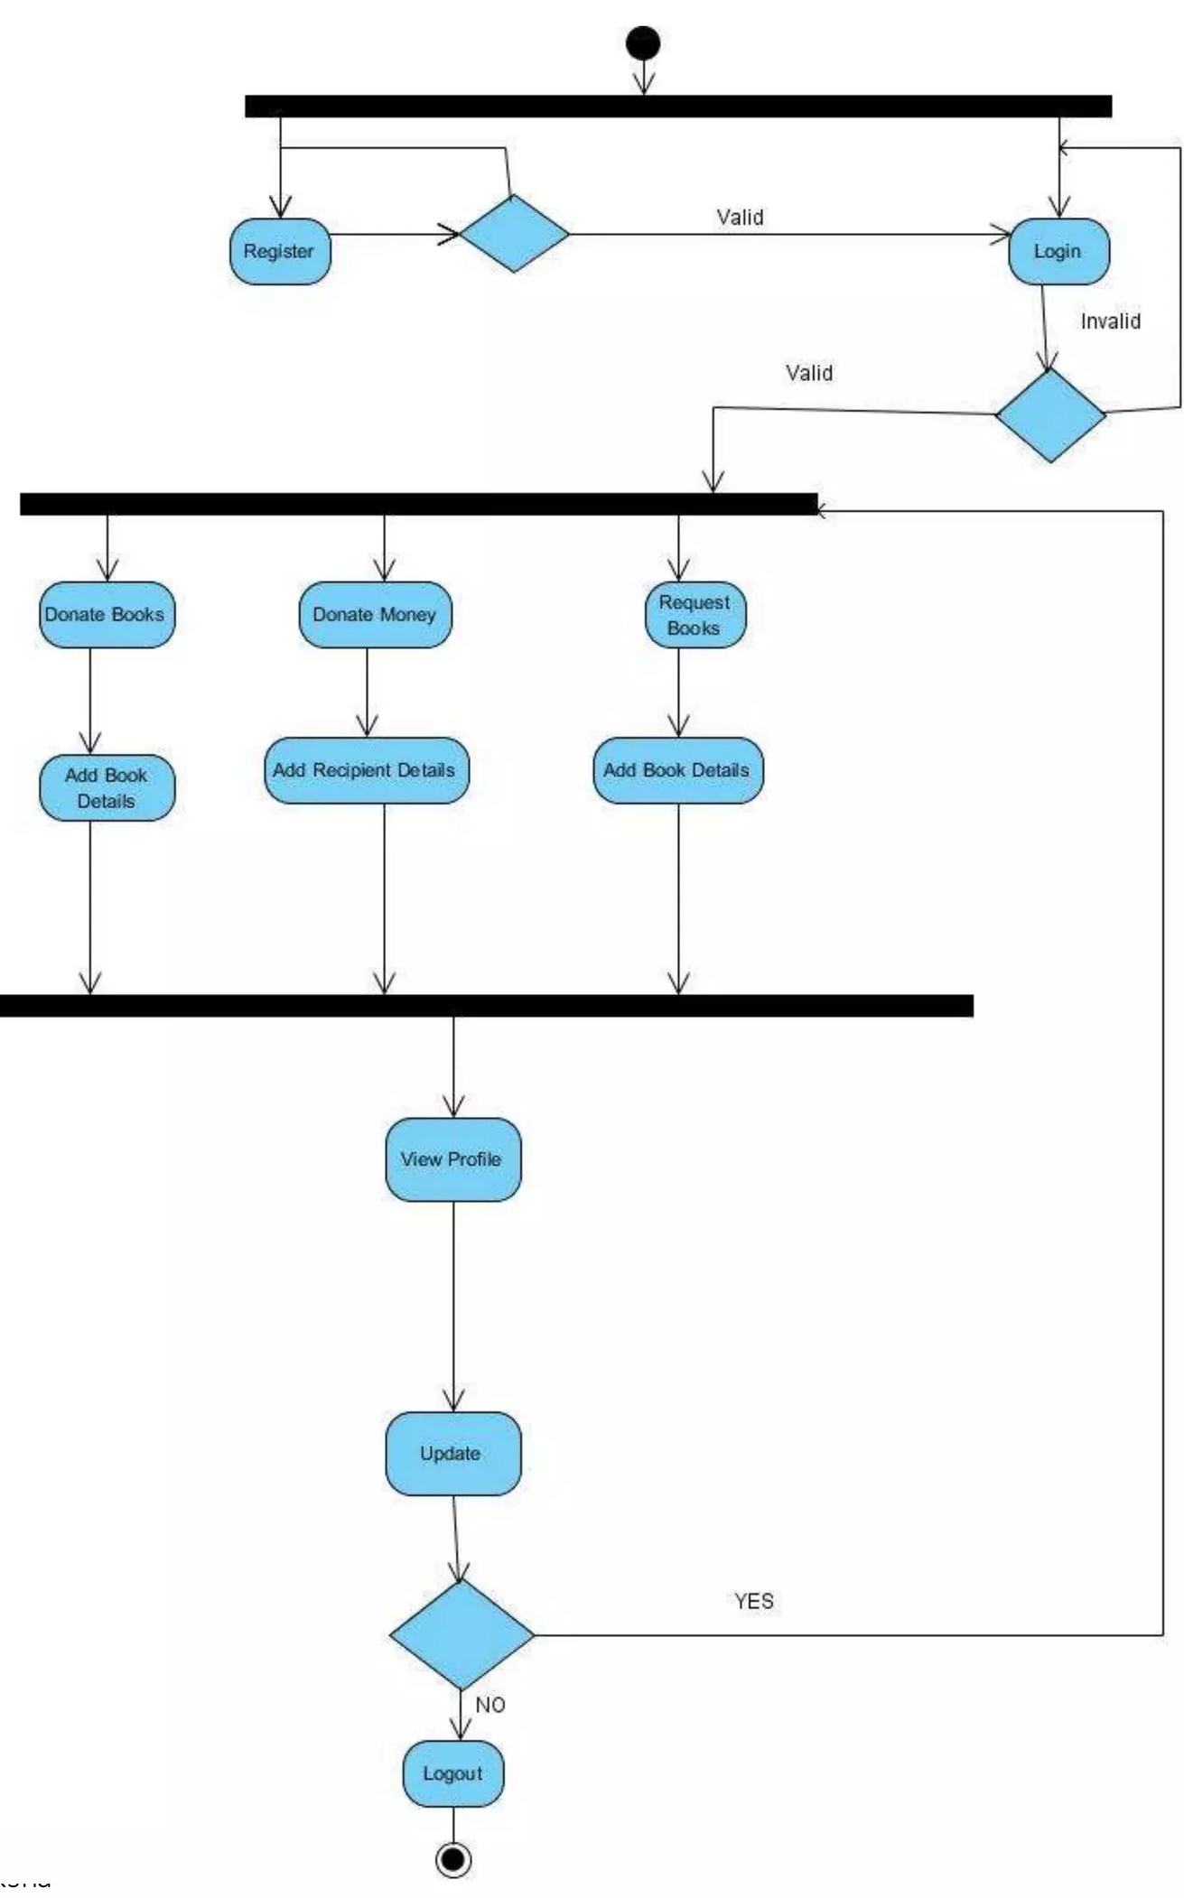
SYSTEM ARCHITECTURE

Slide 10
Entities and Relationships
User
Attributes: UserID, Name, Email, Password, UserType (Donor/Recipient)
Relationships:
A User can make Donations (for Donors).
A User can request Donations (for Recipients).
Book
Attributes: BookID, Title, Author, ISBN, Category, Condition, DonorID (FK),
Relationships:
A Book belongs to a Donor (One-to-Many relationship).
A Book can be requested by a Recipient.
Donation
Attributes: DonationID, BookID (FK), DonorID (FK), RecipientID (FK), DonationDate, Status (Pending, Confirmed, Delivered)
Relationships:
A Donation involves a Donor and a Recipient (Many-to-One relationship from Donation to Donor and Recipient).
A Donation is linked to a Book (One-to-One relationship between Donation and Book).
Recipient
Attributes: RecipientID, Name, Email, Address, Phone

Slide 11
ER Diagram Description
User and Donation:
A User (either a Donor or a Recipient) can be involved in a Donation. If the user is a Donor, they will donate Books. If the user is a Recipient, they will receive Books. This is a Many-to-Many relationship, which we break down using the Donation entity.
Book and Donation:
A Book is donated by a Donor and can be received by a Recipient. Each donation links a Book to a Recipient. The Book entity is connected to the Donation entity.
Book and User:
A Book is donated by a User (Donor). This establishes a One-to-Many relationship between the User and Book.
Recipient and Donation:
A Recipient can request a Donation, which corresponds to receiving Books. This is a One-to-Many relationship.

Slide 12
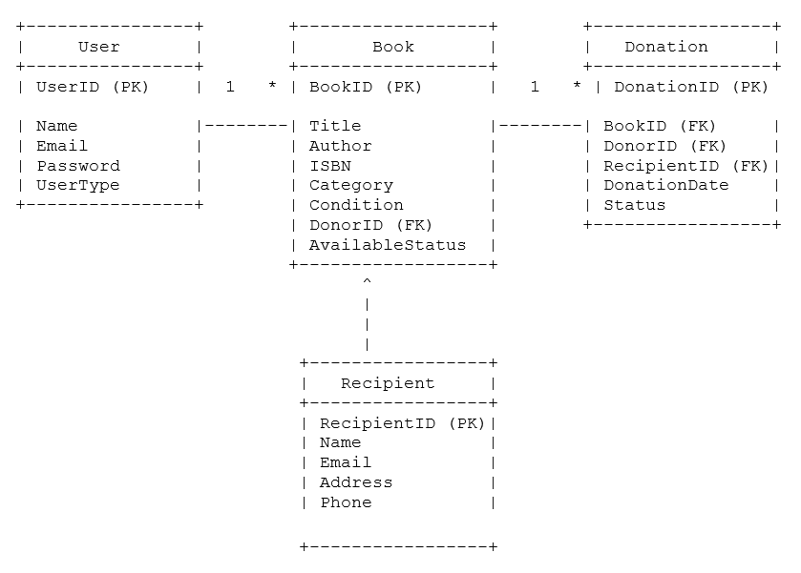
ER Diagram (Textual Representation)

Slide 13
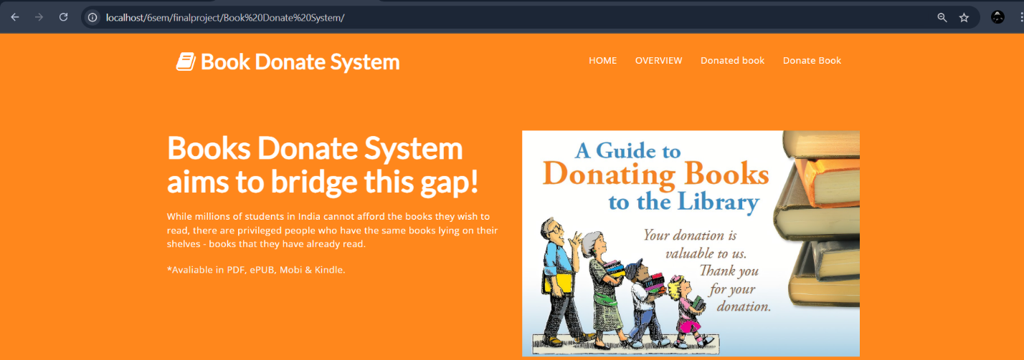
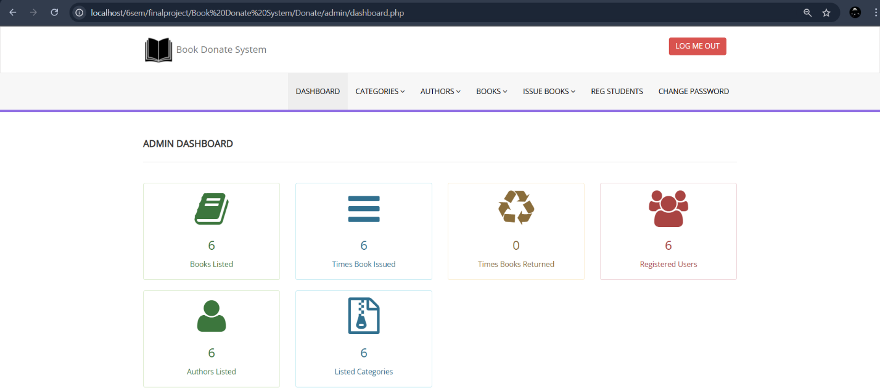
Screen shots

Slide 14
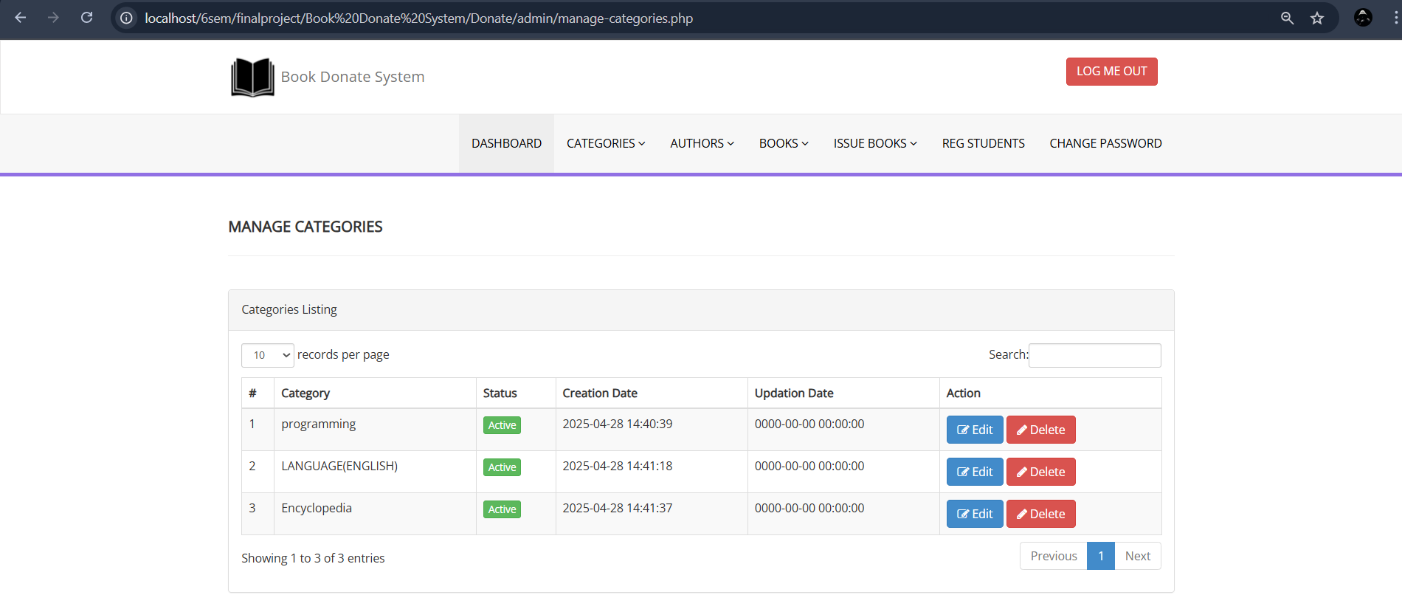
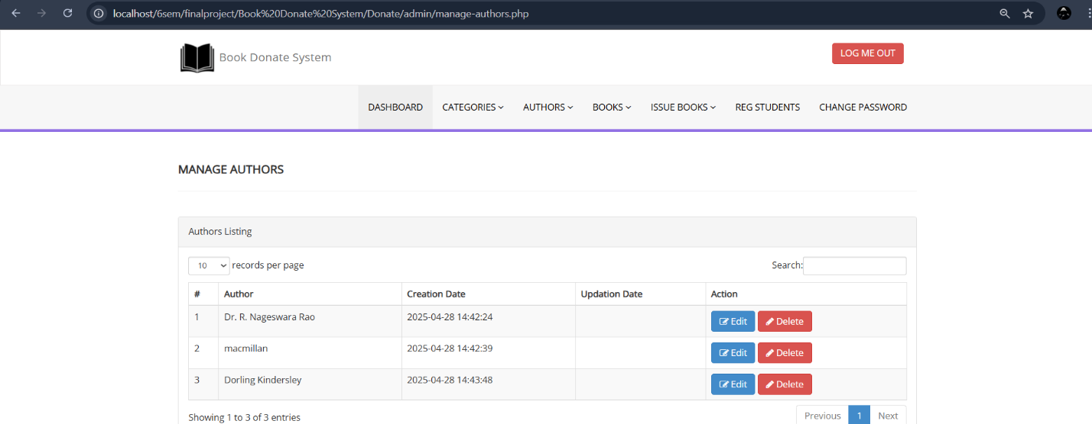
Screen shots

Slide 15
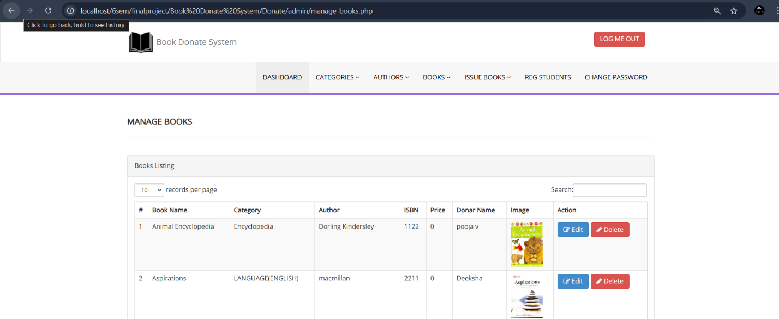
Screen shots

Slide 16
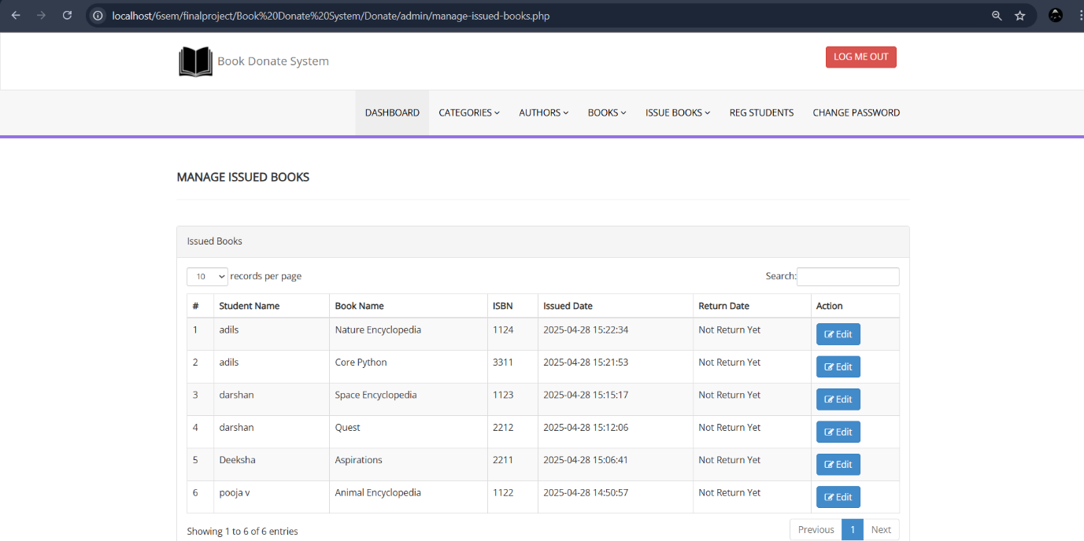
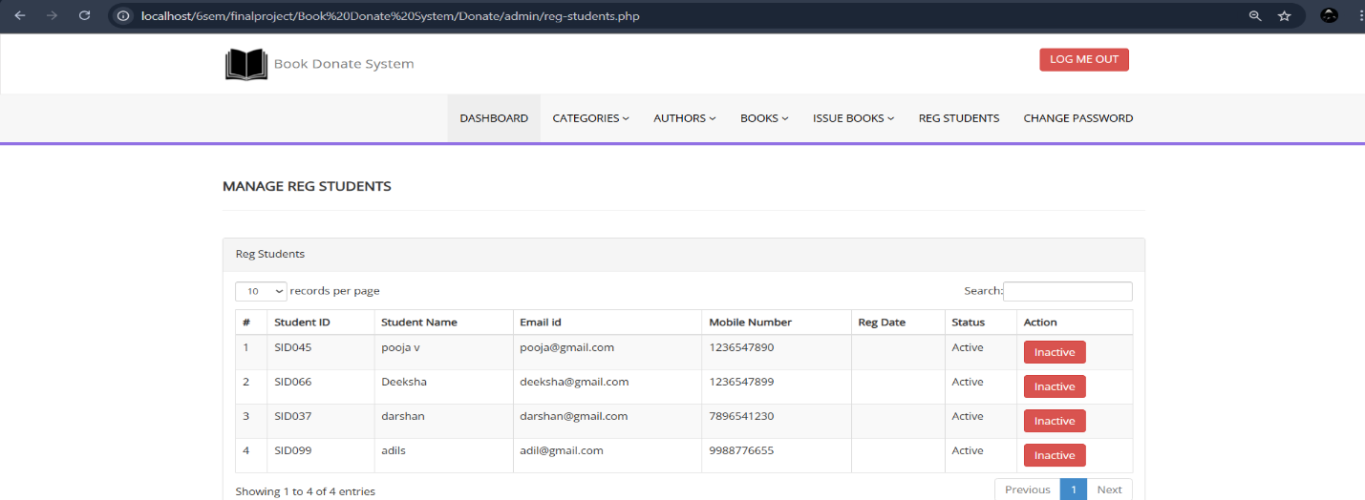
Screen shots

Slide 17
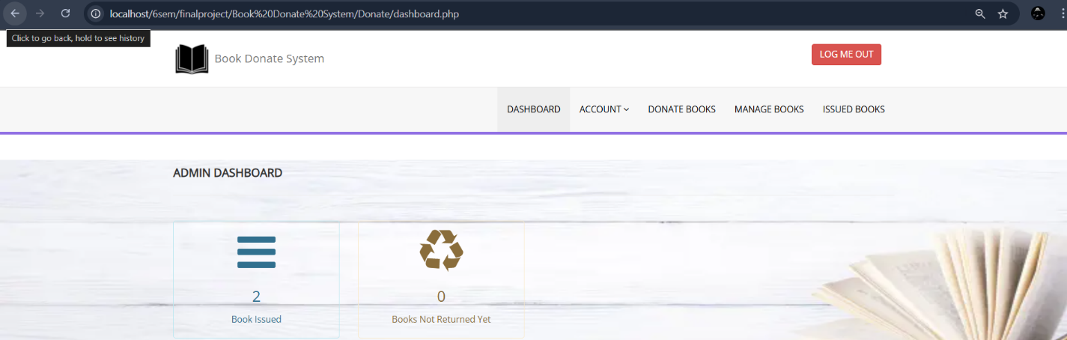
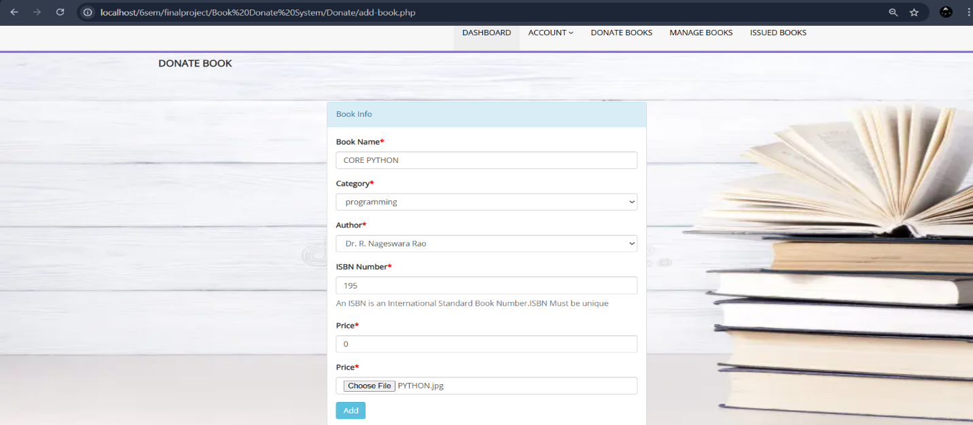
Screen shots

Slide 18
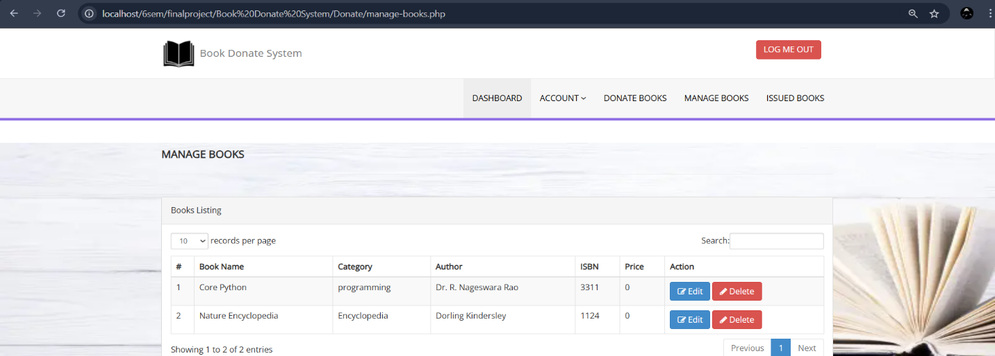
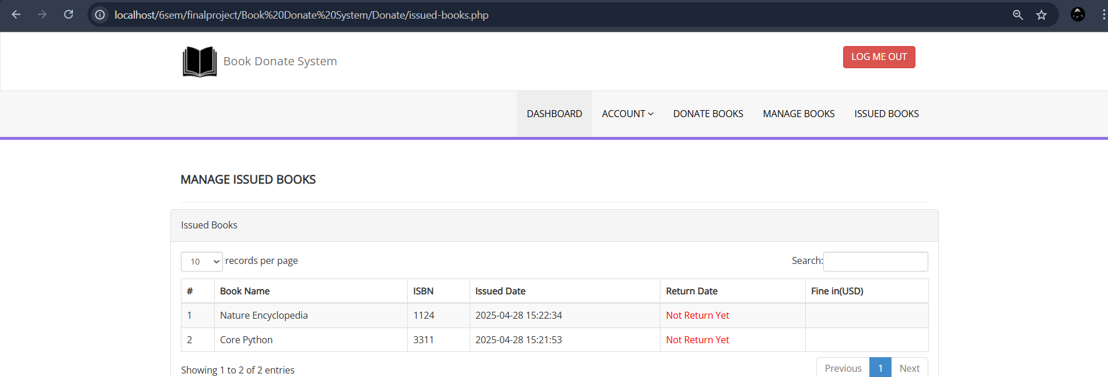
Screen shots

Slide 19
testing
Testing is the process in which the system is run on manually created input so that the system is correctly working as desired or not.
During systems testing, the system is used experimentally to ensure that the software does not fail. In other words, we can say that it will run according to its specifications and in the way users expect.
VALIDATION CRITERIA
All the screens have a similar look and feel. They all have the almost same color combinations in its background. This provides a better user interface to the users.
The primary key values cannot be duplicated.
All the entries in any combo box have been sorted in alphabetical order. This helps a user while selecting a value from the combo box.

Slide 20
importance of testing
During systems testing, the system is used experimentally to ensure that the software does not fail. In other words, we can say that it will run according to its specifications and in the way users expect. Special test data are input for processing, and the results examined. The importance of system testing is that the system is expected to run according to member’s requirement before delivering it to the customer. The System is tested on the basis of specification so that it does not fail on user site.

Slide 21
Conclusion
The system provides an efficient, flexible, and user-friendly platform for book reselling and donation. The donor feature enhances accessibility and usability, ensuring books reach those in need.
Our Effort Is to create our website’s “Donation” Feature more efficient, Flexible and more user friendly to our customer. The Book Donation Management System was successfully developed and implemented, providing a platform that connects book donors with recipients in need

Slide 22
Future enhancement
Mobile Application: A mobile version of the system could be developed to increase accessibility and user engagement.
Real-Time Book Tracking: Implementing a real-time tracking system for donations could improve the transparency of the donation process.
Expanded User Base: The system can be scaled to include more diverse groups of donors and recipients, including international users.

