Slide 1




KIT-KALAIGNARKARUNANIDHI INSTITUTE OF TECHNOLOGY
COIMBATORE - 641402
Approved by AICTE Affiliated to Anna University, Chennai Accredited With ‘A’ Grade by NAAC & By NBA
DEPARTMENT OF ELECTRONICS AND COMMUNICATION ENGINEERING
Review 1
Design of CMOS LNA for Radio Receiver Using Cadence Simulation Tool
BATCH NO: 1
TEAM MEMBERS
SUPERVISOR
1.Vaishnavi
2.Syed Afridi
3.Sanjay
4.Rahul
Dr.R.GOWRISHANKAR
Professor, ECE Department
KIT, Coimbatore

Slide 2
OBJECTIVE
Design & Performance: Develop a CMOS LNA for 2.4 GHz RF receivers achieving >15 dB gain, <2 dB noise figure, with high linearity and stability.
Simulation & Optimisation: Validate the design using Cadence Virtuoso (S-parameters, noise, linearity) while optimising power efficiency for practical integration.

Slide 3
ABSTRACT
CMOS Low-Noise Amplifier (LNA) designed for 2.4 GHz radio receivers
Focus on amplifying weak signals with minimal added noise
Designed and simulated using Cadence Virtuoso
Methodology includes:
Schematic design and component sizing
S-parameter, noise figure, and harmonic balance simulations
Expected performance:
Gain > 15 dB
Noise figure < 2 dB
Supports modern wireless standards:
5G, Wi-Fi (2.4 GHz)
Enables low-power, cost-effective RF front-end integration
Key Specifications
Frequency: 2.4 GHz
Technology: 180nm CMOS
Target Gain: >15 dB
Noise Figure: <2 dB
Power: Optimised

Slide 4
LITERATURE REVIEW….
S.No | ARTICLE TITLE & PUBLICATION DETAIL | METHODOLOGY USED
1. | IEEE TCAS-II, 2023 | Proposed a broadband CMOS LNA with variable gain, achieving low noise figure (<2 dB) and improved linearity for wireless receivers.
2. | IEEE Transactions on Microwave Theory and Techniques, 2023 | Presented a noise-cancelling CMOS LNA operating at mm-wave frequencies, demonstrating excellent NF–power trade-off.

Slide 5
LITERATURE REVIEW….
3. | IEEE Solid-State Circuits Letters, 2024 | Designed a low-power variable-gain CMOS LNA optimized for RF front-end integration in modern wireless standards.
4. | IEEE Journal of Solid-State Circuits, 2024 | Reported a high-gain CMOS LNA using transformer-based matching, achieving superior noise and stability performance.

Slide 6
LITERATUE OVERVIEW….
Evolution of CMOS LNAs:
Transition from discrete bipolar designs to integrated CMOS architectures offering cost and power advantages
This Project's Contribution:
Implementation of cascode topology with inductive degeneration, validated through Cadence simulations for stability and performance
Key Challenge:
Noise-power trade-off remains primary limitation, particularly at RF frequencies where thermal and flicker noise dominate

Slide 7
Problem statement ( Source : hackathon/Industry/Journal)
CMOS LNA Design Challenges & Requirements
CMOS LNAs face high noise at RF frequencies due to device and substrate effects. Modern 5G and Wi-Fi 6/6E systems demand <2 dB NF and <5 mW power, requiring advanced techniques to balance noise, power, and linearity.

Slide 8
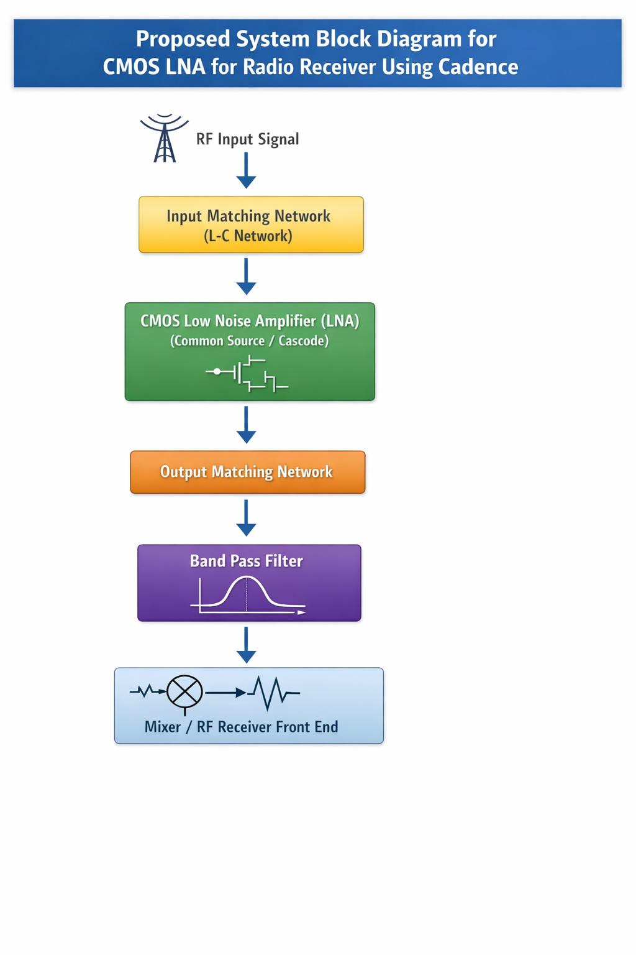
Proposed System Block Diagram

Slide 9
Methodology
Technology Selection
180nm CMOS process for optimal noise and power characteristics
Schematic Design
Cadence Virtuoso for transistor-level schematic capture
Component Sizing
Transistor W/L ratios, inductor values, capacitor selection
Simulations
SpectreRF for DC, AC, noise, harmonic balance analysis
Layout Implementation
Physical design with parasitic extraction and verification
Optimisation
Iterative refinement targeting S21 gain, NF, IIP3, stability

Slide 10
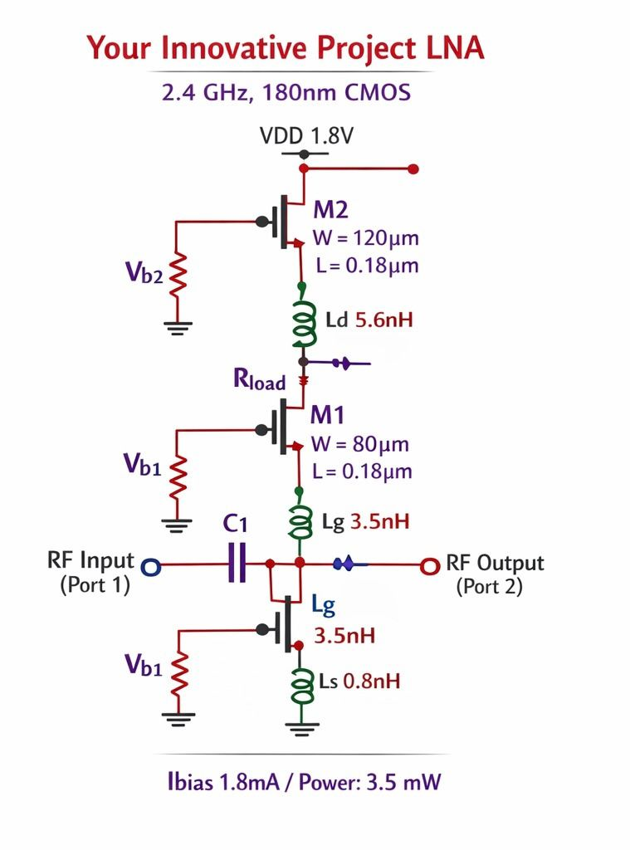

Slide 11
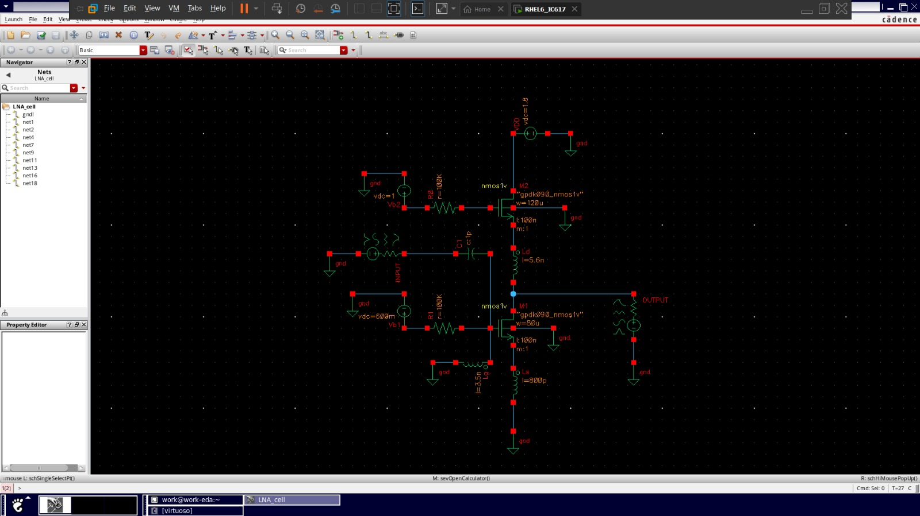
SCHEMATIC

Slide 12
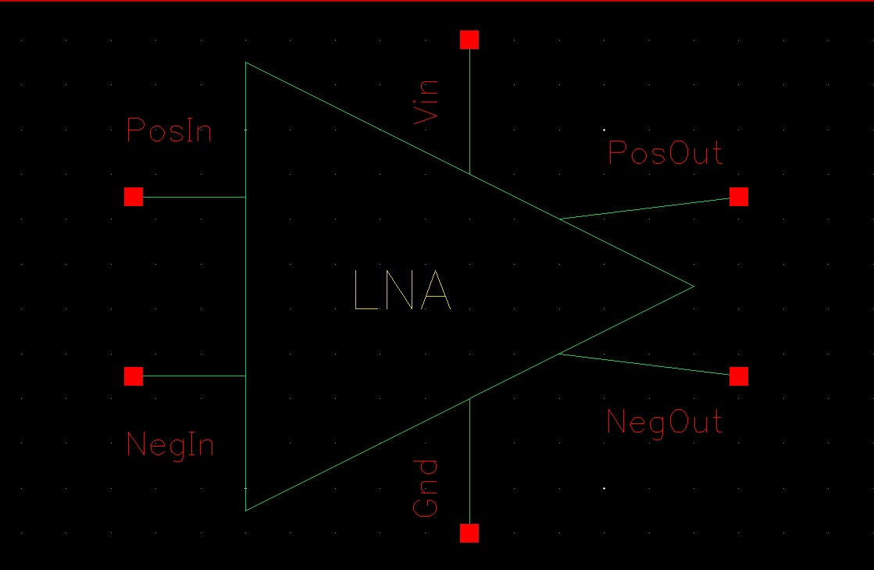
SYMBOL:-

Slide 13
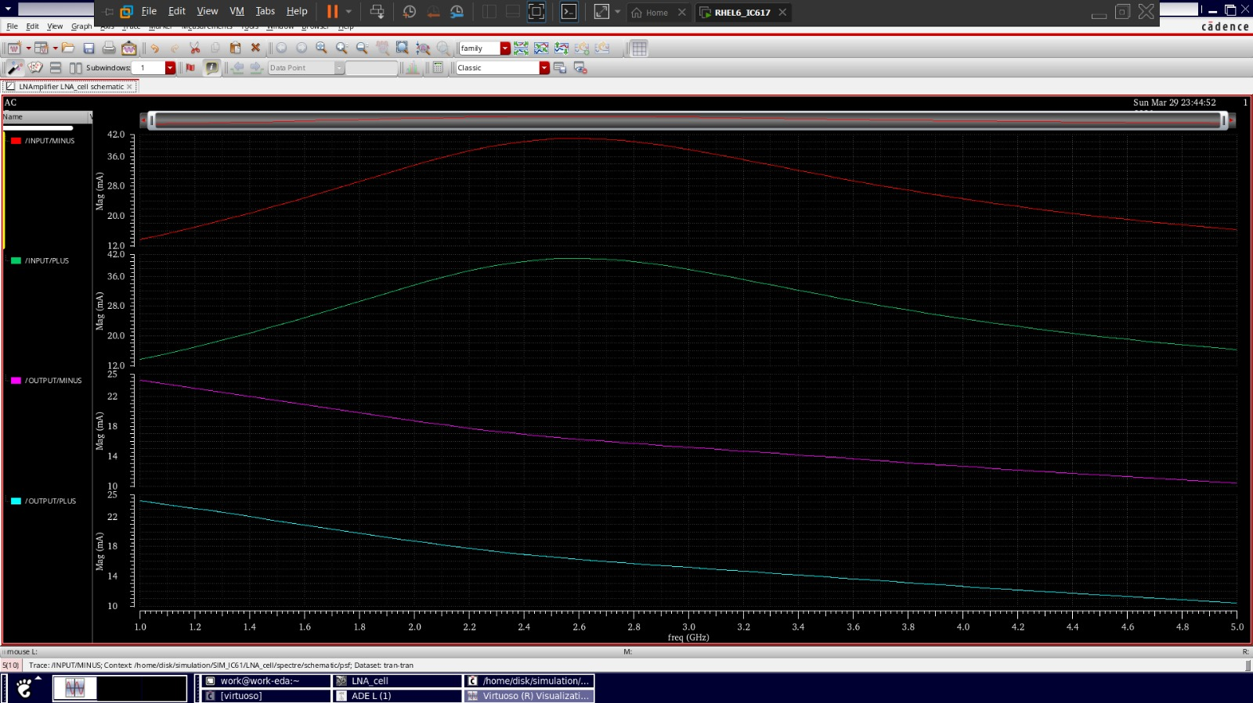
waveform

Slide 14
Work Completion status
S.No | Work Description | Completion Percentage
1. | Problem Identification | 100%
2. | Literature Survey | 100%
3. | System Design | 100%
4. | Implementation | 100%
5. | Testing and Validation | 100%

Slide 15
Paper preparation status
S.No | Description | Completion Status
1 | Abstract | Completed
2 | Introduction Literature Survey | Completed
3 | Proposed System and Methodology | Completed
4 | Experimental results | Completed
5 | Conclusion and Reference | Completed

Slide 16
REFERENCES
S.NO | REFERENCE DETAILS
1. | R. Wang, C. Li, and Y. Wang, “A Broadband Variable-Gain Low-Noise Amplifier With Low Noise Figure,” IEEE Transactions on Circuits and Systems II, 2023.
2. | S. K. Khyalia et al., “A Low-Power Noise-Canceling CMOS LNA for RF Receivers,” IEEE Transactions on Microwave Theory and Techniques, 2023.
3. | Y.-T. Chang and W.-J. Lin, “A Low-Power Variable-Gain CMOS LNA for RF Front-Ends,” IEEE Solid-State Circuits Letters, 2024.
4. | J. Ke et al., “A High-Gain CMOS LNA With Transformer-Based Matching,” IEEE Journal of Solid-State Circuits, 2024.
5. | K.-S. Choi et al., “A High-Gain Low-Noise CMOS Receiver Front-End,” IEEE Transactions on Microwave Theory and Techniques, 2024.

