Slide 1




PARTICIPANT PRESENTATION
Participant Details
Qiskit
Fall Fest
2026
PROJECT TITLE
ReliefQ
TRACK
Quantum and AIML
TEAM NAME
Bit and Byte
TEAM LEADER
Syeda Hafsa
EMAIL / CONTACT
25ug1byai234@bmsit.in
Hackathon · Team Details
TEAM MEMBERS
Syeda Hafsa (Team Leader)
Rubicia Angelina
INSTITUTION / ORGANISATION
BMS Institute of Technology
COUNTRY
India

Slide 2
Problem Statement
During natural disasters such as floods, earthquakes, and cyclones, affected communities often face shortages of essential resources such as food, drinking water, medicines, and hygiene kits.
At the same time, donations may be unevenly distributed, and relief centers may struggle to identify urgent needs and allocate available supplies efficiently.
ReliefQ is a web-based disaster relief coordination system designed to connect donors, relief centers, and volunteers through a centralized platform. It allows donors to register available resources, relief centers to submit requests for essential supplies, and users to identify areas with the greatest needs.
The system incorporates AI-based resource optimization and Quantum Approximate Optimization Algorithm (QAOA) to explore efficient resource allocation strategies, alongside a classical greedy algorithm for comparison.
The main objective is to minimize resource shortages, prioritize critical requests, reduce wastage, and improve the speed and fairness of disaster relief distribution.

Slide 3
Objectives & Novelty
Objectives | Novelty
To connect donors, volunteers, and relief centers on one platform. To manage donations and requests for essential supplies. To prioritize relief requests based on urgency. To optimize resource allocation using QAOA and a classical greedy algorithm. To reduce resource shortages and wastage. To improve the efficiency and transparency of disaster relief. | Combines quantum computing and classical algorithms for resource allocation. Prioritizes emergency requests based on their urgency. Connects donors and relief centers through a single platform. Supports both whole-request selection and partial resource allocation. Provides a dashboard to compare allocation results. Offers a technology-based approach to improving disaster relief coordination.

Slide 4
Solution & Quantum Advantage
Solution | Quantum Advantage
Develop a web platform connecting donors, volunteers, and disaster relief centers. Allow users to register donations and submit requests for essential supplies. Prioritize requests based on urgency and resource availability. Use QAOA and a classical greedy algorithm to optimize and compare resource allocation. Display allocation results, shortages, and resource requirements through a dashboard. | Optimization: QAOA explores different combinations of relief requests to find promising allocation solutions. Complex Decisions: It can be applied to resource allocation problems involving multiple constraints and limited supplies. Comparison: Comparing QAOA with a classical greedy algorithm helps evaluate their allocation results.

Slide 5
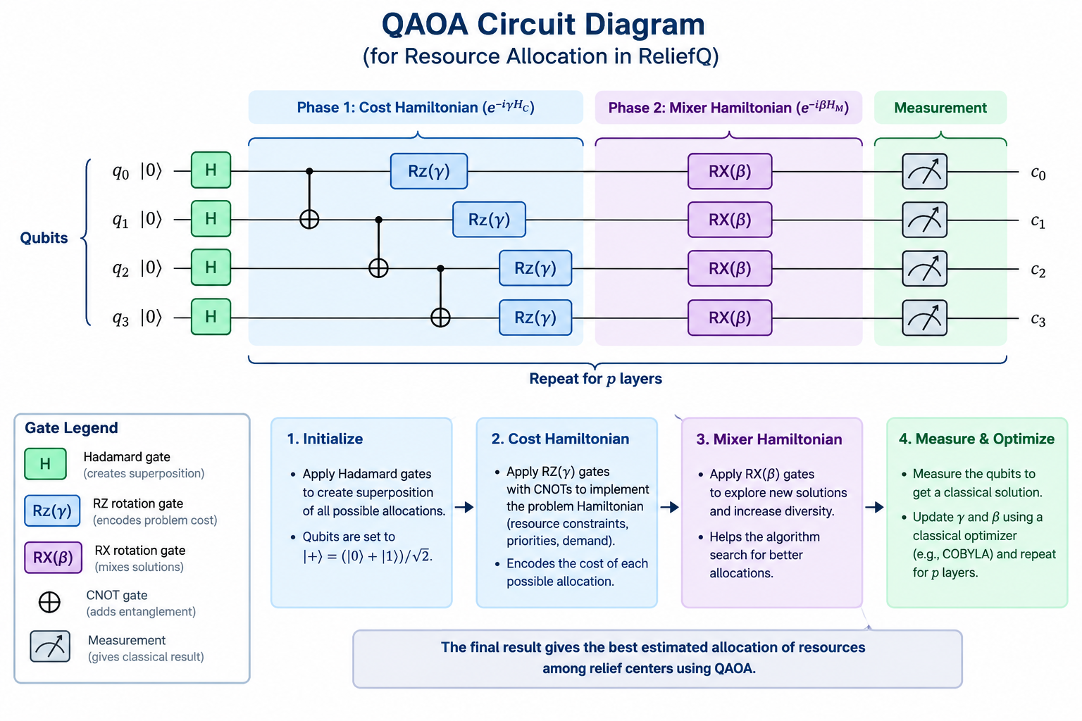
Algorithm & Circuit Design
Purpose: Demonstrates quantum computing for disaster relief resource allocation.
Qubits: 4 qubits represent possible resource-allocation decisions.
Hadamard (H) gates: Create superposition to explore different possibilities.
CNOT gates: Introduce entanglement between qubits.
RZ and RX gates: Apply rotations to modify quantum states.
Expected outcome: Generate candidate allocation decisions for analysis.
Insert circuit diagram
e.g. qc.draw("mpl")

Slide 6
Implementation & Tech Stack
Implementation | Tech Stack
User Interface: Develop a web application using Streamlit for donors and relief centers. Data Management: Store donation details, available resources, and relief requests using Python data structures or CSV files. Request Prioritization: Rank relief requests according to urgency and resource requirements.* Quantum Optimization: Implement QAOA using Qiskit to select suitable relief requests under resource constraints. Classical Optimization: Implement a greedy algorithm to allocate available resources and compare its results with QAOA. Visualization: Display resource allocation, unmet demands, and comparison results on an interactive dashboard. Deployment: Host the application online using Streamlit Community Cloud. | Python Streamlit Qiskit NumPy & Pandas Matplotlib CSV / SQLite Google Colab Streamlit Community Cloud.

Slide 7
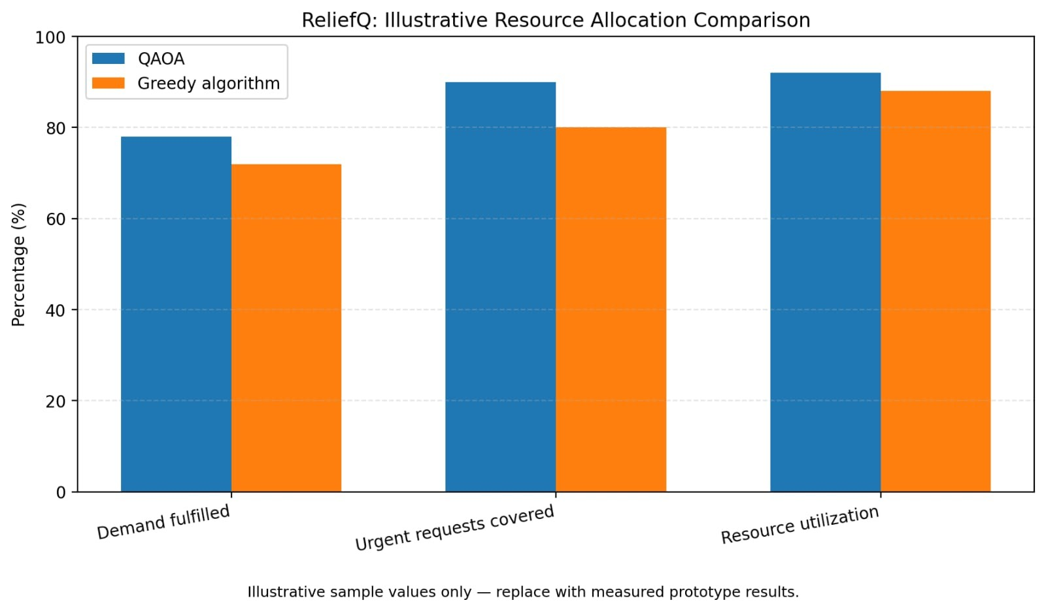
Results & Analysis
Insert results
Histogram, plot or table
Purpose: Disaster relief coordination.
Quantum: QAOA optimization.
Classical: Greedy algorithm.
Tech: Python, Streamlit, Qiskit.
Goal: Efficient resource allocation.
Impact: Prioritize urgent needs.

Slide 8
Impact & Real-World Applications
Improves disaster relief coordination and resource distribution.
Prioritizes urgent needs and reduces wastage of essential supplies.
Helps donors, NGOs, and relief centers work together efficiently.
Supports food, water, and medicine distribution during floods, earthquakes, and cyclones.
Assists hospitals, emergency shelters, and government agencies in managing limited resources.
Uses quantum and classical optimization to explore better allocation strategies.

Slide 9
Challenges & Future Scope
Resource Shortages: Improve allocation when supplies are limited and demand is high.
Data Accuracy: Maintain updated donation records and relief requests.
Quantum Complexity: Develop effective QAOA circuits for resource optimization.
Performance Comparison: Evaluate QAOA and greedy algorithms using allocation results.
AI Integration: Predict future resource requirements and prioritize urgent needs.
Real-Time Tracking: Monitor available supplies and shortages.
Route Optimization: Identify efficient delivery routes to relief centers.
Future Expansion: Integrate ReliefQ with NGOs, government agencies, and mobile applications.

Slide 10
CLOSING
Thank You
Questions?
Inspiring Minds. Shaping Tomorrow.
GITHUB REPOSITORY
https://github.com/vtu-qiskit-fall-fest-2026/vtu-hc-bit-and-byte
DEMO VIDEO LINK
https://youtu.be/Lhj1XXKMHxo

