Slide 1
An AI Interview Platform
That Explains Its Own Marking
It interviews a candidate, marks the answers, and shows how it
reached every mark — including how sure it is about each one.
Abdul Wahab
Student Number: [STUDENT NUMBER] · CMP7200 Individual Master's Project · Birmingham City University · 2025-26
Notes:
Good morning. My project is an AI system that interviews a job candidate, marks
their answers, and explains how it reached every mark.
The one sentence to hold on to: most automated interview tools give you a score
and no explanation. Mine measures how far its own scores can be trusted, and
says so when they cannot.

Slide 2
THE PROBLEM
Companies score interviews with AI. Candidates get a number and no reason.
It has caused real trouble. In 2019 a privacy group complained about HireVue scoring candidates from their faces. The feature went in 2021. The problem stayed.
It costs companies money. Candidates who think a process was unfair are less likely to accept the job — cancelling out the time saved.
The law has caught up. The EU AI Act treats hiring software as high risk. It asks that problems be tested for, written down, and checked by a person.
The question is not “can AI mark an interview answer?” It clearly can.
It is “can it be honest about how much to trust each mark?”
2
Notes:
Companies now use AI to interview and score people at a scale no human team
could manage. It is fast, and it asks everyone the same questions.
The trouble is what comes out: a number, and nothing else. No reason, and no way
to argue with it.
This has caused real trouble. In 2019 a privacy group formally complained about
HireVue scoring candidates from their faces. HireVue dropped that in 2021, but
the deeper problem stayed.
It also costs companies money. Candidates who think a process was unfair are
less likely to accept the job, which cancels out the time saved.
And the law has caught up. The EU AI Act now treats hiring software as high
risk. Notice what it asks for: not a perfect model, which nobody can build, but
that problems be tested for, written down, and checked by a person. That is a
list of requirements, and it is the one I built to.
So my question is not whether AI can mark an answer. It plainly can. It is
whether it can be honest about how far each mark should be trusted.

Slide 3
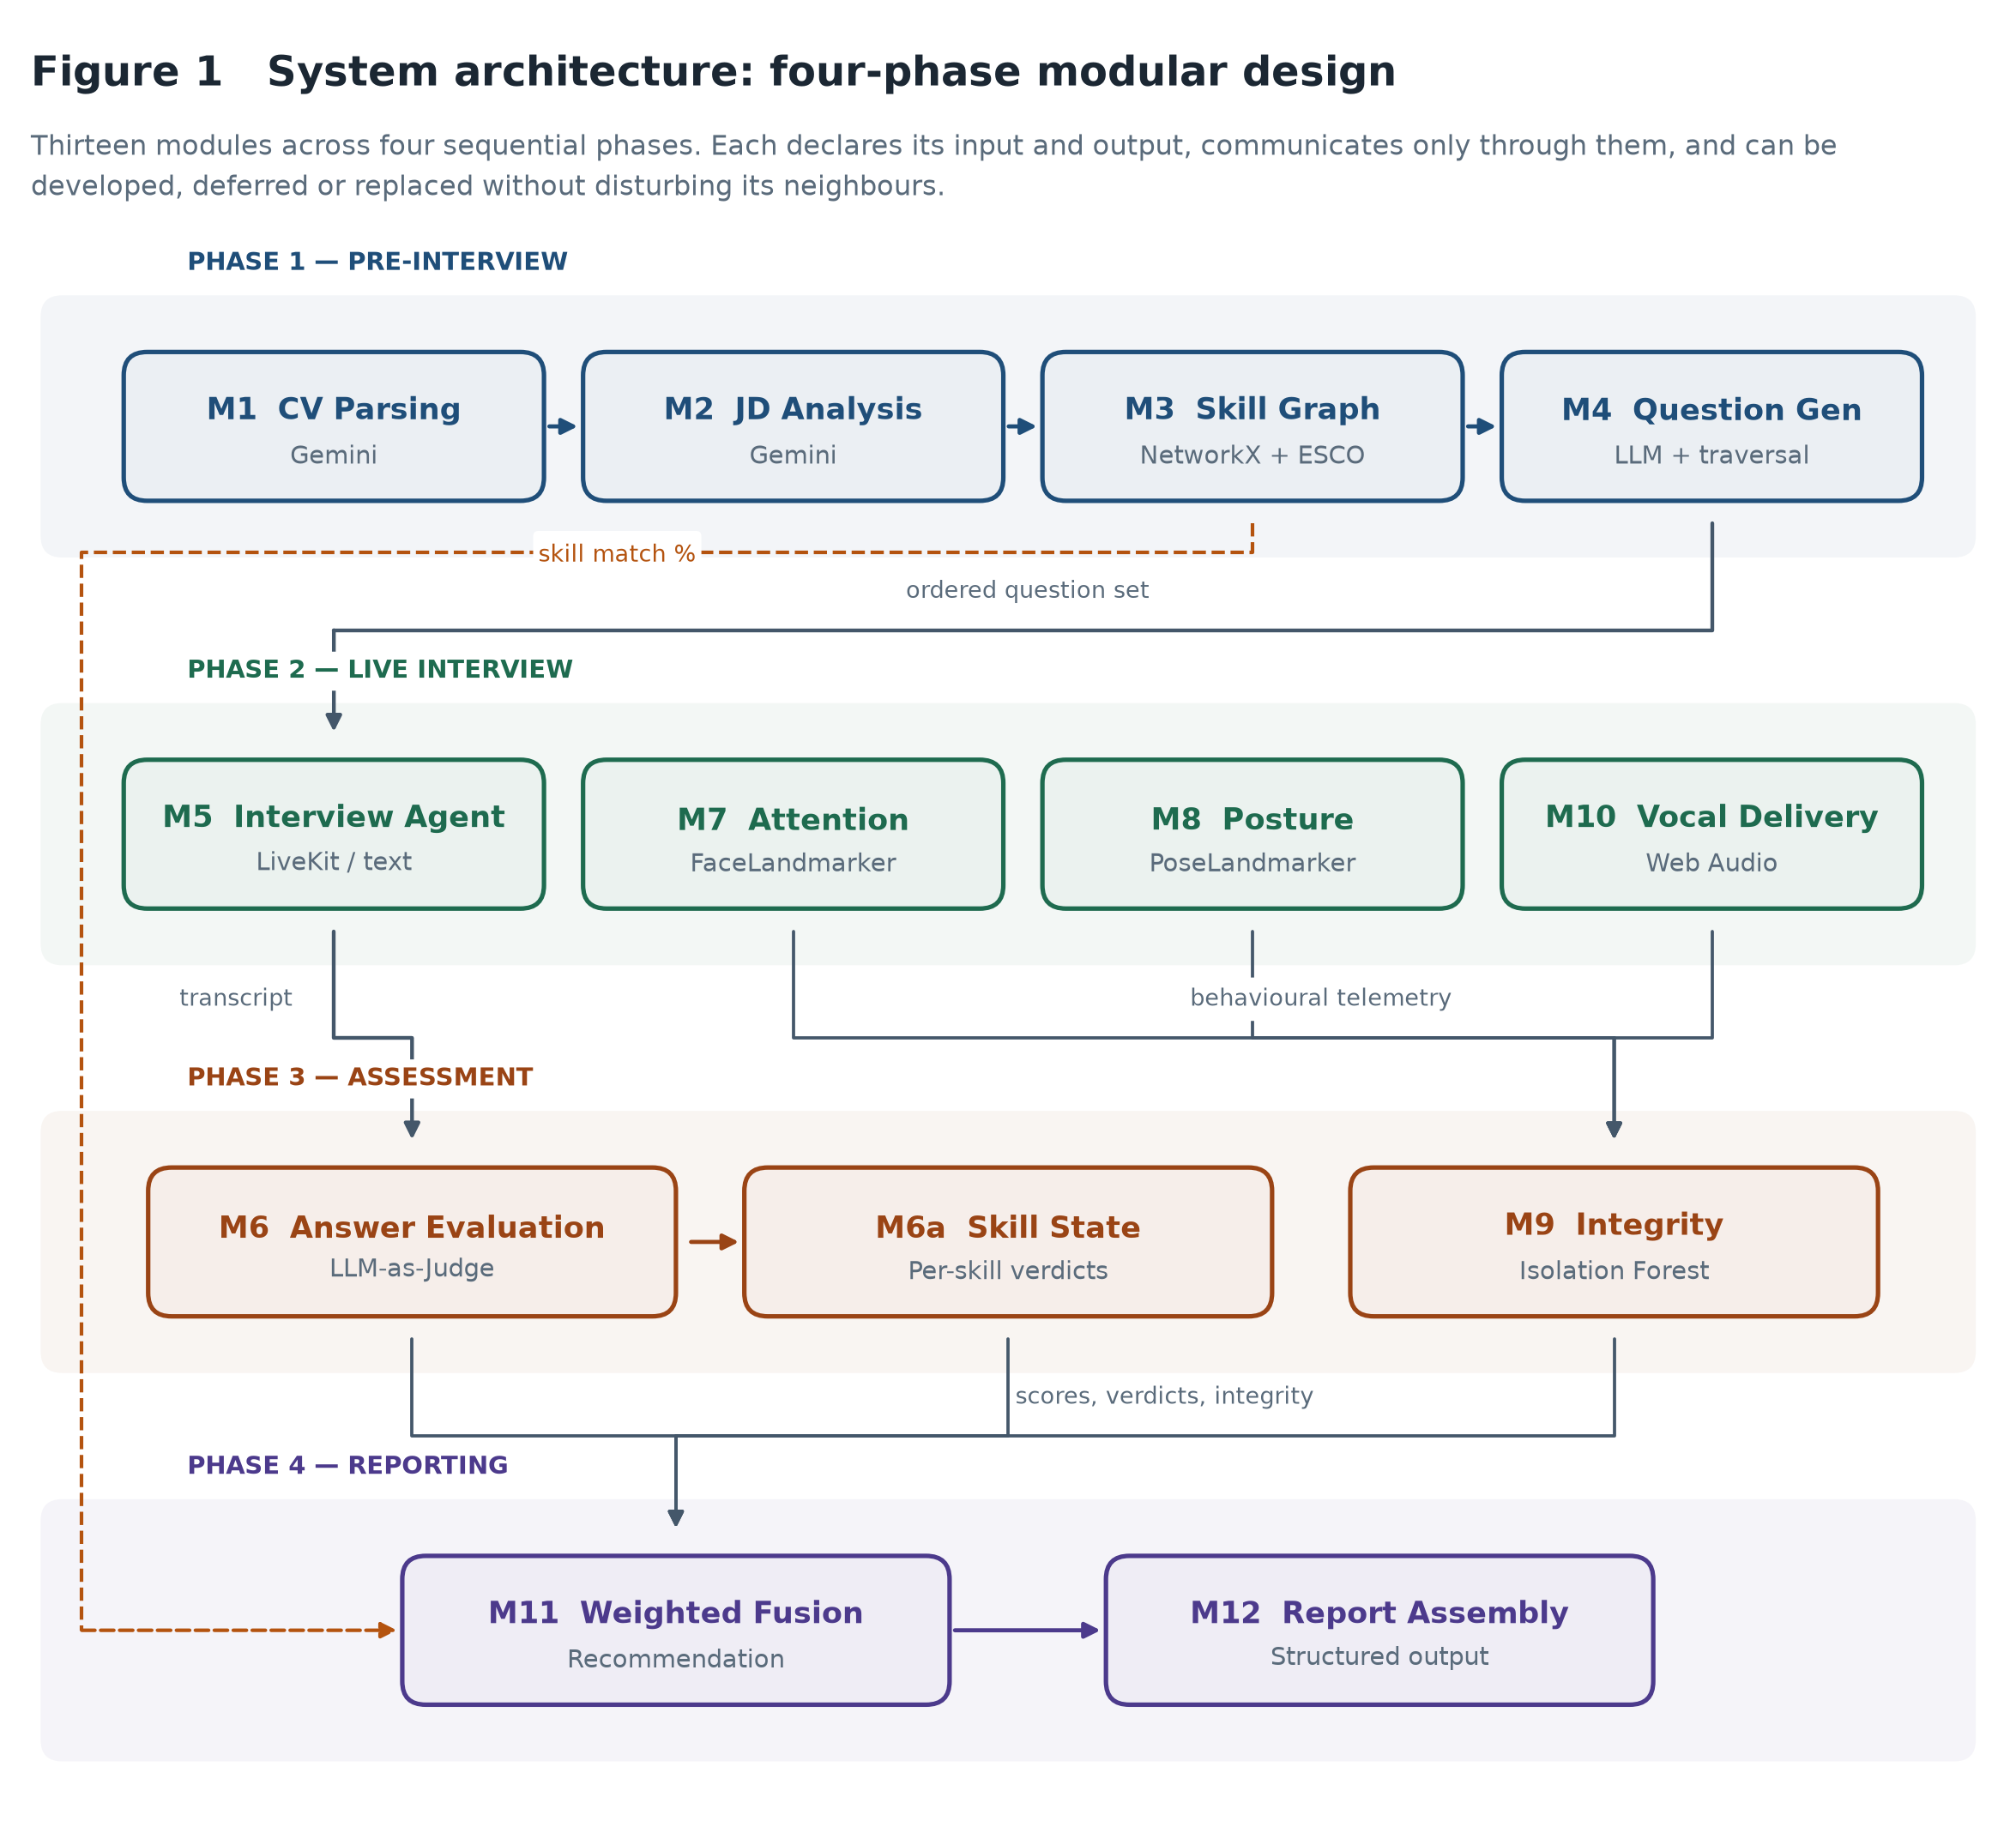
THE SOLUTION
How it works, start to finish
1. Prepare
2. Interview
3. Mark
4. Report
read both documents, find the missing skills, write the questions
by speaking or typing — both give the same transcript
score every answer twice, check the session looked normal
combine into a recommendation, and show the working
Thirteen parts, four stages — the next four slides go through them.
3
Notes:
Here is the whole thing, left to right, in four stages.
Prepare. A CV and a job advert go in. The system maps the skills onto ESCO, the
official EU skills list, so when it says a skill is missing, that skill is a real
published thing and not something the AI invented. It writes the interview and
puts the missing skills first, because every interview runs out of time and a
question at the end never gets asked.
Interview. The candidate picks speaking or typing. Both produce exactly the same
transcript, so nothing after this point knows which one ran.
Mark. Greetings and goodbyes are thrown away so they cannot drag the average up.
Every real answer is marked twice. Timing and tab switches get checked.
Report. Everything is combined into one score and a recommendation, with the
working shown.
Thirteen parts do this, and the next four slides go through them.

Slide 4
MODULES 1 TO 4
Preparing the interview
MODULE
WHAT IT DOES
BUILT WITH
M1
Reads the CV
Google Gemini
3.6 Flash
+ PyMuPDF
Pulls out skills, jobs, education and projects from an uploaded PDF or pasted text. Repairs broken replies rather than failing.
M2
Reads the job advert
Google Gemini
3.6 Flash
Same treatment for the role: required skills, nice-to-have skills, seniority and domain.
M3
Compares them and finds the gaps
NetworkX
+ ESCO v1.1.1
(1,201 skills)
Maps both lists onto ESCO, the EU skills standard, through four increasingly forgiving matching steps, then reports what is missing.
M4
Writes the questions
Google Gemini
3.6 Flash
Produces openers, technical questions per skill, behavioural questions and closers — then reorders so missing skills come first.
Because ESCO is a published standard, “this skill is missing” means something a candidate could check.
4
Notes:
The first four parts turn two documents into a plan.
M1 and M2 read the CV and the job advert. Both use Gemini, asked to return a
fixed structure. Models sometimes return broken data, so the client repairs it
rather than failing the request — unglamorous, but it is the difference between
a demo that works and one that dies in front of you.
M3 is the core of the project. It maps both skill lists onto ESCO, the EU's
published skills taxonomy, using four matching steps that get gradually more
forgiving. This is deliberately not machine learning: ESCO is already a curated
hierarchy, and learning over it would add opacity while removing the one
property that makes it defensible — that every skill traces to a published
standard.
M4 writes the interview, then reorders it so the missing skills get asked first.
That reordering is Objective 2, and it matters because every interview has a
time budget and a question at the end never gets asked.

Slide 5
MODULES 5, 5T AND 6A
Running the interview
MODULE
WHAT IT DOES
BUILT WITH
M5
Runs the spoken interview
LiveKit
+ Deepgram Nova-3
+ ElevenLabs
Shows each question, speaks it aloud, listens to the answer, decides whether to dig deeper, and saves the transcript.
M5t
Runs the typed interview
FastAPI
The same interview answered in a chat box. Produces an identical transcript, so nothing afterwards knows which mode ran.
M6a
Tracks how each skill is going
Plain Python
(state machine)
Keeps a live note on every skill — not asked, asked, answered well, answered badly — which decides whether a follow-up is needed.
M5 and M5t are the same interview with a different way of answering — which is why it is thirteen parts, not fourteen.
5
Notes:
The interview itself.
M5 is the talking interviewer. LiveKit carries the audio call, Deepgram turns
speech into text, and ElevenLabs is the voice — with Deepgram's own voice as a
backup if that runs out of credit. It shows each question on screen before
speaking it, so a candidate who mishears can read it.
Two things I got wrong here and had to fix. The system checks the voice provider
actually returns audio before starting, because an exhausted account accepts the
connection and returns silence, which looks exactly like success. And the
turn-taking timings had to be slowed right down: the defaults are tuned for
chat, and an interview answer contains long pauses for thought.
M5t is the same interview, typed. It matters more than it sounds: it produces an
identical transcript, so every part after this point is shared. It also lets you
demonstrate the whole system without any audio hardware at all.
M6a keeps the running verdict on each skill that decides whether to follow up.

Slide 6
MODULES 7, 8 AND 10
Watching the interview
MODULE
WHAT IT DOES
BUILT WITH
M7
Watches attention
MediaPipe
Face Landmarker
Finds 478 points on the face to work out where the head is pointing and whether the eyes are on the screen.
M8
Watches posture
MediaPipe
Pose Landmarker
Finds 33 points on the upper body to check whether the shoulders are level and the person is upright rather than slouched.
M10
Listens to tone of voice
Web Audio API
Measures the sound, not the words: how steady the pitch is, how loud, and how much is speech rather than pauses.
All three run inside the candidate's own browser. Video and audio never leave their computer — only the resulting numbers are sent.
6
Notes:
Three parts watch how the interview went rather than what was said.
M7 finds 478 points on the face and works out where the head is pointing and
whether the eyes are on the screen. M8 finds 33 points on the upper body and
checks posture. M10 listens to the sound of the voice — pitch steadiness,
loudness, how much of the time is actual speech.
The line at the bottom is the one I would emphasise. All three run inside the
candidate's own browser using models downloaded once. The video and the audio
never leave their machine; only the resulting numbers are sent. That is what
makes the privacy claim real rather than a promise.
Two limits I would state before you ask. None of this reads emotion — I removed
a facial emotion classifier precisely because it could not be explained, and my
Chapter 2 criticises HireVue for exactly that. And all three together are worth
fifteen points out of a hundred in the final score, against fifty for what the
candidate actually said. Nobody is marked on their face.

Slide 7
MODULES 6, 9, 11 AND 12
Marking and reporting
MODULE
WHAT IT DOES
BUILT WITH
M6
Marks every answer — twice
Gemini as judge
(permuted order)
Scores each answer on accuracy, completeness, clarity and relevance, with the criteria in a different order each time. The gap between the two marks says how far to trust it.
M9
Checks for cheating
scikit-learn
Isolation Forest
(trains itself)
Looks at tab switches, answers arriving too fast or too slow, and answers that are suspiciously uniform in length.
M11
Adds everything up
Plain Python
(fixed weights)
Answers 50%, skills covered 20%, session integrity 15%, delivery 15% — with every contribution shown, not hidden.
M12
Writes the report
Plain Python
Each answer and mark, how consistent the marking was, the integrity verdict and the recommendation.
M6 is the research contribution: mark twice, and keep the disagreement as a measure of how far to trust the mark.
7
Notes:
The marking, and this is where the research contribution sits.
M6 is the important one. Research shows that if you change the order you present
the marking criteria in, an AI judge gives a different score. Most people cite
that as a reason not to trust AI marking. I read it as an instruction: mark every
answer twice, with the criteria in a different order each time.
Averaging cancels the effect of the order. But the average is not the interesting
part — the gap between the two marks is. Eighty-two then eighty-one means it is
sure. Seventy-one then forty-five means it is not, and the average of fifty-eight
hides that completely. So the gap is kept, and a big gap sends that answer to a
human instead of reporting a confident score.
M9 checks the session behaved normally. It trains its own model of normal on
first run, because labelled examples of cheating are not something anyone can
ethically collect. It always names the behaviour that caused a flag.
M11 combines everything on fixed published weights — half the score is what the
candidate actually said. M12 writes it up with the working shown.

Slide 8
RESULTS AND IMPACT
What testing found — two faults in my own system
0.92
92.8
0.85
2.2
how well it ranks answers
(1.0 would be perfect)
what deliberately average
answers scored
how closely the four
criteria move together
average gap between
the two markings
It ranks well. It almost never puts a worse answer above a better one.
Fault 1 — too generous. The pass mark for “strong” is 70. Deliberately average answers scored 92.8, so average and excellent get the same verdict.
Fault 2 — the four criteria are not separate. It forms one impression and spreads it across all four, so the breakdown explains less than I had claimed.
Both faults are in my own system, and my own testing found them. That is the argument for building it this way.
8
Notes:
I wrote 18 answers to a known quality — deliberately weak, average and excellent
— and ran five experiments.
The good news. It almost never puts a worse answer above a better one: 0.92 out
of 1. As a way of ranking candidates against each other, it works.
The first fault. Weak answers average 53. Deliberately average answers average
92.8. Excellent ones 98.2. And the system calls anything 70 or above strong. So
average and excellent get the same verdict. These marks are usable for comparing
two candidates; they are not usable for deciding whether one candidate is good
enough on their own. My report says exactly that.
The second fault. I ask for four separate criteria. They move together at 0.85.
It forms one overall impression and spreads it across all four. Telling the model
not to do that did not stop it — and it weakens a claim I made in my own design
chapter, that the breakdown explains which part of an answer fell short.
And an honest non-result: the safety net never fired, because the two marks were
only 2.2 points apart on average. I report that as a null result rather than
dressing it up.
The impact line is the one to land. Both faults are in my own system and my own
testing found them. That is the entire argument for building it this way.

Slide 9
LOOKING BACK HONESTLY
What I changed, and what this project cannot claim
What I changed, and why
What it cannot claim
Removed the second marker. Its training answers came from the same AI it was meant to check, so agreement proved nothing. A test showed it measuring length.
18 answers, written not spoken. A small test set.
No human markers to compare against. So no outside check.
Replaced the emotion detector. Now measures how someone speaks. Every part can be inspected; an emotion label cannot.
No bias testing across groups. It needs the personal data I chose not to collect.
Added the double marking. Not in the proposal at all. It became the main contribution.
One interview at a time. A prototype, not a product.
Every one of these changes came from a measurement that proved me wrong about something.
9
Notes:
Where I departed from my proposal.
My proposal's headline idea was a second marker — a trained model to check the AI
judge. I built it, measured it, and removed it. Its training answers came from
the same AI it was meant to check, so the two agreeing tells you nothing. A test
showed it was really keying on answer length. And a second unchecked marker gives
the appearance of safety, not safety.
Removing it late felt like going backwards — it was the part that most looked
like machine learning research. What changed my mind was realising I could not
answer the obvious question: why does that agreement mean anything? Writing it up
as a finding turned the weakest part of the project into one I can defend.
I also replaced a planned emotion detector with a measure of how someone speaks.
Every part of that can be inspected; an emotion label from a black box cannot.
What I cannot claim. Eighteen answers is a small test set, and they were written
rather than spoken. No human markers to compare against. No bias testing across
groups, because that needs exactly the personal data I chose not to collect. And
it runs one interview at a time.
Against the EU AI Act: explaining itself and keeping a human in charge, it does
well. Record keeping and bias testing, it does not.

Slide 10
IN CLOSING
What this project contributes
A working platform that aims its questions using a published skills standard, interviews by speaking or typing, and shows its working.
A clear measurement of how an AI marker behaves in practice — it can rank answers well and still mark them far too generously.
A documented negative result checking an AI against a model trained on that same AI's answers proves nothing, and here is the evidence.
A test setup anyone can rerun included in the submission, so every number here can be produced again.
My own testing found two real faults in my own system.
Something built to be examined can be shown to be wrong, and then fixed. That is worth more than a
better-looking score from something nobody can see inside.
10
Notes:
Four things.
A working platform that aims its questions using a published skills standard,
interviews by speaking or typing, and produces a report that shows its working.
A clear measurement of how an AI marker behaves in practice — that it can rank
answers well and still be far too generous. That distinction is where both faults
came from.
A documented negative result: comparing a trained model against the AI that
supplied its training answers proves nothing, and I have the evidence.
And the whole test setup is in the submission, so every number can be produced
again.
The wider point is deliberately modest. Being open about one marker — what it
did, how sure it was, when a human should step in — is worth more than adding a
second marker nobody has checked.
And the best evidence for that is what I said earlier: my own testing found two
real faults in my own system. Something built to be examined can be shown to be
wrong, and then fixed. That is worth more than a better-looking score from
something nobody can see inside.
Thank you. I am happy to take questions.

