Slide 1

Note: The data and information in this document is reflective of a hypothetical situation and client. This document is to be used for KPMG Virtual Internship purposes only.
Sprocket Central Pty Ltd
Data analytics approach
[Division Name] - [Engagement Manager], [Senior Consultant], [Junior Consultant]

Slide 2
Note: The data and information in this document is reflective of a hypothetical situation and client. This document is to be used for KPMG Virtual Internship purposes only.
Agenda
Introduction
Data Exploration
Model Development
Interpretation

Slide 3
Note: The data and information in this document is reflective of a hypothetical situation and client. This document is to be used for KPMG Virtual Internship purposes only.
Introduction
Steps we need to take to identify the 1000 customers sprocket central Pty Ltd should target based on the dataset.
There are 3 necessary steps we need to take.
Data Exploration
Model Development
Interpretation
These steps will be explained in the next
Next sheet.

Slide 4
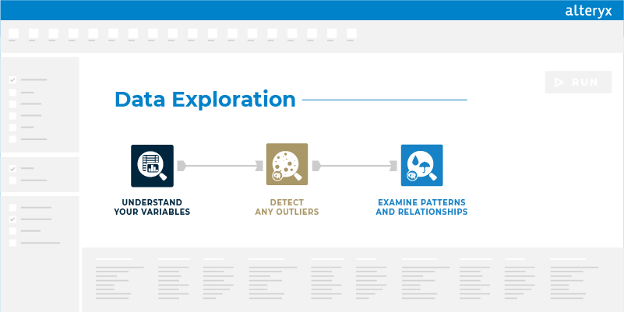
Note: The data and information in this document is reflective of a hypothetical situation and client. This document is to be used for KPMG Virtual Internship purposes only.
Data Exploration
Data exploration is about finding & understanding more about the data.
There are many steps to complete the data analysis.
Understanding the variables.
Cleaning the data.
Detecting the outliers.
Describing the basic qualities of the data set.
Examining the patterns and relationships.
Place any supporting images, graphs, data or extra text here.

Slide 5
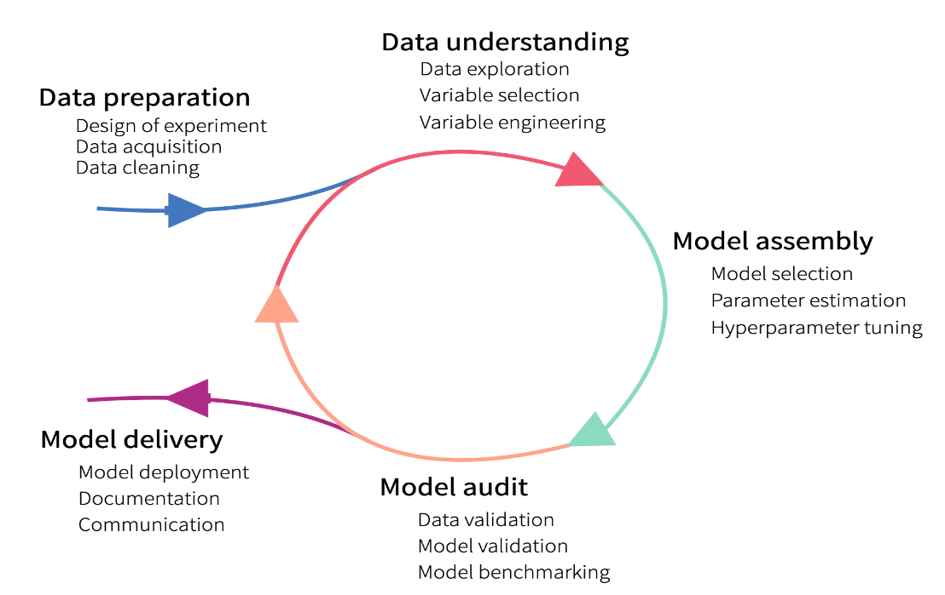
Note: The data and information in this document is reflective of a hypothetical situation and client. This document is to be used for KPMG Virtual Internship purposes only.
Model Development
Predictive modeling is a mathematical process that aims to predict future events or outcomes based on past behavior.
The predictive modeling process begins once a set of current or historical data is collected for analysis. Then data analysts create algorithms and statistical models, train them with subsets of the data and run them against the full data to generate the predictive model. Multiple models are used at once to create one prediction. Popular methods are Decision trees, Time series analysis, Neural networks, Linear regression, and Logistic regression.

Slide 6
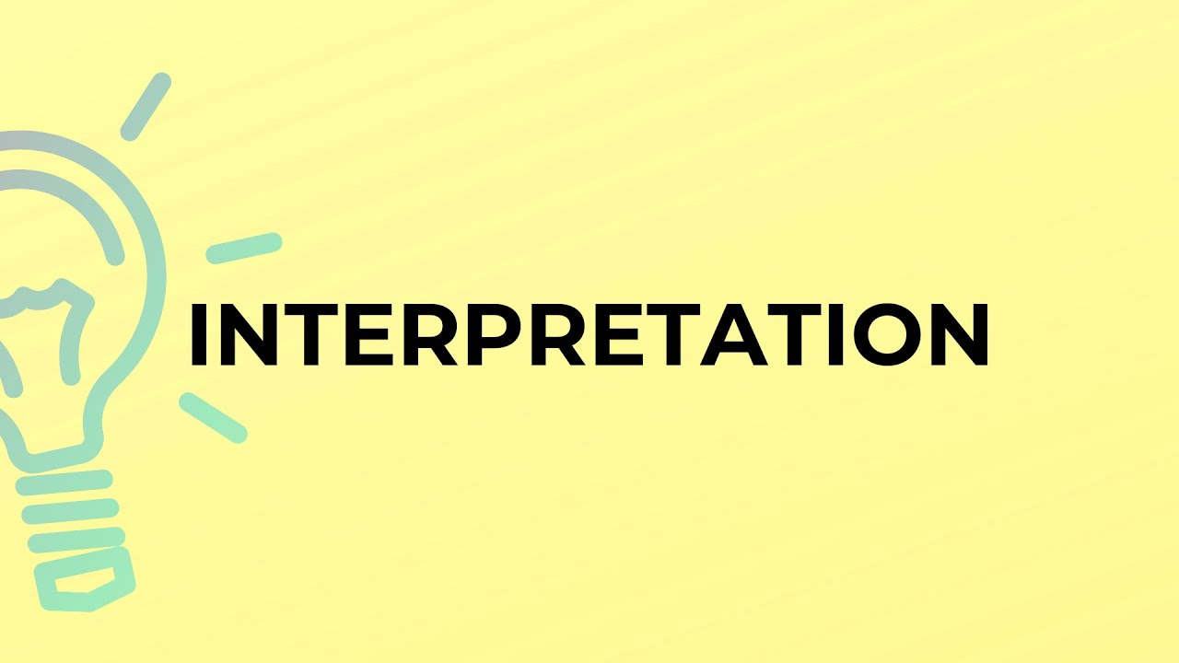
Note: The data and information in this document is reflective of a hypothetical situation and client. This document is to be used for KPMG Virtual Internship purposes only.
Interpretation
Interpretation is the act of explaining the meaning of the data model.
After completing the data analysis and the
Model development. We will do the data visualization to explain the impact on future growth.
In visualization, we will describe the 1000 customers we need to target.
How this is going to be beneficial for the Company?
Place any supporting images, graphs, data or extra text here.

Slide 7
Note: The data and information in this document is reflective of a hypothetical situation and client. This document is to be used for KPMG Virtual Internship purposes only.
Appendix

Slide 8
Note: The data and information in this document is reflective of a hypothetical situation and client. This document is to be used for KPMG Virtual Internship purposes only.
Appendix

