Slide 1
Can a regression network recover φ_{c} and ψ from gravitational-wave strain?
A systematically verified null result on the 2φ_{c} ± 2ψ degeneracy
Syed Ali Mohsin Bukhari
Notes:
Frame: a self-contained study of whether a point-estimating regression network can recover the coalescence phase and polarization angle from two-detector strain. The answer is a systematically verified null. Source: closing_summary.md, paper_summary.md.

Slide 2
Can a network recover φ_{c} and ψ?
Two extrinsic angles, rarely regression targets:
THE TEST
φ_{c} is the coalescence phase
ψ is the polarization angle
For the dominant quadrupole mode both enter the strain doubled
Face-on, only the combination 2φ_{c} ± 2ψ is constrained; the individual angles cannot be told apart
They separate only partially toward edge-on
Train a regression network on two-detector (H1, L1) strain.
Can it recover φ_{c} and ψ at all, individually or through the better-conditioned sum and difference combinations?
2φ_{c} ± 2ψ
A posterior can represent that degeneracy. A single point estimate cannot.
Notes:
Why these two angles: for the dominant quadrupole mode both phi_c and psi enter the strain doubled. Face-on, only 2phi_c +/- 2psi is constrained. A Bayesian sampler or neural posterior estimator can express that degeneracy as a ridge; a point-estimating regression head cannot. Source: paper_summary.md, The question.

Slide 3
The study at a glance
QUESTION
APPROACH
ANSWER
Can a regression network recover φ_{c} and ψ from two-detector strain, individually or through the better-conditioned combinations 2φ_{c} ± 2ψ?
25,000 training and 5,000 validation simulated events. Four models from two trunks, two head parameterizations, a radial penalty at three strengths. Chirp mass, merger time and SNR serve as positive controls.
No. Every configuration sits at the random-guess baseline on both angles, and none of 8 bootstrap tests is significant, while the controls are recovered (R² up to 0.96).
Also found: partial sky localization in CNN_{attention} (+12.6°, z = +23σ), an inclination head that is not a clean noise floor, and memorization of φ_{c} and ψ in the training split.
Notes:
Executive summary up front. Question: can a regression network recover phi_c and psi from two-detector strain, individually or through the better-conditioned 2phi_c +/- 2psi combinations? Approach: 25,000 training and 5,000 validation simulated events, four models from two trunks, two head parameterizations, a radial penalty at three strengths, with chirp mass, merger time and SNR as positive controls. Answer: a null; every configuration converges to the random-guess baseline while the controls are recovered. Also found: partial sky localization, a non-clean inclination head, and memorization in cnn_attention. Source: paper_summary.md, closing_summary.md.

Slide 4
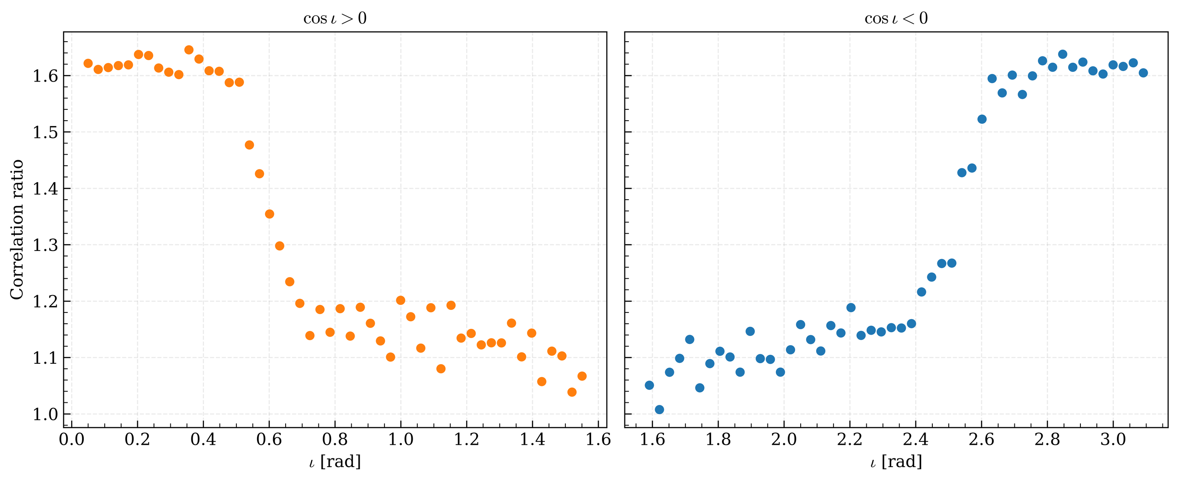
The degeneracy, checked analytically
1.62–1.65×
preference for the constrained combination, face-on
1.04–1.07×
the same ratio, edge-on: the degeneracy lifts only partially
Correlation ratio between the combination 2φ_{c} + 2ψ and its complement, swept over inclination ι.
Self-check passed: (R, δ) stays constant along 2φ_{c} + 2ψ = const at face-on; largest standard deviations 1.16×10⁻¹⁴ and 5.87×10⁻¹⁶.
Notes:
Step 1.1 prerequisite check. The analytic study first confirmed the degeneracy structure: (R, delta) stays constant along 2phi_c + 2psi = const at face-on, to machine precision. The preference for the well-constrained combination falls from about 1.62-1.65x face-on to 1.04-1.07x edge-on, i.e. the degeneracy lifts only partially. Source: sweep_1_1_ratio_vs_iota.png/.csv, paper_summary.md.

Slide 5
Data and targets
25k / 5k
2 s · 2048 Hz
1.0
π/2 · π/4
simulated training / validation events (IMRPhenomD, dominant mode only)
strain windows for H1 and L1
circular loss of a random guess: the chance level for every angle head
angular MAE of a constant prediction, for φ_{c} and ψ respectively
Periodic targets are regressed on the unit circle with a circular loss, so wrap-around never penalizes the network.
POSITIVE CONTROLS
Chirp mass, merger time and SNR must be recovered by the same shared features. If they are, a failure on φ_{c} and ψ is a statement about those angles, not about the pipeline.
Notes:
Population: 25,000 train and 5,000 validation simulated events, IMRPhenomD dominant mode only, 2 s windows at 2048 Hz for H1 and L1. Periodic targets are regressed on the unit circle with a circular loss, so a random guess scores exactly 1; a constant prediction has angular MAE of pi/2 for phi_c and pi/4 for psi. Chirp mass, merger time and SNR serve as positive controls. Note the dataset is unseeded (documented limitation in NOTES.md). Source: paper_summary.md, What we did.

Slide 6
From five trunks to four models
ROUND 1 SCREEN
DOWN-SELECT
ANALYSIS SET
5 trunks, 7 configs
Positive-control R²
4 models, 2 trunks
TCN, plain CNN, conv-transformer, InceptionTime, ResNet. All sat at chance on φ_{c} and ψ, so the screen could not discriminate.
Chirp mass, merger time and SNR. No numeric threshold was used.
POC_{A}, POC_{B}, TCN, CNN_{attention}. The three dropped trunks were never run through the full battery.
Two head parameterizations
Radial magnitude penalty
POC_{A}: independent-angle baseline
POC_{B}: explicit combination-space head (2φ_{c} + 2ψ, 2φ_{c} − 2ψ)
λ = 0.01, 0.05 and 0.10 on the TCN models
Aim: keep the raw head outputs from shrinking to zero magnitude
Notes:
Round 1 screened five trunk architectures in seven configurations. All seven sat at the random-guessing level on phi_c and psi, so the screen could not discriminate on the target question. We down-selected on the positive controls instead, keeping the TCN and the attention model. There was no numeric threshold for that down-selection, and the three dropped trunks were never run through the full battery. Two head parameterizations (independent-angle baseline vs combination-space) and a radial penalty lambda at three strengths on the TCN models. Source: paper_summary.md, closing_summary.md addendum.

Slide 7
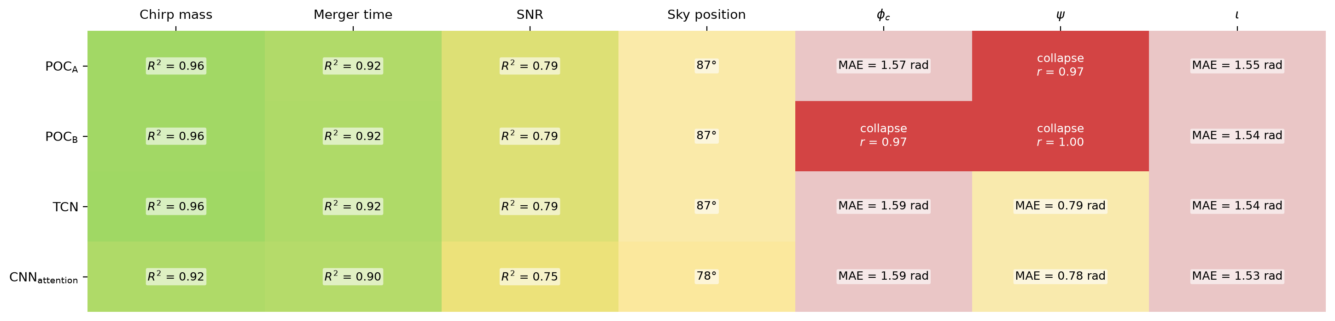
The result at a glance
Controls recover
φ_{c} and ψ do not
Two modes of failure
Chirp mass R² 0.92–0.96, merger time 0.90–0.92, SNR 0.75–0.79: the shared features carry real information.
Every configuration converges to the random-guess baseline (MAE ≈ 1.55–1.59 rad for φ_{c}).
POC_{A} (ψ) and POC_{B} (φ_{c}, ψ) collapse to one angle; TCN and CNN_{attention} are noisy and uninformative instead.
Notes:
Health check across the four models and seven heads. Green: good. Yellow: marginal. XX: dead. COLLAPSE: mode collapse. The positive controls (mchirp R2 0.92-0.96, merger time 0.90-0.92, SNR 0.75-0.79) read healthy in every model; the same shared features give MAE around 1.55-1.59 rad (about pi/2, i.e. chance) on phi_c, and poc_a/poc_b collapse outright on psi/phi_c. Source: analysis_output/health_check_20261019_125442.png.

Slide 8
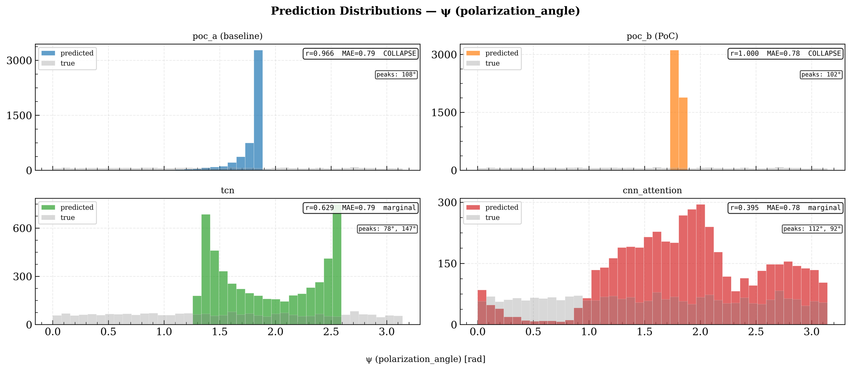
Mode collapse on ψ
99.9%
of POC_{B}'s 5,000 ψ predictions fall in one histogram bin
Collapsed: POC_{A}, POC_{B} output a near-constant angle whatever the input
Not collapsed: TCN, CNN_{attention} are noisy and uninformative, a different failure with the same conclusion
Grey: true ψ (flat over 0 to π). Colour: model predictions on the 5,000 validation events.
Collapse is a model failing to find any φ_{c}/ψ signal, not a plotting artifact: the loss wiring and gradient chain were checked and are healthy.
Notes:
Predicted vs true psi for the four models, validation set. poc_a and poc_b are genuinely mode-collapsed: near-delta-function output regardless of input; poc_b has 99.9% of 5,000 validation predictions in one histogram bin. tcn and cnn_attention are not collapsed but spread over a narrow band and uninformative: a different failure with the same conclusion. Source: analysis_output/histogram_polarization_angle_20261019_125442.png, closing_summary.md.

Slide 9
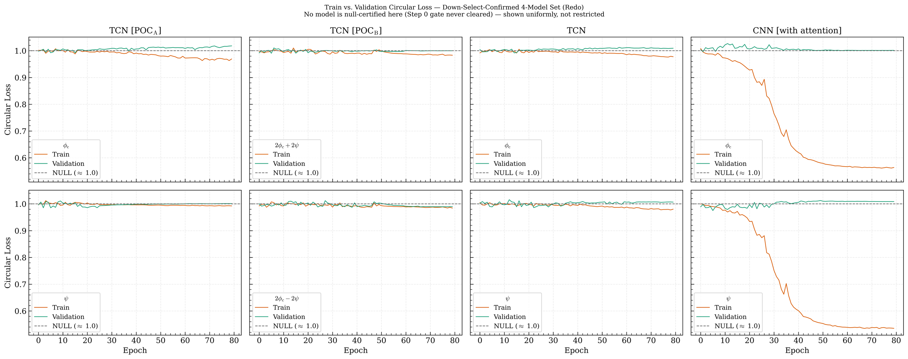
Three at chance, one memorizer
Three models sit at the null on both splits. CNN_{attention} memorizes: training loss falls to about 0.55 while validation stays at 1.0.
Notes:
Train vs validation circular loss for phi_c and psi (rows) across the four models (columns). Three models sit at the null (loss about 1.0) on both splits. cnn_attention drives its training loss down to about 0.55 while validation stays flat at about 1.0: memorization, invisible in every earlier number because the Round-1 summary only tracked validation loss. This is why its sky_position result needed an SNR-stratification check before being trusted. Source: diagnostic_output/redo_models_train_val_loss.png.

Slide 10
The pre-registered gate never cleared
Step 0: do POC_{B}'s 2φ_{c} + 2ψ / 2φ_{c} − 2ψ outputs keep a healthy magnitude (std_ratio) after the penalty?
λ = 0.01
λ = 0.05
λ = 0.10
Gate fails
Gate fails
3 of 4 fail
All readings fail.
All four readings fail.
The 4th passes numerically; its scatter plot shows two flat bands at one angle.
Verdict of record: UNINTERPRETABLE
Not a null, and not counter-evidence. The gate measures the magnitude of raw outputs, not their angular diversity, so a mode-collapsed constant output can pass it. Passing an interpretability gate is not proof that the property it stands for holds.
Notes:
Before running the retune at higher penalty strengths we pre-registered a metric-health gate (Step 0 std_ratio), checking that the raw head outputs have healthy magnitude. It never cleared at any of the three lambda values: 12 readings fail, or in one case pass numerically but fail on inspection. The one nominal pass (phi_c of the combination model at lambda=0.10) shows two flat bands at a single angle on the scatter plot: a literal two-point collapse. The gate measures the magnitude of raw outputs, not their angular diversity. Verdict of record: UNINTERPRETABLE, not null, not counter-evidence. Steps 1-3 of the preregistration never ran because they were gated on Step 0. Source: preregistration_lam_retune.md, NOTES.md 2026-09-15/16.

Slide 11
Four gate-independent checks
1
Prediction inspection
2
Gradient trace
Histograms of predicted angles show whether predictions pile into a few bins.
Code-level check that the training signal reaches the angular heads end to end.
Finding: POC_{A} and POC_{B} mode-collapse; TCN and CNN_{attention} are noisy.
Finding: Loss wiring and gradient chain healthy: rules out an implementation bug.
3
Permutation bootstrap
4
Stratification
10,000 label shuffles: does the angular error beat that of shuffled labels?
Recovery by SNR tercile and by inclination band.
Finding: No φ_{c}/ψ test is significant; most are on the wrong side of chance.
Finding: No band clears the pre-set 0.10 rad materiality floor.
Notes:
Because the gated route stayed uninterpretable, the null rests on four checks that do not depend on the gate, run uniformly on all four models without excluding any on interpretability grounds. We argue this is a legitimate substitute, but it was assembled after the pre-registered route failed, so it carries less confirmatory weight than a pre-registered test. Source: closing_summary.md, paper_summary.md.

Slide 12
Verdict: a statistical null
0 / 8
10,000
0.10 rad
4 / 4
φ_{c} and ψ bootstrap tests significant (4 models × 2 heads)
label shuffles per test in the permutation bootstrap
materiality floor: no inclination band or SNR tercile clears it
models with a healthy gradient chain to the angular heads: not a bug
BOTTOM LINE
On this architecture set, φ_{c} and ψ are not recoverable from strain by a regression network, individually or through 2φ_{c} ± 2ψ.
A well-evidenced null, not an implementation artifact: the gradient chain is healthy end to end. It rests on four checks assembled after the gated route failed, so it carries less confirmatory weight than a pre-registered test.
Notes:
Bottom line, evidence-weighted: under the 2phi_c +/- 2psi degeneracy structure, on this architecture set, phi_c/psi information is not recoverable from strain by a regression network. 0 of 8 phi_c/psi bootstrap tests (4 models x 2 heads) are significant, with 10,000 shuffles; no band clears the 0.10 rad floor. Caveat labelled honestly: the substitute battery was assembled after the gated path failed. The gated path's own language (UNINTERPRETABLE) is left on the record unedited; it is superseded in practical confidence, not contradicted. Source: bootstrap_output, closing_summary.md.

Slide 13
Bonus: sky localization is real
+12.6°
better than the shuffled null (z = +23.2σ); clears the 0.10 rad floor
Error falls monotonically with SNR, the signature of a real strain-to-direction mapping, not a memorization shortcut
Always guessing the mean direction scores only about 89.4°
Inferred, untested: cross-detector H1/L1 amplitude ratio via antenna pattern
Notes:
cnn_attention shows genuine partial sky-localization skill: 12.58 degrees better than the shuffled null (z = +23.23 sigma), error falling monotonically across SNR terciles (80.15, 77.95, 74.47 degrees), while a predictor that always guesses the population-mean direction scores about 89.4 degrees. The other three models are small-but-real and sub-floor (about 2.9-3.4 degrees). The leading explanation is cross-detector H1/L1 amplitude-ratio information via the antenna pattern; that is INFERRED, consistent with the evidence, and has not been tested directly. Source: bootstrap_sky_separation.py, snr_stratification_sky_position.py.

Slide 14
Inclination and memorization
INCLINATION IS NOT A CLEAN NOISE FLOOR
CNN_ATTENTION MEMORIZES φ_{c} AND ψ
p ≤ 0.022
0.44–0.47
bootstrap significance in all 4 models, but the effect is only about 0.02–0.04 rad, below the 0.10 rad floor.
train–validation loss gap, against 0.003–0.05 for the other three models.
Predictions cluster at a handful of preferred angles: a partial mode collapse
Its severity tracks each model's φ_{c}/ψ collapse, pointing to shared training dynamics rather than recoverable physics
Training circular loss falls to about 0.55 while validation stays flat at 1.0
Invisible in earlier numbers because the Round-1 summary tracked only validation loss
Why the sky-position result needed an SNR-stratification check before it was trusted
Notes:
Two findings from looking further than the main question required. (1) The inclination head, which had been used as a noise-floor calibration, is not clean noise: the bootstrap finds it significant but sub-floor in all four models (p <= 0.022, effect about 0.02-0.04 rad), and the paper summary reads its predictions as clustering at a few preferred angles, a partial mode collapse whose severity tracks each model's phi_c/psi collapse, pointing to shared training dynamics rather than recoverable physics. Note the closing summary (2026-09-18) framed it as 'a small real sub-floor signal'; the later paper summary (2026-09-30) is the interpretation used here. (2) cnn_attention memorizes phi_c/psi in the training split without generalizing. Source: bootstrap_ang_mae.py, plot_certified_memorization.py.

Slide 15
How strong is the evidence?
✓
What holds up
!
Limitations and open items
Four independent methods agree on the null
Run uniformly on all four models, none excluded on interpretability grounds
Positive controls read correctly in every model
An implementation bug is ruled out by the gradient trace
Every quantitative claim traces to a repository artifact
Narrow pool: two trunk families; down-select had no numeric threshold
Single seed (42): null holds across configurations, not seeds
Reconstructed branch: POC_{B} bootstrap numbers are ground-truth-assisted (disclosed)
Probe parked: perturbation trace failed its own positive control
Unrun: synthetic ablation, high-SNR / Fisher bound, joint (φ_{c}, ψ) scatter
No adversarial review of the manuscript yet
Notes:
This is the part we most want scrutinized. The null is established across configurations, not across seeds (all runs use seed 42; the dataset is unseeded). Two trunk families only; down-selection used positive-control R2 with no numeric threshold. poc_b's individual-head bootstrap numbers rest on ground-truth-assisted branch reconstruction (formulae_reference.md A.8), which does not change the verdict and is disclosed. The perturbation-trace probe failed its own positive control (mchirp reads AMBIGUOUS for all 4 models at the early stage) so 'final' was never run: parked, not closed. Unrun: synthetic-data ablation, high-SNR (25-30) validation set or Fisher-matrix bound, dataset regeneration from a version-controlled generator, joint (phi_c, psi) scatter. No independent adversarial review of the manuscript yet. Source: paper_summary.md, closing_summary.md.

Slide 16
Takeaways and open items
1
A null for regression heads
STILL OPEN
φ_{c} and ψ are not recoverable from strain on this architecture set, individually or through 2φ_{c} ± 2ψ.
Separate degeneracy from a sensitivity floor: high-SNR (25–30) set or Fisher bound
Joint (φ_{c}, ψ) scatter to test for the degenerate ridge
Multiple seeds; the three dropped trunks through the full battery
Direct test of the H1/L1 amplitude-ratio explanation for sky localization
Independent adversarial review
2
A practical hazard
Neural posterior estimators (VItamin, DINGO) represent degenerate targets by construction; point-estimate and hybrid pipelines do not.
3
Discipline is the contribution
Positive controls on every instrument, and the lesson that passing an interpretability gate is not proof the property holds.
Notes:
Positioning: this does not reopen a settled question. Neural posterior estimation (VItamin, DINGO, DINGO-IS) represents degenerate targets correctly by construction. What the study documents is a practical hazard for point-estimate and hybrid pipelines still built on regression heads, and the diagnostic discipline needed to notice the failure. Open items are those not yet run or not yet mechanistically confirmed. Source: paper_summary.md, closing_summary.md.

